Slide 1
Communication is the key to healthy relationships.
One of the most basic claims of Christianity is that
God speaks to people.

Slide 2
The Greatest Stories Ever Told
Jesus was the Master Story Teller!
Even the soldiers sent to capture him were enthralled. There own testimony was that
“Never man spake like this man.” (John 7:46)

Slide 3
Communication is often missed or misunderstood.
The problem is not so much that we don’t “recognize” or hear the words,
but rather that we’re distracted or not really “tuned in” to what’s being said.
Mt. 13:13 “I speak unto them in parables because they seeing see not; and hearing they hear not,
neither do they understand.”

Slide 4
This is often the case when God is trying to communicate with us.
Mt. 13:9 “Who hath ears to hear, let him hear.”
He repeated this seven times in Rev. 2 and 3.
He’s basically telling us that we need to get tuned into what God is trying to say to us!

Slide 5
Mt 13:3 “He spake many things unto them in parables…”
Parable comes from parabole' which literally means: “to cast near” (where someone can “grasp” it.)
In Mt. 13 Jesus shares 8 “parables” to help us
grasp (understand) God’s Kingdom.
19 x Jesus mentions “hearing” in Mt. 13.

Slide 6
Mt 13:3 “He spake many things unto them in parables…”
This first parable is so important that Jesus actually says in Mark 4:13:
“Know ye not this parable?
and how then will ye know all parables? “
He then proceeds to interpret it for us.

Slide 7
1. THE SOWER (messenger) Mt. 13:3
“Behold, a sower went forth to sow…”
Someone has to share the message of God’s love.
Ro 10:13-14 “For whosoever shall call upon the
name of the Lord shall be saved.
How then shall they call on him in whom they have not believed? and how shall they believe in him of whom they have not heard?
and how shall they hear without a preacher?”

Slide 8
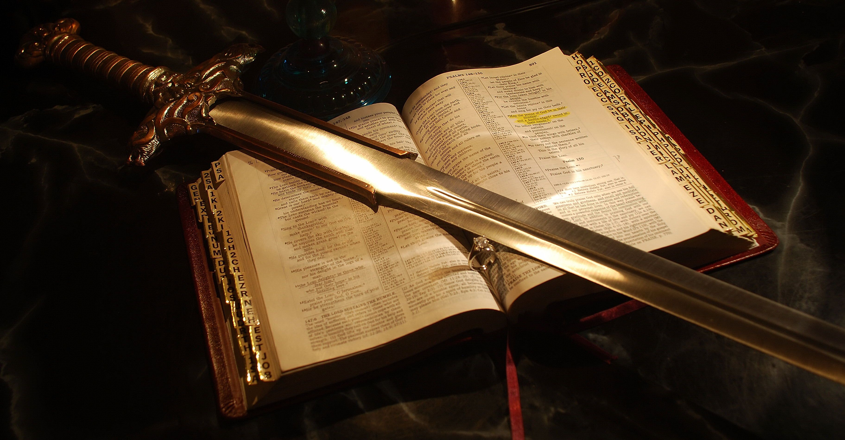
THE SEED: (The Message) vs 3, 19
A. “The seed is the word of God.” Lk 8:11
1) This Seed Is Life. Jn 1:1-4 “In Him was life…”
Eph. 6:17 “the Sword of the Spirit …the Word of God”
Heb. 4:12 “Word of God is quick and powerful
and sharper that any
two edged sword…”

Slide 9
THE SEED: (The Message)
A. “The seed is the word of God.” Lk 8:11
1) This Seed Is Life.
Jn. 6:63 "It is the Spirit that quickeneth;
the flesh profiteth nothing:
the words that I speak unto you,
they are spirit, and they are life."

Slide 10
2. THE SEED: “The seed is the word of God.” Lk 8:11
A. THE SEED IS LIFE. Eph. 6:17; Heb. 4:12
B. THE SEED GIVES LIFE. 1 Peter 1:23
"Being born again, not of corruptible seed,
but of incorruptible, by the word of God,
which liveth and abideth for ever.“
Jn 6:67-68 “Will ye also go away? Peter answered
Lord, to whom shall we go?
thou hast the words of eternal life.”

Slide 11
Mt 13
3. The Soil Vs. 4-9, 18-23
The soil is the condition of the
hearts of the hearers. Ro. 10:10
“with the heart man believeth unto righteousness”
It’s the quality of the soil that determines
the effectiveness of the seed! Pr. 4:23
“Keep thy heart with all diligence;
for out of it are the issues of life."

Slide 12
Mt 13
3. The Soil Vs. 4-9, 18-23
B. The four types of soil in this story
represent four attitudes or conditions
of our hearts that effect how we
receive or respond to God’s word.
These are not necessarily four kinds of people, but rather 4 “heart conditions” that most of us have had at some point in our lives.

Slide 13
B. Four types of “hearers”
1) THE DECEIVED (Hard) HEARER. Vs 4, 19
“some fell by the wayside and the fowls
came and devoured them up.” Vs 4
a) Wherever God Is At Work, you’ll find Satan. 19
“When any one hears the word of the kingdom,
and understands it not, then comes the wicked one,
and catches away that which was sown in his heart.
This is he which received seed by the way side.”
See 1 Cor. 2:14; 2 Cor. 4:4

Slide 14
1) The Deceived hearer.
b) The “wayside” was the well worn path.
Mt 7:13-14 “for wide is the gate, and broad is the way,
that leads to destruction, and many go in thereat:”
Pr 14:12 “There is a way which seems right unto a man,
but the end thereof are the ways of death.
Pr. 3:5,7 “lean not to thine own understanding…
be not wise in thine own eyes”

Slide 15
1) The Deceived (Hardened) hearer.
c) Satan Seeks To Remove The Influence
Of The Seed Before It Germinates.
“Hears …and understands not…” Vs 19
They’re “aware” of the gospel but not
“awakened” to their true condition. (Eph. 5:14)
“understandeth” (suni’emi) to put together.
From sun (union or to join/associate with)
They hear it, but don’t associate themselves
with it or act in faith upon it.

Slide 16
1) The Deceived hearer.
The seed (God’s Word) must be
germinated by our faith. Heb. 4:2
“For unto us was the gospel preached,
as well as unto them:
but the word preached did not profit them,
not being mixed with faith in them that heard it.”
(See Ro. 5:1; Eph. 2:8)

Slide 17
Example: 2 H₂ + O₂ → 2 H₂O
This reaction requires the catalyst
of energy to break the covalent bonds.
In much the same way, The Holy Spirit acts as the catalyst between the gospel and our faith.

Slide 18
The Holy Spirit acts as the catalyst between the gospel and our faith.
God’s word + God’s Spirit produces conviction (of our sin) and clarity (of Christ’s sacrifice).
Under these conditions, when we add our own personal faith (commitment)
It produces Salvation!
Ro. 8:16 “The Spirit itself bears witness with our spirit that we are the sons of God”

Slide 19
Germination is required for Salvation.
Saving Faith requires that we cultivate
an open mind/heart.
A Receptive Vs. Resistant
(or deceptive) Heart.
John 12:24 “Except a corn of wheat fall into
the ground and die, it abideth alone:
but if it die, it bringeth forth much fruit.”

Slide 20
Without God’s Spirit, we can’t hear
from God! (We Lack a receiver!) 1 Cor. 2:14
“the natural man receiveth not the things of the Spirit of God: …neither can he know them,
because they are spiritually discerned.”
a) The soil (heart) must be open (broken)
to receive the seed. (Ro. 10:10)
The Seed must penetrate to germinate!
RECEPTIVE vs. RESISTANT HEART

Slide 21
The Seed must penetrate to germinate!
b) You can’t be “saved” until you realize
that you’re “lost”!
Eph. 2:9 “not of yourselves…”
Titus 3:5 “Not by works of righteousness which we’ve done, but according to his mercy he saved us, by the washing of regeneration, and renewing of the Holy Ghost”
This is at the heart of Repentance! (Lk 13:3,5)
“Except ye repent, ye shall all likewise perish”

Slide 22
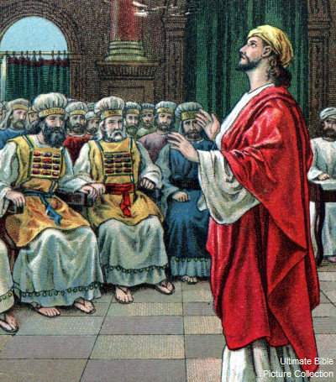
Cultivating an open heart
1) Some “Can’t” hear from God
2) Some “Won’t” hear God.
a) God’s Spirit is working, but they’re resisting Him.
Simply not “tuned in” (or Interested!?!)
Acts 7:51,52 “Ye do always resist the Holy Ghost.
Which of the prophets have not your fathers persecuted? and they have slain them which shewed the coming of the Just One;
whom ye have been now the betrayers and murderers”

Slide 23
Cultivate an open heart
2) Some “Won’t” hear God.
a) God’s Spirit is working, but they’re resisting Him.
Mt. 13:15 “This people’s heart is waxed gross, (calloused)
and their ears are dull of hearing, and their eyes
they have closed; lest at any time they should see with their eyes, and hear with their ears and understand with their heart, and should be converted, (turned around)
and I should heal them.”

Slide 24
2) Some “Won’t” hear God.
b) Possible Causes A Closed Mind:
Pride: “I don’t need God’s direction…” (Pr. 3:7)
Fear: “I’m afraid of what God might want from me.”
Bitterness: (Hard hearted Over past failures/frustrations.)
We “blame God” for what we or others have done.
Pr. 19:3 “The Foolishness of man perverteth his way
and his heart fretteth (zāʿap: boils in anger) against the Lord.”

Slide 25
3) Causes A Closed Mind: Pride, Fear, Bitterness
a) The “hard soil” had been “trodden down”. Lk 8:5
b) Bitter people are seldom fruitful because
they’ve become hard and narrow.
(1) God understands your Pain and cares. (1 Pt 5:7)
(2) Run to God with your pain, not away from Him.
(He’s the comforter.) 2 Cor 1:3,4
The tragedy of that hard path is that it’s barren!
The (Devil) takes the seed before it can even take root.

Slide 26
Application:
Is your heart closed to God’s voice?
1) Are you “able” to hear from God?
Have you ever really “opened” your
heart up to voice of God’s Spirit? (Rev. 3:20)
“If any will hear my voice and open the door,
I will come in unto Him…”
This is what being “born again” means!

Slide 27
Is your heart closed to God’s voice?
1) Are you “able” to hear from God?
2) Are you “willing” to hear from God?
Is pride, fear, or anger deafening you to Him
or distracting you from Him?
Pr. 3:5,6 “Trust in the Lord with all thine heart,
and lean not to thine own understanding.
In all thy was acknowledge Him
and He shall direct thy steps.”

Slide 28
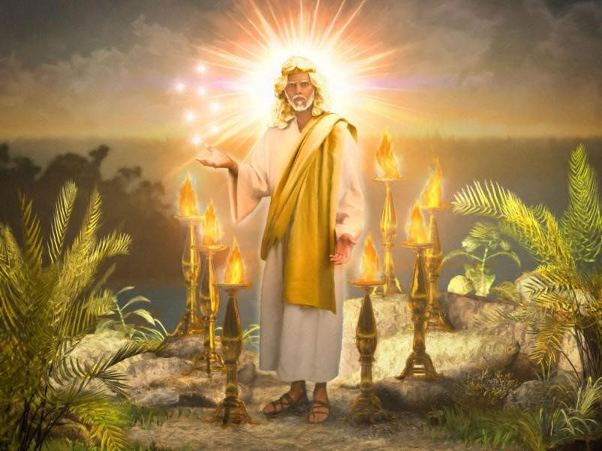
“He that hath an ear, let him hear what the Spirit saith”
Revelation 2:7, 11, 17, 29; 3:6, 13, 22

