Slide 1
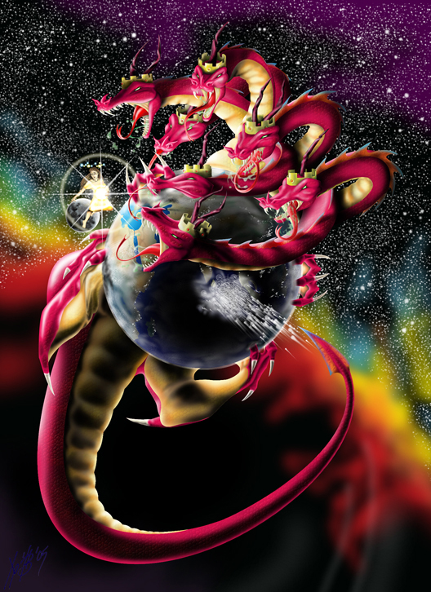
The Strategy of Satan
(The Cycle of The Soul)
“Woe to the inhabiters
of the earth!
For the devil is come down unto you,
having great wrath,
because he knows that he hath but a short time.”
Revelation 12:12

Slide 2
Last week we discussed how History has way of repeating itself because there are
spiritual forces at work seeking to shape it
(History)
by shaping us (Humans)!
1 Jn 5:19 “the whole world lieth in wickedness.”
2 Cor. 4:4 “The god of this world blinds the minds…”
Eph. 6:12 “we wrestle …against principalities…powers,
the rulers of the darkness of this world, against spiritual wickedness (Ponēria: depravity, disease) in high places.”
Romans 12:1,2

Slide 3
Because of this, there’s a remarkably predictable pattern behind the rise and fall of
Societies (civilizations)
God stopped Israel at the brink of the Promised land to review this cycle in Deuteronomy 8-11
1. Revelation: God reveals himself and his will.
8:1,2 “All the commandments…shall ye observe to do
that ye may live, and multiply, and possess the land…
Thou shalt remember all the way which the
LORD thy God led thee…”
and even individual “souls”.

Slide 4
1. Revelation: God reveals himself and his will.
God initiates this Revelation. Heb. 1:1; Jn 6:37,44
“no man can come to me except the Father draw him”
B. God’s Revelation is always our “Invitation”
Dt 8:2 “…to humble thee, and to prove thee,
to know what was in thine heart,
whether thou wouldest keep (Shamar: protect, honor)
his commandments, or no.”

Slide 5
When God invites, he expects a:
2. Response: We decide if (or how) we will
respond to God and His revelation.
Vs 1 “All these commandments …shall ye observe to do
עָשָׂה‎ שָׁמַר (shamar asa) guard and obey/commit
that ye may live and multiply”
Freedom of Choice is God’s gift to us. Josh 24:15
“Choose you this day whom ye will serve…”
1Kg 18:21 “how long halt ye between two opinions?”

Slide 6
A. Freedom of Choice is God’s great gift to us.
Dt 20:19 “I Set before you life and death; blessing and cursing;
B. Freedom of choice is Satan’s greatest
opportunity.
Therefore choose life.”
Genesis 3:1-6 “Now the serpent was more subtil than any beast which the LORD God had made. And he said unto the woman,
Yea, hath God said, Ye shall not eat of every tree of the garden?”

Slide 7
If we respond obediently to God’s Revelation ➔
3. Reward: God blesses (that soul and society).
Vs 2 “ye shall multiply and possess the land…”
7… the LORD thy God bringeth thee into a good land,
10 When thou hast eaten and art full, then thou shalt
bless the LORD for the good land …”
A. Honoring God is Good for US!
Dt. 10:13 “keep the commandments of the LORD,
…for thy Good!”

Slide 8
The Alternative to obediently responding is obstinate
4. Rebellion: We shift loyalties!
We grow proud of “our” success
and forgetful of their real source.
Dt 8: 11 “Beware that thou forget not the LORD …
17 And thou say in thine heart, My power and the
might of mine hand hath gotten me this wealth.
18 “remember it is the LORD, for it is He
that giveth thee power to get wealth…”

Slide 9
4. Rebellion:
B. Rebellion ultimately causes us to replace God,
for Self (Gen. 3:5)
“rebellion{merî (rebellion) comes from marah (Bitter)}
as the sin of witchcraft,
stubbornness is as iniquity and idolatry.
Because thou hast rejected the word of the LORD,
He hath also rejected thee….”
Pr 13:10 “Only by pride (zadon: arrogance) comes contention”
(and/or Satan!) 1 Sam 15:23

Slide 10
Rebellion eventually produces:
5. Rebuke: God tries to get our attention.
Dt 8:5 “consider …that, as a man chasteneth his son,
so the LORD thy God chasteneth thee.”
A. God Loves Us To Much To Let Us Go Unchallenged.
Rev 3:19 “As many as I love, I rebuke and chasten:
be zealous therefore, and repent.”
2 Tim. 3:16 “all scripture is given by inspiration of God and is profitable for doctrine…reproof, …correction,
for instruction in righteousness…”

Slide 11
1. Revelation 2 . Response 3. Reward 4. Rebellion 5. Rebuke
God’s Rebuke is His Revelation/Invitation to:
6. Reconsider: We determine how we’ll respond.
Dt 8:6 “Therefore thou shalt keep the commandments
of the LORD…walk in his ways, and… fear him.”
A. If we repent, the cycle repeats! (Restores/blesses)
Pr. 2:23 “Turn you at my reproof: behold,
I will pour out my Spirit unto you,
I will make known my words unto you.”

Slide 12
God’s Rebuke is His Revelation/Invitation to:
6. Reconsider: We determine how we’ll respond.
2 Chron 7:14 “If my people…shall humble themselves,
and pray, and seek my face
and turn from their wicked ways;
Then will I hear from heaven;
and will forgive their sin;
and will heal their land”

Slide 13
6. Reconsider: We determine what we’ll do.
1) Repentance brings Renewal! James 4:7-8
“Submit yourselves therefore to God.
(hupotasso: subordinate, line up under)
Resist the devil, and he will flee from you.
(Anthis’tēmi: to stand or fight against.)
Draw nigh to God, and he will draw nigh to you.
Cleanse your hands, ye sinners;
and purify your hearts, ye double minded.”

Slide 14
Further rebellion will result in eventual:
7. Reprobation! Deut 8:11-20
A. Definition: Unprincipled, Rejected, Disapproved
1) OT: Maas’: despised, rejected, useless
Jer 6:30 “Reprobate silver shall men call them,
because the LORD hath rejected them. “
2) NT: Ro.1:28 “God gave them over to a reprobate mind”
Adokimos nous: rejected; worthless; reasoning
(2 Cor 4:4)

Slide 15
Ro.1:28 “God gave them over to a reprobate mind”
Mt 13:15 “For this people's heart is waxed gross,
and their ears are dull of hearing,
and their eyes they have closed;
lest at any time they should see with their eyes,
and hear with their ears,
and should understand with their heart,
and should be converted, (epistrephō: turned back)
and I should heal them.”

Slide 16
7. Reprobation!
B. Declaration (God’s Warning) Deut 8:11 “Beware thou forget not the LORD thy God, in not keeping his commandments… judgments, …statutes”
19 “And it shall be, if thou do at all forget the LORD thy God, and walk after other gods, and serve them,
and worship them, I testify against you this day
that ye shall surely perish.”
Ābad’: wander, lose / destroy yourselves
(Pr. 14:12; Mt 7:13)

Slide 17
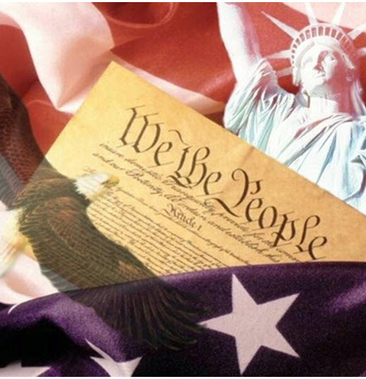
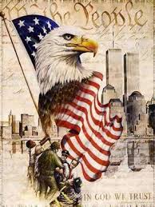
“America, America, God shed His Grace on Thee”

Slide 18
“Whose God
is the LORD!”
Ps. 33:12

Slide 19
Pr. 14:34 “Righteousness exalts a nation,
But sin is a reproach to any people.”
Pr 29:2 “When the righteous are in authority, the people rejoice:
but when the wicked beareth rule,
the people mourn.”

Slide 20
Mayflower Compact
“In the name of God, Amen. …Having undertaken, for the Glory of God, and advancements of the Christian faith, …a voyage to plant the first colony in the Northern parts …; do by these presents, solemnly and mutually, in the presence of God, and one another; covenant and combine ourselves together into a civil body politic;
for our better ordering, and preservation and furtherance of the ends aforesaid…” 11/20/1620

Slide 21
In response to conflicts (the Pequot War 1636-38)
1643 “New England Confederation” between
Massachusetts, Plymouth, Connecticut, and New Haven
(The first American “Constitution”) opens with:
“We all came into these parts with one aim,
to advance the kingdom of our lord Jesus Christ, and to enjoy the liberties of the gospel
in purity and peace…“
This Led to temporary prosperity.

Slide 22
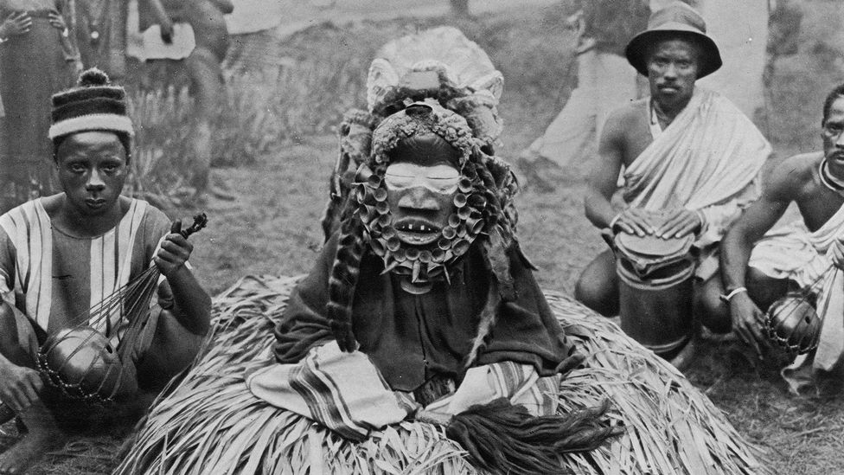
Prosperity led to Increased immigration
The King gave land grants to supporters.
Europeans immigrated for “better lives”.
Prisoners sent to America as indentured slaves.
Slaves were sent to “work” the plantations.
Some Brought voodoo practices to America

Slide 23
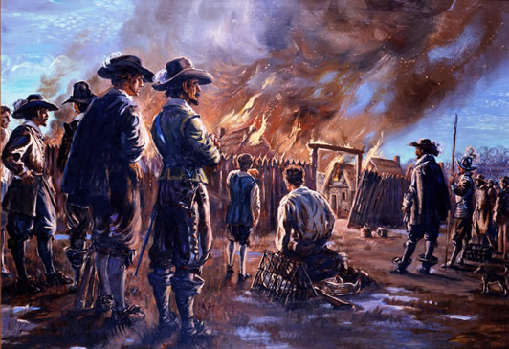
Prosperity led to Pride.
1674 Farmers demanded that the Indians
be driven from their treaty protected land.
This led to the Bacon's Rebellion (1675)
that pitted “poor” against the wealthy.
Burning of Jamestown

Slide 24
Pride led to Spiritual Apathy.
Increased focused on prosperity/work!
Church attendance decreased <10%
(Partially due to the Halfway Covenant 1662)
The Church’s “salt” had
“lost its savor.” Mt 5:13

Slide 25
God raised up some preachers to call us
back to God. (George Whitefield, John Wesley,
Jonathan Edwards, Charles Finney)
“Circuit Riding Preachers” took God’s
word to the people.
God sent a “Great Awakening”. (1740’s)
So many people gathered to hear God’s word that the churches could not contain them.

Slide 26
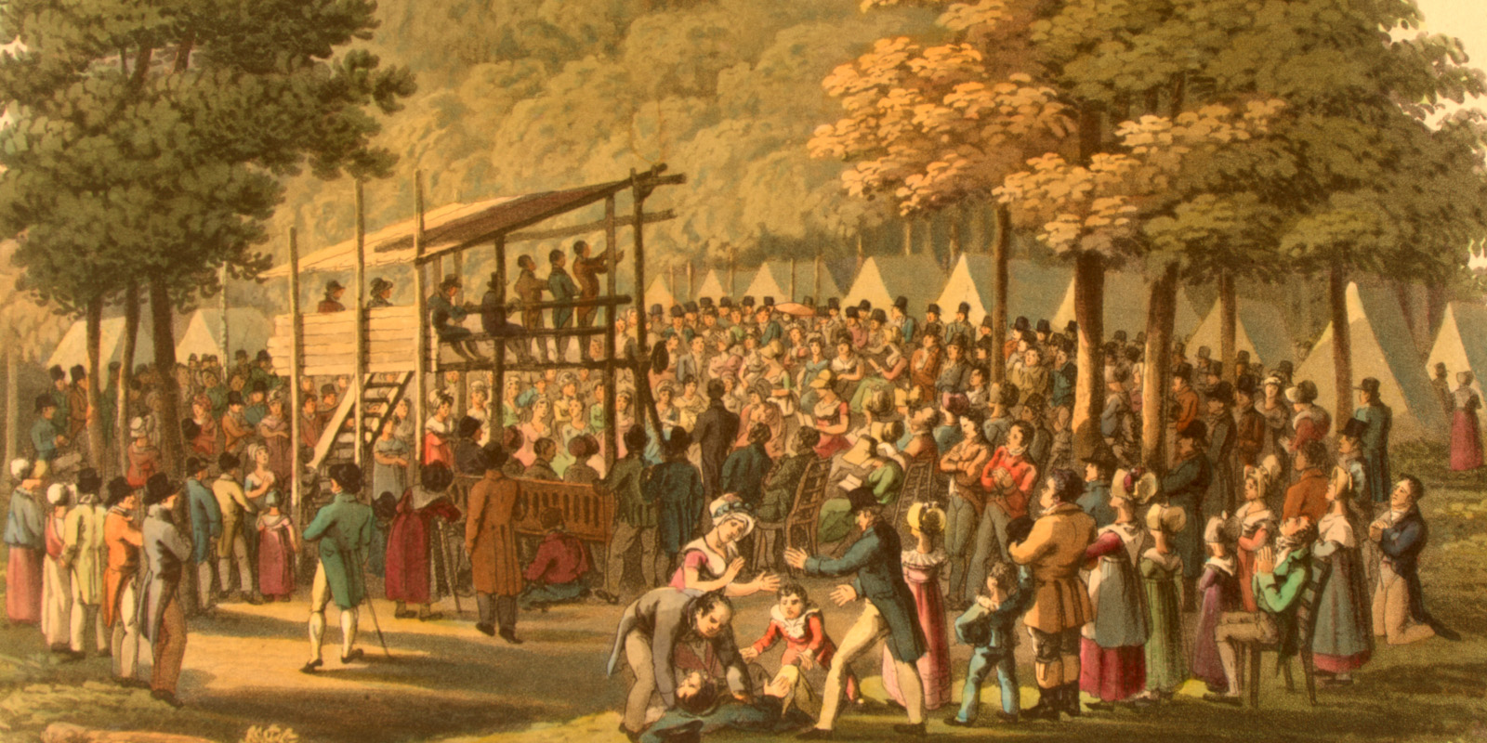
Great “open air meetings” took placed.

Slide 27
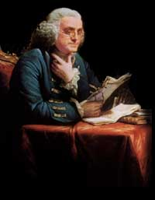
Benjamin Franklin wrote, “It was wonderful to see the change made in the manners of our inhabitants.
From being thoughtless or indifferent about religion, it seemed as if all the world were growing religious,
so that one could not walk through the town in an evening without hearing psalms sung in different families
of every street.”

Slide 28
Franklin was so impressed with Edwards’ preaching that he built an auditorium to accommodate the crowds of more than 30,000 that came to hear him.
(Philadelphia’s population was 25,000 at that time.)
Within 20 years “active” church membership grew from 10% to over 50% in America.
(1740 – 1760)

Slide 29
Our founding fathers were influenced by this Great Awakening!
God raised up men of character and
integrity to lead our Nation to freedom!
Political-science professors at the University of Houston collected & cataloged 15,000 writings by the founding fathers in order to determine the primary source of ideas behind the Constitution by identifying the sources quoted most often by them.
94% of the quotes of the founders of our nation were based upon the Bible.

Slide 30
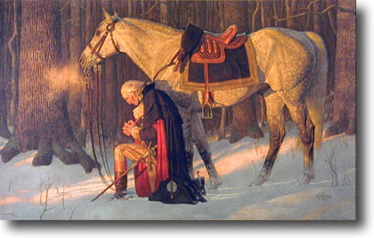
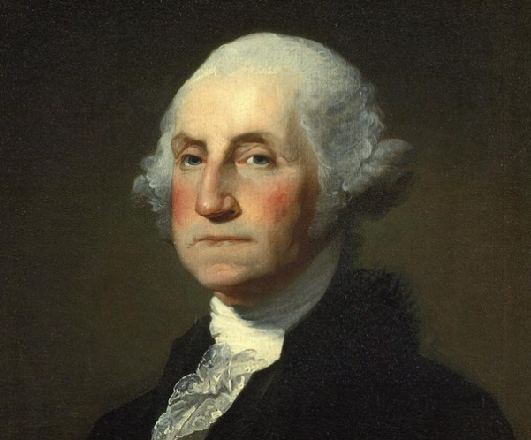
From Washington’s Inauguration: April 30, 1789
“No people can be bound to acknowledge and adore the Invisible Hand which conducts the affairs of men more than those of the United States.
Every step by which they have advanced to the character of an independent nation seems to have been distinguished by some token of providential agency.”

Slide 31
From Washington’s Inauguration: April 30, 1789
It would be peculiarly improper to omit this first official act my fervent supplications to that
Almighty Being who rules over the universe,
who presides in the councils of nations,
and whose aid can supply every human defect,
that His benediction may consecrate to the liberties of the people a Government instituted …
for these essential purposes.”

Slide 32
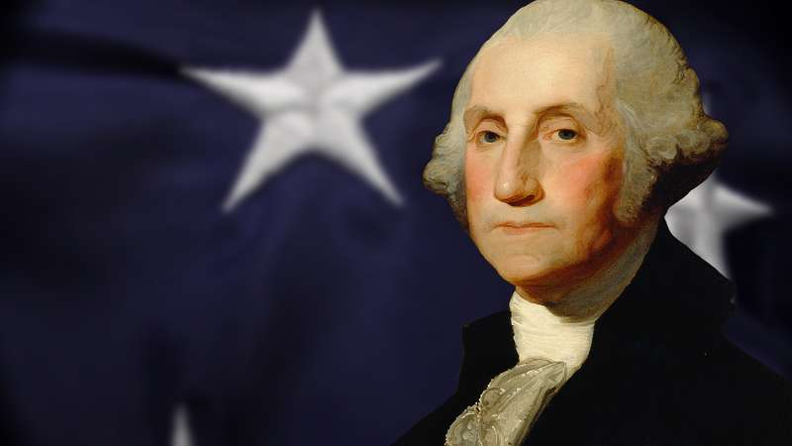
“It is impossible to rightly govern …without God and the Bible.”
George Washington

Slide 33
That’s Why Congress passed legislation in 1782 affirming:
“The Congress of the United States approves of and recommends …
the Holy Bible for use in the schools.’”
(Paid for by federal funds)

Slide 34
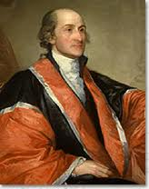
“Divine Providence has given to our people the choice of their rulers,
and it is the duty of our Christian nation to select and prefer
Christians for their rulers.“
(John Jay, Supreme Court
Chief Justice)
Oct. 12, 1816

Slide 35
This is why Most state legislatures passed laws requiring all elected officials to take this oath:
“I do profess faith in God the Father,
and in the Lord Jesus Christ His only Son…
and I do acknowledge the holy scriptures of the Old and New Testaments
to be given by divine inspiration.’"

Slide 36
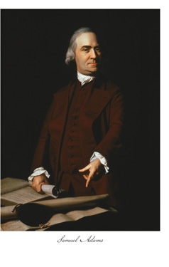
“A general dissolution of principles and manners will more surely overthrow the liberties of America than the whole force of the common enemy.
While people are virtuous, they cannot be subdued;
but when once they lose their virtue then will be ready to surrender their liberties to the first external or internal invader. “
Samuel Adams February 12, 1779.

Slide 37
“Our laws and our institutions must necessarily be based upon and embody the teachings of the Redeemer of mankind.
It is impossible that it should be otherwise.
In this sense and to this extent,
our civilizations and our institutions are emphatically Christian.”
Richmond v. Moore, Illinois Supreme Court, 1883

Slide 38
This Cycle repeated again in the 1800’s
(Lincoln’s 1763 call for fasting and prayer?)
and again in the 1900’s
(Remember the Wars?)
And is actively at work today!

Slide 39
Where do you think America is in this Cycle?
1. Revelation 2. Response 3. Reward
4. Rebellion 5. Reproof 6. Reconsider
7. Reprobation
An honest and objective review of
our History/values will show us!

Slide 40
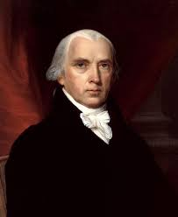
“We have staked the whole future of American,
not upon the power of government,
far from it!
We have staked the future of all of our political institutions upon the capacity of each and all of us
to govern ourselves ...according to the
Ten Commandments of God. “
James Madison
(Author of the US Constitution!)

Slide 41
Where are YOU in this Cycle?
1. Revelation 2. Response 3. Reward
4. Rebellion 5. Reproof 6. Reconsider
7. Reprobation
An honest and objective review of
your “story” and values will reveal it!

Slide 42
Deuteronomy 30:19 “I call heaven and earth to record this day
against you,
that I have set before you life and death,
blessing and cursing:
therefore choose life,
that thou and thy seed may live:”

Slide 43
"God who gave us life gave us liberty.
Can the liberties of a nation be thought secure when we have removed their only firm basis,
a conviction in the minds of the people
that these liberties are the gift of God;
That they are not to be violated
but by his wrath?

Slide 44
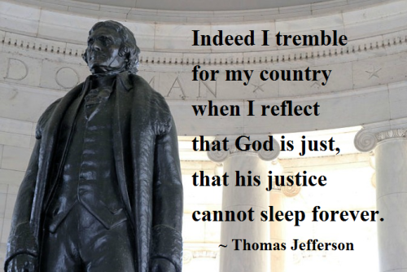

Slide 45
The Strategy of Satan
“And they overcame him
by the blood of the Lamb,
(Genuine Conversion)
by the word of their testimony;
(Sincere Christian Conduct)
and they loved not their lives unto the death.”
(Devoted Commitment)
Revelation 12:11

