Slide 1
71 years ago (1953), some believers were burdened about the spiritual condition of the people in our area.
They prayed, prepared and planned services in an old fashioned “Tent” seeking to win the lost to Christ.
God’s Spirit moved and on June 21st , 1953 some believers covenanted together to form Cheney Baptist Church.

Slide 2
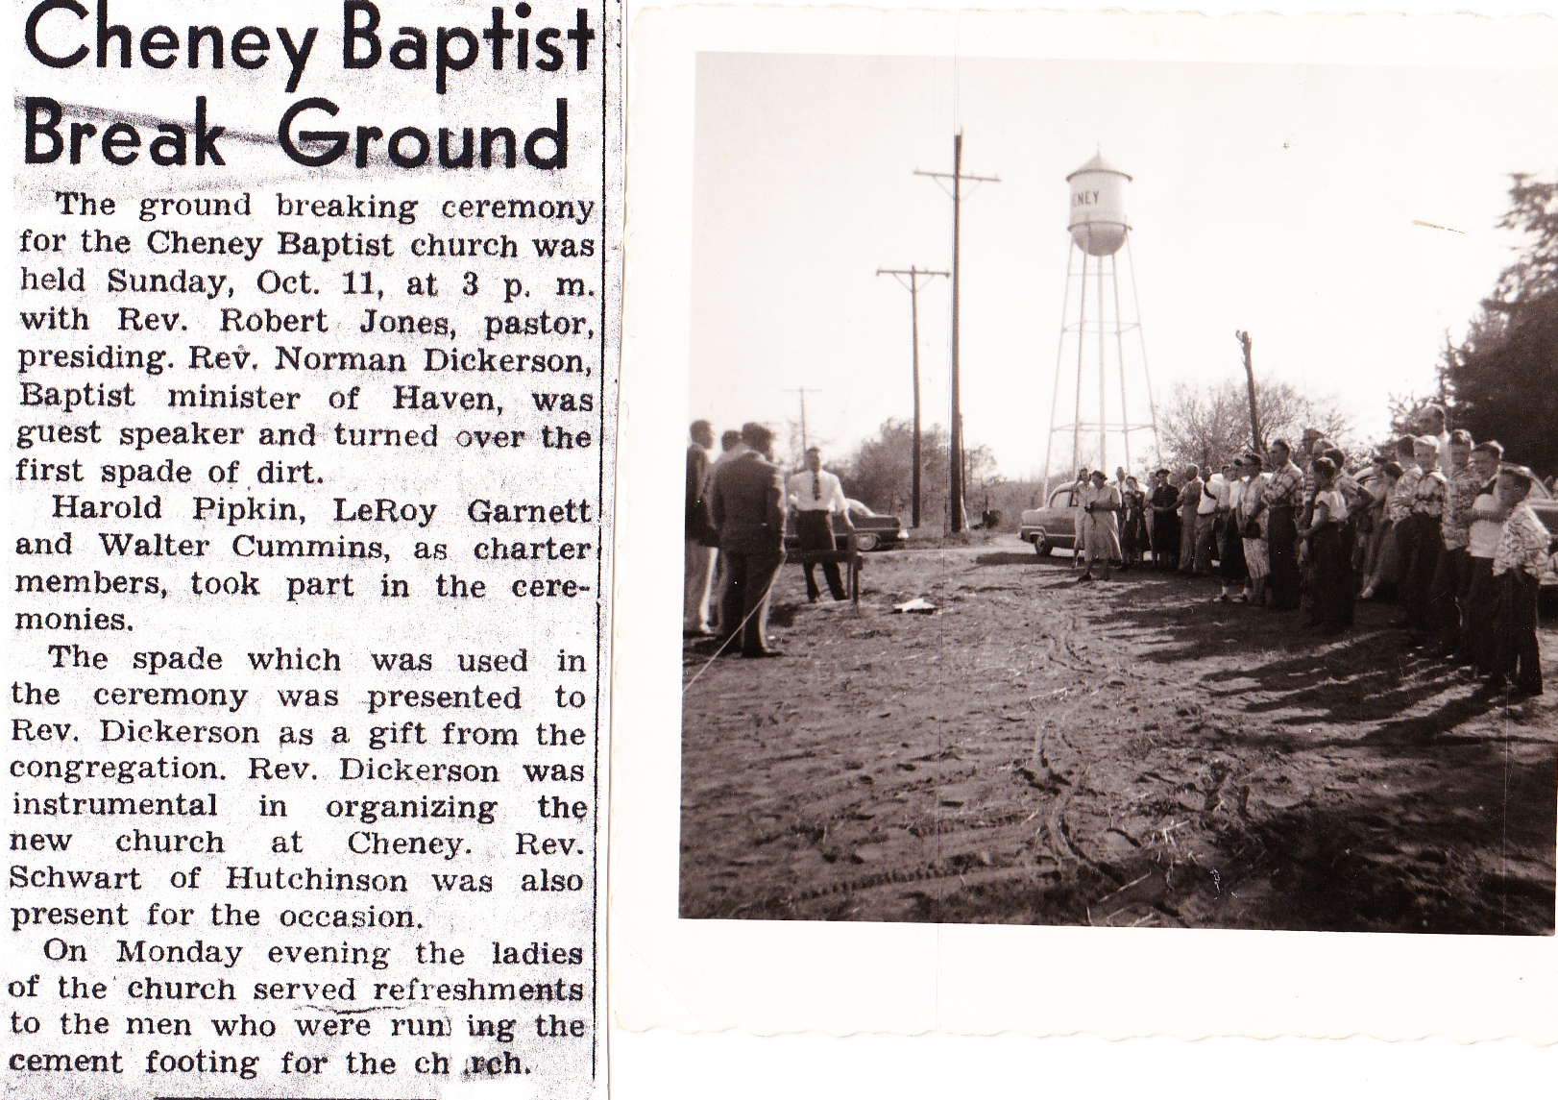
They moved into the American Legion Hall and by August began a Missions Program.
In October they broke ground for the church Building.
Much has changed since then,
But some things
have not.
The Purposes and power of God hasn’t changed;
And neither has Satan’s!

Slide 3
God warned 2000 years ago: 2 Cor 2:11
“Lest Satan should get an advantage of us: (pleonekte’ō: covet, overreach)
for we are not ignorant of his devices.”
(no’ēma: mind, purpose, disposition)
When we’re ignorant of Satan’s “devices” ,
He gains an advantage over us!
2Cor 4:4

Slide 4
America’s Sacred values (“self evident truths”)
are decaying exponentially!
While we changed the definition of Marriage to accommodate the <3% homosexual population, (2015)
The Russian Parliament voted 436-0 to outlaw the: “Propaganda of non-traditional sexual relations.”
Luke 16:8 “The children of this world are in their
generation wiser than the children of light.”
The world has adopted the commitment and fire
that once characterized the church!

Slide 5
Scripture clearly warns that Satan and his followers will become bolder and more determined as we approach the end of this age. (Mt. 25; 1 Tim. 4, 2 Tim. 3; 2 Thes. 2; Rev. 12,13)
1 Tim 3:13 “evil men and seducers shall wax worse and worse, deceiving, and being deceived.”
It’s clear that they have intensified their attacks in an attempt to further
“The Devices of the Devil” (2 Cor. 2:11)

Slide 6
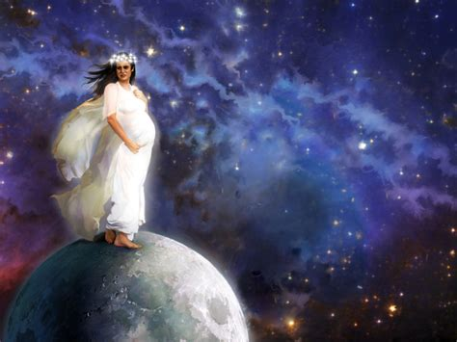
The Devices of the Devil Part 1
“There appeared a great wonder in heaven;
a woman clothed with the sun,
and the moon under her feet,
and upon her head a crown of twelve stars:
And she being with child cried, travailing in birth,
and pained to be delivered.”
2Cor 4:4
Rev. 12:1,2

Slide 7
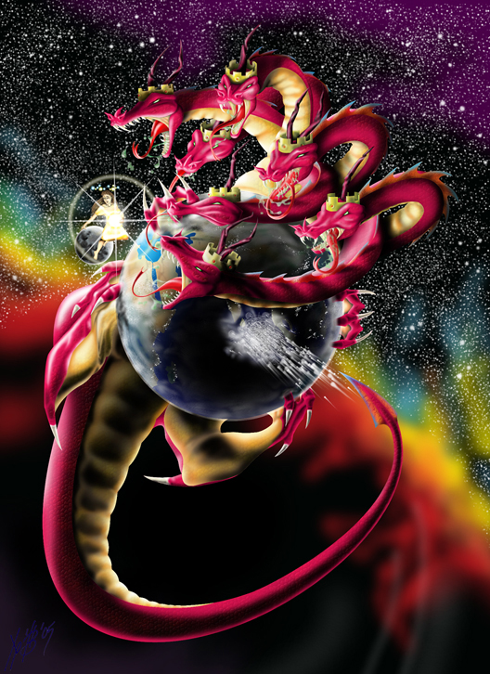
“there appeared another wonder in heaven; …a great red dragon, having 7 heads and 10 horns,
and 7 crowns upon his heads.
And his tail drew the third part of the stars of heaven,
and did cast them to the earth:
and the dragon stood before the woman …ready to be delivered,
for to devour her child
as soon as it was born.”
2Cor 4:4
Revelation 12:3,4

Slide 8
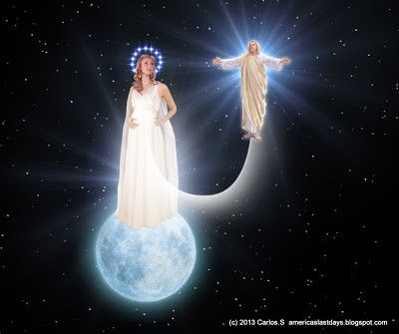
“And she brought forth a man child, who was to rule all nations
with a rod of iron: (Ps 2, Is 9:6)
and her child was caught up unto God, and to his throne.
Vs 5,6
And the woman fled into the wilderness,
where she hath a place prepared of God,
that they should feed her there 1260 days.”
(The last 3 ½ years of the Great Tribulation)
see Rev. 13

Slide 9
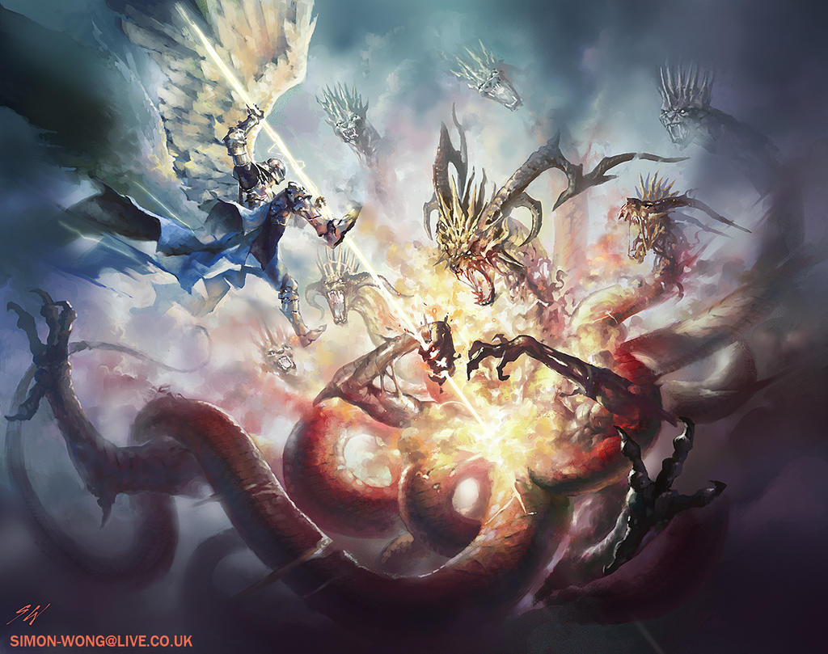
“And there was war in heaven: Michael and his angels fought against the dragon; and the dragon fought
and his angels,
And prevailed not;
neither was their place found any more in heaven.
And the great dragon was cast out, that old serpent, called the Devil, and Satan, which deceiveth the whole world: …
and his angels were cast out with him”
Vs 7-8

Slide 10
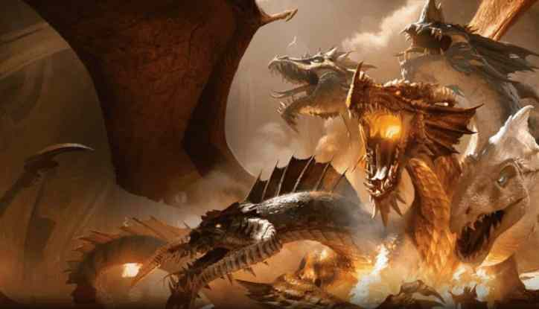
“Woe to the inhabiters of the earth!
For the devil is come down unto you,
having great wrath,
Rev. 12:12
because he knows that he has
but a short time.”

Slide 11
Rev. 12:17
“And the dragon was wroth with the woman,
and went to make war with the remnant of her seed, which keep the commandments of God,
and have the testimony of Jesus..”
(martyri’a: from Martys: to give evidence)
Is there enough evidence in your life
to convict you for being a Christian?

Slide 12
What Devices (agenda) has Satan been using to: Corrupt our culture and Contaminate/Compromise God’s church?
“No man can enter into a strong man’s house,
and spoil his goods,
except he will first bind (deō: Restrain, remove)
the strong man; (ischyros’: valiant, forceful, mighty),
and then he will spoil (diarpaz’ō: plunder)
his house.“
Mark 3:27

Slide 13
Satan seeks to blind and bind us:
ECONOMICALLY Through:
A. Personal Selfishness/ Covetousness.
1Tim 6:9-10 “But they that will be rich fall into temptation and a snare, and into many foolish and hurtful lusts,
which drown men in destruction and perdition.
For the love of money is the root of all evil: which while some coveted after, they have erred from the faith,
and pierced themselves through with many sorrows.”

Slide 14
B. Through Poisoned Govt. policy. 1 Jn 5:19
1) Ave family income in 1953 was $3200 per year.
Now it’s $69,000 {KS} and mostly dual incomes.
2) Purchasing power.
a) $1 in 1882 had purchase power of $2.62 in 1953,
(Inflation of 1.36% per year or 162% over 71 years.)
b) $1 in 1953 had purchase power of $11.76 today.
(3.53% per year or cumulative increase of 1076%)

Slide 15
1953 advertisement

Slide 16
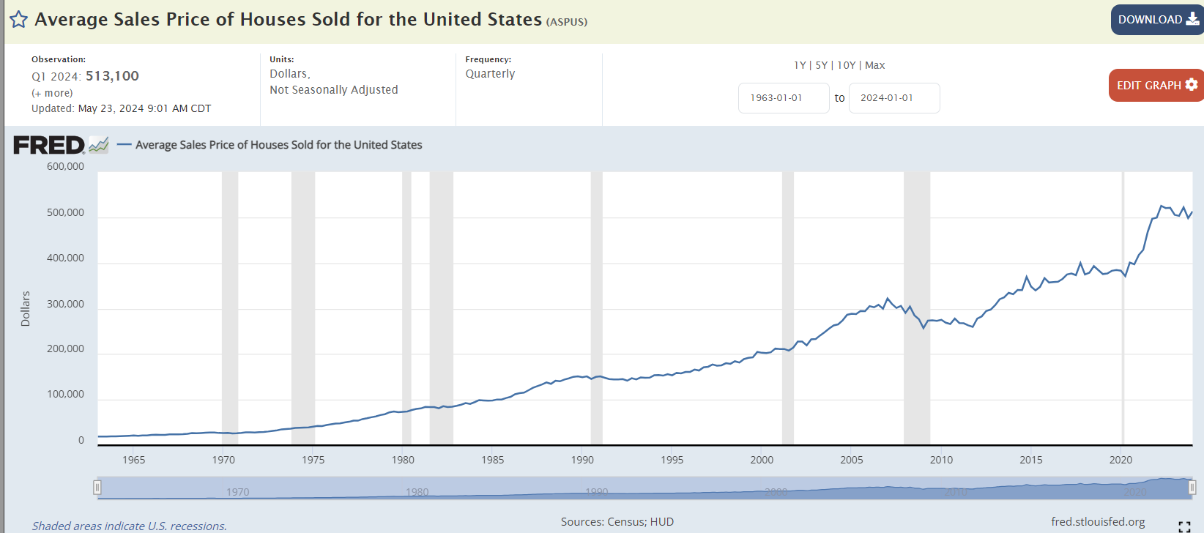
That’s $513,100!
Medium Price $420,000

Slide 17
He Binds us Economically:
C. Through pressured transitions from:
1) Patriarchal (Strong Father influence) ➔
2) Matriarchal (Strong Mother influence) ➔
3) Governmental (Strong Government influence)
a) If you can remove or restrain God and God
ordained “institutions” (Church and Family)
then society begins to panic and crumble.
b) The Government has to come to the “rescue”,
to fix the problems they created!

Slide 18
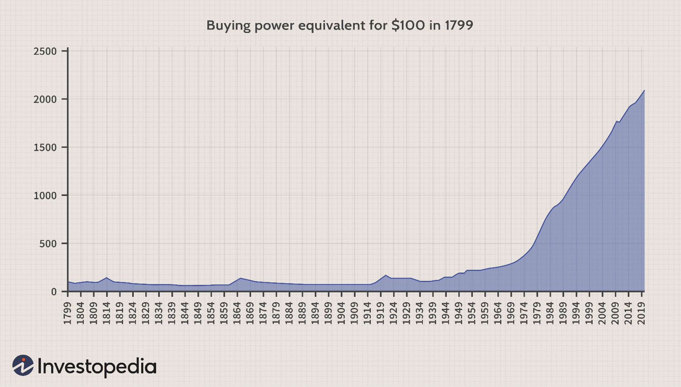
$2573 Jan 24
Government Tyranny
Biden’s Digital dollar
Exec. Order 2022
Nixon removed international gold standard 1971
Fed Reserve 1913
Wilson
FDR removed National Gold standard 1933
Notes:
FDR removed National Gold standard 1933

Slide 19
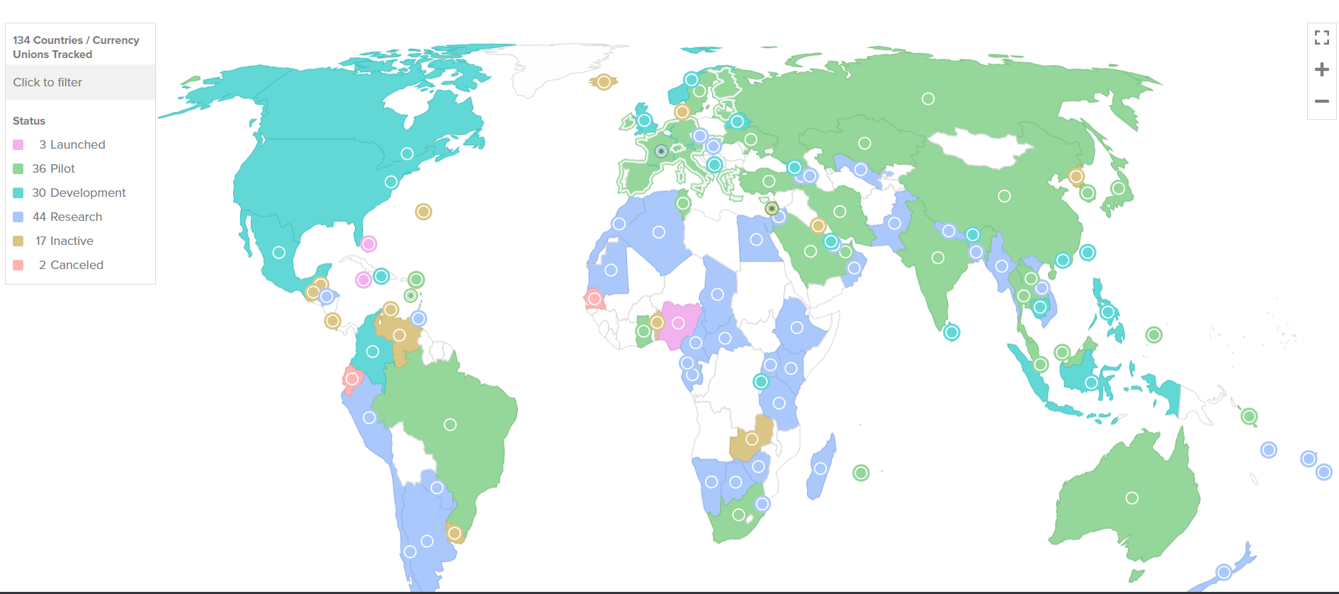
a) Central Bank Digital Currency Tracker
Revelation 13:16-18
https://www.atlanticcouncil.org/cbdctracker/

Slide 20
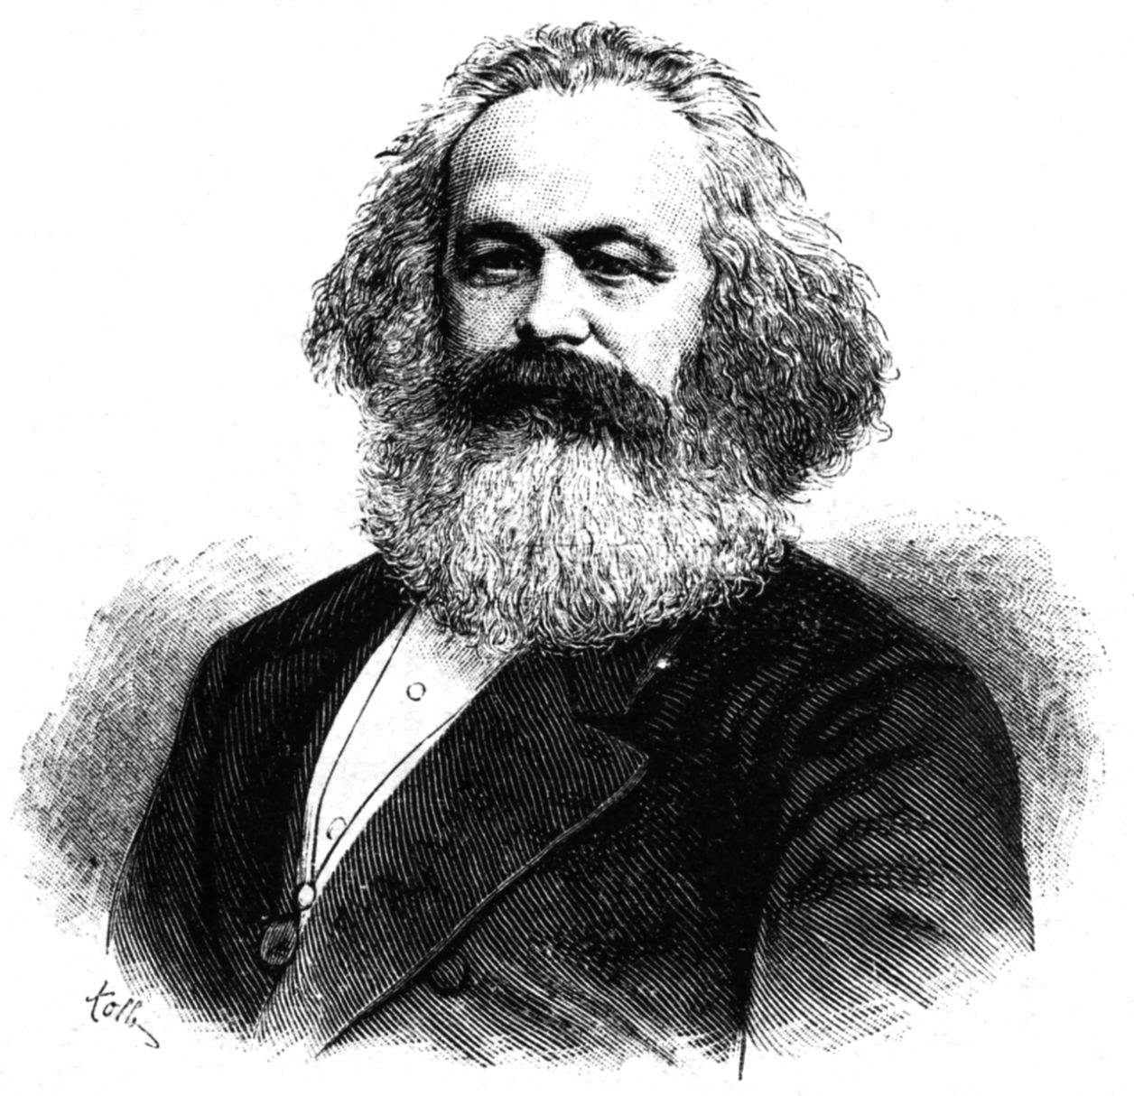
“My purpose in life is to dethrone God
and destroy Capitalism.” Karl Marx
Author of
The Communist Manifesto
(To Dethrone God)
And Das Kapital
(To Destroy Capitalism)

Slide 21
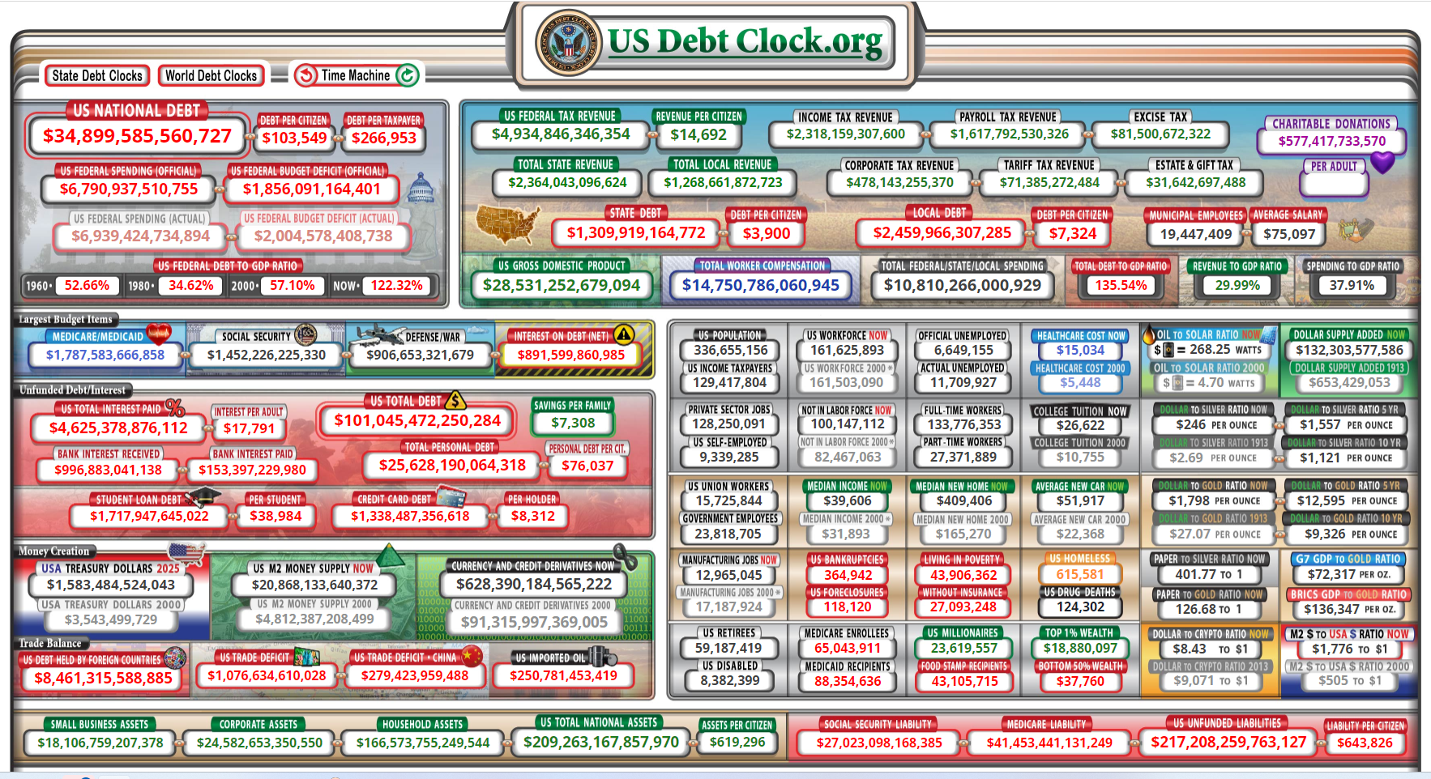
www.usdebtclock.org
As of July 12 6:45 PM

Slide 22
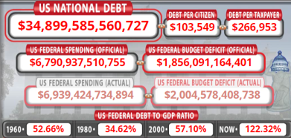

Slide 25
How do we “resist” the devil’s devices?
1) Separation: 1 Tim 5-7 “Perverse disputings of
men of corrupt minds, and destitute of the truth,
supposing that gain is godliness:
2) Recognition: 1 Tim. 5:6,7 “But godliness with contentment is great gain. For we brought nothing into this world, and it is certain we can carry nothing out.”
3) Protection: Vs 8 “And having food and raiment let
us be therewith content.”
from such withdraw thyself.” Ro. 12:1,2; 2 Cor 6:14-18;
(Arkeō: to raise a barrier)

Slide 26
4) Realization: Vs 9 ”But they that will be rich fall into temptation and a snare, and into many foolish and hurtful lusts,
Which drown men in destruction…
10 For the love of money is the root of all evil: which while some coveted after,
they have erred from the faith,
and pierced themselves through
with many sorrows.”

Slide 27
5) Dedication: 11 ”But thou, O man of God,
flee these things; and follow after righteousness, godliness, faith, love, patience, meekness.
12 Fight the good fight of faith… (Mt 6:33)
Charge them that are rich in this world, that they be not highminded, nor trust in uncertain riches,
but in the living God, (aka: Faith!)
who giveth us richly all things to enjoy;

Slide 28
6) Participation! Vs 17-19 “Charge them…
That they do good, (agathoerge’ō: work to benefit)
that they be rich in good (kalos: virtuous) works,
ready to distribute, (eumetad’otos: share, impart)
willing to communicate; (koinōnikos: partner)
Laying up in store for themselves a good foundation against the time to come...”
(See Mt 6:19-21; 2 Tim. 4:7-8)

