Slide 1
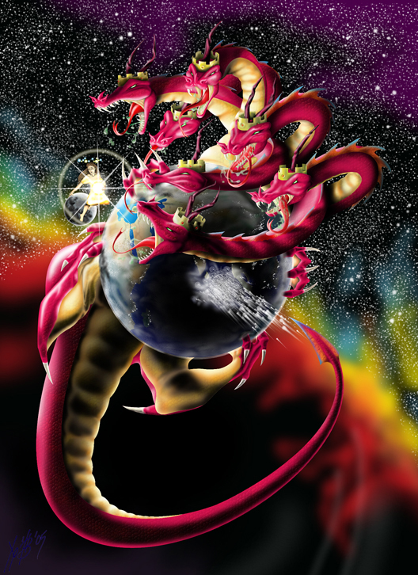
The Strategy of Satan
2 Cor. 4:4 calls Satan
“the god of this world”
3x Jesus referred to him as:
“The Prince of this world”
Jn 12:31; 14:30; 16:11
Prince (archon) means
chief ruler
Rev. 12

Slide 2
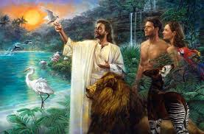
God originally gave this power to Adam.
Gen. 1:28 “have dominion (rāḏâ: rule, reign)
…over every living thing”
So how did Satan end up with it?

Slide 3
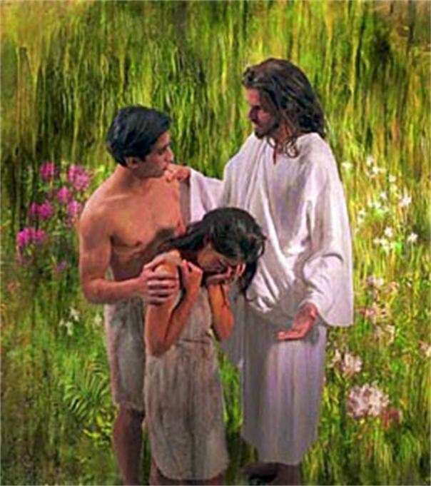
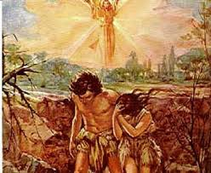
When Adam sinned, he surrendered this authority to Satan! Gen. 3; Ro. 5:12a
“Wherefore, as by one man sin entered into the world,
and death by sin…”

Slide 4
Eden’s fall has been played out in every life…
Ro. 5:12b “…so death passed upon all men,
for that all have sinned”
Romans 6:16 “Know ye not, that to whom ye yield yourselves servants to obey,
his servants ye are to whom ye obey;
whether of sin unto death,
or of obedience unto righteousness?”

Slide 5
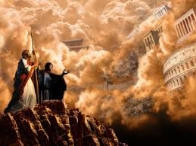
Eden’s fall has been played out in
every life…
but one! Luke 4:6-8
“All this power will I give thee,
and the glory of them:
for that is delivered unto me;
(paradidomi: surrendered, betrayed)
and to whomsoever I will I give it.
If thou therefore wilt worship me, all shall be thine.
Get thee behind me Satan…Thou shalt worship the Lord Him only shalt thou serve”

Slide 6
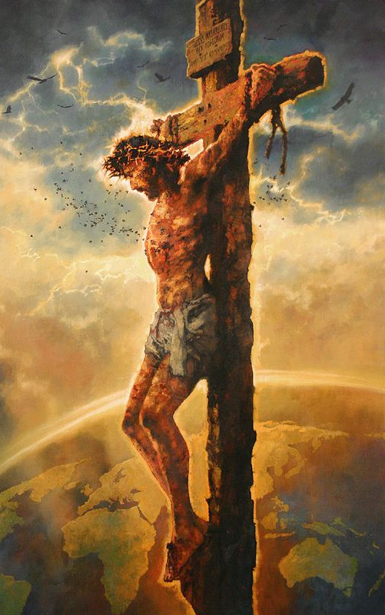
Eden’s fall has been played out in
every life…
but one!
This is why Jesus was the only possible substitution for our sin.
“For he hath made him to be sin for us,
who knew no sin;
that we might be made the righteousness of God in him.”
(2 Cor 5:21; Ro. 6:23a; 5:8; 6:23:b)

Slide 7
Satan uses this power and position
to gain more influence and power
in order to accomplish his “agenda”.
2 Cor 2:11 “Lest Satan should get an advantage of us:
for we are not ignorant of his devices.”
The more we sin (surrender to him)
The more influence he gains in our lives,
and the further he advances his Agenda.

Slide 8
Last week we discussed how Satan uses
Personal Covetousness as well as
Politically Corrupt (1 Jn 5:19) Policies
to pressure us in an attempt to financially
“Bind (deō: Restrain, remove) the strong man
so he can spoil his house” Mt. 12:29
2Cor 4:4
This Economic Pressure produces:

Slide 9
2. Relational Pressure: He binds us with:
Busy-ness with “our” Business (Priorities)
The curse of sin affects us differently. Gen. 3
1) Woman:
a) Child/family related frustrations. 16
“multiply thy sorrow” (iṣṣāḇôn’: worry, grief, pain)
b) Control issues “thy desire (tᵊšûqâ: reaching
after {to control}) see Gen. 4:7
shall be to (el: toward or against) thy husband,
but he shall rule over thee”

Slide 10
Business with our business (Priorities)
1) Woman: Home related frustrations. 16
2) Men: Work related frustrations. 17-19
“Because thou hast hearkened unto the voice of thy wife, and hast eaten of the tree, …
cursed is the ground for thy sake;
in sorrow (ʿiṣṣābôn’: worrisome toil)
shalt thou eat of it all the days of thy life;
thorns and thistles shall it bring forth to thee”

Slide 11
2. Relational Pressure: He binds us with:
Busy-ness with “our” business.
B. Dual income often needed to “survive”.
1) Whose raising the kids? Titus 2:5
“keepers (oikourgos’: guardians) at home”
2Cor 4:4
Of Who?
From who/what?

Slide 12
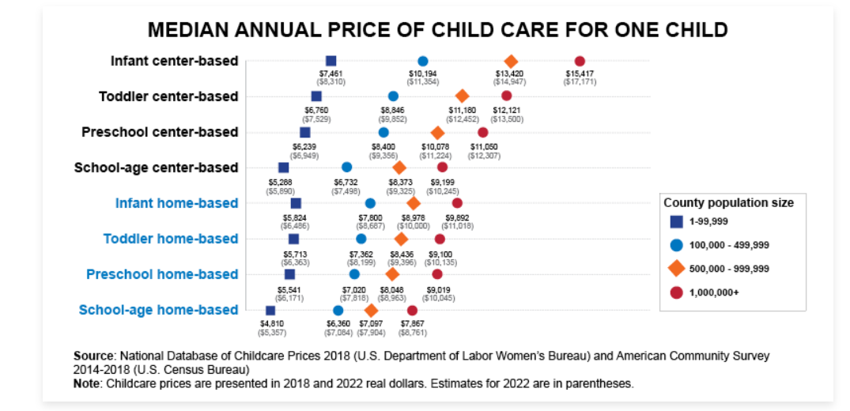
B. Dual income often needed to “survive”.
2) The deception of dual incomes! (2022)
$15,000
$12,500
$11,200
$9,300
2Cor 4:4
$48,000
with 4 kids
More “fast food”, clothing, exhaustion, etc

Slide 13
B. Dual income often needed to “survive”.
1) Whose raising the kids?
2) The deception of dual incomes!
3) The Pressure of balancing:
a) Roles and Responsibilities
Housework, meals, kid time, homework, etc.
b) Expectations: “I thought…believe…want…need”
c) Compensation: “Me time and/or toys”
(hobbies, toys, TV, relaxation, rewards)
2Cor 4:4

Slide 14
C. The Pressure of trying to navigate/balance
these factors work together to produce:
1) Women tend to pursue to resolve conflict.
(“We need to talk…”)
2) Men tend to withdraw to reduce/avoid
conflict that they don’t think they can solve.

Slide 15
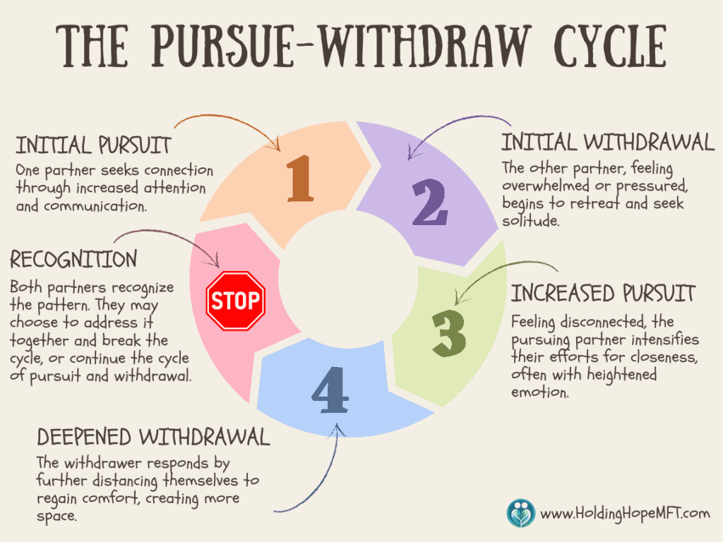

Slide 16
Satan binds men 1. Economically 2. Relationally
3. Spiritually: He uses:
A. Society “The world” (1 John 2:15-17)
Ro 12:2 “Be not conformed to this world…”
1 Jn 5:19 “…the whole world lieth in wickedness.”
Mk 4:19 “the Cares of this world…choke the word…”
2 Tim. 4:10 “Demas hath forsaken me,
having loved this present world”

Slide 17
3. Spiritually: (1 John 2:14-18) Satan uses:
A. Society “The World” Mk 4:19
B. Selfishness “The flesh” (Phil. 2:4,5)
“Look not every man on his own things, (interests)
but every man also on the things of others.
Let this mind be in you, which was also in Christ”
1) It’s natural to feel you “deserve” …
Appreciation, Affirmation (Respect), Affection…
But what happens if/when you don’t get them?
2Cor 4:4

Slide 18
Society (The world) and Selfishness (The Flesh)
“tag team” to defeat us.
Phi 3:18-20 “For many walk, of whom I have told you often, and tell you now even weeping;
that they are the enemies of the cross of Christ:
Whose end is destruction, (apōleia: waste, ruin)
whose God is their belly, (appetites)
and whose glory is in their shame,
who mind (phroneo: regard, value) earthly things.
For our citizenship is in heaven…!” (see Col 3:1-5)

Slide 19
3. Spiritually: (1 John 2:14-18)
Society and Selfishness distracts us an lead us toward:
C. Satan (Demonic pressure) to deceive and destroy us.
Our real battle is “…against principalities
…powers…spiritual wickedness in high places…” (Eph. 6:12)
What’s his ultimate agenda?
Mk 4:19 “the Cares of this world…deceitfulness of
riches…lusts of other things…,
and it* becomes unfruitful.”
2Cor 4:4
choke the word

Slide 20
How to become a “Strong man” 2 Tim 2 “be strong in the grace that’s in Christ…
The things thou has heard…commit to faithful men, who shall be able to teach others.
3 Endure hardness as a good soldier of Jesus…
4 No man that warreth entangleth himself with the affairs of this life, that he may please him who hath chosen him to be a soldier.
And if a man also strive for masteries,
yet is he not crowned, except he strive lawfully….
2Cor 4:4

Slide 21
15 “Study to show thyself approved unto God…
A Workman… rightly dividing the word of truth.
16 but shun profane and vain babblings…
17 Their word will eat like a canker…
19 Nevertheless the foundation of God standeth sure, having this seal,
The Lord knoweth them that are his.
And, Let every one that nameth the name of Christ depart from iniquity.

Slide 22
20 “But in a great house (and life) there are not only vessels of gold and of silver, but also of wood and of earth; and some to honor, and some to dishonor.
21 If a man therefore purge himself from these, he shall be a vessel unto honour, sanctified, and meet for the master's use, and prepared unto every good work.
Flee also youthful lusts:
but follow righteousness, faith, charity, peace,
with them that call on the Lord out of a pure heart.
23 But foolish and unlearned questions avoid, knowing that they do gender strifes.”

Slide 23
Notice how 2 Tim. 2 closes! 24-26
“The servant of the Lord must not strive;
but be gentle unto all men, apt to teach, patient,
In meekness instructing those that oppose themselves;
if God peradventure will give them repentance
to the acknowledging of the truth;
And that they may recover themselves
(ananēphō: literally to sober up!)
out of the snare of the devil,
who are taken captive (bound) by him at his will.”

Slide 24
Application: Ps. 12:1 “Help, LORD;
for the godly man ceaseth; for the faithful fail from among the children of men.”
Instead of surrendering to Satan’s snares, making you a fearful/frustrated man,
Will you to surrender to God and become a faithful “Strong man”?
(James 4:4-10)

Slide 25
What does a “faithful” man do?
1 Pt 5:8,9 “Be sober, be vigilant; because your
adversary the devil, as a roaring lion, walketh
about, seeking whom he may devour:
(“bind the strong man…spoil his house”)
Whom resist steadfast in the faith…”
Resist: anthistēmi: to stand against, oppose, fight off!
Steadfast: stereos; solid, stable, strong, sure.

Slide 26
History repeats itself.
2600 years ago Israel was where America now is:
Ez 22:29 “The people …have used oppression, and exercised robbery, and have vexed the poor and needy: yea, they have oppressed the stranger wrongfully.
30 And I sought for a man among them,
that should make up the hedge,
and stand in the gap before me for the land,
that I should not destroy it:
but I found none.”

Slide 27
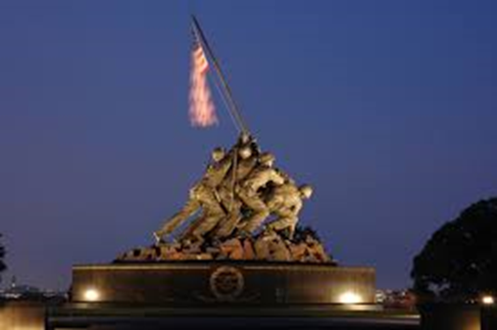
This Battle is real and relentless.
This world a battleground, not a playground!
Our Enemy is determined, deceitful,
and destructive. (Jn 10:10a) Is. 59:19
“When the enemy shall come in like a flood,
the Spirit of the LORD shall lift up a
standard (flag to rally to)
against him. “
Will you “rally” to God’s cause?

Slide 28
God’s still searching for such men
Will He find one here today…
in YOU? (Is. 6:8)

Slide 29
Steps of action:
Get involved in the Men’s
ministry.
2) Seek out a godly Mentor.
Eccl. 4:9,10 “Two are better than one;
because they have a good reward for their labor.
For if they fall, the one will lift up his fellow:
but woe to him that is alone when he falleth…”

