Slide 1
The Strategy of Satan Pt 3
Jesus referred to him as:
“The Prince (archon) of this world”
Jn 12:31; 14:30; 16:11
2 Cor. 4:4 “the god of this world
blinds our minds”
(To Deceive us)
in order to “bind us” (Mk 3:27)
(To destroy us. {Jn 10:10})

Slide 2
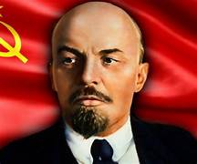
His cunning corrupted 1/3 of Heaven’s angels into following him in his rebellion. (Rev. 12:4)
He uses them (the demons) and his growing influence as “the god of this world” to influence people to set the stage for the last days recorded in Revelation.
Vladimir Lenin called such people
“Useful Idiots”
Not knowing that he was actually one of Satan’s most “useful Idiots”.

Slide 3
Last week we learned that He uses
“all that is in the world, the lust of the flesh, the lust of the eyes, and the pride of life” (1 Jn 2:15,16)
to gain increasing influence in our lives,
and ultimately our culture and world.
To the degree we’re “ignorant of his devices”
(noema: mind, purpose, disposition {Jn 10:10})
he’ll “get an advantage of us.” (2 Cor. 2:11)
(Pleonekteō: to covet, overreach)

Slide 4
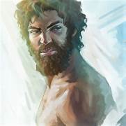
Satan “covets” you!
Gen. 4:6 “the LORD said unto Cain, …
7 If thou doest well, shalt thou not be accepted?
and if thou doest not well,
(From ḥāṭāʾ: to lead astray…forfeit)
sin lieth at the door.
And unto thee shall be his desire,
(teshûqâ: longing, to reach out for)
From shûq: to run after and/or over
and thou shalt rule over him.”

Slide 5
Some of Satan’s “devices” include:
1. Removing (Binding) Strong men as the
leaders of the family. Mk 3:27
“No man can enter into a strong man's house, and spoil his goods, except he will first bind
(deo: to bind, knit) the strong man;
then he will spoil (Diarpazō: seize, plunder) his house.”
Satan’s not interested in your stuff,
he’s interested in your soul!

Slide 6
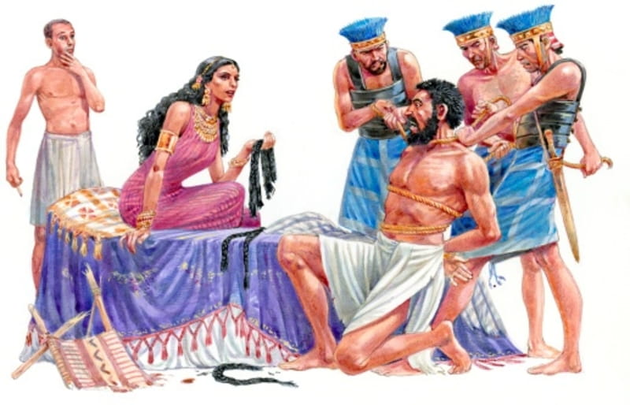
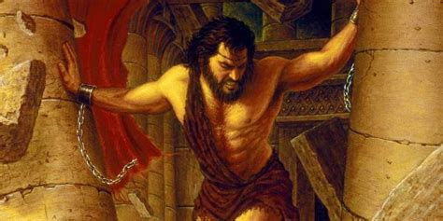
Pr 5:21-23 “For the ways of man are before the eyes of the LORD, and he pondereth all his goings.
His own iniquities shall take the wicked himself,
and he shall be holden with the cords of his sins.
He shall die without instruction;
and in the greatness of his folly he shall go astray.”

Slide 7
Satan’s devices include:
2. Removing Marriage as the
foundation of Society.
➔The Defense of Marriage Act (DOMA) defined that marriage was between a man and a woman,
Passed in 1996 with a veto proof majority.
1/3 Democrats opposed it.
President Bill Clinton described it as
“Divisive and unnecessary”

Slide 8
2) Removing the Marriage as the foundation of Society. ➔2015 the “Supreme Court” 5/4 invalidated DOMA, (Obergefell v. Hodges)
Forcing each state to accept gay marriage.
“Love Wins”
Who actually won?

Slide 9
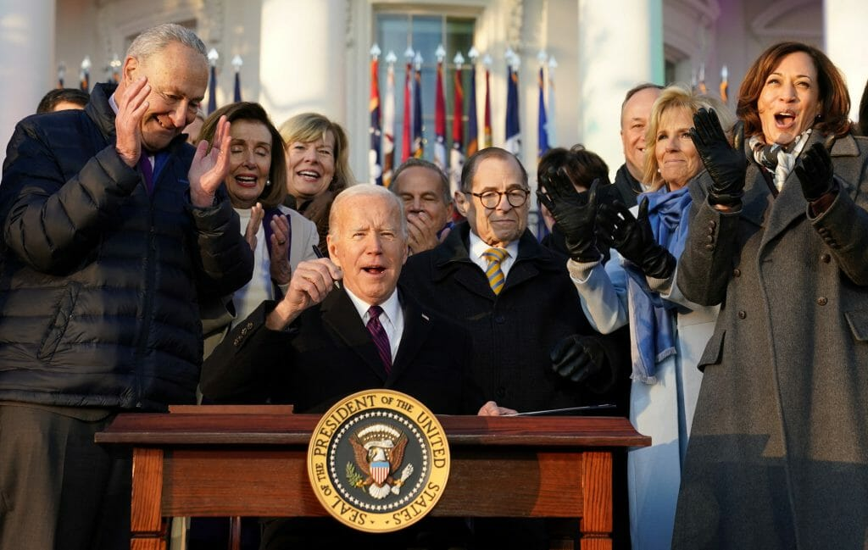
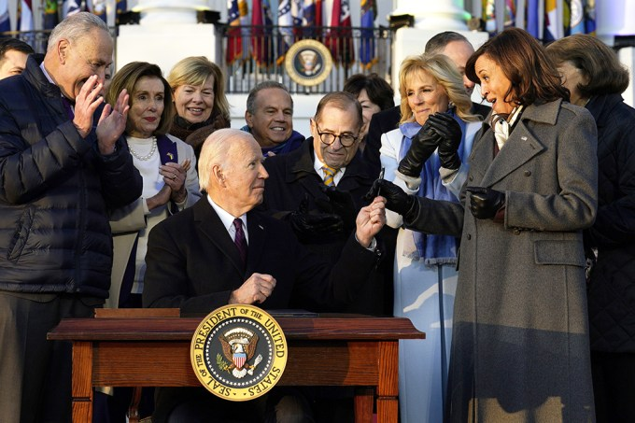
➔2022 Biden signs the “Respect for (Gay) Marriage Act” (with Republican support)
to prevent future Supreme Courts from ever overturning the prior decision.

Slide 10
Satan’s devices include:
1. Removing the Father as the “Strong man” of
the family.
2. Removing Marriage as the foundation of
Society.
This was made possible because he facilitated:
3. Removing the Scriptures (God’s Word)
as the Standard of Society.
We no longer recognize “Self evident” truth.

Slide 11
A. As recent as 1952: (Zorach v. Clauson)
The Supreme Court upheld Biblical instruction
in public schools.
“We are a religious people whose institutions presuppose a Supreme Being.
We guarantee the freedom to worship…”
What Happened To Change This?
Within the next 10 years there were 7 new appointees
to the Supreme Court. (1952 – 1962)
(Eisenhower {5} and Kennedy {2})
.

Slide 12
1) In 1962 the ACLU challenged the following Valedictorian Prayer.
"Almighty God, we acknowledge our dependence upon Thee, and we beg Thy blessings upon us,
our parents, our teachers, and our Country.“
The Supreme Court decided that prayer was “unconstitutional” (Engel v. Vitale)
claiming that our Founding Fathers never intended Public prayer to be encouraged.
“Wall of separation of Church and State”

Slide 13
This was quickly followed by
2) Removing the Bible in the public school.
(Abington Tp. v. Schempp 1963)
3) Forcing States to teach Evolution.
(Epperson v. Arkansas 1968)
4) Removing images of 10 commandments
(Stone vs Graham 1980)
5) Removing Creation teaching in schools
(Edwards v. Aguillard 1987)

Slide 14
B. These were the clearly stated goals of the Humanist Manifesto (1933)
as well as the 45 Communist Goals!
Revealed by FBI agent W. Cleon Skousen 1958 book:
“The Naked Communist”
(The Congressional Record, 1963)

Slide 15
1958 “The Naked Communist” goals:
17. Get control of the schools!
“Use them as transmission belts for Socialism and current Communist propaganda.
Soften the curriculum. Get control of teachers associations. Put the party line in textbooks.”

Slide 16
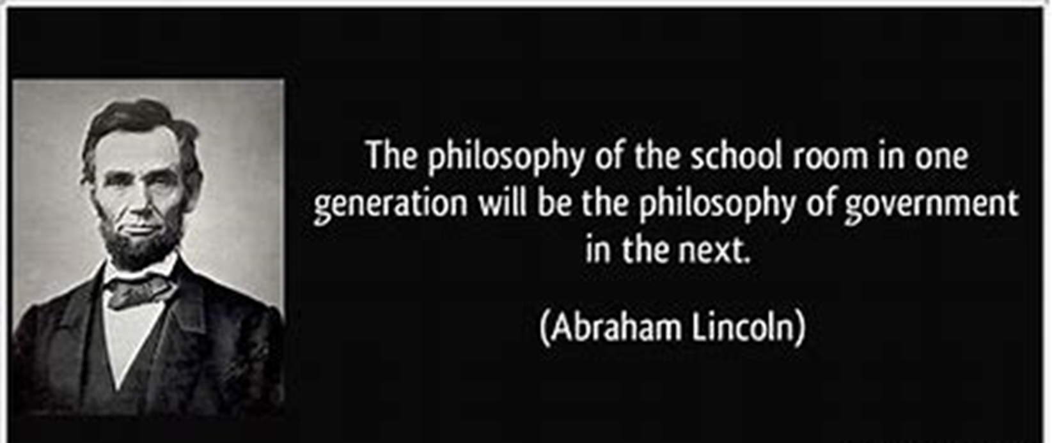
1) These were intentionally designed to “Fundamentally Transform America”

Slide 17
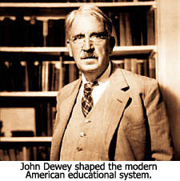
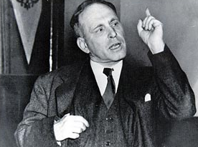
Re-Education = Indoctrination
2) Both John Dewey (1933 Humanist Manifesto) and Roger Baldwin (ACLU founder) went to Russia
to study the educational methods of Communism.
Roger Baldwin

Slide 18
Remember, 18 of the HM1 signers were educators!
Humanist Manifesto signer Charles F. Potter wrote,
"Education is a most powerful ally of humanism, and every American school is a school of humanism.
What can a theistic Sunday school's meeting for an hour once a week and teaching only a fraction of the children do to stem the tide of the five-day program of humanistic teaching?“
(Charles F. Potter, "Humanism: A New Religion," 1930)

Slide 19
John J. Dunphy, The Humanist essay (1983), writes,
"The battle for humankind's future must be waged and won in the public school classroom
by teachers who correctly perceive their role
as the proselytizers of a new faith:
A religion of humanity –
utilizing a classroom instead of a pulpit to carry humanist values into wherever they teach.”

Slide 20
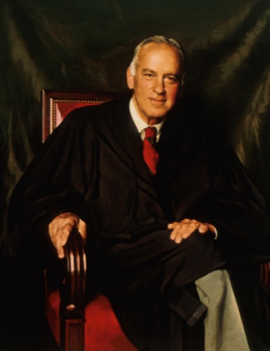
C. Removing the “The Laws of Nature and
Nature’s God” as the standard of our society
left a moral and philosophical Vacuum….
Into which Satan stepped.
Justice Stewart:
"It led not to true neutrality with respect to religion,
but to the establishment of a religion of secularism.“ (humanism)
https://supreme.justia.com/cases/federal/us/370/421/

Slide 21
2) How has this “Fundamental Transformation”
Worked for us?
William Bennett (Sec. of Education in the 80s) compiled an Index of Leading Cultural Indicators in 1994.
He noted that for the past three decades. (60s-90s)
Violent crime has increased > 560 percent.
Divorces have more than doubled.
Children in single-parent homes has tripled.
40 percent of all American births and 80 percent of minority births occur out of wedlock….

Slide 22
“The United States leads the industrialized world
in murder, rape and violent crime.
At the same time, our students rank at or near the bottom in tests of math and science skills.
Since 1960, average SAT scores in our high schools have dropped over 75 points.”
William Bennett “The Index of Leading Cultural Indicators:
Facts and Figures on the State of American Society”

Slide 23
3) What is the Secular Solution to these failed Educational policies?
Less God…More Government;
and more money.
Ave cost to educate a K-12th student in America in 1962 was less than $1000.
https://usafacts.org/data/topics/people-society/education/k-12-education/spending-per-student-in-k-12-public-schools/

Slide 24
2024
$30,992
per student
https://www.census.gov/newsroom/press-releases/2019/school-spending.html
https://worldpopulationreview.com/state-rankings/per-pupil-spending-by-state
https://www.learner.com/blog/states-that-spend-the-most-on-education

Slide 25
Jeremiah 2:11
“Hath a nation changed their gods,
which are yet no gods?
12 My people have changed their glory
for that which doth not profit.
Be astonished, O ye heavens, at this,
and be horribly afraid,
be ye very desolate saith the LORD.”

Slide 26
13 “My people have committed two evils;
they’ve forsaken me
the fountain of living waters,
and hewed them out cisterns, broken cisterns,
that can hold no water.
14 Is Israel a servant? is he a slave?
why is he spoiled?”

Slide 27
Jer 2:14 “Is Israel a servant? is he a slave?
why is he spoiled?”
Because they chose the wrong god!
Mark 3:27; Deuteronomy 30:19
“I call heaven and earth to record this against you, that I have set before you life and death,
blessing and cursing:
therefore choose life,
that both thou and thy seed may live:”

Slide 28
1Corinthians 10:11-13
“these things happened to them for ensamples: and they are written for our admonition,
upon whom the ends of the world are come…
12 Wherefore let him that thinks he stands
take heed lest he fall.
14 Wherefore, my dearly beloved,
flee from idolatry.”

Slide 29
Jer 2:14 “Is (America) a servant?..a slave?
(Jn 8:34; Ro. 6:16)
why is she spoiled?”
Jer 2:17 “Hast thou not procured this unto thyself, in that thou hast forsaken the LORD thy God?”
Satan has bound us by our own prideful
sin and stupidity. (Ro. 1:28)
“as they did not like to retain God
in their knowledge,
God gave them over to a reprobate mind.”

Slide 30
Pr 1:31-33 “They would none of my counsel:
they despised all my reproof.
Therefore they’ll eat of the fruit of their own way,
and be filled with their own devices.
For the turning away of the simple shall slay them, and the prosperity of fools shall destroy them.
But whoso hearkeneth unto me shall dwell safely,
and shall be quiet from fear of evil.”

Slide 31
Jer. 2:14 “Is (America) a servant…a slave?”
How can she (WE) be freed and restored?
John 8:31 “If ye continue in my word,
then are ye my disciples indeed;
32 And ye shall know the truth,
and the truth shall make you free….
36 If the son shall make ye free,
ye shall be free indeed”

Slide 32
Ps 16:4 “Their sorrows shall be multiplied
that hasten after another god….
6 The lines are fallen unto me in pleasant places;
yea, I have a goodly heritage.
7 I will bless the LORD,
who hath given me counsel:
8 I have set the LORD always before me: because he’s at my right hand, I shall not be moved…
11 Thou wilt shew me the path of life…”

Slide 33
Ps 16:7 “I will bless the LORD,
who hath given me counsel:
Who has/is “given you counsel”?
I have set the LORD always before me:…
Who (or what) have you “set before you”?
Thou wilt shew me the path of life:”
Which (whose) path are you pursuing?
The thief or the good shepherd?

Slide 34
Which (whose) path are you following?
The thief or the good shepherd?
Jn 10:10 “The thief cometh not,
but for to steal, and to kill, and to destroy:
I am come that they might have life,
and that they might have it more abundantly.”
Jn 10:27 “My sheep hear (obey) my voice,
and I know them,
and they follow me:”

