Slide 1
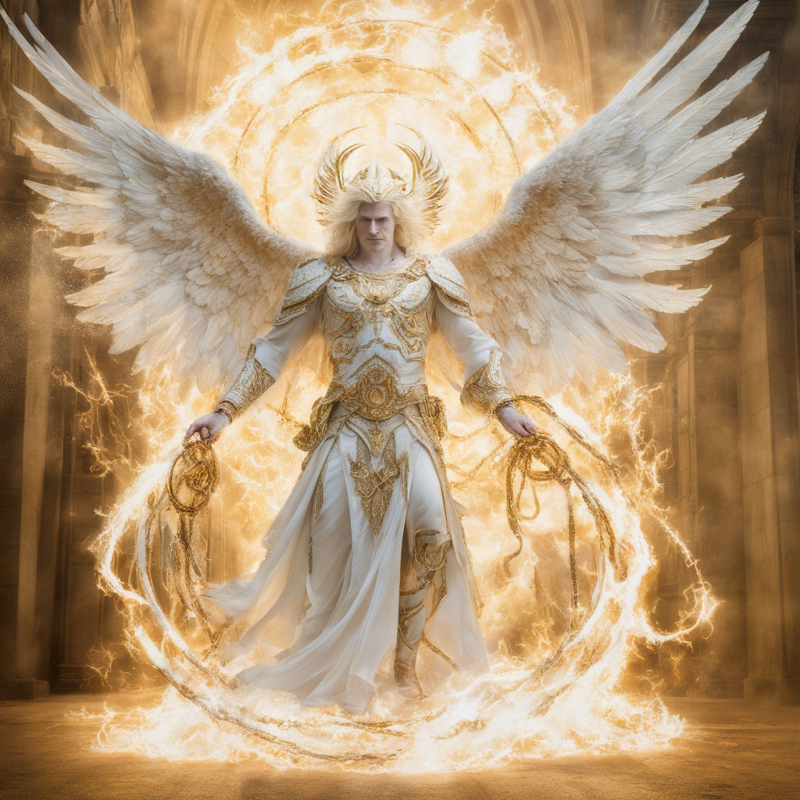
The Strategy of Satan Pt 4
Satan is described in many ways in scripture:
“an angel of light”
(2Cor 11:14)
“a roaring Lion”
(1 Pt 5:8)

Slide 2
Satan is described in scripture as:
“The tempter” (Mt 4:3);
“The wicked one” (Mt 13:19);
“The Thief” (Jn 10:10:
“Prince of this world” (Jn 12:31);
“the god of this world” (2 Cor 4:4);
“your adversary” (1Pt 5:8);
“the destroyer” (Rev. 9:11);
“the accuser” (Rev. 12:10); etc.

Slide 3
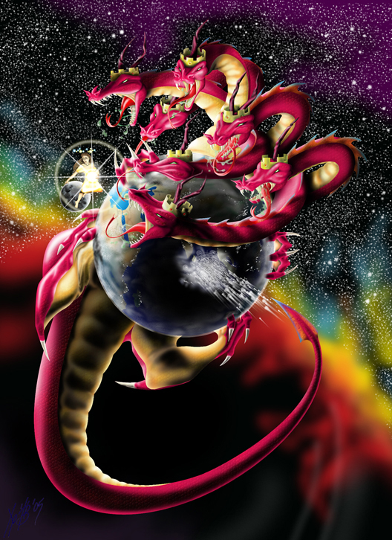
We first see him as a subtle (deceiving) serpent in Genesis 3
He’s last described as a strong (destroying)
7 headed Dragon! (Rev. 12, 14, 16, 20)
He must deceive us (2 Cor 4:4)
before he can devour/destroy us!
(1 Pt 5:8; 1 Jn 4:4; 5:4)

Slide 4
2 Cor 2:11 “Lest Satan should get an advantage of us:
for we are not ignorant of his devices.”
Some of Satan’s devices include:
1. Removing the “Strong man” as the
leader/protector of the family. Mark 3:27
2. Removing Marriage as the foundation of
Society. Heb. 13:4
3. Removing the Scriptures (God’s Word)
as the Standard of Society. Ro. 1:28

Slide 5
As individuals and societies
reject God and embrace Satan’s devices,
God begins remove His protection,
allowing the consequences of our choices
to manifest themselves in our lives and culture.
This is usually progressive,
allowing time for repentance and restoration.
(Pr 1:20-33; 2 Chr. 6,7)

Slide 6
During this time the “remnant” (God’s people) must decide whether they’ll remain faithful to represent God with “Grace and Truth”
(Jn 1:14; Phil. 2:14-16)
or compromise in order to “get along”.
If there’s no repentance,
there can be no renewal
but only inevitable reprobation.
(Ro 1:18-32)

Slide 7
Eventually that society crosses the line and God’s “hedge of protection” is completely removed
leaving them to suffer the consequences of Satan’s deceptions and devastation.
This will eventually manifest itself
on a world-wide scale!
(1 Thess. 5; Rev. 13-18; 2 Thes. 2)
7 “For the mystery of iniquity doth already work”

Slide 8
Since so much hinges on God’s people accurately representing him (2 Chr. 7:14)
It shouldn’t surprise us that one of Satan’s “devices” includes:
Removing the church (God’s People) as the Salt & light (Hope) of society.
Mt. 5:13-16

Slide 9
If he can remove “Christ”
(a Christlike commitment to God)
from “Christians”
(Christlike followers)
The result will be
Confusion!

Slide 10
Mt 5:13 “Ye are the salt of the earth:
but if the salt have lost his savour,
(Mōrai’nō: become insipid, passive)
From moros: dull, stupid (we get “moron” from this)
from Myster’ion: to shut the mouth
wherewith shall it be salted?
it is thenceforth good for nothing,
but to be cast out, and to be trodden under foot”

Slide 11
How does Salt lose its “savour”?
Salt can be rendered ineffective by:
Contamination
(Dilution from other things.)
or Containment
(Isolation from where it’s needed)

Slide 12
How does Salt lose its “savour”?
1. Contamination (diluted by other things.)
A. Contamination distracts us:
1) Jesus described this effect in Mark 4:19
as “sowing among thorns”, resulting in:
“the cares of this world, the deceitfulness of riches, and the lusts of other things entering in,
choke the word,
and it becometh unfruitful.”

Slide 13
Contamination (diluted by other things.)
2) 2 Tim. 2:1,3,4 warn that worldly weeds would
both distract and detain (entangle) us.
“Be strong in the grace that’s in Christ Jesus…
Endure hardness as a good soldier of Jesus…
No man that warreth entangleth himself
with the affairs of this life,
That he may please him who chose him
to be a soldier…” See also Vs 21-26

Slide 14
B. Contamination can “infect” us.
1 Jn 5:19 “we know that we are of God,
and the whole world lieth in wickedness.
(Poneros: diseased)
21 “Keep yourselves from idols!”
1 Cor 5:6,7 “Know ye not that a little leaven
(zym’ē : yeast, corruption)
Leaveneth the whole lump?“ (Also Gal. 5:9)

Slide 15
B. Contamination can “infect” us 1 Jn 5:19
1) God would have spared Sodom if Lot had been
able to influence only 9 others! (Gen. 18:32)
2) Instead of Lot impacting Sodom, he allowed
Sodom to “vex his righteous soul” 2 Pt. 2:8
With terrible consequences.
3) Jesus warned that history would repeat Lk 17:28
“as it was in the days of Lot…30 thus shall it
be in the day when the Son of man is revealed….
32 Remember Lot’s Wife!” (Gen 19:26)

Slide 16
C. Contamination can “conform” us.
Ro. 12:2 “And be not conformed to this world:”
(Syschēmatiz’ō: fashioned like)
Phil. 3:18,19 “For many walk,
…they are the enemies of the cross of Christ:
Whose end is destruction, whose God is their belly,
whose glory is in their shame,
who mind (phroneo: think, value, focus on) earthly things.”
Jms 4:4 “friendship of the world is enmity with God”

Slide 17
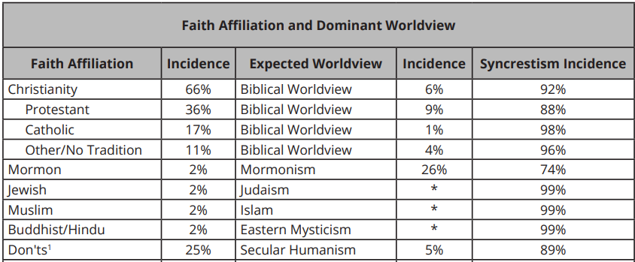
How effective has Satan been in contaminating God’s people?
“The amalgamation of different religions, cultures, or schools of thought”

Slide 18
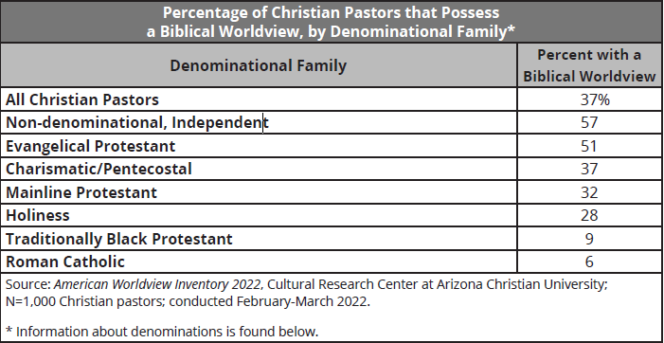
2Tim 4:2 “the time will come when they will not endure sound doctrine; but after their own lusts shall they heap to themselves teachers, having itching ears;
And they shall turn away their ears from the truth”

Slide 19
How effective has Satan been?
Only 37% of American “Christian” Pastors
and 6% of “Christians”
have a biblical world view! (Perspective)
God calls this being “spiritually minded”
1 Cor 2:15,16 “he that is spiritual judgeth all things…
(Men anakrinō: truly examines, distinguishes)
For who hath known the mind of the Lord…?
But we have the mind (nous) of Christ.”

Slide 20
The other “Pastors and Christians”
(63% And 92% Respectively)
have a syncretistic world view!
“The amalgamation of different religions, cultures, or schools of thought”
Aka: a corrupted operating system!

Slide 21
God calls this condition “Carnal” 1 Cor 3:1-3
“I, brethren, could not speak unto you as unto spiritual, but as unto carnal, (sarkikos: Fleshly)
even as unto babes in Christ.
I have fed you with milk, and not with meat:
for hitherto ye were not able to bear it, …
For ye are yet carnal: for whereas there is among you envying, and strife, and divisions,
are ye not carnal,
and walk as (unregenerate) men?”
(See Gal. 5:17-22; James 3:14-16)

Slide 22
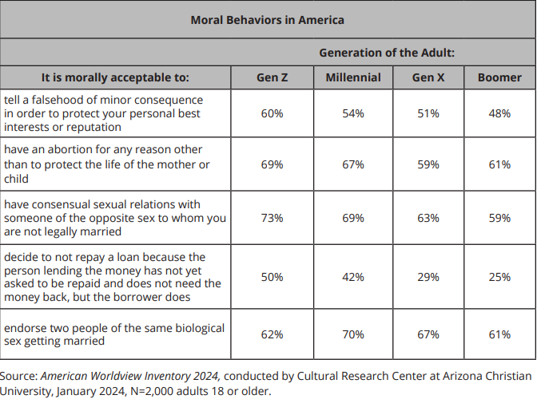
The impact: Moral behaviors in America
LIE Ex. 20:16
Kill Ex 20:13
Fornicate Ex 20:14
Steal Ex 20:15
Gay marriage

Slide 23
How does Salt recapture its “savour”?
The Solution to Contamination is:
Purification: Ro. 12:2
“Be not conformed to this world
But be ye transformed (metamorphoō: changed)
by the renewing (anakainōsis: renovation)
of your mind, (nous: understanding, feeling, will)
that ye may prove what is that good, and acceptable, and perfect will of God.”

Slide 24
1) Purification 1 Jn 1:5-9
“God is light, and in Him is no darkness at all.
If we say we have fellowship with Him and walk in darkness, we lie, and do not the truth.
But if we walk in the light…we have fellowship…
and the blood of Jesus cleanses us from all sin.
If we say we have no sin we deceive ourselves…
If we confess our sins, he is faithful and just
To forgive us our sins,
Also 1 Jn 2:28-3:3
and to cleanse us…”

Slide 25
The Solution to Contamination is:
2) Separation: Keep the contamination
out of the salt shaker!
2 Cor 6:14-16 “Be ye not unequally yoked together…
For what fellowship (metochē: participation)
hath righteousness with unrighteousness?
and what communion (koinonia: partnership)
hath light with darkness?
And what concord (symphōnēsis) hath Christ with Belial?
or what part hath he that believeth with an infidel?”

Slide 26
6:16 “And what agreement (sygkatath’esis: joint deposit)
hath the temple of God with idols?
for ye are the temple of the living God; as God hath said, I will dwell in them, and walk in them;
and I will be their God, and they shall be my people.
17 Wherefore come out from among them, and be ye separate, saith the Lord, and touch not the unclean thing; and I will receive you,
18 And will be a Father unto you, and ye shall be my sons and daughters, saith the Lord Almighty.”

Slide 27
How does Salt recapture its “savour”?
Purification 2) Separation:
3) Dedication: 1 Pt 2:9 “ye are a chosen generation,
a royal priesthood, an holy nation, a peculiar people;
that ye should shew forth the praises of him
who hath called you out of darkness
into his marvellous light:…
11 beloved, I beseech you as strangers and pilgrims,
abstain from fleshly lusts,
which war against the soul;”

Slide 28
Has any syncretism settled in your soul and infected you? Ps. 139:23,24
Examination: “Search me, O God, and know
my heart: try me, and know my thoughts:
(See also Ps. 19:14; Heb. 4:12,13)
Purification: “see if there be any wicked
(ʿōṣ’eḇ: idol) way (derek: manner) in me,
Dedication: & lead me in the way everlasting.”

Slide 29
I once read about an American Missionary who was heading to Cambodia many decades ago.
He was sharing a seat of the train with another man who asked what he was doing there.
When the Missionary told him, the man began to laugh and said frankly that he’d never succeed.
When the missionary asked him why he thought that, the man replied:

Slide 30
“I represent the communist party and am going to Cambodia to organize the people to revolt.
I’m perfectly willing to suffer and die for this cause.
You Americans are famous for your self interests and your comforts and conveniences.
Since suffering and sacrifice is contrary to self interest,
you will never this war!”

Slide 31
Are you part of the problem, or God’s Solution?
“If My people which are called by my name
shall humble themselves and pray,
and seek my face,
and turn from their wicked ways;
Then will I hear from heaven,
forgive their sin,
And heal their land!” 2 Chr 7:14

Slide 32
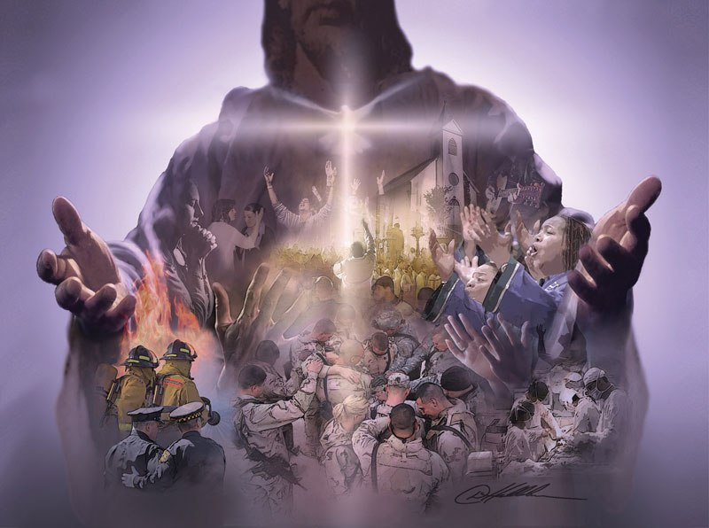
“To reach out with your hands,
See the world through your eyes,
To love with the love of the savior!
To feel with your heart,
And to think with your mind! (1 Cor 2:16)
I’ll give my last breath
for your glory!”
“The power of Christ in me”
Casting Crowns

