Slide 1
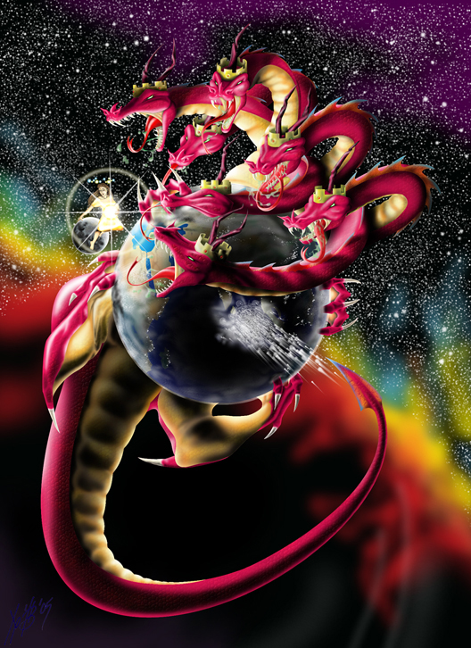
The Strategy of Satan
“The Devices of the Devil”
“Woe to the inhabiters
of the earth!
For the devil is come down unto you,
having great wrath,
because he knows that he hath but a short time.”
Revelation 12:12

Slide 2
Jesus referred to him as:
“The Prince (archon) of this world”
Jn 12:31; 14:30; 16:11
2Cor. 4:4 “the god of this world blinds our minds” (typhloō no’ēma: obscures our perception)
He seeks to “blind” (Deceive) us
in order to“bind” (Destroy) us.
(Mk 3:27; Jn 10:10)

Slide 3
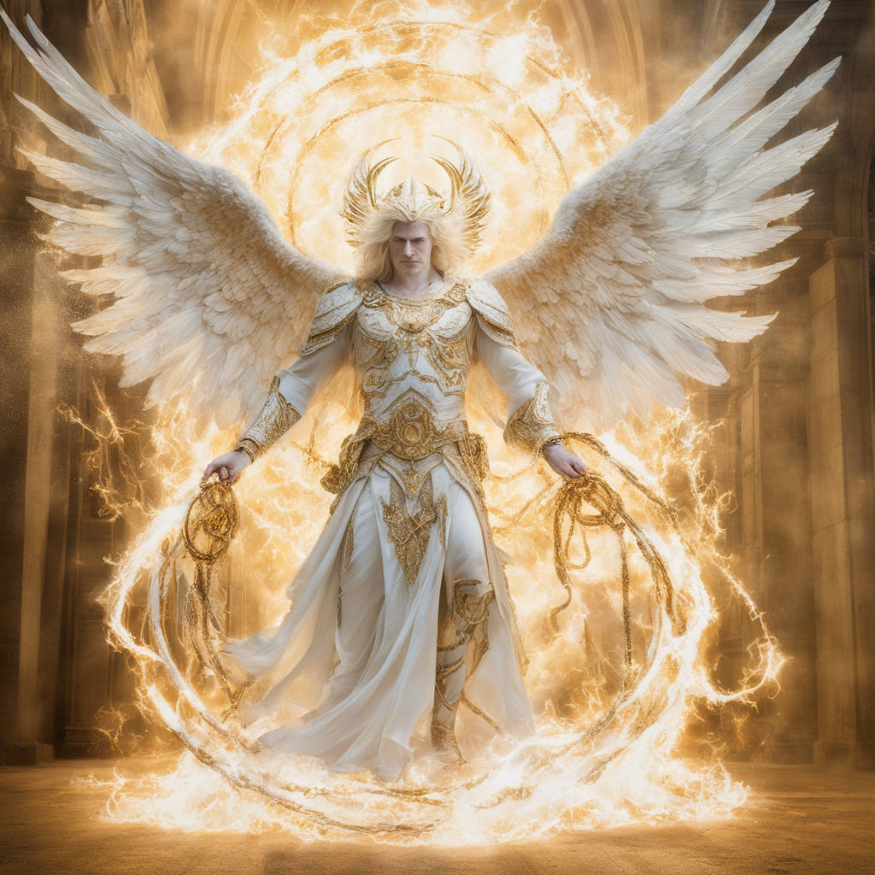
His first and last description validates this.
He’s first introduced to us as “The Deceiver”
or “the father of lies” John 8:44
But inevitably his true nature is revealed as:
The subtil serpent
Genesis 3
“an angel of light”
(2Cor 11:14)

Slide 4
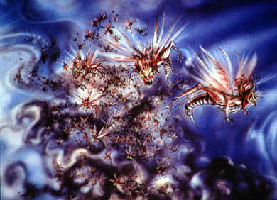
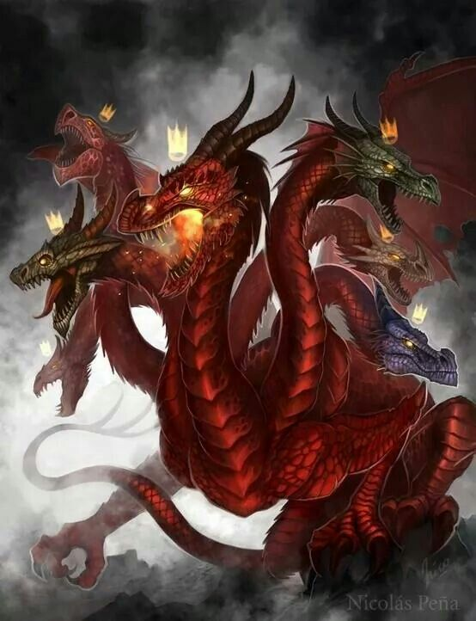
The Destroyer 1 Pt 5:8; Jn 10:10
Rev. 9
11 “they had a king over them, …whose name …(is) Apollyon.”
Destroyer

Slide 5
The Strategy of Satan
2Cor 2:11 “Lest Satan should get an advantage of us: for we are not ignorant of his devices.” (noema: mind)
This Strategy involves:
Removing the “Strong man” as the leader/protector of the family. Mark 3:27
Removing Marriage as the foundation of Society. Heb. 13:4

Slide 6
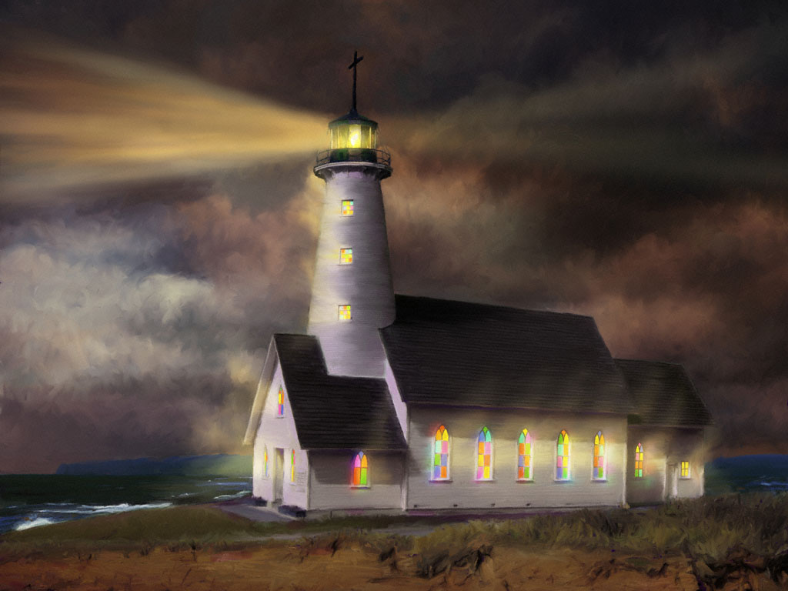
Removing the Scriptures (God’s Word)
as the Standard of Society. Ro. 1:28
Removing the church (God’s People)
as the Salt
(Preservation)
Mt 5:13-16
and Light
(Clarification)
of society.

Slide 7
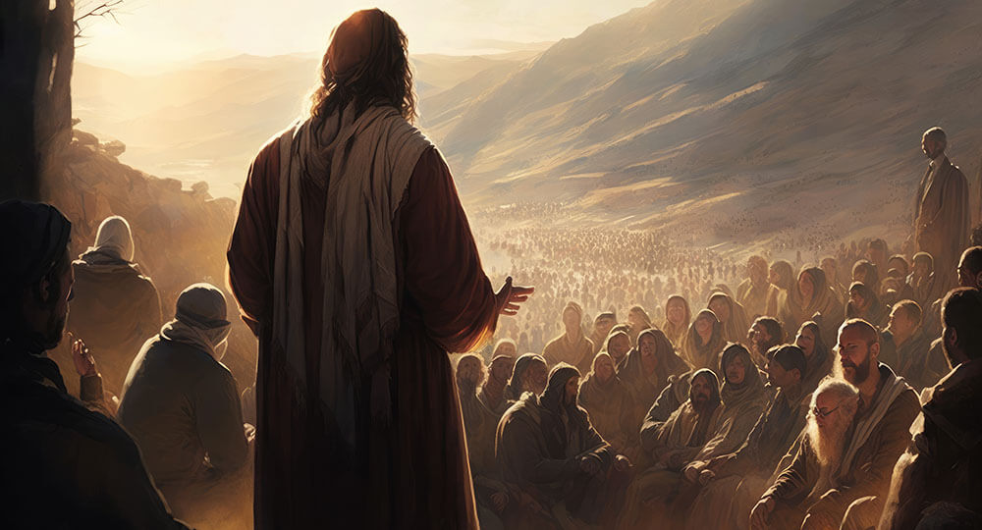
Mt. 5:13
“Ye are the salt
of the earth!
but if the salt have lost his savour,
wherewith shall it be salted?
It is henceforth good for nothing”

Slide 8
Last week we learned that Contamination with worldly things/thinking tends to:
Distract us. Mk 4:19; 2 Tim. 2:4
Infect us. 1 Jn 5:19,21; 1 Cor 5:6,7; 2 Pt 2:8
Conform us (to the world’s thinking/values.)
Ro. 12:2; Phil. 3:18,19; James 4:4; 1 Jn 2:15

Slide 9
Mt. 5:14
“Ye are the light of the world.
A city that is set on an hill cannot be hid.

Slide 10
Salt and Light can also be rendered effectively
“good for nothing” by Contamination
as well as by Isolation! Vs 14
Neither do men light a candle, and put it under a bushel,
but on a candlestick;
and it giveth light unto all that are in the house.
Let your light so shine before men,
that they may see your good works,
and glorify your Father in heaven.”

Slide 11
The Reality Mt 5:14
“Ye are the light of the world.”
A. Who? “Ye”
vs 1 “His disciples (mathētēs: learner, follower)
came to him 2 …and he taught them”
John 10:11 “I am the good shepherd…
27 My sheep hear my voice,
and I know them,
Who was (is) this?
and they follow me”

Slide 12
“Ye are the light of the world.”
B. When? “Ye are”
1) Not someday, but now! Jn 9:4,5
“I must work the works of him that sent me,
while it is day:
the night cometh, when no man can work.
As long as I am in the world,
I am the light of the world.”
(este: present tense verb)

Slide 13
C. What? “The light of the world”
(Phōs: to shine, reveal, manifest)
1) Darkness and light are metaphors
a) Darkness represents Satan and his deceit.
God sent Paul to the Jews (Acts 26:18)
“To open their eyes,
and to turn them from darkness to light,
and from the power of Satan unto God…”
(See also Lk 22:53; 2 Cor 4:4)

Slide 14
C. What? “The light of the world”
1) Darkness and light are metaphors
a) Darkness➔ Satan/deceit.
b) Light represents God and Truth. (alēth’eia)
Eph 5:8 “For ye were sometimes darkness,
but now are ye light in the Lord:
walk as children of light:…
And have no fellowship with the unfruitful
works of darkness,
but rather reprove them.”

Slide 15
C. What? “The light of the world”
1) Darkness and light are metaphors
b) Light is associated with truth. Col 1:12-13
“Giving thanks unto the Father,
which hath made us meet to be partakers
of the inheritance of the saints in light:
Who hath delivered us from the power of darkness,
and translated us into the kingdom of his Son”

Slide 16
The Reality
A. Who? “Ye”
B. When? “Ye are”
C. What? “the light”
D. Where?
Mk 16:15 “Go ye into all the world
and preach the gospel to every creature”
“of the world”

Slide 17
The Reality Mt 5:14
“Ye are the light of the world.”
2. The Reason:
“A city that is set on an hill cannot be hid.
Neither do men light a candle, and put it under a bushel,
but on a candlestick;
and it gives light unto all that are in the house”
To Reveal vs 15,16

Slide 18
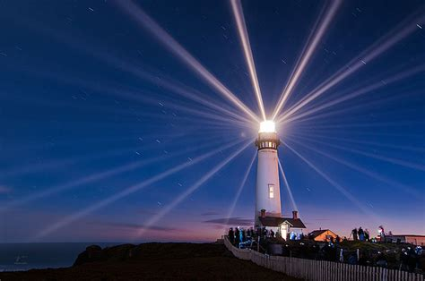
2. The Reason: To Reveal
Mt 5:16 “Let your light (phos: to manifest)
so shine (lampō: radiate) before men,
that they may see your good (kalos: virtuous) works,
and glorify your Father
which is in heaven.”

Slide 19
A. Jesus came to reveal:
1) Who God is. (Heb. 1:1-3; Jn 1:5-14; Jn 9:4,5
⁴ ”I must work the works of him that sent me, while it is day:
the night comes,
when no man can work.
⁵ As long as I am in the world,
I am the light of the world.”

Slide 20
A. Jesus came to reveal:
2) How we can come to know Him. Jn 14:6,7
“I am the way, the truth, and the life:
no man cometh unto the Father, but by me.
If ye had known me,
ye should have known my Father also.”
Jn 17:3 “this is life eternal,
that they might know thee the only true God,
and Jesus Christ, whom thou hast sent.”

Slide 21
A. Jesus came to reveal:
1) Who God is. (Heb 1:1-3; 1 Jn 1:5)
2) How we can come to know Him. Jn 14:6,7
3) How we can partner/fellowship with God.
Mt 11:29 “Take my yoke upon you and learn of me”
1 Cor 3:9 “We are laborers together with God”
Jn 15:5 “I am the vine, ye are the branches…”
1 Jn 1:7 “If we walk in the light, as he is in the light,
we have fellowship one with another…”

Slide 22
2. The Reason for light is to reveal.
B. This is what we’re to do!
By our Words and Works, we reveal who Jesus is and what he’s done for us.
Lk 24:48 “Ye are witnesses of these things.”
Jn 8:12 “I am the light of the world
he that followeth (akoloutheō: joins) me
shall not walk in darkness, (1 Jn 1:5-10)
but shall have the light of life.”

Slide 23
1) God calls this our “Reasonable Service”.
Ro. 12:1 “Present your bodies a living sacrifice, holy, acceptable unto God, which is your reasonable service”
(Logikos latreia: logical act of worship)
2 Cor 5:14-15 “the love of Christ constraineth us
because we thus judge,
that if one died for all, then were all dead.
And that he died for all, that they which live
should not henceforth live unto themselves,
but unto him which died for them, and rose again.”

Slide 24
By our Words and Works, reveal who Jesus is
and what he’s done for us.
1) God calls this our “Reasonable Service”.
2) This enables God’s Spirit to shine through us. Gal 2:20 “I am crucified with Christ: nevertheless I
live; yet not I,
and the life which I now live in the flesh
I live by the faith of the Son of God,
who loved me, and gave himself for me.”
but Christ liveth in me:

Slide 25
3. The Resistance John 3:19-21
“this is the condemnation,
that light is come into the world,
and men loved darkness rather than light,
because their deeds were evil. (1 Jn 5:19)
20 For every one that doeth evil hateth the light, neither cometh to the light, lest his deeds should be reproved.
21 But he that doeth truth cometh to the light,
that his deeds may be made manifest,
that they are wrought in God.”

Slide 26
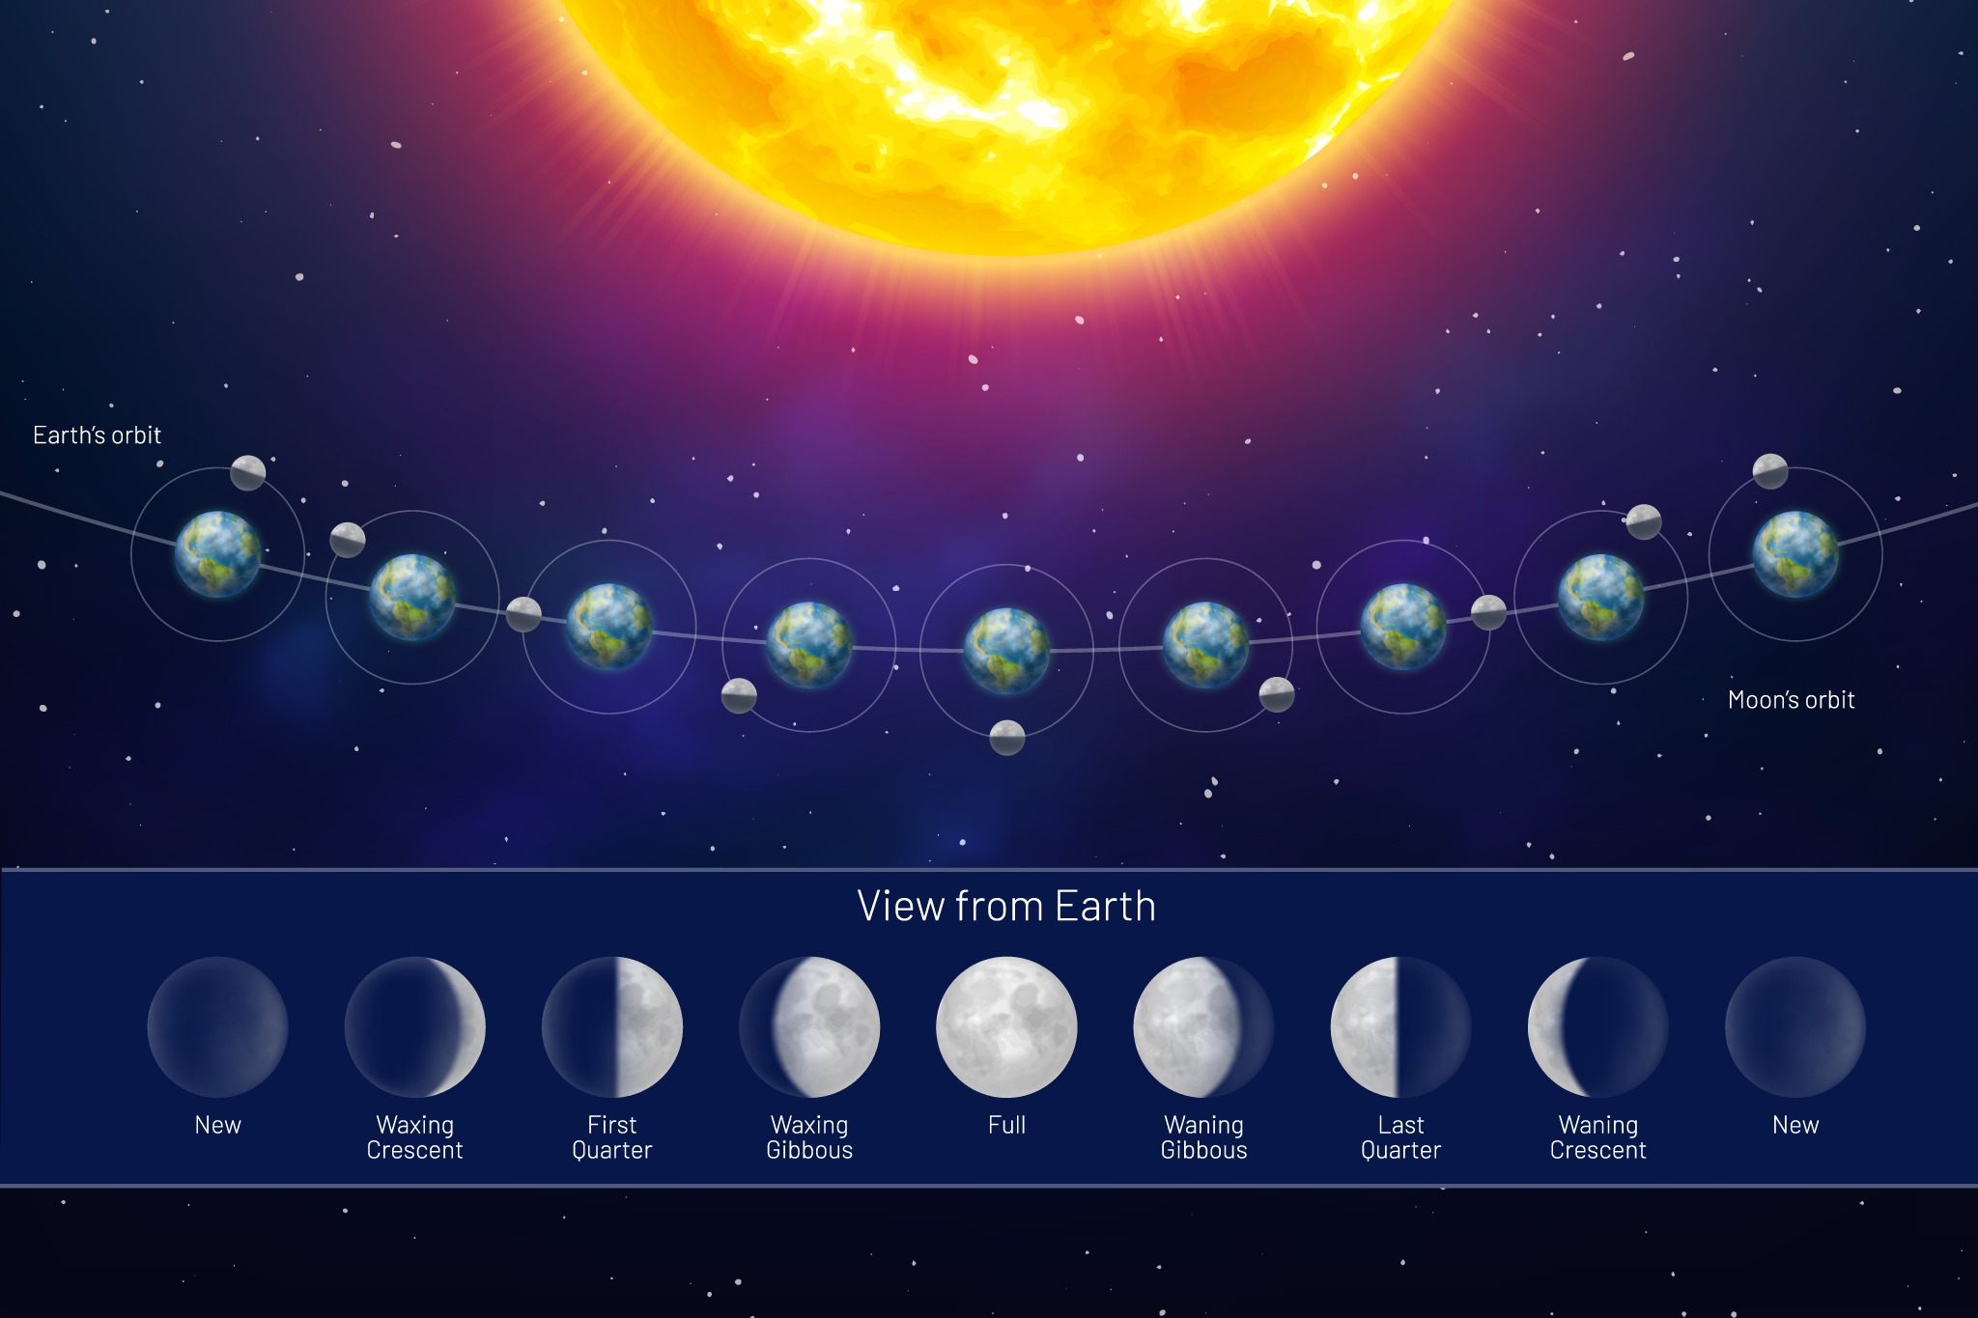
God calls us to Reflect His light
How much of this world is blocking the “Son”
from reflecting in your life? Phil. 3:19

Slide 27
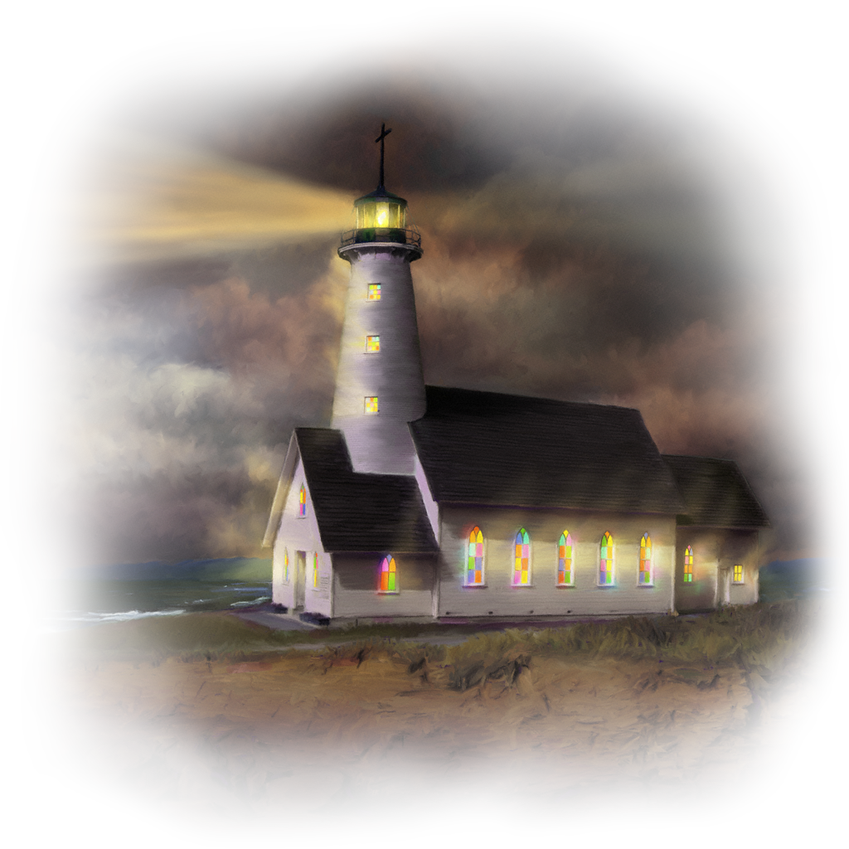
God calls us to Radiate His light.
Phil. 2:12 “Work out your own salvation…
13 For it is God which worketh in you
both to will and to do of his good pleasure.
14 Do all things without murmurings and disputings:

Slide 28
God calls us to radiate His light.
Phil. 2:15,16 “That ye may be blameless and harmless, the sons of God, without rebuke,
in the midst of a crooked and perverse nation,
among whom ye shine as lights in the world;

Slide 29
“Holding forth the word of life!”
(Epech’ō: paying attention, holding on to)
Ps 119:105 “Thy word is a lamp unto my feet… a light to my path.
Ps 119:130 “The entrance of thy words giveth light….”
Ps 119:11 “Thy word have I hid in mine heart,
that I might not sin against thee.”
What priority does God’s word have in your life?

