Slide 1
Pictures of the People of God
Seeing ourselves through God’s Eyes.

Slide 2
The world is full of Distractions (Mk 4:19) and Deceptions (2 Cor. 4:4)
The real danger in these is that they keep us from seeing God, others,
and even ourselves, clearly.

Slide 3
1 Jn 5:19-20 “we know that we are of God,
and the whole world lieth in wickedness.
And we know that the
Son of God is come,
and hath given us an understanding,
that we may know him that is true,
and we are in him that is true…”

Slide 4
It’s when we’re able to focus on Truth that we’re Transformed. (2 Cor 3:18; Rev. 3:18,19)
John 8:32 “Ye shall know the truth,
(ginosko: recognize, understand)
and the truth
shall make you free!”
(From Satan’s & societies’ delusions)

Slide 5
God’s Word provides many glimpses of the truth about how God sees us.
1) We’re a “Buried Treasure”. Mt 13:44
2) We’re a “Goodly Pearl” Mt. 13:45,46
3) We’re clay being molded into God’s
Masterpiece. Is. 64:8 Eph. 2:10; 1 Pt 2:9
4) We’re “Engaged” as a Bride to Jesus Christ.
Mt. 25:1-13; 2 Cor. 11:2; Eph. 5:22-33; Rev. 19:7

Slide 6
How is the Church like a Bride?
Our relationship develops through stages!
1. Dating: A time to gather Information. Mt 11:29
2. Engagement: A time of Preparation
and Anticipation 1 Jn 2:28-3:3
This is the current stage of our relationship!
2 Cor 11:2 “I have espoused you to one husband,
that I may present you as a chaste virgin to Christ.”

Slide 7
3. The Wedding: A time for Celebration!
Revelation 19:1-9
A. When will this “Wedding” occur?
1) The Groom’s Father sets the date.
Mt 24:3; 36; 44 “What shall be the sign of thy coming…
36 But of that day and hour knoweth no man, …
but my Father only….
44 Therefore be ye also ready: for in such an hour
as ye think not
the Son of man cometh.”

Slide 8
2) He sends out “invitations” Mt 22:2-5
“The kingdom of heaven is like unto a certain king, which made a marriage for his son,
And sent forth his servants to call them that were bidden to the wedding: and they would not come.
I have prepared my dinner: …all things are ready: come unto the marriage.
But they made light of it, and went their ways,
one to his farm, another to his merchandise: ”
(See also Luke 14:16-24)

Slide 9
A. When will this “Wedding” occur?
1) The Groom’s Father sets the date.
2) He sends out invitations.
Mt 24:3; “What shall be the sign of thy coming…
14 this gospel of the kingdom shall be preached in
all the world for a witness unto all nations;
and then shall the end come.”
Rev. 19:1,7 “After these things…
the marriage of the lamb is come…”

Slide 10
A. When will this “Wedding” occur?
1) The Father sets the date. 2) Sends out invitations
B. How will the Wedding occur?
1) He sends His Son to claim his bride.
Jn 14:2,3 “In my Father’s house are many
mansions…I go to prepare a place for you.
If I go to prepare a place for you,
I will come again and receive you unto myself,
that where I am, there ye may be also!”

Slide 11
B. How will the Wedding occur?
1) He sends His Son to claim his bride. Mt. 25:1-13
1“The Kingdom of heaven is like 10 virgins…
that went forth to meet the bridegroom…
5 While the bridegroom tarried,
they all slumbered…
6 And at midnight there was a cry made,
Behold, the bridegroom cometh;
go ye out to meet him.”

Slide 12
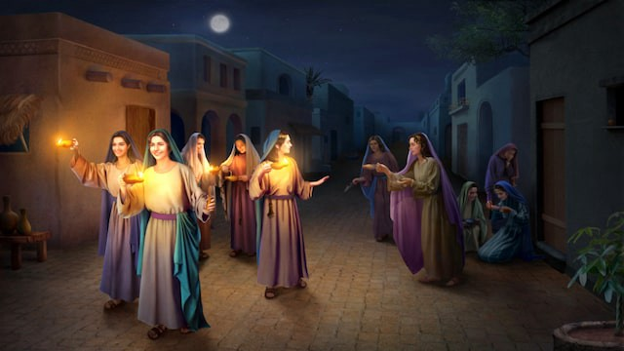
Mt. 25:13 “Watch therefore, for ye know neither the day nor the hour wherein the Son of man cometh.
All had an invitation,
but only some made adequate preparation!

Slide 13
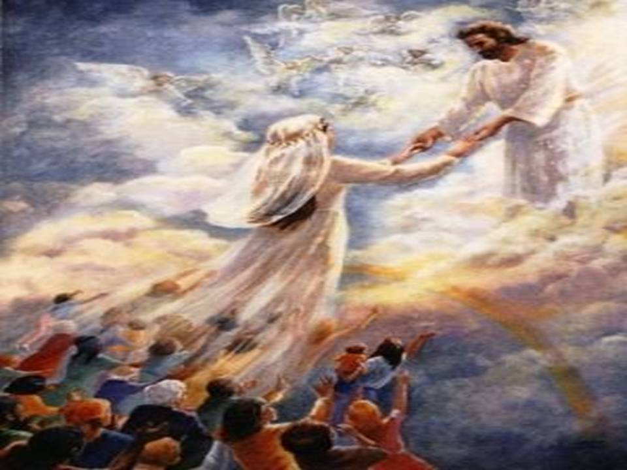
a) This is commonly known as the Rapture. 1Thes 4:16-17 “the Lord himself shall descend from heaven with a shout, with the voice of the archangel, and with the trump of God: and the dead in Christ shall rise first:
Then we which are alive and remain shall be caught up (Harpazo:
(from haire’omai: to take to/for oneself)
together with them in the clouds,
to meet the Lord in the air:

Slide 14
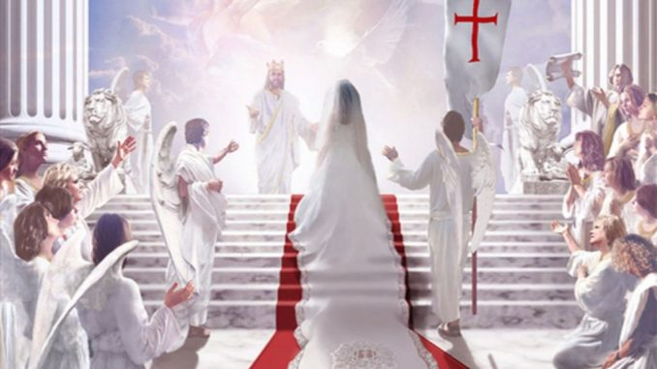
17 “so shall we ever be with the Lord.”
Rapture: “feeling of intense pleasure or joy”

Slide 15
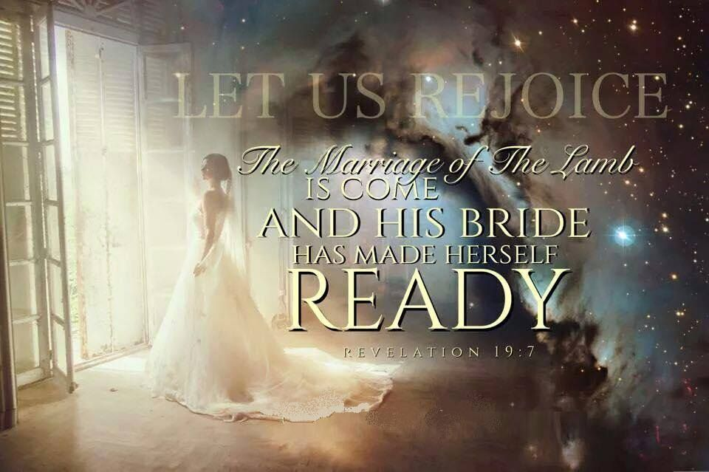
The Wedding begins the Marriage!

Slide 16
4. Marriage! Is a time for:
A. Intimacy. 1 Jn 3:2 “We shall be like him,
for we shall see him as he is!”
1) The degree of our intimacy (now and then)
is related to the degree of our faithfulness.
Jn 14:21 “He that hath my commandments,
and keepeth them, he it is that loveth me:
and he that loveth me shall be loved of my Father,
and I will love him,
and will manifest myself to him.”
See also Mt 25:21; Luke 16:10-13; 1 Cor 13:12

Slide 17
4. Marriage! Is a time for:
A. Intimacy. 1 Jn 3:2
B. Extasy (Enjoyment)! Ps. 16:11 “In thy
presence is fulness (soba’: satisfaction)
of joy; (śimḥâ: pleasure)
at thy right hand are pleasures (nāʿîm: delights)
for evermore.” (nēṣ’aḥ: splender continuously;
“the bright object at a distance travelled towards!”

Slide 18
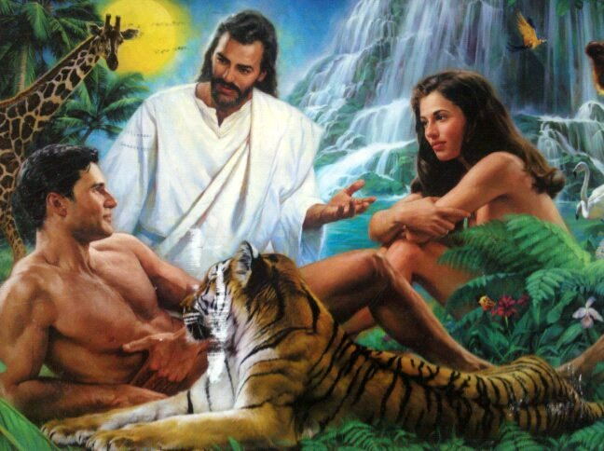
Enjoyment!
1) God intended this! Gen. 2:8 “God planted a
garden in Eden; and there he put the man whom he
had formed”
Eden (ʿēden) means:
pleasure 2x;
delights 1x,
delicates 1x

Slide 19
Enjoyment! Gen. 2:8 “God planted a garden in Eden; and there he put the man whom he had formed”.
1) Eden (ʿēden) pleasure 2x; delights 1x, delicates 1x
2) The first time the word “Pleasure” is found in the
Bible is in the context of marriage intimacy!
After God told Abraham Sarah would conceive (vs 10)
Gen 18:12 “Sarah laughed within herself, saying,
After I am waxed old shall I have pleasure, (eden)
my lord being old also?

Slide 20
Enjoyment! Gen. 2:8 “God planted a garden in Eden”.
3) Solomon’s love story takes place in a garden!
a) Song of Solomon is a journal of the development of their romance, cumulating in their marriage!
S.S 4:12; “A garden enclosed
is my spouse…
16 Let my beloved come into
his garden,
and eat his pleasant fruits.”
Meged: precious, pleasant, valuable

Slide 21
4) Marriage! Is a time for:
A. Intimacy. 1 Jn 3:2 B. Enjoyment! Ps. 16:11
C. Discovery! 1 Cor. 2:9,10
“Eye hath not seen, nor ear heard,
neither have entered into the heart of man,
the things which God hath prepared
for them that love him.
But God’s revealed them unto us by His Spirit”

Slide 22
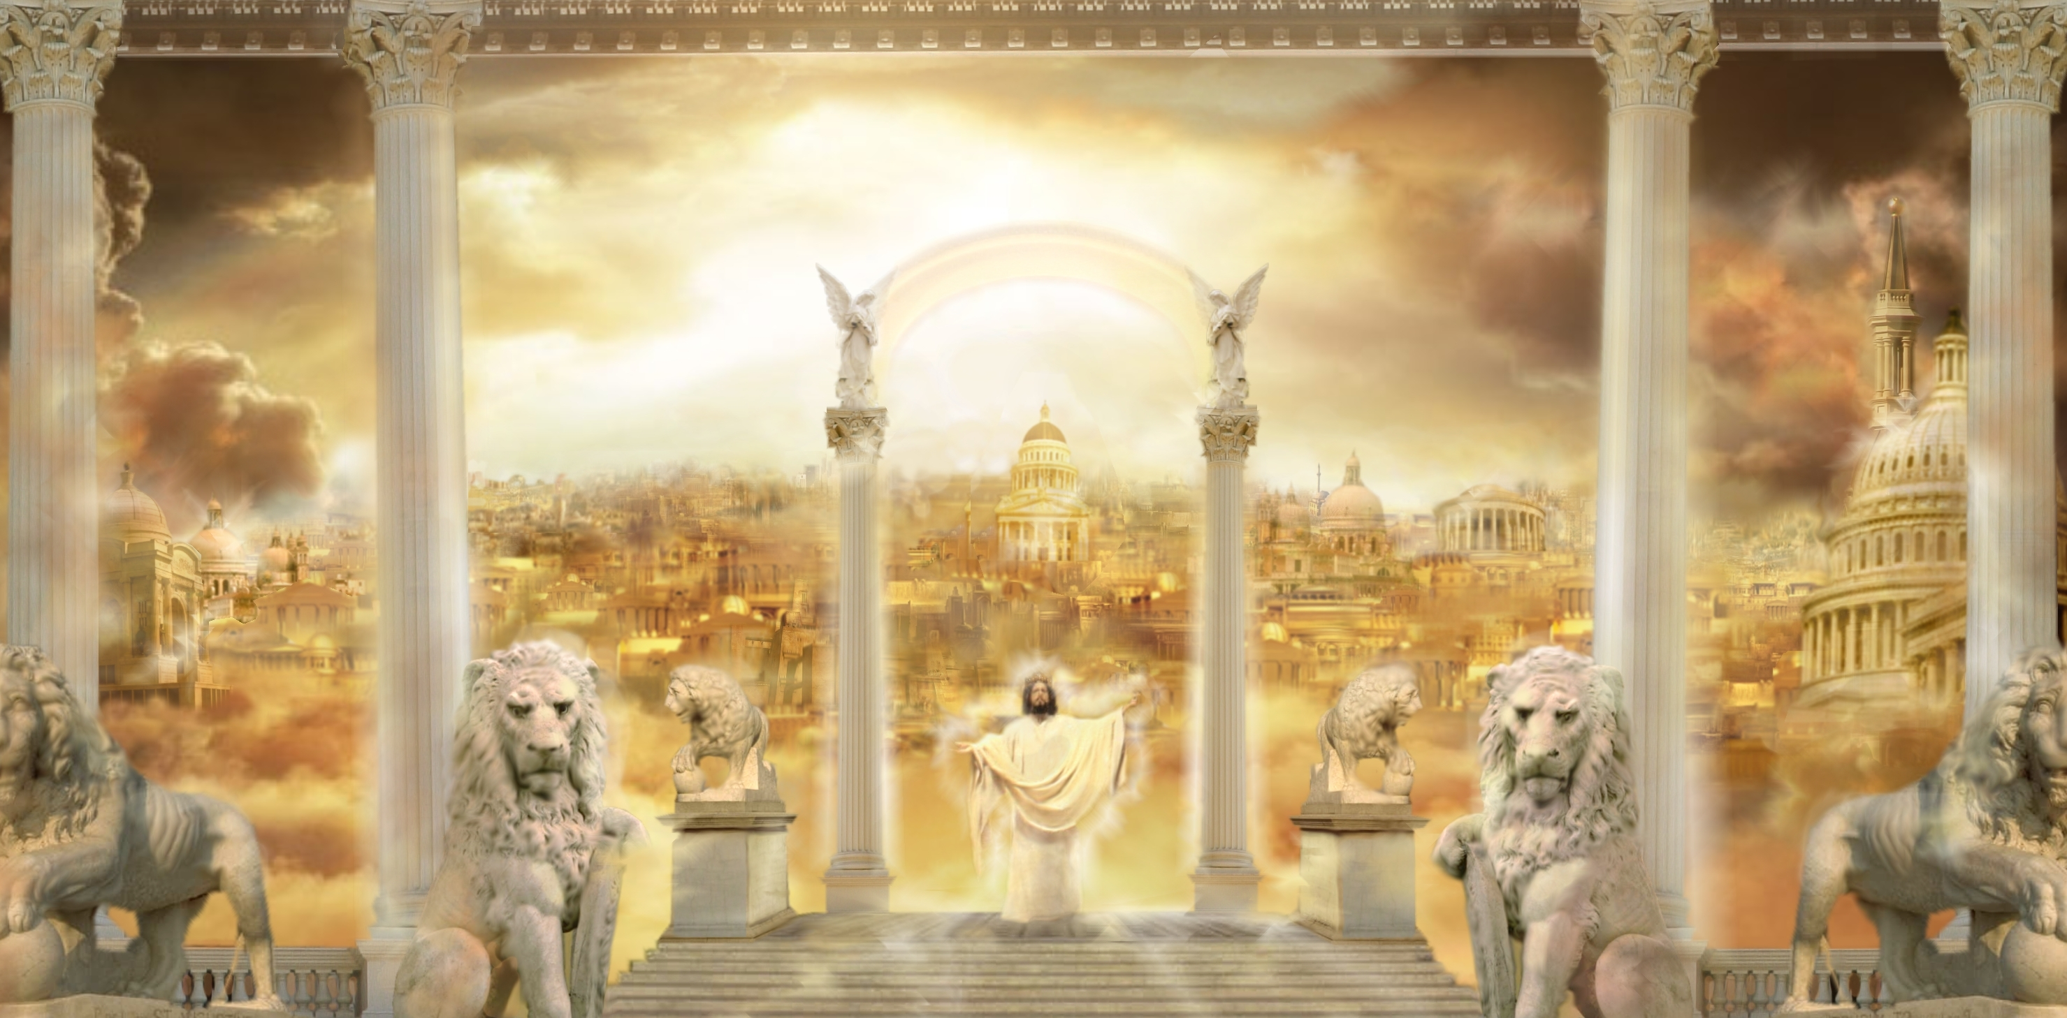
C. Discovery! 1) Eden will be restored in Heaven.
“I will shew thee the bride, the Lamb's wife.”
Rev. 21:9-22:6

Slide 23
4) Marriage! Is a time for:
D. Discovery! 1 Jn 3:1-3
“Behold, what manner of love the Father hath bestowed upon us, that we should be called the sons of God:…
Beloved, now are we the sons of God,
and it doth not yet appear what we shall be: but we know that, when he shall appear, we shall be like him;
for we shall see him as he is.
every man that hath this hope in him purifieth himself, even as he is pure.”
(engaged)

Slide 24
4. Marriage! Is a time for:
D. Committed company 1 Thes. 5:17,18 “The Lord himself will descend …with a shout…
so shall we ever be with the Lord.
Wherefore comfort one another with these words.”
Parakaleo: to call near, invite, desire
From para: beside and kaleho: to call or invite.
Heb. 13:5 “I will never leave thee or forsake thee!”

Slide 25
4. Marriage! Is a time for:
D. Committed company Rev 19:7-9
“The marriage of the lamb is come and His wife hath made herself ready, and to her was granted that she should be arrayed in fine linen, clean and white:
for the fine linen is the righteousness of saints.
And he saith …Write, Blessed (Makarios) are they which are called unto the marriage supper of the Lamb.
…These are the true sayings of God.”

Slide 26
God’s Final Invitation: Revelation 22:17
“The Spirit and the bride say, Come.
And let him that heareth say, Come.
And let him that is athirst come.
And whosoever will, let him take the water of life”
Eventually there’ll be no more time to respond!
Are you Preparing for that wedding day?
Are you inviting others?

Slide 27
Some Day will be your Last day!
2 Cor 6:1-2 “We then, as workers together with him, beseech you also that ye receive not
the grace of God in vain.
For he saith, I have heard thee in a time accepted, and in the day of salvation have I succoured (helped, enabled) thee:
behold, now is the accepted time;
behold, now is the day of salvation.”

Slide 28
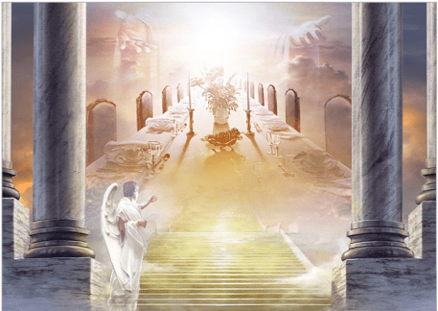
You are invited to dine with me,
Throughout all of eternity.
Believe in the Father, Son, Holy Ghost
To Dine with Jesus as your Host.
To live with Him Eternally,
All you must do is RSVP!
Have you Responded to God’s Proposal?

