Slide 1
“Understanding what the will of the Lord is.”
Eph. 5:17
Pr 3:5,6; Heb. 11:6; 1 Jn 5:4

Slide 2
More

Slide 3
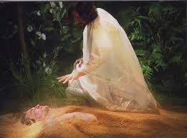
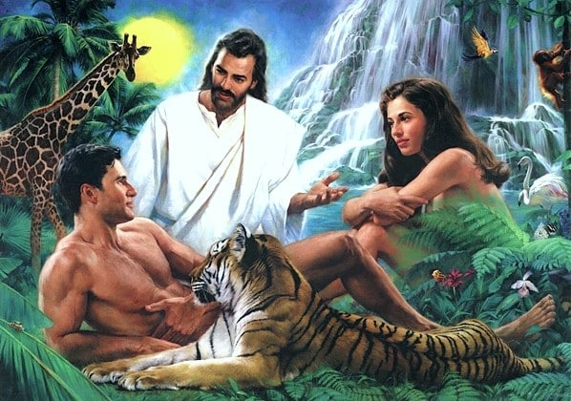
Existence: Why are we here?
We were created to Have a Consummate relationship with God. Gen. 2:Jer 31:3; 1 Jn 4:7-10
Gen. 1:26 “Let us make man in our image, after
our likeness:
and let them have dominion”
Rāḏâ:
Prevail

Slide 4
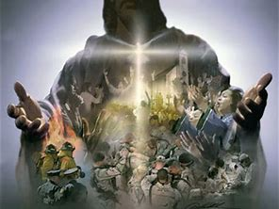
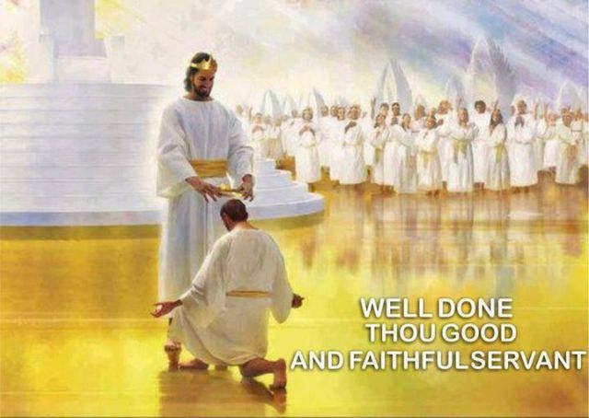
Significance: Do I really matter?
You weren’t created for just survival,
Or even temporary success;
but for eternal Significance!
Jn 10:10;
Ro. 8:37;
Eph. 1-2:10
1 Tim. 4:8

Slide 5
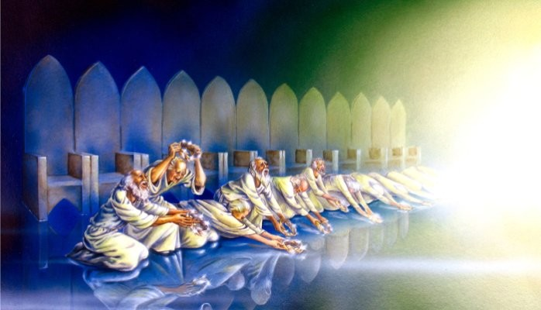
Intention: What’s the Point/purpose?
“Thou art worthy, O Lord, to receive glory and honor and power: for thou hast created all things,
and for thy pleasure (thelēma: Purpose)
they are and were created.”
Revelation 4:11
Mt 11:29; 1 Cor 3:9; 4:1;
2 Cor 5:20

Slide 6
Expectation:
What does God want from me?
Pr 23:26 “My son, give me thine heart,
(lēḇ: mind, will, emotions; aka: “The Center”)
God’s not asking to be a part of our life,
But to be Preeminent. Col. 1:17,18
Proteuo: first in rank and influence

Slide 7
Pr 23:26 “My son, give me thine heart,
How do we know if He really is Preeminent?
and let thine eyes observe (nāṣar: value, guard)
my ways.” (dereḵ: path or course of life)
Jn 14:21 “He that hath my commandments, and
keepeth (tēreō: value, guard) them,
and he that loveth me shall be loved of my Father,
and I will love him,
(See also Lk 6:46; Jn 14:15; 1 Jn 5:3)
he it is that loveth me:
and will manifest myself to him.”

Slide 8
Pr 23:26
“let thine eyes observe my ways.”
Congressional Prayer Chapel
“THIS NATION UNDER GOD”
Ps. 16:1 “Preserve me O God
for in thee do I put my trust….
11 Thou wilt show me the path of life…”
What will it cost us to follow it? Jn 10:27

Slide 9
Last week we closed with Luke 9:57-62
“Lord I will follow thee …; but let me first…”
Modern Christianity focuses on believing the
right things.
The word “Believer” is only found 2 X in the Bible!
While education is important, biblical Christianity focuses on Application of truth
leading to Transformation!
(Jn 13:17; Ro. 8:29; 12:2; 2 Cor 3:18; James 1:22)
aka: The correct “education”

Slide 10
Lk 9:61 “Lord I will follow thee …; but let me first…”
While “Believer(s)” is found 2x (Acts 5:15; 1 Tim 4:12)
"Disciple(s)" (Mathētēs: a learner, pupil)
is found 273 times. (1x OT, 272x NT)
From manthano: to learn by use and practice!
{to be in the habit of, accustomed to}
It’s Clear that God’s expectation is not just that we “believe” in him, but that our belief (faith)
will motivate us to follow Him! Ph. 2:13

Slide 11
“Me first” believers are always looking for a “deal” or shortcut.
Imagine Adam asking God
what the “ideal wife”
will cost him.
“An arm and a leg!”
To which Adam replies:
“What can I get for a rib?”

Slide 12
Transitioning from a “Me first” believer to a “God First” disciple involves a cost.
What will God’s “Ideal life” cost me?
Jesus addresses this Price (and process involved in paying it) in Luke 14
Vs 28 “For which of you,
…sits not down first,
and counts the cost…”

Slide 13
This first part (price) in this process involves a
Realization of our actual position/ condition
Leading to a genuine Repentance.
The 1st context of Jesus’ public ministry. Mt 4:
16 “The people which sat in darkness saw great light; and to them which sat in the region and shadow of death light is sprung up. (2 Cor 4:4-6)
17 From that time Jesus began to preach, and to say, Repent: (metanoeō: Change your mind, Reconsider)
for the kingdom of heaven is at hand.”

Slide 14
In Luke 14 Jesus challenges the religious pharisees to “reconsider” their lives.
1. At the Pharisee Dinner party Lk 14:1-24
A. A Subtle Trap Vs 1,2 “he went into the house of one of the chief Pharisees to eat on the sabbath day,
that they watched him.
2 And, behold, there was a certain man before him
which had the dropsy.” (edema from kidney, heart, liver problems)
1) Who invited this sick man
and why?

Slide 15
1. At the Dinner Party
B. Jesus’ Pointed question (Vs 3) “is it lawful to heal
on the sabbath?” vs 4 “and they held their peace.”
1) Who’s “Law” outlawed this? (See Mt 15:6; Mk 7:13)
C. His gracious intervention. Vs 4 “And he took him,
and healed him,
1) Who had “bound” him? (Lk 14:5 & Lk 13:15,16)
“hypocrite, doth not each one of you on the sabbath loose his ox or his ass from the stall, and lead him away to watering?
And ought not this woman …whom Satan hath bound, 18 years be loosed from this bond on the sabbath day?”
and let him go” (apolyō: set at liberty)

Slide 16
2. Parables about Pride and Prejudice. Vs 7-14
A. Positioning for Power 7 “And he put forth a parable
to those which were bidden, (the other guests)
when he marked how they chose out the chief rooms; …”
B. Practical advice: 8-10 “But when thou art bidden of
any to a wedding, sit not down in the highest room;
lest a more honourable man than thou be bidden of him;
But …, go and sit down in the lowest room;
that when he that bade thee cometh,
he may say unto thee, Friend, go up higher..:”

Slide 17
2. Parables about Pride and Prejudice. Vs 7-14
A. Positioning for Power 7 “he marked how they chose..”
B. Practical advice: 8-10 “sit not down in the highest room;
C. Principled Counsel vs 11
“For whosoever exalteth himself shall be abased;
and he that humbleth himself shall be exalted….”
James 4:6-10 “But he giveth more grace.
Wherefore he saith, God resisteth the proud,
but gives grace unto the humble….
10 Humble yourselves in the sight of the Lord,
and he shall lift you up.”

Slide 18
2. Parables of Pride and Prejudice. Vs 7-14
Positioning for Power; Practical advice; Principled Counsel
D. Practical Application 12-14 “But when thou makest a feast, call not thy friends, ..brethren..., nor thy rich neighbours; lest they also bid thee again, and a recompence be made thee.
13 But… call the poor, the maimed, the lame, the blind:
14 And thou shalt be blessed; for they cannot recompense thee:
for thou shalt be recompensed at the resurrection of the just.
15 And when one of them that sat at meat with him heard
these things, he said unto him,
Blessed is he that shall eat bread in the kingdom of God.”

Slide 19
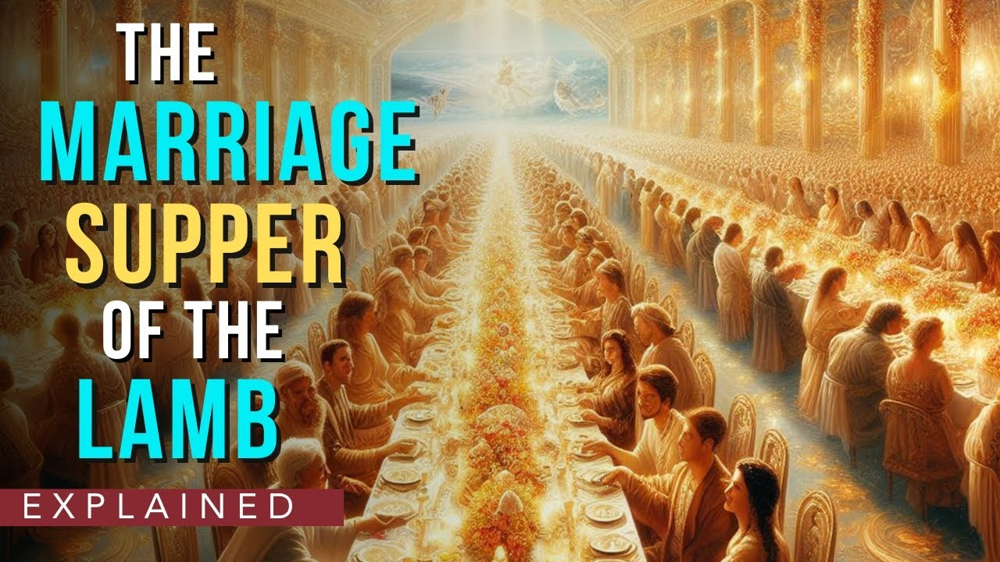
15 “Blessed is he that shall eat in the Kingdom of God”
Prompted Jesus to share the:
3. Parable of the Great Supper Invitation 16-24
This is a parallel of the Great wedding feast of
Mt 22:1-14
and ultimately
Rev. 19:1-10

Slide 20
1. Parable of the Great Supper Invitation 16-24
A. Notice the types of people involved:
1) The Master (Host)
2) The Servant (Messengers)
3) The original Invited guests.
4) The eventual invited guests.
God
God’s people {Us!}
“Religious” Israel
Lost sinners
Which of these categories best describe you?

Slide 21
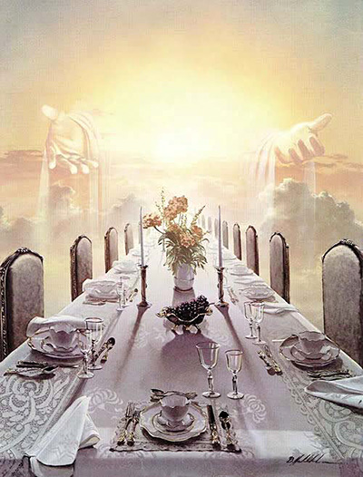
3. Parable of the Great Supper Invitation 16-24
B. Notice the Invitation:
Lk 14:17,18 The Master
“sent his servant at supper time to say to them that were bidden, Come; for all things are now ready.”
Hetoi’mos: adjusted, prepared
1) Who paid the price for
all this “preparation”?

Slide 22
C. Notice the types of excuses given 18-20
“they all with one consent began to make excuse.”
1) Wealth. 18 “I’ve bought a piece of ground,
I must go see it…”
2) Work: 19 “I’ve bought five yoke of oxen,
and I go to prove them…”
3) Wife/Family: 20 “I have married a wife,
and therefore I cannot come.”
Each was basically saying “You’re not a priority!”
“But Lord…me first” Lk 9:57-62

Slide 23
5) Notice the Master’s response (21-24).
“Then the master of the house being angry said to his servant, Go out quickly into the streets and lanes of the city, and bring in hither the poor, the maimed, the halt, and the blind.
And the servant said, Lord, it is done as thou hast commanded, and yet there is room.
And the lord said unto the servant, Go out into the highways and hedges, and compel (persuade) them to come in,
that my house may be filled. (Jn 3:16; 2 Pt 3:9)
For I say unto you, That none of those men which were bidden shall taste of my supper.”

Slide 24
Conclusion:
Just as Nathan shared a “parable” to get David to reconsider and repent of his sin (2 Sam 21:1-14);
Jesus used a familiar dinner setting to challenge the self righteous “Me first” pharisees to recognize where they were in their relationship to God (Not just his Law)
The vast majority of the religious pharisees failed to recognize themselves (and Jesus) in these parables.
Since they were trusting their “Religious Education”,
they continued to reject God’s “Gracious invitation!”

Slide 25
This wasn’t Jesus’ first attempt to reach them!
John 5:39,40 “Search the scriptures;
for in them ye think ye have eternal life:
and they are they which testify of me.
And ye will not come to me, (er’chomai: trust, join me)
that ye might have life.” (Jn 10:10; 14:6)
Jn 9:39-41 “For judgment I am come into this world, that they which see not might see; and that they which (think they) see might be made blind.
are we blind also?...but now ye say, We see;
therefore your sin (blindness) remaineth.”

Slide 26
God included this in His Word so we’ll ask the same questions about Jesus and ourselves! (1 Cor 10:11)
1) Have you really recognized who Jesus is
and what he’s done to “make all things ready”
for your Salvation
2) Which of these characters best represent you?
Prideful pharisees jockeying for praise & position? 7
The Obedient Inviters (The “Lord’s” servants) 17
The Evasive Excusers (rejecting God’s invitation.) 18-20
The “broken but blessed” responders? (21-23)
and Significance? Jn 10:10

Slide 27
Lk 9:57-62 “Lord I will follow thee …; but let me first…”
Are you a “but let me first…” believer?
In Luke 14 when Jesus spoke about God’s invitation:
“and they all …began to make excuse” vs 18
Wealth “I have bought a piece of ground…”
Work: “I have bought five yoke of oxen”
Wife: “I have married…”
What’s your excuse for being a Casual Christian?
Mt 4:17 “Repent for the Kingdom of God is at hand.”
Which King (Whose Kingdom) are we actually serving?

Slide 28
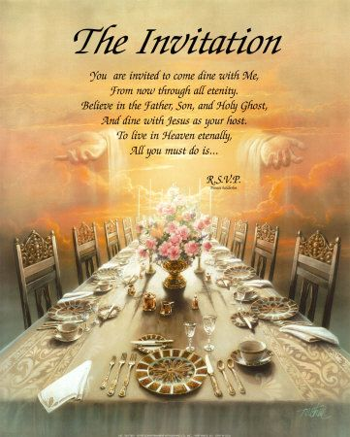
God’s Invitation still stands Today: Rev. 22:17
“The Spirit and the bride say, Come.
Let him that heareth say, Come.
And let him that is athirst come.
And whosoever will,
let him take the water of life freely.”
RSVP
But someday it will end!
Gen. 6:3 “My Spirit will not always strive with man”
See also Pr 1:10-33

Slide 29
2 Cor 6:2 “Behold,
now is the accepted time.
Now is the day of salvation.”
Heb. 3:7 “Wherefore
(as the Holy Ghost saith)
today, If you will hear His voice,
8 Harden not your heart”
RSVP

