Slide 1
“Be not unwise (aka: foolish) but Understanding what the will of the Lord is.” Eph. 5:17
Pr 3:5,6; Heb. 11:6; 1 Jn 5:4

Slide 2
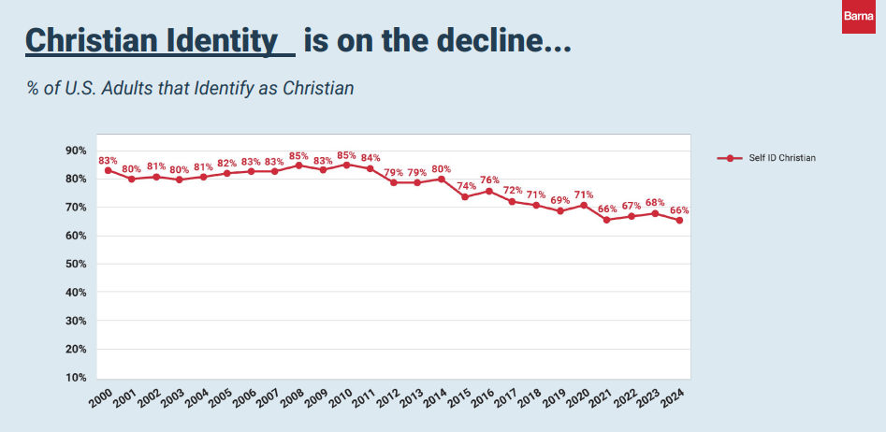
83% in 2000
66%
self ID as Christians

Slide 3
65%
62%

Slide 4
42%
32%

Slide 5
“Christians” 53%
Others
40%

Slide 6
The Cost of Following Christ Luke 14
You can’t really follow Jesus
and stay where (and how) you are!

Slide 7
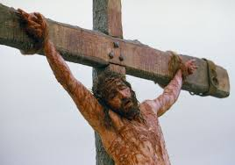
Jesus paid the price for our pardon!
Eph. 2:8 “For by grace (charis: God’s influence)
are ye saved (sōzō: rescued)
through faith; (pistis: conviction of {trust in} truth)
and that not of yourselves:
it is the gift (doron: offering) of God:”
{from what?}
His Cost was the (his) Cross!
John 19:30 “It is finished”
teleo: accomplished, completed,
the debt is discharged (paid in full)

Slide 8
Since the price (penalty) for sin is eternal death (Ro 6:23a) Jesus’ death on our behalf satisfied the righteousness of God. (2 Cor 5:21; Jn 1:29)
God can justly offer us the gift of forgiveness.
(Ro. 6:23b; John 3:16-18)
Ro 5:8 “God commendeth his love toward us, in that, while we were yet sinners, Christ died for us.
9 Much more then, being now justified
(Dikaioō: rendered innocent!) by his blood,
we shall be saved from wrath through him.”

Slide 9
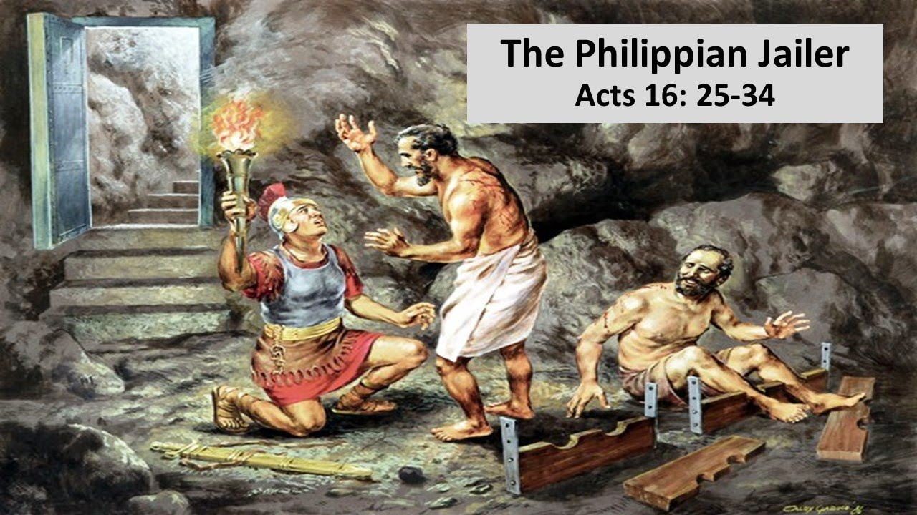
Eph 2:8 “By grace are ye saved through faith…
9 Not of works, (ergon: our effort)
lest any man should boast.” (Titus 3:5)
Acts 16:30 “What must I do to be saved?
31 …Believe on (pisteuō: credit, trust) the Lord Jesus Christ,
and thou shalt be saved”

Slide 10
“What must I do to be saved?
Reconsider Your Condition Luke 19:10 (REPENT)
“The son of man is come to seek and to save that
which was lost!”
Recognize God’s Provision. Ro 10:9a
“if thou shalt confess with thy mouth the Lord Jesus…”
Receive by faith (trust) God’s Gracious gift. Ro 10:9b
“and believe in thine heart that God raised him from the dead,
thou shalt be saved.
10 For with the heart man believeth unto righteousness…”
(apollymi: ruined, destroyed) Eph 2:1
Jn 1:12-14; 3:3; 3:16; Ro 6:23; 2 Cor 5:21

Slide 11
While Jesus paid the cost (Calvary’s cross) to enable us
to become forgiven
He often spoke of the cost we’ll have to pay in order to transition from a “me first” believer (Lk 9:57-62)
to a “Christ first “Disciple. (Lk 9:23).
“If any man will come after me, let him
(See also Mt 16:24; Mk 8:34; Lk 9:23; 14:27; etc.)
(aka: “born again” believers),
deny himself,
and take up his cross daily,
and follow me.”
12 of the 28 NT references to the “Cross” refer to our cross!

Slide 12
The Cost of our Calling. (Our “Cross“)
1. Recognize/Reconsider our Position.
Mt 4:17 “Repent (metanoeō: rethink, reconsider) for the Kingdom (basilei’a: authority) of God is at hand.”
Every Kingdom has a King, Laws, and Citizens!
(Ph 3:17-20) “for our conversation is in heaven”
19 “Follow me, and I will make you fishers of men.
²⁰ And they straightway left their nets,
and followed him.” (also vs 21,22)

Slide 13
Recognize/Reconsider Our position
Mt 16:15 ‘‘Whom say ye that I am?“
Peter‘s Confession: Mt 16:15 ‘‘Thou art the Christ, the son of the living God.“
Jesus‘ Revelation:
1) About Peter Vs 17 ‘‘Blessed art thou Simon...
for flesh and blood hath not revealed it unto thee,
But my Father which is in heaven
18 Thou art Peter..“ (petros: a stone, piece of the rock)

Slide 14
Jesus‘ Revelation:
2) About the church vs 18 ‘‘on this Rock (petra:
who Jesus really is) I will build my church
and the gates of hell shall not prevail“
3) About himself vs 21-23 ‘‘From that time forth began Jesus to shew unto his disciples,
how that he must go unto Jerusalem, and suffer many things of the elders and chief priests,
and be killed, and be raised again the third day.”

Slide 15
Jesus‘ Revelation:
4) About Satan (and Peter) 22 “Then Peter took
him, and began to rebuke him, saying,
Be it far from thee, Lord: this shall not be unto thee.
23 he (Jesus) turned, and said unto Peter,
Get thee behind me, Satan:
thou art an offence unto me: for thou savourest
(phroneo: regard, see one’s interest or advantage)
not the things that be of God,
Aka: You’re a “Me first” follower!
but those that be of men.”

Slide 16
The Cost of our Cross requires that we:
1. Reconsider our Position
2. Realign our Priorities
A.The Requirement: (Cost) Mt 16:24
“Then Jesus said unto his disciples:
If any man will come after me, let him
deny himself, (aparne’omai: disown 1 Cor 6:19)
and take up his cross, (stauros: fig. self denial)
and follow (Akolouthe’ō: to join) me.” (Mt 11:28-30)

Slide 17
B. The Rationalization. Mt 16:25
“For whosoever will save his life (psyche: soul)
shall lose it: (apollymi: waste, destroy) See Mt 7:13
whosoever will lose his life for my sake shall find it.”
(heuris’kō: perceive, recognize, discover)
26 For what is a man profited, if he gain the whole world,
and lose (zēmioō: sustain damage) his own soul?
(“suffer loss” in 1 Cor 3:14)
or what shall a man give in exchange for his soul?

Slide 18
The Rationalization
1) We’ll eventually have to give account. 2 Cor 5:10
“we must all appear before the judgment seat of Christ; that every one may receive (komizo: take care of)
the things done in his body, according to that he hath done,
whether it be good (agathos: beneficial)
or bad. (kakos: worthless)
11 Knowing therefore the terror of the Lord, (Ps 111:10)
we persuade men.”
(See also Eccl. 12:13,14; Gal. 6:6,7)

Slide 19
2) It’s our Reasonable response. 2 Cor 5:14
“For the love of Christ constrains (synecho: arrests) us;
because we thus judge, that if one died for all,
then were all dead:
15 And that he died for all, that they which live
should not henceforth live unto themselves,
but unto him which died for them, and rose again.”
Ro. 12:1 “Present your bodies a living sacrifice…,
Which is your reasonable service”
(Be “me first” believers)

Slide 20
2 Cor 5:17 “if any man be in Christ, he is a new creature:
old things are passed away;
(parer’chomai: perishing through neglect)
behold, all things are become new.
(gin’omai: becoming, regenerating)
18 And all things are of God,
who hath reconciled us to himself by Jesus Christ,
and hath given to us the ministry (diakonia: service/job) of reconciliation” (Katallagē’: adjustment, restoration)
{from katalasso: to change mutually}

Slide 21
2. Realign our Priorities
The Requirement. Mt 16:24 “…and follow me.”
B. The Rationalization. vs 25 “shall find it (his life)”
C. The Reward. Vs 27 “For the Son of man shall come
in the glory of his Father with his angels;
then he shall reward every man according to his works.”
Mt 6:20 “lay up for yourselves treasures in heaven…”
1 Cor 3:14 “If any man's work abide which he hath built thereupon, he shall receive a reward.”
See Mt 25:14-30; Rev. 22:12

Slide 22
whosoever will lose his life for my sake shall find it.”
“God, I pray thee, light these idle sticks of my life, and may I burn for thee!
Consume my life, my God,
for it is thine!
I seek not a long life, but a full one,
like you, Lord Jesus”
1927-1956
“He is no fool who gives what he cannot keep,
in order to gain what he cannot lose!”

Slide 23
What does He expect from us in exchange for his Sacrifice? (His Cross)
Recognize and Respond to his sacrifice.
(Repent and Receive) Eph. 2:8-9
Reprioritize our lives (Our Cross) Eph. 2:10 “For we are His workmanship (poiema: creation)
created in Christ Jesus unto good works,
which God hath before ordained that we should
walk in them.”
Believe differently.
Behave differently!

Slide 24
Believe and Behave differently!
This is your calling! Eph. 4:1
“I …beseech you brethren…, that ye walk
(peripateō: deport yourselves, be occupied with)
Worthy (axios: consistently, appropriately)
of the vocation (klēsis: calling, destiny)
wherewith ye are called…” (kaleō: invited)
What are you doing with Jesus’ invitation?

Slide 25
This is my calling!
Eph. 4:11-13 “And he… gave pastors and teachers;
For the perfecting (katartismos’: equipping)
of the saints, (hagios: consecrated, sacred)
for the work of the ministry,
for the edifying of the body of Christ:
Till we all come in the unity of the faith,
and of the knowledge of the Son of God,
unto a perfect man..” (telios: mature, complete)

Slide 26
Jesus calls us to a radical realignment of our position and priorities!
He illustrated this with “counting the cost” of building and battling (Luke 14:28-32)
And then clarified his meaning in vs 33:
“So likewise, whosoever he be of you that forsaketh not all that he hath,
(Apotassō: to arrange in proper order)
he cannot be my disciple.”

Slide 27
Colossians reiterates this expectation. Col. 1:18,19 “And he (Jesus) is the head of the body, the church:
who is the beginning, the firstborn from the dead;
that in all things he might have the preeminence.
(Proteuo: First in Rank, Place, and Influence)
For it pleased the Father that in him should all fulness (plē’rōma: fulfilment) dwell;…
25 Whereof I am made a minister, according to the dispensation of God, to fulfil the word of God;
26 Even the mystery which now is made manifest…

Slide 28
27 To whom God would make known what is the riches of the glory of this mystery
…which is Christ in you, the hope of glory:
28 Whom we preach, warning every man,
and teaching every man in all wisdom;
that we may present every man perfect (teleios: complete, mature) in Christ Jesus:
29 Whereunto I also labor, striving according to his working, which worketh in me mightily.”

Slide 29
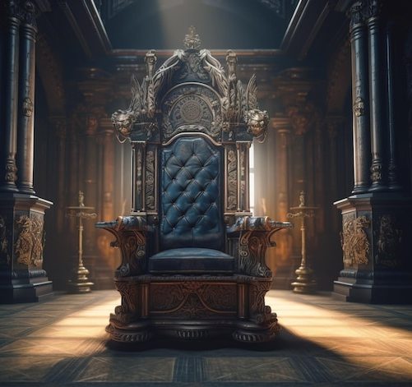
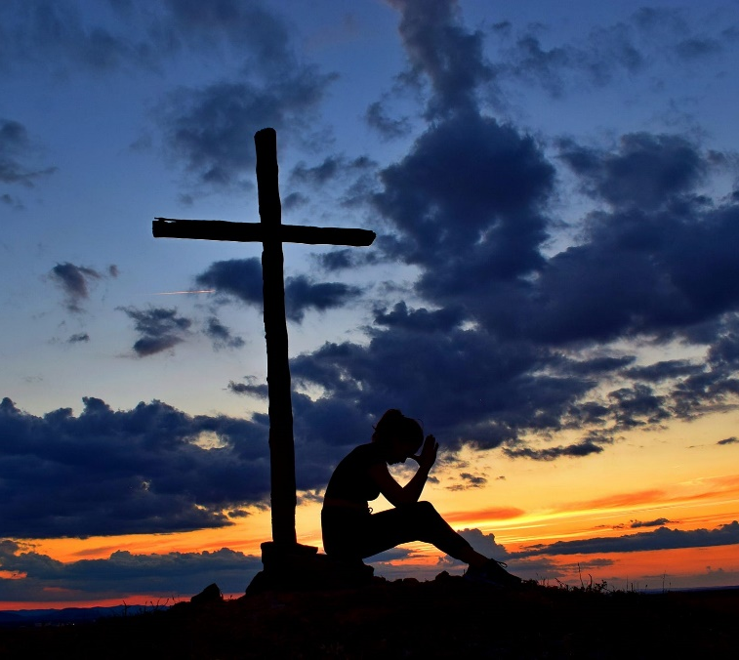
“In every Christian’s heart there is a cross and a throne, and he’s on the throne
until he puts himself on the cross.
If he refuses the cross,
he remains on the throne.

Slide 30
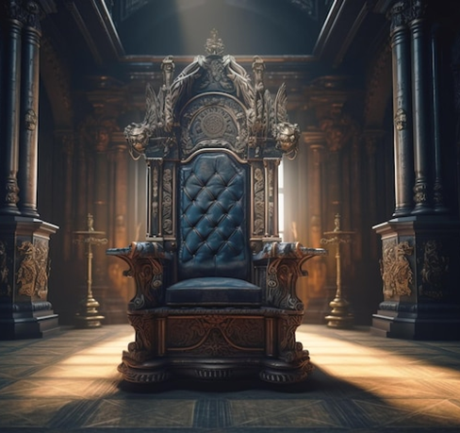
Perhaps this is at the bottom of the backsliding and worldliness among believers today.
We want to be saved,
but we insist Christ do all the dying.
No cross for us, no dethronement,
no dying.
(self denial)

Slide 31
We remain king within the little kingdom of Mansoul, and wear our tinsel crown
with all the pride of a Caesar,
but we doom ourselves to shadows & weakness
and spiritual sterility.”
AW Tozer “The Radical Cross: Living the Passion of Christ”

Slide 32
Mt 16:24 “Then Jesus said unto his disciples:
If any man will come after me, let him
deny himself, (aparne’omai: disown 1 Cor 6:19)
and take up his cross, (stauros: self denial)
and follow (Akolouthe’ō: to join) me.”
Who’s really on the “Throne” of your life?
Who’s on the cross?

