Slide 1
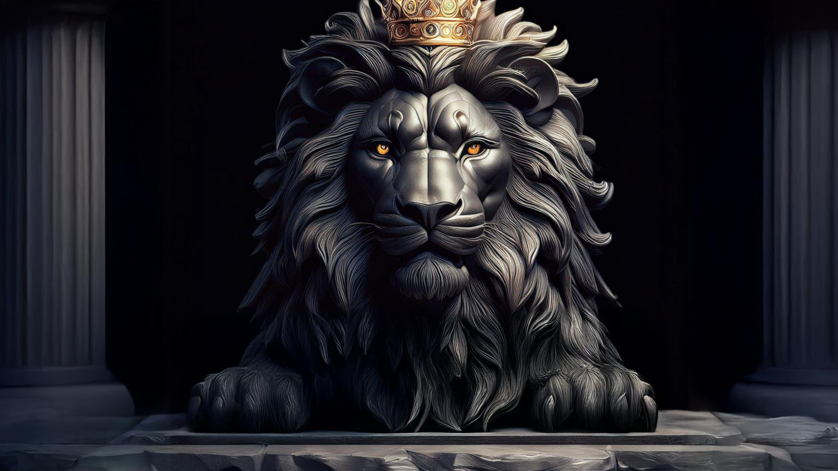
ὅτι ἡ πίστις χωρὶς τῶν ἔργων ἀργή ἐστιν
By Joseph Peters

Slide 2
Martin Luther
“Many sweat to reconcile St. Paul and St. James, as does Melanchthon in his Apology, but in vain. ‘Faith justifies’ and ‘faith does not justify’ contradict each other flatly. If any one can harmonize them I will give him my doctor’s hood and let him call me a fool. Let us banish this epistle from the university, for it is worthless.”
Martin Luther, The Life and Letters of Martin Luther, ed. Preserved Smith (Cambridge: The Riverside Press, 1911), 269.

Slide 3
Paul VS James
What doth it profit, my brethren, though a man say he hath faith, and have not works? can faith save him?... Even so faith, if it hath not works, is dead, being alone (James 2:14, 17).
For by grace are ye saved through faith; and that not of yourselves: it is the gift of God: Not of works, lest any man should boast (Eph 2:8–9).

Slide 4
Paul VS James
For we are his workmanship, created in Christ Jesus unto good works, which God hath before ordained that we should walk in them (Eph 2:10).

Slide 5
Paul VS James
Faith
Works

Slide 6
Paul VS James
Grace
Works
Faith

Slide 7
Paul and James on Justification
Paul
Faith VS works of the law (credit)
James
Works VS words (demonstration)

Slide 8
Being a Doer of the Word
But be ye doers of the word, and not hearers only, deceiving your own selves…
If any man among you seem to be religious, and bridleth not his tongue, but deceiveth his own heart, this man’s religion is vain. Pure religion and undefiled before God and the Father is this, To visit the fatherless and widows in their affliction, and to keep himself unspotted from the world (Jas 1:22, 26–27).

Slide 9
Objective
Every Christian should live out their faith with their actions
For these three reasons

Slide 10
Rationale
A Faith Without Works is Dead
Works Demonstrate Genuine Faith
Works Complete Our Faith

Slide 11
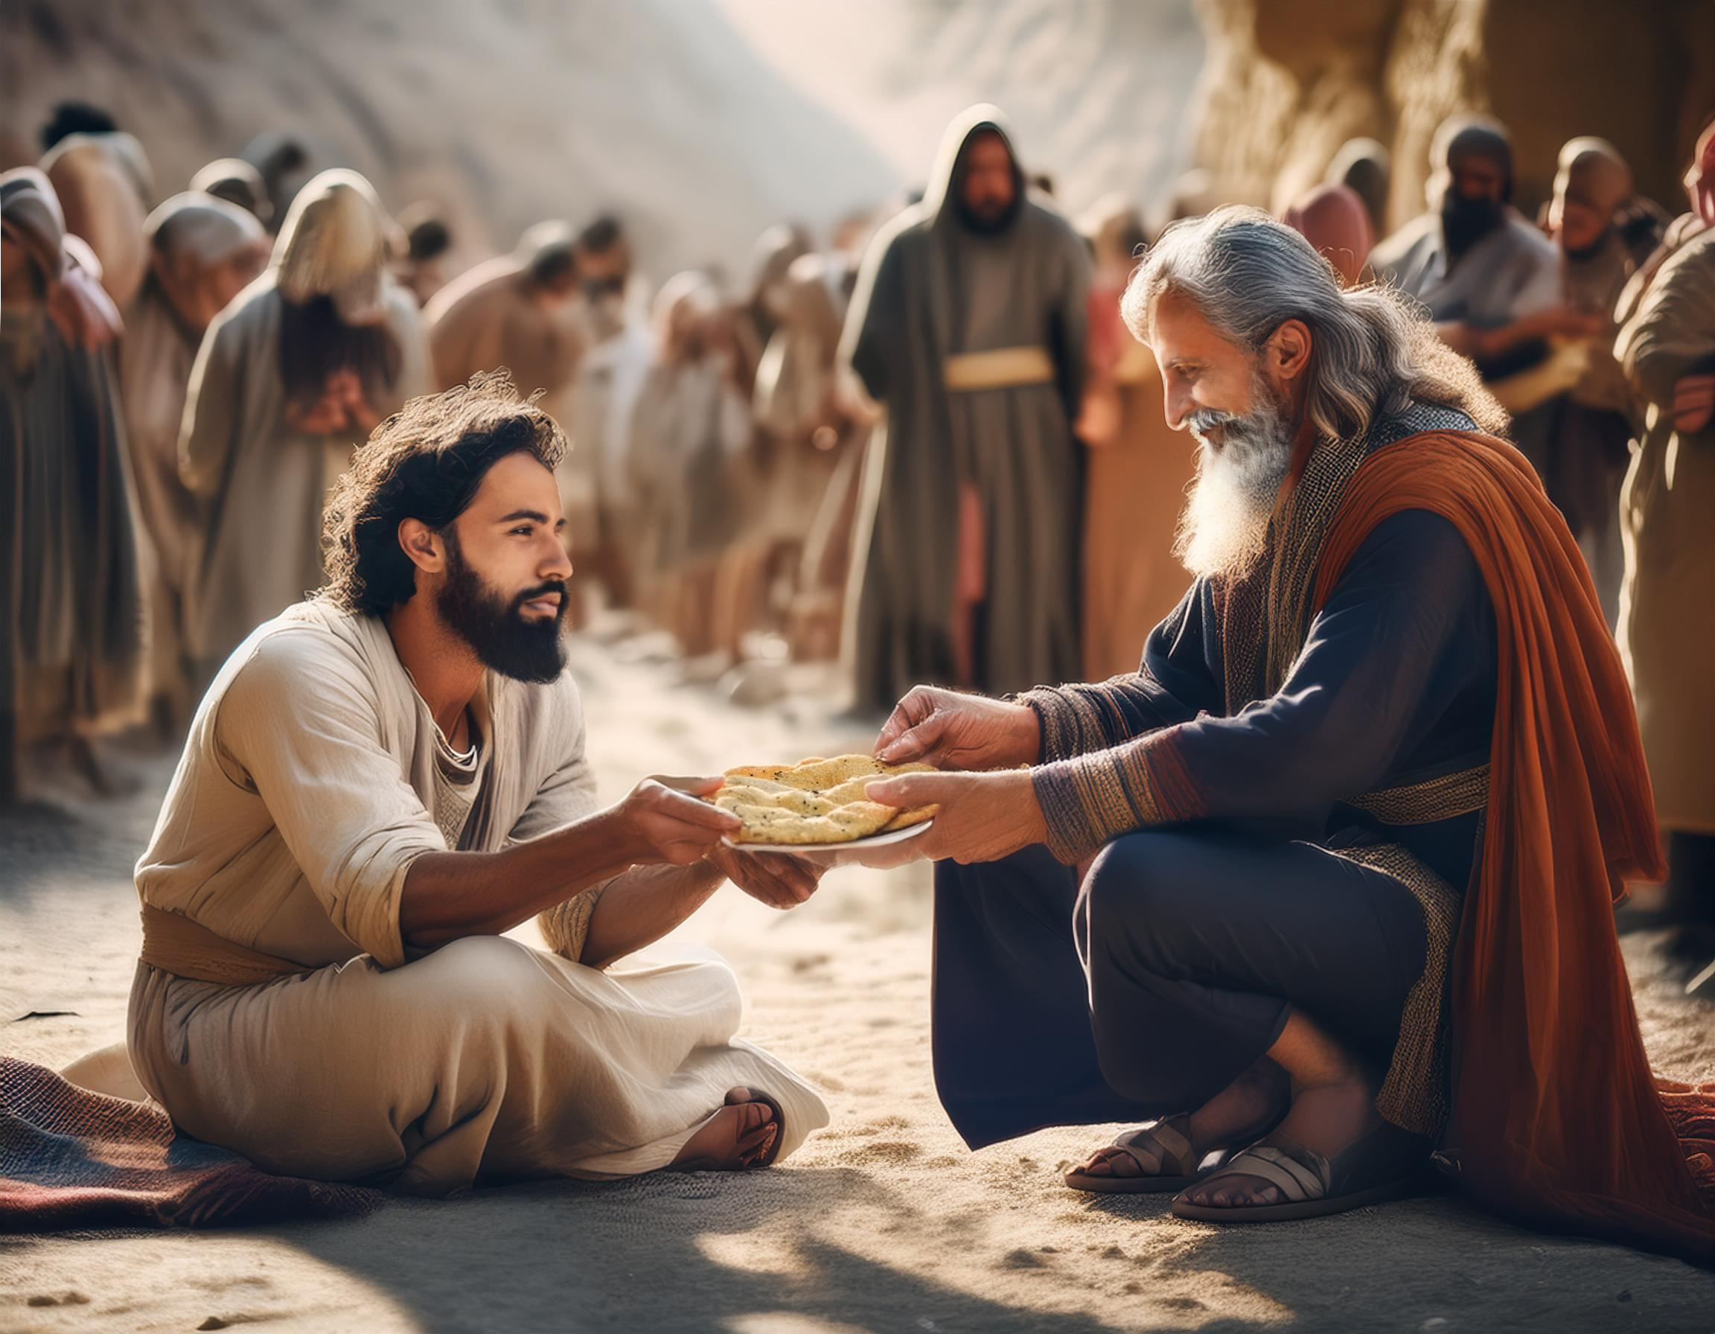
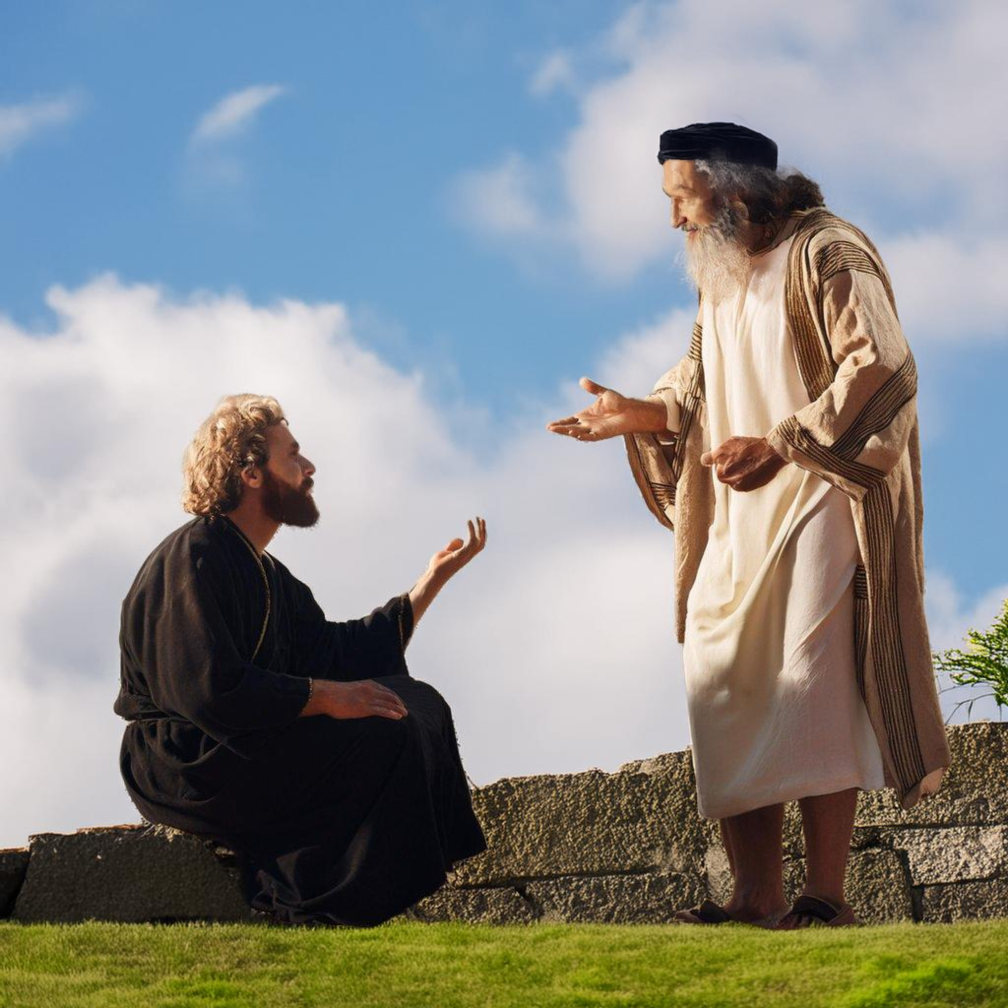
A Faith Without Works is Dead

Slide 12
What Good is Faith Without Works
What doth it profit, my brethren, though a man say he hath faith, and have not works? can faith save him? (James 2:14).

Slide 13
It is not Helpful
If a brother or sister be naked, and destitute of daily food, And one of you say unto them, Depart in peace, be ye warmed and filled; notwithstanding ye give them not those things which are needful to the body; what doth it profit? (James 2:15–16)

Slide 14
Dead Faith
Even so faith, if it hath not works, is dead, being alone (Jas 2:17).
Abide in me, and I in you. As the branch cannot bear fruit of itself, except it abide in the vine; no more can ye, except ye abide in me. I am the vine, ye are the branches: He that abideth in me, and I in him, the same bringeth forth much fruit: for without me ye can do nothing (John 15:4–5).

Slide 15
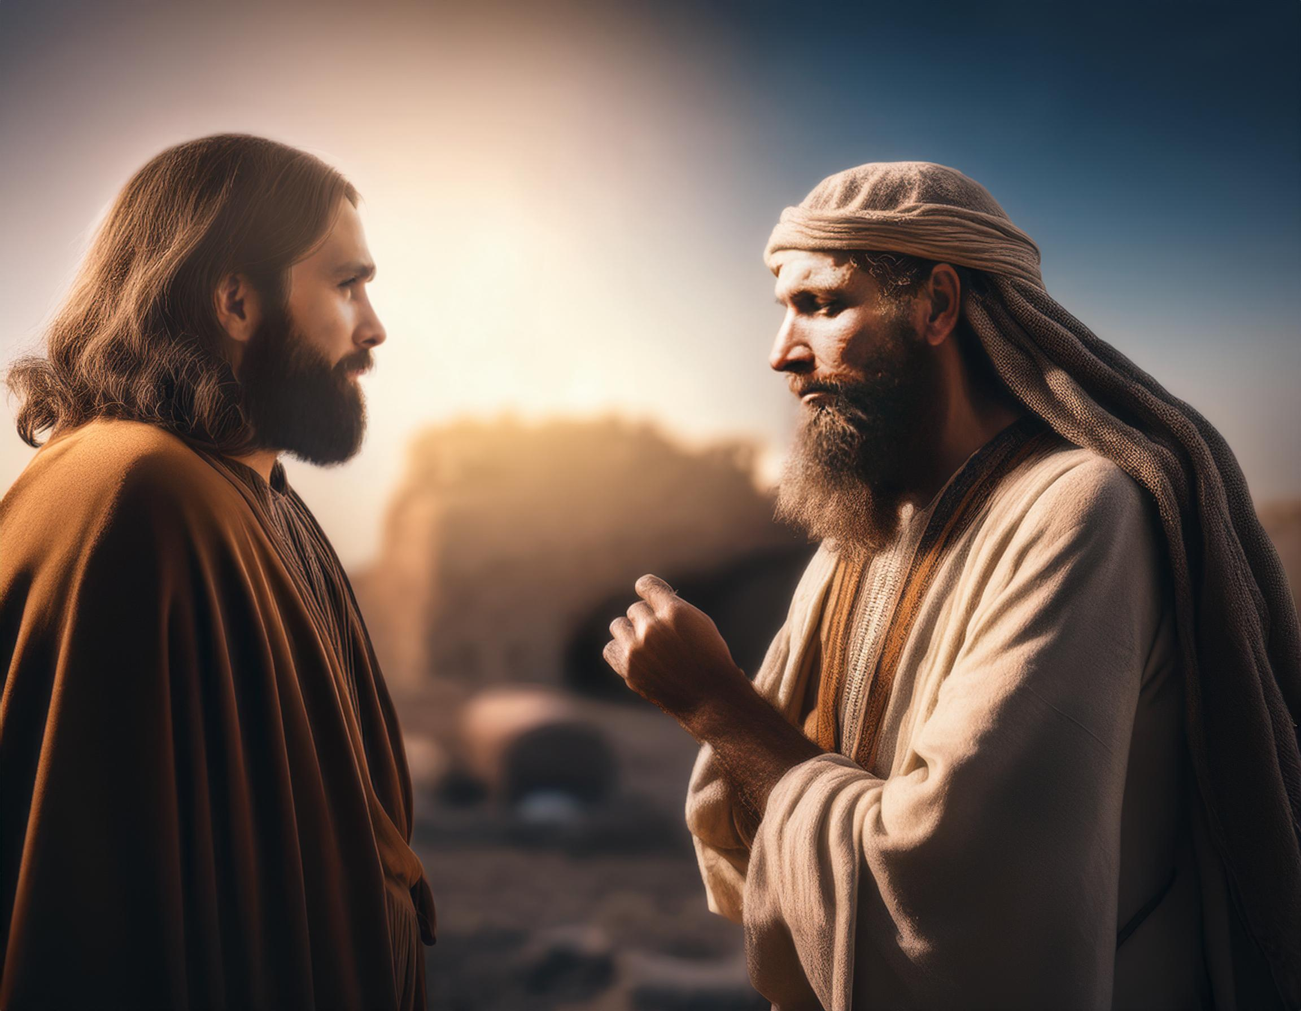
Works Demonstrate Genuine Faith

Slide 16
Works Demonstrate Faith
Yea, a man may say, Thou hast faith, and I have works: shew me thy faith without thy works, and I will shew thee my faith by my works (Jas 2:18).

Slide 17
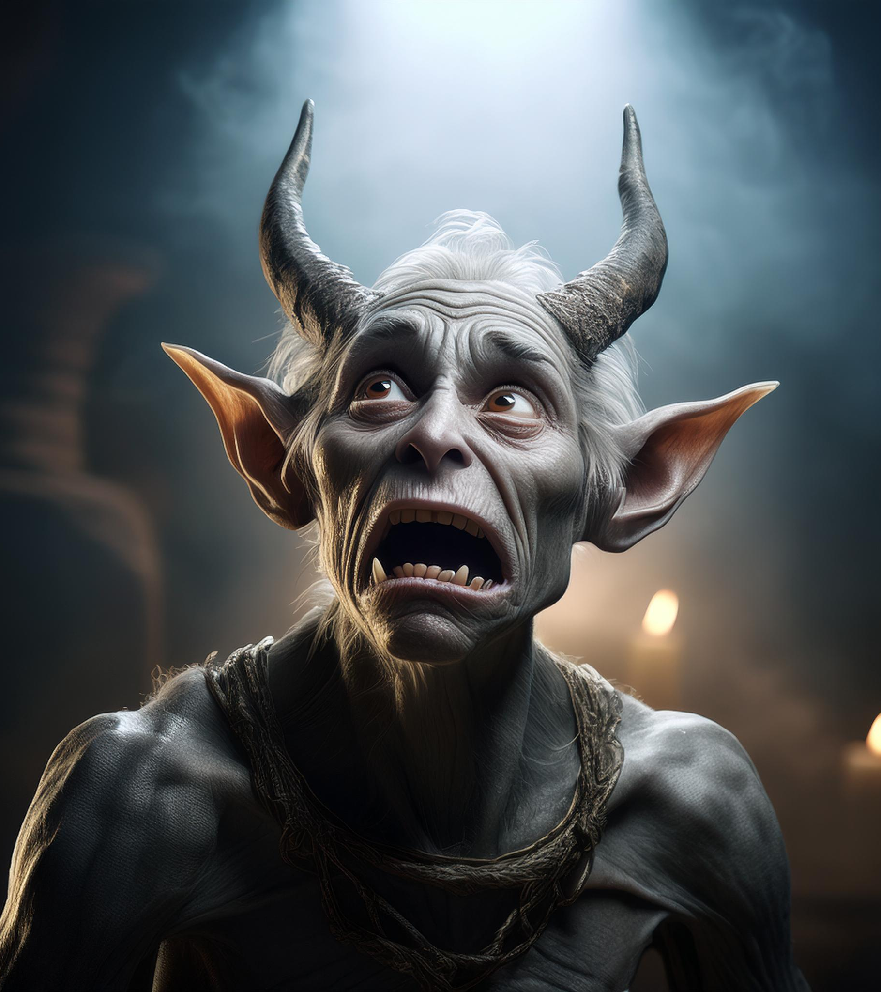
Belief but not faith
Thou believest that there is one God; thou doest well: the devils also believe, and tremble (James 2:19).

Slide 18
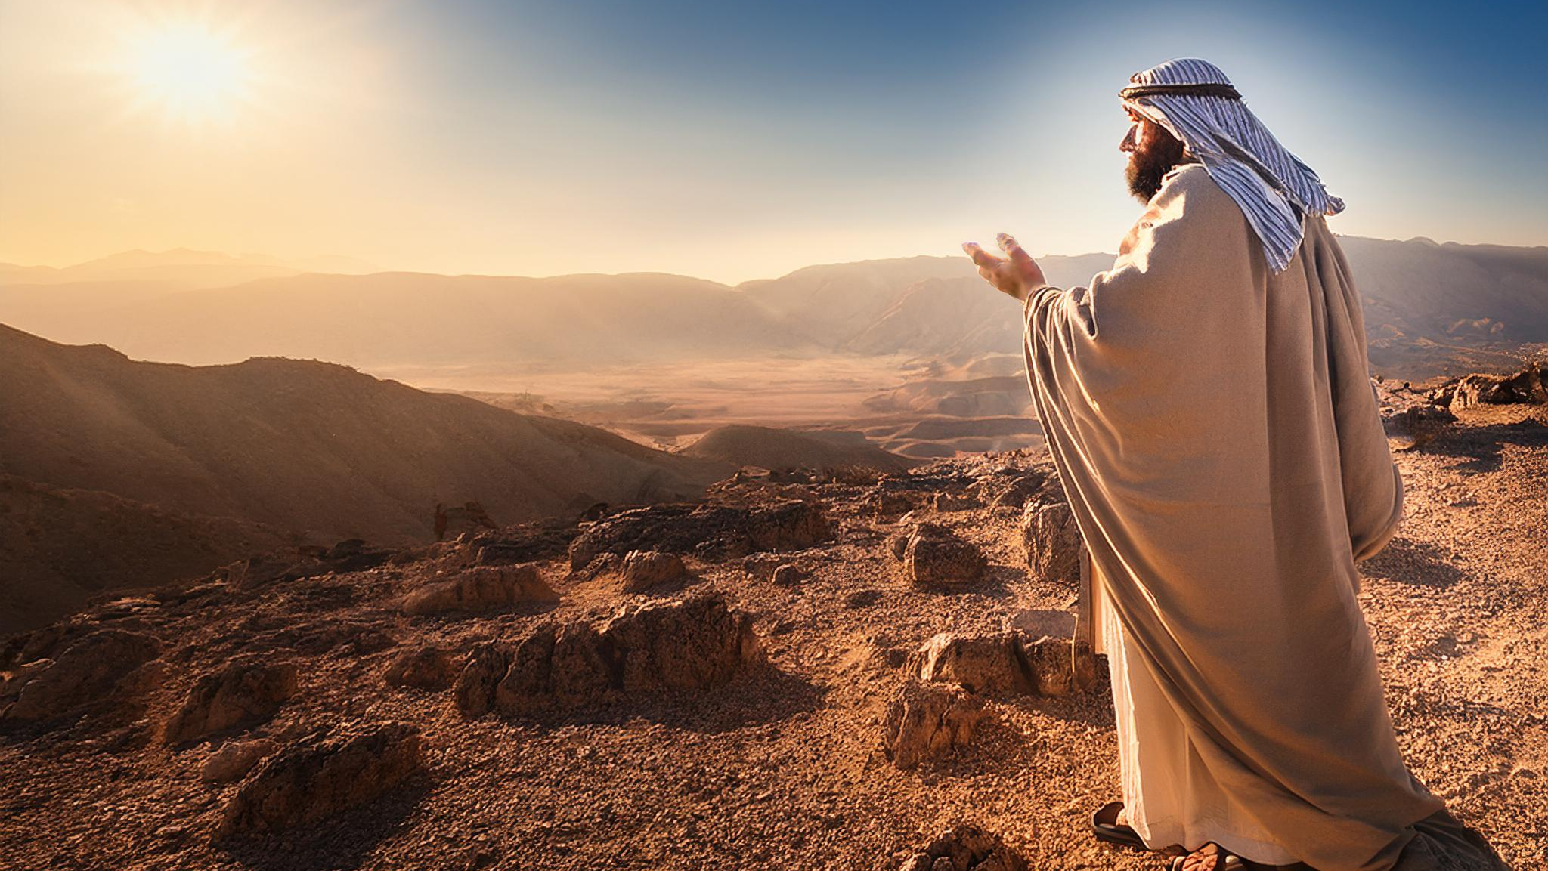
Works Complete Our Faith

Slide 19
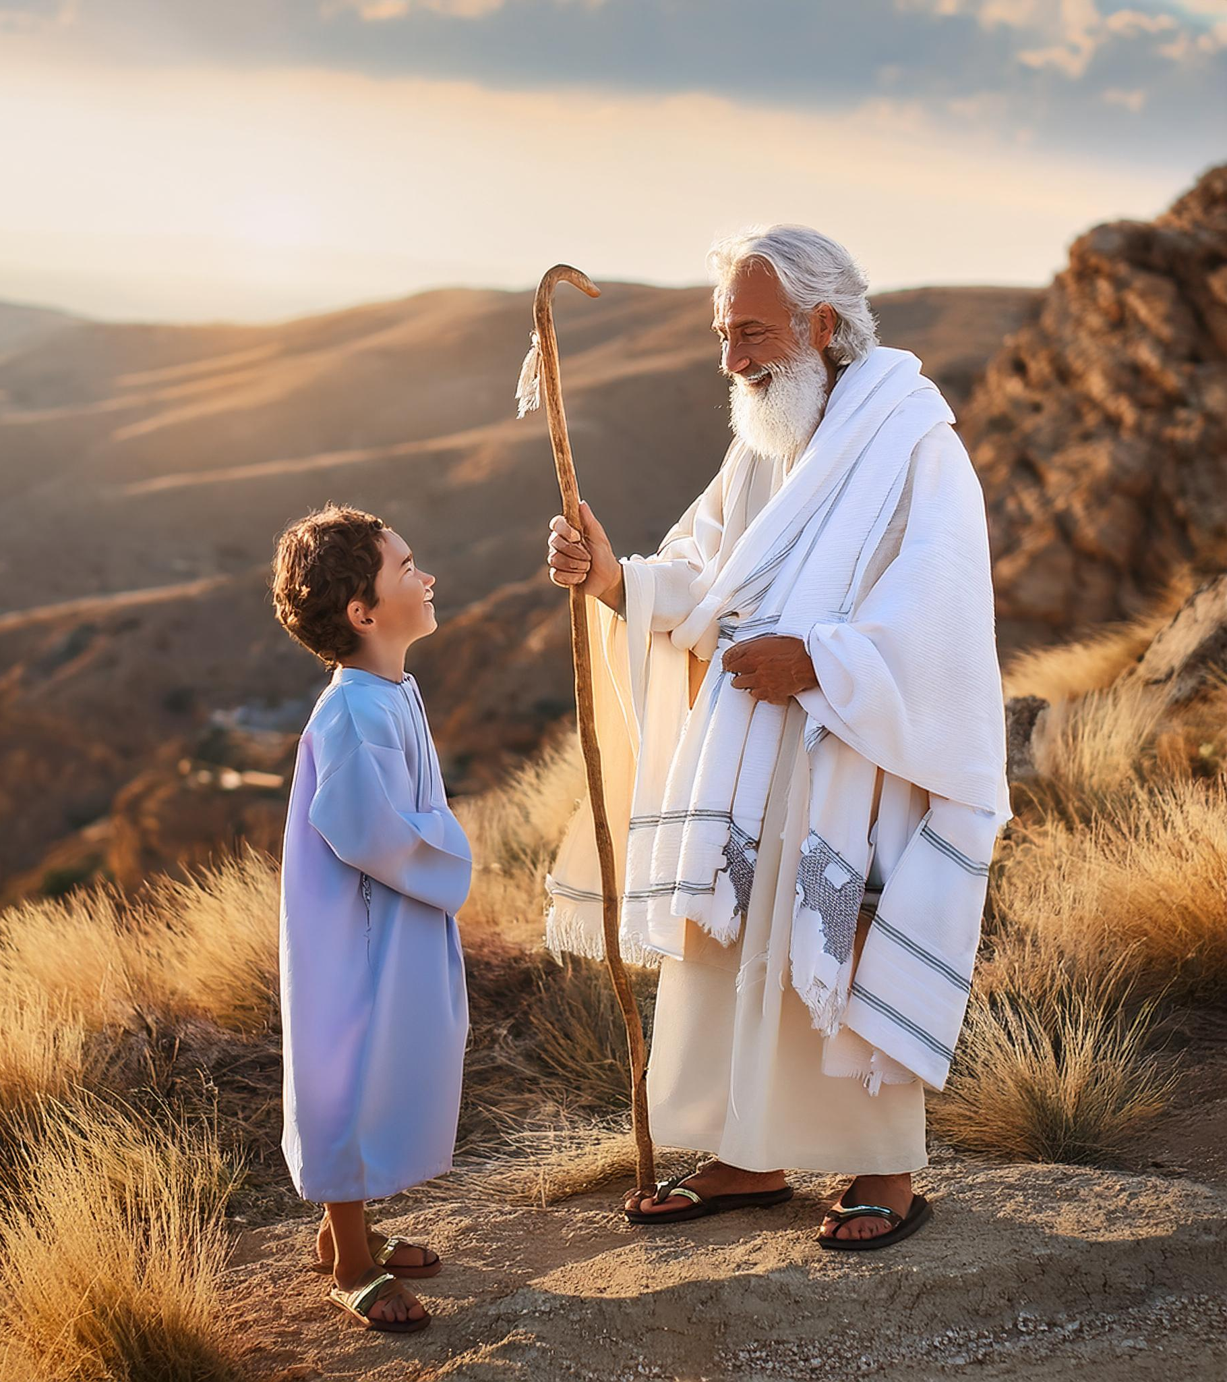
Completing Faith
But wilt thou know, O vain man, that faith without works is dead? Was not Abraham our father justified by works, when he had offered Isaac his son upon the altar? Seest thou how faith wrought with his works, and by works was faith made perfect? (James 2:20–22).

Slide 20
Faith and Works
And the scripture was fulfilled which saith, Abraham believed God, and it was imputed unto him for righteousness: and he was called the Friend of God. Ye see then how that by works a man is justified, and not by faith only (James 2:23–24).

Slide 21
Conclusion
Every Christian should live out their faith with their actions
For these three reasons

Slide 22
Rationale
A Faith Without Works is Dead
Works Demonstrate Genuine Faith
Works Complete Our Faith

Slide 23
Application
We are saved by grace, we accept if by faith, but that is not the end. That is only the beginning
Grace
Faith
Works

