Slide 1
What has happened
“We hold these truths to be self evident…”
to “self evident” truth?

Slide 2
Satan uses seduction and deception
to draw us away from God
and His will/ways. (1 Jn 2:15-17; 5:19)
2 Cor 4:4 “The god of this world
hath blinded (tuphos: obscure, opaque)
the minds…” (Noema: perception, purpose)
1 Jn 5:19 “The whole world lieth in wickedness”
Poneros’: Hurtful (in influence/effect) diseased

Slide 3
Scripture is clear that he will become increasingly bold and desperate.
(1 Tim. 4:1,2; 2 Tim. 3; 4:3,4; Rev. 12:9-12)
2 Tim 3:13 “evil men (poneros’: hurtful, diseased)
and seducers (goes’: wizards, imposters)
shall wax worse and worse,
(epi: superimpose {Values, beliefs, behavior})
deceiving, and being deceived.”
(Planao: Cause to roam out of the way)

Slide 4
Thankfully God gives us His Word
(2 Tim. 3:14-17)
Which is light for the darkness of deceit
Ps. 119:130 “the entrance of thy word giveth light,
It giveth understanding to the simple”
And Medicine (for the poneros / disease of sin)
Pr 4:4; 7:2 “Keep my commandments and live”
NT entole’: authoritative prescription!

Slide 5
Last week we discussed a repeated cycle that is easily identified throughout their history,
And is at work in our own society.
God warned Israel of this cycle in Deut. 8
They ignored his warnings and experienced it repeatedly for the next several millennia.

Slide 6
This cycle God warned about involves:
1. Revelation 2. Response 3. Reward
4. Rebellion (We shift sides/loyalties)
5. Reproof (Consequences) Pr 6:23-24
“the commandment is a lamp; and the law is light;
and reproofs of instruction are the way of life:
(Tôwkêchâh’: correction/reasoning/ warning)
To keep thee (shamar: protect, hedge) from the evil…”

Slide 7
5. Reproof (Consequences) Pr. 1:23
“turn at my reproof, I will pour out my Spirit unto
You, I will make known my words (ways) to you.”
6. Reconsider (repent) 2 Chron. 7:14
“if my people…humble … pray… seek…turn,
then will I hear…forgive… and heal their land”
If not…

Slide 8
The Ruin of Reprobation!
1. Definition of Reprobate:
A. English: Unprincipled, Rejected, Disapproved
B. OT Hebrew: Jer 6:30 Maas’: rejected, useless
C. NT: Ro 1:28 “even as they did not like to retain
God in their knowledge,
God gave them over to a reprobate mind.”
“Reprobate” (Adokimos: disqualified, rejected, worthless)
“mind” (nous: understanding, intellect)

Slide 9
2. Explanation (Development of Reprobation)
A. God gave us a “conscience” to guide us.
Pr 20:27 “The spirit of man is the candle of the LORD,
searching all the inward parts...”
Ro 2:15 “Which shew the work of the law written in their hearts, their conscience
(Synei’dēsis: co-perception
From synei’don: to see completely, understand)
also bearing witness…,
(symmartyre’ō: to testify, corroborate)

Slide 10
2. Explanation (Development of Reprobation)
A. God gave us a “conscience” to guide us.
Ro 2:15 “their conscience also bearing witness,
and their thoughts (logismos’: reasoning, logic)
the mean while accusing
(katēgore’ō: to charge, act as a plaintiff)
or else excusing one another”
(apologe’omai: give an account, defend)

Slide 11
2. Explanation (Development of Reprobation)
A. God gave us a “conscience” to guide us.
Our conscience must have a standard by which to judge right and wrong. Ps 119:9-11
“Wherewithal shall a young man cleanse his way?
by taking heed thereto according to thy word.
With my whole heart have I sought thee:
O let me not wander from thy commandments.
Thy word have I hid in mine heart,
that I might not sin against thee. “

Slide 12
2. Explanation (Development of Reprobation)
A. God gave us a “conscience” to guide us.
Our conscience must have a standard by which to judge right and wrong.
2) This standard is God’s word. 1 Tim 1:5 “the end (telos: goal) of the commandment (parangeli’a: charge)
is charity out of a pure (katharos: clean) heart,
and of a good conscience, (agathos synei’dēsis:
beneficial, effective co-perception)
and of faith (pistis: conviction) unfeigned:” (sincere)

Slide 13
2. Explanation (development of Reprobation)
B. When we sin, our conscience produces conviction.
1) It’s like the spiritual “white blood cells” that try to
expose and fight the infection of sin.
2) Conviction should lead to honest confession.
1 Jn 1:9 “If we confess our sins…”
(homolege’o: say the same thing! {Acknowledge})
3) Honest (humble) confession produces cleansing.
1 Jn 1:9 “…He is faithful and just to forgive us…
and cleanse us from all unrighteousness” (infection!)

Slide 14
C. If we continue in our rebellion, we have to deal
with the conviction of our conscience. Acts 9:5, Ro.2:15
1) In an attempt to rationalize our sin, We begin to:
a) “Re-think”/redefine God’s Standard (Gen. 3:1)
b) Challenge His right to set a standard. (Gen. 3:5)
“ye shall be as gods, knowing good and evil”
Yada: 6 x it’s translated “to declare”
Ex 5:2 “who is the LORD, that I should obey his voice?”
2) This rationalization clouds/corrupts our conscience
(synei’dēsis: co-perception) and it becomes “defiled”.

Slide 15
2. Explanation (development of Reprobation)
D. We then either reject, redesign, or replace God
with a “god” of our own making. Ro. 1:21
“when they knew God, they glorified him not as God…
But became vain in their imaginations, (dialogismos’)
And their foolish heart was darkened” (skotizo: obscured)
from skia (shadowed, dimmed)
22 Professing themselves to be wise, they became fools,
23 And changed the glory of the uncorruptible God
into an image made like to corruptible man…”
(gas lighting!)

Slide 16
D. We then either reject, redesign, or replace God
with a “god” of our own making. Titus 1:14-16 “Not giving heed to ..fables, and commandments of men,
that turn from the truth.
Unto the pure all things are pure: but unto them that are defiled and unbelieving is nothing pure;
but even their mind and conscience is defiled.
Miai’nō: contaminated
They profess that they know God; but in works they deny him, being abominable, and disobedient,
and unto every good work reprobate.”

Slide 17
D. We then either reject, redesign, or replace God
with a “god” of our own making.
1) What then becomes the standard by which
we determine “good and evil”?
Judges 17:6 “In those days there was no king in Israel,
(Authority or standard)
but every man did that which was right in his own eyes.”
Repeated word for word final verse of Judges!
21:25
WE DO!

Slide 18
D. We then either reject, redesign, or replace God
with a “god” of our own making.
2) We basically buy into Satan’s first lie and
become our own “god”. Gen. 3:5
“your eyes will be open…
Ye shall be as gods,
knowing (determining/declaring)
good and evil”

Slide 19
3) Rejecting God, His Wisdom and standards
and then replacing them with our own
Produces a Reprobate mind. Jms 3:14-16
“But if ye have bitter envying and strife in your hearts, glory not, and lie not against the truth.
This wisdom descendeth not from above,
but is earthly, sensual, devilish.
For where envying and strife is, there is confusion
and every evil work.”
This “evil” is infectious!

Slide 20
This modern god is known as “humanism.”
“An outlook or system of thought attaching prime importance to human rather than divine matters.”
AKA: We’re our own “god”!
1933 Humanist Manifesto 1
“The time has come for widespread recognition of the radical changes in religious beliefs throughout the modern world.”
The manifesto reveals their 15 “goals” or creeds”
1st: “Religious humanists regard the universe as
self-existing and not created.”

Slide 21
13th: Religious humanism maintains that all associations and institutions exist for the fulfillment of human life.
The intelligent evaluation, transformation, control,
and direction of such associations and institutions
with a view to the enhancement of human life
is the purpose and program of humanism.
Certainly religious institutions, their ritualistic forms, ecclesiastical methods, and communal activities
must be reconstituted as rapidly as experience allows,
in order to function effectively in the modern world.”

Slide 22
Conclusion of the Humanist Manifesto 1:
“So stand the theses of religious humanism.
Though we consider the religious forms and ideas of our fathers no longer adequate, the quest for the good life is still the central task for mankind.
Man is at last becoming aware that he alone is responsible for the realization of the world of his dreams,
that he has within himself the power for its achievement.
He must set intelligence and will to the task.”
https://americanhumanist.org/what-is-humanism/manifesto1/

Slide 23
“The philosophy of the school room in one generation
will be the philosophy of government in the next.”
https://www.brainyquote.com/quotes/abraham_lincoln_133687

Slide 24
The 34 signers (consisting of 18 Educators,
10 “Ministers”, 5 Editors, and 1 lawyer)
Worked to “fundamentally transform” America.
John Dewey (Father of Modern Education)
Along with many other like-minded people
(Such as ACLU founder Roger Baldwin)
worked to turn their dream
into our current Nightmare!

Slide 25
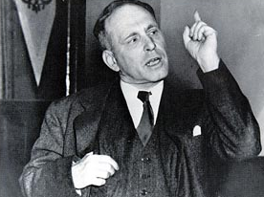
Roger Baldwin (Founded ACLU 1920) wrote:
“I am for socialism, disarmament, and, ultimately,
for abolishing the state itself...
I seek the social ownership of property,
the abolition of the propertied class,
the sole control of those who produce wealth.
Communism is the goal.”
https://www.azquotes.com/author/832-Roger_Nash_Baldwin
Both John Dewey & Roger Baldwin went to Russia to study (and praise)
the educational methods of Stalin.

Slide 26
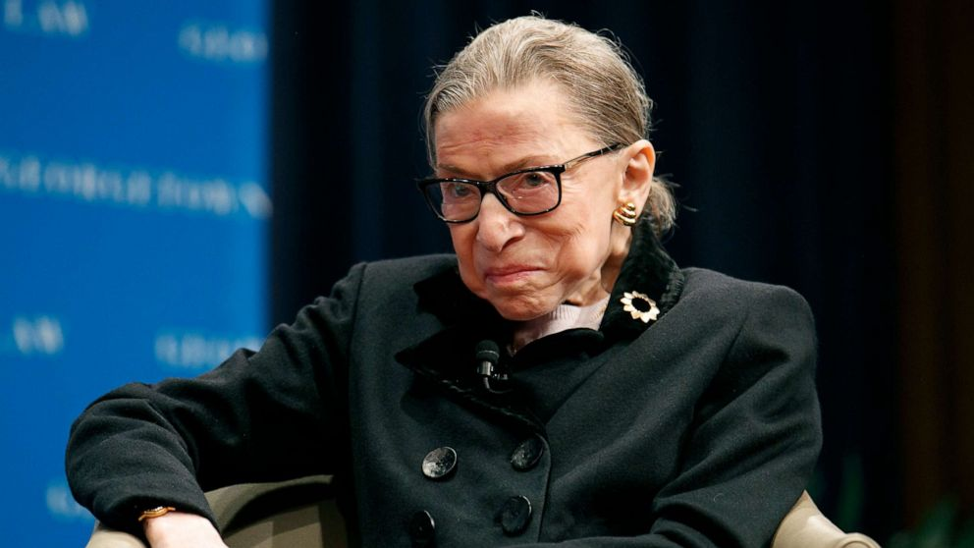
1931 Special House Committee reported:
“The ACLU is closely affiliated with the communist movement in the United States,
and fully 90 percent of its efforts are on behalf of communists who have come into conflict with the law.
It claims to stand for free speech, free press and free assembly, but it is quite apparent that the main function of the ACLU is …to protect the communists.”
Ruth Ginsburg directed ACLU Women’s Projects from
Supreme Court since 1993

Slide 27
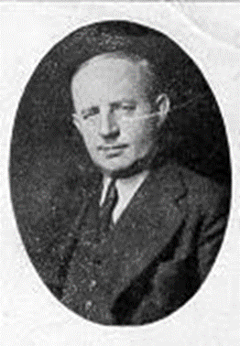
18 of the HM1 signers were educators! Charles F. Potter wrote:
"Education is thus a most powerful ally of humanism,
and every American school is a school of humanism.
What can a theistic Sunday school's meeting for an hour once a week and teaching only a fraction of the children do to stem the tide of the five-day program of humanistic teaching?“
(Charles F. Potter, "Humanism: A New Religion," 1930)
He was a Unitarian Minister!
Their infiltration in Education set the stage for the Humanist takeover of American Schools
(and pulpits) a generation later.

Slide 28
God warned us of this time would come!
2 Tim. 3:13 “Evil men and seducers shall wax worse and worse,
Deceiving and being deceived”
1 Tim 4:1-2 “Now the Spirit speaketh expressly, that in the latter times some shall depart from the faith,
giving heed to seducing spirits,
and doctrines of devils;”
(Gen. 3:5) “Ye shall be as gods”

Slide 29
1 Tim 4:2 “Speaking lies
in hypocrisy;
having their conscience seared with a hot iron”
Jn 8:44-45 “Ye are of your father the devil,
and the lusts of your father ye will do.
He was a murderer from the beginning,
and abode not in the truth,
because there is no truth in him.
…for he is a liar, and the father of it.
⁴⁵ And because I tell you the truth, ye believe me not. “

Slide 30
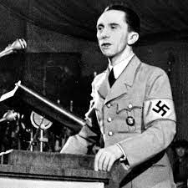
“A lie told once remains a lie,
But a lie told a thousand times becomes the truth!”
“If you tell a lie big enough
and keep repeating it,
people will eventually
come to believe it.”
Joseph Goebbels was Hitler’s “Minister of Propaganda”

Slide 31
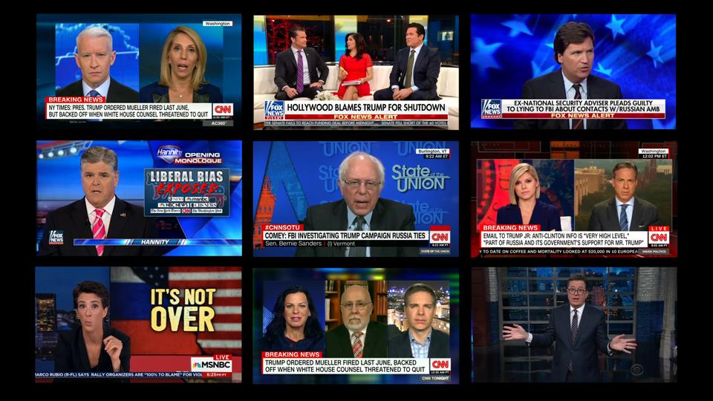
America has many “ministers of Propaganda!”
After 3 years and 32 million in legal fees forcing the “Russian Collusion” story:

Slide 33
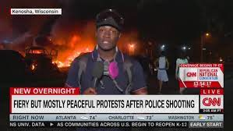
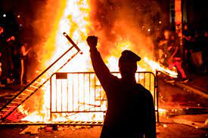
America has many “ministers of Propaganda!”
“Over 60,000 officers assaulted in 2020, with 31% sustaining injuries: and 46 killed”
https://abcnews.go.com/US/60000-officers-assaulted-2020-31-sustaining-injuries-fbi/story?id=80661264

Slide 34
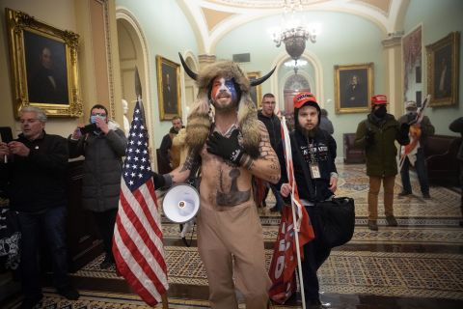
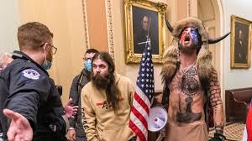
America has many “ministers of Propaganda!”
“An armed insurrection”
(Without any “arms”)

Slide 35
President Biden’s
“Disinformation Czar”
Nina Jankowicz
“Disinformation
Governance Board”
Paused after 3 weeks
of push back.

Slide 36
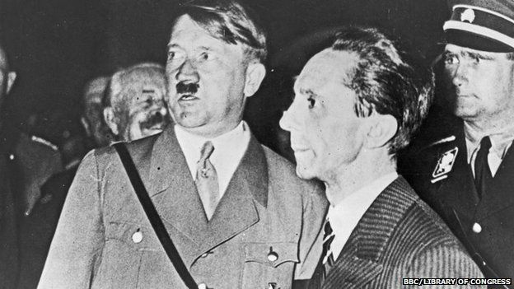
“The lie can be maintained only for such time as the State can shield the people from the political, economic and/or military consequences of the lie.
It thus becomes vitally important for the State to use all of its powers to repress dissent,
for the truth is the mortal enemy of the lie,
and thus by extension,
the truth is the greatest enemy of the State.” J. Goebbels
(See Rev. 12,13!)

Slide 37
Psalm 11:1-3 “In the LORD put I my trust: how say ye to my soul, Flee as a bird to your mountain?
For, lo, the wicked bend their bow, …that they may privily shoot at the upright in heart.
If the foundations be destroyed,
what can the righteous do? “
1) Recognize:
We’re here “For such a time as this” Est. 4:14
We need a clear conscience to “see” clearly!

Slide 38
Remember: God’s not unaware. Ps 11:4
“The LORD is in his holy temple,
The LORD’S throne is in heaven:
his eyes behold…try, (test) the children of men.”
3) Respond to the direction of God / His word.
Phil 2:5 “Let this mind be in you, which was in Christ…
13 For it is God which worketh in you both to will
and to do of his good pleasure.”

Slide 39
4) Reflect Him and His Truth in our beliefs
^{and behavior. Phil. 2:14-16}
14 “Do all things without murmurings and disputings: 15 That ye may be blameless and harmless,
the sons of God, without rebuke,
in the midst of a crooked and perverse nation,
among whom ye shine as lights in the world;
16 Holding forth the word of life”

