Slide 1
Genuine Worship is perhaps one of the
most misunderstood (and mis-applied)
spiritual disciplines.

Slide 3
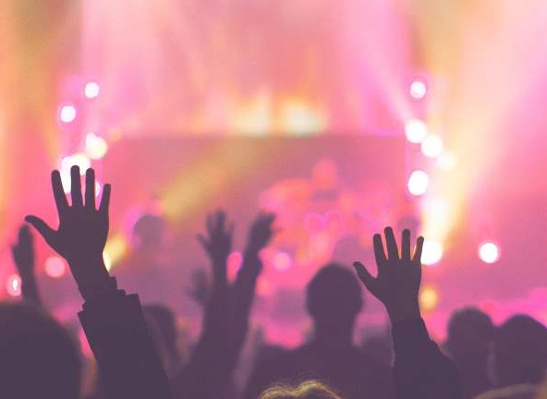
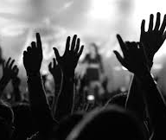
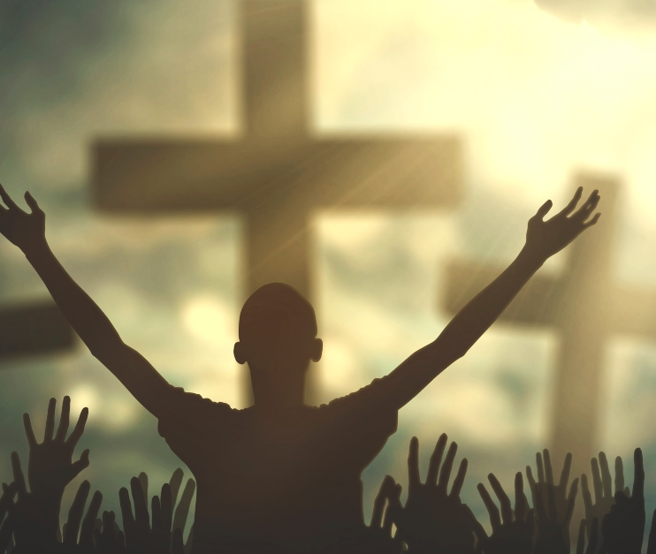
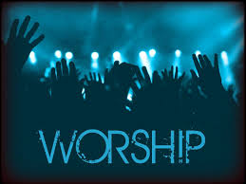
Common “Worship” images.
Doesn’t worship involve more than “waving” to God?
1 Tim 2:8 “I will therefore that men pray every where, lifting up holy hands,
without wrath and doubting.”

Slide 4
Webster’s defines worship as: (verb)
1: to honor or show reverence for a divine being or power
2: to regard with great or extravagant respect, honor, or devotion
(a celebrity worshipped by her fans)
3: to perform or take part in worship or an act of worship
As a Noun it involves:
“Reverence or admiration for or devotion to and object of esteem”
or
“a form of religious practice with its creed and ritual”
aka: American Idol

Slide 5
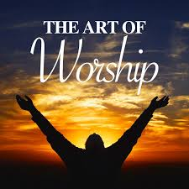
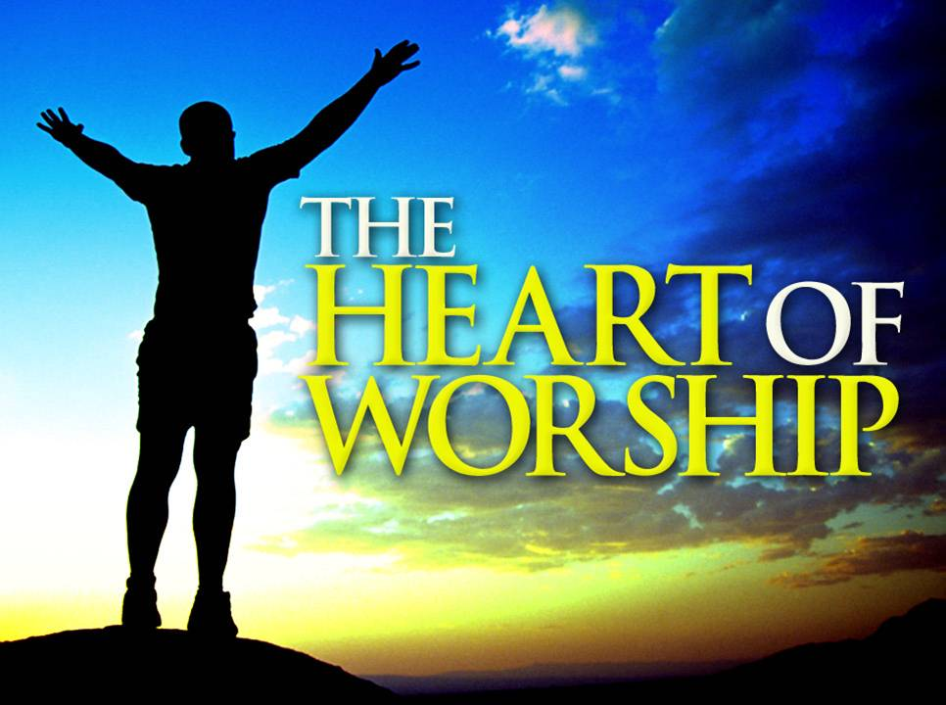
There’s a vast difference between:

Slide 6
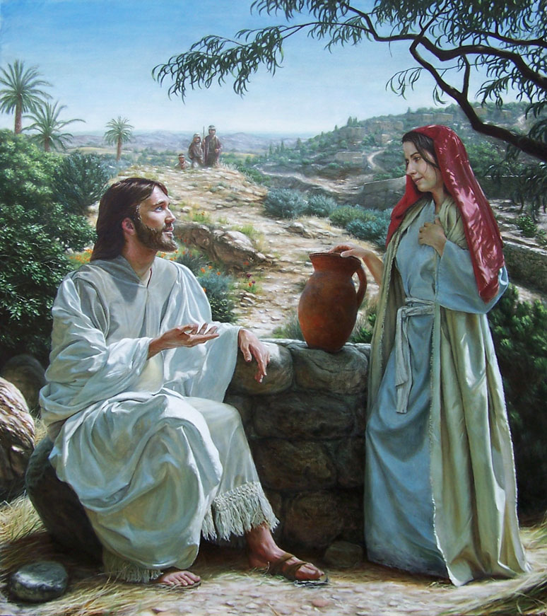
Jesus clarified this in Jn 4 when he asked the woman to be honest with Him and herself. Vs 15-18
When she tried to changed the subject to ritual worship (vs 20) Jesus responded (Vs 22,23)
“Ye worship, ye know not what…
true worshippers shall worship the Father in spirit and in truth:
for the Father seeketh such to worship him.”

Slide 7
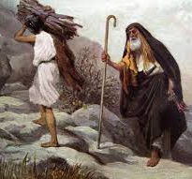
“True (Biblical) Worship” involves:
Sacrificial Giving
1. 1st reference to worship is Gen. 22:5
“I and the lad will go yonder and worship”
Shāḥâ’: worship, reverence, bow before
A. What was the stated purpose of this trip?
Gen 22:2 “Take now thy son, thine only son Isaac, whom thou lovest, and get thee into …Moriah;
and offer him there for a burnt offering upon one of the mountains which I will tell thee of.”

Slide 8
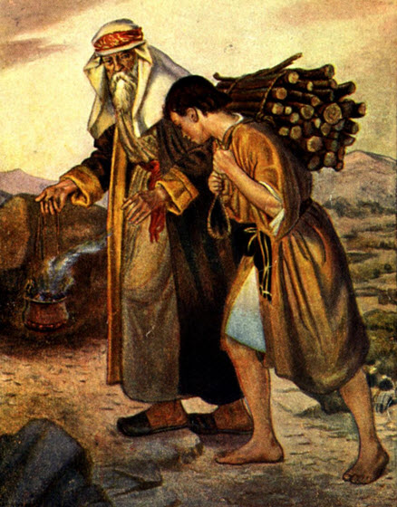
1. 1st reference to worship is Gen. 22:7,8
“Isaac spake unto Abraham his father,
… Behold the fire and the wood:
but where is the lamb for a burnt offering?
⁸ ”My son, God will provide himself a lamb….”

Slide 9
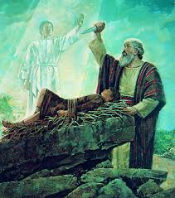
What was the actual purpose of this “worship”?
1) To Test Abraham. Vs 11-12
“the angel of the LORD called unto him …Lay not thine hand upon the lad...
now I know that thou fearest God,
seeing thou hast not withheld thy son, thine only son from me.

Slide 10
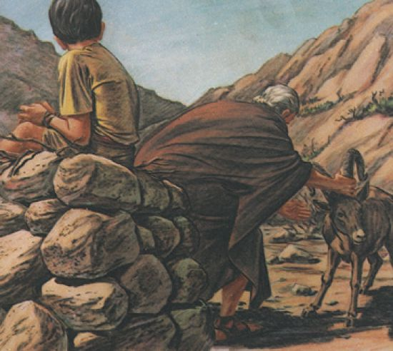
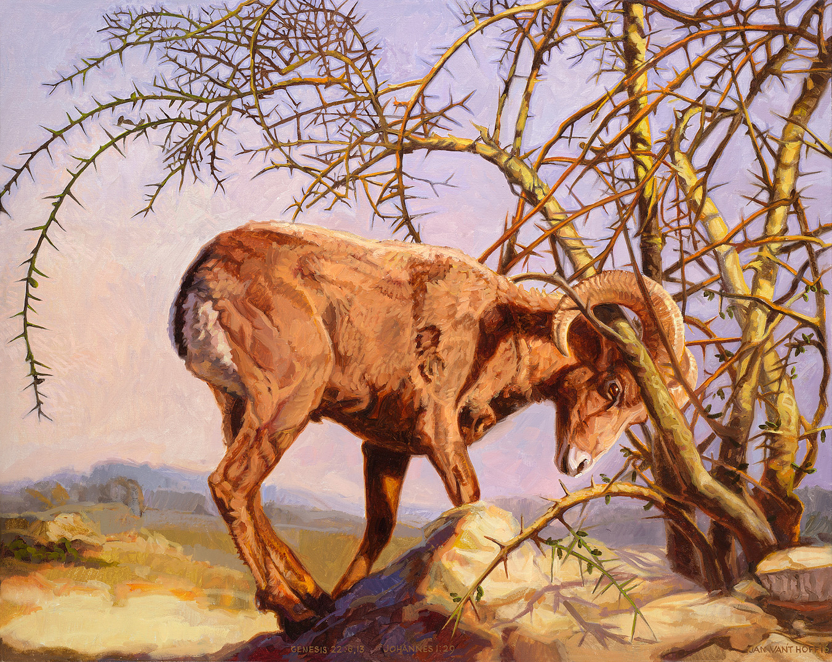
What was the actual purpose of this “worship”?
2) To reveal His larger plan. Compare 8 & 13
“And Abraham lifted up his eyes, and looked, and behold behind him a ram caught in a thicket by his horns:
and Abraham went and took the ram, and offered him up for a burnt offering in the stead of his son.”

Slide 11
2) To reveal His larger plan. 8, 13
Heb 11:17-19 “By faith Abraham, when he was tried, offered up Isaac: and he that had received the promises offered up his only begotten son, Of whom it was said,
That in Isaac shall thy seed be called:
Accounting that God was able to raise him up,
even from the dead;
from whence also he received
him in a figure.”

Slide 12
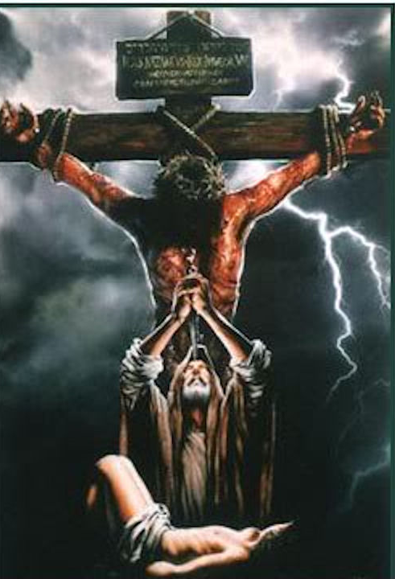
2) To reveal His larger plan. Vs 14
“Abraham called the name of that place Jehovahjireh:
as it is said to this day,
In the mount of the LORD
it shall be seen.”
Remember Vs 2?
“and offer him there for a burnt offering upon one of the mountains which I will tell thee of.”

Slide 13
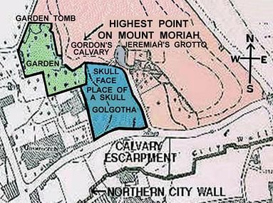
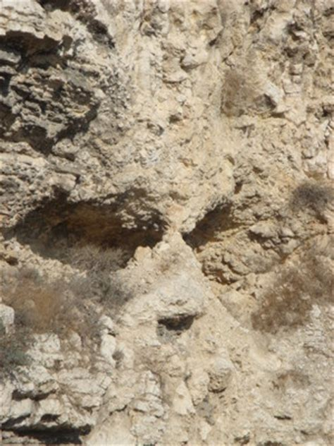
“In the mount of the LORD it shall be seen.”

Slide 14
What was the actual purpose of this exercise?
1) To Test Abraham. 2) To Reveal His larger plans.
3) To Bless Abraham. Vs 15-18
“the angel of the LORD called unto Abraham out of heaven … because thou hast done this thing, and hast not withheld thy son,
17 That in blessing I will bless thee, and in multiplying I will multiply thy seed as the stars of the heaven, …;
And in thy seed shall all the nations of the earth be blessed;
because thou hast obeyed my voice.”
You can’t separate Obedience
from True Worship!

Slide 15
2. Sacrificial Giving is part of worship.
A. David modeled this.
Psalm 29:1-2 “Give unto the LORD, O ye mighty, give unto the LORD glory and strength.
Give unto the LORD the glory due unto his name;
worship the LORD
in the beauty of holiness.”

Slide 16
Ps 96:7-9 “Give unto the LORD,
O ye kindreds of the people,
give unto the LORD glory and strength. Give unto the LORD the glory due unto his name:
bring an offering,
and come into his courts.
⁹ O worship the LORD in the beauty of holiness:
fear before him, all the earth.”

Slide 17
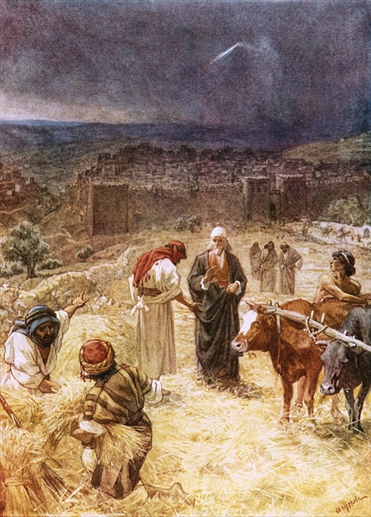
1) David’s pride brought a terrible plague! (70,000 deaths)
1 Chr 21:1 “Satan stood up …, and provoked David to number Israel.”
2 Sam 24:16 “And when the angel stretched out his hand upon Jerusalem to destroy it, the LORD repented him of the evil,
and said to the angel that destroyed the people,
It is enough: stay now thine hand.
And the angel of the LORD was by the threshingplace of Araunah the Jebusite.
2) God prompted him to build an altar, so he offered to buy the land to build the altar to God. Vs 18-21

Slide 18
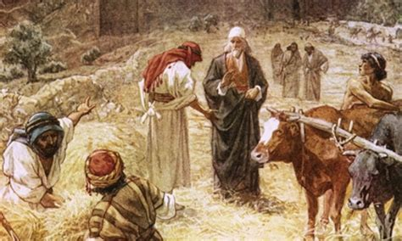
2 Sam 24:22-25 “Araunah said unto David, Let my lord the king take and offer up what seemeth good unto him:
behold, here be oxen for burnt sacrifice, and threshing instruments and other instruments of the oxen for wood.
Nay; but I will surely buy it of thee at a price:
neither will I offer offerings unto the LORD
…of that which doth cost me nothing.”

Slide 19
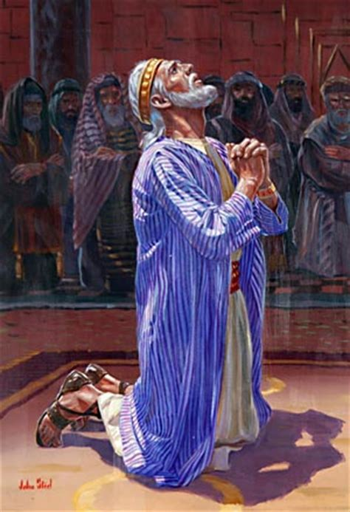
3) Later, David sacrificially prepared to build the Temple there.
1 Chr 29:10-12 “Blessed be thou, LORD God…, for ever and ever.
Thine, O LORD, is the greatness, and the power, and the glory,
and the victory, and the majesty: for all that is in the heaven and
in the earth is thine; thine is the kingdom
and thou art exalted as head above all.
Both riches and honour come of thee,
and thou reignest over all;

Slide 20
1 Chr 29:12-14 “in thine hand is power and might; and in thine hand it is to make great, and to give strength unto all. Now therefore, our God, we thank thee, and praise thy glorious name.
But who am I, and what is my people, that we should be able to offer so willingly after this sort?
for all things come of thee,
and of thine own
have we given thee!”

Slide 21
B. The Magi understood this.

Slide 22
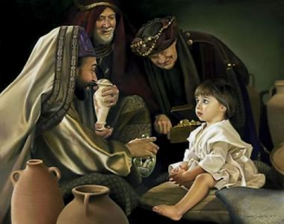
Mt 2:11 “And when they were come into the house, they saw the young child with Mary his mother, and fell down,
and worshipped him:
and when they had opened
their treasures,
they presented unto him gifts;
gold, and frankincense,
and myrrh.”

Slide 23
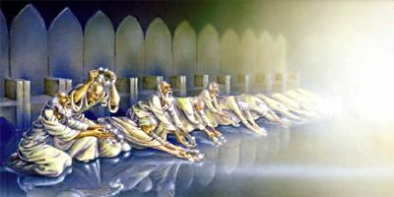
C. Eventually we’ll understand this. Rev 4:10,11
“The 24 elders fall down before him that sat on the throne, and worship him that lives for ever,
and cast their crowns before the throne, saying,
Thou art worthy, O Lord, to receive glory and honor and power: for thou hast created all things,
and for thy pleasure they are and were created.”

Slide 24
Conclusion:
If genuine worship involves giving:
What is it that God wants most from us?
God wants our Hearts! (Devotion)
Pr. 23:26 “My son, give me thine heart,
Lēb: heart (508x); mind (30x); feelings (8x), will (4x)
the center (“midst”11x)

Slide 25
God wants our Hearts! (Devotion)
How Does He (and we) know he has them?
Pr. 23:26 “My son, give me thine heart,
and let thine eyes observe my ways.”
Our Devotion is demonstrated
by our dedication!

Slide 26
Pr. 23:26 “My son, give me thine heart,
and let thine eyes observe my ways.”
Rāṣâ’: to delight in!
Ps 37:4-5 “Delight thyself also in the LORD;
and he shall give thee the desires of thine heart.
Commit thy way unto the LORD;
trust also in him;
and he shall bring it to pass”

Slide 27
Deuteronomy 10:12
“what doth the LORD thy God require of thee,
but to fear (yare’: revere) the LORD thy God,
to walk in all his ways, (yālak derek: follow Him)
and to love (ahab’) him,
and to serve the LORD thy God
(ʿābad’: to work for and worship 5x)
with all thy heart
and with all thy soul,

Slide 28
Deuteronomy 10:13
¹³ To keep (shāmar’: observe, protect)
the commandments (miṣwâ’: to enjoin/prescribe)
of the LORD,
and his statutes, (ḥuq’qâ: prescribe, appoint)
which I command thee this day
for thy good?”
Ṭôb: good, pleasure, precious

Slide 29
Heartless worship is hopeless (Vain) worship!
Isaiah 29:13; Mt 15:8,9
“This people draweth nigh unto me with their mouth, and honoureth me with their lips;
but their heart is far from me.
But in vain they do worship me,
teaching for doctrines the commandments of men.”

Slide 30
Is 1:10-12 “Hear the word of the LORD, …
¹¹ To what purpose is the multitude of your sacrifices unto me? saith the LORD:
I am full of the burnt offerings of rams, and the fat of fed beasts; and I delight not in the blood of bullocks, or of lambs, or of he goats.
¹² When ye come to appear before me,
who hath required this at your hand,
to tread my courts?”

Slide 31
Is 1:13-15 ¹³ Bring no more vain oblations; incense is an abomination unto me; the new moons and sabbaths, the calling of assemblies, I cannot away with;
it is iniquity, even the solemn meeting.
¹⁴ Your new moons and your feasts my soul hateth:
they are a trouble unto me; I am weary to bear them.
¹⁵ And when ye spread forth your hands,
I will hide mine eyes from you: yea, when ye make many prayers, I will not hear:
your hands are full of blood….”

Slide 32
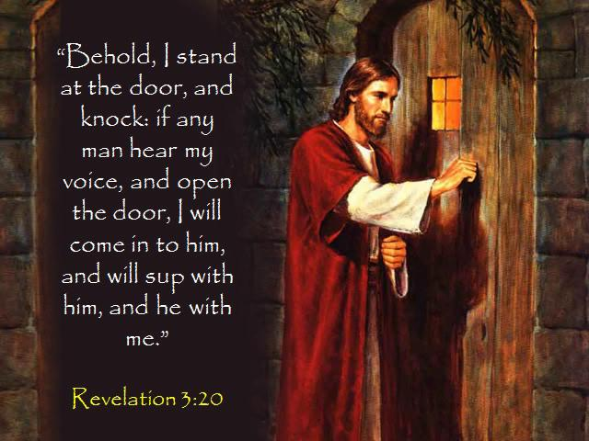
Application:
Is Christ in your heart?
Ro 10:10 “For with the heart man believeth unto righteousness.”
Gal 4:6 “because ye are sons, God hath sent forth the Spirit of his Son into your hearts, crying, Abba, Father.”
Ro 8:16 “The Spirit itself bears witness with our spirit,
that we are the children of God:”

Slide 33
Application:
2) Does Christ “Have” your heart?
Pr 23:26 “My son, give me thine heart,
and let thine eyes observe (delight in) my ways.”
Devotion Demonstrated by Dedication!
(See John 14:21)

Slide 34
Matthew 22:36-38
“Master, which is the great commandment in the law?
Thou shalt love the Lord thy God with all thy heart,
and with all thy soul, and with all thy mind.
This is the first and
great commandment!”

