Slide 1
Mt 22:37 “Thou shalt love the Lord thy God
with all thy heart, and with all thy soul,
and with all thy mind.”

Slide 2
When you separate the “Heart” from the Art of Worship, you end up with a vain worship that dishonors
(and even disgusts) God. Isaiah 1:10-15; 29:13
“This people draweth nigh unto me with their mouth,
and honour me with their lips;
but their heart is far from me.
But in vain they do worship me…”
Mt 15:8-9
Mat’ēn: empty manipulation!

Slide 3
At the heart of worship is Devotion! (Love)
Pr. 23:26 “My son, give me thine heart,
If God isn’t at the Center,
we’re not really worshiping Him!
Lēb: heart (508x); mind (30x); feelings (8x), will (4x),
the center! (11x)

Slide 4
Ex 20:3 “Thou shalt have No other gods
before me”
Pânîym’: before 1137x, Face 390x
from pana’: to turn / look to
Our “gods” are who/whatever we turn (look) to or trust.
What’s pulling your faith and focus away from the one true God?

Slide 5
At the heart of worship is Devotion!
Pr. 23:26 “My son, give me thine heart,
Genuine Devotion leads to Dedication.
(Commitment!)
and let thine eyes observe my ways.”
Rāṣâ’: to delight in!

Slide 6
God wants to be loved/worshipped:
Mt 22:37 “Thou shalt love the Lord thy God
Passionately: “with all thy heart
(Kardi’a: thoughts, feelings, center!)
and with all thy soul”
(psychē’: soul 58x; life 40x; mind 3x; heart 1x)

Slide 7
God wants to be loved/worshipped:
Thoughtfully: “With all thy mind”
dian’oia: mind 9x; understanding 3x; imagination 1x
from dia’: by, through, because.
and nous: intellect, mind, understanding
Effectively: “Deep thought,
Including Careful consideration”
Mt. 22:37

Slide 8
God wants to be loved/worshipped:
Thoughtfully: “With all thy soul”
1. This is how God loves us!
Ps. 40:17“I am poor and needy;
yet the Lord thinketh upon me:”
Ḥāshab’: to Consider, regard, value, purpose
Mt. 22:37

Slide 9
1. This is how God loves us! Jer. 29:11
“For I know the thoughts that I think toward you,
saith the LORD,
He also knows the thoughts we think toward Him!
(See Heb. 4:12,13)
thoughts of peace, and not of evil,
to give you an expected end.”
Mt. 22:37

Slide 10
2. This is how God wants us to love (and worship) Him!
“I beseech you therefore, by the mercies of God, that ye present your bodies a living sacrifice, holy, acceptable unto God,
which is your reasonable service.”
Logikos’: logical, rational
Latrei’a: service (expression) of worship
Romans 12:1

Slide 11
2. This is how God wants us to love/worship Him!
How can complete surrender be “rational”?
A. God deserves our Devotion/dedication.
(aka: 1st place in our lives) for:
1) What He’s done. Col 1:12
“Giving thanks unto the Father,
which hath made us meet (Hikano’ō: qualified, able)
to be partakers of the inheritance
of the saints in light:”

Slide 12
A. God deserves 1st place in our lives for:
1) What He’s done. Col 1:13-14
“Who delivered us from the power of darkness,
and hath translated us into the kingdom
of his dear Son:
In whom we have redemption through his blood,
the forgiveness of sins:”

Slide 13
How can complete surrender be “rational”?
A. God deserves 1st place in our lives for:
1) What He’s done. Col 1:13-14
2) Who He is! Col. 1:15-16 “Who is the image of the invisible God, the firstborn of every creature:
For by him were all things created…
all things were created by him,
and for Him!”
(See Rev. 4:11)

Slide 14
How can complete surrender be “rational”?
A. God deserves 1st place in our lives for:
1) What He’s done. Col 1:13-14
2) Who He is! Col. 1:18
“And he is the head of the body, the church:
who is the beginning,
(archē’: first in order, time place and rank)
the firstborn from the dead;”

Slide 15
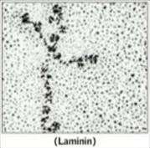
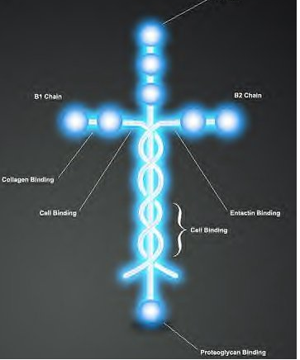
A. God deserves 1st place in our lives for:
1) What He’s done. Col 1:13-14 2) Who He is! Col. 1:15-16
3) What He Does! Col. 1:17 “He is before all things
(pro: above, superior)
and by him all things consist.
(synista’o: hold together)
Laminin proteins are essentially the “glue” that holds our cells together!

Slide 16
A. While God deserves our Devotion;
(“Heart”, Center, aka: 1st place)
He doesn’t “Demand” it, But:
B. God desires our devotion!
Col. 1:18 “that in all things he might have
the preeminence.”
Prōteuō: first in rank
and influence!.

Slide 17
B. God Desires our Devotion (1st Place).
Pr. 23:26 “My son, give me thine heart…”
John 4:23 “the true worshippers shall worship the Father in spirit and in truth:
for the Father seeketh (zete’o: desires)
Such to worship him.”
proskyne’o: reverence, adore

Slide 18
Conclusion:
God deserves and desires to be loved/worshipped:
Passionately: “With all thy heart… soul”
Thoughtfully: “With all thy mind”
Mt. 22:37

Slide 19
When it comes to our devotion & dedication:
1) Love and Reason are compelling cousins!
2 Cor 5:14-15 “For the love of Christ constrains us;
(Synech’ō: Holds together, compels, preoccupies.)
because we thus judge,
that if one died for all,
¹⁵ And that he died for all,
should not henceforth live unto themselves,
Krino: determine, conclude, reason!
then were all dead:
that they which live
but unto him which died for them,
and rose again.”

Slide 20
2) This realization should motivate our Devotion,
as well as our complete dedication.
Gal 2:20-21 “I am crucified with Christ:
nevertheless I live; yet not I, but Christ liveth in me:
and the life which I now live in the flesh
I live by the faith of the Son of God,
who loved me,
and gave himself for me!
21 I do not frustrate the grace of God:”

Slide 21
God wants to be loved (and loves us):
Passionately: “with all thy heart…soul”
and Thoughtfully: “with all thy mind”.
When we truly do so, our devotion and dedication become, not just a duty,
But our delight! Jn 5:3
“our reasonable service” (Ro. 12:1)
Logical expression of worship!

Slide 22
Consider God’s design for marriage:
1) Is it “reasonable” for a man/woman to expect complete devotion and dedication from their spouse?
Is it unreasonable for them to expect to be at the center (aka: 1st place)
In each other’s hearts and thoughts?
Isn’t this part of God’s design?
(1 Cor 7:33,34; Eph. 5:21-32; 1 Pt 3:1-7)

Slide 23
Consider God’s design for marriage:
2) What happens in the relationship when we allow other people/things to take priority over our spouses?
What is our natural human emotional response?
Where might this response come from?
Why do you think God speaks of himself as “Jealous”?
Ex. 20:5; 34:14; Dt. 4:24; 5:9; 6:15; Josh. 24:19; Ezek. 39:25; Joel 2:18; Nahum 1:2; Zech. 1:14; 8:2; 2 Cor. 11:2

Slide 24
3) How do we correct this “shift” or drift in our devotion/dedication?
In Rev. 1:13, Jesus is seen in the center of the churches.
Rev 2:4-5 “I have somewhat against thee,
because thou hast left thy first love.
Remember therefore from whence thou art fallen,
and repent, (metanoeo: reconsider, think differently)
and (re)do the first works;
Protos: Foremost (Most important) in time, place, order, or importance

Slide 25
Rev 2:4-5 “Remember from whence thou art fallen,
and repent, and (re)do the first works;
4) What will happen if we fail to prioritize this?
“or else I will come …remove thy candlestick out of his place, except thou repent.”
We’ll lose our light and love,
effecting our testimony and effectiveness.
See Mt. 5:13-16.

Slide 26
God doesn’t have your mind (attention))
unless you give (express) it to Him.

Slide 27
God’s at work in all things! Ro. 8:28,29
“Jesus draw me ever nearer;
As I labor through the storm. You have called me to this passage,
And I'll follow, though I'm worn.
May this journey bring a blessing,
May I rise on wings of faith;
And at the end of my heart's testing,
With Your likeness let me wake.”
Songwriters: Keith Getty / Margaret Ellen Becker

Slide 28
God’s at work in our storms! Ro. 8:28,29
“Jesus guide me through the tempest;
Keep my spirit staid and sure. When the midnight meets the morning,
Let me love You even more.
Let the treasures of the trial;
Form within me as I go –

Slide 29
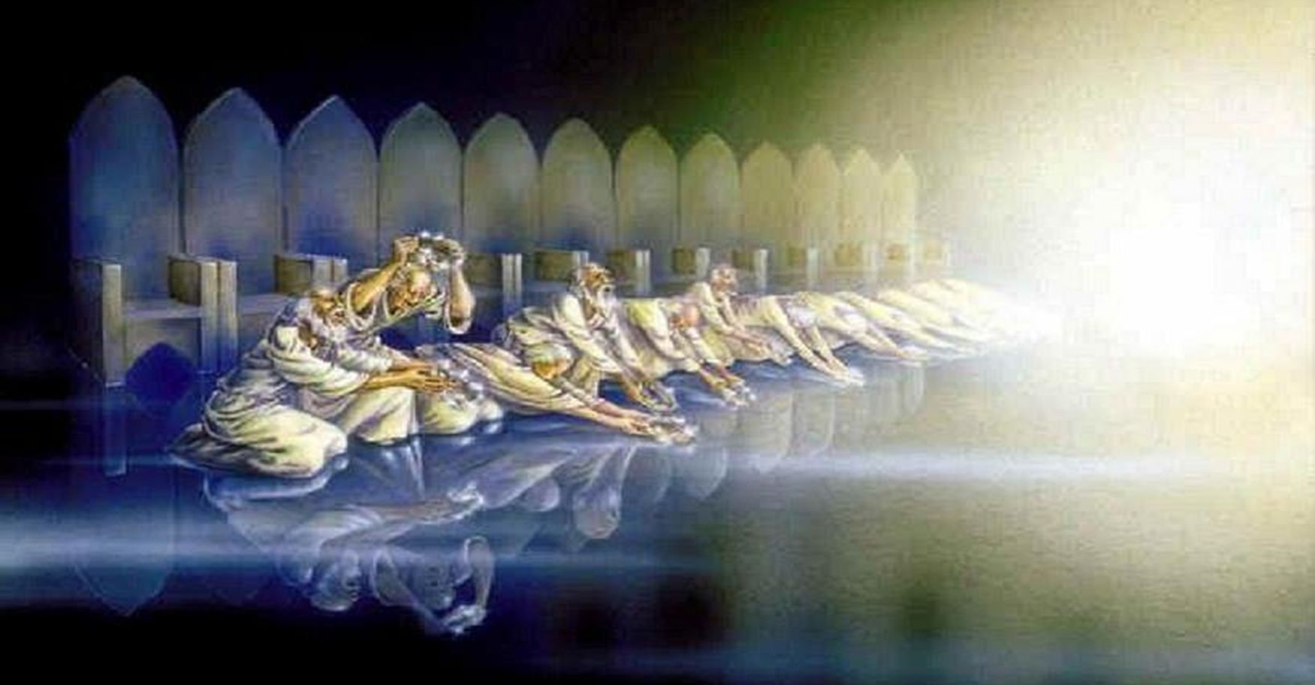
“And at the end of this long passage,
Let me leave them at Your throne.”

