Slide 1
Learning to take The Long Look
Part 2

Slide 2
By Examining the choices of Abel, Enoch, Noah, Abraham and Moses, we see that:
Their Focus affected their Faith.
(Jn 10:10a; Col. 3:2; Heb. 11:1)
Their Faith affected their Future
and Fulfilment!
(Jn 10:10b; Col. 3:3,4; Heb. 11:13-16)

Slide 3
What’s involved in the “Long Look?”
Beginning with an end in view!

Slide 4
Heb 11:13-16 “These all died in faith,
not having received the promises,
but having seen them afar off,
and were persuaded of them,
and embraced them,
and confessed that they were strangers
and pilgrims on the earth.
14 For they that say such things declare plainly that they seek a country.”

Slide 5
Heb 11:13-16
15 “And truly, if they had been mindful of that country from whence they came out,
they might have had opportunity to have returned.
16 But now they desire a better country,
that is, an heavenly:
wherefore God is not ashamed
to be called their God:
for he hath prepared for them a city.”

Slide 6
1. A Long Look Begins With A Promise
This is the basis of our Faith. Heb. 11:6
A. The Promise Must Be Perceived vs 13
“Having seen them afar off”
eido: to recognize, know, understand
2 Pt 1:4 "Whereby are given to us exceeding great and precious promises: that by these ye might be partakers of the divine nature, having escaped the corruption that is in the world through lust."

Slide 7
1. A Long Look Begins With A Promise
B. The Promise Must Be Believed vs 13
“and were persuaded of them.”
Peitho: (root word for faith) persuaded, convinced,
to rely on (Trust) Ro 4:20,21
“He staggered not at the promise of God through unbelief; but was strong in faith, giving glory to God;
being fully persuaded that, what he had promised,
he was able also to perform.”

Slide 8
B. The Promise Must Be Believed vs 13
“and were persuaded of them.”
Ro 8:38,39 “For I am persuaded, that neither death, nor life, nor angels, nor principalities, nor powers, nor things present, nor things to come,
Nor height, nor depth, nor any other creature,
shall be able to separate us from the love of God, which is in Christ Jesus our Lord.”

Slide 9
1. A Long Look Begins With A Promise
C. The Promise Must Be Received vs 13
“and embraced them.” aspaz’omai
from a: (union) and spao: (to draw together)
To enfold, welcome, embrace!
How do you know if you’ve “Embraced” the promises of God?

Slide 10
A Long Look Begins With A Promise
2. A Long Look requires Participation
A. True Faith requires, and is revealed by,
Obedient ACTION!
Heb. 11:1 “Faith is the substance of things hoped for,
the evidence (proof) of things not seen”
Jms 2:18 “I will shew thee my faith by my works.
…20 But wilt thou know, O vain man,
that faith without works is dead?”

Slide 11
A Long Look Begins With A Promise
2. A Long Look requires Participation
B. Faith Is Not Passive Indifference,
But Active Obedience.
1) Faith involves recognizing God’s will,
and obediently responding (cooperating)
with Him to accomplish it! (Phil. 2:13)
1 Cor 3:9 "we are laborers together with God: "

Slide 12
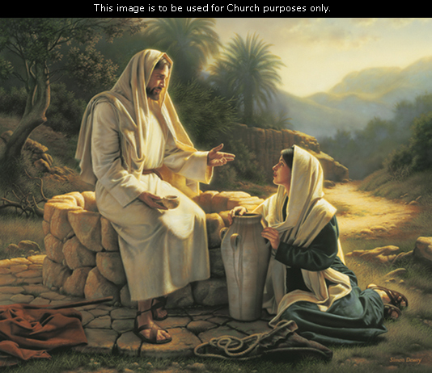
a) Jesus consistently modeled this.
1) After meeting with the woman at the well
of Samaria, he told his disciples that:
“My meat is to do the will of him that sent me,
and to finish his work.”
John 4:34

Slide 13
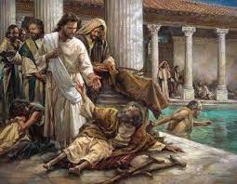
a) Jesus consistently modeled this. Jn 5
2) At the pool of Bethsesda, “lie a great multitude of
impotent folk…(vs 3)
Yet he healed: “a certain man was there, which had
an infirmity 38 years…” Vs 5
When asked why he did so:
“My Father worketh hitherto,
and I work.”
Vs 17

Slide 14
A Long Look Begins With A Promise
2. A Long Look requires Participation
3. The Long Look Involves A Pilgrimage vs 13
"They confessed that they were strangers (xenos)
and pilgrims on the earth“
Parepid’ēmos: resident foreigners
A. We Must Recognize Our Allegiance To
“a better (heavenly) country…” Vs 16
Phil. 3:15 “our conversation (citizenship) is in heaven…”

Slide 15
A. We Must Recognize Our Allegiance To Heaven.
Col 1:12-13 “the Father…hath made us meet to be partakers of the inheritance of the saints in light:
Who hath delivered us from the power of darkness,
and translated us into the kingdom of his dear Son::
1 Pt 2:9 “ye are a chosen generation, a royal priesthood, an holy nation, a peculiar people;
(Peripoiēsis: purchased and protected treasure)
that ye should shew forth the praises of him who hath called you out of darkness into his marvellous light:”

Slide 16
We must Resist The Entanglements Of This World.
(aka: “the snares of the devil.” 2 Tim. 2:26)
Heb. 11:14 "If they had been mindful of (focused on)
that country from whence they came out,
they might have had opportunity to have returned."
1 Peter 2:11 "I beseech you as strangers and pilgrims,
abstain from fleshly lusts
which war against the soul."

Slide 17
3. The Long Look Involves A Pilgrimage vs 13
B. We must Resist The Entanglements Of This World.
2 Tim 2:1, 3,4 “Be strong in grace…Endure hardness,
as a good soldier of Jesus Christ.
No man that warreth entangleth himself
with the affairs of this life;
that he may please him who hath chosen him…”
2 Cor 6:17 "Wherefore come out from among them,
and be ye separate, saith the Lord,…”

Slide 18
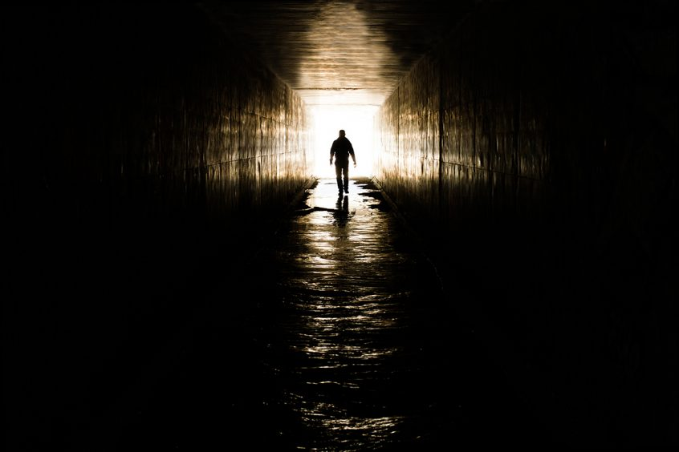
“ye were sometimes darkness,
but now
are ye
light in the Lord
Walk as children of light.
Proving what is acceptable unto the Lord. ”
And have no fellowship with the unfruitful works of darkness,
but rather reprove them.”
Eph. 5:8-11

Slide 19
The Long Look:
1. Begins With A Promise,
2. Requires Participation
3. Involves A Pilgrimage vs 13
4. Requires Patience!
Heb. 10:36 "For ye have need of patience,
(Hypomonē’: cheerful endurance)
that, after ye have done the will of God,
ye might receive the promise“

Slide 20
4. The Long Look Requires Patience!
A. Noah worked and waited 120 years for the flood.
B. Abraham Waited 100 Years For Isaac.
C. Isaac Waited 75 Years For Jacob
D. Moses Waited 120 Years To See The Promised Land.
E. David Waited 15 Years (after being anointed King)
To Sit On The Throne.
F. Paul Waited 3 Years To Preach. (Gal. 1:18)

Slide 21
James 1:2-4 “My brethren, count it all joy when ye fall into divers temptations;
Knowing this,
that the trying of your faith worketh patience
But let patience have her perfect work,
that ye may be perfect and entire,
wanting (lacking) nothing.

Slide 22
2 Corinthians 4:16-18
“For which cause we faint not; but though our outward man perish, yet the inward man is renewed day by day.
For our light affliction, which is but for a moment, worketh for us a far more exceeding
and eternal weight of glory;
While we look not at the things which are seen,
but at the things which are not seen:
for the things which are seen are temporal;
but the things which are not seen are eternal.”

Slide 23
Shifting our focus from the Temporary to the Eternal involves:
Grasping (Embracing) the Promises of God.
Are you Recognizing and Responding to them?
(Sword/Shield of Eph. 6:16,17; 2 Peter 1:4)
2) Acting on the Directions of God. (Mt 7:24-27)
Is there something God has asked of you
that you’re currently ignoring?
(Luke 6:46)
(Disobeying!)

Slide 24
Shifting our focus from the Temporary to the Eternal involves:
3) Being Loyal to the Kingdom of God.
Does Christ have your complete allegiance?
(Luke 9:26; Phil. 3:18-20)
4) Being Patient with the Will of God.
Have you grown “weary with well doing”?
(Mal. 3:14; Lk 9:62; Jn 6:67; 1 Cor. 15:58; Gal. 6:9; Heb. 10:36-38)

Slide 25
What “End” do you have “in view”?
“I press toward the mark for the prize of the high calling of God”
Phil. 3:15

Slide 26
There once was an oyster whose story I tell,
Who found that sand had got under his shell,
Just one little grain, but it gave him much pain,
For oysters have feelings although they're so plain.
Now, did he berate the working of Fate,
Which had led him to such a deplorable state?
Did he curse out the government, call for an election? No; as he lay on the shelf he said to himself
"If I cannot remove it,
I'll try to improve it."

Slide 27
So the years rolled by as the years always do,
And he came to his ultimate destiny--stew.
And this small grain of sand which had bothered him so,
Was a beautiful pearl, all richly aglow.
Now this tale has a moral--for isn't it grand
What an oyster can do with a morsel of sand;
What couldn't we do, if we'd only begin
With all of the things that get under our skin.

Slide 28
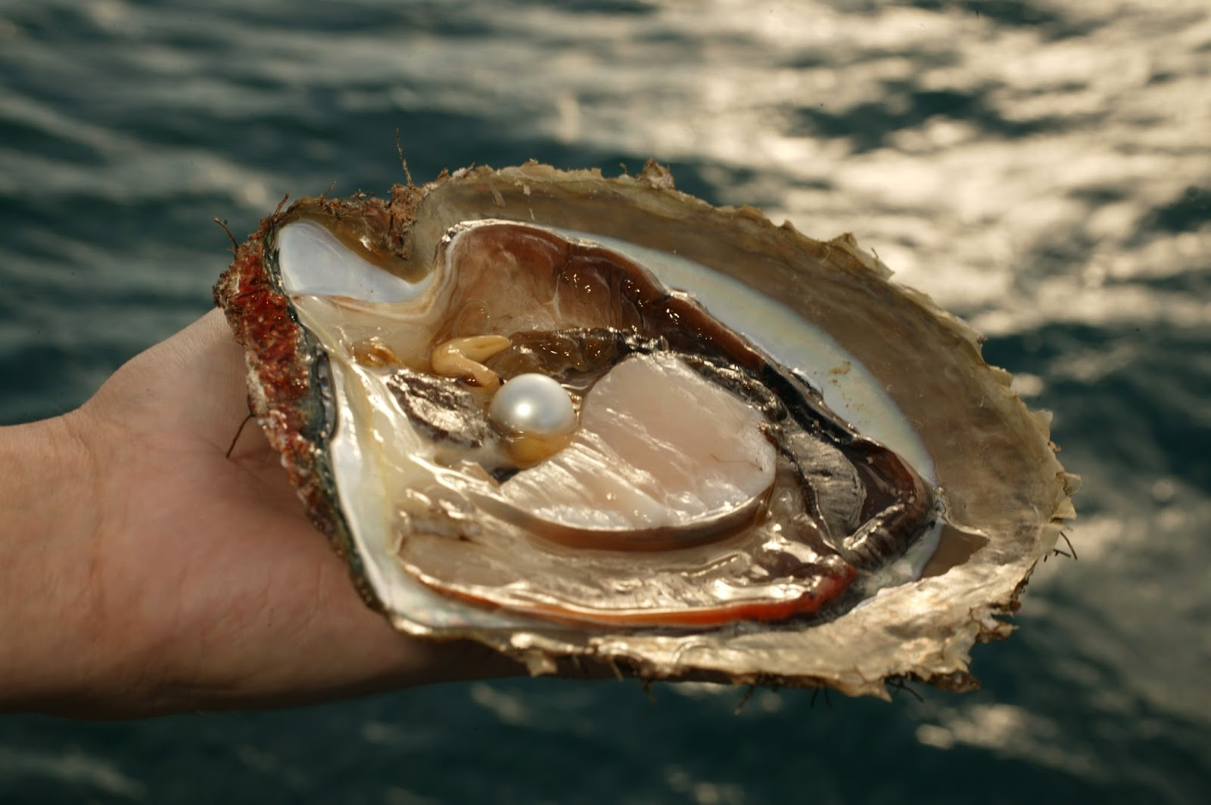
Malachi 3:17,18

