Slide 1
The world pressures us to conform.
2 Cor 4:4 “the god of this world hath blinded
(typhlo’o: obscured) the minds…”

Slide 2
God challenges us to Transform (change)!
Ro. 12:2 “Be not conformed to this world
but be transformed (metamorphoō)
by the renewing (anakainōsis: renovation)
of your mind.” (nous: understanding)
Any truly substantial change is hard!
It requires embracing biblical principles and building solid habits (based on those principles) into our lives that will produce positive / productive change.

Slide 3
I am your constant companion,
I am your greatest helper or your heaviest burden.
I will push you forward or drag you down to failure.
I am at your command.
Half of the tasks that you do you might just as well turn them over to me,
I will do them quickly and correctly.
I am easily managed, if you’ll just be firm with me.
Show me exactly how you want something done;
and after a few lessons I will do it automatically.

Slide 4
I am the servant of all great people
and the master of all the failures as well.
Those who are great I have made great,
those who are failures, I have made failures.
I am not a machine, but I work with all the precision of a machine, plus the intelligence of a person.
Now you may run me for profit or you may run me for ruin. It makes no difference to me.
Take me, train me, be firm with me,
and I will lay the world at your feet.
Be easy with me and I will destroy you. Who am I?
My name is HABIT!

Slide 5
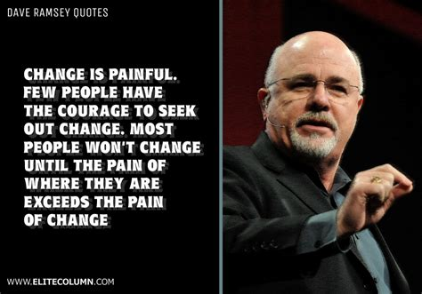
Dave Ramsey: “Change is Painful!
Few have the courage to seek out change.”
“Most won’t change until the pain of where they are exceeds the pain of changing.”
Dave has built an international business by creatively helping people incorporate basic and biblical financial principles such as Pr. 22:7

Slide 6
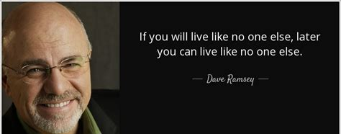
Pr. 22:7 “The rich ruleth over the poor,
and the borrower is servant to the lender.”
In order to “reverse the curse” he observes that:
“If you’re willing to live like no one else now;
(Sacrificially)
You can eventually be able to live like no one else.
(Peacefully, Securely)

Slide 7
Principles for Powerful Living

Slide 8
The Passion Principle! Col. 3:16-25
The Scope of our Passion.“whatsoever ye do” 17 Hostis (any) & pas (all):
The Strength Of Our Passion. “ do it heartily” 23 (ek psyche: from the soul)
The Secret of our Passion. “as unto the Lord” 23 (kurios: supreme authority)
The Source Of Our Passion.
“The Lord Jesus” 24

Slide 9
The Principle of the “Open Hand”
Moses experienced enough disappointment in himself, his people, his circumstances, and (from his perspective) even his God to last a life time.
He went from the palace, to his people, to a problem,
to a pauper on the backside of the desert.
At the age of 80 he was probably past the point of any hope (or even desire) for significant change.

Slide 10
While minding his business God confronts him with a major challenge in Ex. 3 and 4. Notice:
Our choices lead to other choices:
Moses Chose to investigate the burning bush. 3:3
God Revealed Himself and His will to Moses. 3:4-8
God revealed Moses’ place in His will. (Vs 9-10)
That’s when the excuses and conflict started!
Moses Began to make excuses, blaming Israel (4:1)
…Himself (3:11; 4:10)
“who made man’s mouth…have not I the LORD?”
and indirectly, even God! v11

Slide 11
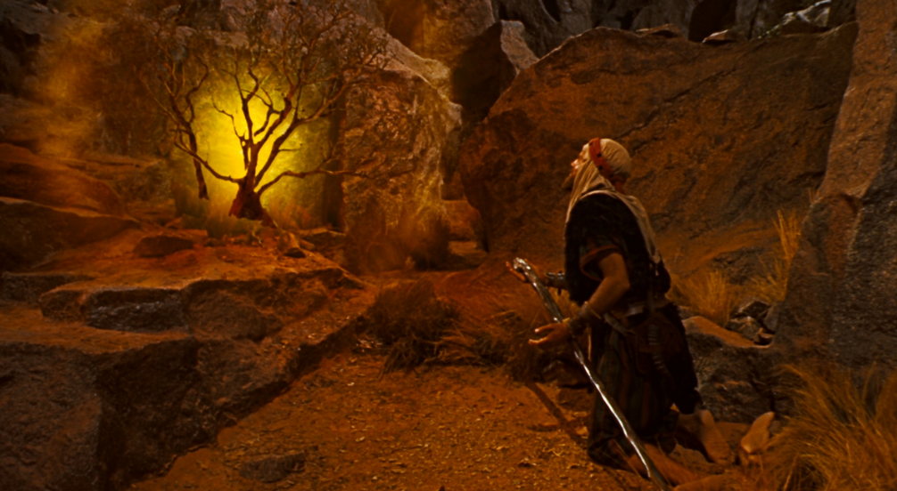
Finally, God asked Moses:
“What is that in thine hand?” (Ex. 4:2)

Slide 12
God used the principle of the “Open Hand” to encourage a reluctant Moses to get going again.
Many Approach God With A Closed Hand.
Due to the distrust and proliferation of knives/swords, Ancient duelists would greet another with an open hand as a signal of peaceful intentions.
This became the “birth” of the “handshake”.
https://www.history.com/news/what-is-the-origin-of-the-handshake

Slide 13
1) A closed hand indicates:
a) There’s something in our grasp
that we don’t want to let go of!
b) That we know better than God.
(We must protect what we grasp.)
c) What we’re Clinging to means more to us
than God’s will! Luke 22:42
“Nevertheless, not my will, but thine be done”
(see also Jn 5:40; Jn 10:10; 27,28)
(A Possession, plan, person, or position.)

Slide 14
Jer. 29:11 “I know the thoughts that I think toward you,
(maḥashābâ’: intentions, plans, purposes)
saith the LORD, thoughts of peace,
(shālôm’: safety, prosperity)
and not of evil, to give you an expected end.”
(tiqwâ: hope, expectation from qāwâ: bind together)
Is. 40:31 “wait upon (qāwâ) the Lord…”
“End” (ʾaḥarît’: posterity, {from ʾaḥar: afterwards})
The trouble is that we have our own “expected end”.
We’re bound to our own plans (or those of others)
We’re not considering “afterwards”. (Mt 6:19-24)

Slide 15
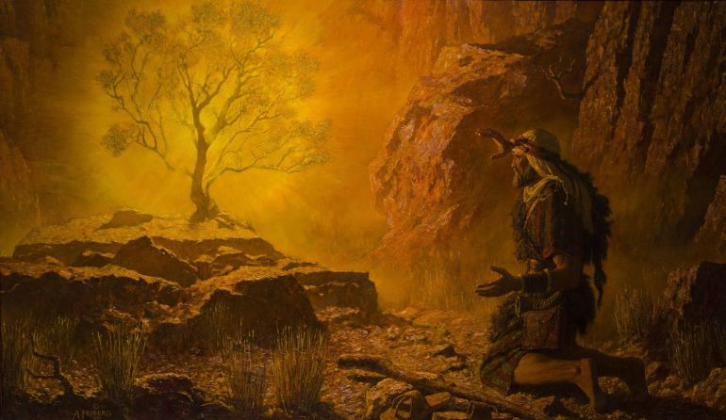
2. God Will Often Ask Us To Surrender What We’re Clinging To (to Him).
A. Moses. “What is that in thine hand?” (4:2)
“cast it on the ground” Ex. 4:3
Aka: “Give it to me!”

Slide 16
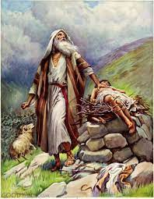
B. Abraham. “Release your grip” on Isaac.
2 “Take now …thine only son Isaac, whom thou lovest, and get thee into the land of Moriah;
Genesis 22
and offer him there
for a burnt offering…”
¹² ”Lay not thine hand upon the lad, neither do thou any thing unto him:
for now I know that thou fearest God,
seeing thou hast not withheld thy son, thine only son from me.”

Slide 17
C. Paul (Ph. 3:7-10) “what things were gain to me,
those I counted loss for Christ.
Yea doubtless, and I count all things but loss for the excellency of the knowledge of Christ Jesus my Lord: for whom I have suffered the loss of all things,
and do count them but dung,
that I may win (kerdai’nō: gain) Christ, and
be found in him, not having my own righteousness… of the law, but that which is through the faith of Christ, the righteousness which is of God by faith:
That I may know him, and the power of His …”

Slide 18
D. Jesus. (Ph. 2:5-8) “Let this mind (phroneo: disposition)
be in you, which was also in Christ Jesus:
6 Who, being in the form of God,
thought it not robbery to be equal with God:
7 But Made himself of no reputation
keno’o: from kenos: to make empty
And took upon him the form of a servant,
8 and humbled himself…even unto death”
This is known as the kenosis of Jesus
(literally the act of emptying himself) Mt 26:29

Slide 19
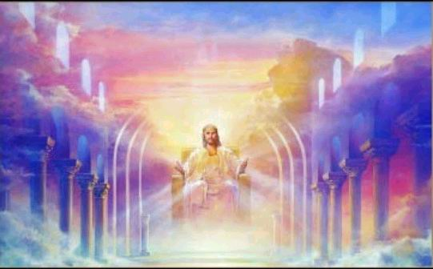
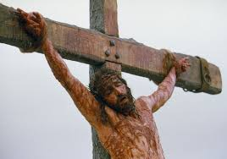
2 Cor 8:9 “For ye know the grace of our Lord Jesus Christ, that, though he was rich,
yet for your sakes he became poor,
that ye through his poverty might be rich.”

Slide 20
3. An Open Hand Indicates an attitude of:
A. SURRENDER (A Willingness to trust)
1) When Jesus revealed his submission to God’s plan
for redemption in Mt. 16:21:
22 “Then Peter took him, and began to rebuke him, saying, Be it far from thee, Lord: this shall not be unto thee.
23 But he turned, and said unto Peter,
Get thee behind me, Satan: thou art an offence unto me:
for thou savourest (phroneo) not the things that be of God,
but those that be of men.”

Slide 21
3. An Open Hand Indicates an attitude of:
A. SURRENDER (A Willingness to trust)
Mt 16:24-26 “Then (vs 23) said Jesus unto his disciples,
If any man will come after me, let him deny himself, and take up his cross, and follow me.
For whosoever will save his life shall lose it:
and whosoever will lose his life for my sake shall find it.
25 For what is a man profited, if he shall gain the whole world, and lose his own soul?
or what shall a man give in exchange for his soul? “

Slide 22
An Open Hand Indicates an attitude of:
B. RECEPTIVITY. (A willingness to receive.)
Ps. 145:15,16. “The eyes of all wait upon thee;
and thou givest them their meat in due season.
Thou openest thine hand,
and satisfiest the desire of every living thing.”
Lk 12:31-32 “seek ye the kingdom of God;
and all these things shall be added unto you.
Fear not, little flock; for it is your Father's good pleasure to give you the kingdom.

Slide 23
B. RECEPTIVITY. (A willingness to receive.)
Ps 81:10-12 “I am the LORD thy God,
…open thy mouth wide,
11 But my people would not hearken to my voice;
and Israel would none of me.
12 So I gave them up unto their own hearts' lust:
and they walked in their own counsels.”
and I will fill it!

Slide 24
B. RECEPTIVITY. (A willingness to receive.)
Ps 106:13-15 “They soon forgat his works;
they waited not for his counsel: ¹⁴ But lusted exceedingly in the wilderness,
and tempted God in the desert. ¹⁵ And he gave them their request;
but sent leanness into their soul.”

Slide 25
3. An Open Hand Indicates an attitude of:
A. Surrender B. Receptivity
C. COOPERATION. (A willingness to participate)
1Cor 3:9 “For we are laborers together with God...”
Mt 11:28-30 “Come unto me, all ye that labor and are heavy laden, and I will give you rest.
Take my yoke (zygos’: a coupling, servitude) upon you,
and learn of me; for I am meek and lowly in heart:
and ye shall find rest unto your souls.”
(anap’ausis: recreation! Refreshment)

Slide 26
3. An Open Hand Indicates an attitude of:
C. COOPERATION.(A willingness to participate/partner)
Mt 11:30 “For my yoke is easy,
(chrestos: usefully employed)
(From chraomai: to furnish what’s needed!)
and my burden (phorti’on: task, service)
is light” (elaphros’: small, easy)
Ro. 12:1 “your reasonable service”

Slide 27
D. GENEROUSITY. (A Willingness to Share)
2 Cor. 9:6-7 “He which sows sparingly shall reap also sparingly; and he which sows bountifully
shall also reap bountifully.
(epi {superimposed} eulogia: {blessing, largess})
Every man according as he purposeth in his heart,
so let him give; not grudgingly, or of necessity:
for God loveth a cheerful (hilaros’: willing) giver.

Slide 28
D. GENEROUSITY. (A Willingness to Share) 2 Cor. 9:8
“And God is able to make all grace abound toward you; that ye, always having all sufficiency in all things,
may abound to every good (agathos) work:”
1 Tim 6:17-19 “Charge them …, that they be not highminded, nor trust in uncertain riches, but in the living God, who giveth us richly all things to enjoy;
18 That they do good, that they be rich in good works, ready to distribute, willing to communicate; (koinōnikos’)
19 Laying up in store for themselves a good foundation against the time to come…”

Slide 29
One by one He took them from me;
All the things I valued most;
Until I was empty-handed,
Every glittering toy was lost.
And I walked earth's highways, grieving,
In my rags and poverty.
Until I heard His voice inviting,
"Lift those empty hands to Me!"

Slide 30
Then I turned my hands toward heaven,
And He filled them with a store
Of His own transcendent riches,
'Till they could contain no more.
And at last I comprehended;
With my stupid mind, and dull,
That God cannot pour His riches
Into hands already full!

Slide 31
Moses was full of excuses in Ex. 3,4;
but when he finally opened his hand to God,
his heart began to open again.
God didn’t ask Moses to give Him anything that he didn’t have!
Since Moses was willing to “open his hand”,
and give God what he had,
God transformed it and it became known as “The Rod of God.” (Ex. 4:21, 17:9)

Slide 32
Dorcus had a needle; David had a sling.
Samson had a jawbone; Aseph, he could sing.
The boy had loaves and fishes; Mary had perfume,
Someone shared his donkey; Others used the loom.
A woman built the chamber; Prophets used to rest.
The Magi gave their riches; starting on their quest.
Joseph gave reputation; Mary, a virgin womb,
Abraham had his only son; Joseph had a tomb.
Gideon had a pitcher; Moses had a rod.
Each were freely given; so each were used of God.
What’s in your hand?

Slide 33
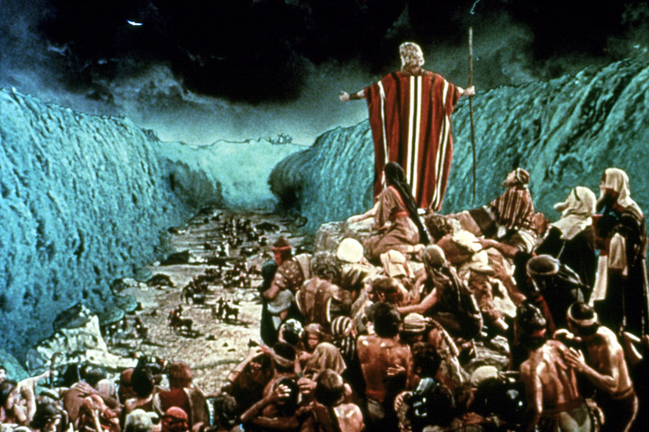
Are you willing to give it to God?
He’ll sanctify it and use it for His Glory.
Ex 4:17 “thou shalt take this rod in thine hand,
wherewith thou
shalt do signs.”
(ʾôt: evidence)

