Slide 1
Principles for Powerful Living

Slide 2
The Bible reveals Spiritual principles to help guide us to God and His plans.
Passion (Open Heart) Principle. (Col. 3:16-24)
Purpose (Open Hand) Principle. (Ex. 3,4)
Path (Open Door) Principle. (Rev. 3:7-13)
Preparation (Soil/Seed) Principle. (Mt 13:3-30)
The Cultivation Principle. (Mt 13; 1Cor 3:9)

Slide 3
The Parable of Mt 13 reminds us that
In order for the soil to become productive, it must be Cultivated!
The fruitfulness of a farm, family, friendship and even our Faith will be in direct proportion to the amount of care and cultivation they receive.

Slide 4
Cultivation involves:
Preparing: Soil (and souls) for growth. Hos. 10:12
Protecting: Foster/improve growth by labor, care
or study. “Nourish and Cherish” Eph. 5:29; 1 Pt 3:7
Partnering: Seek the society of or make friends with.
This involves “Cultivating” Relationships”
(Gen. 2:18; Pr 18:24)

Slide 5
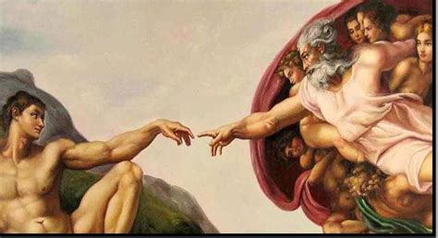
Last week we discussed the reality that:
“we are laborers together with God.” (1 Cor 3:9)
in the cultivation of the “soil of our souls”.
The partnership involves two way relationships:

Slide 6
God partners with us! 1 Cor 3:9
“We are Laborers together with God”
God’s Part | Our Part
Reveal (roots, rocks, weeds, sin) 1 Jn 1:5,6; Ps. 139:23-24 | Respond (Recognize, Repent, Realign, Relinquish) Mt 16:24-26; Lk 14:33-35
Convict (Reprove) Jn 16:8 | Cooperate: (Repent) 1 Jn 1:9

Slide 7
God’s Part | Our Part
Direct (Guide) Ps 32:8; Pr 3:5,6 | Decide to follow (Go and Grow!) Josh 24:15; Pr 3:5-6
Lead Ps. 5:8; Ps. 23 Nāḥâ’: to guide and govern! | Follow (Ps 23); Feed (Heb 5:12-14); and Weed. (Heb 12:1,2; 2 Tim 2)
Keep/ Protect, (Jn 17:12; Jude 24) | Cultivate (Jer. 4:3) and Pursue (Phil. 3:14)

Slide 8
God Partners with others in Ministry!
Direct (personal) partnership. 1 Cor 3:9; Phil. 2:13
Indirect (Practical) partnership “laborers together”
God works through others! 1 Cor 3:9; Heb 13:7,17
Heb 3:12-13 “Take heed, brethren, lest there be in any of you an evil heart …, in departing from the living God.
But exhort one another daily, …lest any of you be hardened through the deceitfulness of sin.”
Heb. 10:23-25 “let us consider one another to provoke
to love and good works”

Slide 9
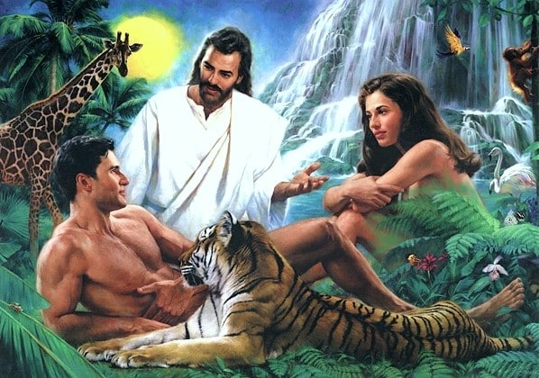
Partners in Marriage!
1. God’s Design
A. God created us with the need for “help”
Gen 2:18 “It is not good that the man should be alone;
I will make him an help meet for him.”
²² And the rib, which the LORD God had taken from man,
made he a woman, and
brought her unto the man.”
Ro 14:7 “no man lives to himself”

Slide 10
1. God’s Design
A. God created us with the need for “help”
B. In order to help, she had to be similar,
yet different. “an help meet (ʿēzer) for him.”
(Fromʿāzar’: meaning to surround, protect, aid
A variant! “manifesting variety, deviation,
disagreement.”
(Vive la difference!)
b) We appreciate the “variety”
but are vexed by the deviation & disagreement.

Slide 11
B. In order to help, she had to be similar,
yet different. “an help meet (ʿēzer) for him.”
1) A variant! “variety, deviation, disagreement”
2) God created her to both “Complete”
and occasionally “Compete”.
(Example: left brain vs
right brain perspective)

Slide 12
Partners in Marriage!
2. Satan’s Desire
A. Satan sought (and seeks) to divide this
partnership. Gen. 3:1-6;
1) This is his nature! Jn 8:44; Jn 10:10
“The thief comes not but for to steal, kill,
and destroy” (apollymi: to mar, destroy)
(See Mt 10:13 and Rev. 9:11)

Slide 13
2. Satan’s desire
B. Notice how he did (does) this. Gen. 3:1-6
1) Through Separation. (Makes it easier for him)
Remember “help meet” means to protect, aid
b) Where was Adam during this conversation?
c) Separation gives him room to work.
Eph. 4:26,27 “Be angry and sin not:
Let not the sun go down on your wrath,
neither give place to the devil.”
topos: room, location, opportunity

Slide 14
2. Satan’s desire
B. Notice how he did (does) this. Gen. 3:1-6
2) Through Deception vs 1 “more cunning…”
a) Questions God’s Words 1 “hath God said...?”
b) Questions God’s Motives. 5 “God knows
…your eyes shall be open and ye shall be as gods”
1 Tim 2:14 “Adam was not deceived,
but the woman being deceived
was in the transgression.”

Slide 15
B. Notice how he did (does) this. Gen. 3:1-6
Through Separation and Deception
3) Through Seduction. 1 Jn 2:15 “all that’s in the world:
a) “the Lust of the flesh”: “good for food” vs 6
b) “Lust of the eyes”: “pleasant to the eyes” vs 6
c) “Pride of life”: “desired to make one wise” vs 6
“Then she took the fruit and did eat,
and gave to her husband…”

Slide 16
1) Separation 2) Deception 3) Seduction
4) Through Rebellion (Sin) (This makes it
natural for us!) 1 Sam. 15:23; Ro. 6:16; Jms 1:13-16
15 “when lust hath conceived it bringeth forth sin,
And sin, when it is finished, bringeth forth death!
16 Do not err (planao: roam, drift) my beloved…”
a) Eve’s “mind” drifted from God. (Deceived)
b) Adam’s “heart” drifted from God. (Seduced)
(Ro. 5:12)

Slide 17
C. Notice the Immediate consequences of sin
affected key relationships.
1) With God: Hiding (separating) from God. 3:8
2) With each other: Blaming each other(s). 3:12
Failure to accept personal responsibility!
“the woman whom thou gavest…”
13 “…the serpent beguiled me”

Slide 18
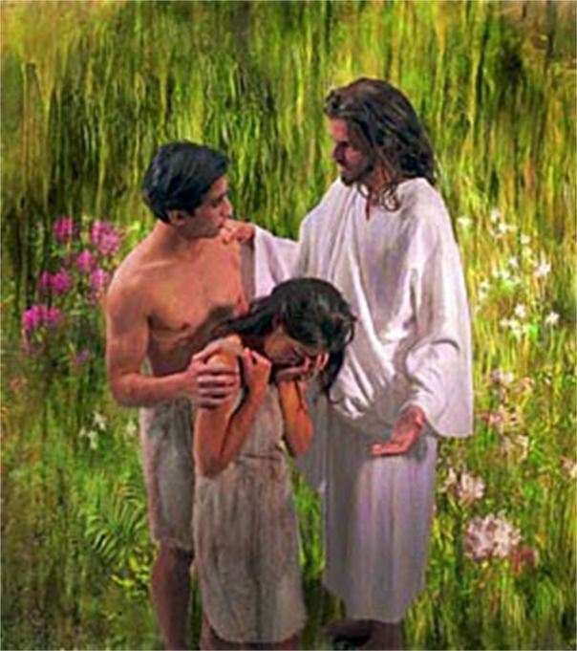
D. Notice the long term consequences of their choices.
1) The nature of Eve’s consequence (curse). 3:16
“I will greatly multiply thy sorrow and thy conception; in sorrow thou shalt bring forth children;
…thy desire (Teshûqâ’) shall be to thy husband,
from shûq: to run, reach after
and he shall rule over thee.”
or over!)
(māshal’: govern)

Slide 19
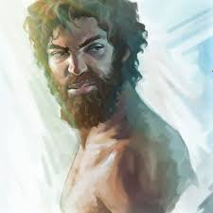
a) This exact phrase is repeated in Gen. 4 to Cain
Gen 4:6,7 “the LORD said unto Cain, Why art thou wroth? and why is thy countenance fallen?
If thou doest well, shalt thou not be accepted?
and if thou doest not well, sin lieth at the door.
And unto thee shall be his desire,
(Teshûqâ)
and thou shalt rule (māshal’)
over him.” (Sin and/or Satan)

Slide 20
2) The nature of Adam’s consequence (curse).17-19
“Because thou hast hearkened unto the voice of thy wife, and hast eaten of the tree, cursed is the ground for thy sake; in sorrow shalt thou eat of it all the days of thy life;
18 Thorns also and thistles shall it bring forth to thee;
19 In the sweat of thy face shalt thou eat bread, till thou return unto the ground…”

Slide 21
3) Notice that the specific consequences (curses) of their sin effected that that which God intended
and designed to bring fulfilment:
For the woman:
For the Man:
Satisfaction and success at “work”
In the pursuit of providing for his family.
Harmony and Satisfaction in Family relationships.
Became contaminated with
tension and frustration!

Slide 22
3. God’s greater than Satan’s plans or our problems.
Ro 8:28 “All things work together for good…”
Gen. 50:20 “You thought evil…, God meant it unto good”
A. This tension is inevitable
1) We’re all inherently/occasionally selfish. Ro 3,6,7
2) Paul acknowledges this pressure in 1 Cor 7:28
reminding us that marriage will produce:
“trouble (thlipsis: pressure) in the flesh”
and commands the married couple to focus on each
other’s pleasure instead of their own. (Vs 33-34)

Slide 23
B. This tension is intentional!
1) Marriage is the best platform for growth B/C:
a) It exposes our own natural (carnal) selfishness.
b) This requires Growth and Grace to overcome.
(Jms 4:5-8) “The spirit that dwelleth in us lusteth to envy?
6 But he giveth more grace. Wherefore he saith,
God resists the proud,
7 Submit yourselves therefore to God.
Resist the devil, and he will flee from you.
8 Draw nigh to God, and he will draw nigh to you. “
but gives grace unto the humble.

Slide 24
C. This tension is navigable!
1) God’s solution is to let him “mashal” (govern)
each of us.
Eph. 5:18-33 vs 21 “submitting yourselves one to another
(hupotasso: subordinate, line up in order)
in the fear (phobos) of God.”
a) 22 “wives, submit to your husbands as unto the Lord…
b) 25 “husbands, love…as Christ loves the church…”
1 Pt 3:1-7 “dwell…according to knowledge, giving honor
…as being heirs together of the grace of life…”

Slide 25
Gen. 2:15 “the LORD God took the man, and put him into the garden of Eden to dress it (ʿābad: cultivate)
and to keep it.” (shamar: protect)
God gave him Eve to do the same with (and to) Adam!
Satan came (comes) to frustrate God’s design cultivating:
Separation, Deception, Seduction
And ultimately Rebellion in order to drive us from God and each other
Filling our “paradise” with weeds of selfishness, worldliness, and worry.

Slide 26
God asks us to partner with him (and others)
to restore His designs (Eden) in our relationships.
(Jer 29:11; 1 Cor 3:9; Phil 2:13; Jn 10:10; Is 62:3-4
“Thou shalt also be a crown of glory in the hand of the LORD, and a royal diadem in the hand of thy God.
Thou shalt no more be termed Forsaken;
neither shall thy land any more be termed Desolate:
but thou shalt be called Hephzibah, and thy land Beulah:
for the LORD delighteth in thee,
and thy land shall be married.”

Slide 27
1 Cor 3:9 “We are laborers together with God…”
The next several verses remind us that what we grow and/or build out of our lives will be tested. Vs 10-13
Fruitfulness / usefulness will be rewarded. (vs 14)
“he (she) shall receive a reward” (misthos: payment)
Selfishness, shallowness will cost us in the end. (vs 15) “he shall suffer loss” (zēmio’ō: detriment)
What we produce reflects on God! 1 Cor 3:16 “Know ye not that ye are the temple of God, and that the Spirit of God dwelleth in you?”

Slide 28
1 Cor. 3:9 “we are laborers together with God…”
Will you purpose to Partner with Him,
as well as those He seeks to use,
to cultivate (prepare) you for the life (and eternity) that Jesus designed and desires for you?
Jn 10:10 “The thief comes…to steal, kill, destroy.
I am come that they might have life,
And that they might have it
more abundantly!”

Slide 29
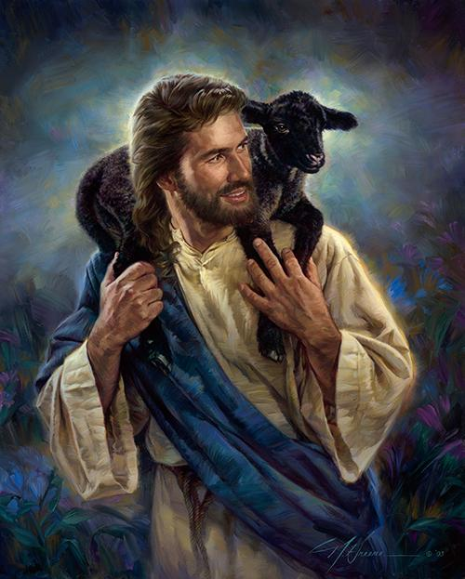
John 10:27
“My sheep hear my voice
And I know them,
and they follow me.”

