Slide 2
The Passion Principle!
Col. 3:16 “Let the word of Christ dwell in you richly in all wisdom teaching and admonishing one another…with Grace in your hearts.
17 …And whatsoever ye do in word or deed,
do all in the name of the Lord Jesus,
giving thanks to God and the Father by him…
23 And whatsoever ye do, do it heartily,
as to the Lord, and not unto men;
24 Knowing that of the Lord ye shall receive
the reward of the inheritance:
for ye serve the Lord Christ.” ”

Slide 3
1. The Scope of our Passion. 17-22
17 “Whatsoever ye do”
Compound word from Hostis (any) & pas (all):
Relationships (vs 18-22)
Words (Vs 19)
Works (Choices/Actions) (Vs 19)

Slide 4
2. The Strength Of Our Passion. Vs 23
“do it heartily …”
from: ek (the source or origin)
and psyche: the soul (mind, will, and emotions.)
Eccl 9:10 “Whatsoever thy hand findeth to do,
do it with thy might…”
(kō’aḥ: vigor, force, capacity)

Slide 5
3. The Secret Of Our Passion
17 “Do all in the name
(onoma: character, authority)
of the Lord Jesus”
23 “do it as unto the Lord
and not unto men”

Slide 6
“as unto the Lord”
A. We Do What We Do For Jesus. This Means:
1) When we serve others, we’re serving Jesus.
Mt 18:5 “whoso shall receive (dech’omai: accept)
one such little child in my name receiveth me.”
Mt 25:40 “Inasmuch as ye have done it unto
one of the least of these my brethren,
ye have done it unto me.”

Slide 7
3. The Secret Of Our Passion
A. We Do What We Do For Jesus. This Means:
2) No act or motive is missed. Col. 3:22
“not with eyeservice, as menpleasers;
(from ophthalmos’: eye, sight and doulei’a: a slave)
Has the idea of having to be guarded!
but in singleness of heart, fearing God:
Haplot’ēs: sincere generosity

Slide 8
A. We Do What We Do For Jesus. This Means:
3) Our rewards have an eternal dimension.
Vs 24 “knowing that of the Lord
(kurios: supreme authority)
ye shall receive the reward
(antapod’osis: requital)
of the inheritance:”
(klēronomi’a: patrimony, possession)
(see Mt 6:19-24)

Slide 9
3) Our rewards have an eternal dimension.
Ro 8:16-18 “The Spirit itself bears witness with our spirit, that we are the children of God:
And if children, then heirs; heirs of God,
and joint-heirs with Christ;
if so be that we suffer with him,
that we may be also glorified together.
For I reckon that the sufferings of this present time
are not worthy to be compared
with the glory which shall be revealed in us.”

Slide 10
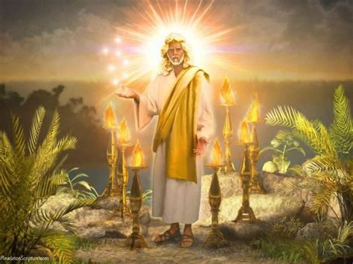
Rev 22:12-13 “behold, I come quickly; (Tachu’: suddenly)
and my reward is with me,
(Misthos: pay for service)
to give every man according
as his work shall be.”
Eph 4:1 “I therefore the prisoner of the Lord,
beseech you that ye walk worthy (axios: deserving)
of the vocation (klesis: invitation, selection) wherewith ye are called”

Slide 11
B. Our service is compelling,
Vs 24 “For ye serve the Lord Christ.”
(douleuō: (v) slave, involuntary or voluntary)
Understanding Biblical/Historical Slavery.
In Roman culture 1/3 of the population were “slaves”
and another 1/3rd had once been slaves.
Acts 22:27,28 “art thou a Roman? And Paul said yea.
the chief captain answered,
With a great sum obtained I this freedom.
And Paul said, But I was free born.”
but not compulsory.

Slide 12
B. Our service is compelling,
Understanding Biblical/History Slavery.
1) Involuntary Slavery involves being conquered /
captured and sold into slavery. (or born into it)
a) All of humanity are born under sin’s “bondage”
Ro. 3:10;23; 5:12; 6:23; 8:21-22 “the creature itself also shall be delivered from the bondage of corruption
into the glorious liberty of the children of God.
22 For we know that the whole creation groaneth and travaileth in pain together until now.”
but not compulsory.

Slide 13
b) Our actions demonstrate and reinforce this bondage. John 8:34 “Verily, verily, I say unto you, Whosoever committeth sin is the servant of sin…” (Ro 3:10;23)
c) We must be redeemed to be free!
We can never work off our debt,
so Jesus paid it for us! (Ro. 6:23)
Jn 8:36 “If the Son therefore shall make you free,
ye shall be free indeed.”
Mark 10:45 “the Son of man came … to give his life a
ransom for many.” (Lk 19:10; 2 Cor 5:21; 1 Peter 1:19)

Slide 14
c) We must be redeemed to be free! Gal 4:3-7
“Even so we, …were in bondage under the elements (stoichei’on: principles) of the world:
4 But when the fulness of the time was come, God sent forth his Son, made of a woman, made under the law,
5 To redeem them that were under the law,
that we might receive the adoption of sons.
6 And because ye are sons, God hath sent forth the Spirit of his Son into your hearts, crying, Abba, Father.
7 Wherefore thou art no more a servant, but a son;
and if a son, then an heir of God through Christ.”

Slide 15
2) Voluntary slavery involves indentured service.
(Selling ourselves/ labor in exchange for something.)
Our current job system is a reflection of this.
Ex. 21 provides for indentured service for 6 years.
Borrowing places us in a type of indentured service.
Pr 22:7 “The rich ruleth over the poor,
and the borrower is servant to the lender.”
The Pilgrims became “servants” of the merchant “adventurers” who funded the trip in exchange for their labor for supplies of furs, wood, etc.

Slide 16
2) Voluntary slavery involves “indentured service”
(Selling ourselves in exchange for something.)
a) Our choices (even after being redeemed)
can shackle and enslave us! Pr. 5:22,23
“His own iniquities shall take the wicked himself,
and he shall be holden with the cords of his sins.
He shall die without instruction;
and in the greatness of his folly he shall go astray.”
Pr. 23:26-28 “My son, give me thine heart & let thine eyes observe my ways. For a whore is a deep ditch…
she increases the transgressors”

Slide 17
Pr. 23:29-35 Who hath woe? …sorrow? …contentions…babbling? … wounds without cause? who hath redness of eyes?
30 They that tarry long at wine; that go to seek mixed wine.
At the last it bites like a serpent, and stings like an adder.
31 Look not thou upon the wine when it is red, when it giveth
his color in the cup, when it moveth itself aright. (fermented)
33 Thine eyes shall see strange women
and thine heart shall utter perverse things….
35 They have stricken me, shalt thou say, and I was not sick; they have beaten me, and I felt it not:
when shall I awake?
I will seek it yet again.”

Slide 18
a) Our choices (even after being redeemed)
can shackle and enslave us!
Ro 6:16 “Know ye not, that to whom ye yield yourselves Paris’tēmi: stand beside/with
(from para: with and histemi: to stand)
servants (doulos) to obey, (hypakoē’: comply or submit)
his servants ye are to whom ye obey;
whether of sin unto death,
or of obedience unto righteousness?”

Slide 19
b) This principles can work in our favor as well.
Ro 6:17-18 “But God be thanked,
that ye were the servants of sin,
but ye have obeyed from the heart that form of doctrine (truth) which was delivered you.
(Jn 8:32 “the truth shall make you free”)
Being then made free from sin,
ye became the servants of righteousness.”
We will all serve someone or something!
Will that service bring freedom or bondage?

Slide 20
The Scope of our Passion. “whatsoever”
2. The Strength Of Our Passion. “Heartily…”
3. The Secret Of Our Passion “ye serve the Lord”
4. The Source Of Our Passion. “The Lord Jesus”
A. The Example of Jesus encourages us. Heb. 12:2,3
“Looking unto Jesus the author and finisher of our faith; who for the joy that was set before him endured the cross, despising the shame, and is set down at the right hand of the throne of God.
3 For consider him who endured…”

Slide 21
B. The Spirit of Jesus ENABLES US. (Acts 1:8)
“ye shall receive power, after that the Holy Ghost is come upon you: and ye shall be witnesses unto me”
1) The power of the Spirit Transformed the apostles!
Phil. 4:13 “I can do all things through Christ
which strengtheneth me.” (endynamo’ō: empowers)
He can transform us as well! 2 Cor. 3:18
a) Enthusiasm from en: (Within) & Theos (God)
Phil. 2:13 “It is God which worketh in you,
Both to will and to do of His good pleasure.”

Slide 22
2) We must cooperate with Him for this process
of transformation. (1 Cor 3:9; Mt. 11:28,29)
Ro. 12:1,2 “Be not conformed to this world but be ye
transformed by the renewing of your mind”
Jn 15:4-5 “Abide in me, and I in you. As the branch cannot bear fruit of itself, except it abide in the vine;
no more can ye, except ye abide in me.
I am the vine, ye are the branches: He that abides in me, and I in him, the same bringeth forth much fruit:
for without me ye can do nothing.”

Slide 23
3) This is at the heart of Grace! 1 Cor 15:10
“But by the grace of God I am what I am:
his grace which was bestowed upon me was not in vain;
but I labored more abundantly than they all:
yet not I, but the grace of God which was with me.”
Charis: “the divine influence upon the heart,
and its reflection in the life; including gratitude) :
Phil. 2:13 “It is God which worketh in you,
Both to will and to do of His good pleasure.”

Slide 24
4. The Source Of Our Passion. “The Lord Jesus”
A. The Example of Jesus encourages us. Heb. 12:2,3
B. The Spirit of Jesus ENABLES US. (Acts 1:8)
C. The Love Of Christ Constrains Us. (2 Cor 5:14)
“For the love of Christ constraineth us; (synech’ō: holds together, compels, preoccupies) because we thus judge,
that if one died for all, then were all dead:
15 And that he died for all, that they which live
should not henceforth live unto themselves,
but unto him which died for them, and rose again.”

Slide 25
Paul repeatedly compared our lives to a long race.
(Heb. 12:1,2; 1 Cor 9:27-27; 2 Tim.7-8)
In Phil 3 he gives his testimony and a type of “before and after” picture. Notice vs 12,13
“Not as though I had …attained, either were… perfect…
but I follow after, (dioko: pursue) if I may apprehend
that for which also I am apprehended”
13 I count not myself to have apprehended: but this one thing I do, forgetting those things which are behind,
and reaching forth unto those things which are before,

Slide 26
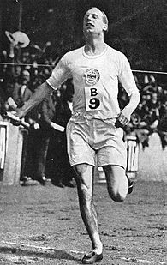
14 “I press toward (dioko kata: pursue against opposition)
the mark (skopos’: goal) for the prize of the high calling of God in Christ Jesus.
Let us therefore, as many as be perfect, (teleios) be thus minded:…”
What “mark” are you moving toward?
Are you “Pressing” or Drifting?

Slide 27
Roman poet Horace (Quintus Horatius Flaccus) wrote:
“Carpe Diem” meaning to “Seize the day”.
We need to embrace a new logo:
“Carpe deus”: “seize God”!
“if I may apprehend
(katalambano: seize, possess)
that for which also I am apprehended”
See also Jn 15:16

Slide 28
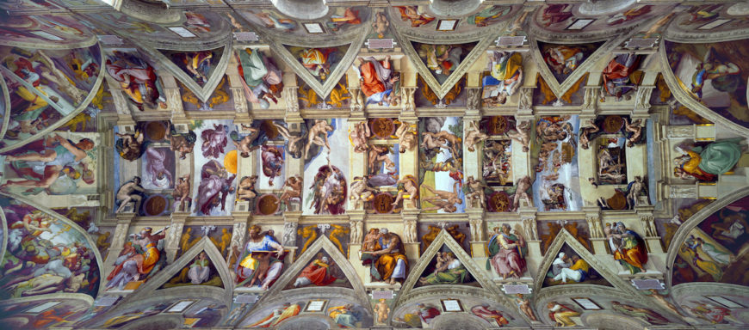
Michelangelo, Ceiling of the Sistine Chapel, 1508-12

Slide 29
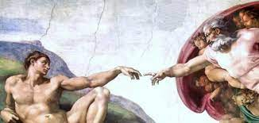
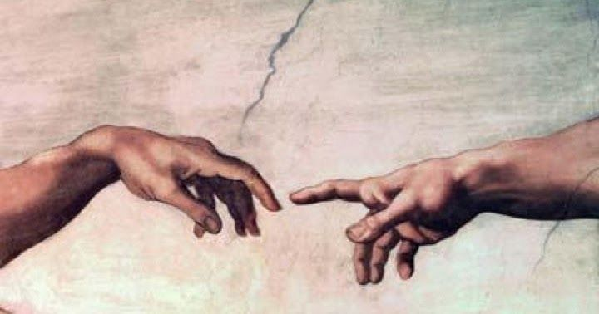
The creation of Adam
How Passionately are you reaching toward and responding to the one who created, redeemed and loves you?
Phil. 3:14 “I press toward the mark for the prize…”

