Slide 1
Pictures of the People of God
Seeing ourselves through God’s Eyes.

Slide 2
We’ve been discussing some of the ways God “pictures” or describes His people.
Precious pictures
(Treasure/Pearl)
Progressive Pictures
(Sheep, Vessels, Masterpieces)
Personal Pictures
(Family, Bride)

Slide 3
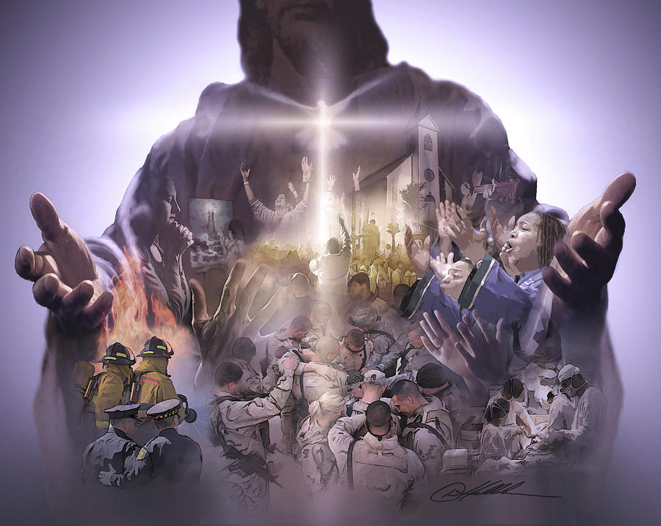
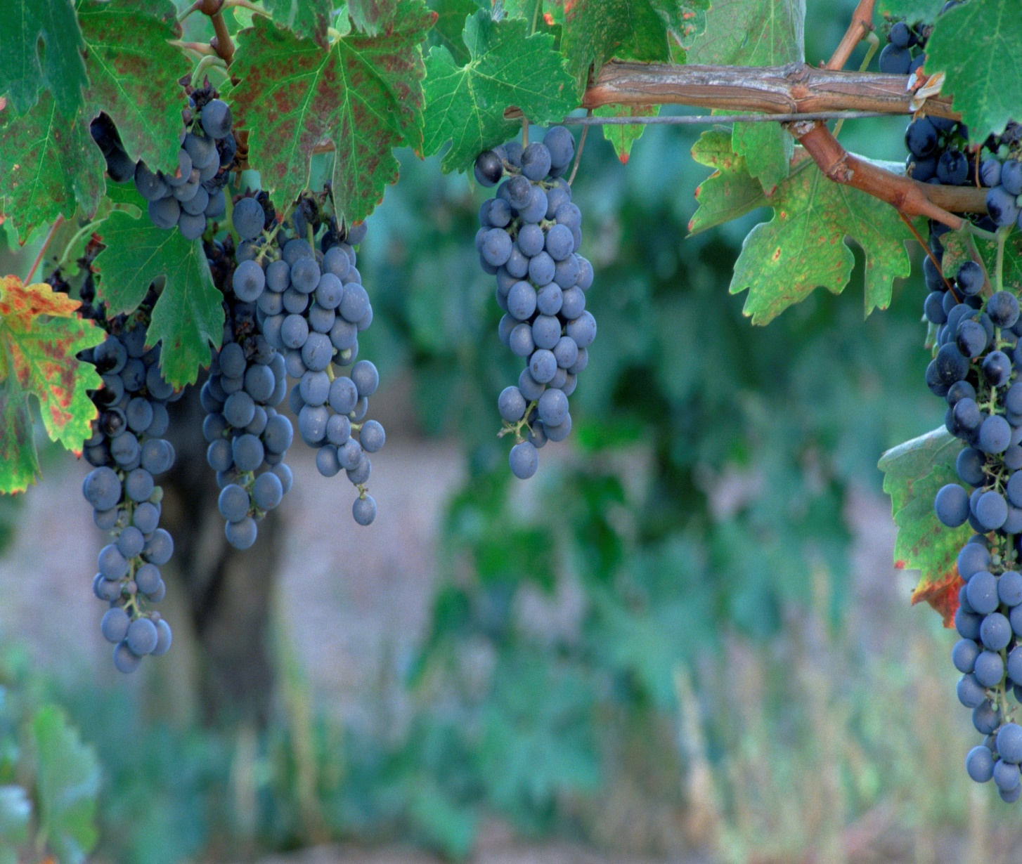
Some Practical Pictures:
The Body of Christ
The Garden of God.
“Ye are God’s Husbandry” 1 Cor 3:9
“Ye are the body of Christ…” 1Cor 12:27; Eph. 4

Slide 4
Pruning for a Productive Life.
Lessons in the Vineyard
John 15
The Picture: Vs 1,5
“I am the true vine,
my father is the Husbandman…
ye are the branches.”

Slide 5
Pruning for a Productive Life.
Lessons in the Vineyard
The Purpose: Jn 15:16
“I have chosen you and ordained you (tith’ēmi: appointed, placed)
… To bring forth fruit”

Slide 6
Pruning for a Productive Life.
Lessons in the Vineyard
The Process: vs 2-10
“every branch that beareth fruit,
he purgeth it,
that it may bring forth more fruit.”

Slide 7
1. The Point Of Pruning/Purging. Vs 2,3
Kathai’ro, actually has a double meaning:
A. To Cleanse: vs 3, 1 Jn 1:5-10
It comes from the root word “katharos’” meaning to make clean, clear, and pure.
B. To Cut: kathairō also means to prune/cut 1) To remove infected branches. (Sin)
2) To redirect unproductive branches. (Self)

Slide 8
2. The Purpose of Pruning/Purging. 2,3
A. Not Simply To “Remove” But To “Renovate”
Ro. 12:2 “transformed by the renewing of your mind...”
Anakai’nōsis: to renovate, or make new.
B. Not to Hurt / Harm us, but to help us to grow.
Jn 15:3 “He purgeth that it may bring forth more fruit”
2 Cor 4:17 "our light affliction, which is but for a moment,
worketh for us (See Ro. 8:28)
a far more exceeding and eternal weight of glory;"

Slide 9
2. The Purpose of Pruning/Purging. Vs 2,3
C. Not to Terrorize, but to Test (Prove) us.
Is 48:10-11 “I have refined thee…; (ṣārap’: purged)
I have chosen thee in the furnace of affliction.”
Jms 1:2-3 “Count it all joy when ye tall into diverse temptations, (peirasmos’: putting to proof)
Knowing that the trial (doki’mion: testing)
of your faith (pistis: conviction/reliance/trust)
worketh patience.”

Slide 10
4. The Patience of Pruning.
A. Patience is related to God’s purpose for
pruning. Jn 15:3 “that it may bring forth more fruit”
Jms 1:4 “But let patience have her perfect work,
(teleios: complete, from telos: to reach the goal)
that ye may be perfect and entire,
(holok’lēros: from holos {whole}
and Kleros {inheritance}!
lacking nothing.”

Slide 11
4. The Patience of Pruning. Jms 1:4
A. Patience is related to God’s purpose (for pruning)
that ye may be perfect and entire lacking nothing.”
1) Sin (hamartano) means to miss the mark
and so not receive the prize. 1 Jn 2:1
It Comes from “a” (no/not) & “meros” (portion)
Would you pay a contractor
who failed to finish the job?

Slide 12
A. Patience is related to God’s purpose.
2) Satan tempts us to resist/rebel and thus
forfeit the prize of Patience. 2 Jn 1:8
“Look to yourselves, that we lose not those things which we have wrought,
but that we receive a full (ple’res: replete)
reward.” (misthos’: pay for service)

Slide 13
2) Satan tempts us to resist/rebel and thus
forfeit the prize of Patience. Hebrews 10:35-36 “Cast not away therefore your confidence, (faith)
which hath great recompence of reward.
36 For ye have need of patience, that,
after ye have done the will of God,
ye might receive the promise. (reward)
38 Now the just shall live by faith,
but if any draw back,
my soul shall have no pleasure in him!”

Slide 14
4. The Patience of Pruning. Jms 1:4
“But let patience have her perfect work.
B. Patience requires endurance.
1) Patience comes from hypomeno: endure, stay under
Jn 15:4 “Abide in me, and I in you.
As the branch cannot bear fruit of itself,
except it abide in the vine; no more can ye,
except ye abide in me.”
Meno: to stay, continue, endure, remain
(It’s used 6 times in Jn 15:4-7)
It is the root word in hypomone: (Patience)

Slide 15
B. Patience requires endurance.
2) Endurance is tested under pressure (pruning).
Jn 6:66-69 “From that time many of his disciples went back, and walked no more with him.
Then said Jesus unto the 12, Will ye also go away?
Then Simon Peter answered him, Lord, to whom shall we go? thou hast the words of eternal life.
And we believe and are sure that thou art that Christ, the Son of the living God.”

Slide 16
B. Patience requires endurance.
3) God’s Grace enables us to become
“more than conquerors
through Him that loved us” Ro. 8:37
a) “Patience” in James 1:4 isn’t just
hypomone (endurance)
but hypomeno:
“Cheerful Endurance”

Slide 17
Patience: Cheerful Endurance! Ph 2:13-16 “For it is God which worketh in you
both to will and to do of his good pleasure.
14 Do all things without murmurings and disputings:
15 That ye may be blameless and harmless,
the sons of God, without rebuke,
in the midst of a crooked and perverse nation,
among whom ye shine as lights in the world;
16 Holding forth the word of life….”

Slide 18
4. The Patience of Pruning. Jms 1:4
A. Patience is related to God’s Purposes.
B. Patience requires endurance.
C. Patience (longsuffering) is one of the fruits
of the Holy Spirit. Gal. 5:22,23
“But the fruit of the Spirit is love, joy, peace, longsuffering, gentleness, goodness, faith,
Meekness, temperance: (self control)
against such there is no law.”

Slide 19
God uses a farmer to illustrate the need for patience (James 5:7-8)
“Be patient, brethren, unto the coming of the Lord. Behold, the husbandman waiteth for the precious fruit of the earth, and hath long patience for it,
until he receive the early and latter rain.
Be ye also patient; stablish your hearts:
for the coming of the Lord draweth nigh.”

Slide 20
God uses a farmer to illustrate the need for patience (James 5:7-8)
1) There is a summer season between the
pruning and the production of fruit.
2) The Harvest Season will eventually come
to those who are faithful. (1 Cor. 15:58; Gal. 6:9)
a) Satan often comes to us during the
“heat/drought of the summer”
trying to get us to quit.
(the opposite of “abide”)

Slide 21
What season are you currently in?
Planning? (Ps. 28:18)
Preparation? (Hab. 10:12)
Planting? (Gal. 6:7,8)
Protecting? (Job 1:10)
Pruning? (Jn 15:1-8)

Slide 22
In every Season Jesus asks us to:
“Abide in me, and I in you.
As the branch cannot bear fruit of itself, except it abide in the vine;
no more can ye, except ye abide in me.”
John 15:4
“Will ye also go away?” Jn 6:67
Mark 14:50 “they all forsook him…”

Slide 23
Isaiah 32:15-17
“Until the spirit be poured upon us from on high, and the wilderness be a fruitful field,
and the fruitful field be counted for a forest.
Then judgment shall dwell in the wilderness,
and righteousness remain in the fruitful field.
And the work of righteousness shall be peace;
and the effect of righteousness
quietness and assurance for ever.”

