Slide 1
Principles for Powerful Living

Slide 2
The Universe Operates through natural principles because the Creator Does.
The Bible reveals Spiritual principles to help guide us to God and His plans. These include:
The Passion (Open Heart) Principle. (Col. 3:16-24)
The Purpose (Open Hand) Principle. (Ex. 3,4)
The Path (Open Door) Principle. (Rev. 3:7-13)
The Preparation (seed) Principle (Mt 13:3-30)

Slide 3
Jesus used seed and harvest principles to illustrate the importance of what we allow to grow in the soil of our souls. Pr 4:20-23
“My son, attend to my words; incline thine ear unto my sayings. Let them not depart from thine eyes;
keep them in the midst of thine heart.
For they are life unto those that find them,
and health to all their flesh.
Keep thy heart with all diligence;
for out of it are the issues of life.”

Slide 4
Sources of the Seed sown in our hearts.
God seeks to sow Good Seed. Mt 13:24
“The kingdom of heaven is likened unto a man
which sowed good seed in his field.”
Satan seeks to sow bad/evil Seed Mt. 13:25
“while men slept, his enemy came and sowed tares..”
People (society) seeks to sow Selfish Seed.
Gal. 5:16-21 “the flesh lusteth against the Spirit,
and the Spirit against the flesh:
and these are contrary the one to the other”

Slide 5
Harvest Principles reveal we will reap:
What we sow. Ga. 6:7,8 “whatsoever a man
sows, that shall he also reap”
After we Sow. Gal. 6:9 “be not weary in well
doing, for in due season we shall reap…”
More than we sow. Mt 13:8,9; Hosea 8:7
“they have sown the wind,
they shall reap the whirlwind”

Slide 6
We closed last week by reminding ourselves that there’s a limited season for preparing, planting, protecting and harvesting that which we sow.
Eccl. 3:1 “To every thing there is a season,
and a time to every purpose under the heaven:
A time to be born, and a time to die; a time to plant,
and a time to pluck up that which is planted;…
11 He hath made every thing beautiful in his time:
also he hath set the world in their heart…”
(ôlām’: eternity)

Slide 7
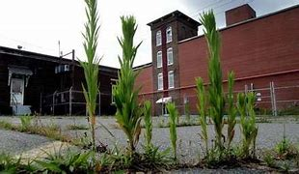
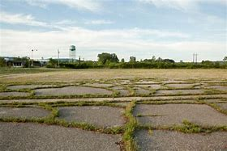
If we don’t prepare the soil (heart), the seed won’t be able to Penetrate, Germinate, or Propagate. aka: “bring forth fruit” (Mt. 13:18-22)
Isn’t it interesting how weeds can thrive anywhere
and without any intentional preparation/effort!

Slide 8
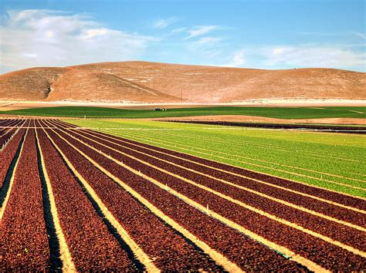
But good seed requires “good ground” Mt 13:8
in order to produce a healthy, fruitful crop.
“Good ground” requires Preparation!
“Before anything else,
Preparation is the key to success.”
Alexander Graham Bell
“By failing to prepare,
you are preparing to fail!”
Benjamin Franklin

Slide 9
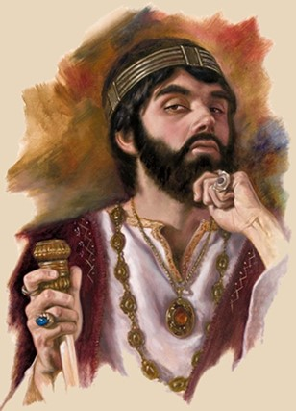
If we fail to intentionally prepare our hearts,
even if they’re exposed to God’s “good seed”,
It will have trouble taking root and bearing fruit.
2 Chron. 12:14 tell us that King Rehoboam
“did (āśâ: produced, prepared)
evil, (ra: hurt, wickedness)
because he prepared not (kûn: set up, established, fixed) his heart
to seek the LORD.”
(dārash’: frequent, follow, search, Worship)

Slide 10
Instead of Proactively preparing his heart for God’s guidance (aka: wisdom),
he ignored God and lived Reactively to the challenges of his day.
This led to hardening his heart,
constant conflict, a divided Kingdom,
and millions of Israelites
turning away from God.
(Back to worshiping Golden Calves!)
1 Kings 12

Slide 11
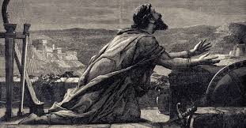
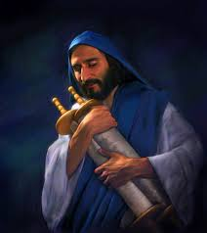
Contrast this with his grandfather David:
Ps. 119:10 “With my whole heart have I sought thee,
Oh let me not wander from thy commandments.”
Or with Ezra
Ezra 7:10 “Ezra had prepared his heart to seek the law of the LORD,
and to do it, and to teach in Israel statutes and judgments.”

Slide 12
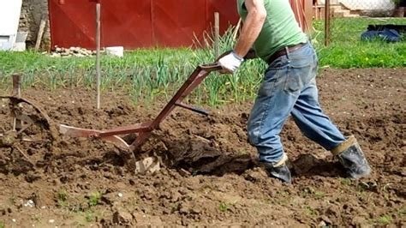
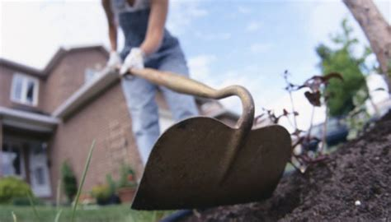
In order to prepare the soil of our souls,
We must Plow or Soften our hearts.
Hosea 10:12 “…break up your fallow ground:
for it is time to seek the LORD…”

Slide 13
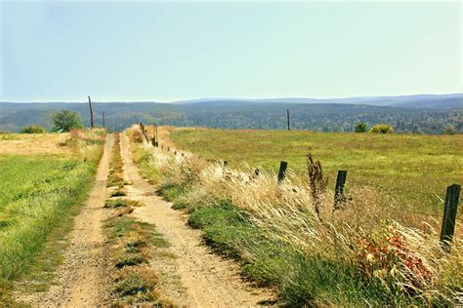
What makes a heart hard?
1. Hearts (like soil) can grow hard through
Repeated use and/or exposure.
“Wayside” in Mt 13:4 (hodos’) means a path or road.
ground that’s been packed hard by foot/cart traffic.
It was so hard that even God’s “good seed” couldn’t penetrate it.

Slide 14
A. We can become so “familiar” with something (or
someone) that we fail to recognize their value.
1) Familiarity may not always breed contempt,
but it often produces lack of honor / receptivity.
a) After raising Jairus’ daughter from the dead, (Mk 5)
Notice Jesus’ reception in Nazareth in Mk 6:1-6
“Is not this the carpenter…and they were offended at him….
…A prophet is not without honor, but in his own country,
and among his own kin, and in his own house.
And he could do no mighty work …
And he marveled because of their unbelief”

Slide 15
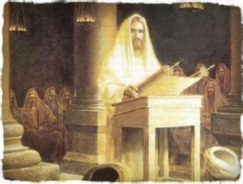
b) Luke 4:14-32 “Jesus returned in the power of the Spirit into Galilee: and there went out a fame of him through all the region round about. And he taught in their synagogues, being glorified of all.
All that changed when he came to Nazareth (Vs 16-30);
Where He read the prophecy of Is. 61:1-3 and said
“This day is this scripture fulfilled in your ears.” vs 21
“²⁸ …they…were filled with wrath, ²⁹ … rose up, and thrust him out of the city, and led him unto the brow of the hill
..that they might cast him down headlong.”

Slide 16
2) This is equally true in our marriages & ministries;
Particularly if what they say or want challenges us.
Luke 9:43-46 “they were amazed at the mighty power of God. But while they wondered every one at all things which Jesus did, he said unto his disciples,
Let these sayings sink down into your ears:
for the Son of man shall be delivered into the hands of men.
But they understood not this saying, …
that they perceived it not: and they feared to ask him …. Then there arose a reasoning among them,
of them should be greatest.”

Slide 17
A. Familiarity breeds contempt (or devaluation)
B. Many have become inoculated
(desensitized) to the gospel.
1) Familiarity is not the same as faith!
a) There’s a significant difference between being
conscious of
and committed to truth.
2 Tim 3:15 “from a child you’ve known the holy scriptures, which are able to make thee wise unto salvation
(sōtēri’a: rescue, deliverance) through faith (pistis: persuasion, conviction, trust) which is in Christ Jesus.”

Slide 18
a) There’s a significant difference between being
conscious of and committed to truth.
2) Knowing the scriptures doesn’t save us,
Gal. 2:16 “by the works of the law shall no flesh be justified”
a) They reveal our need of mercy and salvation,
And reveal God’s provision for it. (Gal. 3:24)
Jn 5:39,40: “Search the scriptures in them you think you
have eternal life.
They are they which testify (martyreo) of me.
And ye will not come to me, that ye might have life.”
they (the law) condemn us! (Ro 7:7)
(Head knowledge {Ro. 10:10})

Slide 19
3) Jesus’ ministry was to spiritually educated people
who were spiritually deaf and blind!
Mt 13:14-15 “in them is fulfilled the prophecy of Esaias… By hearing ye shall hear, and shall not understand;
and seeing ye shall see, and shall not perceive:
For this people's heart is waxed gross,
(Pachy’nō: thick, render callous)
their ears are dull of hearing, their eyes they’ve closed;
lest at any time they should see with their eyes, and hear with their ears, and should understand with their heart,
and should be converted, and I should heal them.”

Slide 20
What makes a heart hard?
1. They can grow hard through exposure and/or use.
(Familiarity without Faithful obedience)
2. Hearts can also grow hard (numb/embittered)
through disappointment and/or abuse.
Pr 13:12 “Hope deferred makes the heart sick...”
Hope: tôḥel’et- expectation
Deferred: māshak- drawn out, delayed, scattered
Heart: leb- feelings, will, understanding (aka: soul)
Sick: ḥālâ- worn, grieved, rubbed (calloused)

Slide 21
2. They can also grow hard (numb/embittered)
through disappointment and/or abuse. Pr 13:12
A. Satan seeks to use past disappointments
to hinder/sabotage future faith (trust).
1) He knows your past better than you do.
2) He’s the “accuser of the brethren” Rev. 12:10
B. Broken hearts may mend eventually, but:
1) They’re easily infected with bitterness. (Heb. 12:15)
2) They often scar (harden). (Heb 3:7-13)

Slide 22
2. They can grow hard through disappointment
Heb 3:7-13 “To day if ye will hear his voice,
Harden not your hearts, as in the provocation, …
Take heed, brethren, lest there be in any of you an evil (poneros’: infected) heart of unbelief,
in departing from the living God.
But exhort one another daily, while it is called To day; lest any of you be hardened (sklēryn’ō: stubborn)
through the deceitfulness of sin.”
(See 1 Sam. 15:23)

Slide 23
C. Jesus came to heal the broken hearted. (Is. 61:1-3)
“the LORD anointed me to preach good tidings unto the meek; he hath sent me to bind up the brokenhearted,
(Shabar’ leb: crushed, hurt, quenched)
to proclaim liberty to the captives, and the opening of the prison to them that are bound;…
To give them beauty for ashes… joy for mourning,
The garment of praise for heaviness.
That they might be called trees of righteousness,
the planting of the Lord,
that He might be glorified!”

Slide 24
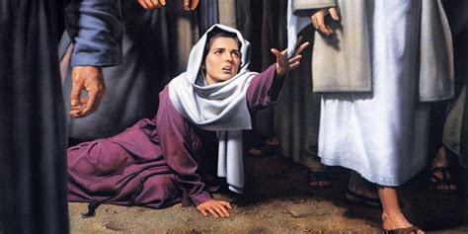
Pr 13:12 “Hope deferred makes the heart sick...”
C. Jesus came to heal the broken hearted. (Is. 61:1-3)
1) Woman with the issue of blood for 12 years. Mk 5
“And had suffered many things of many physicians,
and had spent all that she had, and was nothing bettered,
but rather grew worse, …said,
If I may touch but his clothes,
I shall be whole.”
vs 25-28

Slide 25
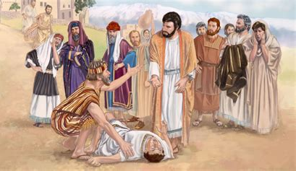
2) The Father of the demonized son. Mark 9:21-24
“of a child...ofttimes it hath cast him into the fire, and into the waters, to destroy him: but if thou canst do any thing, have compassion on us, and help us.
Jesus said unto him, If thou canst believe,
all things are possible to him that believeth.
And straightway the father …cried out, and said with tears, Lord, I believe;
help thou mine unbelief.”

Slide 26
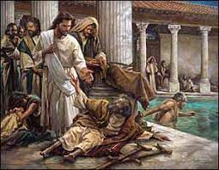
3) The man at the pool of Bethesda. Jn 5:5-16
6 “When Jesus saw him lie, and knew that he had been now a
long time in that case, he saith Wilt thou be made whole?
7 The impotent man answered him, Sir, I have no man,
when the water is troubled, to put me into the pool:
but while I am coming, another steppeth down before me.
(He felt helpless and hopeless!)
8 Jesus saith unto him,
Rise, take up thy bed, and walk.”
¹⁷ ”My Father worketh hitherto, and I work.”

Slide 27
Hard hearts are unreceptive to God’s Truth.
Hearts can grow hard through:
Repeated exposure and/or use.
(Familiarity without Faithful obedience)
Repeated Pain and disappointments can numb/embittered a heart.
This was Satan’s goal in Job! Job 1:11; 2:4,5
“put forth thine hand now, and touch all that he hath,
and he will curse thee to thy face.”

Slide 28
Application:
Has your heart grown hard or numb through:
Information without Application?
Repeated Disappointments without Explanation?
God is not done with you!
He’s trying to motivate you to grow roots of faith that can survive the heat.
Mt 13:21
(Job never did get an explanation!)

Slide 29
Jer 29:11-14 “I know the thoughts that I think toward you, saith the LORD, thoughts of peace, and not of evil,
to give you an expected end. (tiqwâ’: a cord, hope)
Then shall ye call upon me, and ye shall go and pray unto me, and I will hearken unto you.
And ye shall seek me, and find me,
when ye shall search for me
And I will be found of you, saith the LORD:
and I will turn away your captivity...”
with all your heart.

Slide 30
1 Sam. 13:14 reveals that God is seeking
“a man after His heart”?
He found such a man in David!
Ps 9:1 “I will praise thee, O LORD, with my whole heart.”
Ps 111:1 “I will praise the LORD with my whole heart…”
Ps 119:10 “With my whole heart have I sought thee…”
Ps 119:34 “I shall observe it (thy law) with my whole heart.”
Ps 119:58 “I intreated thy favour with my whole heart…”
Ps 119:145 “I cried with my whole heart;
hear me, O LORD: I will keep thy statutes.”

Slide 31
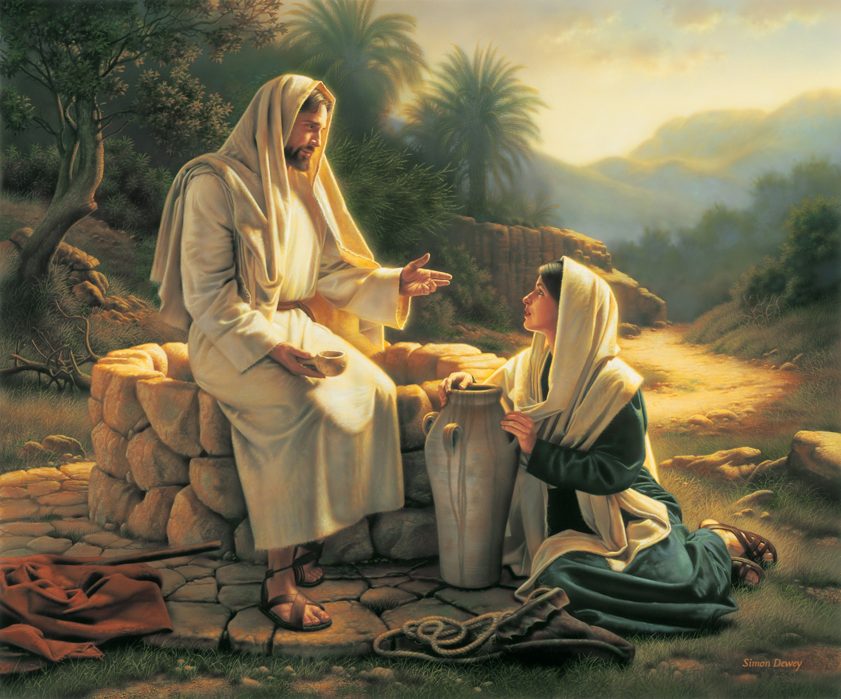
God’s still looking for such.
John 4:23 “the hour cometh,
and now is, when the true worshippers shall worship the Father in spirit and in truth:
for the Father seeketh such to worship him.”
Are you willing to become
A “whole hearted?” Christian?

Slide 32
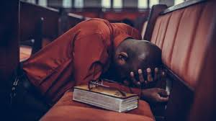
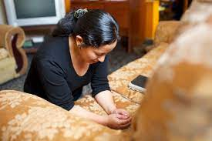
God’s still looking for such.
Are you willing to become
A “whole hearted?” Christian?

