Slide 1
Pictures of the People of God
Seeing ourselves through God’s Eyes.

Slide 2
The Pictures of God’s People
Pictures & parables have many points of focus.
Likewise, words can have multiple definitions
and/or applications,
many of which are affected by our own experiences.
Most define “church” as either a building
or a loosely associated group of people.

Slide 3
God sees his church much differently
The English word church comes from the Greek kuriaskos’, meaning “belonging to the Lord.”
The most common word in the New Testament for church is ekklesia, from ek: out & Kaleo (a calling)
Taken together these two words mean the church is: “a called out assembly of people
that belong to the Lord!”

Slide 4
Pictures of God’s People
The Bible is filled with different “word pictures” that God uses to describe us.
These help us better understand what He’s looking at (and for)
when he sees us.

Slide 5
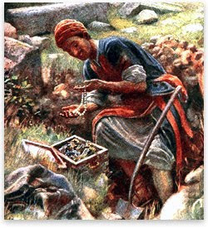
God describes us as: Pt 1: A Hidden Treasure!
“The kingdom of heaven is like unto treasure hid in a field;
the which when a man hath found, he hideth,
and for joy thereof goeth
and selleth all that he hath,
and buyeth that field.”
Mt. 13:44

Slide 6
God describes us as Pearls of Great Price!
Mt 13:45,46 “The kingdom of heaven is like unto a merchant man, seeking goodly pearls:
Who, when he had found one pearl of great price,
(Poly’timos: extraordinary value)
went and sold all that he had, and bought it.”

Slide 7
God describes us as clay in the hands of a Master Potter. Jer. 18:1-6
“Behold, as the clay is in the potter's hand,
so are ye in mine hand”
Is 64:8 “Lord, thou art our father; we are the clay,
and thou our potter;
We are the work of thy hand.”

Slide 8
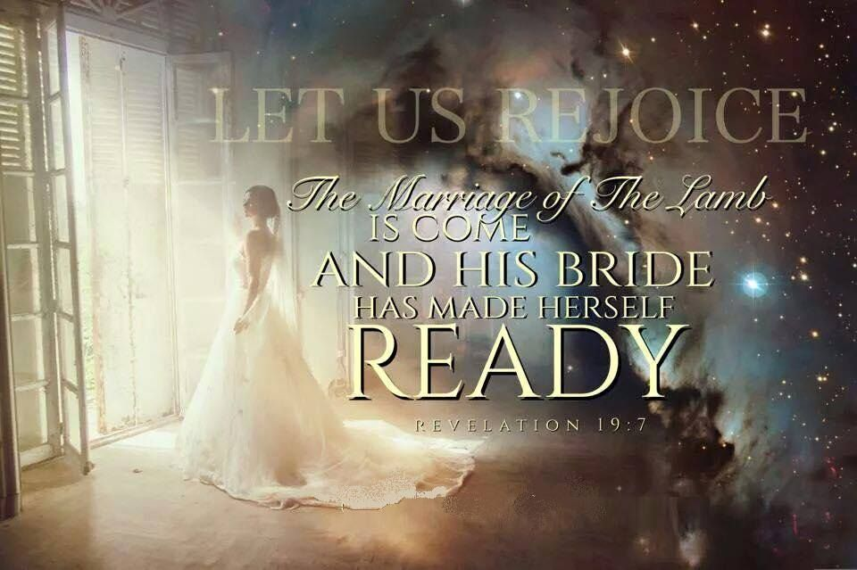
God describes us as the Bride of Christ!
(Eph 5:22-33; 2 Cor 11:2; Rev 19, 21)

Slide 9
God describes us as the
“Sheep of His Pasture” Ps. 100:3

Slide 10
Pt.6 God describes us as members of His Family!
Eph 2:18,19 “For through him we have access
by one Spirit unto the Father.
Now therefore ye are no more strangers
and foreigners,
but fellow-citizens with the saints,
and of the household of God!”;

Slide 11
How does someone become part of a family?
Either by Birth / Conception
(Jn 3:3; 1 Pt 1:21)
Or by Adoption / Invitation!
(Ro. 8:15, 23; Gal. 4:5; Eph. 1:5)
God’s word uses both examples to illustrate the nature of His Family.

Slide 12
1. The Privilege of God’s Family
As members of God’s Family:
We obtain His nature! 2 Peter 1:3-4
“his divine power hath given unto us all things that pertain unto life and godliness, through the knowledge of him that hath called us to glory and virtue:
Whereby are given unto us exceeding great and precious promises: that by these ye might be
partakers of the divine nature…”

Slide 13
A. We have His nature!
When? When we recognize and respond in faith (Trust) to the Gospel. Jn 3:16, Gal 2:8,9; Rev. 3:20
“Behold I stand at the door and knock (See Ro. 10:10)
If any …hear my voice and open the door,
I will come in unto him”
2 Cor. 4:6 “God, who commanded the light to shine out of darkness, hath shined in our hearts, to give the light of the knowledge of the glory of God in Jesus Christ.”

Slide 14
A. We have His nature!
2) How? By being born again by His Spirit. Jn 3:3
“Verily I say unto thee, Except a man be born again,
he cannot see the kingdom of God. …
That which is born of the flesh is flesh;
and that which is born of the Spirit is spirit.
Marvel not that I said unto thee,
Ye must be born again.”
Genna’ō: regenerated (from Genos: kin)

Slide 15
A. We have His nature!
2) How? By being born again by His Spirit. Tit 3:5-6 “Not by works of righteousness which we have done,
but according to his mercy he saved us,
by the washing of regeneration,
and renewing of the Holy Ghost;
Which he shed on us abundantly
through Jesus Christ our Savior;
7 That being justified by his grace, we should be made heirs according to the hope of eternal life.”

Slide 16
A. We have His nature!
Gal. 4:4-7 “God sent his Son…to redeem them that were under the law,
that we might receive the adoption of sons.
And because ye are sons, God sent forth the Spirit of his Son into your hearts, crying, Abba, Father.”
Ro 8:15-16 “we’ve received… the Spirit of adoption, whereby we cry, Abba, Father. The Spirit itself bears witness with our spirit, that we are the children of God”

Slide 17
A. We have His nature!
3) Why: To help us develop a “Family Likeness”
Ro. 12:2 “Be not conformed to this world,
But be transformed…”
2Cor 3:18 “we all…are changed, from glory to glory,
even as by the Spirit of the Lord.”
Ro. 8:28,29 “to be conformed to the image of his son.”

Slide 18
1. This Describes our Privilege
We have His nature!
We share His Riches. Ro 8:16-18 “His Spirit bears witness that we are the children of God.
if children,
if so be that we suffer with him,
that we may be also glorified together.
For I reckon that the sufferings of this present time
are not worthy to be compared with the glory
which shall be revealed in us.”
then heirs of God, & joint-heirs with Christ;

Slide 19
B. We share His Riches. Eph. 1:18
“The eyes of your understanding being enlightened;
that ye may know what is the hope of his calling,
and what the riches of the glory of his inheritance in the saints,
And what is the exceeding greatness of his power to us-ward who believe,
according to the working of his mighty power”

Slide 20
1. This Describes our Privilege
C. We bear His Name! Gal. 4:7 “Wherefore thou
art no more a servant,
Acts 11:26 “the disciples were called Christians first in Antioch…”
1) Christianos’ (from Christos): anointed (Is 61:1-3)
“The Spirit of the Lord God is upon me;
Because the Lord hath anointed me to…”
but a son!”

Slide 21
1. This Describes our Privilege
a) What has God “anointed” you for? 1Pt 2:9
“ye are chosen generation, a royal priesthood,
a holy nation, a peculiar people,
(peripoi’ēsis: purchased, precious, preserved acquisition)
To Show forth the praises of Him who hath called you out of darkness and into his marvelous light!
10 Which in times past were not a people,
but are now the people of God.”

Slide 22
C. We Bear His Name!
Acts 11:26 “the disciples were called Christians…”
1) Christianos’ (from Christos) anointed
2) Christos comes from chrio: to make contact!
a) The more “Contact” we make with Christ;
the more consistently we become “Like Christ!”
Jn 15:4-5 “Abide in me, and I in you. As the branch cannot bear fruit of itself, except it abide in the vine;
no more can ye, except ye abide in me.”

Slide 23
C. We bear His Name.
a) The more “Contact” we have with Christ,
the more like Him we become. (Jn 15)
Acts 4:13 “they marveled (thaumazo: wondered)
and they took knowledge of them,
that they had been with Jesus.”
b) Your behavior reflects the degree of intimacy in your relationship with Jesus. (1 Pt 3:15)

Slide 24
C. We bear His Name
3) That means our conduct reflects on Him
and so, affects others!
Positively. Mt 5:16 “Let your light so shine before men,
that they may see your good works,
and glorify your Father which is in heaven.”
b) Negatively Ro. 2:24 “The name of God is
blasphemed among the Gentiles through you”

Slide 25
As Members of God’s Family we:
Receive His Nature (Gal. 4:4-6)
Share His Resources (2 Pt. 1:3-4)
Bear His Name (Reputation) (Mt 5:16)
With Great Privilege comes
Great Responsibility!

Slide 26
The Privileges of God’s Family
An audience is a general group of unrelated people drawn together by a short lived attraction, event or interest.
A Church is a specific group of people who belong to the Lord and have been “called together” by Him to accomplish His purposes.
Which most accurately describes us?

Slide 27
“I'm so glad I'm a part of the family of God-
I've been washed in the fountain, cleansed by His blood!
Joint heirs with Jesus as we travel this sod;
For I'm part of the family, the family of God.
You will notice we say brother and sister 'round here,
It's because we're a family and these folks are so near;
When one has a heartache, we all share the tears,
And rejoice in each victory in this family so dear.”

Slide 28
“From the door of an orphanage to the house of the King, No longer an outcast, a new song I sing;
From rags unto riches,
from the weak to the strong,
I'm not worthy to be here,
but Praise God! I belong!”

Slide 29
Church is not something
or someplace you go to,
but a family you belong to!
Hebrews 10:23-25

Slide 30
Who do you belong to?

