Slide 1
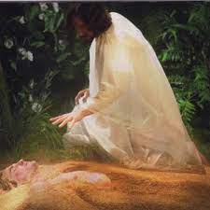
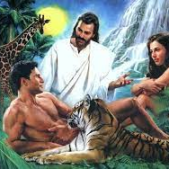
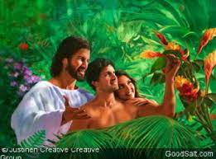
Christ created Adam and Eve and placed them in the “Garden of Eden” (pleasure) offering them:
An infinite Purpose (Gen 1:26-28)
An intimate Partnership. (Gen 2:21-25)

Slide 2
Satan seduced them to reject God’s will and to rely on their own moral compass. Gen. 3:5
“Ye shall be as gods
knowing good and evil…”
With disastrous consequences!
Gen. 3:8-24
Ro. 5:12

Slide 3
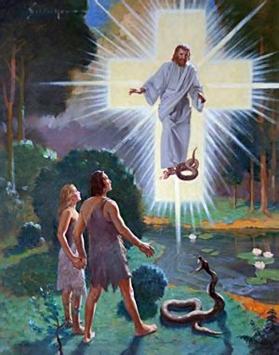
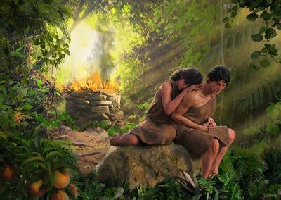
In spite of their rebellion,
God offered the promise of redemption
Through the sacrifice of the innocent lamb.
Gen. 3:15;
Rev. 13:8

Slide 4
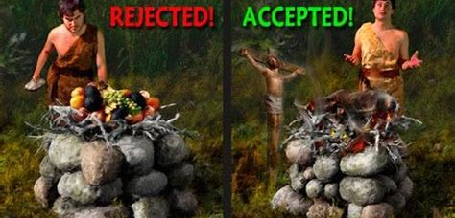
But their sin had left their hearts corrupted. Gen. 4 (Jer. 17:9)

Slide 5
Gen. 4:7 “If thou doest well,
shalt thou not be accepted?
and if thou doest not well,
sin lieth at the door.
And unto thee shall be his desire,
Teshûqâ’: to reach out for
From Shûq: to overflow
and thou shalt
rule over him.”

Slide 6
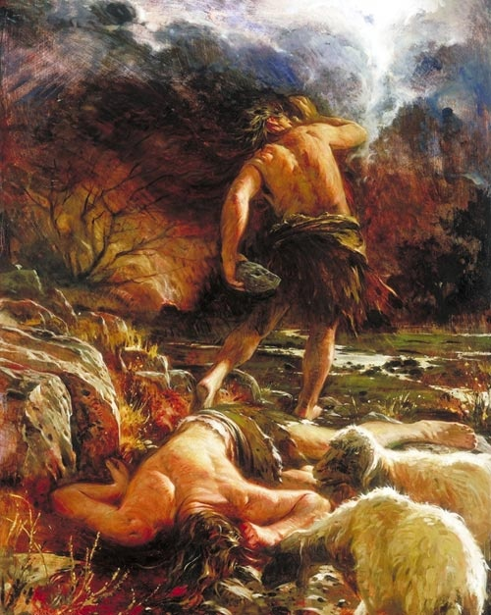
Gen. 4:8 “And Cain talked with Abel his brother:
and it came to pass,
when they were in the field,
that Cain rose up against
Abel his brother,
and slew him.”
Romans 5:12

Slide 7
To this day we still rely on our own inclination (Pr 3:5) rather than divine inspiration
to guide our choices.
Pr. 21:2 “Every way of a man is right in his own eyes:
but the LORD pondereth the hearts”
“Right” (Yāšār) can mean correct
or convenient!
This inevitably leads to this same cycle of
Problems (Corruption), Pain (Separation)
and Thankfully God’s Promise (Redemption)!

Slide 8
This cycle is woven throughout scripture and History, because it’s part of the Human story.
We know that Compasses don’t point to true north,
but to a fluctuating magnetic north that changes
(based on distance and changing core composition).
In much the same way, our Understanding (conscience/compass) has been Corrupted
(Ro 3:10, 23; 5:12) and varies in intensity based on:
Our distance (from God/truth)
Changes in cultural composition. (Values)

Slide 9
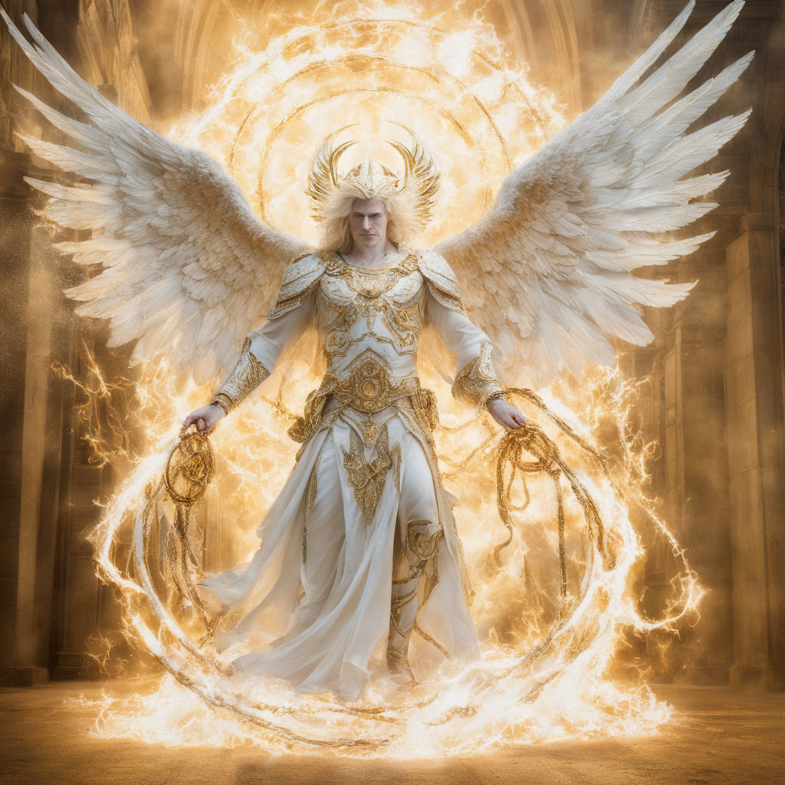
The Problem: Our Conscience (compass)
has been Corrupted by:
1. Satan. 2 Cor 4:4
“in whom the god
of this world hath blinded
(typhlo’ō: obscure, darken)
the minds (no’ema:
perception, purpose)
(See also Eph. 2:1-3)
2 Cor 11:14

Slide 10
Our Conscience (compass) is Corrupted by:
1. Satan. 2 Cor 4:4 “the god of this world hath
blinded the minds (no’ema: perception, purpose)
A. Our “minds” are affected by our perception
(recognition) and perceived purpose! (reason)
1) He seeks to obscure our Perception (understanding)
so as to divert us from our Purpose! (Rev. 4:11)
“Thou has created all things …for thy pleasure”
(thel’ema: desire, determination, purpose)

Slide 11
1. Satan. 2 Cor 4:4 “hath blinded the minds…”
B. Our minds are influenced by our conscience.
(synei’dēsis) literally means co-perception!
from syn (with) and eido (to know, perceive)
1) We’re created to perceive/see with God!
Ps 36:9 “With thee is the fountain of life:
in thy light, we see light!” (See Jn 1:5-7)
2) Satan seeks to obscure the truth by getting
us to “see” (perceive, consider) with him!

Slide 12
a) After Eve conversed with Satan, (and sin)
she “saw” the tree differently! Gen. 3:6
“And when the woman saw that the tree was
good for food,
and was pleasant to the eyes,
and a tree to be desired to make one wise,
she took of the fruit thereof, and did eat, and gave also unto her husband with her; and he did eat.”
1 John 2:16

Slide 13
b) After Eve conversed with Satan (and sin)
she “saw” Adam (and herself) differently!
7 “And the eyes of them both were opened, and they knew that they were naked;
and they sewed fig leaves together, and made themselves aprons.”
From innocent (2:25)
to ashamed! (3:7,8)

Slide 14
c) After Eve conversed with Satan (and sin)
They saw God differently! Vs 8-10
“And they heard the voice of the LORD God walking in the garden in the cool of the day:
and Adam and his wife hid themselves from the presence of the LORD God amongst the trees of the garden.
10 “I heard thy voice
and was afraid”

Slide 15
Our Conscience (compass) is Corrupted by:
Self (interest and/or perspective)
A. This was Satan’s “poisoned” promise. Gen. 3:6
“Ye shall be as gods, knowing (yada’) good and evil.”
1) “Yada” has many subtle meanings and uses.
a) It’s translated: “Know or Knowledge” 750x,
“perceive” 18x; “acquaintance” 6x;
“declare, show, tell, or teach” 37x
b) Not just awareness or understanding,
but “declaring” (deciding) what’s good/evil.

Slide 16
Self (interest/perspective)
A. This was Satan’s “promise”. Gen. 3:6
B. This “poisoned promise” corrupted us.
Jer. 17:9 “The heart (labe: understanding) is deceitful (ʿāqōb’: crooked, twisted) above all things,
and desperately wicked:” (ʾānash’: incurably sick)
Pr. 21:2 “Every way of a man is right in his own eyes”
Is 53:6 “all we like sheep have gone astray,
We have turned everyone to his own way!”

Slide 17
This “infection” affects our perception & choices. Eph 4:17-18 “walk not as other Gentiles,
in the vanity {mataios: emptiness/idol} of their mind,
Having the understanding darkened, (skotizo: obscured)
being alienated from the life of God
through the ignorance that is in them,
because of the blindness
(Pō’rōsis: callousness, hardness)
of their heart: (kardia: thoughts, mind, feelings)

Slide 18
1) This “infection” affects our perception/choices.
Eph 4:19 “Who being past feeling
(apal’geō: apathetic)
have given themselves over (paradidōmi: yielded)
Same word Satan used in Luke 4:6)
unto lasciviousness, (asel’geia: wantonness)
to work all uncleanness with greediness.” (pleonexia’a: covetousness)
See Rom 1:18-32

Slide 19
3. By Sin:
A. “Sin” (hamartia) means:
1) To offend (skandalizo: to hurt/ snare)
Who do we offend by our sin?
a) Others. Mt. 18:15-22
b) Ourselves Mt 18:23-25 34 “tormentors…”
See also Romans 6:14-24
c) God! Eph. 4:30

Slide 20
c) God! Eph. 4:30 “grieve not (lype’ō: distress, make sorrowful)
the Holy Spirit of God, whereby ye are sealed
(sphragizō: stamped for security/preservation)
unto the day of redemption.”
Eph.1:13-14 “In whom ye also trusted, …
in whom also after that ye believed,
ye were sealed with that holy Spirit of promise,
Which is the earnest of our inheritance
(arrabōn: security deposit)
until the redemption of the purchased possession”

Slide 21
A. “Sin” (hamartia) means: 1) To offend:
2) To Trespass: Mk 11:25; Mt 18:15; 35
a) Greek: (parap’tōma: to deviate, fall)
Deviate/Fall from Who?
b) English:
➔ Commit an injury to the person, property, or rights;
especially to enter onto another's land wrongfully.
➔ Infringe on the privacy, time, or attention of another.
➔ To commit an offense or a sin; transgress or err.
From What?

Slide 22
When we trespass (sin):
Whose “property” are we trespassing on?
Whose “attention” are we now getting?
Remember Christian and Hopeful trespassing on Giant Despair’s property?
John Bunyon’s “Pilgrim’s Progress” Published in 1678

Slide 23
3. Our conscience/ compass is Corrupted by Sin:
A. “Sin” in the New Testament (hamartia)
means to Offend and/or Trespass.
B. It comes from hamartano which means:
“to miss the mark (skopos: God’s Goal {Phil. 3:14})
and so not share the prize” (brebei’on: award/reward)
1) God has a “mark” (purpose/goal) for us.
(Eccl. 3:9; Jer 29:11; 1 Cor 3:9; Rev 4:11)
Phil 3:14 “I press toward the mark (skopos: goal) …
of the high calling of God in Christ Jesus”

Slide 24
Sin: “to miss the mark (skopos: God’s Goal {Phil. 3:14})
and so not share the prize” (brebei’on: award/reward)
1) God has a “mark” (goal/purpose) for each of us.
2) God has a “Prize” for each of us. Phil. 3:14
“I press toward the mark for the prize (brabeion: umpire)
of the high calling of God…”
Mt 25:21,23 “well done good and faithful servant…
enter thou into the joy of the Lord”
34 “inherit the kingdom prepared for you”
Jn 14:3 “I go to prepare a place for you”

Slide 25
Satan uses our own Selfishness (Jm 1:12-16)
to tempt us to sin, which results in our:
Offending/grieving God. Eph. 4:30; Pr 6:16-19
Obscuring our mind/conscience. 1 Tim. 1:5; Pr 4:19
Drifting further from God. Jm 1:16
Forfeiting the Prize/Peace of God. Is 48:22;
2 Tim 4:3-4 “For the time will come when they will not endure sound doctrine; but after their own lusts shall they heap to themselves teachers, having itching ears;
And they shall turn away their ears from the truth”

Slide 26
Contrast this “current” attitude with Paul’s
in vs 6-8 “For I am now ready to be offered,
and the time of my departure is at hand.
I have fought a good fight, I have finished my course, I have kept the faith:
Henceforth there is laid up for me a crown of righteousness, which the Lord, the righteous judge,
shall give me at that day:
but unto all them also that love his appearing.
10..Demas hath forsaken me having loved this world”
and not to me only,

Slide 27
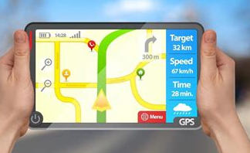
Has a map or GPS ever misled you?
How do you determine the accuracy of any compass, map, or GPS?
You must compare and calibrate it
to a reliable standard.

Slide 28
2) How do you know if your “moral compass”
(GPS) is reliable
➔Honest Self Examination: 1 Cor 11:28-31 “let a man examine himself, …(dokimazo: test, discern)
30 For this cause many are weak and sickly among you, and many sleep. (obviously been misled)
31 For if we would judge (diakrino: clearly discern) ourselves, we should not be judged”. (Krino: questioned)
In light of Jer. 17:9,10 what standard do you use to accurately “judge” yourself?
(or has been corrupted)?

Slide 29
3) How do you know if your “moral compass”
(GPS) has been corrupted or is reliable?
Honest Self Examination: 1 Cor 11:28-31
Humble God Examination: 1 Cor 11:32
“But when we are judged, (krino: cross examined)
we are chastened (paideu’ō: disciplined) of the Lord,
that we should not be condemned
(Katakrino: sentenced) with the world.”
See also James 4:4-10

Slide 30
Humble God Examination: Ps. 139:23-24
“Search me, (ḥāqar’: examine intimately)
O God and know my heart:
Try me (bāḥan’: test, prove, investigate),
and know my thoughts:
And see if there be any wicked (ʿōṣeb: idol)
way (derek: manner) in me,
and lead me in the way everlasting.”

Slide 31
Ps 16:11 “Thou wilt shew me the path of life:
in thy presence is fulness of joy;
at thy right hand there are pleasures for evermore.”
When’s the last time you calibrated
your Conscience?
https://sethadamsmith.com/

