Slide 1
History tends to repeat itself!

Slide 2
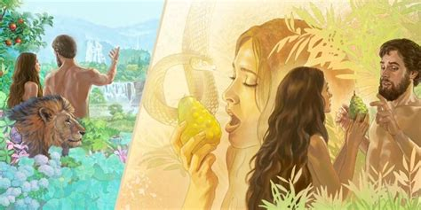
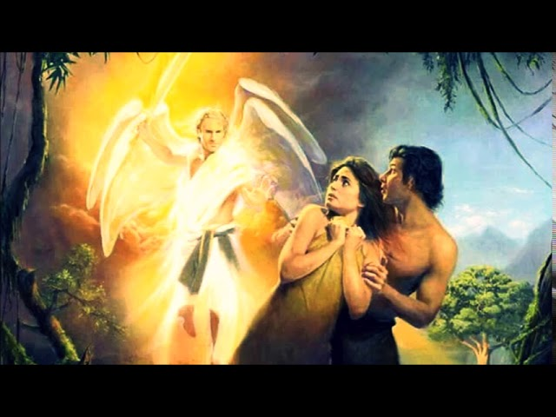
Throughout history there’s a cyclical theme: Rebellion ➔ Reaction (consequences)
and (the offer of) Redemption.
We’re introduced to this cycle in Genesis 3

Slide 3
This cycle is summed up in Rev. 20
7 “when the thousand years are expired,
Satan shall be loosed out of his prison,
8 And shall go out to deceive the nations
which are in the four quarters of the earth,
…to gather them together to battle:
the number of whom is as the sand of the sea.
9 And they went up on the breadth of the earth, and compassed the camp of the saints about, …
: and fire came down from God …, and devoured them.”

Slide 4
In spite of this cycle being played out in every age, and in every human heart,
Why do we, (who are made in God’s image)
repeatedly fall for Satan’s lies and
temptations?

Slide 5
Ro 1:28-32 “Who knowing the judgment of God,
that they which commit such things
are worthy of death,
but have pleasure in them that do them.”
not only do the same,

Slide 6
This cycle is woven throughout History,
because the human heart/soul (mind, will, emotion)
has been corrupted. Ro. 7:21-23
“When I would do good,
I delight in the law of God after the inward man:
But I see another law in my members,
warring against the law (nomos: rule) of my mind (Nous: perception, understanding, feeling)
and bringing me into captivity to the law of sin”
evil is present with me!

Slide 7
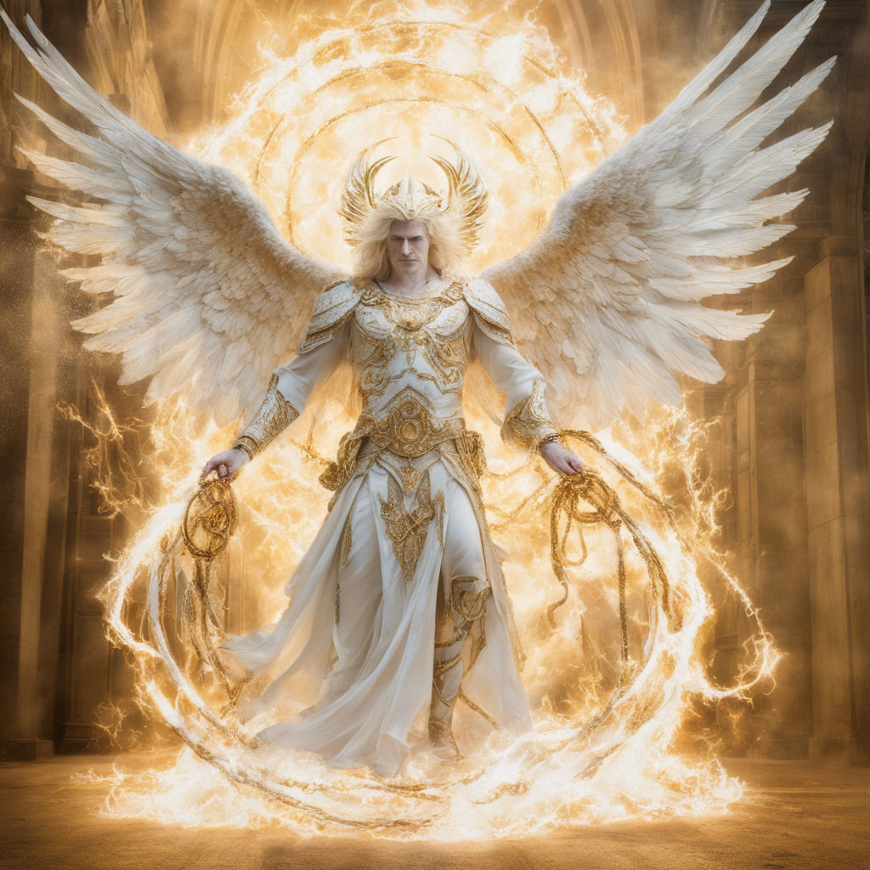
Our mind (perception, Conscience, compass)
has been Corrupted by:
1. Satan. 2 Cor 4:4
“in whom the god
of this world hath blinded
(typhlo’ō: obscure, darken)
the minds (no’ema:
perception, purpose)
(See also Eph. 2:1-3)
2 Cor 11:14

Slide 8
Our Conscience (compass) is Corrupted by:
1. Satan. 2 Cor 4:4 “hath blinded the minds…”
A. Our Perception (recognition) influences
our Purposes (reason, rationality, choices)
B. Our Choices affect our Conscience
synei’dēsis: co-perception! Titus 1:15 “to them that are defiled and unbelieving is nothing pure;
but even their mind and conscience is defiled.” (miainō: stained, polluted, contaminated)
& vice versa!

Slide 9
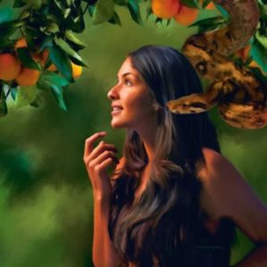
After choosing Satan’s lies, they “saw” :
1) The tree (good and evil) differently! Gen. 3:6
“And when the woman saw that the tree was
good for food, and was pleasant to the eyes,
and a tree to be desired to make one wise,
she took of the fruit …and gave also unto her husband”
1 John 2:16

Slide 10
After choosing Satan’s lies, they “saw” :
2) Each other differently! Gen. 3:7,8
7 “And the eyes of them both were opened, and they knew that they were naked; and they sewed fig leaves together, and made themselves aprons.”
From innocent (2:25)
to ashamed! (3:7,8)

Slide 11
After Choosing Satan’s lies they saw:
3) God differently! Vs 8-10
“And they heard the voice of the LORD God walking in the garden in the cool of the day:
and Adam and his wife hid themselves from the presence of the LORD God.
10 “I heard thy voice
and was afraid”

Slide 12
Our Conscience (compass) is Corrupted by:
Self (interest and/or perspective)
A. This was Satan’s “poisoned” promise. Gen. 3:6
“Ye shall be as gods, knowing (yada’) good and evil.”
1) “Yada” has several subtle meanings/ uses.
a) It’s translated: “Know or Knowledge” 750x,
“perceive” 18x; “acquaintance” 6x;
“declare, show, tell, or teach” 37x
b) Not just an awareness or understanding,
but “declaring” (deciding) what’s good/evil.

Slide 13
Self (interest/perspective)
B. Acting on this poisoned promise corrupted us.
Ro 5:12 “as by one…sin entered into the world, …
so death hath passed upon all…
Jer. 17:9 “The heart (labe: understanding) is deceitful (ʿāqōb’: crooked, twisted) above all things,
and desperately wicked:” (ʾānash’: incurably sick)
Is 53:6 “all we like sheep have gone astray,
We have turned everyone to his own way!”
For all have sinned!”

Slide 14
This “infection” affects our perception & choices. Eph 4:17-18 “walk not as other Gentiles,
in the vanity {mataios: emptiness/ } of their mind,
Having the understanding darkened, (skotizo: obscured)
being alienated from the life of God (2 Cor 6:14)
through the ignorance that is in them,
because of the blindness
(Pō’rōsis: callousness, hardness)
of their heart: (kardia: thoughts, mind, feelings)
idol

Slide 15
B. Acting on this poisoned promise corrupted us.
1) This “infection” affects our perception/choices.
Eph 4:19 “Who being past feeling (apal’geō: apathetic)
have given themselves over (paradidōmi: yielded)
(Same word Satan used in Luke 4:6)
unto lasciviousness, (asel’geia: wantonness)
to work all uncleanness with greediness.” (pleonexia’a: covetousness)
See Rom 1:18-32

Slide 16
Our Hearts/Minds have been corrupted:
3. By Sin:
A. “Sin” (hamartia) literally means:
1) To offend (skandalizo: to hurt/ snare)
Who do we offend (hurt) by our sin?
a) Others. Mt. 18:15-22
b) Ourselves Mt 18:23-25
vs 34 “deliver him to the tormentors…”

Slide 17
Ro. 7:14 “For we know that the law is spiritual:
but I am carnal, sold under sin.
that which I do I allow not: what I would, that do I not;
but what I hate, that do I….
23b I see another law in my members,
warring against the law of my mind,
and bringing me into captivity to the law of sin which is in my members.
24 O wretched man that I am!
Who shall deliver me from the body of this death?”

Slide 18
c) God! Eph. 4:30 “grieve not (lype’ō: distress, make sorrowful)
the Holy Spirit of God, whereby ye are sealed
(sphragizō: stamped for security/preservation)
unto the day of redemption.”
Eph.1:13-14
“In whom ye also trusted, …after that ye believed,
ye were sealed with that holy Spirit of promise,
Which is the earnest of our inheritance
(arrabōn: security deposit)
until the redemption of the purchased possession”

Slide 19
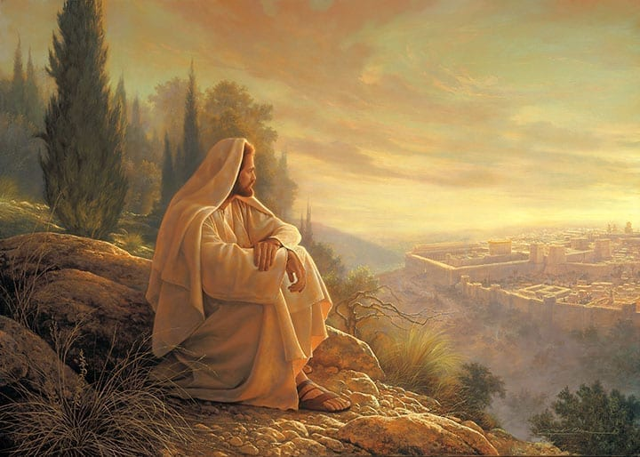
Lk 19:41-44 “he beheld the city, and wept over it, saying, If thou hadst known, even thou, at least in this thy day, the things which belong unto thy peace!
but now they
are hid from
thine eyes…
Because thou knewest not the time of thy visitation.”

Slide 20
A. “Sin” (hamartia) means: 1) To offend:
2) To Trespass: Mk 11:25; Mt 18:15; 35
a) Greek: (parap’tōma) to deviate or fall:
From What?
From Whom?
To What?
To Whom?
b) English:
➔ Commit injury to person, property, or rights;
especially to enter onto another's land wrongfully.
➔ Infringe on the privacy, time, or attention of another.
➔ To commit an offense or sin; to transgress or err.

Slide 21
When we trespass (sin):
Whose “property” are we trespassing on?
Whose “attention” are we now getting?
Remember Christian and Hopeful trespassing on Giant Despair’s property?
John Bunyon’s “Pilgrim’s Progress” Published in 1678

Slide 22
3. Our conscience/ compass is Corrupted by Sin:
A. “Sin” (hamartia) means to Offend and/or
Trespass.
B. It comes from hamartano which means:
“to miss the mark (skopos: God’s Goal {Phil. 3:14})
and so not share the prize” (brebei’on: award/reward)
1) God has a “mark” (purpose/goal) for us.
(Eccl. 3:9; Jer 29:11; 1 Cor 3:9; Rev 4:11)
Phil 3:14 “I press toward the mark (skopos: goal) …
of the high calling of God in Christ Jesus”

Slide 23
Sin: “to miss the mark (skopos: God’s Goal {Phil. 3:14})
and so not share the prize” (brebei’on: award/reward)
1) God has a “mark” (goal/purpose) for each of us.
2) God has a “Prize” for each of us. Phil. 3:14
“I press toward the mark for the prize (brabeion: umpire)
of the high calling of God…”
Mt 25:21,23 “well done good and faithful servant…
enter thou into the joy of the Lord”
34 “inherit the kingdom prepared for you”
Jn 14:3 “I go to prepare a place for you”

Slide 24
Satan uses our own Selfishness (Jm 1:12-16)
to tempt us to sin, which results in our:
Offending/grieving God. Eph. 4:30; Pr 6:16-19
Obscuring our mind/conscience. 1 Tim. 1:5; Pr 4:19
Drifting further from God. Jm 1:16
Forfeiting the Prize/Peace of God. Is 48:22
2 Tim 4:3-4 “For the time will come when they will not endure sound doctrine; but after their own lusts shall they heap to themselves teachers, having itching ears;
And they shall turn away their ears from the truth”

Slide 25
Contrast this “current” attitude with Paul’s
in vs 6-8 “For I am now ready to be offered,
and the time of my departure is at hand.
I have fought a good fight, I have finished my course, I have kept the faith:
Henceforth there is laid up for me a crown of righteousness, which the Lord, the righteous judge,
shall give me at that day:
but unto all them also that love his appearing.
10..Demas hath forsaken me having loved this world”
and not to me only,

Slide 26
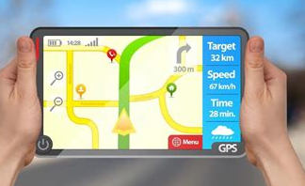
Has a map or GPS ever misled you?
How do you determine the accuracy of any compass, map, or GPS?
You must compare and calibrate it
to a reliable standard.
What “reliable Standard” do you use?

Slide 27
2) How do you know if your “moral compass”
(GPS) is reliable
➔Honest Self Examination: 1 Cor 11:28-31 “let a man examine himself, …(dokimazo: test, discern)
30 For this cause many are weak and sickly among you, and many sleep. (obviously been misled)
31 For if we would judge (diakrino: clearly discern) ourselves, we should not be judged”. (Krino: questioned)
In light of Jer. 17:9 what standard do you use to
accurately “judge” yourself?
(or has been corrupted)?
Jer 17:10; Ps 119:9

Slide 28
Humble “other” examination: Heb 3:12,13
“Take heed, lest there be in any of you an evil heart of unbelief, in departing from the living God.
But exhort one another daily, …lest any of you be hardened through the deceitfulness of sin.”
Heb. 10:23-24 “Let us hold fast the profession of our faith without wavering; for He is faithful…
And let us consider (katanoe’o: observe) one another
to provoke unto love and to good works:”

Slide 29
Honest Self Examination: 1 Cor 11:28-31
Humble “other” examination: Heb 10:23-25
Heartfelt God Examination: 1 Cor 11:32
“But when we are judged, (krino: cross examined)
we are chastened (paideu’ō: disciplined) of the Lord,
that we should not be condemned
(Katakrino: sentenced) with the world.”
See also James 4:4-10

Slide 30
Humble God Examination: Ps. 139:23-24
“Search me, (ḥāqar’: examine intimately) O God and know my heart: (lēḇāḇ: mind, understanding)
Try me (bāḥan’: test, prove, investigate),
and know my thoughts:
And see if there be any wicked (ʿōṣeb: idol)
way (derek: manner) in me,
and lead me in the way everlasting.”

Slide 31
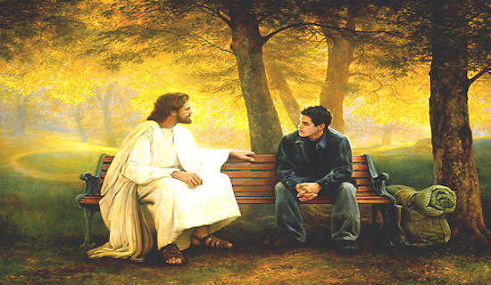
Ps 16:11 “Thou wilt shew me the path of life:
in thy presence is fulness of joy;
at thy right hand there are pleasures for evermore.”
When’s the last time you calibrated
your Conscience?
https://sethadamsmith.com/

