Slide 1
Pictures of the People of God
Seeing ourselves through God’s Eyes.

Slide 2
The Pictures of God’s People
Many words (pictures and parables) can have multiple definitions and/or applications,
many of which are affected by our own experiences/perspectives.
Most define “church” as either a building
or a loosely associated group of people.
Like a “Sam’s” or “Costco” Club member.
I “go to” (or shop at?!?)…

Slide 3
God sees his church much differently
The word church is derived from the Greek kuriaskos’, meaning “belonging to the Lord”
And ekklesia, from ek: out & Kaleo (a calling)
Taken together these two words imply the church is:
“a called out assembly of people
that belong to the Lord!”

Slide 4
He uses many “pictures” to describe us:
Hidden Treasure (Mt. 13:44)
Costly Pearls (Mt 13:45,46)
Clay in a master potter’s hands (Is. 64:8)
His Bride to be. (Eph. 5:22-33; Rev. 19:7)
His Flock of Sheep (Ps. 23; 100; Jn 10)
Members of His Family!

Slide 5
We’re Introduced into God’s Family by:
“Birth” (Spiritual Conception/Regeneration)
John 3:3; Titus 3:5; 1 Peter 1:23
“Adoption” (Spiritual Selection/Invitation)
See John 3:16; Ro. 8:15, 23; Gal. 4:5; Eph. 1:5
“predestined us unto the adoption of Children
by Jesus Christ…”

Slide 6
Eph 2:18,19 “For through him (Jesus) we have access by one Spirit unto the Father.
Now therefore ye are no more strangers
and foreigners,
but fellow-citizens with the saints,
and of the household of God!”

Slide 7
Last time we discussed the Privileges of
being a part of God’s Family, which include:
A. Receiving His Nature (Gal. 4:4-6)
B. Sharing His Resources (2 Pt. 1:3-4)
C. Bearing His Name (Acts 11:26 “Christians” )
(We reflect/affect His Reputation)
Mt. 5:16; Ro. 2:24

Slide 8
With Great Privilege comes Great Responsibility!
These can produce “Great Pressures!”

Slide 9
The Pressures of God’s Family
The family is the laboratory of life!
What we learn (or don’t learn) about relationships in our families,
Follow us throughout our lives!
If the Church is a family,
Then we’ll face many of the same challenges as a large (diverse) family.

Slide 10
The Pressures of God’s Family
1. Different levels of Spiritual Maturity
A) Some are “natural” 1 Cor 2:14
“the natural man (psychikos: Soul based sensitivity)
receiveth not the things of the Spirit of God:
for they are foolishness unto him: (mori’a: absurd)
neither can he know them, (ginosko: discern/understand)
because they are spiritually discerned. “
(Pneumatikōs: Spirit based sensitivity)

Slide 11
The Pressures of God’s Family
1. Different levels of Spiritual Maturity.
A. Some are “natural” 1 Cor 2:14
1) They’re not actually part of God’s family.
Profess but don’t Possess genuine faith. Mt 7:21-23
2) These are the “tares” in Mt.13:24-30
3) These are the “hard soil“ of Mt. 13:19
4) Symbolized by the “Mixed Multitude” (Ex. 12:38
and Neh. 13:3) who came “along for the ride”
d)

Slide 12
1) Some are “natural” 1 Cor 2:14
5) These often affect the actual “believers”. Nu 11:4 “the mixt multitude that was among them fell a lusting: and the children of Israel also wept again, and said,
Who shall give us flesh to eat?”
Heb 3:15-17 “To day if ye will hear his voice, harden not your hearts, as in the provocation. For some, when they had heard, did provoke: … not all that came out of Egypt
…. But with whom was he grieved 40 years? Was it not with them that had sinned…who fell in the wilderness?”

Slide 13
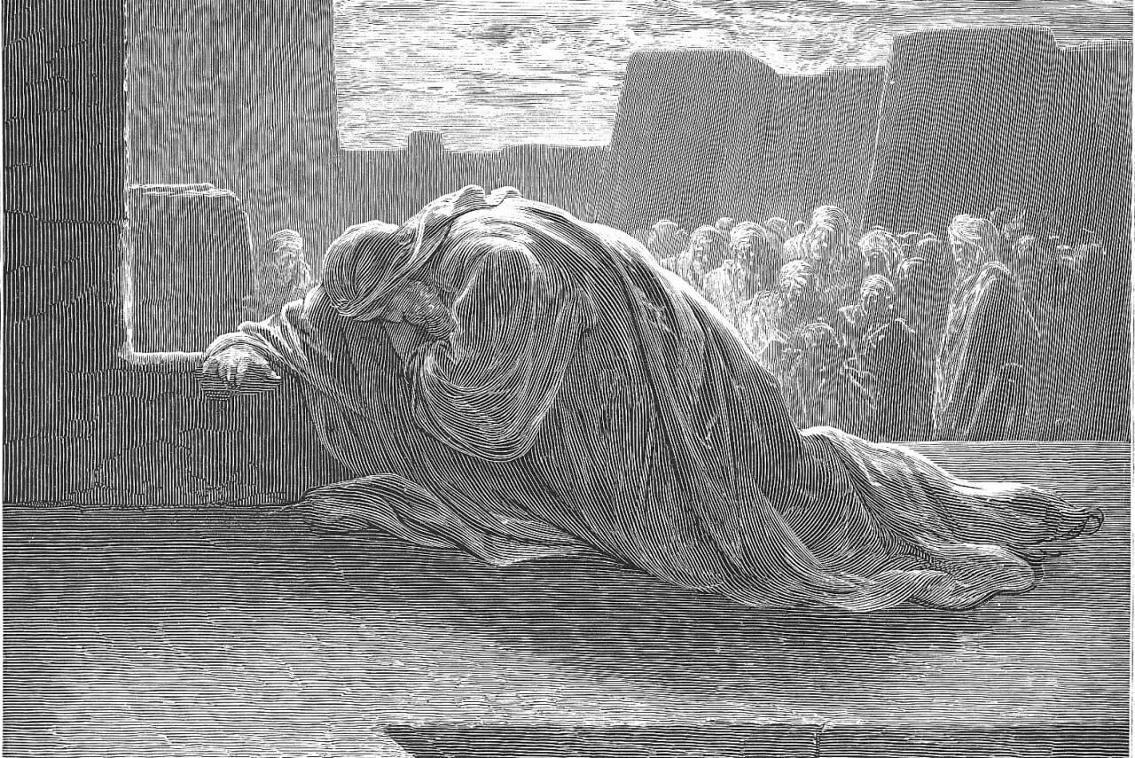
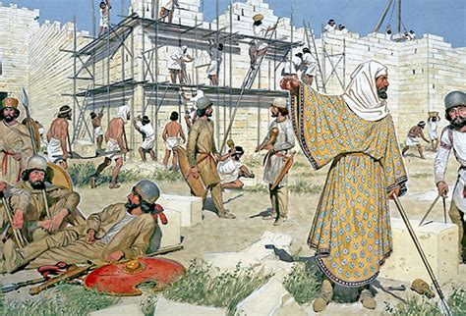
1) Some are “natural” 1 Cor 2:14
e) These often affect the actual “believers”.
Ezra 9 and Nehemiah 13 provide painful lessons about the impact this “mixed multitude” can have on God’s People and Plan.

Slide 14
1. Levels of spiritual maturity
B. Some are “Spiritual” 1 Cor 2:15,16
“But he that is spiritual (pneumatikos: spiritually sensitive)
judgeth all things, (mem {truly} anakrino {examines})
For who hath known the mind of the Lord…?
But we have the mind of Christ.”
nous: understanding (of the Spirit)
1) These are the “good ground” of Mt. 13:23
2) These are the mature (of full age) in Heb. 5:14
3) These are the “Perfect” (telios) in Phil. 3:15

Slide 15
1. Levels of spiritual maturity
C. Some (most) are “Carnal” 1 Cor 3:1-3
“I, brethren, could not speak unto you as unto spiritual, but as unto carnal, even as unto babes in Christ.
I have fed you with milk, and not with meat:
for hitherto ye were not able to bear it…,
For ye are yet carnal: for whereas there is among you envying, and strife, and divisions,
are ye not carnal, (sarkikos’: temporal, fleshly focus)
and walk as (unregenerated) men?”

Slide 16
1. Levels of spiritual maturity
C. Some (most) are “Carnal” 1 Cor 3:1-3
1) These are the babes in Heb. 5:11-13
2) They’re the “rocky, shallow, weedy” of Mt. 13:20-22
3) These are easily influenced by the natural “tares”.
4) These are “enemies of the cross” in Phil. 3:18,19
19 “Whose end is destruction, (apolia: waste Mt. 5:13)
whose God is their belly, (carnal appetites)
and whose glory is in their shame, who mind (phroneo: regard, value) earthly things.” (1Jn 2:15-17)

Slide 17
2. Emotional/Relational maturity
A. Jesus demonstrated this priority.
1) He’s our “example”! Ro 8:28,29; Phil 3:10
Lk 2:40 “waxed strong in spirit, filled with wisdom:
and the grace of God was upon him.
52 “Jesus increased in wisdom (Sophia Jms 3)
and stature, (heliki’a: Maturity)
and in favor (char’is: grace) with God
and man.”

Slide 18
2. Emotional/Relational maturity
B. A sure sign of immaturity is
self absorption.
Ro 15:1-3 “We then that are strong ought to bear the
infirmities of the weak, and not to please ourselves!
Let every one of us please his neighbor
for his good to edification.
For even Christ pleased not himself…”

Slide 19
2. Emotional/Relational maturity
B. A sure sign of immaturity is self absorption.
Phil. 2:3-5 “Let nothing be done through strife or vainglory; but in lowliness of mind
let each esteem other better than themselves.
Look (skopeo: regard) not every man on his own things,
but every man also on the things of others.
5 Let this mind be in you which was in Christ…”

Slide 20
2. Emotional/Relational maturity
Maturity can be measured by
an attitude of “self denial!”
Mt 16:24 “If any man will come after me,
let him deny himself,
and take up his cross,
and follow me.”
(also Mark 8:34; Luke 9:23)

Slide 21
2. Emotional/Relational maturity
1) Such Maturity develops under pressures.
1 Peter 2:21 “hereunto were ye called: because
Christ also suffered for us, leaving us an example,
that ye should follow his steps:”
Heb. 5:8 “Though he were a son, yet learned he obedience through the things he suffered.
9 And being made perfect, he became the author of eternal salvation unto all them that obey him;”

Slide 22
The Pressures of God’s Family
3. Diversity Were just different! 1 Cor 4:7
“For who maketh thee to differ from another?”
A. We tend to migrate/appreciate those with whom
we agree or share common interests/experiences.
1) These relationships are most “comfortable”
because they require the least “adjustments”.
1Cor 2:4,22 “I am of Paul…Apollos…Cephas”

Slide 23
2. Diversity 1 Cor 4:7
B. The more diversity,
1) Friction is inevitable when people and things
aren’t moving in the same direction
and at the same speed!
2) Friction produces heat.
3) Heat / Pride causes things to expand. (Swell)
Pro 13:10 “Only by pride cometh contention:
but with the well advised is wisdom.“
4) God’s Spirit is symbolized by Oil! (Zech. 4:1-6)
the more “friction”.

Slide 24
2. Diversity 1 Cor 4:7
C. The more Grace/Godliness (maturity), the more
1) Cooperation! Eph. 4:14-16
2) Compassion! 1 Cor 13:4-6
“Charity vaunteth not itself, is not puffed up,
…seeketh not her own”
1 Peter 4:8 “above all have fervent charity among yourselves:
for charity shall cover the multitude of sins.”

Slide 25
2. Diversity 1 Cor 4:7
C. The more Grace/Godliness, the more
1) Compassion 2) Cooperation
3) Completion (accomplishment) 1 Cor 4:1-2
“…so account of us, as of the ministers of Christ,
(Hypēret’ēs: literally under oarsemen)
and stewards of the mysteries of God.
Moreover it is required in stewards,
that a man be found faithful”
What happens if oarsmen aren’t working together?

Slide 26
Conclusion
The Privileges & Problems of families include
being involved in committed relationships
with people of differing maturity levels.
God designed the Family to help us grow in spiritual & relational maturity.
Others benefit (or suffer) based on how effectively this is accomplished.

Slide 27
As Part of God’s Family
We have both Privileges and Problems.
Thankfully God uses these as part of His process to Perfect (Mature) us! (Ro. 8:28,29)
“we know that all things work together for good to them that love God, to them who are the called
according to his purpose.
For whom he did foreknow, he also did predestinate
to be conformed to the image of his Son.”

Slide 28
Conclusion:
Our Heavenly Father is involved in this process:
1 Thes 5:23 “The very God of peace sanctify (hagiazo: purify)
you wholly; (holoteles’: completely)
And so do we!
and I pray God your whole spirit (pneuma)
and soul (psyche) and body (soma) be preserved
tereo: to guard from loss or injury
blameless unto the coming of our Lord Jesus Christ.”
2 Pt 3:18 “Grow in Grace and Knowledge of our Lord…”

Slide 29
God begins this maturing process through our Human Families;
and Continues (perfects) it through the Church Family.

Slide 30
God expects His church family to be at least as committed as our human families!
Heb 10:22-24 “Let us draw near with a true heart
in full assurance of faith…
Let us hold fast the profession of our faith without wavering; (for he is faithful that promised;)
let us consider (kataoneo: understand) one another
to provoke (paroxysmos’: sharpen, exasperate!)
unto love and to good works:”

Slide 31
Heb 10:25
“Not forsaking the assembling of ourselves together,
as the manner of some is;
but exhorting (parakaleō: call beside) one another:
and so much the more,
as ye see the day approaching.”
1 Tim. 4; 2 Tim. 3 & 4 all describe these last days!
Read these passages and you‘ll recognize
they are upon us!

Slide 32
Heb 3:13 “exhort one another daily, … lest any of you be hardened through the deceitfulness of sin.”

Slide 33
What is your current level of
1) Spiritual Maturity?
Natural? Carnal? Spiritual?
2) Relational Maturity?
(Often measured by our appreciation of diversity!)

Slide 34
Are you committed to Partnering with God
(and His people)
as He seeks to Grow us into a functioning
family of faith?

