Slide 1
Pictures of the People of God
Seeing ourselves through God’s Eyes.

Slide 2
Pictures of God’s People
Our Perspective is shaped by our Perception.
Our Perception can be poisoned by deception!
Lies that are believed have great power over us.
2 Cor 4:4 “The God of this world blinds the minds…”

Slide 3
That’s why it’s important for us to see ourselves and others through God’s eyes!
The Bible reveals many different truths & pictures that enable us to do this.
2 Cor. 4:6,7 “God…commanded the light to shine…in our hearts
…we have this treasure in earthen vessels”

Slide 4
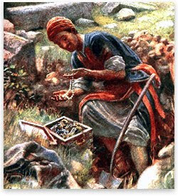
God describes us in many ways: Pt 1: He sees us as a hidden treasure.
“The kingdom of heaven is like unto treasure hid in a field;
the which when a man hath found, he hideth,
and for joy thereof goeth
and selleth all that he hath,
and buyeth that field.”
Agorazo: to redeem

Slide 5
Pt. 2 We’re Goodly Pearls of Great Price!
Mt 13:45,46 “The kingdom of heaven is like unto a merchant man, seeking goodly pearls:
Who, when he had found one pearl of great price,
(Poly’timos: extraordinary value)
went and sold all that he had, and bought it.”

Slide 6
Pt. 3 We’re like clay in the hands of a Master Potter. Jer. 18:1-6
“Behold, as the clay is in the potter's hand,
so are ye in mine hand”
Is 64:8 “Lord, thou art our father; we are the clay,
and thou our potter;
We are the work of thy hand”
Eph. 2:10 “we’re His workmanship”

Slide 7
Pt 4: We’re the Bride of Christ!
2 Cor 11:2 “espoused…to Christ…”

Slide 8
Pt. 5: God sees us as His Sheep!
Ps 100:3 “the Lord, He is God… we are his people,
and the sheep of his pasture.”
Jn 10:27 “My sheep hear my voice…
and they follow me.”
1 Pt 5:2 “feed the flock of God…”
Mt 9:36 “when he saw the multitudes, he was moved with compassion… because they were as sheep having no shepherd.”

Slide 10
1. This Picture describes our problems.
A. We are “Prone to wander.” Is. 53:6
“All we like sheep have gone astray,
we’ve turned everyone to his own way.”
1) Sheep are indiscriminate eaters and can be led
astray by following their appetites.
Phil. 3:18,19 “for many walk…who are the enemies of the
Cross of Christ; whose God is their belly…
who mind (phroneō: disposed, regard) earthly things.”

Slide 11
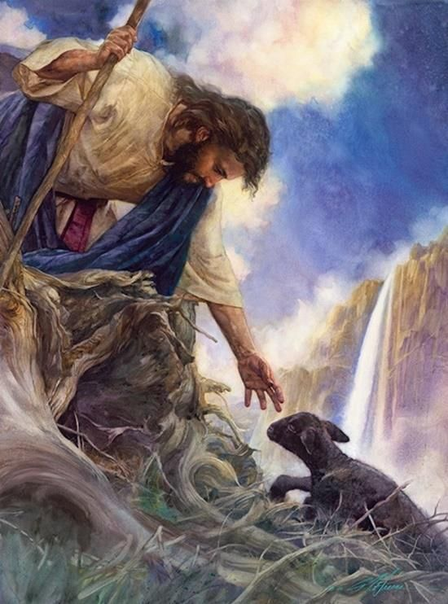
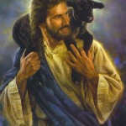
A. We’re Prone to Wander.
2) This is why the Shepherd goes after the lost sheep. Lk 15:3-7
⁵ ”And when he hath found it, he layeth it on his shoulders, rejoicing. …
⁶ rejoice with me!
for I have found
my sheep
which was lost.”

Slide 12
1. This Picture describes our problems.
B. We are Prone to “Poison.” (Deception)
1) Sheep have trouble differentiating between
healthy and unhealthy plants.
a) The shepherd prepares the field they’ll be
grazing in by removing poison plants.
Ps. 23:5 “Thou preparest a table before me…”
John 10:4 “And when he putteth forth his own sheep,
he goeth before them,
and the sheep follow him: for they know his voice.”

Slide 13
B. We are Prone to “Poison.” (False Doctrine)
b) That’s why God challenges Pastors (shepherds) to
“Preach the Word…reprove, rebuke, exhort with all longsuffering and doctrine.
For the time will come when they will not endure sound doctrine; but after their own lusts shall they heap to themselves teachers, having itching ears;
And they shall turn away their ears from the truth,
and shall be turned unto fables.”
2 Tim. 4:2-4

Slide 14
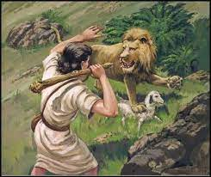
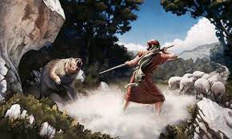
C. We’re Prone to “Predators”
1) Sheep have no natural defenses.
(Their only security is the Shepherd!)
Ps. 23:5 “thou preparest a table before me
(arak’: to order, arrange, furnish, battle)
in the presence of mine enemies.”
a) David learned this personally!
1 Sam. 17:37

Slide 15
C. We’re prone to predators. 1Pt 5:2-4,8,9
2 “Feed the flock of God which is among you, taking the oversight thereof, not by constraint, but willingly
3 Neither as being lords over God's heritage, but being ensamples to the flock.
4 And when the chief Shepherd shall appear, ye shall receive a crown of glory that fadeth not away. …
8 Be sober…vigilant; because your adversary the devil, as a roaring lion, walketh about,
seeking whom he may devour”

Slide 16
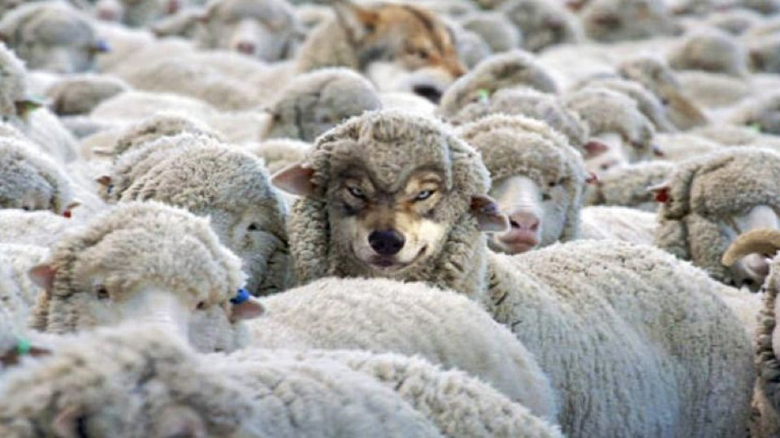
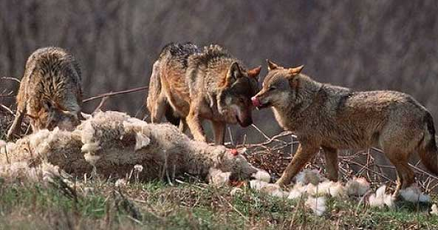
C. We’re Prone to Predators.
2) That’s why Satan seeks to Infiltrate the flock
to divide us from the Shepherd! Mt 7:15
“Beware of false prophets, which come to you in sheep's clothing,
but inwardly they are ravening wolves.”

Slide 17
D. We’re prone to division.
1) Sheep are “followers” so Satan infiltrates the
flock with Bitterness / Rebellion. 1 Sam 15:23
“rebellion is as the sin of witchcraft…”
Merî (rebellion) comes from mara (Bitterness).
Bitterness is infectious! (Heb. 12:15)
“Looking diligently lest any fail of the grace of God;
lest any root of bitterness springing up trouble you,
and thereby many be defiled”
Miano: contaminated!

Slide 18
D. We’re prone to division.
2) Satan tries to accomplish this through:
a) False Shepherds. Acts 20:28-29
“Take heed to yourselves, and to all the flock,
over which the Holy Ghost hath made you overseers,
to feed (poimain’ō: shepherd) the church of God,
which he hath purchased with his own blood.
For I know this, that after my departing shall grievous wolves enter in among you, not sparing the flock.”

Slide 19
Acts 20:30 “Also of your own selves shall men arise,
speaking perverse things,
(diastreph’ō: distorted and corrupted)
to draw away disciples after them.”
(1) That’s why we all need to know the scriptures!
(Mt. 22:29; Acts 17:11; 2 Tim. 2:15; Heb. 13:7,17)
“Remember them which rule over you, who have spoken unto you the word of God; whose faith follow,
considering the end of their conversation”
(See Mt. 7:15-20; 2 Cor 11:13,14)

Slide 20
1) Satan fuels Bitterness/Rebellion from…
b) False Sheep. (Followers/Tares) Ro 16:17-18
“brethren, mark (skopeo: consider) them which cause divisions (dichostasi’a: disunion) and offences (skan’dalon: trap stick) to the doctrine ye have learned;
and avoid them. (Ekklinō: shun)
For they that are such serve not our Lord Jesus Christ, but their own belly; and by good words and fair speeches deceive the hearts of the simple.”
(a’kakos: innocent, uninformed) Pr. 13:10; 22:10

Slide 21
2) Satan infiltrates the flock with rebellion.
b) False followers (Rebellion against leaders)
1 Sam 15:23 “rebellion is as the sin of witchcraft”
(1) Remember Korah’s rebellion! Numbers 16
(a) Korah (Dathan & Abiram) “took men” (vs 1)
(b) Those “took” 250 others. vs 2
(c) “They Gathered together against Moses” Vs 3
(d) God publicly “tested them” (16-20)
1 Cor 11:18,19 “there must also be heresies (disunion)
that they which are approved might be manifest”

Slide 22
(e) God publicly judged them. Vs 28-35
32 “the earth opened her mouth, and swallowed them up, and their houses, and all the men that appertained unto Korah, and all their goods.
(f) The infection spreads. vs 41 “But on the morrow all the congregation of the children of Israel murmured against Moses & Aaron…
Ye have killed the people of the LORD.”
God sent a Plague killed 14,700!?!Vs 49
James 3:5 “How great a matter a little fire kindleth”

Slide 23
1. This Picture describes our problems.
E. We’re Prone to Panic!
1) We’re Easily influenced!
Sheep are easily “spooked” and tend to react
with a “crowd mentality.”
a) This tends to produce a “stampede effect” where
others can get “caught up”, confused and hurt.
➔ Korah? Numbers 16
➔ Jesus’ judgement before Pilate? Mt 27:22
(Dominant Dams!)

Slide 24
1. This Picture describes our problems.
E. We’re Prone to Panic!
b) Most “church problems” can easily be resolved
if we follow Christ’s prescription. (Mt 18)
(1) Jesus addresses the inevitability of “offences” vs 7
(2) He shares the parable of the lost sheep. (vs 11-14)
(3) Gives directions on how to resolve offences. (15-17)
(4) Warns about the consequences of unforgiveness. (21-33)
(a) Our Pride keeps us from forgiveness / reconciliation.
(b) This inevitably “infects us” with bitterness.
(c) We tend to “infect” others. (Heb. 12:15)

Slide 25
E. We’re Prone to Panic!
2) We’re easily Infected!
a) Insects & mites lay eggs in head/facial wounds.
(Psoroptes ovis) which can easily spread when the
sheep “get their heads together.”
Pr 16:27-28 “An ungodly man diggeth up evil:
and in his lips there is as a burning fire.
A froward (from hapak: to overturn) man soweth strife:
and a whisperer separateth chief friends.”
God refers to this as “seeds of discord”. Pr. 6:16-19

Slide 26
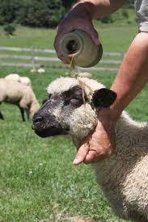
E. We’re Prone to Panic!
2) We’re easily Infected!
b) Wise shepherds rub medicinal oil on their heads
to prevent or kill mites that have already infected.
Ps. 23:5 “Thou annointest my head
with oil…”
Oil is a picture of the Holy Spirit.
Zech 4:6 “Not by might, nor by power,
but by my spirit, saith the LORD”

Slide 27
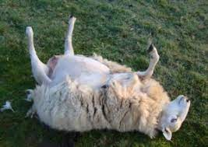
1. This Picture describes our problems.
F. We’re also Prone to becoming “bloated.”
1) This condition is called becoming “cast”.
(gasses in stomach cause bloating when on back)
2) Usually caused by being overweight (Heb 5:12-14)
or having too much wool.
3) If they don’t get help quickly,
they can die within a day!
Gal. 6:1 “if a man… be overtaken…
ye which are spiritual, restore…”

Slide 28
Conclusion: We, like sheep, are prone to:
Wander (Get distracted and sidetracked) Jms 1:14-16
Poison (Ingest unhealthy things) 1 Thes. 5:21,22
Predators (Fall prey to evil/deceit) 2 Tim. 3:13
Division (Often motivated by pride) 1 Cor 3:1-4
Panic (Influenced/Infected) Heb. 12:15
Bloat (Overtaken and overwhelmed) Gal. 6:1
Which of these problems are you struggling with?

Slide 29
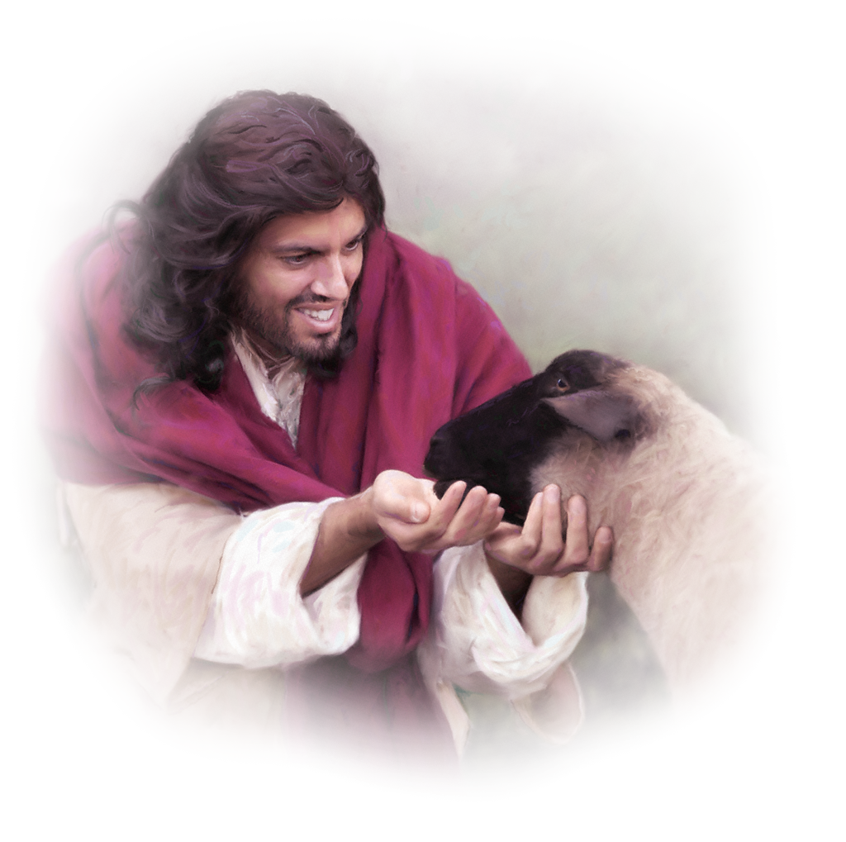
What’s the solution for all of these Problems?
Staying Close to the Shepherd!
Ps. 23:1 “The LORD is my Shepherd; I shall not want!”
(ḥāsēr’: lack or fail)
1 Pt 5:7 “Casting all your cares upon Him
For he careth for you.”
melo: interested, concerned
Mer’imna: concerns, distractions

Slide 30
Next week we’ll focus on the Provision God gives His Sheep!
Jn 10:11 “I am the good shepherd:
the good shepherd giveth
his life for the sheep.”
14 “I am the good shepherd,
and know my sheep,
and am known of mine.”
27 My sheep hear my voice,
and I know them,
and they follow me!”

