Slide 1
Pictures of the People of God
Seeing ourselves through God’s Eyes.

Slide 2
Satan as “the god of this world” (2 Cor 4:4)
rules through “the power of darkness” Col. 1:13
Skotos: from skia (shadow)
He uses the darkness of deception and the distractions of the world to “blind our minds”
to keep us from recognizing and responding to God’s Light/Truth.
(2 Cor. 4:4; 1 Jn 2:15,16; 5:19)
The Satanic Temple statue of Baphomet

Slide 3
1 Jn 1:5 “God is light, (phos: to reveal)
and in him is no darkness”
He sent Jesus to enable us to “see” clearly!
1Jn 1:4-5 “In him was life;
and the life was the light of men.
And the light shineth in darkness.”
Jn 8:12 “I am the light of the world:
he that followeth me
shall not walk in darkness,
but shall have the light of life.”

Slide 4
Col 1:13 God “delivered us from the power of darkness, and hath translated us into the kingdom of his Son”
2 Cor. 4:6,7 “God…commanded the light to shine out of darkness
hath shined in our hearts.
To give the light of the knowledge of the glory of God, in the face (person) of Jesus Christ.
But we have this treasure in earthen vessels…”

Slide 5
1 Jn 1:7 “if we walk in the light, (of His Truth)
as he is in the light,
we have fellowship
one with another,
and the blood of Jesus Christ his Son cleanseth us
from all sin.”
To enable us to walk in His truth, (light)
God’s provides many “truths” about how God sees us.

Slide 6
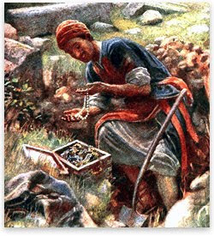
We’ve discussed how God sees us as: Pt 1: A hidden treasure. Mt 13:44
“The kingdom of heaven is like unto treasure hid in a field;
the which when a man hath found, he hideth,
and for joy thereof goeth
and selleth all that he hath,
and buyeth that field.”
Agorazo: to redeem

Slide 7
Pt. 2: Goodly Pearls of Great Price!
Mt 13:45,46 “The kingdom of heaven is like unto a merchant man, seeking goodly pearls:
Who, when he had found one pearl of great price,
(Poly’timos: extraordinary value)
went and sold all that he had, and bought it.”

Slide 8
Pt. 3: Clay in the hands of a Master Potter. Jer. 18:1-6
“Behold, as the clay is in the potter's hand,
so are ye in mine hand”
Is 64:8 “Lord, thou art our father; we are the clay,
and thou our potter;
We are the work of thy hand”
Eph. 2:10 “we’re His workmanship”

Slide 9
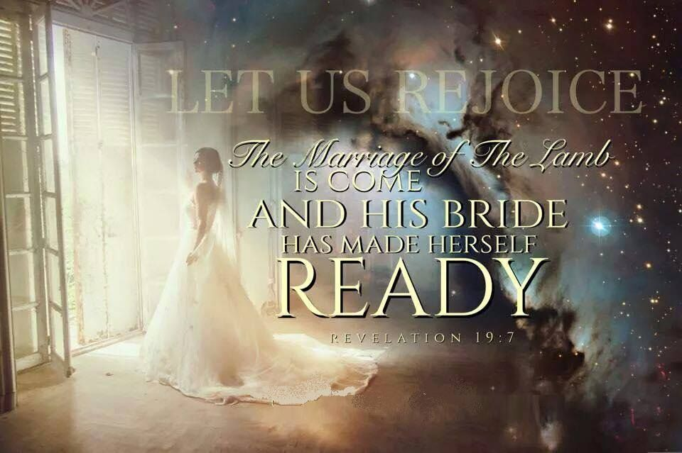
Pt 4: As the Bride of Christ!
2 Cor 11:2 “espoused…to Christ…”

Slide 10
Pt. 5: As Sheep under His care!

Slide 11
1. This Picture describes our problems.
A. We are “Prone to wander.” Is. 53:6
“All we like sheep have gone astray,
we’ve turned everyone to his own way.”
B. We are Prone to Poison. (Deception)
You are what you “eat”!
Ps. 23:5 “Thou preparest a table before me…”
C. We’re Prone to Predators Ps. 23:5 “preparest a
table before me in the presence of mine enemies.”

Slide 12
D. We’re prone to division.
1) Sheep are “followers” so Satan infiltrates the
flock with bitterness / Rebellion. 1 Sam 15:23
“rebellion is as the sin of witchcraft…”
2) Satan tries to accomplish this through:
a) False (or selfish) Shepherds. (Leaders/influencers)
Acts 20:28-29
b) False (or selfish) Sheep. (Followers/Tares) Ro 16:17-18
“mark them which cause divisions and offences...”

Slide 13
D. We’re prone to division.
1 Thes 5:12-14 “know them which labor among you, and are over you in the Lord, and admonish you…
to esteem them very highly in love for their work's sake.
And be at peace among yourselves.
Eirēneu’ō: from eiro: to join (unity/partnership)
Now we exhort you…warn them that are unruly,
(a’taktos: insubordinate)
comfort the feebleminded, support the weak,
be patient toward all men.”

Slide 14
3) Division produces Decisions! (choices)
1Cor 11:18-19 “there be divisions among you…”
(Schisma: splits or gaps) from schizo: to tear
For there must be also heresies among you,
Hair’esis: disunion, a choice
that they which are approved may be manifest”
(dokimos: tested and current after assayal)
a) Our choices reveal our level of maturity 1 Cor. 3:1-3
“there is among you envying, and strife, and divisions, are ye not carnal, and walk as (unregenerated) men?”

Slide 15
Prone to Wander, Poison, Predators, Division
E. We’re Prone to Panic!
Sheep are easily “spooked” (herd/crowd mentality)
1) We’re Easily influenced!
a) Everyone influences someone!
b) The closer we are, the more influence we feel.
c) Sullen, angry sheep influence those around them.
This can produce a “ripple effect” where
others can get “caught up”, confused and hurt.

Slide 16
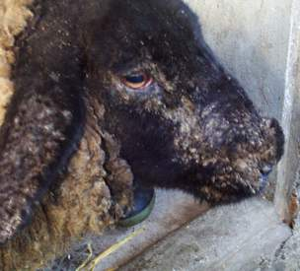
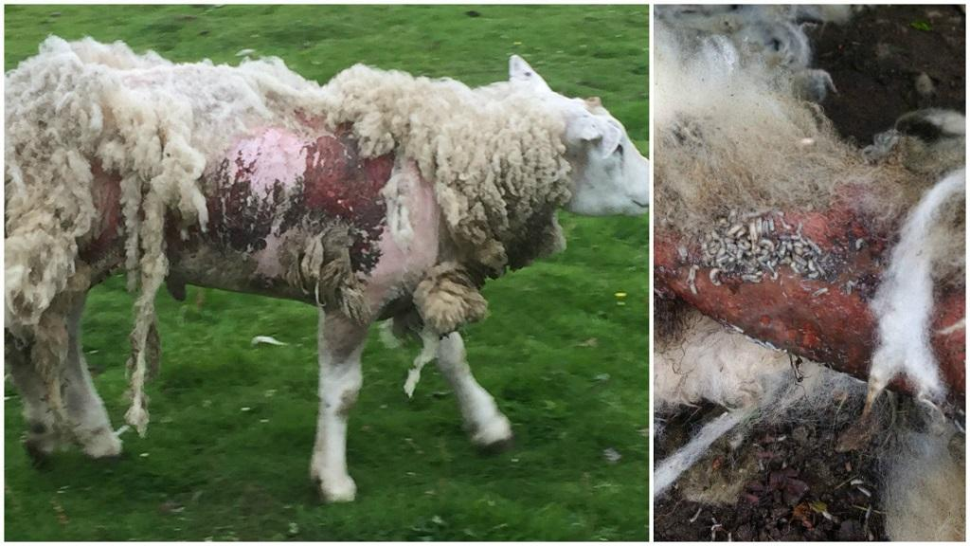
2) Influence can lead to infection!
a) Sheepstrike (Myiasis) comes from flies laying larva in unprotected face/head (or wounds) of sheep.
Transferred when sheep “rub up against each other”

Slide 17
2) Influence can lead to infection!
b) Hurting people often HURT PEOPLE! Ro 16:17,18 “mark them that cause divisions…by good words and fair speeches deceive the hearts of the simple.”
Pr 16:27-28 “An ungodly man diggeth up evil:
and in his lips there is as a burning fire.
A froward (from hapak: to overturn) man soweth strife:
and a whisperer separateth chief friends.”
Pr 6:16-19 refers to this as sowing “seeds of discord”.
And calls it an “abomination to Him”.

Slide 18
2) Influence can lead to infection.
c) Remember Satan is known as:
(1) Baal-zebub (2 Kings 1:2, 3, 6, 16; Mt 10:25)
Literally «The Lord of the flies (Filth)»
(2) Rev. 12:10 “the accuser of our brethren is cast down, which accused them before our God day and night.”
We’re never more like Satan than when we rebel
and spread the infection of bitterness/backbiting!

Slide 19
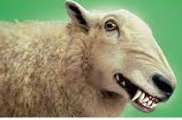
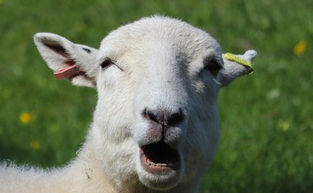
We’re never more like Satan than when we rebel
and spread the infection of bitterness/backbiting!
Gal 5:15-16 “if ye bite and devour one another,
take heed that ye be not
consumed one of another.
Walk in the Spirit,
and ye shall not fulfil
the lust of the flesh.”

Slide 20
Remember Korah’s rebellion! Numbers 16
(1) Korah (Dathan & Abiram) “took men” (vs 1)
(2) Those “took” 250 others. vs 2
“famous (influential) in the congregation…
and they gathered together against Moses” Vs 3
(3) God publicly “tested them” (16-20) (1 Cor 11:18,19)
(4) God publicly judged them. Vs 28-35
(5) The infection spreads. vs 41 “the whole congregation”
God sent a Plague that killed 14,700! Vs 49

Slide 21
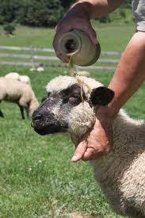
E. We’re Prone to Panic! (Infection)
2) We’re easily Infected!
e) Wise shepherds rub medicinal oil on their heads
to prevent larva/mite infections.
Ps. 23:5 “Thou annointest my head
with oil…”
Oil is a picture of the Holy Spirit.
Zech 4:6 “Not by might, nor by power,
but by my spirit, saith the LORD”

Slide 22
f) Most infections can easily be avoided / resolved
if we apply the oil of Christ’s prescription. (Mt 18)
(1) Jesus addresses the inevitability of “offences” vs 7
(Irritations {Flies} are a part of our fallen world!)
(2) He shares the parable of the lost sheep. (vs 11-14)
(3) Gives directions on how to resolve offences. (15-17)
(4) Warns about the consequences of unforgiveness. (21-33)
(a) Our Pride Causes contentions/offences (Pr. 13:10)
and keeps us from forgiveness / reconciliation.
(b) This inevitably “infects us” with bitterness.
(c) We tend to “infect” others. (Heb. 12:15)

Slide 23
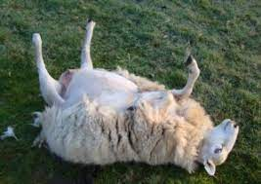
1. This Picture describes our problems.
F. We’re also Prone to becoming “bloated.”
1) This condition is called becoming “cast”.
(gasses in stomach cause bloating when on back)
2) Usually caused by being overweight (Heb 5:12-14)
or having too much wool.
3) If they don’t get help quickly,
they can die within a day!
Gal. 6:1 “if a man… be overtaken…
ye which are spiritual, restore…”

Slide 24
Conclusion: We, like sheep, are prone to:
Wander (Get distracted and sidetracked) Jms 1:14-16
Poison (Ingest unhealthy things) 1 Thes. 5:21,22
Predators (Fall prey to evil/deceit) 2 Tim. 3:13
Division (Often motivated by pride) 1 Cor 3:1-4
Panic (Influenced/Infected) Heb. 12:15
Bloat (Overtaken and overwhelmed) Gal. 6:1
Which of these problems are you struggling with?

Slide 25
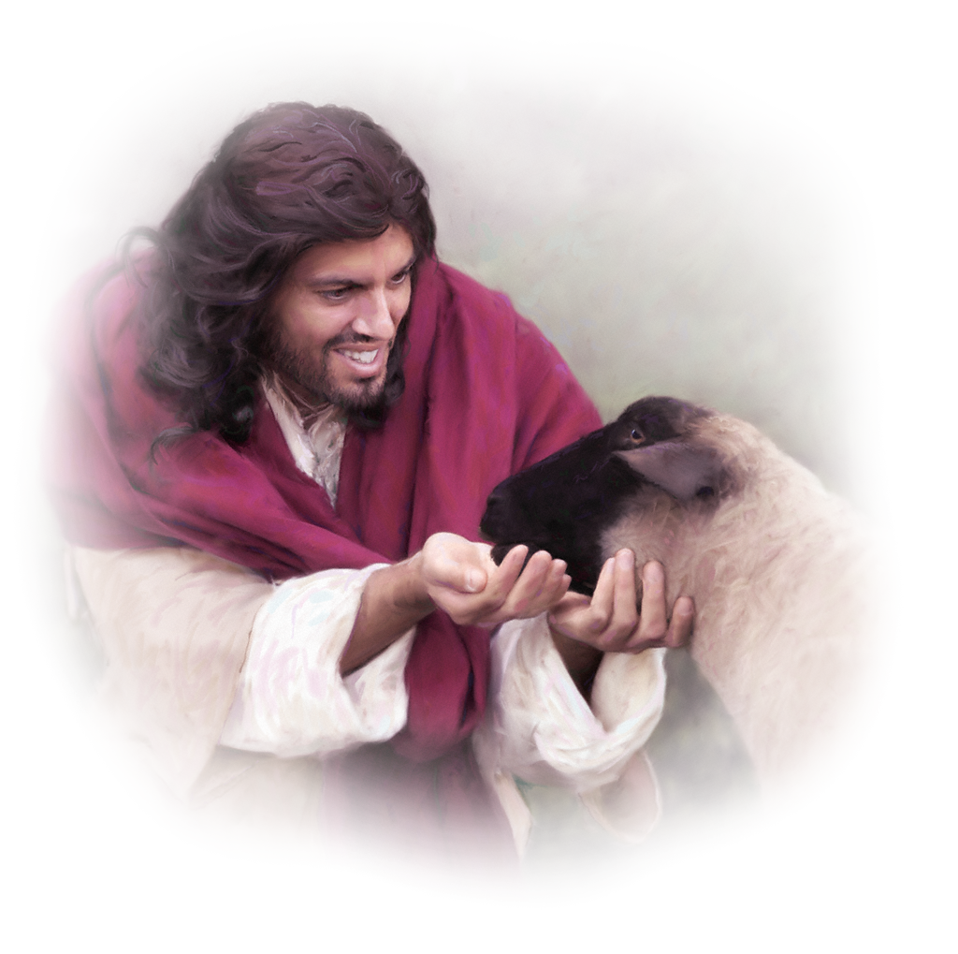
What’s the solution for all of these Problems?
Staying Close to the Shepherd!
Ps. 23:1 “The LORD is my Shepherd; I shall not want!”
(ḥāsēr’: lack or fail)
1 Pt 5:7 “Casting all your cares upon Him
For he careth for you.”
melo: interested, concerned
Mer’imna: concerns, distractions

Slide 26
Next week we’ll focus on the Provision God gives His Sheep!
Jn 10:11 “I am the good shepherd:
the good shepherd giveth
his life for the sheep.”
14 “I am the good shepherd,
and know my sheep,
and am known of mine.”
27 My sheep hear my voice,
and I know them,
and they follow me!”

