Slide 1
Pictures of the People of God
Seeing ourselves through God’s Eyes.

Slide 2
God sees differently than us!
Isaiah 55:8-9
“my thoughts are not your thoughts…
For as the heavens are higher
than the earth, so are my ways
higher than your ways,
and my thoughts than your thoughts.”
Because of this, God must reveal himself to us in order for us to “see” (understand) Him
and even ourselves.

Slide 3
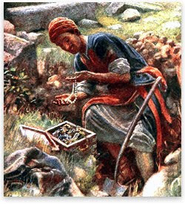
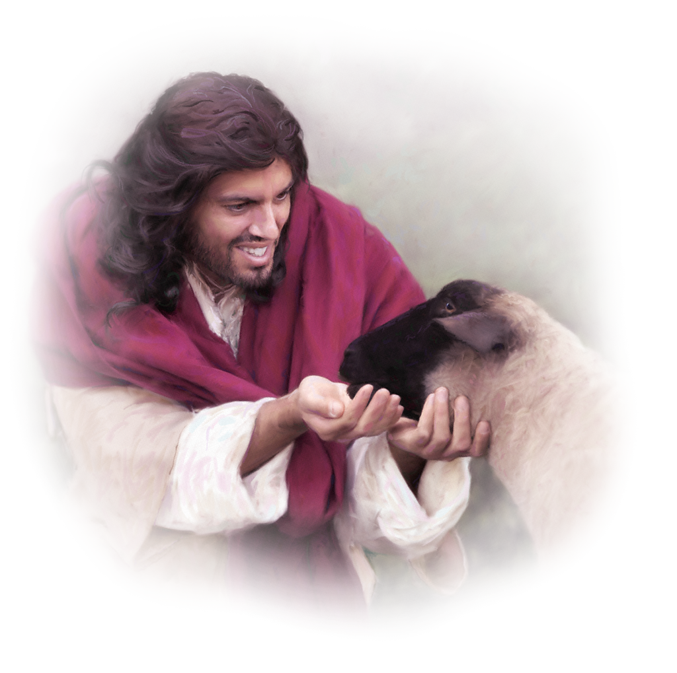
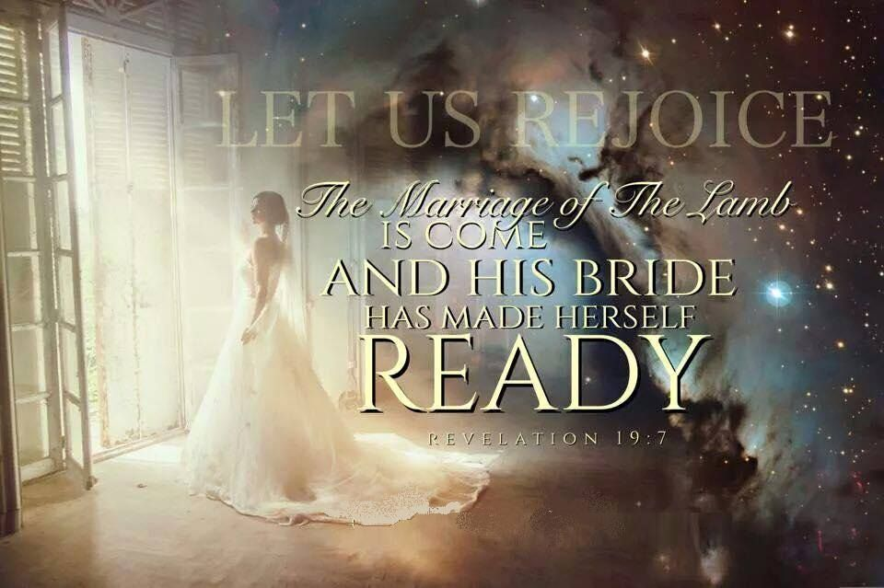
God describes us as:
Mt 13:45,46
Isaiah 64:8
Mt 13:44
2 Cor 11:2; Rev 19:7
Jn 10:11-14,27

Slide 4
We’re His Sheep under His care!

Slide 5
1. This Picture describes our problems.
A. We are “Prone to wander.” Is. 53:6
“All we like sheep have gone astray,
we’ve turned everyone to his own way.”
B. We are Prone to Poison. (Deception)
You are what you “eat”!
Ps. 23:5 “Thou preparest a table before me…”
C. We’re Prone to Predators Ps. 23:5 “preparest a
table before me in the presence of mine enemies.”

Slide 6
D. We’re Prone to Panic! We’re easily:
1) Influenced. Gal 4:16-17 “Am I become your enemy,
because I tell you the truth?
They zealously affect you,
2) Infected. Heb. 12:14,15
“Follow peace with all men, and holiness, …
Looking diligently lest any fail of the grace of God;
lest any root of bitterness springing up trouble you,
and thereby many be defiled”
but not well…”

Slide 7
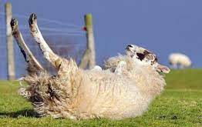
The Problems of God’s Sheep. Prone to:
Wander; Poison; Predators; Panic;
E. Becoming bloated and/or “cast” (down).
Ps 42:5 “Why art thou cast down, O my soul?
why art thou disquieted in me?
Hope thou in God:”
Gal. 6:1 “if a man… be overtaken in a fault,
ye which are spiritual restore…
in the spirit of meekness…”

Slide 8
F. We’re prone to division.
1) From of false (Selfish) leaders: Acts 20:28,29
Barna Research Group found that only 51 percent of Pastors (surveyed) possess a Biblical World view.
Jer 10:21 “the pastors …have not sought the LORD therefore …their flocks shall be scattered.”
Jer 12:10 “Many pastors have destroyed my vineyard,
Mt 15:14 “they be blind leaders of the blind…
If the blind lead the blind,
both shall fall into the ditch.”

Slide 9
D. We’re prone to division.
2) From of false (Selfish) followers: Ro. 16:17,18
Barna research 2020 discovered that:
21% of those attending evangelical Protestant churches have a biblical worldview,
16% of those attending charismatic churches ,
8% attending Mainline Protestant Churches,
1% attending Catholic churches.
https://www.arizonachristian.edu/wp-content/uploads/2020/10/CRC_AWVI2020_Release11_Digital_04_20201006.pdf

Slide 10
D. We’re prone to division.
3) Division Destroys! Hosea 4:6
“My people are destroyed for lack of knowledge:
because thou hast rejected knowledge,
I will also reject thee, that thou shalt be no priest to me:
seeing thou hast forgotten the law of thy God,
I will also forget thy children.”
(See also Ex. 20:5)
Barna found that only 2% of those 18 to 29 years old possess a Biblical World View

Slide 11
“Twas a sheep not a lamb that strayed away
In the parable Jesus told, A grown-up sheep that strayed away
From the ninety and nine in the fold.
And why for the sheep should we seek
And earnestly hope and pray? Because there is danger when sheep go wrong;
They lead the lambs astray.

Slide 12
Lambs will follow the sheep, you know,
Wherever the sheep may stray. When sheep go wrong, it won’t take long
Til the lambs are as wrong as they. And so with the sheep we earnestly plead
For the sake of the lambs today,

Slide 13
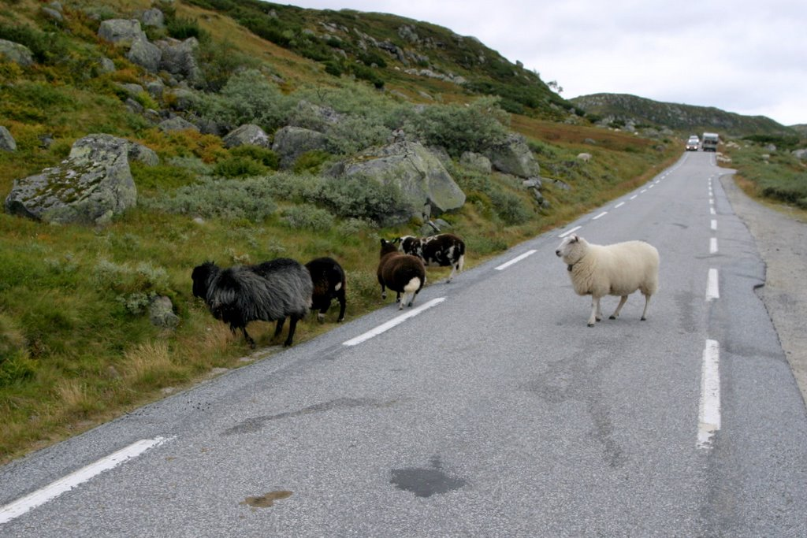
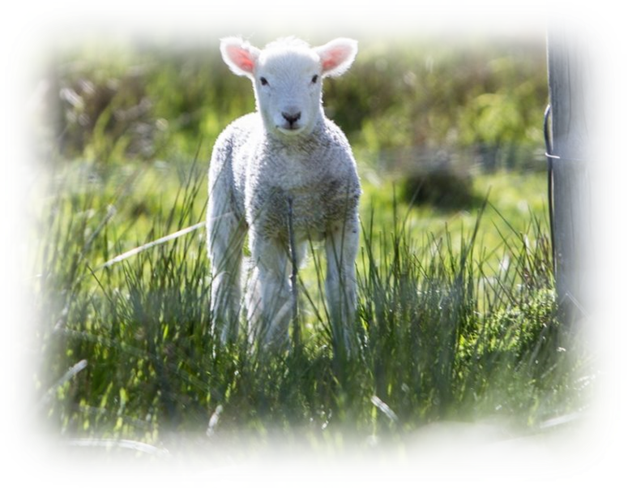
For when sheep are lost,
what a terrible cost
The lambs will have to pay!”
C.C. Miller

Slide 14
Pt 2 The Provision for God’s Sheep. Ps 23
“The Lord is my shepherd (rāʿâ) I shall not lack:
1. Pastors (Shepherds) Jeremiah 3:14-15
“Turn, O backsliding children, saith the LORD;
for I am married unto you:
and I will take you …and I will bring you to Zion:
And I will give you pastors (rāʿâ: shepherds)
according to mine heart,
which shall feed you (rāʿâ) with knowledge
and understanding.” (śākal’: wisdom, prudence)

Slide 15
1. Pastors (poimaino: to feed, rule, shepherd)
A. The Bible describes them in 3 main ways.
(Acts 20:17-32; Phil. 1:1; 1 Tim. 3:1-7; 1 Ptr 5:1-9)
1) Elders “The elders which are among you I exhort”
(presbyt’eros: older; mature)
a) This describes their (spiritual) maturity!
(How they’re to keep “learning”. 2 Tim. 2:15)
1 Tim 3:6 “Not a novice, (neoph’ytos: newly planted)
lest being lifted up with pride he fall into the
condemnation of the devil.”

Slide 16
1) Elders (presbyt’eros: older; mature)
a) This describes their (spiritual) maturity!
b) They’re to be “examples”
1 Tim. 4:12 “Be thou an example of the believers in
word..conversation..charity…spirit…faith…purity”
1 Pt 5:1,3 “The elders…not as lords over God’s heritage,
(klē’ros: portion, acquisition, inheritance)
but being ensamples to the flock.”
(typos: a model or “type”)

Slide 17
A. The Bible describes them as: (1 Pt 5:1-9)
1) Elders vs 1 “The elders which are among you …”
2) Pastors vs 2 “Feed the flock of God …”
(poimai’no: to feed 7x, rule 4x, shepherd)
Eph. 4:11 “He gave some…Pastors (poimen: shepherd),
for the perfecting (katartismos’: complete furnishing) of the saints, for the work of the ministry, (diokonia)
for the edifying (oikodomē: building) of the body of Christ.”
a) This describes their “Ministry” (Their “loving”)
Jer. 3:15 “I’ll give you Shepherds according to my heart”

Slide 18
A. The Bible describes them as: (1 Pt 5:1-9)
1) Elders vs 1 “The elders which are among you …”
2) Pastors vs 2“Feed the flock of God
3) Bishop vs 2 “taking the oversight thereof”
Episkope’ō: to oversee, watch over.
“Bishop” in 1 Tim 3; Titus 1 is “episkope”
meaning to inspect or superintend
a) This describes his Management role.
(How they’re to lead)

Slide 19
1) Elders vs 1 (presbyt’eros)“The elders …among you …”
2) Pastors (poimen) vs 2“Feed the flock of God
3) Bishop (episcope’) vs 2 “taking the oversight thereof”
B. These three roles are used interchangeably.
Acts 20:17,28 “He called the elders (presbyteros)
28…take heed unto yourselves and to all the flock (poim’nion: flock, group of believers)
over which the Holy Ghost hath made you overseers (epis’kopos)
feed (poimaino: shepherd) the church of God.”

Slide 20
B. These three roles are used interchangeably.
1) Notice Paul’s greeting when writing the
various churches in Philippi: Philippians 1:1
“Paul and Timotheus, the servants of Jesus Christ,
to all the saints in Christ Jesus which are at Philippi,
with the bishops
Either there were no Pastors and/or Elders
in any of these churches;
Or they were also considered “Bishops”.
and deacons:”

Slide 21
B. These three roles are used interchangeably.
2) Notice God’s directions to the churches.
Heb. 13:7 “Remember them which have the rule over you,
(acting in the “role” of the Bishop/overseer)
who have spoken unto you the word of God:
(acting in the role of the mature teaching “elder”)
whose faith follow, (in their role as Pastor/Shepherd)
considering (anatheōre’ō: pay attention to)
the end of their conversation.”
(Anastrophē’: behavior/lifestyle/ example)

Slide 22
B. These three roles are used interchangeably.
2) Notice God’s directions to the churches.
1 Thes 5:12-13 “know them which labor among you,
(Pastor/shepherd)
and are over you in the Lord, (bishop/overseer)
and admonish you; (Teaching elder)
And to esteem them very highly in love
for their work's sake.
And be at peace among yourselves.”

Slide 23
1. Pastors (poimaino: to feed, rule, shepherd)
C. They’re accountable to the Chief Shepherd
2 Tim 4:1-2 “I charge thee before God,
and the Lord Jesus Christ,
who shall judge the quick and the dead at his appearing and his kingdom;
Preach the word; be instant in /out of season;
reprove, rebuke, exhort with all longsuffering
and doctrine.”

Slide 24
C. They’re accountable to the “Chief Shepherd” 1 Pt 5:2,4 “Feed the flock of God …taking the oversight..
4 And when the chief Shepherd shall appear,
ye shall receive a crown of glory that fadeth not away.”
Heb 13:17 “Obey them that have the rule over you,
and submit (hupeiko: yield) yourselves:
for they watch for your souls,
as they that must give account (logos)
That they may do it with joy & not with grief:
For that is unprofitable for you.”

Slide 25
C. They’re accountable to the “Chief Shepherd”
1) That’s why they must be “called” (confirmed).
Heb 5:4 “no man taketh this honor unto himself,
but he that is called of God..”
2) That’s why they must be qualified. (1Tim. 3:1-7)
“a bishop then must be ….”
3) That’s why they must be careful! James 3:1
“Be not many masters, (didas’kalos: teachers)
Knowing that we shall receive the greater condemnation”
(Krima: judgment/decision)
(Acts 13:1,2; 1Tim. 4:14)

Slide 26
Pastors are so much more than “preachers”
Or some type of “fire alarm” to call/pull
in case of emergencies.
They’re part of God’s Provision for His People and as such are God’s:
Gifts to the local church. (Eph. 4:10,11)
Guides for the local Church. (Heb. 13:7,17)
Guards for the local church. (Acts 20:28,29)

Slide 27
Pastors (under-shepherds) are God’s:
Gifts (Eph. 4:10,11) Guides (Heb. 13:7,17); Guards (Acts 20:28,29)
In these roles they help us to GROW. (2 Tim. 2:24-26)
“the servant of the Lord must not strive;
but be gentle unto all men, apt to teach, patient,
In meekness instructing those that oppose themselves;
if God peradventure will give them
repentance to the acknowledging of the truth;
And that they may recover themselves out of the snare of the devil,
who are taken captive by him at his will. “

Slide 28
A
Jeremiah 3:14-15
“Turn, O backsliding children, saith the LORD;
for I am married unto you:
and I will take you …and I will bring you to Zion:
And I will give you pastors (rāʿâ: shepherds)
according to mine heart,
which shall feed you (rāʿâ) with knowledge
and understanding.” (śākal’: wisdom, prudence)
1) Do you have a Pastor/Shepherd?

Slide 29
2) Are you allowing God to use Him to:
Guide you “this is the way, walk in it”? (Is 30:20,21)
Guard you “from the snares of the devil”? (2 Tim 2:25)
Help you Grow “In grace and knowledge of our Lord and Savior Jesus Christ” (2 Pt 3:18)
If not, Prayerfully/Carefully Find one
“according to mine (God’s) heart” Jer. 3:15
and Prayerfully/Carefully Follow Him
“in paths of righteousness for His names sake”
Ps 23:3

