Slide 1
The Power and Purposes of Scripture
“Preach the Word...” 2 Tim 4:2
What was “The Word” the apostles preached?
Acts 20:26-27 “I am pure from the blood of all men.
For I have not shunned to declare unto you
all the counsel
of God.”
Boulē: will, wisdom, purpose

Slide 2
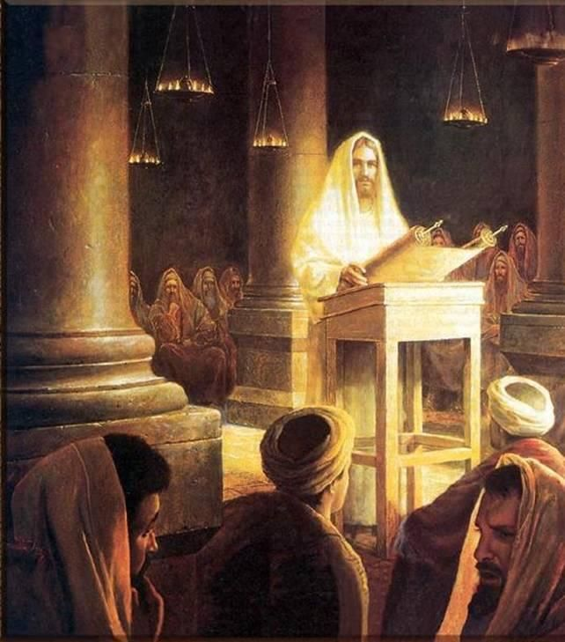
Jesus taught from the Old Testament!
“Search the scriptures;
for in them ye think ye have eternal life:
and they are they which testify of me!
And ye will not come to me that ye might have life.”
John 5:39,40

Slide 3
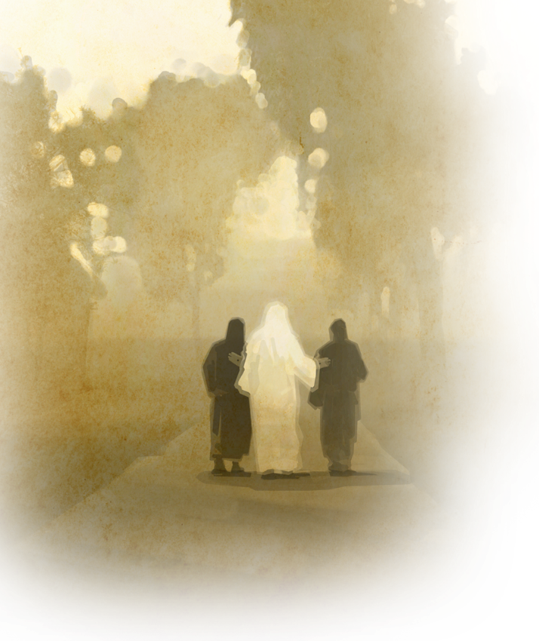
“O fools, and slow of heart to believe all that the prophets have spoken:
Ought not Christ to have suffered these things,
and to enter into his glory?
And beginning at Moses
and all the prophets,
he expounded unto them
in all the scriptures
the things concerning himself.”
Luke 24:25-27

Slide 4
We’re to “Preach the word” because:
“All scripture is given by inspiration of God,
(theop’neustos: Literally “God Breathed”)
and is profitable for doctrine, for reproof,
for correction, for instruction in righteousness:
That the man of God may be perfect,
(Ar’tios: complete)
thoroughly furnished (Exartiz’o: fully equipped)
unto all good (agathos: useful) works.”
2 Timothy 3:16-17

Slide 5
1. Ignorance of scripture leaves us Incomplete:
“That the man of God may be perfect” (Ar’tios: complete)
A. Knowledge of God’s resources is critical!
2 Pt 1:2-3 “Grace and peace be multiplied unto you
through the knowledge of God, and of Jesus our Lord,
3 According as his divine power hath given unto us
all things that pertain unto life and godliness,
through the knowledge of him that hath called us
to glory (doxa: dignity)
and virtue:” (Aretē’: valor!) Ro. 8:37
{from dokeo: to think!}

Slide 6
A. Ignorance of scripture leaves us Incomplete:
A. Knowledge of God’s resources is critical!
a) God’s word is powerful and transformative.
2 Pt 1:4 “Whereby are given unto us exceeding great and precious promises:
that by these ye might be partakers (koinonos)
of the divine nature,
having escaped the corruption that is in the world through lust.”
(1Jn 2:15-17; 5:19)
(2 Cor 3:18)

Slide 7
B. Ignorance of scripture leaves us Ill Equipped:
2 Tim. 3:16 “That the man of God might be…
thoroughly furnished” (Exartiz’o: fully equipped)
1) God gives us scripture to equip us for
spiritual warfare! (Eph. 6:10-18) 16 “Above all, taking the shield of faith, (Ro. 10:17)
wherewith ye shall be able to quench
all the fiery darts of the wicked.
17 And take the … sword of the Spirit,
which is the word of God:” (Heb 4:12)

Slide 8
B. Ignorance of scripture leaves us Ill Equipped:
1) God gives us scripture to equip us for
spiritual warfare! (Eph. 6:10-18)
a) Facing temptation without scripture
is like facing battle without bullets!

Slide 9
B. Ignorance of scripture leaves us Ill Equipped:
2) God gives us Pastors/Teachers to instruct us.
Eph 4:11-12 “And he gave some,
...pastors and teachers;
For the perfecting of the saints,
(katartismos: complete furnishing,
{from arteos: equipping})
for the work of the ministry,
for the edifying of the body of Christ:”
(oikodomē’: building up!)

Slide 10
3) We must avail ourselves of:
a) God’s “equipment”. Eph. 6:11 “Put on the
whole armor of God, that ye may be able
to stand against the wiles of the devil.”
2 Pt 1:5-7 “And beside this, giving all diligence,
add to your faith virtue; and to virtue knowledge;
And to knowledge temperance; and to temperance patience; and to patience godliness;
7 And to godliness brotherly kindness; and to brotherly kindness charity.”

Slide 11
3) We must avail ourselves of:
a) God’s equipment. Eph 6:12: 2 Pt 1:5-7
“add to your Faith, virtue… knowledge…,
temperance…, godliness…, kindness…, charity”
2 Pt 1:8 “For if these things be in you,
and abound,
they make you that ye shall neither be
barren nor unfruitful in the knowledge
of our Lord Jesus Christ.”

Slide 12
3) We must avail ourselves of:
b) God’s “equippers” Heb. 10:23-25
Heb 12:7 “Remember them which have the rule over you,
who have spoken unto you the word of God:
whose faith follow, …”
Jeremiah 3:15
“I will give you pastors according to mine heart,
which shall feed you with knowledge
and understanding.”

Slide 13
3. Ignorance of scripture leaves us Ineffective:
“That the man of God may be perfect, Thoroughly furnished unto all good (agathos: useful) works.”
2 Pt 1:9-11 “But he that lacketh these things is blind,
and cannot see afar off,
and hath forgotten that he was purged
from his old sins.”
How effective is a blind soldier?
…a blind guide? (Mt 15:14)
(2 Cor 4:4)

Slide 14
2 Peter 1:10-11
“Wherefore the rather, brethren, give diligence
to make your calling and election sure:
for if ye do these things, ye shall never fall:
For so an entrance shall be ministered unto you abundantly into the everlasting kingdom
of our Lord and Savior Jesus Christ.”
Remember Mt 25:21?

Slide 15
2. The solution to ignorance is Information.
A. The secret (key) of learning is repetition. 2Pt 1:12-13
“Wherefore I will not be negligent to put you always in remembrance of these things,
though ye know them,
and be established in the present truth.
Yea, I think it meet,
as long as I am in this tabernacle,
to stir you up by putting you in remembrance”

Slide 16
2. The solution to ignorance is Information.
A. The secret (key) of learning is repetition. 2Pt 1:12-13
1) Direction (decisions) without reflection (learning)
usually produces Repetition. (failure)
“Those who fail to learn from history
Are doomed to repeat it!” Winston Churchill
B. Information (Repetition) without application
produces frustration!
1) That’s why Israel wandered (and wasted)
in the dessert for 40 years!

Slide 17
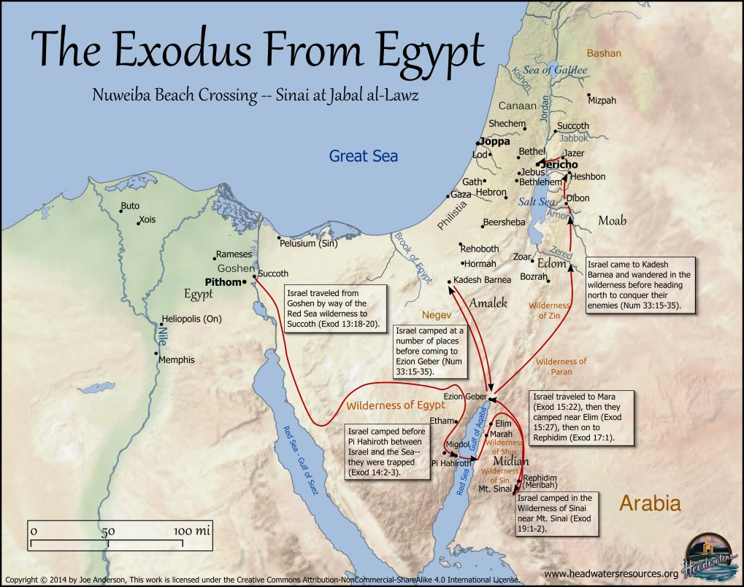
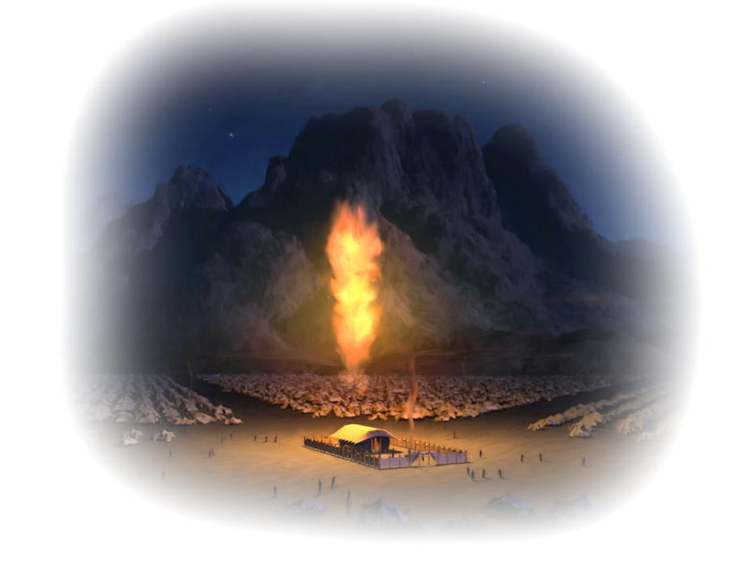
2) They moved 42 times in 40 years!
Spent 38 years going in circles

Slide 18
a) Failing to learn God’s direction, provision,
purpose and power,
they wandered in the dessert for 40 years.
b) This failure hunted / haunted them
even in the promised land!
The last verse in Judges (400 years later) revealed:
“every man did that which was right
in his own eyes.” Judges 21:25
(Not God’s!)

Slide 19
2000 years later Stephen reviewed their history and rebuked Israel’s leaders in Acts 7:51-52
“Ye stiffnecked and uncircumcised in heart
(indifferent) and ears, (ignorant)
ye do always resist the Holy Ghost:
as your fathers did, so do ye.
Which of the prophets have not your fathers persecuted? and they have slain them which shewed before of the coming of the Just One; of whom ye have been now the betrayers and murderers: “

Slide 20
Acts 7:53 “Who have received the law by the disposition of angels,
(From diatassō: to appoint, arrange thoroughly)
and have not kept it. (phylassō: guarded)
54 When they heard these things,
they were cut to the heart,
and they gnashed on him with their teeth.”
And then stoned him! (Vs 55-60)

Slide 21
Application: What about us?
Do we have any less “light” (truth/information) than they did?
Are we Ignorant of God’s truths?
Indifferent to them?
Ineffective with them?
Which do you struggle with most?

Slide 22
1) The solution to ignorance
Is accurate “information” (Truth!)
Jn 8:32 “Ye shall know the truth,
And The truth shall set you free!”
Jn 17:17 “Sanctify them through thy truth:
thy word is truth.”

Slide 23
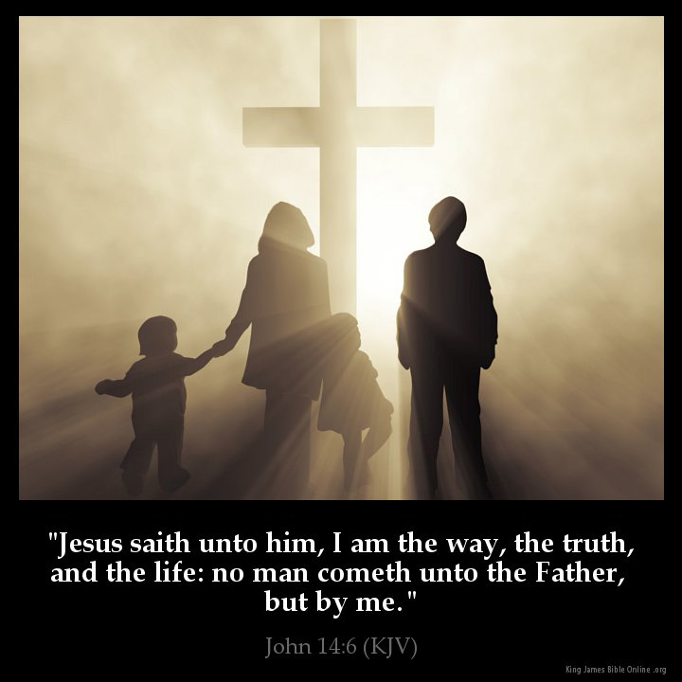
Where are you getting truth?
“I am the way,
the truth,
and the life:
no man comes
unto the Father,
but by me.”
John 14:6

Slide 24
Are we “indifferent” towards God’s truths?
2) The only cure for indifference
is effective Motivation!
What does God have to do to effectively “motivate” you?
Pr 1:23-33 23 “Turn you at my reproof:
behold, I will pour out my spirit unto you,
I will make known my words unto you.”

Slide 25
What are you doing with God’s
Truth?
“But be ye doers
of the word
And not hearers
Only,”
Deceiving your own selves.”
(James 1:22-26)

Slide 26
Are we “ineffective” in God’s work? The cure for ineffectiveness is intentional Prioritization! (Pruning)
What’s standing in the way of your fruitfulness in God’s work? Mt 13:22,23
Jn 15:2 “Every branch in me that beareth not fruit he taketh away: and every branch that beareth fruit,
he purgeth it, that it may bring forth more fruit.”

Slide 27
1 Cor 10:11 “These things happened to them for examples…our admonition”
Where are you in the “Exodus” of your life?
Still in bondage to sin (and Satan)?
Delivered (by the passover lamb)
But drifting through spiritual deserts?

Slide 28
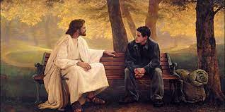
God has a promised “land” for you! (Jer. 29:11)
And knows what you’ll need to get there
and “be more than conquerors” (Ro 8:37)
Will you let him lead you there?
Ps. 16:11
“Thou wilt show me the path of life.
In thy presence is fulness of joy!”

Slide 29
“This book of the law shall not depart out of thy mouth; but thou shalt meditate therein day and night,
that thou mayest observe to do according to all that is written therein:
for then thou shalt make thy way prosperous,
(ṣālaḥ: to push forward)
and then thou shalt have good success.”
(śākal: understand/prosper)
Joshua 1:8

Slide 30
“Though the cover is worn, and pages are torn;
Though places bear traces of tears.
Yet more precious than gold is this book worn and old;
That can shatter and scatter my fears!
This old book is my guide, it’s a friend by my side.
It will lighten and brighten each day.
And each promise I find,
Cheers and gladdens my mind;
As I Read it, and Heed it each day!”

