Slide 1
Principles for Powerful Living

Slide 2
The Bible reveals Spiritual principles to help guide us to God and His plans.
The Passion (Open Heart) Principle. (Col. 3:16-24)
The Purpose (Open Hand) Principle. (Ex. 3,4)
The Path (Open Door) Principle. (Rev. 3:7-13)
The Preparation (Soil/Seed) Principle.
(Mt 13:3-30)

Slide 4
In Mt. 13:1-23 Jesus described how the seed of God’s word falls on different types of soil (hearts).
The “wayside” was the only area of the field that failed to respond in any way to the seed that was sown,
primarily because it had not been cultivated!
(Prepared in any way to receive the seed.)

Slide 5
Without any cultivation, the hard soil wouldn’t allow the seed to even penetrate it
and the “fowls” quickly devoured it. (Vs 4 and 19)
In 2 of the 3 areas of the field Jesus described
(the rocky and thorny soil) the seed was able to “penetrate” the soil (heart)
and it even began to “germinate” (grow),
but it was never able to propagate
(produce fruit). (vs 5-7 & 20-22)

Slide 6
Only on the “good ground” was the seed able to Propagate!
(grow to maturity and produce fruit)
What makes some soil (and souls) “good” (kalos‘ : beautiful, valuable)
while other soil is rocky or cluttered
and therefore unproductive?

Slide 7
The soil was the same in the field. The only difference between them
was the amount of Cultivation that was invested in each.
Last week we discussed how hearts become hard.
This week we’ll examine how to “soften” them through cultivation!

Slide 8
The Purpose Of Cultivation. 1 Cor 3:9
1. There are three distinct dimensions (meanings) of the Word Cultivate:
A. Preparing (The Soil for the growth of plants).
1) Planning. “What do I want to grow?” (Produce)
(Josh 24:15; 1 Kg 18:21)
2) Purging (Clearing) “What has to go?”
(2 Tim. 2:21; 1 Cor 5:7)
3) Plowing (What’s “below”?) (Hosea 10:12)

Slide 9
The Purpose Of Cultivation. 1 Cor 3:9
B. Protecting: To Foster/improve growth by:
1) Study: (Learn) 1 Pt 3:7 “Dwell with your wives accordingto knowledge, giving honor unto her…”
a) Learn what helps and what harms it (her).
2) Care: (Love) Eph. 5:28,29 “So ought men to love their
wives…Nourish (ektreph’o: feed, rear to maturity)
and Cherish (thalpo: warm, brood, foster growth)
even as the Lord the church.”

Slide 10
B. Protecting: To Foster/improve growth by:
1) Study: (Learn) 1 Pt 3:7
2) Care: (Love) Eph. 5:28,29
3) Work: (Labor) apply what you learn
to what (and who) you love. John 13:17
“If ye know (ido: are aware of) these things,
happy are ye if ye do them.”
(Makarios: supremely fortunate)
Knowledge and love without application
is useless. Jn 14:15, 21 “If ye love me…”

Slide 11
1. Meanings (dimensions) of cultivation.
A. Preparing: Soil for growth (of plants). Hos. 10:12
B. Protecting: Foster/improve growth. Eph. 5:29
C. Partnering: Seek the society of or make friends with.
“Cultivating Relationships”
1) We were created for relationships! Gen. 2:18
“It is not good that the man should be alone!”
Eccl 4:7-12 vs 9: “Two are better than one;
because they have a good reward for their labor….
10 “…but woe to him that is alone when he falls…”

Slide 12
The Purpose of Cultivation
2. We Were Created To Cultivate!
Adam’s first job was to cultivate Eden! Gen. 2:15a
“The LORD took the man, and put him into
the garden of Eden…”
(from ʿêden: pleasure, delights)

Slide 13
A. Cultivation requires effort (work). Gen 2:15
“The LORD took the man and put him in…Eden
“…to dress it
(ābad’: work or till)
and to keep it.” (shamar’:
to guard, attend to.)
This was before Sin entered into the world!

Slide 14
A. Cultivation requires effort (work). Gen 2:15
1) If this was true before the fall,
How much more is it true now?!?
2) Sin affects the soil (as well as the soul). Ro. 8:22
Work was not part of the fall (curse of sin),
but the “stubbornness of the soil” was! Gen. 3:17,18 “cursed is the ground for thy sake;
in sorrow shalt thou eat of it all the days of thy life;
(ʿiṣṣābôn’: worrisome labor, grief, pain)
Thorns also and thistles shall it bring forth to thee… “

Slide 15
A. Cultivation requires effort (work).
2) Sin affects the soil (and the soul).
a) Left to itself the soil (and the soul) will grow wild and cluttered with thorns and thistles!
(Entropy!)
3) God calls us to this work! 1 Cor 3:9 “we are laborers together (synergos’: to work with)
ye are God’s husbandry” (geōr’gion: cultivable farm)
from ge (soil) & ergon (to toil/work)
with God!”

Slide 16
3) God calls us to Cultivate! 1 Cor 3:9
a) The soil (and soul) won’t cultivate itself.
Pr. 24:30-32 “I went by the field of the slothful,
…the man void of understanding;
and lo it was all grown over with thorns,
and nettles had covered the face thereof,
and the stone wall thereof was broken down.
Then I …considered it well; (sheth leb)
(Set, placed, planted it in my heart!)
I looked upon it and received instruction.”

Slide 17
a) The soil (and soul) won’t cultivate itself. Pr. 24:30-32 b) Neglect will bring certain sorrow. Pr. 24:33-34
“Yet a little sleep, a little slumber,
a little folding of the hands to sleep:
(I’ll get around to it some day!)
So shall thy poverty come as one that travelleth;
(Constant motion doesn’t leave room for cultivation)
and thy want (maḥsôr’: lack, deficiency)
as an armed man.”
(Like a thief that comes suddenly. Jn 10:10)

Slide 18
“Good seed” needs “good ground” to
Penetrate, Germinate, and Propagate.
Good ground requires Cultivation!
The only difference in the actual soil in Jesus’ story was the amount of Cultivation each section received!

Slide 19
The fruitfulness of a farm, garden, or field
will be in direct proportion to the amount of care and cultivation it receives.
What’s True in Farming is also true of:
Our Faith
2 Peter 1:5-10
3:18

Slide 20
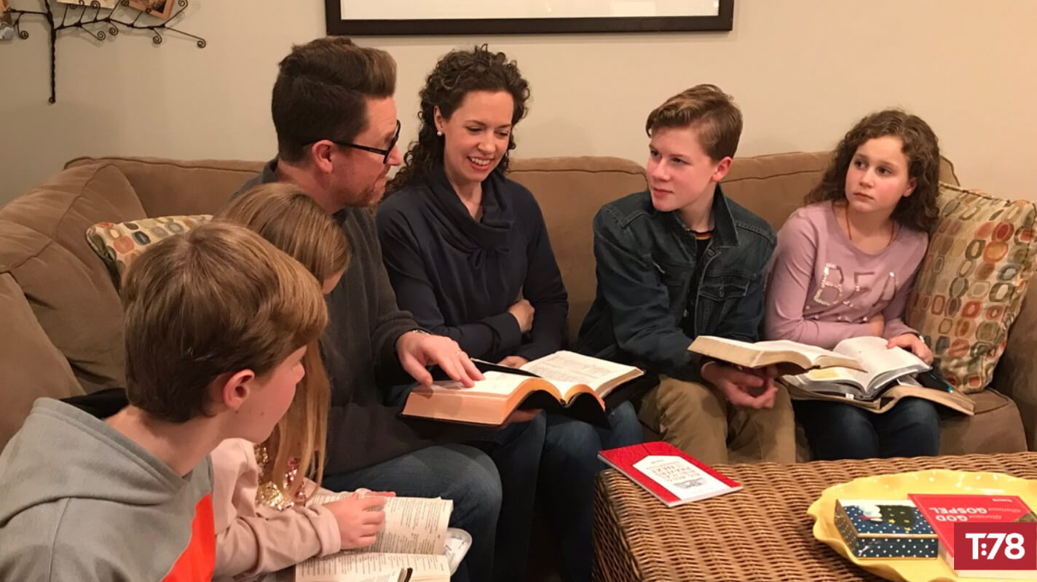
What’s True in Farming
is also true in:
Our Families Eph. 5:21-6:4

Slide 21
What’s True in Farming
is also true in:
Our Friendships Pr. 18:24

Slide 22
If Cultivation involves intentionally
Preparing, Protecting, and Partnering
In order to produce fruitful crops
(Faith, Family, & Friendships)…
Cultivation (like Consecration) takes time, energy and commitment.

Slide 23
Gal 6:7-10 “whatsoever a man sows,
that shall he also reap.
he that sows to his flesh
shall of the flesh reap corruption;
he that soweth to the Spirit shall of the Spirit
reap life Everlasting!
And let us not be weary in well doing:
for in due season we shall reap, if we faint not.
As we have therefore opportunity, let us do good …”
Because harvest time is coming! Ps. 126:5,6

Slide 24
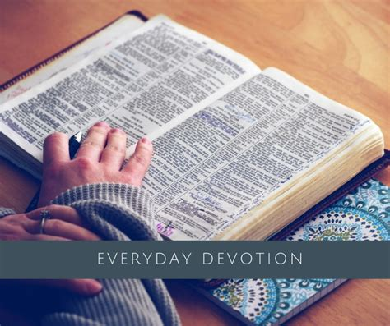
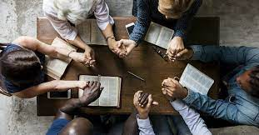
What are you doing to cultivate
these important relationships
with God and others?
Faith Family Friends

