Slide 1
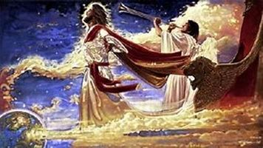
The “Why” of the Rapture Pt 2
Jn 14:3 “I will come again to receive you unto myself,
That where I am,
there ye may be also.”
Notes:
Meta Tauta used three times.
18:1 Concerning religious Babylon.
19:1 Concerning political Babylon
Next slide, Door open in heaven.

Slide 2
There are >100 prophecies about Jesus’ second coming recorded in the New Testament!
If Jesus fulfilled the >300 O.T. prophecies about his 1st coming,
He will certainly fulfil the ones about his second coming!
Mt 5:18 “Till heaven and earth pass, one jot or one tittle shall in no wise pass from the law, till all be fulfilled.”

Slide 3
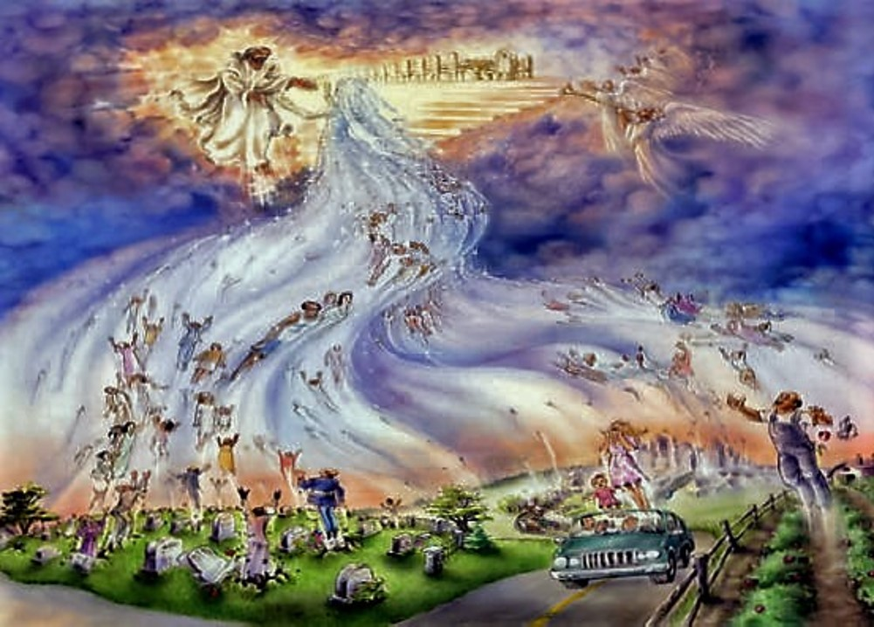
Scripture reveals that there will be two distinct “stages: to his Second Coming.
1st: He will come
“in the air”
for His Church!
(Acts 1:11;
1 Thes. 4:13-18;
1 Cor. 15:51-58)

Slide 4
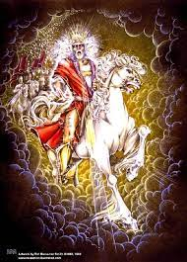
2nd Stage He’ll come in power to reign. (2 Th 2:7-9)
“when the Lord Jesus shall be revealed from heaven with his mighty angels,
In flaming fire taking vengeance on them that know not God, and that obey not the gospel of our Lord Jesus Christ:
Who shall be punished with everlasting destruction from the presence of the Lord, and from the glory of his power”
Rev. 19:11-13

Slide 5
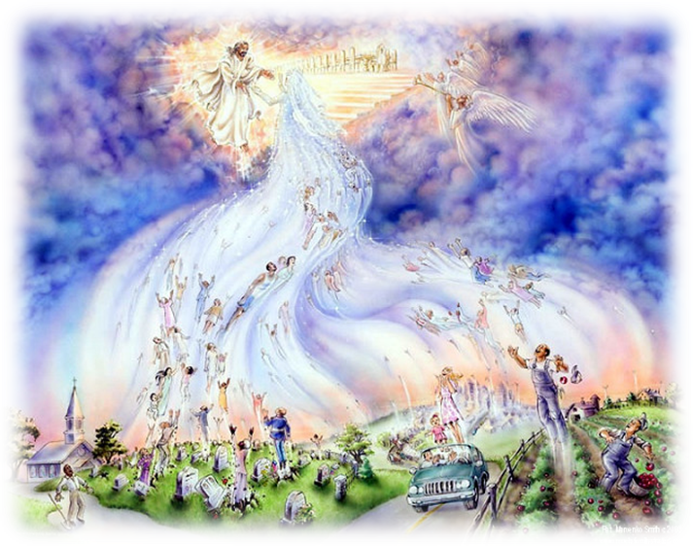
The Rapture involves the:
1. Transportation of God’s people to heaven.
(Jn 14:2; 1 Th. 4:13-18; 1 Cor. 15:50-58; Rev 4)
A. “caught up together” in 1 Thes. 4:17 (harpazo) means to remove, or take away.
B. The English “Rapture” comes
from the Latin "raptus",
meaning to seize or transport.

Slide 6
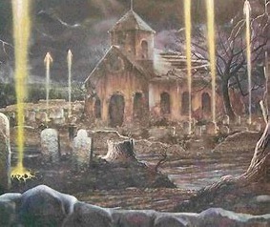
2. Transformation of our bodies. 1Co 15:51,52
“I shew you a mystery; We shall not all sleep, but we shall all be changed, (Allasso) made different.
in the twinkling of an eye,
at the last trump:
for the trumpet shall sound,
and the dead shall be raised
incorruptible, (aphthartos: undecaying)
and we shall be changed!”
Allassō: transformed

Slide 7
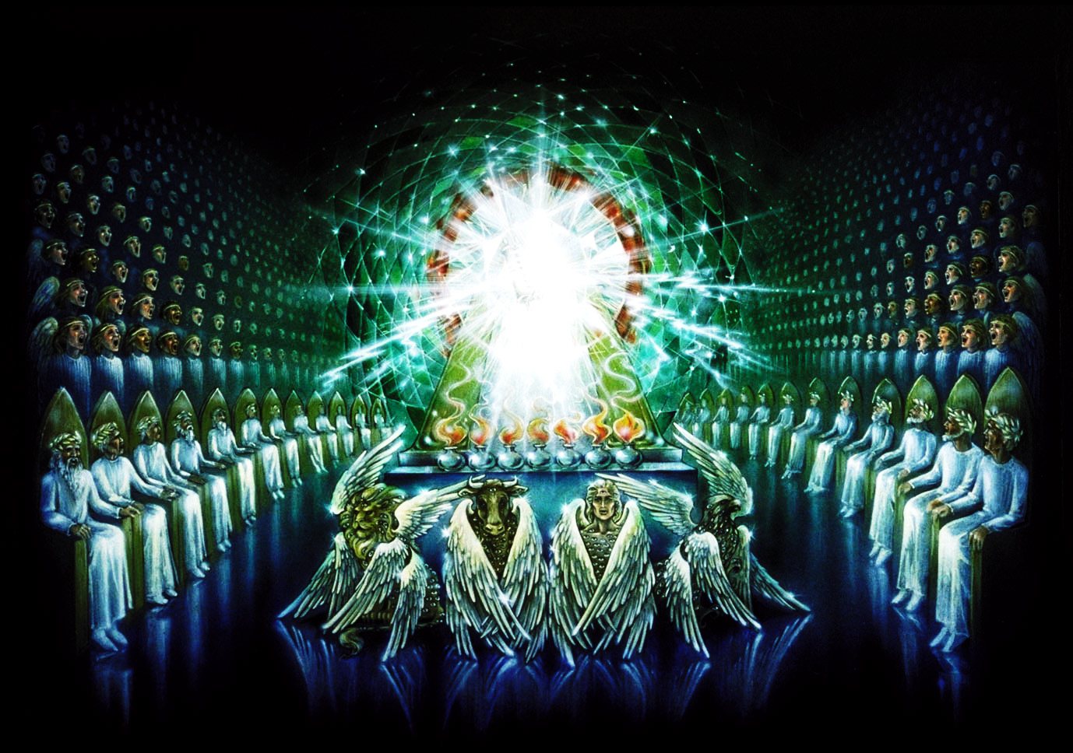
3. Evaluation of our lives: Rev. 4
2 Cor 5:10 “we must all stand before the judgment seat (bēma) of Christ…”

Slide 8
3. Evaluation : 1 Cor. 3:9-13 “We are laborers together with God: ye are God’s building…
but let every man take heed how he buildeth thereupon.
For other foundation can no man lay than that is laid, which is Jesus Christ.
Now if any man build upon this foundation gold, silver, precious stones, wood, hay, stubble;
every man’s work shall be manifest,
for the day shall declare (reveal) it…”

Slide 9
4. Remuneration 1 Cor 3:13-15
“Every man's work shall be made manifest:
for the day shall declare it, because it shall be revealed by fire; and the fire shall try every man's work
of what sort it is.
If any man's work abide which he hath built thereupon,
he shall receive a reward. (Misthos: pay for service)
If any man's work shall be burned, (wood, hay, stubble)
He shall suffer loss:
but he himself shall be saved; yet so as by fire.”
(Temporary or Eternal)

Slide 10
4. Remuneration/Payment for faithful service.
Rev 4:4-5 “I saw four and 24 elders…in white raiment;
and they had on their heads crowns of gold.”
Crowns symbolize both reward and responsibility!
(Mt 25:21,23; Rev. 5:10; 22:5)

Slide 11
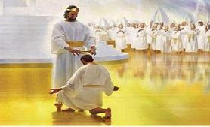
Rev 22:12 “behold, I come quickly; and my reward is with me, to give to every man
according as his
work shall be.”
Eph. 4:1 “I …beseech you that ye walk worthy of the vocation wherewith ye are called”

Slide 12
5. Consummation of our relationship!
The Bible uses different “analogies” to describe our relationship with Christ.
Members of His Body: (1 Cor. 12; Eph. 4)
Sheep of His pasture: (Jn. 10; Ps. 23, 100)
Building blocks in His temple: Eph. 2:21
Members of His Family. Gal. 4; Ro. 8

Slide 13
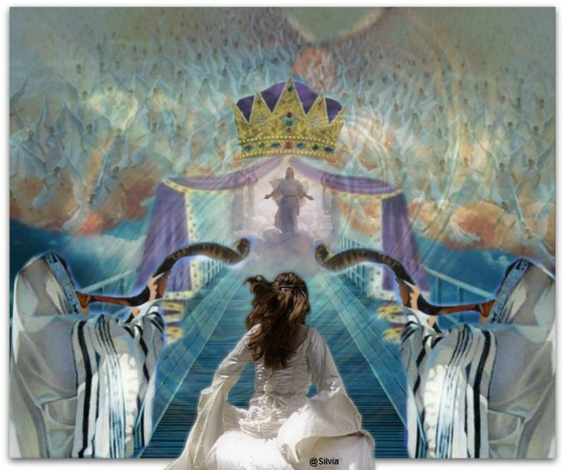
A. Perhaps the most intimate analogy is that
God describes us as:
“the bride of Christ”.
(Mk 2:19,20; Jn 3:29;
Mt. 9:15; Eph. 5:22-31;
Rev. 19:7-9;
21:2,9-11; 22:7)

Slide 14
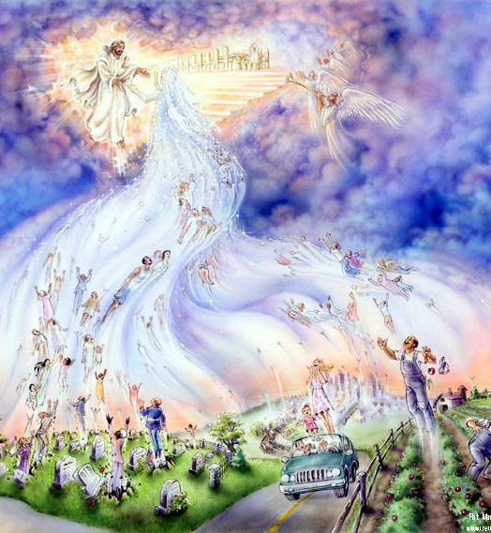
1) The Oxford Dictionary defines “Rapture” as:
a) The transporting of
believers to heaven at
the Second Coming of
Christ.
Psalm 16:11
b) Feelings of intense
joy or pleasure.
(ecstasy, bliss, euphoria, elation, exaltation)

Slide 15
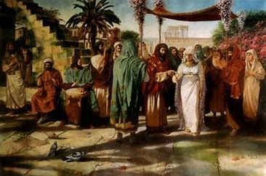
Jesus used a Jewish Wedding to
illustrate his return. Mt. 25:1-13
1) The Negotiation stage resulting in a “betrothal”.
2 Cor. 11:2 “I am jealous over you with a godly jealousy;
for I have espoused you to one husband,
that I may present you as a chaste virgin to Christ.”

Slide 16
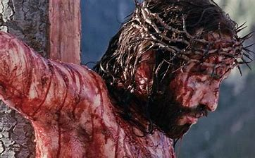
1) Begins with a negotiation: “betrothal”.
a) The “Groom” would travel to the Bride’s house to
negotiate a “Bride Price” (Mohar) (See Gen. 22)
(1) What “Price” did Jesus pay for a relationship with us?
“ye were redeemed with the precious blood of Christ”
1 Peter 1:19

Slide 17
1 Cor. 6:19,20
“Ye are bought with a price,
therefore glorify God in your body and your spirit,
which are God’s”

Slide 18
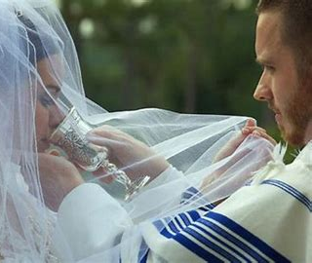
b) Once the mohar was paid, the marriage
“covenant” took effect.
(1) Sealed by drinking from a common cup of wine.
1 Cor. 11:24-26 “this do in remembrance of me, for as often as ye…drink this cup,
ye do show the Lord’s death,
(mohar)
til he come!”
(2) They were considered legally “married”
and sanctified (separated) for each other!

Slide 19
1) Begins with a Negotiation. “betrothal”.
2) Involved a Time of Separation!
a) During this time, though “legally married”,
they were physically separated.
(1) Remember Joseph and Mary. Mt 1:18
“When as his mother Mary was espoused to Joseph, before they came together,
she was found with child of the Holy Ghost. “
Luke 2:6 “with Mary His espoused wife”

Slide 20
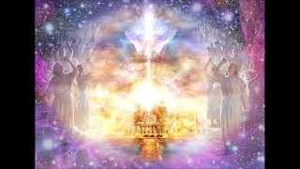
3) The Preparation Stage
a) The Groom would return to his father’s home
to prepare a room or home for his bride. Jn 14:3
“In my Father’s house are many mansions…
I go to prepare a place for you!”
“I John saw the holy city…coming down from God out of heaven,
prepared as a bride
adorned for her husband.”
Rev. 22:2

Slide 21
3) The Preparation Stage
a) The Groom would return to his father’s home
to prepare a room or home for his bride. Jn 14:3
“In my Father’s house are many mansions…
I go to prepare a place for you!”
“I John saw the holy city…coming down from God out of heaven,
prepared as a bride adorned for her husband.” Rev. 22:2
Vs 9 “I will show thee the bride!”

Slide 22
b) The Bride would prepare herself for married life.
Revelation 19:7
8 “to her was granted that she should be arrayed in linen, …for the fine linen is the righteousness of saints.”

Slide 23
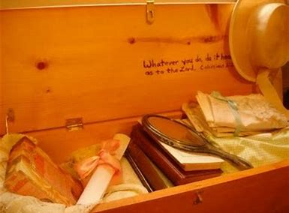
3) Preparation.
b) The Bride would:
(1) Prepare her trousseau (Hope chest)
Filling it with things she’d use to help her set
up her new home.
“Lay up for yourselves treasures in heaven…
For where your treasure is, there shall your heart be also! ”
Mt. 6:20,21

Slide 24
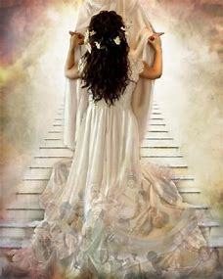
(2) She would prepare/protect her heart and body!
She “belonged” to the groom!
Immorality would be considered adultery.
2 Cor. 11:2 “I am jealous over you…
for I have espoused you…that I may present you as a chaste virgin to Christ.
3 But I fear lest by any means as Satan beguiled Eve…”
James 4:4 “ye adulterers…know ye not that friendship with the world
is enmity with God.”
“I am my beloved’s, and he is mine!”
S. S. 6:3
exapata’ō: Seduced!

Slide 25
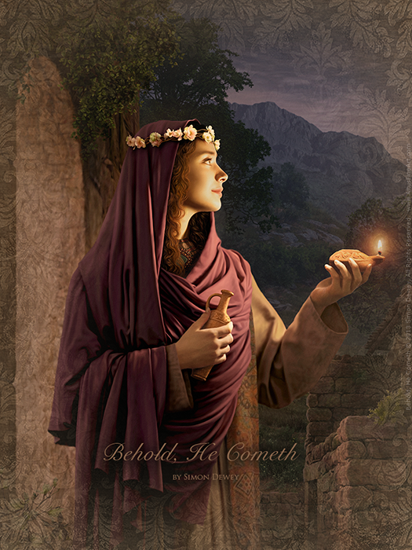
Negotiation, Separation, Preparation
4) Anticipation!
a) At the time appointed by the Groom’s father,
The Groom would go to the Bride’s
home to claim her! Jn. 14:3,4
“If I go and prepare a place for you,
I will come again
to receive you unto myself.”

Slide 26
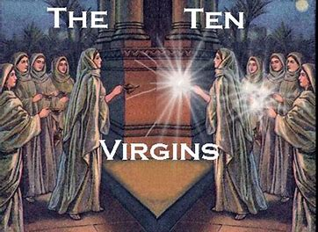
4. Anticipation! Mt. 25
Mt 25:1-6 “Then shall the kingdom of heaven be likened unto ten virgins, which took their lamps, and went forth to meet the bridegroom. five of them were wise, and five were foolish.
While the bridegroom tarried, they all slumbered and slept.
⁶ And at midnight there was a cry made,
Behold, the bridegroom cometh;
go ye out to meet him.

Slide 27
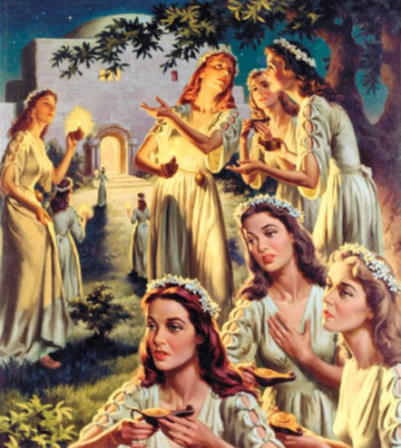
4. Anticipation! Mt. 25
Mt 25:7-10 “Then all arose, and trimmed their lamps.
And the foolish said unto the wise, Give us of your oil;
for our lamps are gone out. But the wise answered, saying…
go ye rather to them that sell,
and buy for yourselves.
And while they went to buy,
the bridegroom came;
and they that were ready
went in …to the marriage:
and the door was shut.

Slide 28
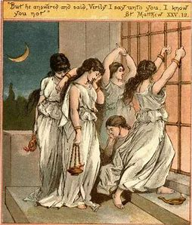
4. Anticipation! Mt. 25:11-13
“Afterward came also the other virgins, saying,
Lord, Lord, open to us.
But he answered and said,
I know you not.
Watch therefore,
for ye know neither the day nor the hour wherein the Son of man cometh.”

Slide 29
Jesus will return for his bride. Jn 14
1) Negotiation:
Are you “His”?
Have you accepted His offer of love?
2) Separation:
Are we staying “true” and “Faithful” to our “Fiancé” during his absence?

Slide 30
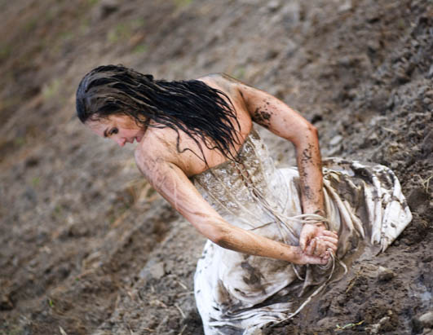
3) Preparation:
While He’s preparing Heaven for us,
What are we doing to prepare for Him?
1 Jn 2:28 “now…abide in him, that when he shall appear, we may have confidence,
and not be ashamed at his coming.
Everyone that hath this hope in him
Purifieth himself”
1 John 3:3

Slide 31
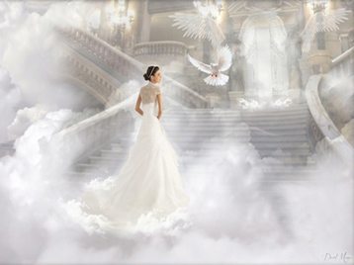
Rev 19:7-9 “Alleluia: for the Lord God omnipotent reigneth.
Let us be glad & rejoice for the marriage of the Lamb is come,
and his wife hath made herself ready.
And to her was granted that she should be arrayed in fine linen, clean and white:
for the fine linen is the
righteousness of saints.”

Slide 32
Without Negotiation, Separation, Preparation,
4) There’ll be no real Anticipation!
1 John 2:18
Jesus’ last words (Rev. 22:20) “Surely I come quickly,
Our reasonable response: Even so Come,
Lord Jesus!”

Slide 33
Our Sacred Responsibility. Rev. 22:17
And let him that heareth say, Come.
and let him that is athirst come.
And whosoever will, let him take the water of life freely.”

