Slide 1
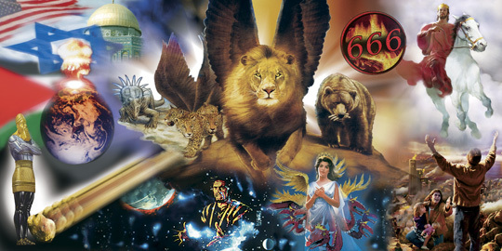
Prophecy is like a complicated puzzle portraying the Story and Struggle of the ages
In Advance!

Slide 2
2 Timothy 2:15
“Study to shew thyself approved unto God,
a workman that needeth not to be ashamed,
rightly dividing the word of truth.”
Studying God’s word is necessary to learn how to rightly put the pieces of God’s “Prophetic Puzzle” together!

Slide 4
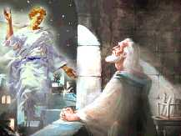
Daniel 9:24 “Seventy weeks (shābûaʿ: 7s) are determined upon thy people and upon thy holy city,
to finish the transgression…to make an end of sins…to make reconciliation for iniquity …
To bring in everlasting righteousness,
…to seal up the vision and prophecy,
and to anoint the most Holy.”

Slide 5
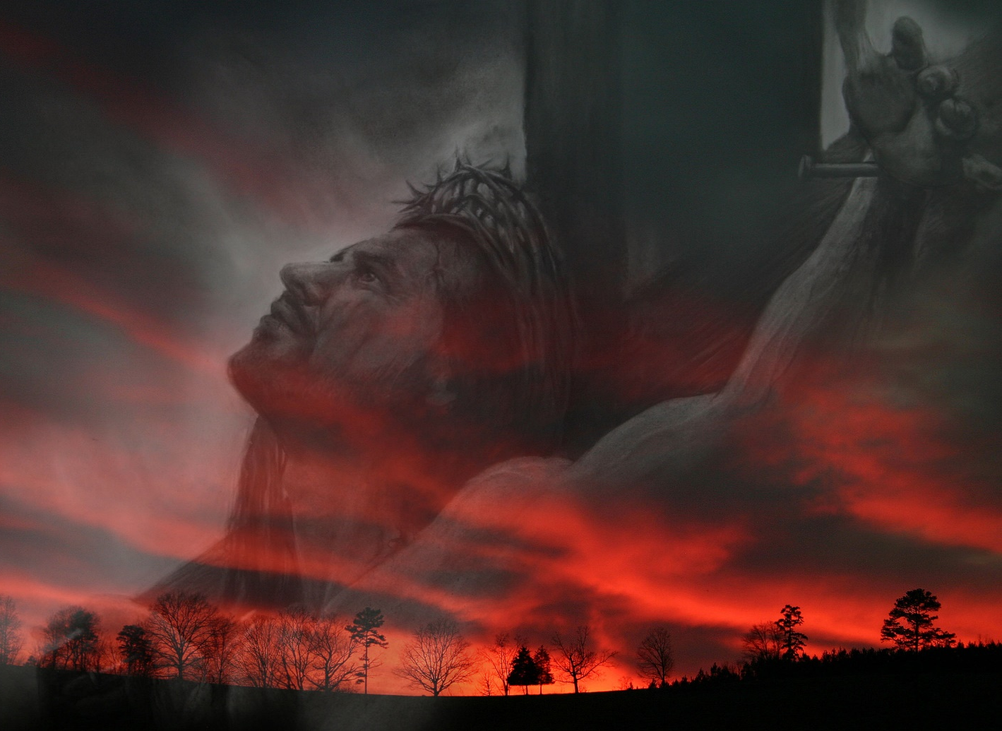
Da 9:25 “Know therefore and understand, that from the going forth of the commandment to restore and to build Jerusalem unto the Messiah the Prince shall be seven weeks, and threescore and two weeks:
26 And after (the) 62 weeks
(for 69 total or 483 years)
shall Messiah be cut off,
Ps. 22; Isaiah 53
but not for himself:”

Slide 6
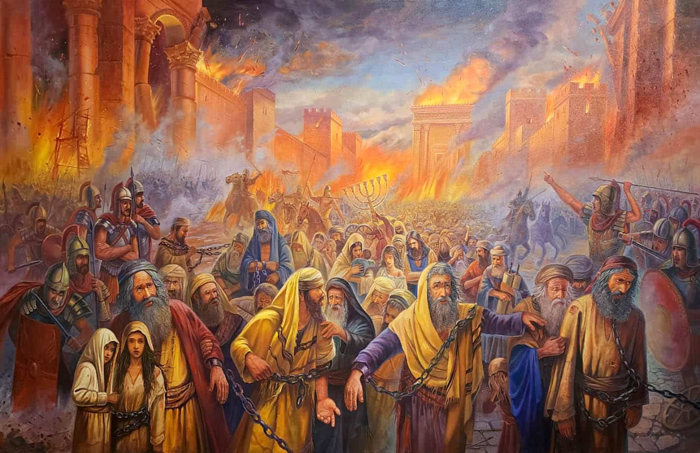
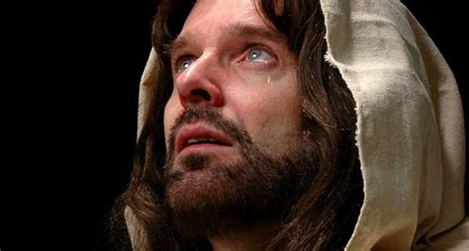
Da 9:26b “and the people of the prince that shall come shall destroy the city and the sanctuary;…
(“There shall not be left one stone upon another.”)
Mt. 24:2
AD 70
unto the end of the war desolations are determined.”

Slide 7
Israel’s rejection of the Messiah ushered in the current age of Grace. (Jn 1:10-14; 3:16)
“this mystery… blindness in part is happened to Israel, until the fulness of the Gentiles be come in.”
Ro. 11:25
Prophecy
Church
Age
History
33 AD
Mt 24:14 “this gospel of the kingdom shall be preached in all the world for a witness unto all nations;
and then shall the end come.”

Slide 8
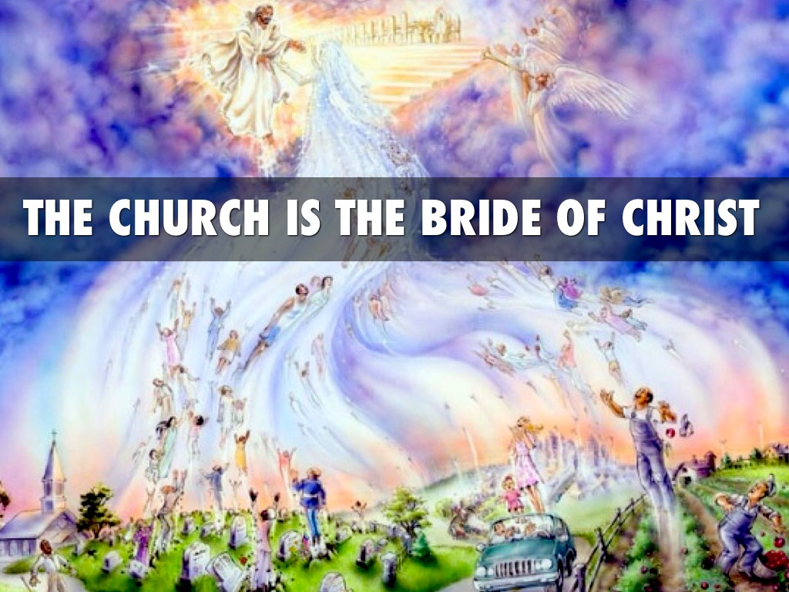
This church age ends with the Rapture.
1 Thes. 4:16,17; 1 Cor 15:51,52; Rev. 19
This is the great Mystery!
Mt. 25:1-13; 1 Cor 15:51; Eph. 5:31; Col. 1:26-28

Slide 9
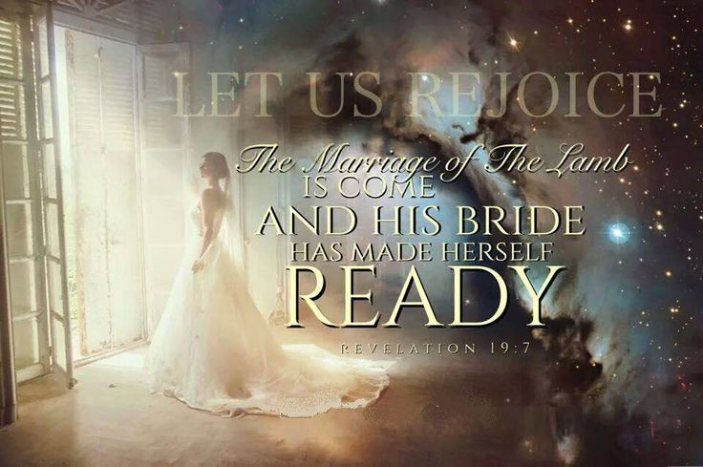
Mystery!
Hetoimazo:
Adjusted, Fit
Rev 19:7; 1 Jn 3:3
Mt 24:44 ”be ye also ready: for in such an hour as ye think not the Son of man cometh.”

Slide 10
2 Thes 2:1-3 ”Now we beseech you, brethren,
by the coming of our Lord Jesus Christ,
and by our gathering together unto him,
That ye be not soon shaken in mind, or be troubled, …, as that the day of Christ is at hand. …for that day shall not come, except there come a falling away first, and that man of sin be revealed, the son of perdition;…
7 For the mystery of iniquity doth already work, only he who now lets will let, until he be taken out of the way.
8 And then shall that Wicked be revealed…”

Slide 11
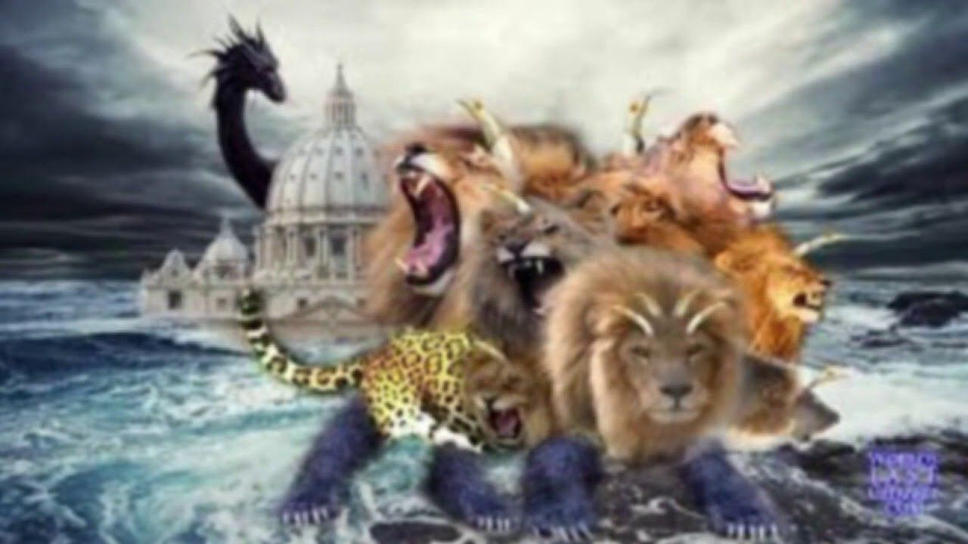
Destiny! (Of a world that’s rejected God!)
Revelation 13
Revelation of the Beast
Revelation 6
Daniel’s 70th Week

Slide 12
1. The Rise of the Antichrist Rev 6
A. Starts with a “Peace” treaty. Dan 9:27
“he shall confirm the covenant with many for one week:”
1) This peace will be short lived! 1 Thes 5:2-3 “the day of the Lord cometh as a thief in the night.
For when they shall say, Peace and safety;
then sudden destruction cometh upon them,
as travail upon a woman with child;
and they shall not escape.”

Slide 13
B. He spends the first half of this 70th week
(shābûa) accumulating power.
1) This “prince” is initially portrayed as a
victorious king on a white stallion.
Rev. 6:1,2“…and a crown was given
unto him:
and he went forth conquering,
and to conquer.”
(Nikaō: to subdue, overcome)

Slide 14
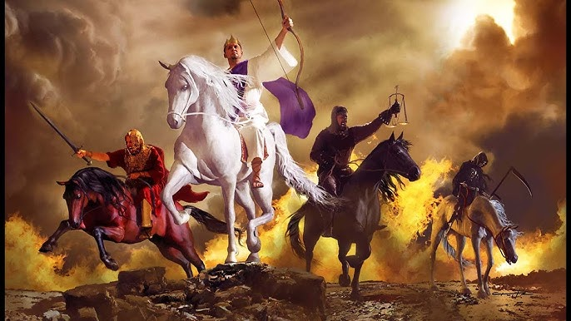
2) His rise will leave a wake of destruction.
Rev. 6:
1st seal
2nd War
vs 3-4
3rd Famine
vs 5,6
4th Death
Vs 7-8
5th Persecution: vs 9,10

Slide 15
2) His rise will leave a wake of destruction.
a) This first half of Daniel’s final week reveal
the natural consequences of his rise to global
dominance and tyranny. (seals of Rev. 6)
(1) Tyrannical leader➔ (2) War ➔
(3) Famine ➔ (4) Death ➔ (5) Persecution
b) This could be described as
“the wrath of the antichrist”
on those who oppose his tyrannical rise.

Slide 16
3) The 6th seal (vs 12-17) introduces the supernatural consequences of rejecting God, Rev 6:12-15 “when he had opened the sixth seal, … there was a great earthquake; and the sun became black … and the moon became as blood;
And the stars of heaven fell unto the earth…;
and every mountain and island were moved…
And the kings of the earth, and the great men, …and every bondman, and every free man, hid themselves in the dens and in the rocks of the mountains;

Slide 17
Rev 6:16-17 “And said to the mountains and rocks,
Fall on us, and hide us from the face of him that sitteth on the throne, (Rev. 4)
and from the wrath of the Lamb:
17 For the great day of is wrath is come;
and who shall be able to stand?”
This sets in motion a series of 21 divine judgements on a rebellious earth.
(Rev 8-14)

Slide 18
2. The Revelation of the Beast!
Eventually his true nature is revealed. (Rev. 13)
A. Why?
Rev 13:2 “the beast …was like unto a leopard, and his feet were as the feet of a bear, and his mouth as the mouth of a lion: and the dragon gave him
Satanic possession and plans Is. 14:14
his power, (dynamis: force, ability)
and his seat, (thronos: throne!)
and great authority.” (exousia: mastery)

Slide 19
B. When: Dan. 9:27 “in the midst of the week “
1) When Satan is cast to the earth in Rev. 12
a type of “time line” is established. Vs 6
“the woman (believing Israel) fled into the wilderness, where she hath a place prepared of God,
that they should feed her there
12 …Woe to the inhabitors of the earth…!
for the devil is come down unto you, having great wrath,
because he knoweth that he hath but a short time.
13 … he persecuted the woman (Israel) which brought forth the man child.” (vs 5: Jesus)
1260 days.

Slide 20
14 And to the woman were given two wings of a great eagle, that she might fly into the wilderness, into her place, where she is nourished
for a time (1), and times (2), and half a time, (1/2)
from the face of the serpent….
(3 ½ years=1260 days)
17 And the dragon was wroth with the woman,
and went to make war with the remnant of her seed, which keep the commandments of God,
and have the testimony of Jesus Christ.”
(see Ro 9)

Slide 21
Daniel prophesied of this time line:
Dan. 7:25 “he shall speak great words against the most High, and shall wear out the saints of the most High,
…and they shall be given into his hand
until a time and times and the dividing of time. ”
(3 ½ years)
John confirmed this same time line in Rev. 13:5
“Power was given unto him to continue
Forty and two months”

Slide 22
C. How: Is his true nature revealed?
1) He’ll experience some type of an assassination
(attempt)
“I saw one of his heads as it were wounded to death; and his deadly wound was healed:
and all the world wondered after the beast.
And they worshipped the dragon which gave power unto the beast: and they worshipped the beast saying:
Who is like unto the beast?
Who’s able to make war with him?”
and resurrection. Rev 13:3-4

Slide 23
2) He makes war with God’s people. Rev. 13:
5 “And there was given unto him a mouth speaking great things and blasphemies; and power was given unto him to continue forty and two months. (3 ½ years)
6 And he opened his mouth in blasphemy against God, to blaspheme his name, and his tabernacle, and them that dwell in heaven. 7 And it was given unto him
to make war with the saints, and to overcome them:
and power was given him over all kindreds,
and tongues, and nations.”
Dan. 7:25

Slide 24
3) He receives global worship. Rev. 13:7
“And all that dwell upon the earth shall worship him,
whose names are not written in the book of life
of the Lamb slain from the foundation of the world. “
a) The false prophet orchestrates this. Rev 13:12-13
“he exerciseth all the power of the first beast before him, and causeth the earth …to worship the first beast,
whose deadly wound was healed.
And he doeth great wonders, so that he maketh fire come down from heaven on the earth in the sight of men,

Slide 25
b) An idol is made to facilitate this. 13:14,15
“And deceiveth them that dwell on the earth by the means of those miracles which he had power to do in the sight of the beast; saying to them that dwell on the earth,
that they should make an image to the beast,
which had the wound by a sword, and did live.
he had power to give life unto the image of the beast,
that the image of the beast should both speak,
and cause that as many as would not worship the image of the beast should be killed.”
(AI?)

Slide 26
c) A mark verifies compliance! Rev. 13:16,17
(Somehow tied to this worship of him)
“And he causeth all, …to receive a mark in their right hand, or in their foreheads:”
(1) This “mark” enables global currency control. Rev. 13:17 “And that no man might buy or sell, save he that had the mark, or the name of the beast, or the number of his name.”
Ultimate goal of the World Economic Forum
https://www.weforum.org/

Slide 27
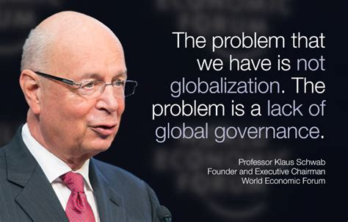

Slide 28
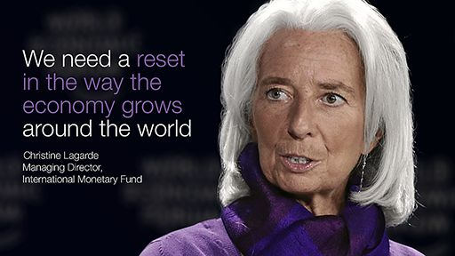

Slide 31
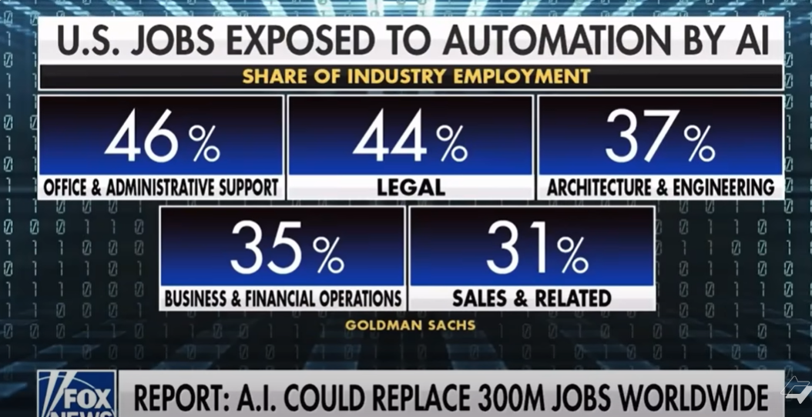
Dockworkers held our country captive for a 62% pay raise over this!
according to a 2019-20 annual report from Waterfront Commission of New York Harbor, about one-third of local longshoremen made $200,000 or more a year.

Slide 32
https://www.weforum.org/agenda/2019/10/future-predictions-what-if-get-things-right-visions-for-2030/

Slide 33
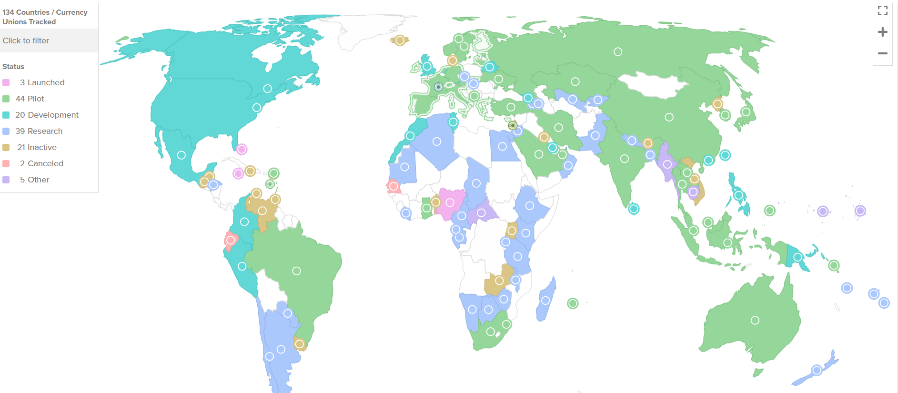
Central Bank digital currency tracker
134 countries,
98% of global GDP,
are exploring a CBDC
In 2020 that number
was only 35.
Currently, 66 countries are in the advanced phase of exploration—development, pilot, or launch.
https://www.atlanticcouncil.org/cbdctracker/

Slide 34
c) A mark verifies compliance! Rev. 13:16,17
(Somehow tied to this worship of him)
“And he causeth all, …to receive a mark in their right hand, or in their foreheads:”
(2) This Mark seals their eternal fate! Rev 14:9-11
“If any man worship the beast and his image,
and receive his mark in his forehead, or in his hand,
The same shall drink of the wine of the wrath of God, …and he shall be tormented with fire and brimstone …
…The smoke of their torment ascendeth for ever”

Slide 35
C. How: Is his true nature revealed? Rev 13
1) He’ll have some type of “resurrection”. 3-4
2) He makes war with the saints. 5,6
3) He Demands & Receive Global Worship. 7-18
4) He’ll desecrate the Jewish temple. Dan. 9:27
“in the midst of the week he shall cause
the sacrifice and oblation to cease,
and for the overspreading of abominations
he shall make it desolate,…”
(shāmēm: astonish, stupefy)

Slide 36
4) He’ll desecrate the Temple with his image.
a) Jesus warned of this in Mt 24:15 “When ye therefore shall see the abomination of desolation,
spoken of by Daniel the prophet, stand in the holy place,
(whoso readeth, let him understand:)
21 For then shall be great tribulation, such as was not since the beginning of the world to this time, no,
nor ever shall be.
22 And except those days should be shortened,
there should no flesh be saved:
but for the elect's sake those days shall be shortened.”
vs 16-20 (RUN!)

Slide 37
4) He’ll desecrate the Temple with his image.
b) Paul described this in 2 Th 2:4
“then shall that Wicked be revealed, the son of perdition who opposes and exalts himself above all that is called God, or worshiped;
so that he as God sitteth in the temple of God,
shewing (apodeiknymi) himself that he is God.”
From deikny’ō: to show and apo: off!

Slide 38
Rev 12:12 “… for the devil is come down unto you, having great wrath,
because he knoweth that he hath but a short time”

Slide 39
With this, faithful Jews (and believers) will recognize him as the false messiah and reject him.
God will miraculously protect a remnant,
but many will suffer! Dan. 12; Rev. 7:9-14
9 “I beheld, and, lo, a great multitude, which no man could number, of all nations, …stood before the throne, and before the Lamb, clothed with white robes…;
14 These are they which came out of great tribulation, and have washed their robes,
and made them white in the blood of the Lamb.”

Slide 40
Conclusion: 1 Thess. 5:
1 “But of the times and the seasons, brethren,
ye have no need that I write unto you.
2 For yourselves know perfectly that the day of the
Lord so cometh
3 For when they shall say, Peace and safety;
then sudden destruction cometh upon them,
as travail upon a woman with child;
and they shall not escape.
as a thief in the night.

Slide 41
1 Thessalonians 5:
4 But ye, brethren, are not in darkness, that that day should overtake you as a thief.
5 Ye are all the children of light, and …of the day: we are not of the night, nor of darkness.
6 Therefore let us not sleep, as do others;
but let us watch and be sober.
7 For they that sleep sleep in the night; and they that be drunken are drunken in the night.

Slide 42
1 Th 5:8 But let us, who are of the day, be sober,
putting on the breastplate of faith and love;
and for an helmet, the hope of salvation.
9 For God hath not appointed us to wrath,
but to obtain salvation by our Lord Jesus Christ,
10 Who died for us, that, whether we wake or sleep, we should live together with him.
11 Wherefore comfort yourselves together,
and edify one another, even as also ye do.”
Heb. 10:25 “and so much the more…”

Slide 43
History
Mystery
Destiny
Rapture
1 Th 4
Jesus’ 2nd coming Rev 19
Re-Creation
Rev. 21:5
Church
Age
The Tribulation
Kingdom Age
Jer 30:7
Prophecy

Slide 44
Destiny: Which will be yours?
Rapture
1 Th 4
Jesus’ 2nd coming Rev 19
Church Age
The Tribulation
Kingdom Age
New Heaven and Earth
There’s no time in Eternity
To change your Destiny!
2 Cor 8:2 “Now is the accepted time”

