Slide 1
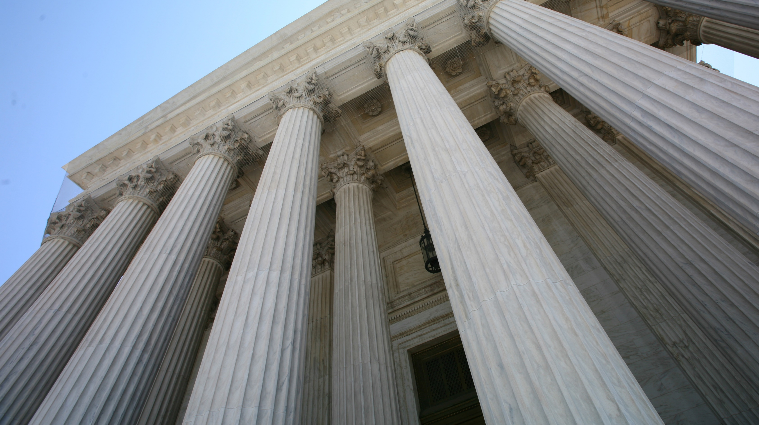
μὴ ἐν προσωπολημψίαις
By Joseph Peters

Slide 2
Objective
No Christian should show biased favor in hopes of selfish gain
For these three reasons

Slide 3
Rationale
It breaks the royal command
It misrepresents God
It should only be done selflessly

Slide 4
James 2:1-4

Slide 5
The Rich Man
My brethren, have not the faith of our Lord Jesus Christ, the Lord of glory, with respect of persons. For if there come unto your assembly a man with a gold ring, in goodly apparel (James 2:1–2a)

Slide 6
The Poor Man
and there come in also a poor man in vile raiment; (James 2:1–2a)

Slide 7
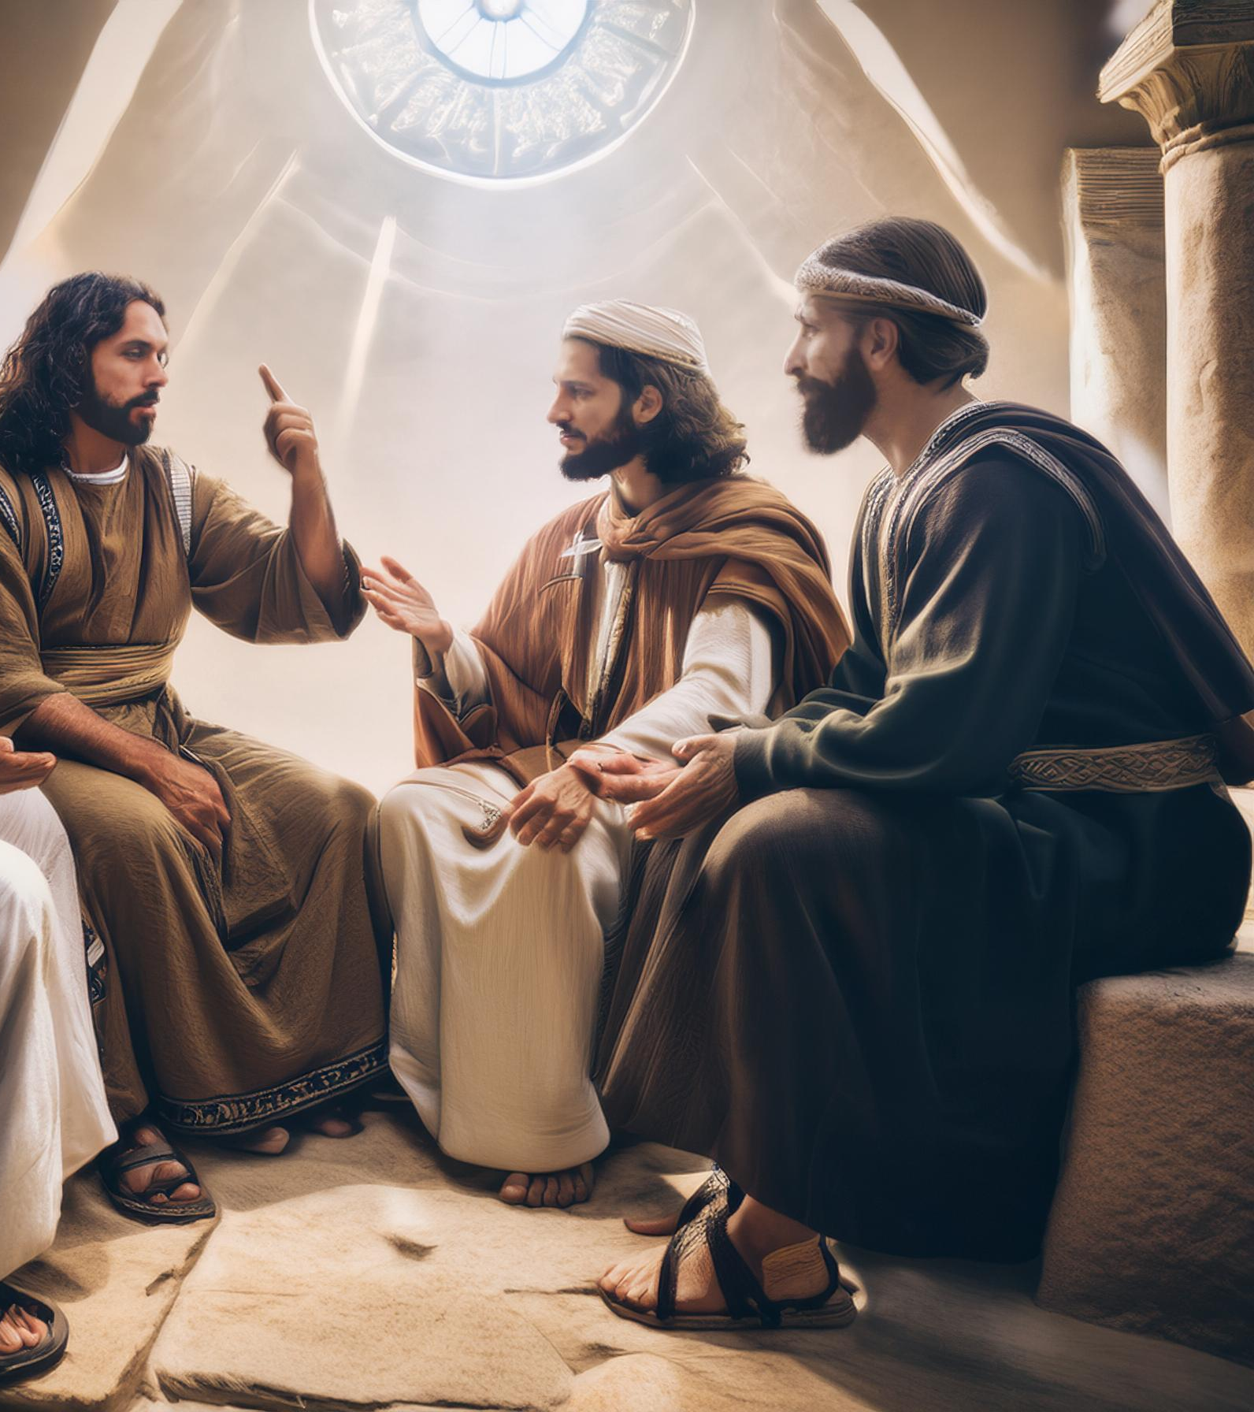
The Church’s Response
And ye have respect to him that weareth the gay clothing, and say unto him, Sit thou here in a good place; and say to the poor, Stand thou there, or sit here under my footstool: Are ye not then partial in yourselves, and are become judges of evil thoughts? (James 2:3–4).

Slide 8
Possibility of a Christian Court
Are ye not then partial [διακρίνω] in yourselves, and are become judges [κριτής]… (James 2:4a).
Do not rich men oppress you, and draw you before the judgment [κριτήριον] seats? (2:6b)
There is one lawgiver, who is able to save and to destroy: who art thou that judgest [κρίνω] another? (James 4:12).
Ye have condemned… (5:6a)

Slide 9
Early Christian Courts (Paul)
Dare any of you, having a matter against another, go to law before the unjust, and not before the saints? Do ye not know that the saints shall judge the world? and if the world shall be judged by you, are ye unworthy to judge the smallest matters? (1 Cor 6:1–2).

Slide 10
Early Christian Courts (Jesus)
Moreover if thy brother shall trespass against thee, go and tell him his fault between thee and him alone: if he shall hear thee, thou hast gained thy brother. But if he will not hear thee, then take with thee one or two more, that in the mouth of two or three witnesses every word may be established. And if he shall neglect to hear them, tell it unto the church… (Matt 18:15–17a).

Slide 11
Babylonian Talmud
“How do we know that, if two came to court, one dressed in rags, the other in a fine cloak worth a hundred manehs, they should say to the dandy, ‘Either dress like him or dress him up like you?...”
“How do we know that, if a disciple was sitting before his teacher [who was acting as a judge] and knew something for the case of the poor man and something against the case of the rich man, he is not free to keep silent? (b. Shabu. 31)

Slide 12
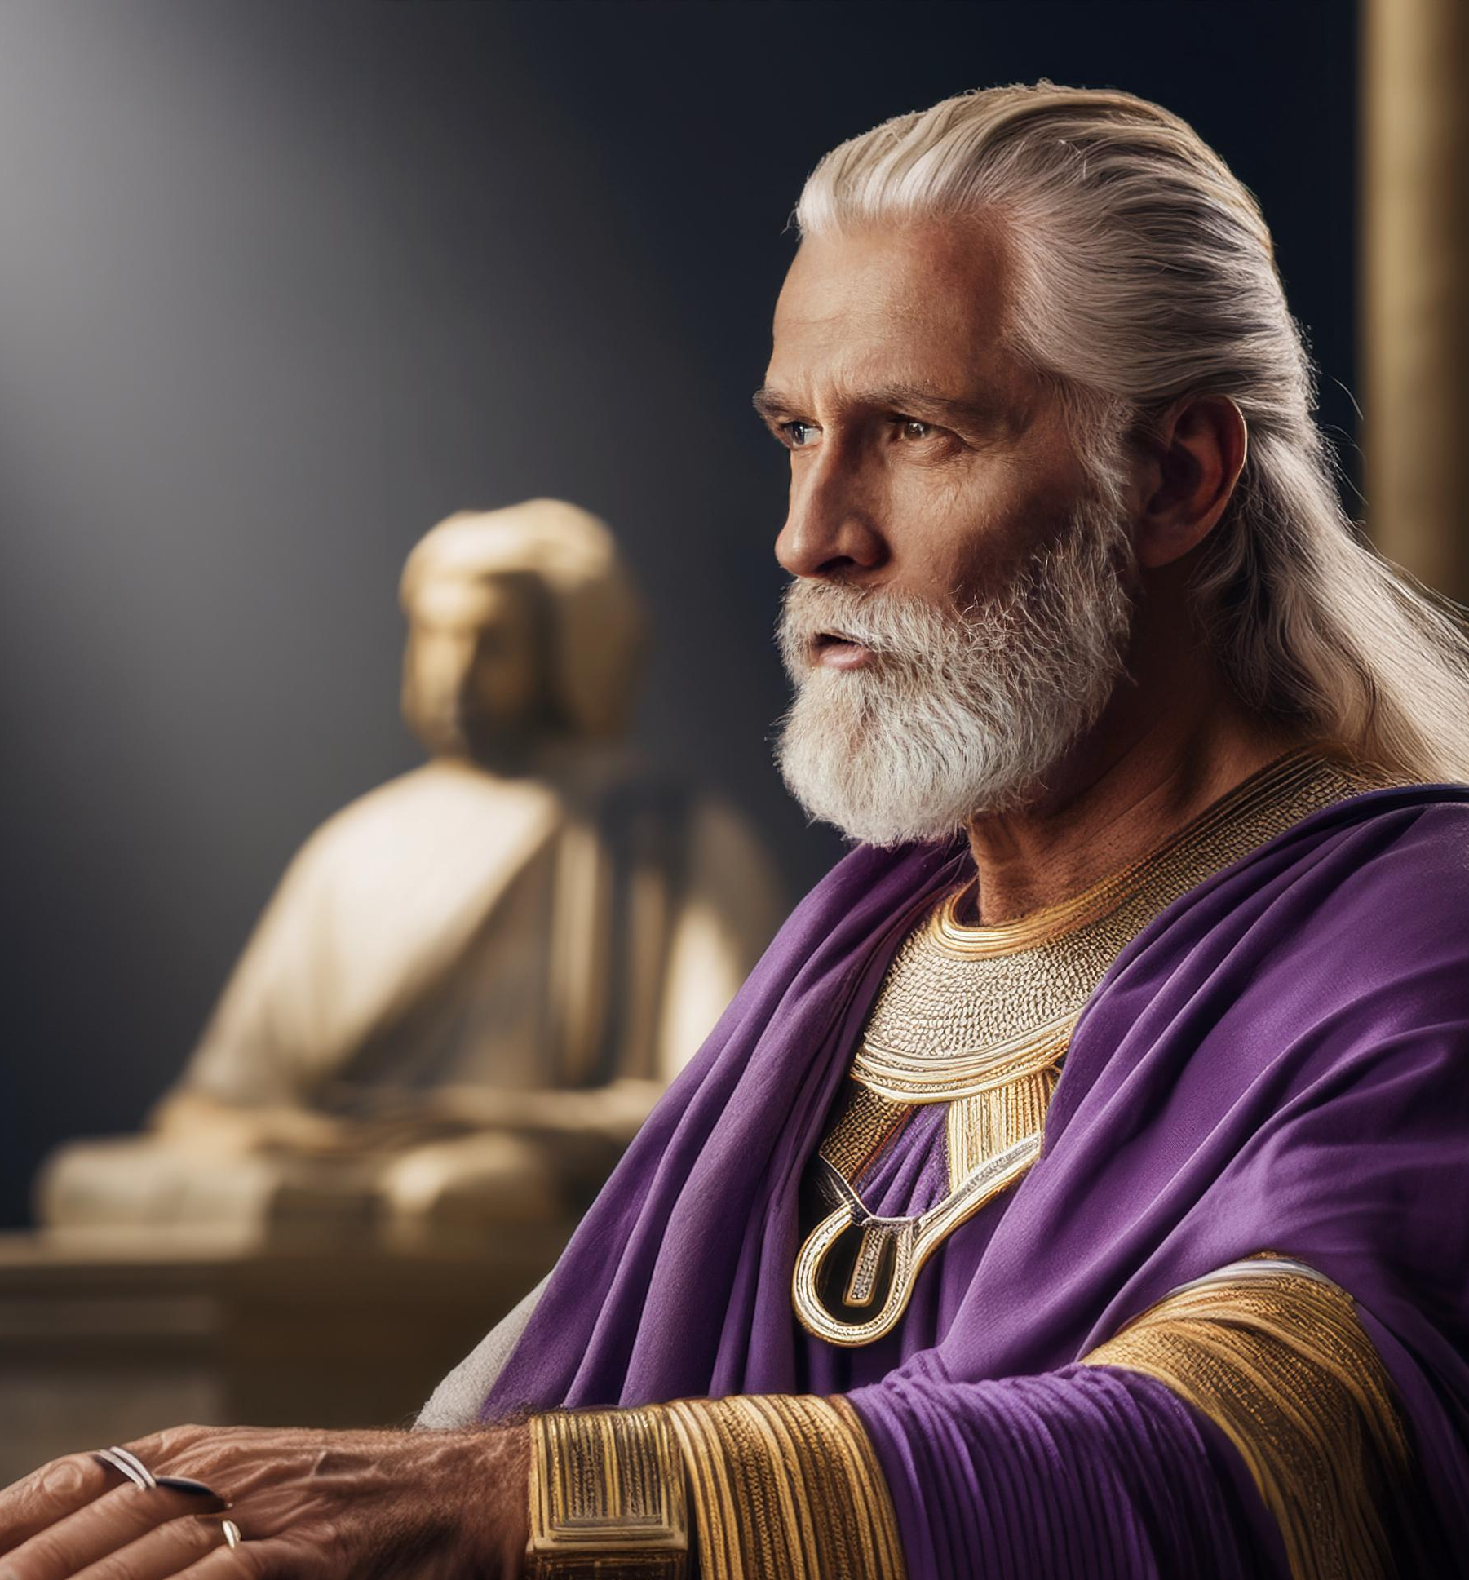
James 2:5-7

Slide 13
James’ Criticism
Are ye not then partial in yourselves, and are become judges of evil thoughts? Hearken, my beloved brethren, Hath not God chosen the poor of this world rich in faith, and heirs of the kingdom which he hath promised to them that love him? But ye have despised the poor. Do not rich men oppress you, and draw you before the judgment seats? Do not they blaspheme that worthy name by the which ye are called? (James 2:4-7).

Slide 14
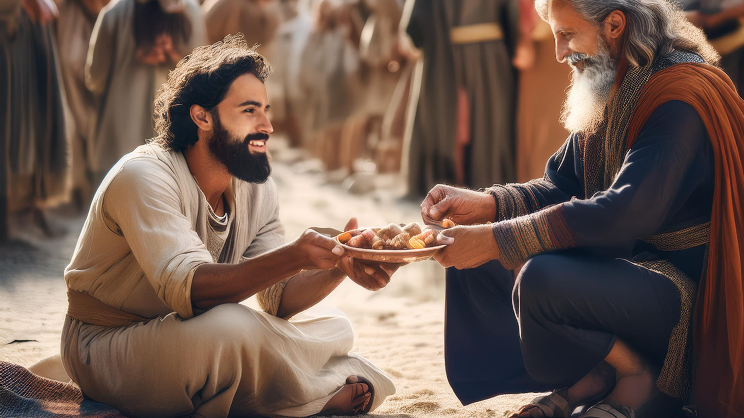
James 2:8-11

Slide 15
The Royal Law
If ye fulfil the royal law according to the scripture, Thou shalt love thy neighbour as thyself, ye do well: But if ye have respect to persons, ye commit sin, and are convinced of the law as transgressors. For whosoever shall keep the whole law, and yet offend in one point, he is guilty of all. For he that said, Do not commit adultery, said also, Do not kill. Now if thou commit no adultery, yet if thou kill, thou art become a transgressor of the law (James 2:8-11)

Slide 16
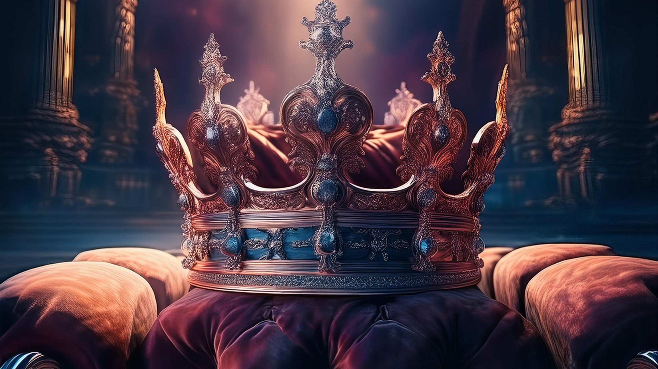
It Breaks the Royal Command

Slide 17
Love your neighbor
…but thou shalt love thy neighbour as thyself: I am the LORD (Lev 19:18).
Thou shalt love thy neighbour as thyself. On these two commandments hang all the law and the prophets (Matt 22:39–40).
…but to love one another: for he that loveth another hath fulfilled the law… and if there be any other commandment, it is briefly comprehended in this saying, namely, Thou shalt love thy neighbour as thyself… therefore love is the fulfilling of the law (Ro 13:8b, 9c, 10b).
For all the law is fulfilled in one word, even in this; Thou shalt love thy neighbour as thyself (Gal 5:14).

Slide 18
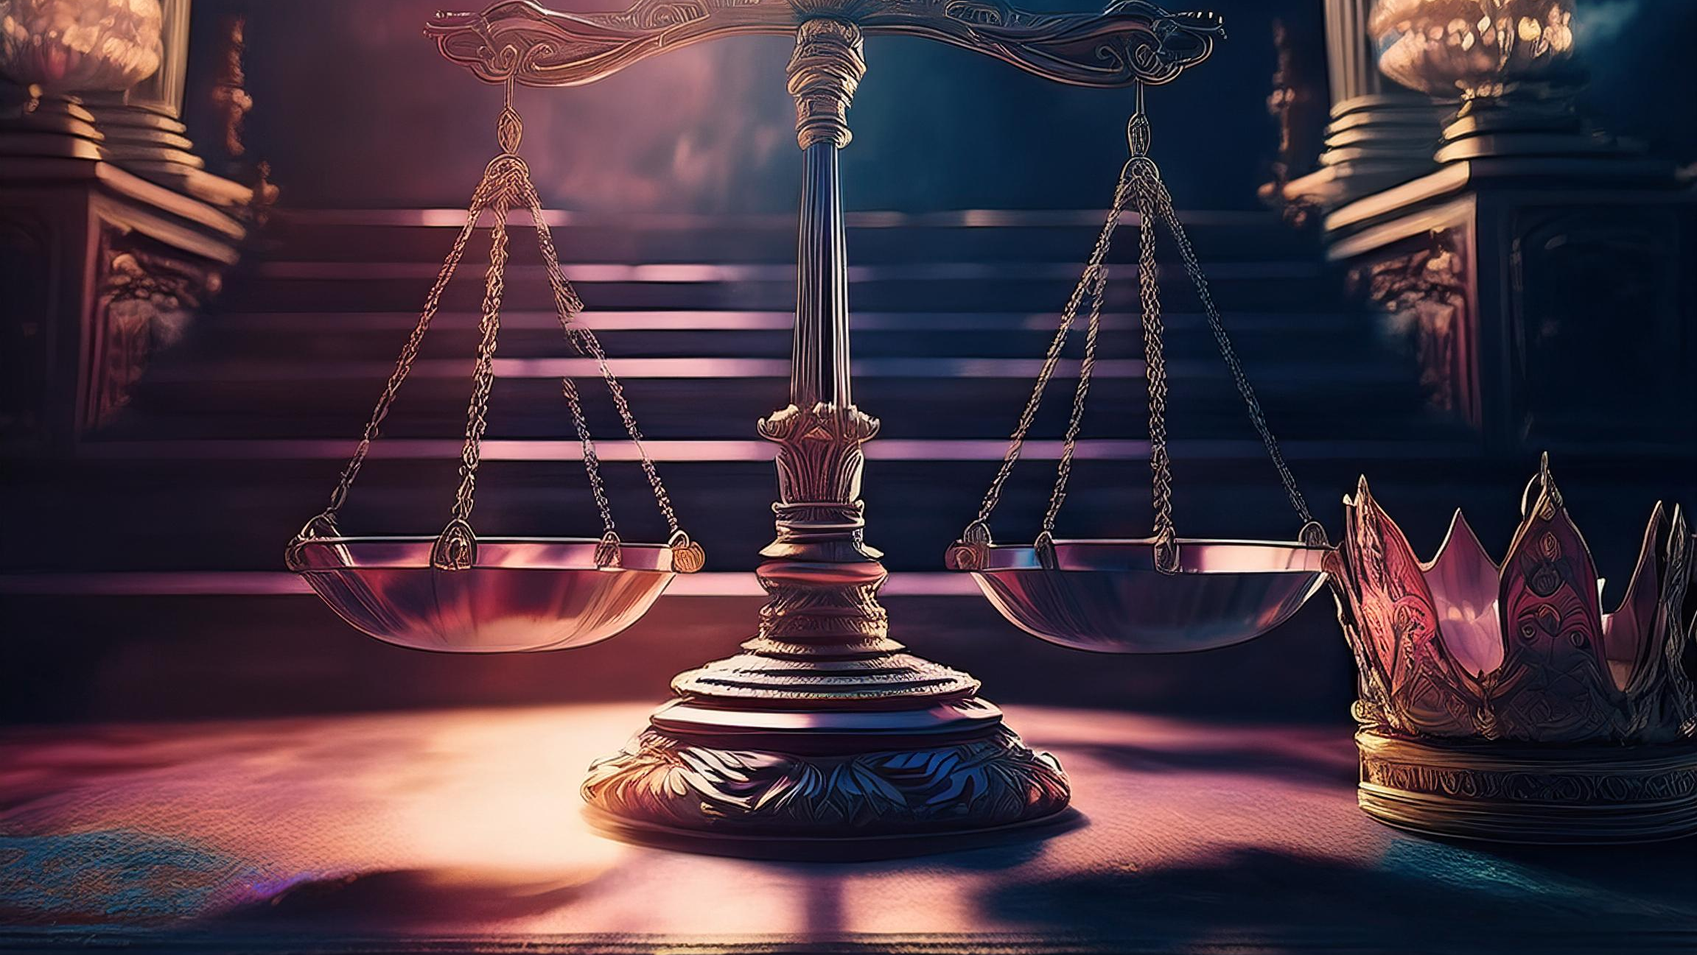
It Misrepresents God

Slide 19
God is the Impartial Judge/Master
And, ye masters, do the same things unto them, forbearing threatening: knowing that your Master also is in heaven; neither is there respect of persons with him (Eph 6:9).
But he that doeth wrong shall receive for the wrong which he hath done: and there is no respect of persons. (Col 3:25).
For there is no respect of persons with God (Rom 2:11).

Slide 20
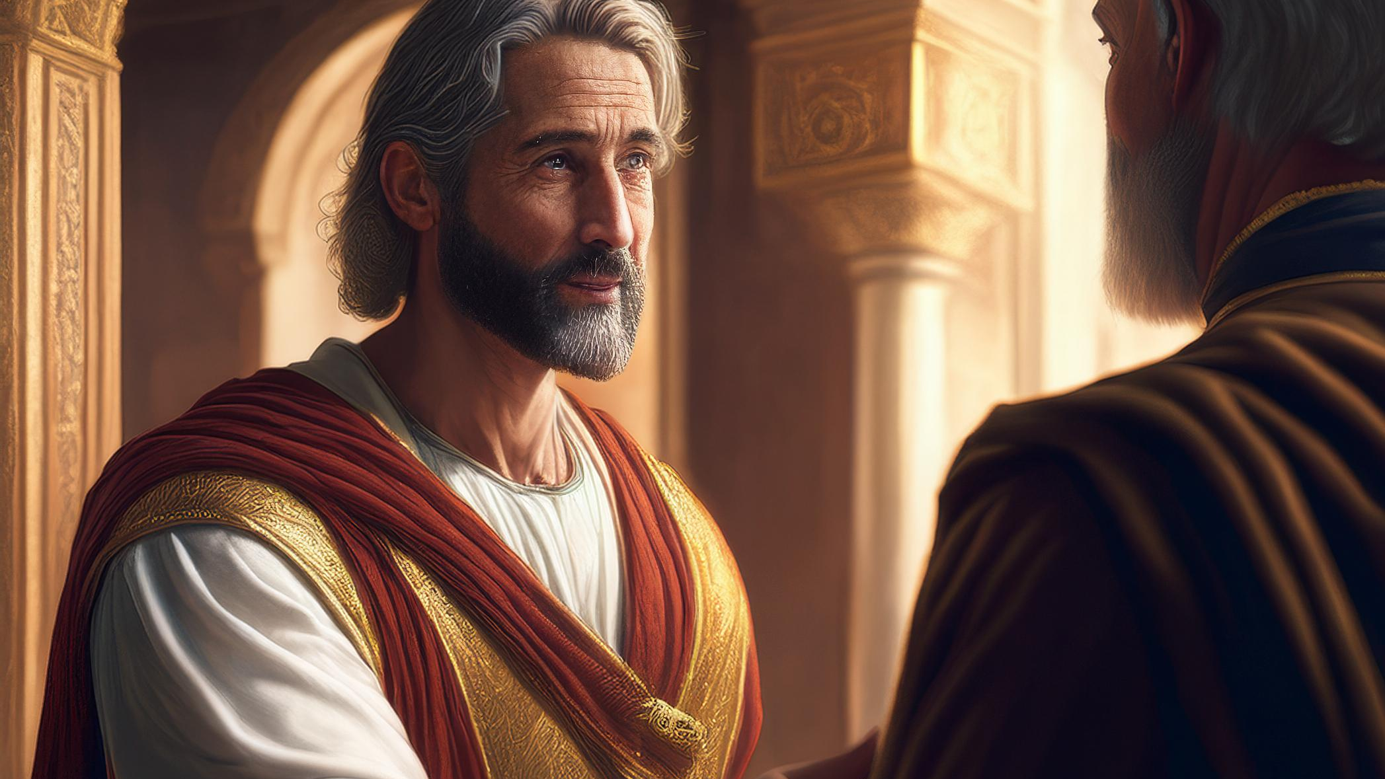
It Should Only be Done Selflessly

Slide 21
Showing Favor Selflessly P1
When thou makest a dinner or a supper, call not thy friends, nor thy brethren, neither thy kinsmen, nor thy rich neighbours; lest they also bid thee again, and a recompence be made thee. But when thou makest a feast, call the poor, the maimed, the lame, the blind: And thou shalt be blessed; for they cannot recompense thee: for thou shalt be recompensed at the resurrection of the just (Luke 14:12–14).

Slide 22
Showing Favor Selflessly P2
And if ye do good to them which do good to you, what thank have ye? for sinners also do even the same. And if ye lend to them of whom ye hope to receive, what thank have ye? for sinners also lend to sinners, to receive as much again. But love ye your enemies, and do good, and lend, hoping for nothing again; and your reward shall be great, and ye shall be the children of the Highest: for he is kind unto the unthankful and to the evil (Luke 6:33–35).

Slide 23
Conclusion

Slide 24
Objective
No Christian should show biased favor in hopes of selfish gain
For these three reasons

Slide 25
Rationale
It breaks the royal command
It misrepresents God
It should only be done selflessly

