Slide 1
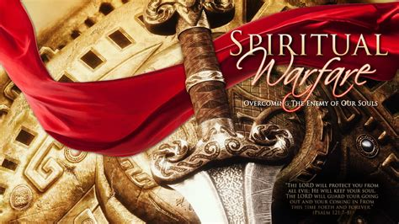

Slide 2
Eph. 6:10
“Finally brethren, be strong in the Lord and in the power of His might.”
11 “Put on the whole armor of God,
That ye may be able to stand against the wiles of the devil.”

Slide 4
“Lest Satan should get an advantage of us:
for we are not ignorant of his devices.”
2 Cor 2:11 (No’ēma: mind, thoughts, purposes)
Satan (and his demons) are trying to infect us with his mind, thoughts, purposes!

Slide 5
2 Cor 2:11“Lest Satan should get an advantage of us:
for we are not ignorant of his devices.”
His Motive:
His Means:
His Method:
1Jn 5:19 “the whole world lieth in wickedness”
(Poneros: evil, hurtful, infected)
Pride/Rebellion (Is. 14:14)
Deception/Temptation (Ro. 6:16)
Infection/corruption (1Jn 2:15,16)

Slide 6
1 Cor 10 uses Israel’s Exodus as the
foundational example of how God (and Satan)
works to try to accomplish their purposes.
1 Cor 10:11 “Now all these things happened unto them for ensamples: and they are written for our admonition...
14 Wherefore, my dearly beloved, flee from idolatry…
20 But I say, that the things which the Gentiles sacrifice, they sacrifice to devils, (daimon’ion: demons)
I would not that ye should have
fellowship (koinonos’: partnership) with devils.”

Slide 7
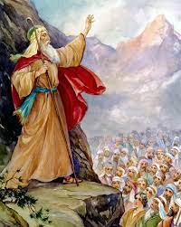
“Fellowship with devils” corrupts us. Deut. 32 is Moses’ swan song.
What God is. Vs 3,4
“I will publish the name of the LORD,
ascribe greatness unto our God.”
A. Stable, powerful. Vs 4 “He is the Rock”
(ṣûr: refuge, strength)
Pr 18:10 “The name of the LORD is a strong tower:
the righteous runneth into it, and is safe.”
(Mt 16:18; Heb 6:19

Slide 8
What God is. Dt 32: 3,4
B. Perfect “his work is perfect:”
Tamim: without fault, entire
This is how God wants us:
1) To love. Dt. 6:5 “Love the Lord thy God with all
thine heart” (See also Mt 22:37)
2) To live. Mt 5:48 “be thou therefore perfect,
even as your Father in heaven is perfect”
(teleios: complete)

Slide 9
What God is. Dt 32: 3,4
C. Just: “for all his ways are judgment:
(Mishpāṭ’: Justice, right)
a God of truth and without iniquity,
just (ṣaddîq’: lawful, clear) and right is he.” (yāshār’: straight, righteous)
You cannot always trace God’s hand;
But you can always trust His heart!”
(Job 13:15; 23:10)

Slide 10
2. What God did (and does) Dt 32:6-14
Vs 6 “Is not he thy father that hath bought thee?
hath he not made thee, and established thee?
vs 10 “He found him (Israel) in a desert land, ...;
he led him about, he instructed him, he kept him
as the apple of his eye.”
11,12 “as an eagle…the LORD alone did lead him,
and there was no strange god with him.
Vs 13 “He made him ride on the high places of the earth,
that he might eat the increase of the fields; …

Slide 11
3. What God’s people did (and do) 5-6
5 “they have Corrupted (shāḥat’: ruined) themselves,
their spot (mûm: birthmark) is not the spot of his children:
they are a perverse (ʿiqqēsh: distorted) and crooked (pātal’: to twine, twist, torture) generation.
6 Do ye thus requite the LORD, O foolish people?
Is not he thy father that hath bought thee?
hath he not made thee, and established thee?”

Slide 12
3. God’s people corrupted themselves.
A. Who or what was behind this corruption?
To answer this question Moses gave them an important History lesson. Dt. 32:7-28
Ancient History Deut 32:7 “Remember the days of old, consider the years of many generations:
Modern (recent) “ask thy father, and he will shew thee; thy elders, and they will tell thee.”
This corruption “cycle” is both ancient
and continuous!

Slide 13
3. God’s people commit spiritual adultery Dt 32:5
B. Infidelity is a biproduct of Forgetfulness!
If we fail to learn the lessons of History
(1 Cor 10:11 “these things happened for ensamples” )
History will repeat itself! (1 Cor. 10:12)
Vs 7-8 7 “remember the days of old … when the most High divided to the nations their inheritance,
when he separated the sons of Adam.
(This happened at the tower of Babel in Gen. 11)

Slide 14
9 “For the LORD'S portion is his people;
Jacob is the lot of his inheritance.”
Naḥalâ: possession, heritage
If Israel was “God’s inheritance”,
Whose inheritance (possession, reflection)
were the other nations?
To understand this, we must go
Back to Babylon. (Gen. 10,11)

Slide 15
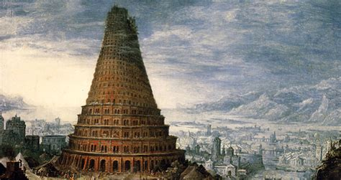
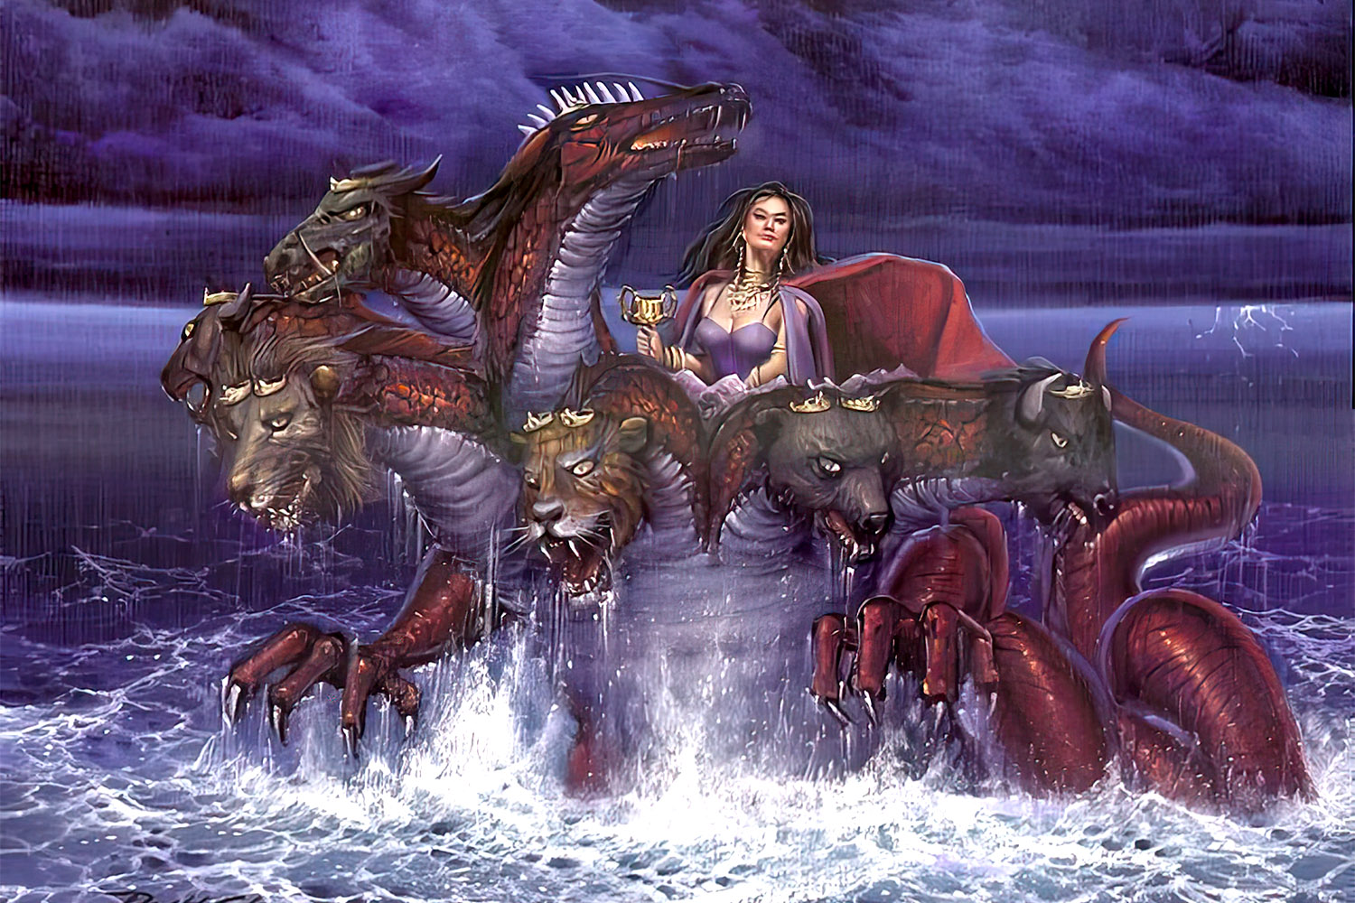
Babylon was the first (Gen. 10,11)
and will be the last example (Rev. 17, 18)
of a world empire in rebellion against God.
Rev 17:5 “Mystery, babylon the great,
the mother of harlots and abominations of the earth.”

Slide 16
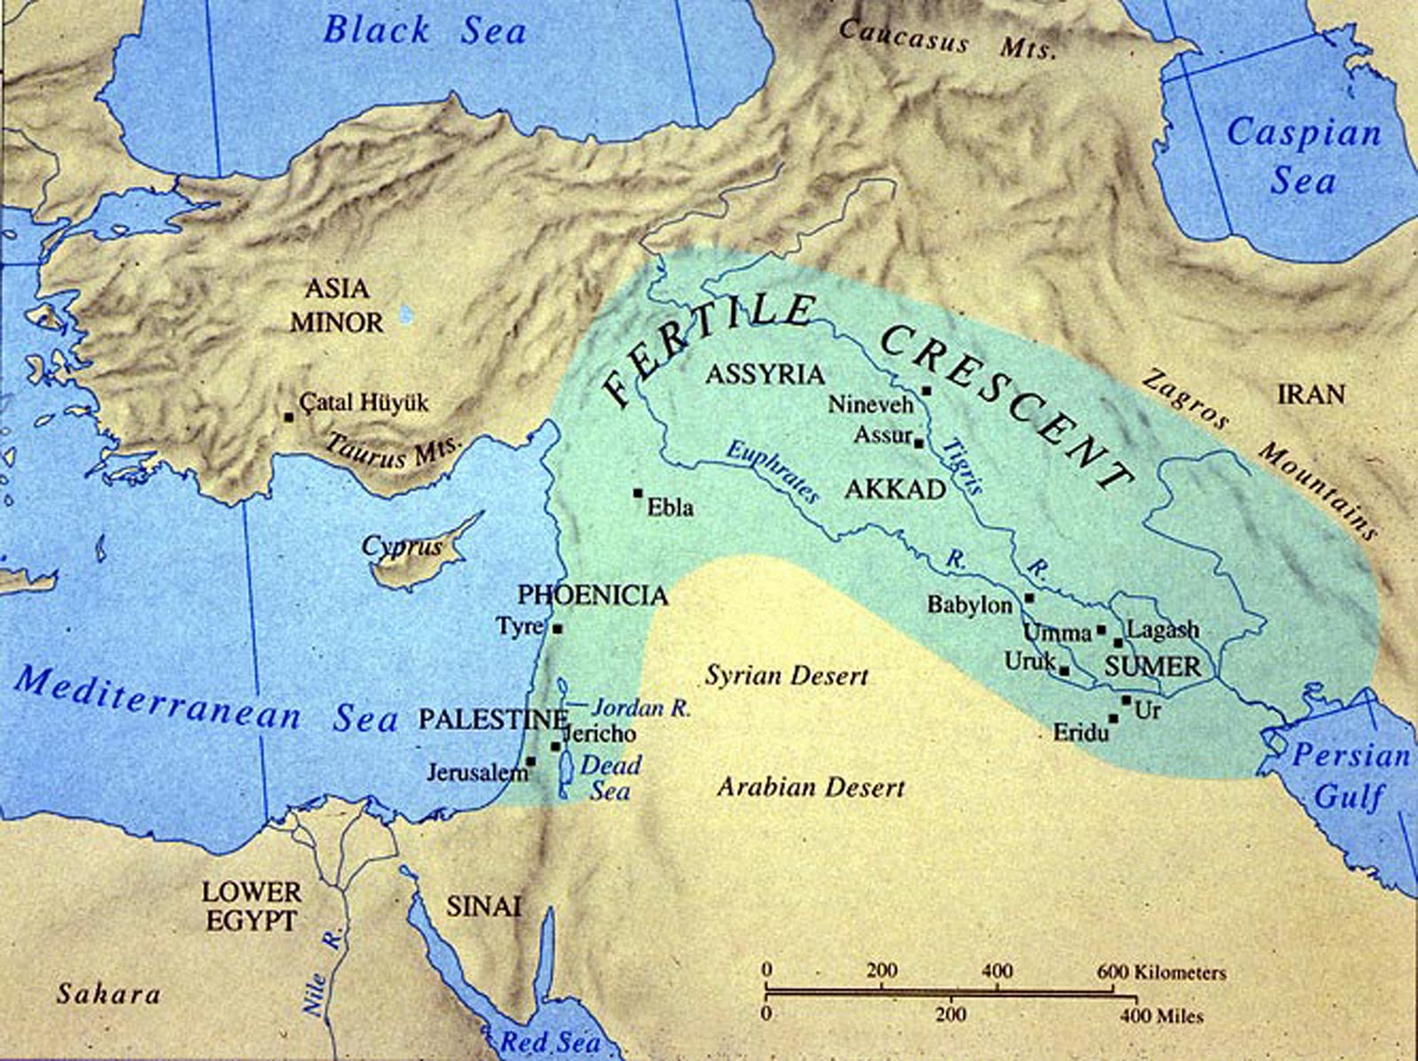
4. Back to Ancient Babylon Gen. 10,11
A. Founded by Nimrod. Genesis 10:8-10
“Cush (Ham’s son) begat Nimrod: (semitic: The Rebel)
(he began to be a mighty one (gibbor: tyrant) in the earth.)
¹⁰ And the beginning of his kingdom was Babel, and Erech, and Akkad, and Calneh, in the land of Shinar.”
Also known as Sumer

Slide 17
4. Back to Ancient Babylon Gen. 10,11
B. It was founded/built to defy God.*
Gen 11:4 “let us build us a city and a tower,
whose top may reach unto heaven;
and let us make us a name,
lest we be scattered abroad upon … the earth.”
1) Replenishing earth was God’s command. Gen. 9:1
2) God promised not to flood the earth again (9:11,12)
But they apparently didn’t believe/trust him!
* Josephus: Antiquities of the Jews, Book 1, Ch. 4

Slide 18
C. Became a center of polytheism, cultic worship.
1) The “gods” (fallen angels) quickly found inroads
into the descendants of Noah. (Gen. 9; Lev 18:8; 20:11)
2) Nimrod and Semiramis claimed to be demigods and created a polytheistic system focused on the stars. (Hislop)
3) Eusebius records that Nimrod’s wife Semiramis gives
birth (after Nimrod’s death) to a son, claiming an
“immaculate conception” by Nimrod as the sun god
and a “reincarnation” of Nimrod in this child.
a) She named this child “Tammuz” and named herself
“the mother of god and the queen of heaven.” (Ishtar)

Slide 19
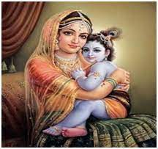
b) Semiramis was the original goddess of false religion
later known as Ishtar (Babylon), Asherah (Canaan);
Isis (Egypt); Astarte, Artemis or Diana (Greece/Rome)
Osiris
Isis and Horis
Semiramis
and
Tammuz
Devka and Krishna
Israel worshiped both Tammuz (Ex. 8:17)
and the “queen of heaven” (Jer. 7:18; 44:17)

Slide 20
4) At the division at Babylon, the people continued these
cultic practices, carrying these false “gods” with them.

Slide 21
D. This implies the people/nations (that rejected God)
became the “inheritance” of the demons who worked (with and through Nimrod) to oppose God at Babylon.
1) Notice how God describes the final Empire.
Rev 17:5 “Mystery, babylon the great, the mother of harlots and abominations of the earth.”
Rev. 18:2 “Babylon the great is fallen,
and is become the habitation of devils,
and the hold of every foul spirit…”

Slide 22
Israel was seduced by these false gods
to commit spiritual adultery. Dt. 32:15-17
15 “But Jeshurun (Israel) waxed fat, and kicked:
(bāʿaṭ’: despised, rebelled)
then he forsook (nāṭash: rejected) God which made him,
and lightly esteemed the Rock of his salvation.
16 They provoked him to jealousy with strange gods,
with abominations provoked they him to anger.
17 They sacrificed unto devils, (shed: demons);
to gods whom they knew not, …”

Slide 23
Conclusion: 1 Cor 10:11,12
God repeatedly warns us that these same “gods” are seeking to seduce us.
2 Tim. 2:1-4; 2 Tim. 4:10; 1 Jn 2:15,16; 5:18
James 4:4 “Ye adulterers and adulteresses,
know ye not that the friendship of the world
is enmity (ech’thra: hostility/opposition) with God?
Whosoever therefore will be a friend of the world
is the enemy of God. “
(Echthros’: hostile adversary)

Slide 24
How does Spiritual Adultery develop? Dt. 32:
1) Begins with ingratitude. Vs 15
“waxed fat and kicked”
2) We begin to drift from God. 15b
“then he forsook God which made him”
a) Grow “bitter” at his “rules”. “and lightly
esteemed (nābēl: despised) the Rock of his salvation.”
b) This cultivates the seeds of “infidelity”.
(Lack of trust and faithfulness)

Slide 25
How does Spiritual Adultery develop? Dt. 32:
1) Begins with ingratitude. Vs 15
2) We begin to drift from God. 15b
3) We eventually drift toward false gods/idols v16
“They provoked him to jealousy with strange gods,
(zûr: to turn aside, profane, commit adultery)
with abominations provoked they him to anger.”
4) We (and others) pay a horrible price. Vs 17
“they sacrificed unto devils, not to God; to gods whom they knew not, to new gods that came newly up”

Slide 26
4) We (and others) pay a horrible price. Dt 32:17
Dt. 8:11,19,20 “Beware that thou forget not the LORD thy God, in not keeping his commandments...
If thou do at all forget the Lord thy God, and walk after other gods and serve and worship them,
I testify against you this day that ye shall surely perish.
20 As the nations which the Lord destroyed before you, so shall ye perish;
because ye would not be obedient unto the Lord your God.”

Slide 27
Application: How do we avoid spiritual adultery
James 4:6-8 “But he giveth more grace.
Wherefore he saith, God resisteth the proud,
but giveth grace unto the humble.
Submit yourselves therefore to God.
Resist the devil, and he will flee from you.
Draw nigh to God, and he will draw nigh to you.
Cleanse your hands, ye sinners; (actions)
& purify your hearts, ye double minded.” (attitudes)
See 1 Jn 1:5-10

