Slide 1
Principles for Powerful Living

Slide 2
The Universe Operates through natural principles because the Creator Does.
The Bible reveals Spiritual principles to help guide us to God and His plans. Some of these include:
The Passion (Open Heart) Principle. (Col. 3:16-24)
The Purpose (Open Hand) Principle. (Ex. 3,4)
The Path (Open Door) Principle. (Rev. 3:7-13)
This morning we’re going to examine
“The Preparation Principle” (Seed)

Slide 3
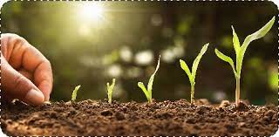
The Bible often uses agricultural terms to describe our lives and Relationships.
“Seed” is mentioned 254 times in the Bible,
Often metaphorically.
The importance of planting even small seeds or “preparations” can’t be overstated.

Slide 4
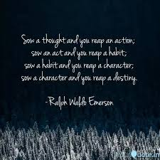
Sow a thought
and you reap and action;
Sow and act
and you reap a habit;
Sow a habit
and you reap a character;
Sow a character
and your reap a destiny!
Ralph Waldo Emerson

Slide 5
Into Every Field (Life) A Little Seed Will Fall.
God Is Busy Planting Good Seed. Mt 13:24
“The kingdom of heaven is likened unto a man which sowed good (kalos: valuable, virtuous) seed in his field.”
“The seed is the word of God.” Luke 8:11
Mt 13:19 calls it “the word of the kingdom”
A. The initial purpose of the seed is to produce life!
Jn 1:1-5; Mt 13:38 “children of the kingdom”
1) Before it can do this, it must germinate. Jn 12:24 “Except a corn of wheat fall into the ground and die,
it abideth alone: but if it die, it brings forth much fruit.”

Slide 6
B. The ultimate purpose for the seed
is to produce fruit.
Gal. 5:22,23 “The fruit of the Spirit is love, Joy, Peace…”
1) “Fruit” isn’t for the plant, but for the Planter!
Jn 15:8 “Herein is my Father glorified, that ye bear
much fruit; so shall ye be my disciples.”
Jn 15:16 “I have chosen you, and ordained you,
that ye should go and bring forth fruit.”
2) Without fruit, there will be no more seed!
(The seed is in the fruit!)

Slide 7
Luke 8:11 “The seed is the word of God.” (Mt 13:19)
C. To help propagate (spread) the seed God uses:
1) People “a sower went forth to sow.” Vs 3
This is part of the Great Commission. Mt 28:18-20
2) Problems (Acts 8:3,4) “Saul…made havock of
the church, entering into every house, and haling
men and women committed them to prison.
Therefore they were scattered abroad
and went everywhere preaching.”
God can even use the “birds” to spread the seed.
(Gen. 50:20; Psalm 76:10; Ro. 8:28)

Slide 8
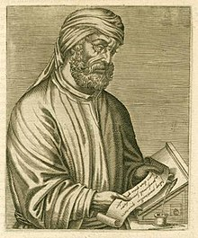
Luke 8:11 “The seed is the word of God.” (Mt 13:19)
B. To help propagate (spread) the seed God uses:
1) People 2) Problems
“The blood of the martyrs
is the seed of the church”
Tertullian of Carthage
(155-220 AD)

Slide 9
2. Satan Is Busy Planting “Bad Seed” Mt. 13:25
“while men slept, his enemy came and sowed tares
among the wheat,
A. Satan also uses people, problems, and
pressures to spread his seed.
1) The more trusted the source, (Messenger)
the more trusted the seed. (Message)
2) False prophets are mentioned at least 146 times.
Mt 7:15 “Beware of false prophets…in sheep’s clothing,
but inwardly they are ravening wolves”
and went his way.”

Slide 10
2. Satan Is Busy Planting “Bad Seed” Mt. 13:25
His seed is usually disguised as thoughts,
feelings, or attitudes that:
1) Seem reasonable (Ro. 1:28)
2) We assume are our own (Mt 16:23) and/or
3) Maybe even come from God! (Jn 16:2)
“whoever kills you will think that he does God service”
Sadly they’re actually from “seducting spirits
and doctrines of devils.” (1 Tim. 4:1)
(Jer. 17:9; John 10:10a; James 3:14-16; 2 Tim 3:13)

Slide 11
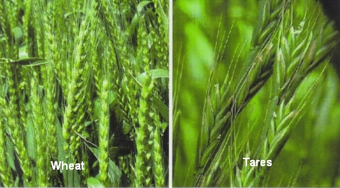
Wheat and tares look similar from a distance!

Slide 12
“while men slept, his enemy came and sowed tares…”
C) He tries to sow these seeds early on, before we
develop the ability to recognize or resist him.
Ecc. 12:1 “Remember now thy Creator in the days of
thy youth, while the evil days come not, …
when thou shalt say, I have no pleasure in them”
1) God describes these seeds (thought patterns)
which grow into “Strongholds”
which must be torn down with Truth! (2 Cor 10:3-5)

Slide 13
1) God describes these seeds (thought patterns) as
“Strongholds” which must be torn down (2 Cor 10:3-5)
“the weapons of our warfare are not carnal, but mighty through God to the pulling down of strong holds;
(Ochy’rōma: to fortify {a thought, argument, castle})
Casting down imaginations, and every high thing that exalteth itself against the knowledge of God,
and bringing into captivity every thought
to the obedience of Christ;”

Slide 14
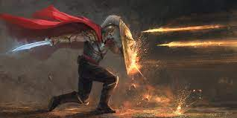
2) It’s from these strongholds that he sows more seeds
(lies and false reasoning) aka: stinking thinking;
that attack (fiery darts) God’s truth in our lives.
See Eph. 6:10-18
Eph 6:16
“Above all, taking the shield of faith, wherewith ye shall be able to quench all the fiery darts of the wicked.”

Slide 15
2. Satan Is Busy Planting “Bad Seed” Mt 13:18-22
Not only does Satan plant his own seed…
D. He tries to sabotage the soil (mind) through:
1) Distraction: “then cometh the wicked one…” to snatch God’s seed away before it can be acted on. 19
2) Obstruction: He “plants” his rocks
(bitterness, pride, lust, habits, prejudice, tradition)
so that even if God’s seed takes root,
it can’t go deep because of obstacles. Vs 20,21

Slide 16
D. He tries to sabotage the soil! (mind) Mt 13:18-22
1) Distraction Mt. 13:19
2) Obstruction vs 20,21
3) Competition: His seed (weeds/worries/worldliness) competes with and so chokes God’s seed. Mt. 13:22
“the cares (mer’imna: divide, distract) of this world
and the deceitfulness (apat’ē: delusion, cheat) of riches
(“and the Lusts of other things” in Mark 14:19)
choke the word (sympni’gō: to crowd and strangle)
and it (the seed) becometh unfruitful.”

Slide 17
Into Every Field (Life) A Little Seed Will Fall. Mt 13
1. God Is Busy Planting Good Seed. Mt 13:24
2. Satan’s busy planning bad seed. Mt. 13:25
3. We’re Busy Planting “Selfish Seed.” Gal. 5:19-21
“Now the works of the flesh are manifest, which are these; Adultery, fornication, uncleanness, lasciviousness, ²⁰Idolatry, witchcraft, hatred, variance, emulations, wrath, strife, seditions, heresies, ²¹Envyings, murders, drunkenness, revellings, and such like: of the which I tell you before, …,
that they which do such things shall not inherit
the kingdom of God.”
(see 1 Cor 3:15; Ph. 3:19)

Slide 18
We need wisdom to “take our thoughts captive” 2 Cor 10:3-5 in order to determine their source.
(God, Satan, or Self)
In Mt. 16:15 Jesus asked “whom say ye that am I?”
Peter answered (16) “thou art the Christ, the son of ...God.”
Who planted this “Seed thought”
in Peter’s mind?
Notice Jesus’ response Mt. 16:7 “Blessed art thou, Simon
… for flesh and blood hath not revealed it unto thee,
but my Father which is in heaven.”

Slide 19
Mt 16:21-23 “From that time began Jesus to shew unto his disciples, how that he must go to Jerusalem, suffer many things of the elders and chief priests and scribes, and be killed, and be raised again the third day.”
Then Peter took him, and began to rebuke him, saying,
Be it far from thee, Lord: this shall not be unto thee.
Who planted this seed thought in Peter’s mind?
But he turned, and said.., Get thee behind me, Satan:
thou art an offence unto me: for thou savourest (phroneo) not the things that be of God, but those that be of men.”

Slide 20
Pam and Bob served as Missionaries in the Philippines when Pam got pregnant with her 5th child.
She developed amoebic dysentery during the pregnancy and was very sick.
Her doctors told her to abort the baby for her own safety because the medicines had done irreversible damage to the baby.
She told God that if He would give her a son,
she would name him Timothy (honoring God)
and dedicate him to God.

Slide 21
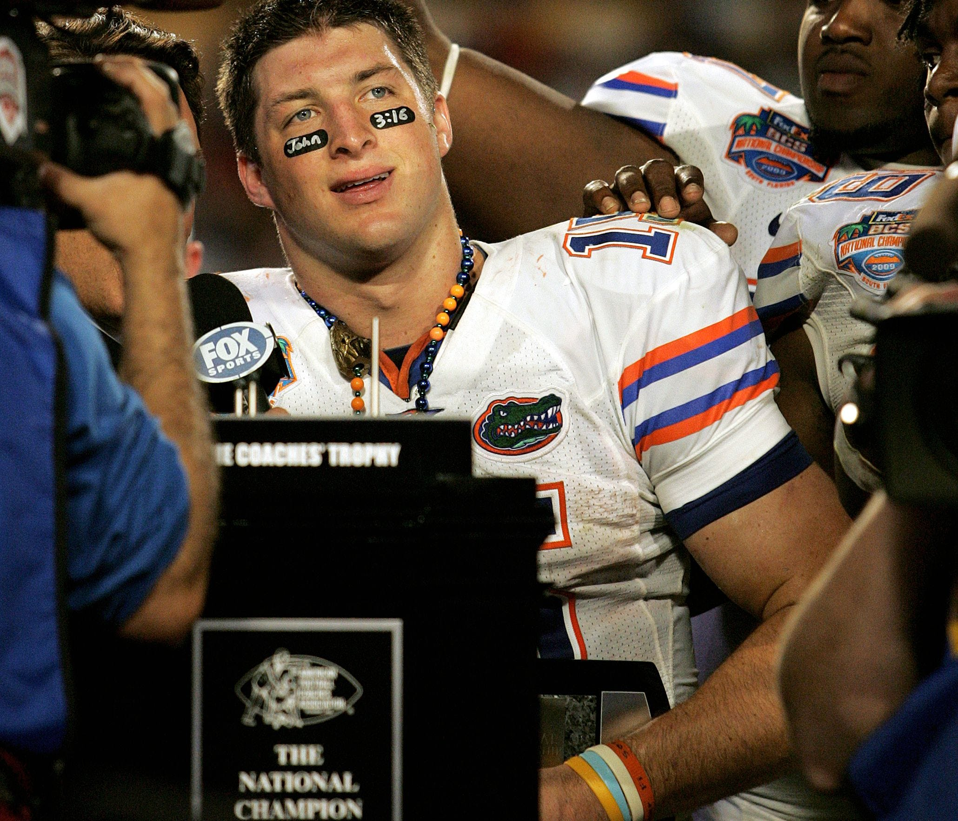
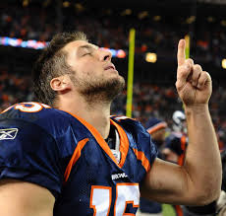
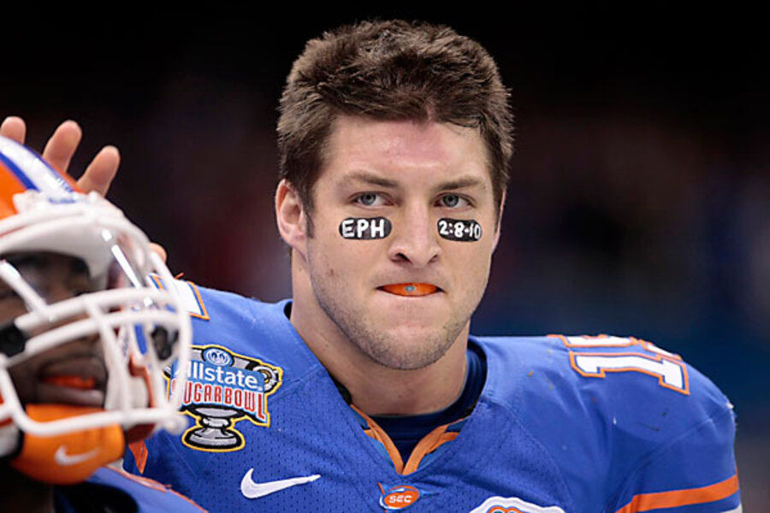
God answered her with a healthy baby boy
and she honored her commitment by raising him
to know and love God.
We know that son as “Tim Tebow”
Eph. 2:8,9; John 3:16

Slide 22
Application
Who’s voices are you listening to?
What seeds are they sowing into the soil of your soul?
What will these seeds produce in and through your life?
Are you prepared to do some “weeding” and “Feeding”?

Slide 23
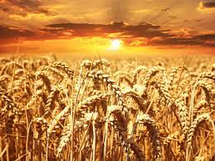
Ps 126:5-6 ”They that sow in tears shall reap in joy. He that goeth forth and weepeth, bearing precious seed,
shall doubtless come again with rejoicing,
bringing his sheaves
with him.”
What will you be bringing to God in that inevitable day!

