Slide 1
Ἐὰν ὁ κύριος θελήσῃ
By Joseph Peters

Slide 2
Objective
Every Christian should acknowledge God’s sovereignty over their plans
For these three reasons

Slide 3
Rationale
Tomorrow is unknown
Self-assurance is arrogance
Inactive Faith is Active Sin

Slide 4
Making Plans
Go to now, ye that say, To day or to morrow we will go into such a city, and continue there a year, and buy and sell, and get gain (James 4:13).

Slide 5
The Security of Rome
Epictetus argued “For you see that Cæsar appears to furnish us with great peace, that there are no longer enemies nor battles nor great associations of robbers nor of pirates, but we can travel at every hour and sail from east to west” (Diatr. 3.13).

Slide 6
The Dangers
Thrice was I beaten with rods, once was I stoned, thrice I suffered shipwreck, a night and a day I have been in the deep; In journeyings often, in perils of waters, in perils of robbers, in perils by mine own countrymen, in perils by the heathen, in perils in the city, in perils in the wilderness, in perils in the sea, in perils among false brethren (2 Cor 11:25–26).

Slide 7
The Uncertainty of Tomorrow
Whereas ye know not what shall be on the morrow. For what is your life? It is even a vapour, that appeareth for a little time, and then vanisheth away (James 4:14).

Slide 8
The Fading of the Rich
But the rich, in that he is made low: because as the flower of the grass he shall pass away. For the sun is no sooner risen with a burning heat, but it withereth the grass, and the flower thereof falleth, and the grace of the fashion of it perisheth: so also shall the rich man fade away in his ways (Jas 1:10–11).

Slide 9
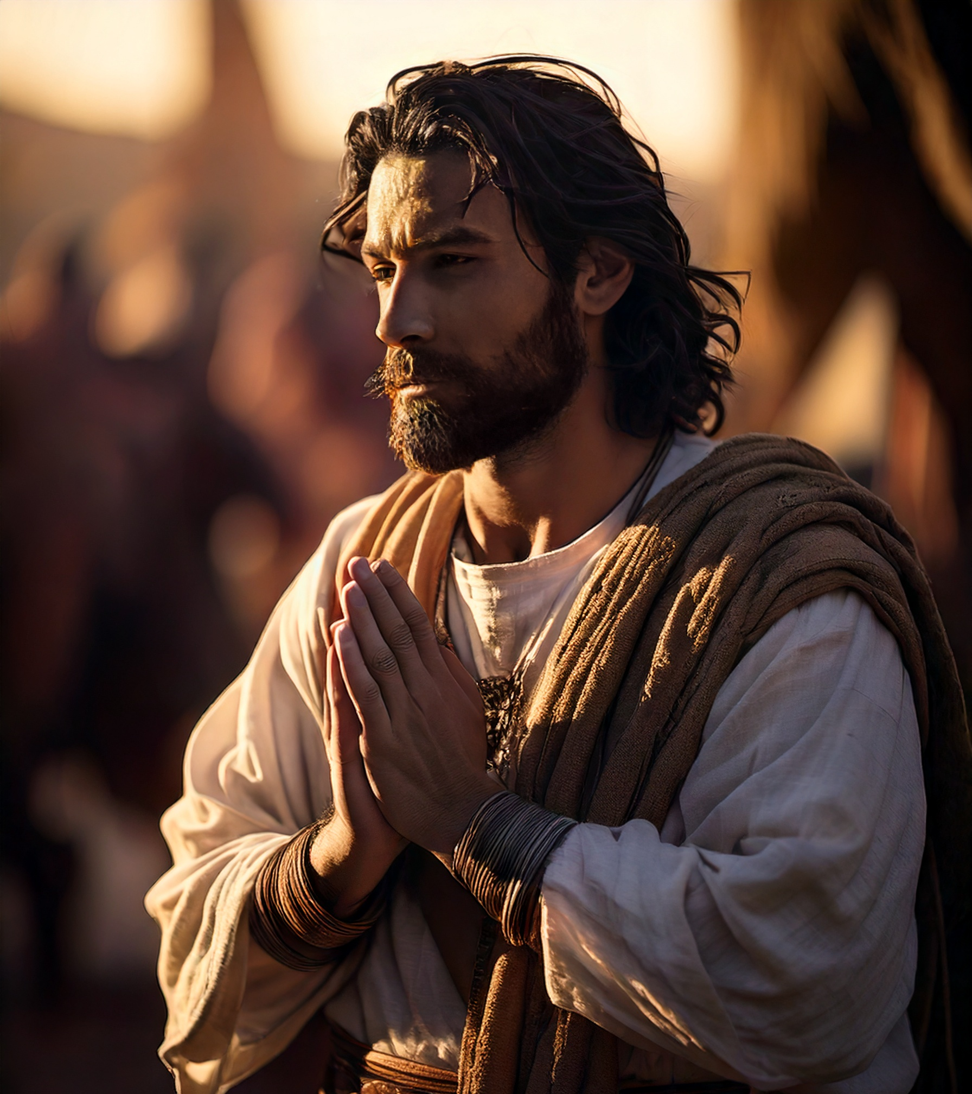
Acknowledging God
For that ye ought to say, If the Lord will, we shall live, and do this, or that (James 4:17).
Charge them that are rich in this world, that they be not highminded, nor trust in uncertain riches, but in the living God, who giveth us richly all things to enjoy (1 Tim 6:17).

Slide 10
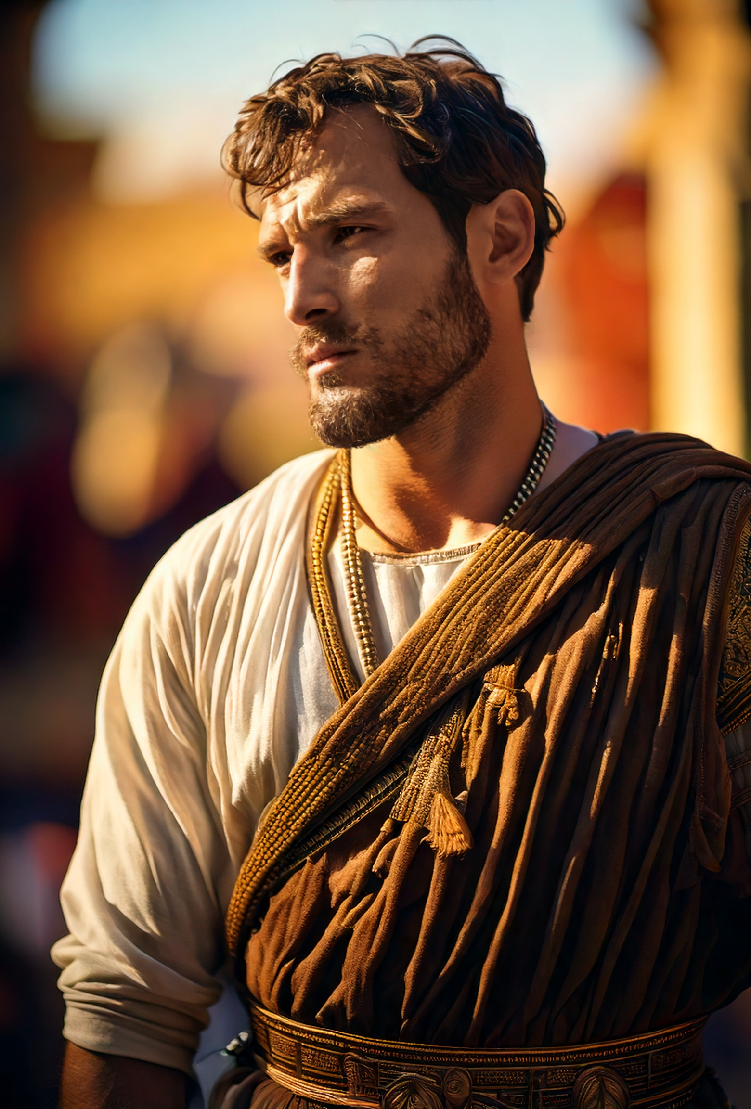
Arrogance is Evil
But now ye rejoice in your boastings: all such rejoicing is evil (James 4:16).
But if ye have bitter envying and strife in your hearts, glory not, and lie not against the truth. This wisdom descendeth not from above, but is earthly, sensual, devilish. For where envying and strife is, there is confusion and every evil work (James 3:14–16).

Slide 11
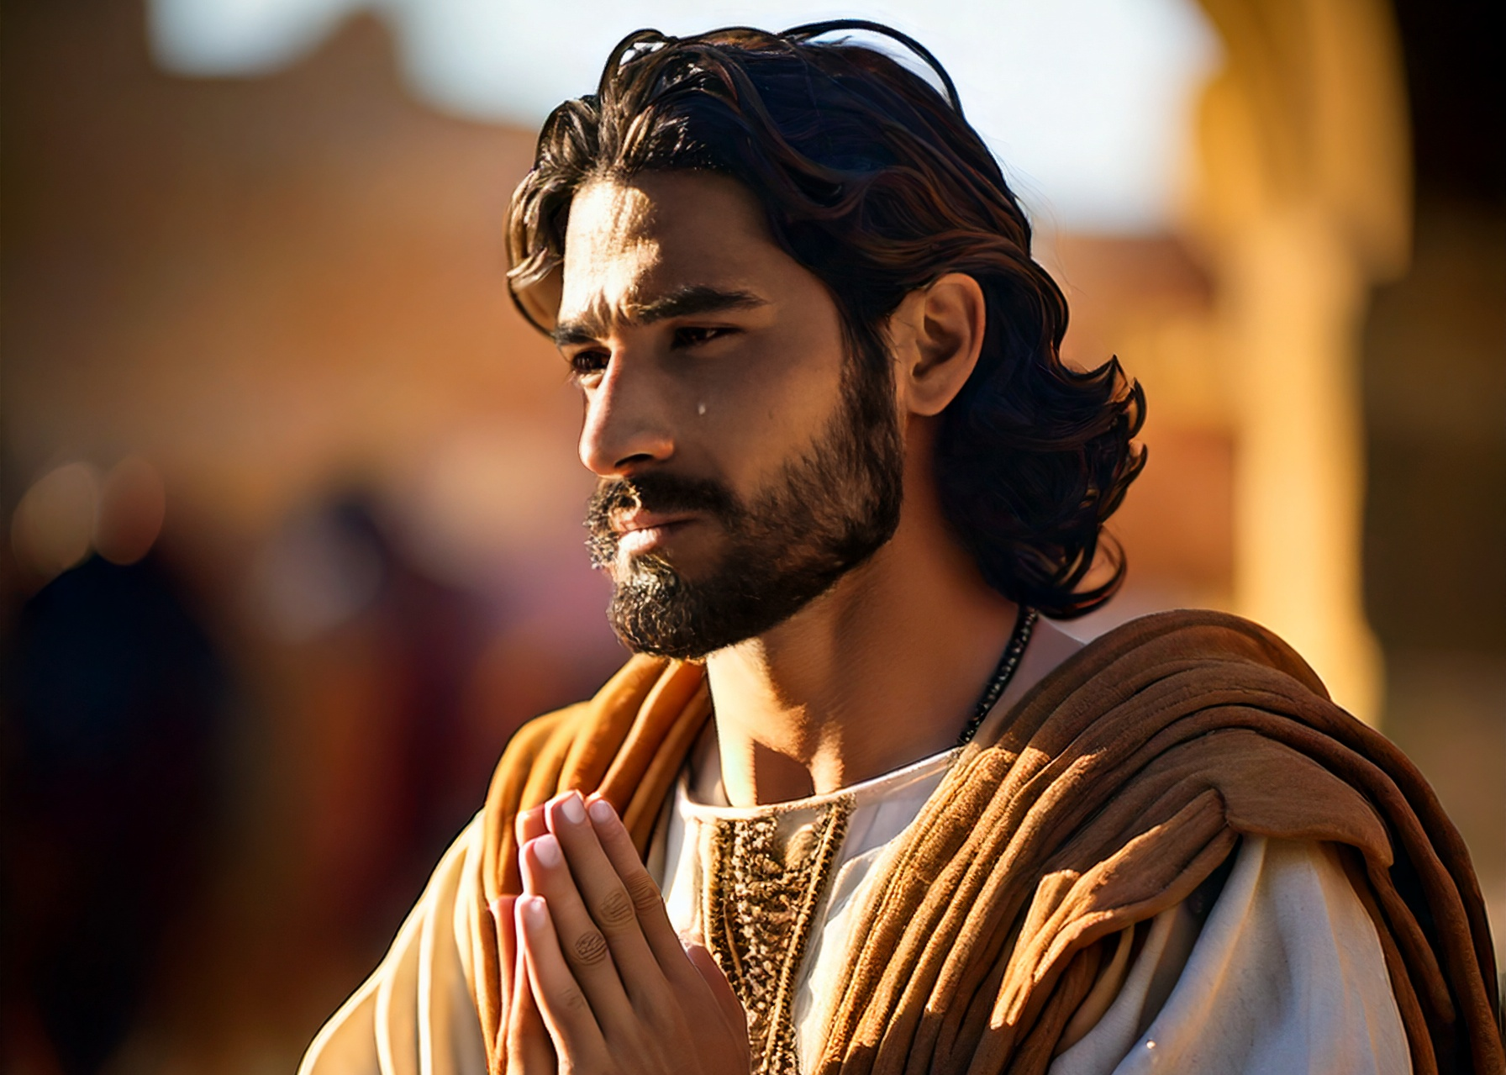
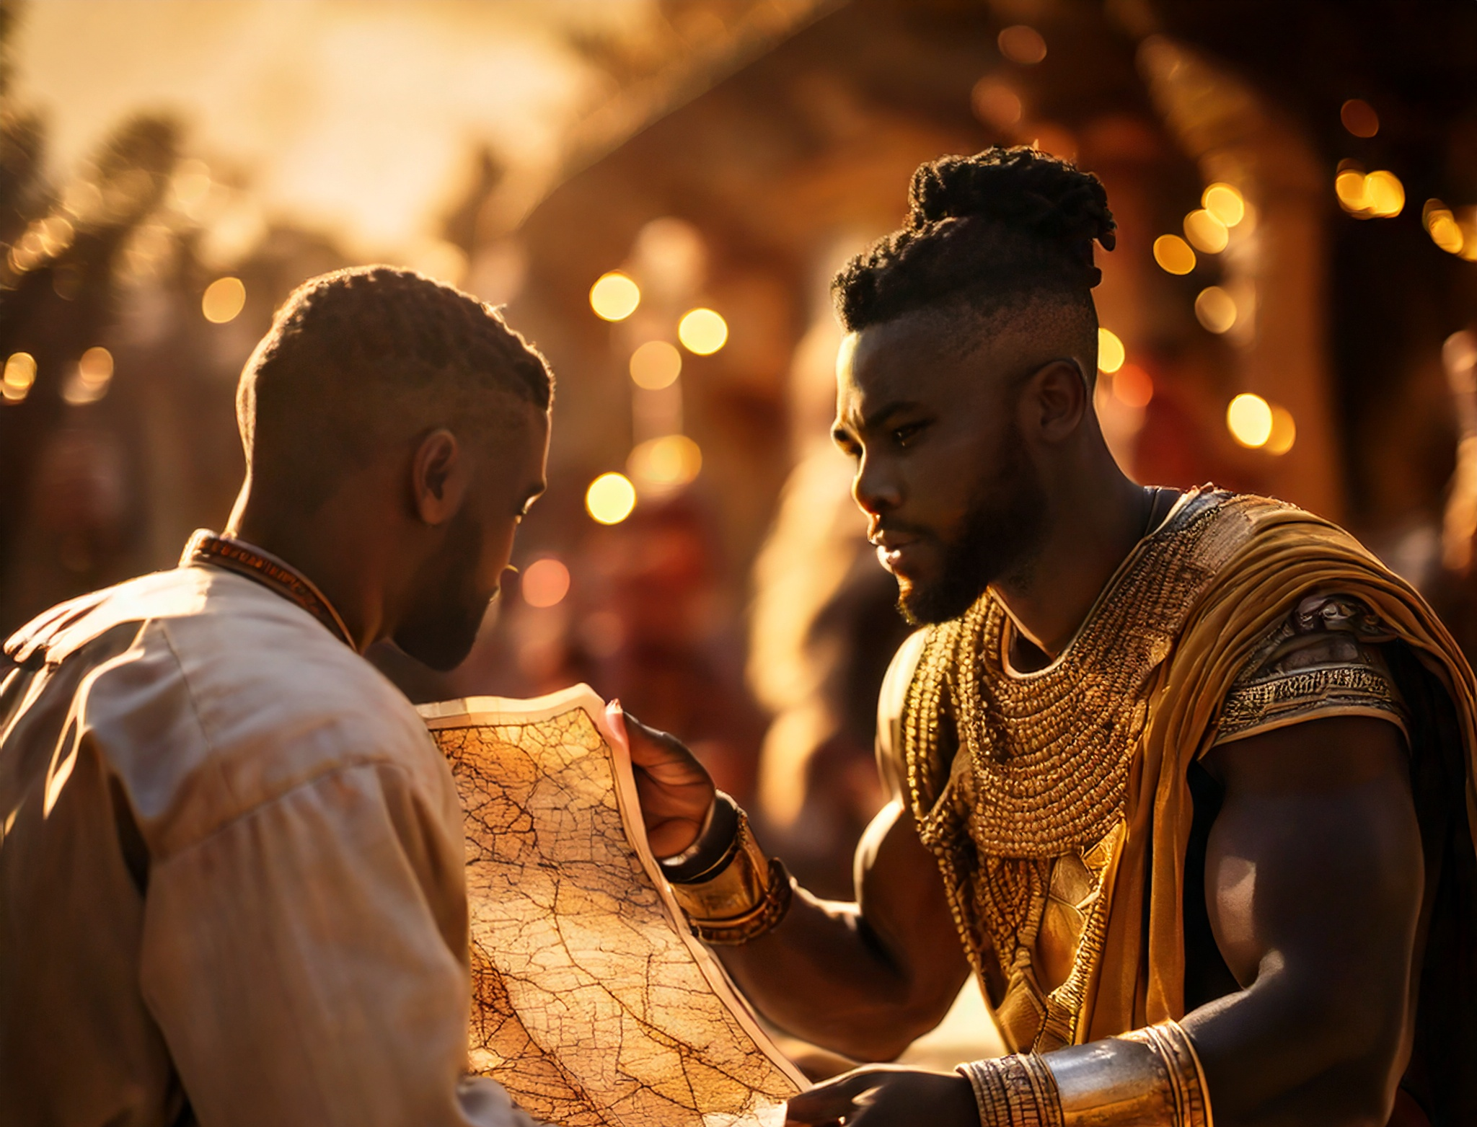
Inactive Faith is Active Sin
Therefore to him that knoweth to do good, and doeth it not, to him it is sin (James 4:17).

Slide 12
Conclusion
Every Christian should acknowledge God’s sovereignty over their plans
For these three reasons

Slide 13
Conclusion
Tomorrow is unknown
Self-assurance is arrogance
Inactive Faith is Active Sin

