Slide 1
The Priorities of God’s People
Understanding God’s call to Serve

Slide 2
The Passion of God is reflected in the Priorities He’s given His people.
These can be summed up in the:
The Great Commission (Mt. 28:18-20)
Sharing the gospel (Salvation)
Baptism (Identification/Association)
Discipleship (Transformation)

Slide 3
The Great Commandment Mt 22:37-39
“Thou shalt love the Lord thy God
with all thy heart, and with all thy soul, and with all thy mind.
This is the first and great commandment.
And the second is like unto it,
Thou shalt love thy neighbor as thyself.”

Slide 4
Sin (hamartano) literally means:
“to miss the mark”.
If this is true, then wouldn’t the greatest “sin” be to miss (through neglect or intent)
The Greatest Command?

Slide 5
“loving our neighbor as ourself” should reveal itself through practical service. 1. The “What” of Ministry.
diakonia: service, aid, relief.
A. Love in Action (Jn. 13:1-17)
B. Labor in Jesus’ Name. (Mt. 25:40)
C. A Litmus test. (1 Jn. 3:10-19)

Slide 6
We also learned that God’s Word (revealing His will and ways) is a type of Mirror (James 1:22-27) that reveals:
What (where) we actually are.
What we can (and should) become.
2 Cor. 3:18; 2 Tim. 3:16,17

Slide 7
How we respond to the mirror of God’s word will determine if we’re:
Blinded 22 “deceiving their own selves”
Blessed: “whoso looketh into the perfect law of liberty, and continueth therein,
he being not a forgetful hearer, but a doer of the work, …shall be blessed in his deed.” vs 25

Slide 8
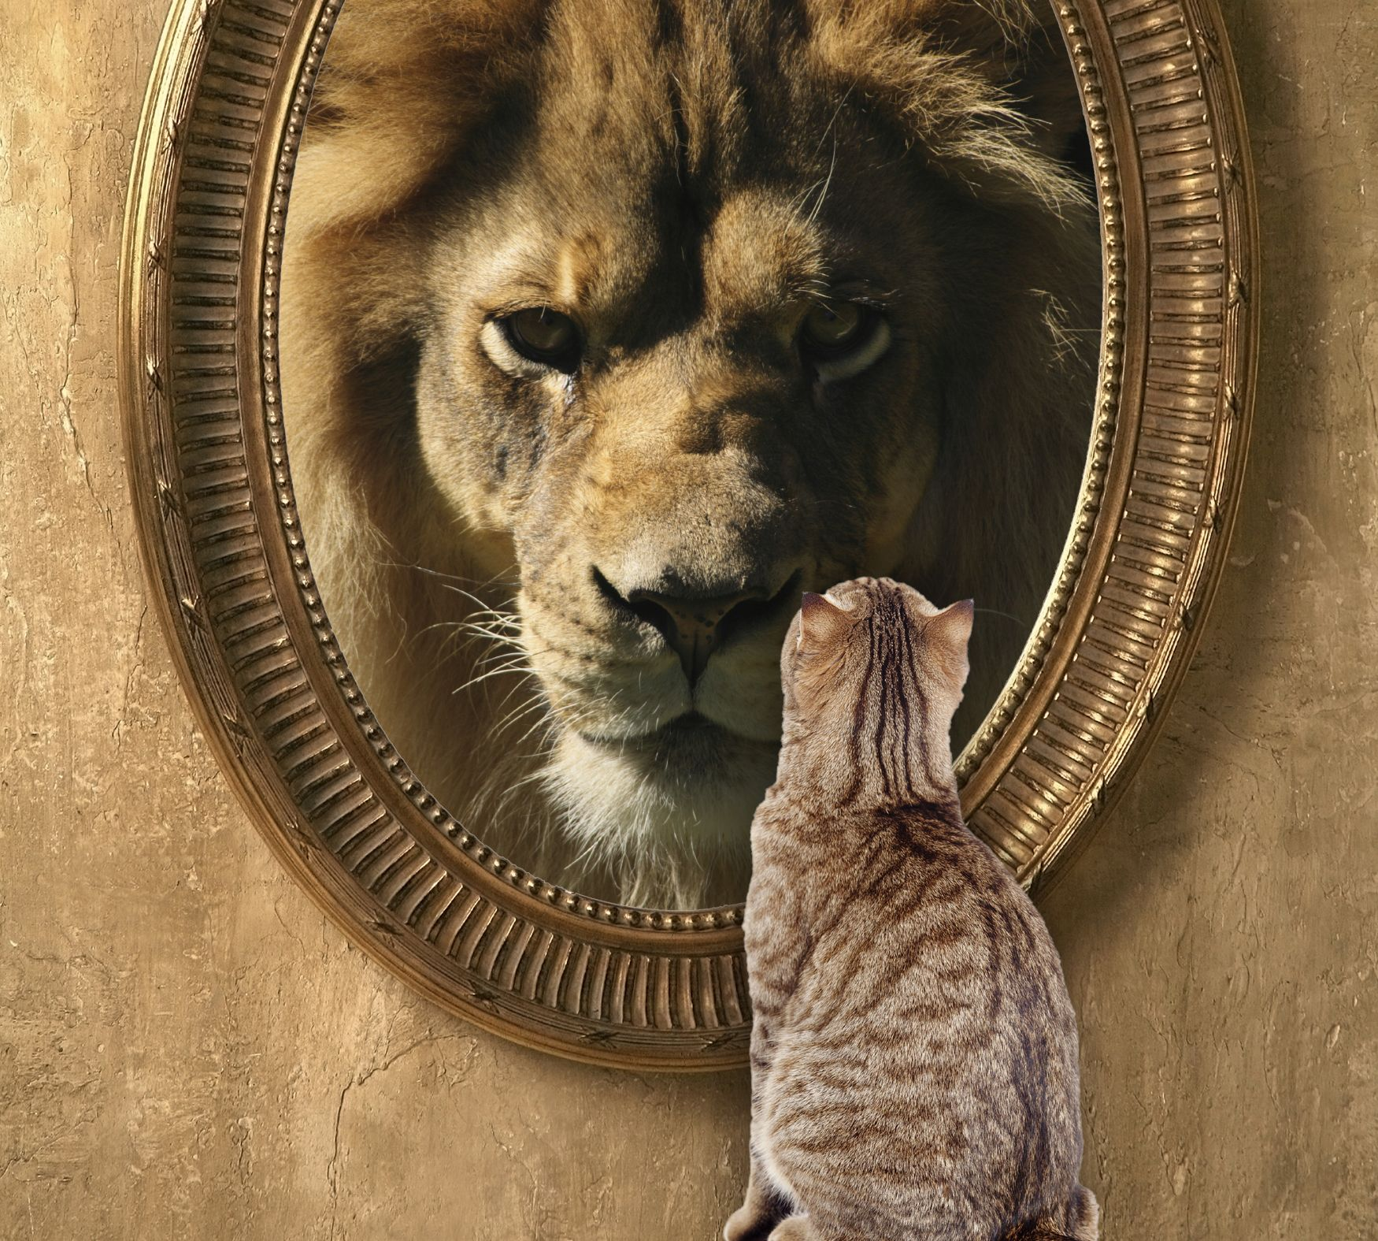
What do you see in this picture?
A Kitten with a lion’s heart?
Or a Lion with a kitten’s heart?
Jer. 17:9

Slide 9
The Why of Ministry 1Jn 4:16-17
“God is love; and he that dwelleth in love dwelleth in God, and God in him.
Herein is our love made perfect, that we may have boldness in the day of judgment:
because as he is,
so are we in this world.”

Slide 10
2 Cor 5:18-20 “God, who hath reconciled us to himself by Jesus Christ, and hath given to us the ministry of reconciliation;
…and hath committed unto us the word of reconciliation. (katallagē’)
Atonement, restoration, adjustment!
Now we are ambassadors for Christ…
be ye reconciled to God.”

Slide 11
The Why of Ministry 1Jn 4:16-17
A. God’s love is Powerful. 1 Cor 13:13
“now abideth faith, hope, charity…;
but the greatest of these is charity.”
“Agape” love is the most powerful motivator known to man.

Slide 12
The Why of Ministry 1Jn 4:16-17
A. God’s love is Powerful.
1) It Motivated Christ to die for us.
Jn 15:13 “Greater love hath no man than this,
That a man lay down his life
for his friends.”

Slide 13
A. God’s love is Powerful. 1 Cor 13:13
2) It Motivates us to live for him.
2 Cor 5:14 “the love of Christ constrains us;
because we thus judge, that if one died for all, then were all dead:
And that he died for all, that they which live should not henceforth live unto themselves,
but unto him which died for them.”
but unto him which died for them, and rose again.

Slide 14
A. God’s love is Powerful. 1 Cor 13:13
2) It Motivates us to live for him.
Gal 2:20 “I am crucified with Christ: nevertheless I live; yet not I,
but Christ liveth in me:
and the life which I now live in the flesh
I live by the faith of the Son of God,
who loved me, and gave himself for me.”

Slide 15
B. God’s love is Personal Mt 25:35,36
"I was an hungered, and ye gave me meat: I was thirsty, and ye gave me drink:
I was a stranger, and ye took me in: Naked, and ye clothed me:
I was sick, and ye visited me:
I was in prison, and ye came unto me."

Slide 16
Mt 25:37-40 “Lord, when saw we thee hungry, … or thirsty, … a stranger… naked, … sick, in prison, and came unto thee?
And the King shall say unto them, Verily I say unto you, Inasmuch as ye have done it unto one of the least of these my brethren,
ye have done it unto me.”

Slide 17
God’s love is Powerful, Personal, and
C. God’s Love Is Practical. 1 Cor 13
“Charity suffereth long, and is kind; charity envieth not; charity vaunteth not itself, is not puffed up, Doth not behave itself unseemly, seeketh not her own, is not easily provoked, thinketh no evil;” vs 5,6
Agape literally means benevolence.

Slide 18
God’s Love Is Practical. Gal 6:9-10 “let us not be weary in well doing:
for in due season we shall reap,
if we faint not.
As we have therefore opportunity,
let us do good (agathos: benefit) unto all,
especially unto them who are of the household of faith.”

Slide 19
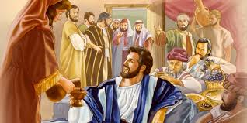
God’s love meets us where we are.
Jesus consistently demonstrated this!
Mk 2:17 “They that are whole have no need of the physician, but they that are sick...
I came not to call the righteous,
but sinners to repentance.”

Slide 20
The Why of Ministry
C. God’s Love Is Practical.
1) We needed a Savior. Jn 3:16; Ro 5:8
2) Multitudes needed food. Mt 14:13-21
3) Apostles needed cleansing. Jn. 13:7-12
"let us not love in word, neither in tongue;
but in deed and in truth." (1 Jn 3:18)

Slide 21
C. God’s Love Is Practical. Jms 2:15-17 “If a brother or sister be naked, and destitute of daily food, And one of you say unto them,
Depart in peace, be warmed and filled;
notwithstanding ye give them not those things which are needful to the body;
what doth it profit?
Even so faith, if it hath not works, is dead.”

Slide 22
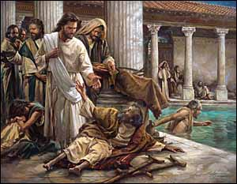
God’s Love Is Powerful, Personal, and Practical. John 5:3
“In these lay a great multitude of impotent folk, …waiting for the moving of the water.
5 And a certain man was there, which had an infirmity 38 years.
Jesus …saith unto him,
Wilt thou be made whole?”

Slide 23
John 5:7 “The impotent man answered him,
Sir, I have no man, when the water is troubled, to put me into the pool: but while I am coming,
another steppeth down before me.
8 Jesus saith unto him, Rise, take up thy bed, and walk.
9 And immediately the man was made whole, and took up his bed, and walked: and on the same day was the sabbath.”

Slide 24
John 5:10-13 “The Jews therefore said unto him that was cured, It is the sabbath day:
it is not lawful for thee to carry thy bed.
He that made me whole, the same said unto me, Take up thy bed, and walk.
Then asked they him, What man …??
And he that was healed wist not who it was:
for Jesus had conveyed himself away,
a multitude being in that place. ”

Slide 25
14-16 Jesus findeth him in the temple, and said unto him, Behold, thou art made whole:
sin no more, lest a worse thing come unto thee.
The man told the Jews that it was Jesus,
And therefore did the Jews persecute Jesus,
and sought to slay him,
because he had done these things on the sabbath day.”

Slide 26
Of all the sick people there that day,
why did Jesus only heal that man?
17 “Jesus answered My Father worketh hitherto,
and I work.
18 the Jews sought the more to kill him, because he not only broke the sabbath,
but said also that God was his Father,
making himself equal with God.”

Slide 27
¹⁹ ”Then answered Jesus and said unto them, The Son can do nothing of himself,
but what he seeth the Father do:
for what things he doeth,
these also doeth the Son likewise.”

Slide 28
Jesus was more concerned with (attentive to) God’s Will,
Than the Cripple’s
Than the Crowds (Pharisees). Jn 12:43
Than His own! (Luke 22:42)
God could trust Jesus with His will!

Slide 29
How can we serve with confidence?
Jn 14:21 “He that hath my commandments, and keepeth them, he it is that loveth me:
and he that loveth me shall be loved of my Father, and I will love him,
and will manifest myself to him.”
Do we want God’s will or our own?
Can Christ Trust us with His Will?

