Slide 1
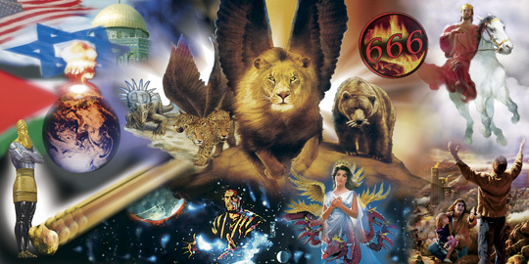
Prophecy is like a complicated puzzle portraying the Story and Struggle of the ages
In Advance!

Slide 2
More than 353 of these pieces dealt specifically with Jesus’ 1st coming.
Prophets were handed “pieces” of History’s puzzle in advance!
Luke 24:46
“Thus it is written, and thus it behoved Christ to suffer, and to rise
from the dead “
Jesus fulfilled every one of them!

Slide 3
2 Timothy 2:15
“Study to shew thyself approved unto God,
a workman that needeth not to be ashamed,
rightly dividing the word of truth.”
Studying God’s word is necessary to learn how to rightly put the pieces of the “Prophetic Puzzle” together!

Slide 4
Most Jews “Missed” Jesus’ first coming because they were focused on the Hundreds of other Prophecies that described the “Messiah’s” second coming in power!
“Search (eryoona’ō: investigate) the scriptures;
for in them ye think ye have eternal life:
and they are they which testify of me!
And ye will not come to me,
that ye might have life.” Jn 5:39,40
(Zech. 9:9; Mt. 21:4,5; Lk 24:26,27)

Slide 5
There are more than 100 prophecies about his second coming recorded in the New Testament!
If Jesus fulfilled all of the O.T. prophecies about his 1st coming,
He will certainly fulfil the O.T. and N.T. ones about his second coming!
Mt 5:18 “Till heaven and earth pass, one jot or one tittle shall in no wise pass from the law, till all be fulfilled.”

Slide 6

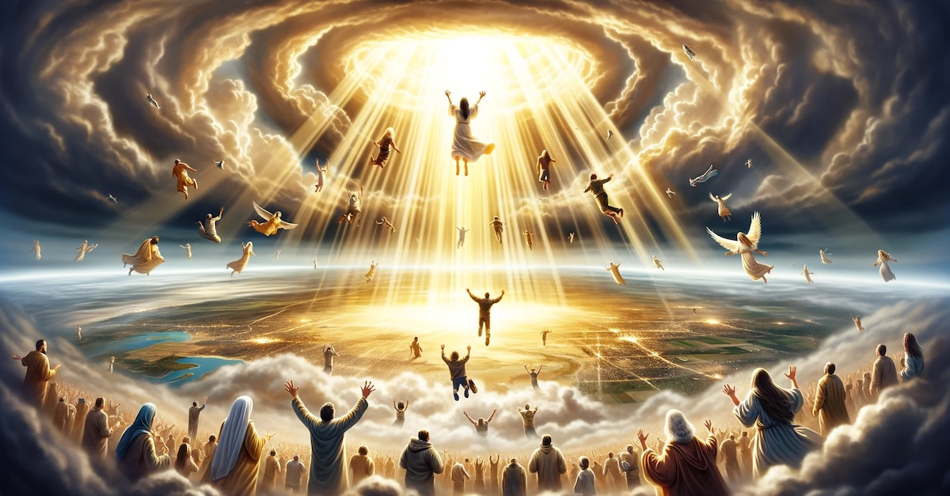
Scripture reveals that there will be two distinct “stages: to his Second Coming.
1st: He’ll come “in the air”
for His Church!
(Acts 1:11; 1 Thes. 4:13-18; 1 Cor. 15:51-58)

Slide 7
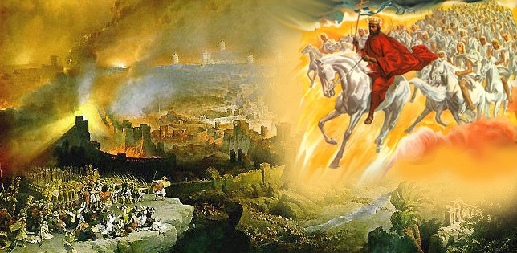
2nd Stage He’ll come “in power” to reign on the earth. (Ps. 2; Zech.12; 2 Thes. 2; Rev. 19)

Slide 8
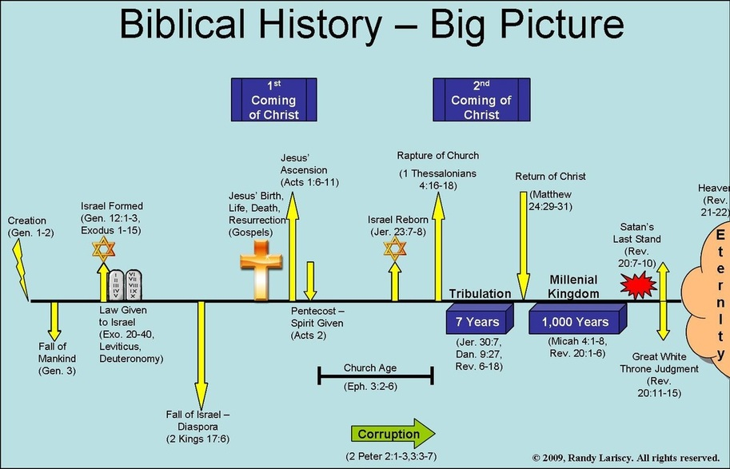
Bible Prophecy Big Picture
The Conquering King Rev 19
New Heaven
And Earth
Rev 21-22
The suffering servant
Is. 42,50,53

Slide 9
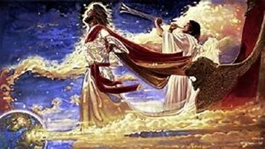
The Church Age will end with the Rapture.
Jn 14:3 “I will come again to receive you unto myself,
That where I am, there ye may be also.”
Notes:
Meta Tauta used three times.
18:1 Concerning religious Babylon.
19:1 Concerning political Babylon
Next slide, Door open in heaven.

Slide 10
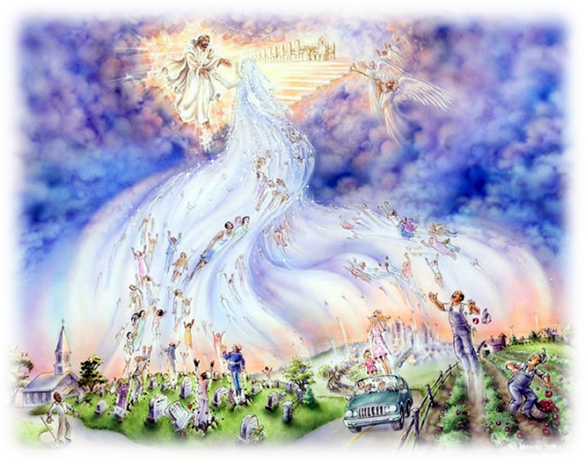
1. The “What” Of The Rapture:
Transportation (of the saints to Heaven.)
(Jn 14:2; 1 Th. 4:13-18; 1 Cor. 15:50-58; Rev 4)
1 Thes 4:17 “we… shall be caught up together
(harpadzo: to remove or take away)
to meet the Lord in the air”
“Rapture” comes from Latin raptus
meaning to seize or transport.

Slide 11
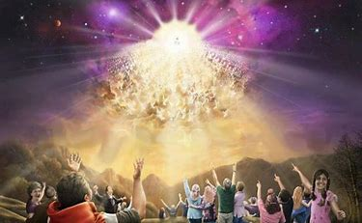
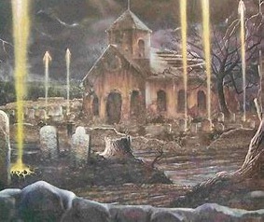
2. The “Why” Of The Rapture:
A. Transformation. 1Co 15:51,52 “I shew you a mystery;
We shall not all sleep,
ἀλλάσσω (Allasso) made different.
… in the twinkling of an eye,
at the last trump:
for the trumpet shall sound,
and the dead shall be raised
incorruptible, (un-decaying)
but we shall all be changed,
and we shall be changed!”

Slide 12
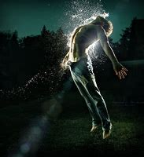
Transformation.
1 Cor 15:53-54
“For this corruptible must put on incorruption,
and this mortal must put on immortality…
then shall be brought to pass the saying that is written,
Death is swallowed up in victory.”
Νῖκος: Triumph!

Slide 13
B. Evaluation: 2 Cor. 5:10 “we must all stand
before the judgment seat (bēma) of Christ…”
1 Cor. 3:10-15 “ye are God’s building…
but let every man take heed how he buildeth…
gold, silver, precious stones, wood, hay, stubble..
13 Every man’s work shall be manifest,
for the day shall declare it…”
(dēlóō; reveal, make plain, clear)

Slide 14
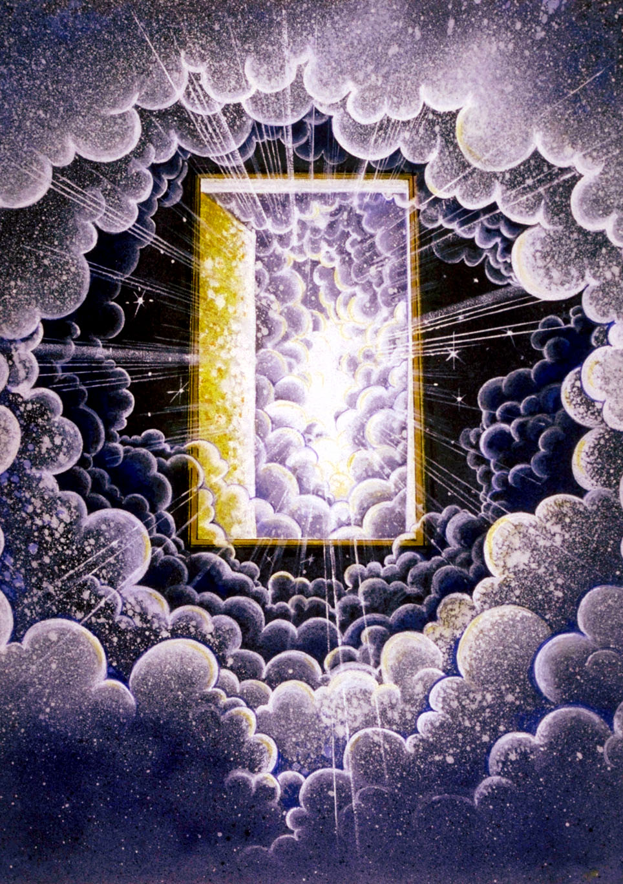
Rev 4:1-2 “After this I looked, and, behold, a door was opened in heaven: and the first voice which I heard was as it were of a trumpet talking with me; which said,
Come up hither,
and I will shew thee things which must be hereafter.
And immediately
I was in the spirit:
a throne was set in heaven, and one sat on the throne...”

Slide 15
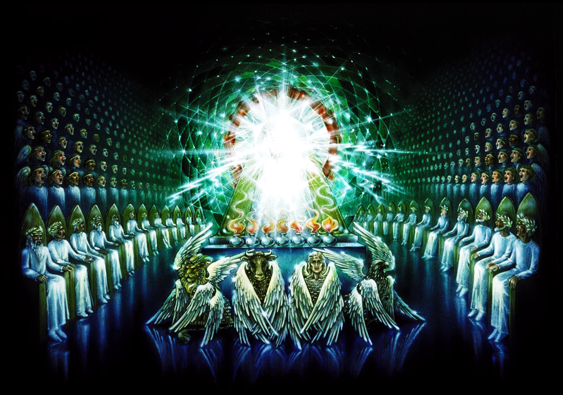
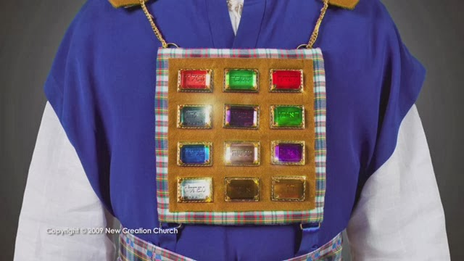
1) The Bema Seat
“He…was to look upon like a Jasper and Sardine stone, and there was a rainbow round about the throne, like an emerald.”
a) Breastplate of the High Priest (Ex. 28:17-20)
Sardine (Sardius) Blood red
Reuben: “Behold a son”
Emerald: (Judah: Praise)
Jasper: White - Benjamin:
“Son of my right hand” (Power)

Slide 16

Evaluation.
2) Elders Rev 4:4-5 “round about the throne … I saw four
and twenty elders sitting, clothed in white raiment;
b) Since we’re a
“Royal Priesthood”
2 Pt 2:9
a) Jewish Priesthood was divided into 24 orders.
1 Chr. 24
These represent the whole church

Slide 17


Rev 4:5 ”out of the throne proceeded lightnings, thunderings and voices: and there were
3) seven lamps of fire burning before the throne,
which are the seven Spirits of God.”
Is 11:2 “And the spirit of the LORD shall rest upon him, the spirit of wisdom and understanding, the spirit of counsel and might, the spirit of knowledge and of the fear of the LORD”

Slide 18
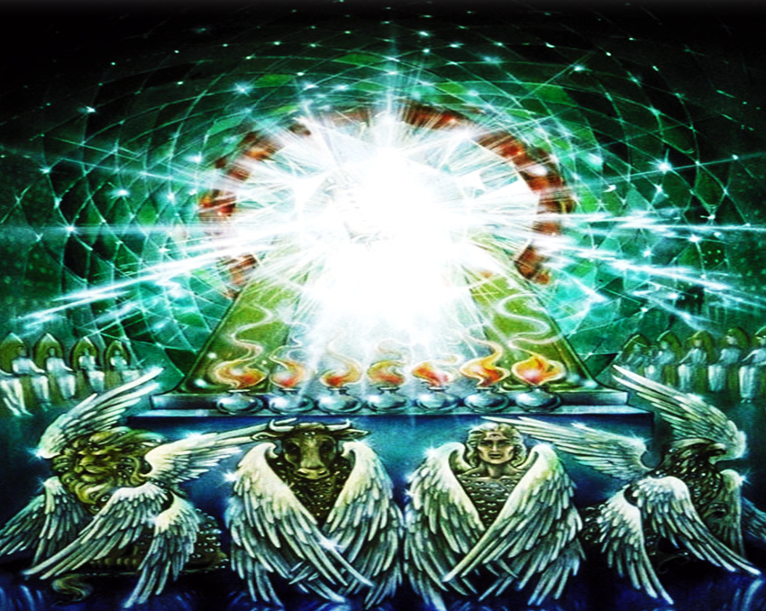
3) seven lamps of fire burning before the throne,
which are the seven Spirits of God.”
1 Cor 3:13-14 “Every man's work shall be made manifest: for the day shall declare it,
because it shall be revealed
by fire;
14 And the fire shall try every man’s work,
of what sort (hopoi’os: quality) it is.”

Slide 19
Transformation, Evaluation
C. Remuneration. (Rewards)
Rev 4:4-5 “I saw four and 24 elders…in white raiment;
and they had on their heads crowns of gold.”
Rewards (crown/responsibility) for faithful service
1 Cor. 3:14 “If any man’s work abide,
he shall receive a reward”
(Misthos: pay for service!)

Slide 20
Jesus’ last parable illustrated this truth!
Mt 25:14-21 “the kingdom of heaven is as a man travelling into a far country, who called his own servants,
and delivered unto them his goods.
19 After a long time the lord of those servants cometh, and reckoneth with them… (synairō: settle accounts)
20 And so he that had received five talents came and brought other five talents, saying, Lord, thou deliveredst unto me five talents: behold,
I have gained beside them five talents more.”

Slide 21
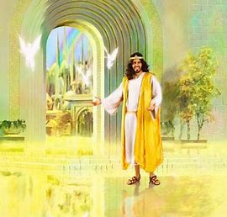
21 “His lord said unto him, Well done, thou good
and faithful servant:
thou hast been faithful over a few things,
I will make thee ruler over many things.
Enter thou into the
Joy of thy Lord!”
2 Tim. 4:8

Slide 22
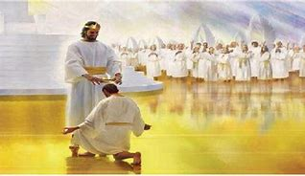
Rev 1:5-6 “Unto him that loved us, and washed us
from our sins in his own blood, Amen.
And hath made us kings and priests unto God
to him be glory and dominion for ever.”
Rev 5:10 “And hast made us unto our God kings and priests:
and we shall reign on the earth.”
2 Tim. 4:8

Slide 23
Rev 22:12 “behold, I come quickly;
(tachu: suddenly)
and my reward is with me,
Μισθός (misthos) Pay for service!
to give every man
according as his
work shall be.”
“Vocation” Eph. 4:1

Slide 24
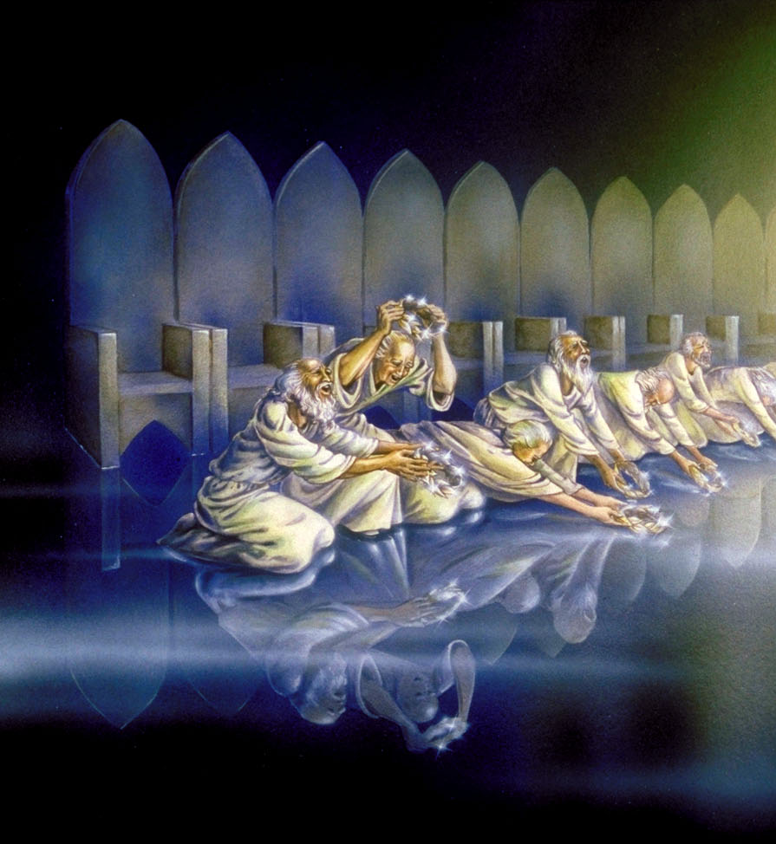
C. Remuneration Rev. 4:10 1) Rewards
2) Realization (Awareness!) 1 Cor 13:12
Crowns returned in worship.
“The four and twenty elders fall down before him that sat on the throne,
and worship him that liveth for ever and ever,
and cast their crowns before the throne”

Slide 25
2) Realization (Renewed Awareness) 4:11
“Thou art worthy, O Lord, to receive glory and honor and power:
for thou hast created all things,
and for thy pleasure
they are and were created.”
Thelēma: Purpose

Slide 26
2. The Why of the Rapture:
A. Transformation (1 Cor 15:51-54; 1 Th. 4:16,17; 1 Jn. 3:1-3)
B. Evaluation. (1 Cor. 3:10-18; 2 Cor 5:10)
C. Remuneration. (Mt. 25:14-30; 2 Tim. 4:8; Rev. 21:12)

Slide 27
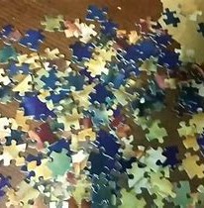

A busy father gave his son a puzzle,
hoping to occupy his time.

Slide 28
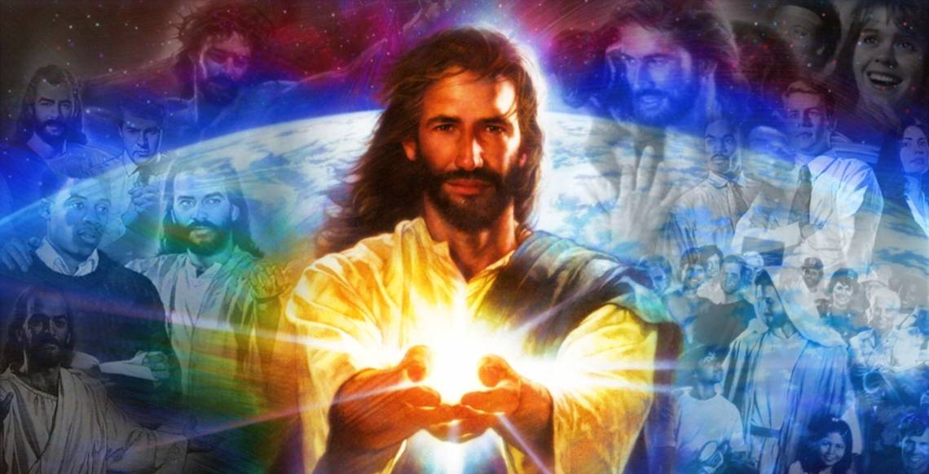
“When I started with Jesus,
Col. 1:12-18
Mt 6:33
the rest of the puzzle made sense.”

Slide 29
Luke 19:11-13 Jesus “spake a parable, … because they thought that the kingdom of God should immediately appear. ..
A certain nobleman went into a far country to receive for himself a kingdom, and to return.
¹³ And he called his servants, and delivered them ten pounds, and said unto them,
Occupy till I come.”
(to busy yourself with trade)

Slide 30
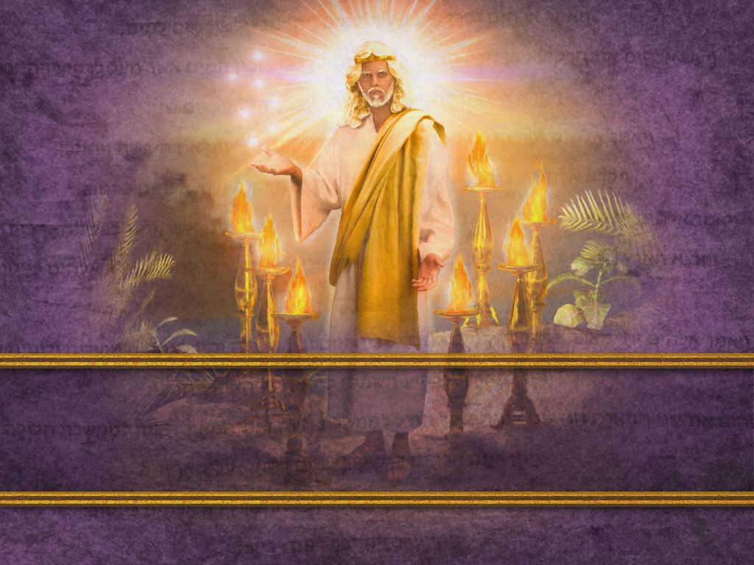
What are you “occupied” with?

