Slide 1
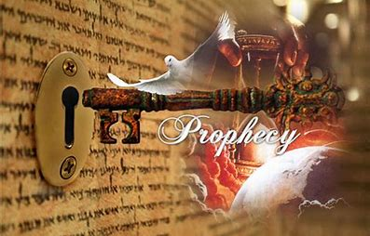
2 Timothy 2:15

Slide 2
God wants us to understand His Plan
so we can be Prepared!
Eph. 5 opens with: “Be ye therefore followers of God as dear children, and walk in love…
but fornication and all uncleanness…
let it not be once named among you.”

Slide 3
Eph. 5:16-18 instructs us to
“Redeem the time, because the days are evil.
Wherefore be ye not unwise,
but understanding what the will of the Lord is.
And be not drunk (under the influence) with wine;
but be filled (under the influence)
with the Spirit!”

Slide 4
The rest of Eph. 5 instructs us on marriage and concludes with vs 32,33:
This is a great mystery: but I speak
concerning Christ and the church.
Nevertheless let every one of you in particular so love his wife even as himself;
and the wife see that she reverence her husband.”

Slide 5
The “Mystery of Marriage” is that it’s a picture of our relationship with Christ.
We’ve examined how the “Bride of Christ” is becoming increasingly “unfaithful” to Christ, and is being “wooed” by the god of this world.
2 Cor 11:1-3 “I have espoused you to one husband, that I may present you as a chaste virgin to Christ,
But I fear, lest…as the serpent beguiled Eve…
so your minds should be corrupted…”

Slide 6
As of 2012, there are 2.4 billion professing “Christians” in the world. (34 % people)
73% of Americans identify as “Christians”
35% claim to be “Born again”
31% attend church at least monthly!
23% read the Bible (weekly).
17% are involved in some type of Small group.
Only 7% are “Evangelical”.
George Barna “The State of the Church”. 2016

Slide 7
Barna’s Definition of “Evangelical”:
Born again, with a personal faith that matters
Acknowledge a Responsibility to share their faith
Believe that Satan actually Exists
Believe that Jesus was sinless
Believe the Bible is Accurate,
Salvation is through Grace, not works,
God is the personal, powerful creator.
Aka: 7% Biblical Christianity!
George Barna “The State of the Church”. 2016

Slide 8
Rev. 3:14-18 describe this process of Satanic Seduction in Laodicea and vs 19-22 represents Jesus final warning to the church.
“As many as I love, I rebuke and chasten:
be zealous therefore, and repent.
Behold, I stand at the door, and knock:
if any man hear my voice, and open the door,
I will come in to him...he that overcometh will I grant to sit with me in my throne”

Slide 9
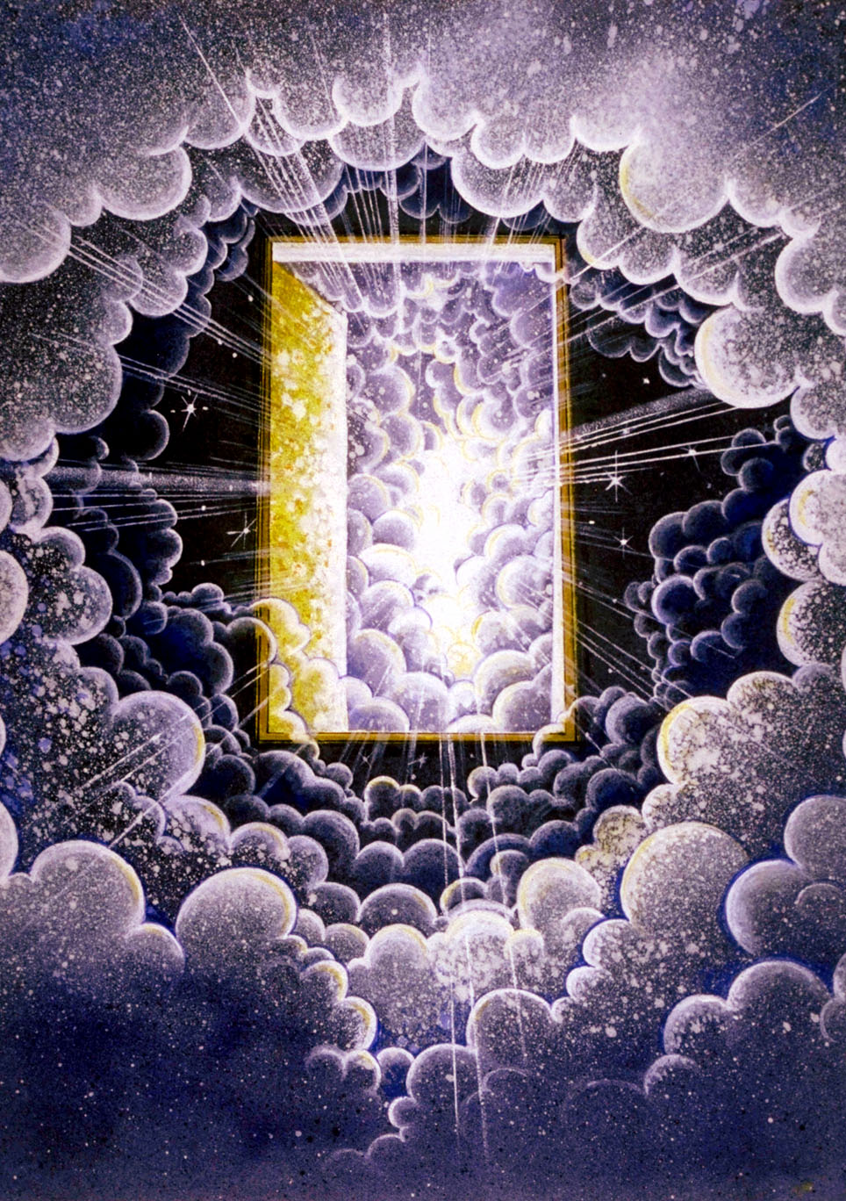
The very next verse (4:1) describes the Rapture of the true believers
(and their subsequent evaluation!)
What will happen to all the “religious” people that are left after this?
“and the door was shut”
Mt. 25:19

Slide 10
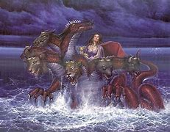
The “Anti Church”
Revelation 17:1
“I will shew unto thee the judgment of the great whore that sitteth upon many waters”

Slide 11
Characteristics of the “Anti Church”
World Wide Rev. 17:14
“The waters, where the whore sitteth, are
peoples, multitudes, nations, and tongues.”
A. This church will break down barriers
between beliefs and settle for the "lowest
common denominator". Amos 3:3
“Can two walk together except they be agreed?”

Slide 12
B. The current "Ecumenical" movement is
paving the way for this!
1) The WCC (2005) had a membership of 349 member church groups which together claimed 590 million “Christian” members in more than 120 countries and 520,000 local congregations.
a) The WCC has been engaged in official dialogues with almost everyone-Roman Catholics, Jews, Muslims, Buddhists, Hindus, Humanists, Traditional African Religions and Communists.

Slide 13
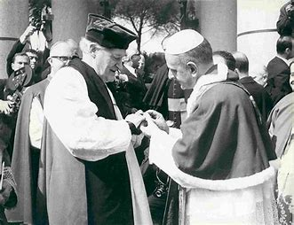
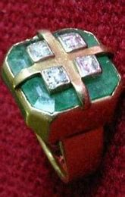
2) October 1989 Pope Paul gave the Archbishop
of Canterbury (Michael Ramsey) a ring which
(The Archbishop) later described as a type of
"an engagement ring".

Slide 14
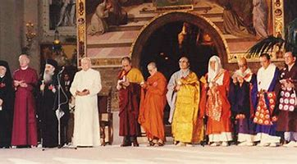
3) In 1986 the Pope met with Dalai Lama (the
Head of the Tibetin Buddhists), witch doctors,
snake handlers from Togo, Hindu gurus from
India, and even Protestant Clergy in Assisi, Italy
for an unprecedented Prayer meeting.
He declared that there were
many paths to God.

Slide 15
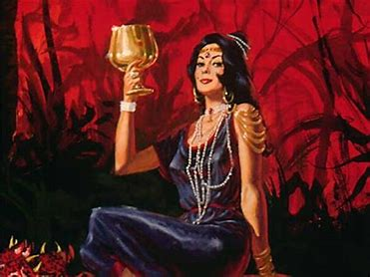
Characteristics of the “Anti-Church”
2. Wealthy. Vs 4 "Arrayed in purple and scarlet,
and decked with gold, precious stones and pearls"
A. Like Laodicia, they’ll equate wealth with
“blessing” and success.
1 Tim 6:5 "perverse disputings
of men of corrupt minds,
and destitute of the truth,
supposing that gain is godliness“

Slide 16
3. Whorish. Vs 2 “With whom the kings of the
earth have committed fornication,
and the inhabitants of the earth have been
made drunk with the wine of her fornication.”
A. Compromise leads to corruption!
1) Compromised “purity” for “Power”.
Vs 5 “the mother of harlots…”
2) Compromised integrity for influence.

Slide 17
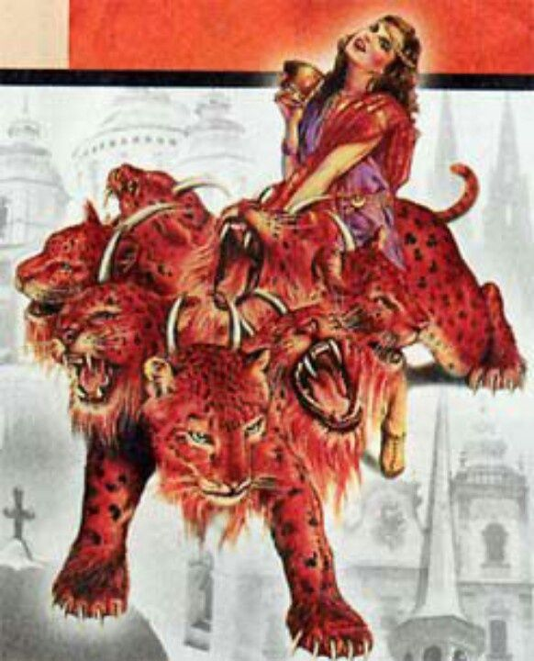
3. Whorish “kings…committed fornication…”
B. The “Beast” will carry this “Church.”
Vs 3 “sit upon the scarlet beast”
1) The “Beast” is the political
“System” of the Anti Christ.
Rev. 13.
2) They will “mutually” use
each other for a season.

Slide 18
2 Cor 6:14-17 “ Be not unequally yoked together with unbelievers: for what fellowship hath righteousness with unrighteousness?
and what communion hath light with darkness?
what concord hath Christ with Belial?...
Wherefor come out from among them and be ye separate…”

Slide 19
3. Whorish Vs 3 “a woman sit upon the beast”
a) Historically, many godless governments
have pressured the church for support.
(1) This is what led to the “Dark ages”.
(2) This is what’s happening in Jihad!
(3) Remember Hitler and Stalin!

Slide 20
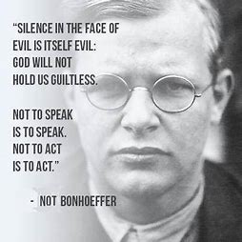
Dietrich Bonhoeffer was one of a few German Ministers who opposed Hitler’s atrocities.
He was imprisoned in 1943 and hung in 1945,
11 days before Germany was liberated.
“This is the end–for me the beginning of life.”

Slide 21
4. Whorish Vs 3 “a woman sit upon the beast”
C. Politics make strange bedfellows.
1) The “Church” will use the Beast!
(Power, Possessions, Pride, Positions)
2) The Beast will use the “church”.
Can Satan use even “sincere” people
for His purposes?

Slide 22
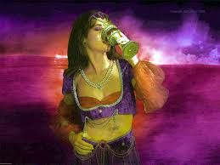
Anti-Church: World-wide, Wealthy, Whorish,
4. Worldly (Satanic) Rev. 18:2
“Is become the habitation of devils”
1Tim. 4:1-3 “some shall depart from the faith,
giving heed to seducing spirits,
and doctrines of devils…”
Rev. 17:6 “I saw the woman drunk with the blood of the saints”

Slide 23
4. Worldly (Satanic) vs 6
A. Satan will use the anti-Christ and false
prophet to seduce people into following him!
“the mystery of iniquity doth already work…
Even him, whose coming is after the working of Satan with all power and signs and lying wonders,
And with all deceivableness of unrighteousness
in them that perish;”
2 Thes. 2:7,10

Slide 24
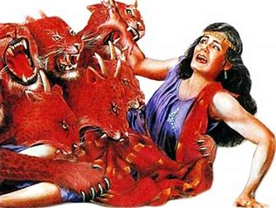
4. Worldly (Satanic) Rev. 17:6-13
B. Once Satan has gained her support,
he will eventually turn on her. Rev. 17:16,17
“the ten horns which thou sawest upon the beast, these shall hate the whore, and shall make her desolate…
For God hath put in their hearts to fulfil his will, and to agree, and give their kingdom unto the beast,
until the words of God shall be fulfilled.”

Slide 25
Satan’s the ultimate counterfeiter.
The Holy Trinity: Father , Son, and Holy Spirit
The Unholy Trinity: The Dragon, the Beast, and
the False Prophet. (Rev. 16:13,14)
“I saw three unclean spirits…come out of the mouth of the dragon, and … the beast,
and …. the false prophet.
they are the spirits of devils, working miracles”

Slide 26
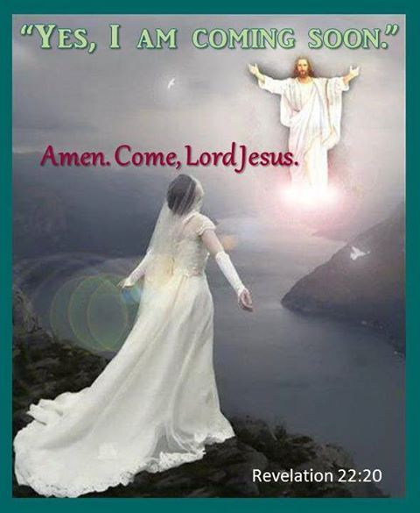
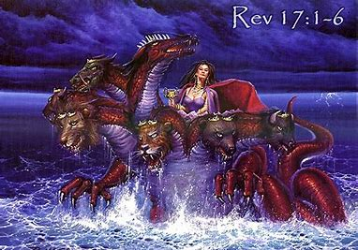
Satan’s the ultimate counterfeiter.
The “Holy Bride of Christ” Rev. 19,21
The “Unholy whore” of the Antichrist. Rev. 17

Slide 27
2 Th 2:7-8 “For the mystery of iniquity
doth already work:
only he who now letteth will let
(katech’ō: holds down or back)
until He be taken out of the way.
And then shall that Wicked be revealed”
What’s God waiting for?

Slide 28
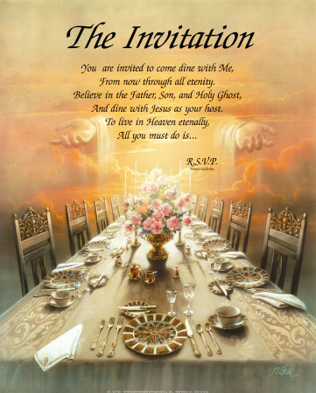
Maybe he’s
waiting for you!
“God is not willing that any should perish,
but that all should come to repentance”
2 Peter 3:9
R.S.V.P.

Slide 29
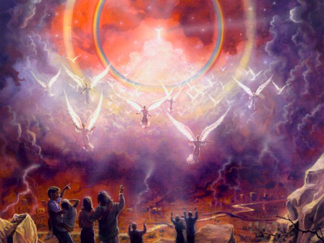
2 Peter 3:10
“But the day of the Lord will come…”
11 Seeing then that all these shall be dissolved
what manner of persons ought ye to be?
12 “looking for the coming of the day of God”

Slide 30
“Behold I come quickly, and my reward is with me.”
Revelation 22:17

