Slide 1
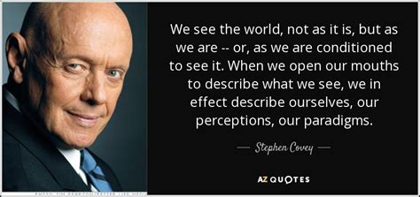
We see the world, not as it is,
but as we are;
Or, as we are conditioned to see it.

Slide 2
Who (what) conditions our perception?
Romans 12:1-3 “I beseech you therefore, brethren,
by the mercies of God, that ye present your bodies a living sacrifice, holy, acceptable unto God,
which is your reasonable service.
Be not conformed to this world:
but be ye transformed
by the renewing of your mind,
that ye may prove what is that good, and acceptable,
and perfect, will of God.

Slide 3
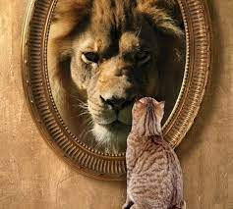
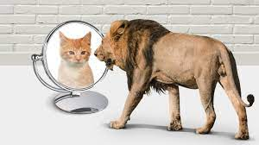
3 “For I say, through the grace given unto me,
to every man that is among you,
“not to think of himself more highly than he ought”
“but to think soberly”
according as God hath dealt to every man
the measure of faith.”

Slide 4
The Cause: Our Perception (Conscience)
has been Polluted (Corrupted) by:
Satan 2 Cor 4:4 “blinded the minds…”
Self (interest/perspective) Jer. 17:9
“The heart is deceitful …and desperately wicked…”
Sin Ro. 1:21 “Became vain (mataio’ō: idolatrous)
in their imagination (dialogismos’: reasoning {logic})
and their foolish heart was darkened”
(Skotizo: obscured)

Slide 5
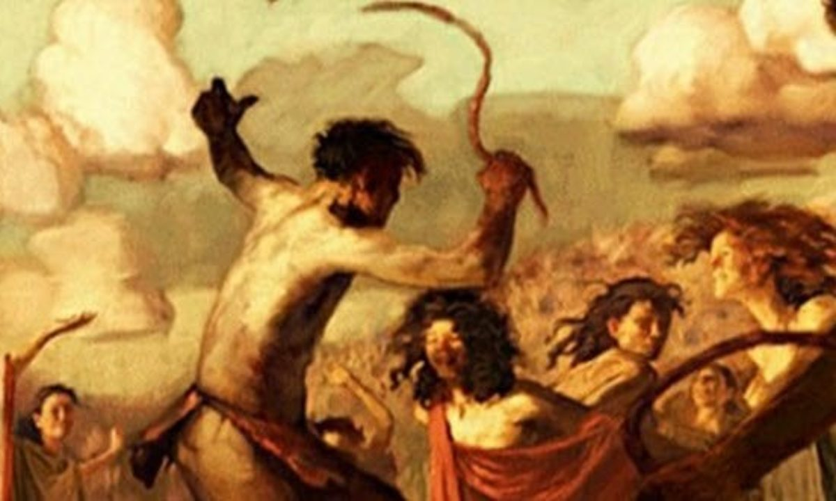
Valentines day originated with Roman festival of Lupercalia (Feb. 13 to 15) in which they sacrificed goats and dogs, then whipped women with the hides/blood of the animals they had just slain.
Men drew women’s names from a jar and then spent the festival in riotous celebration of the Roman fertility god Lupercus.
https://www.history.com/topics/ancient-rome/lupercalia

Slide 6
The Consequences: Satan, Selfishness and Sin will inevitably produce:
Shortsighted-ness.
A. Satan, Selfishness and Sin are Seasonal!
1) Moses Recognized this! Heb. 11:25,26
“Choosing rather to suffer affliction…
than to enjoy the pleasures of sin
…For he had respect (from blepo: aware of) unto the recompense of the reward” (apodidōmi: remuneration!)
for a season.

Slide 7
Shortsighted-ness.
A. Satan, Selfishness and Sin are Seasonal!
2) Solomon learned this! Eccl 11:9
“Rejoice, O young man, in thy youth; … and walk in the ways of thine heart, and in the sight of thine eyes: but know thou, that for all these things
God will bring thee into judgment.”
mišpāṭ:’ to measure and give a verdict
(also 12:13,14)

Slide 8
A. Satan, Selfishness and Sin are Seasonal!
3) The rich fool learned this (too late!)
Lk 12:16-21 19 “I will say to my soul, Soul, thou hast much goods laid up for many years;
take thine ease, eat, drink, and be merry.
20 But God said unto him, thou fool!
This night shall thy soul be required of thee,
Then whose shall those things be…
21 So is he that layeth up treasure for himself,
and is not rich toward God. ”

Slide 9
1. Shortsighted-ness.
A. Satan, Selfishness and Sin are Seasonal!
B. They produce a spiritual Myopia
(near sightedness) that blinds us to:
1) God’s plan/purposes. Mt 16:21-27
Moments after Peter acknowledges Jesus’ divinity:
21 “From that time forth began Jesus to shew unto his disciples, how that he must go unto Jerusalem, and suffer many things of the elders and chief priests and scribes,
and be killed, and be raised again the third day.

Slide 10
B. This produces a Myopia that blinds us to:
1) God’s plan/purposes. Mt 16:22-26
22 “Then Peter took him, and began to rebuke him,
Be it far from thee, Lord: this shall not be unto thee!
23 He …said to Peter, Get thee behind me, Satan:
thou art an offense (skandalon: snare. trap) unto me:
for thou savorest not (Phroneo: interest, regard, value)
{from phren: to understand, recognize,}
the things that be of God,
but those that be of men.”

Slide 11
1) Blinds us to God’s plans/purposes. Mt 16:24
“Then said Jesus unto his disciples, If any man will come after me, let him deny himself,
(aparne’omai: disown! {1 Cor 6:19,20})
and take up his cross,
2) This Blinds us to our own prosperity. 25
“For whosoever will save his life shall lose it: (Apollymi: destroy {waste})
and whosoever will lose his life for my sake
shall find it.”
and follow me.

Slide 12
Myopia blinds us to God’s plan and our Profit!
Mt 16:26 “For what is a man profited, (ōphele’ō: benefited) if he gain the whole world,
and lose (zēmio’ō: injure) his own soul? (1 Cor 3:15)
Or What shall a man give in exchange for his soul?
²⁷ For the Son of man shall come in the glory
of his Father with his angels;
and then he shall reward (apodidōmi: recompense)
every man according to his works.”
(See also 1 Cor 3:9-15)

Slide 13
Satan, Selfishness and Sin inevitably cause:
2. Suffering:
A. The Popular path ends in pain. Mt 7:13
“broad is the way that leadeth to destruction”
(apōleia: Perdition, Destruction, Waste!)
Pr 14:12 “There’s a way which seems right unto a man (yāshār: straight, even, pleasant, convenient)
but the end thereof are the ways of death.”

Slide 14
B. This is Satan’s Name and Nature! Rev 9:11 “And they had a king over them, which is the angel of the bottomless pit, whose name in the Hebrew tongue is Abaddon,
but in the Greek tongue hath his name
Apollyon.” (The Destroyer!)
Jn 10:10 “The thief cometh not but for to steal, and to kill, and to destroy!”

Slide 15
C. This is Satan’s ultimate destiny!
1) Hell was created for Him
Mt 25:41 “Depart from me, ye cursed, into everlasting fire,
prepared for the devil and his angels:”
Is 14:12-13 “How art thou fallen from heaven, O Lucifer, …For thou hast said in thine heart, I will ascend into heaven, I will exalt my throne above the stars of God: …
I will ascend …I will be like the most High.
Yet thou shalt be brought down to hell,
to the sides of the pit.”
and those who follow him.

Slide 16
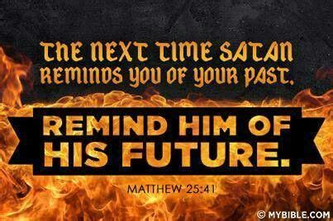
Rev 20:10 “And the devil that deceived them was cast into the lake of fire and brimstone, where the beast and the false prophet are, and shall be tormented
day and night for ever and ever. “

Slide 17
Satan, Selfishness and Sin inevitably cause:
1. Shortsightedness 2. Suffering
3. Separation: Is 59:1-2 “your iniquities have
separated between you and your God,”
A. From God’s Presence (Fellowship)
Gen. 3:8,10 “Adam and his wife hid themselves from the
presence of the LORD God …I was afraid”
1 Jn 1:6 “If we say we have fellowship with him and walk in darkness, we lie, and do not the truth”

Slide 18
3. Separation:
A. From God’s Presence (Fellowship) 1 Jn 1:5-6
B. From God’s Peace
1) Peace (eirē’nē) comes from eiro: “to join”!
“Know God, Know Peace” .
Gal 5:22 “the fruit of the Spirit is love, joy, peace…”
No God, no Peace!
Is 59:8 “The way of peace they know not”
(Is 48:22; 57:21) “no peace to the wicked”

Slide 19
3. Satan, Selfishness, Sin Separate us from:
A. God’s Presence B. God’s Peace
C. God’s Paths Jn 14:6 “I am the way…”
Ps 16:11 “thou shalt show me the path of life…”
Pr 4:18 “the path of the just is as the shining light,
that shineth more and more unto the perfect day.
19 The way of the wicked is as darkness:
They know not at what the stumble”

Slide 20
3. Satan, Selfishness, Sin Separate us from
God’s Presence, Peace, Paths
D) God’s Plan for our Prosperity. Jn 10:10
Ro. 14:23 “whatsoever is not of faith is sin”
Jms 4:17 “to him that knoweth to do good,
and doeth it not,
to him it is sin!”
Hamartia, from hamartano: to miss the mark
and so not share the prize.

Slide 21
3. Satan, Selfishness, Sin Separate us from
God’s Presence, Peace, Paths, and His Plan
Ro 8:5-8 “For they that are after the flesh do mind (phroneo: regard) the things of the flesh;
but they that are after the Spirit the things of the Spirit.
For to be carnally minded is death;
but to be spiritually minded is life and peace.
Because the carnal mind is enmity against God: for it is not subject to the law of God, neither indeed can be.
So then they that are in the flesh cannot please God.”

Slide 22
Satan, Self and Sin ultimately produces:
Shortsightedness, Suffering, Separation:
Ps 9:16-17 “The LORD is known by the judgment which he executeth: the wicked is snared in the work of his own hands.
Higgaion. (from hāgâ: mediate) Selah. (pause)
17 The wicked shall be turned into hell,
and all the nations that forget God. “

Slide 23
Ro. 6:23 “The wages of sin is death!”
Ez 18:4,20 “the soul that sinneth, it shall die.”
Mt 7:22-23 “Many will say to me in that day, Lord, Lord, have we not…done many marvelous works?
And then will I profess unto them,
I never knew you:
depart from me,
ye that work iniquity.”
Rev. 20:11-15

Slide 24
This is sin’s ultimate destiny!
Rev. 20:12-14 “I saw the dead, stand before God;
and the books were opened: and another book was opened, which is the book of life:
…and the dead were judged out of those things which were written in the books,
according to their works.
And death and hell were cast into the lake of fire.
This is the second death.”

Slide 25
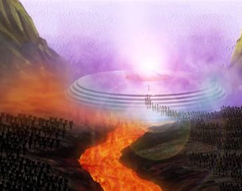
15 “whosoever was not found written in the book of life
was cast into the lake of fire.“
Rev. 3:5; 13:8; 17:8; 20:12; 21:27; 22:19
John 8:24 “for if ye believe not that I am he,
ye shall die in your sins…”
See Jn 3:18;36

Slide 26
Genuine believers will be spared from
this judgment,
2 Tim 2:19 “Nevertheless, the foundation of God standeth sure, having this seal,
The Lord knoweth them that are his. (Jn 10:27)
And, Let every one that nameth the name of Christ depart from iniquity.”
But not all judgment!

Slide 27
Genuine believers will be spared from
this judgment, But not all judgment!
Eccl 12:13,14
“Let us hear the conclusion of the whole matter: Fear God, and keep his commandments:
for this is the whole duty of man.
For God shall bring every work into judgment,
with every secret thing, (See Heb. 4:12,13)
whether it be good, or whether it be evil.”

Slide 28
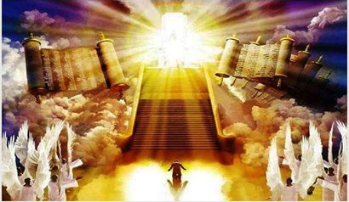
2 Cor 5:10
“we must all appear before the judgment seat of Christ; that every one may receive the things done in his body, according to that he hath done, whether good or bad.”

Slide 29
2 Cor 5:11,20
“knowing therefore the terror of the Lord, we persuade men…
Now then we are ambassadors for Christ, as though God did beseech you by us: we pray you in Christ's stead,
be ye reconciled to God.”

