Slide 1
Eph 6:10-18; 2 Cor 10:3-5; 2 Cor 2:11
“Lest Satan should get an advantage of us: for we are not ignorant of his devices.”

Slide 2
Peace is not the absence of Pain or Problems,
but an awareness of the Power, Promises, Purposes and Partnership
with “the Prince of Peace”! (Is. 9:6)
“Take my yoke upon you and learn of me…,
And ye shall find rest unto your souls.”
Mt 11:28,29
“Peace” (Eirene: from eiro: meaning to join)

Slide 3
Ex. 19 reveals that God, after delivering Israel from bondage to Egypt and her gods,
offered them a Priestly Partnership that was:
Personal vs 4 “brought you unto myself”
Precious vs 5 “ye shall be unto me a peculiar treasure”
Practical vs 6 “ye shall be a kingdom of priests”
Pure vs 6 “and a holy nation”
Provisional: vs 5,6 “if ye will obey my voice indeed,
and keep my covenant, (berît: partnership)
then ye shall be kingdom of priests…”

Slide 4
1. God’s Peace/Protection/Provision would be
a biproduct of this partnership. Dt. 11:26-28
“Behold, I set before you this day a blessing (berākâ’: prosperity, protection, peace)
and a curse; (qelālâ’: to make vile)
27 A blessing, if ye obey (shāmaʿ: hear, understand)
the commandments of the LORD your God,
A. What does understanding have to do
with obedience?

Slide 5
1) If we truly understood God’s commands,
we would value and obey them. Dt 10:12,13
“what doth the LORD thy God require of thee,
but to fear (yārēʾ: revere) the LORD thy God,
to walk in (yalak: pursue) all his ways,
and to love (ahab’) him,
and to serve (abad: work/worship) the LORD thy God
with all thy heart (lēbāb’: courage, understanding)
and with all thy soul, (ne’pesh: spirit, vitality)
(See Psalm 42:1,2)

Slide 6
1) If we truly understood God’s commands,
we would value and obey them. Dt 10:13
“what doth the LORD thy God require of thee…
¹³To keep (shamar: value, guard)
the commandments of the Lord
for thy good?”
(ṭôb: pleasure, prosperity, precious)

Slide 7
Eden illustrates this! Gen 2
The root word for Eden is adan meaning:
Pleasure and/or delight!

Slide 8
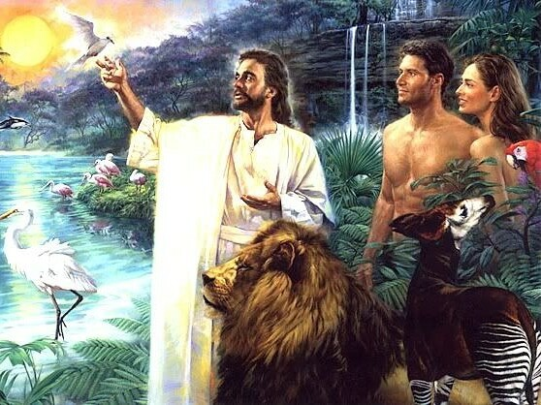
Ge 2:9 “the LORD God made to grow every tree that is pleasant to the sight, and good for food; the tree of life also… and the tree of knowledge of good and evil.
15 And the LORD God put him into the garden of Eden to dress it and to keep it.
16 And the LORD God commanded the man, saying,
Of every tree of the garden thou mayest freely eat:
17 but of the tree of the knowledge of good and evil thou shalt not eat of it.”

Slide 9
2. Rejection of God’s partnership,
produces a poisonous partnership!
A. Disobedience would result in the removal of the peace and protection of God’s blessing.
1) This exposes us to the “curse” of God’s enemies;
producing a legacy of Pain, Pressure, and Problems.
Dt 11:28 “And a curse, if ye will not obey the
commandments of the LORD your God,
(from qālal: to be trifling {of little worth, insignificant})

Slide 10
Is 48:17-19 “Thus saith the LORD, thy Redeemer, the Holy One…; I am the LORD thy God which teacheth thee to profit, (yāʿal: to ascend, be valuable/useful)
This is the opposite of the “curse” of Dt 11:28
which leadeth thee by the way that thou shouldest go.
O that thou hadst hearkened to my commandments!
Then had thy peace been as a river,
and thy righteousness as the waves of the sea:
19 Thy seed also had been as the sand…
22 There is no peace, saith the LORD, unto the wicked.”

Slide 11
B. Sin involves a turning away from the true God,
and turning toward “other (false) gods”.
1) This is the essence of sin
{Hamartano: to trespass, miss the mark}
Dt 11:28 “…And a curse, if ye will not obey the commandments of the LORD your God,
but turn aside out of the way which I command you
to go after other gods…”

Slide 12
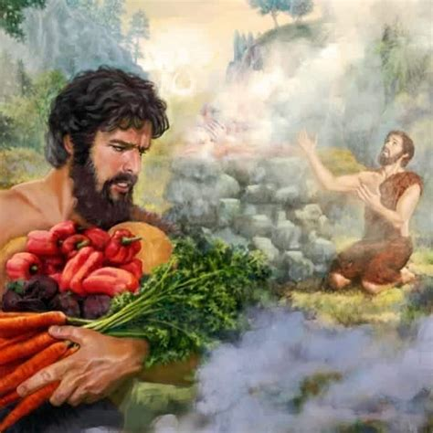
B. Sin actually involves a willful turning away
from God and toward “other (false) gods”.
Dt 11:28 “but Turn aside…To go after other gods”
2) The first reference to “Sin” is Gen. 4:7
“If thou doest well, (God’s will)
shalt thou not be accepted?
(Śeʾēt: elevated, exalted)
and if thou doest not well,
(not doing God’s will)
sin lieth at the door.

Slide 13
Gen. 4:7 “If thou doest well, shalt thou not be accepted?
and if thou doest not well, sin lieth at the door.
(ḥaṭṭāʾt: to offend (God) {and its penalty}
from ḥāṭāʾ: “to miss; hence (figurative and general) to sin;
by inference to forfeit, lack, lead astray.”
a) Sin is Personal! “unto thee shall be his desire,
(teshûqâ’: to reach or stretch out after)
and thou shalt rule (māshal) over him.”
Who is the “his” and “him”
God was warning Cain (& us) about?

Slide 14
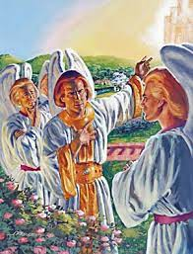
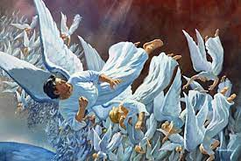
3. Satan has power, popularity, purposes
and is looking for Partners!
A. This has always been his motive.
1) With the angels. (Rev. 12)

Slide 15
3. Satan… is looking for Partners!
A. This has always been his motive.
2) With Adam and Eve Gen. 3:1 “The serpent was more subtle… and said …that God said?
Ye shall not surely die:
⁵ For God doth know that in the day ye eat thereof,
then your eyes shall be opened,
and ye shall be as gods,
knowing good and evil.”

Slide 16
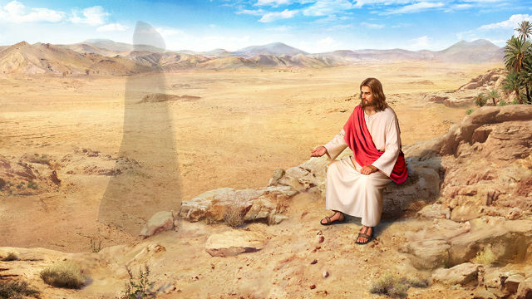
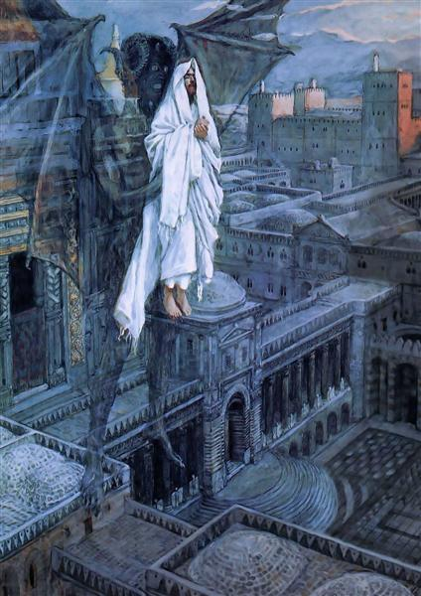
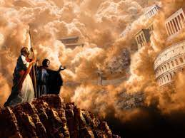
3. Satan… is looking for Partners!
3) With Jesus! (Mt 4)
Vs 3,4
Vs 8-10
Vs 5-7
John 14:30 “the prince of this world cometh,
and hath nothing in me.”

Slide 17
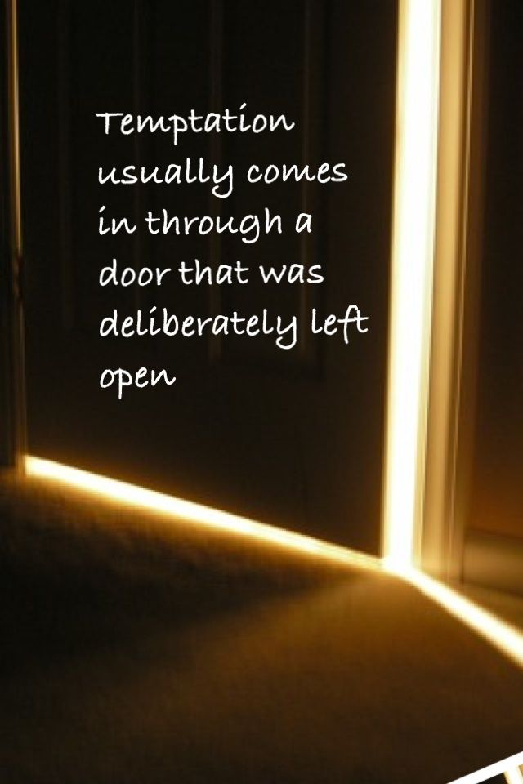
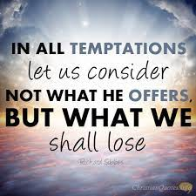
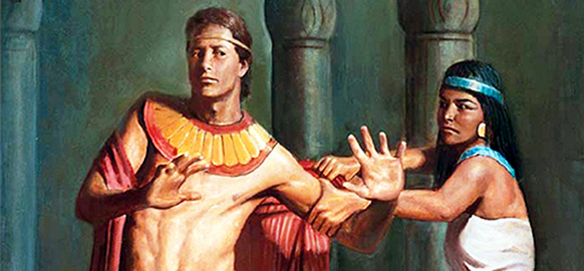
3. Satan… is looking for Partners!
4) With Us
Genesis 39:9 “how then can I do
this great wickedness,
and sin against God?”

Slide 18
3. Satan … and is looking for Partners!
Even with those born in the Millennial! Rev. 20:7-9
“when the thousand years are expired, Satan shall be loosed out of his prison, And shall go out to deceive the nations which are in the four quarters of the earth,
…to gather them together to battle:
the number of whom is as the sand of the sea.
And they went up on the breadth of the earth, and compassed the camp of the saints about, and the beloved city: and fire came down from God out of heaven,
and devoured them.”

Slide 19
3. Satan … and is looking for Partners!
A. This has always been his motive.
B. Sin produces a Partnership with Satan.
1 Sam 15:23 “rebellion (meri: bitterness)
is as the sin of witchcraft, (qes’em: divination)
and stubbornness (pāṣar: to press, stun, peck at)
is as iniquity and idolatry.” (terāpîm: family idol)

Slide 20
There was no sacrifice for presumptuous sin!
David understood this: Ps 51:16-17
“For thou desirest not sacrifice; else would I give it: thou delightest not in burnt offering.
17 The sacrifices of God are a broken spirit: a broken and a contrite heart, O God, thou wilt not despise.”
And prayed: Ps 19:13 “Keep back thy servant also from presumptuous sins; let them not have dominion over me: then shall I be upright,
and I shall be innocent from the great transgression.”

Slide 21
B. Sin produces a Partnership with Satan.
There was no sacrifice for presumptuous sin!
Nu 15:30-31 “But the soul that doeth ought presumptuously, …the same reproacheth the LORD; and that soul shall be cut off from among his people.
31 Because he hath despised the word of the LORD, and hath broken his commandment, that soul shall utterly be cut off; his iniquity shall be upon him.”
Ps 19:13 “Keep back thy servant also from presumptuous sins; let them not have dominion over me: then shall I be upright, and I shall be innocent from the great transgression.

Slide 22
3. Satan … and is looking for Partners!
A. This has always been his motive.
B. Sin produces a Partnership with Satan. Jn 8:34
“Whosoever committeth sin
Ro 6:16-18 “Know ye not, that to whom ye yield yourselves
servants to obey, his servants ye are …;
whether of sin unto death,
or of obedience unto righteousness?
(Notice there are only two choices!!!!)
is the servant of sin.”

Slide 23
1) Only Jesus can free us! Jn 8:36 “If the Son
therefore shall make you free, ye shall be free indeed.”
(eleuthero’ō: to liberate, exempt) (Lk 4:18; Is. 61:1)
Ro. 6: 17 …ye were the servants of sin,
but ye have obeyed from the heart that form of doctrine which was delivered you.
Being then made free from sin,
ye became the servants of righteousness.”
How? 2 Tim. 2:5 “He Gave his life a ransom for all…”

Slide 24
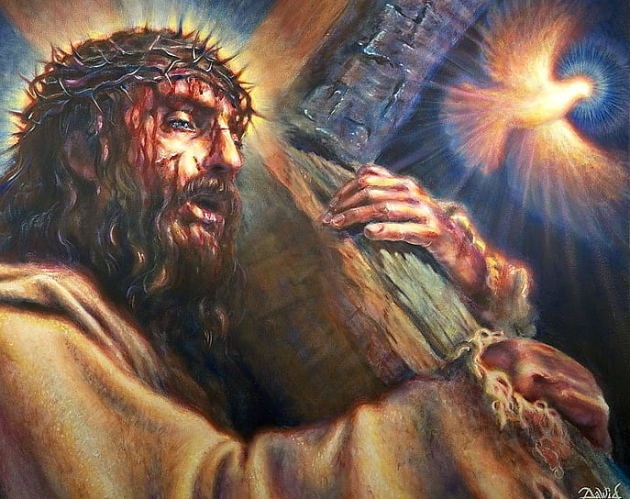
Hebrews 2:14-15
“Forasmuch then as the children are partakers of flesh and blood,
he also himself likewise took part of the same;
that through death he might destroy him that had the power of death,
that is, the devil;
And deliver them who through fear of death were all their lifetime subject to bondage.

Slide 25
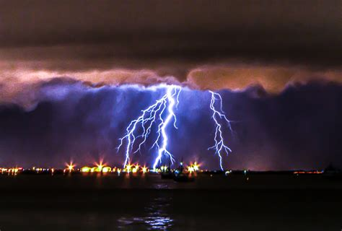
Both our Lord and Satan are seeking partners!
Jn 10:10 “The thief comes not, but for to steal, kill,
and to destroy:
I am come that
they might have life,
and that …more abundantly.”
1 Cor 10:20 “I would not that ye should have fellowship
(Koinōnos: partnership) with devils.”
(daimonion: demons)

Slide 26
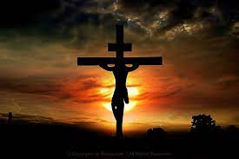
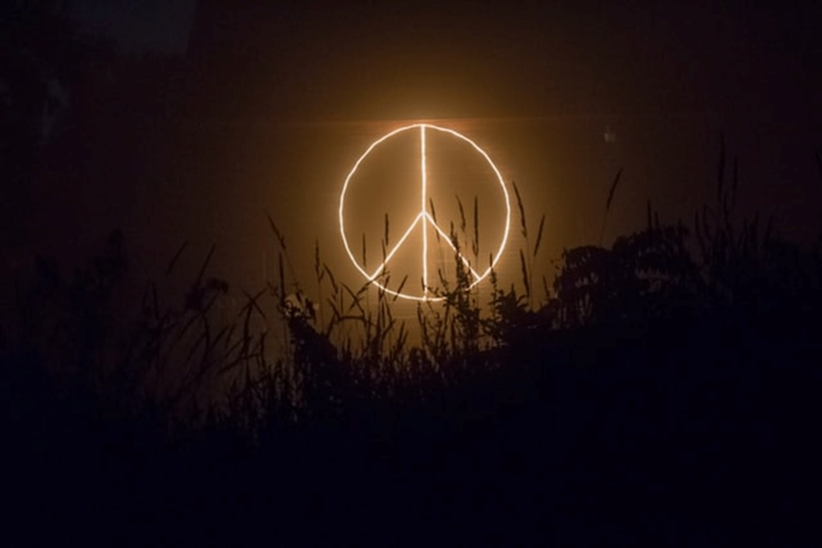
Notice how this thief has “stolen” & corrupted
Eph 2:14 “For he is our peace”
1) The symbol of Peace.

Slide 27
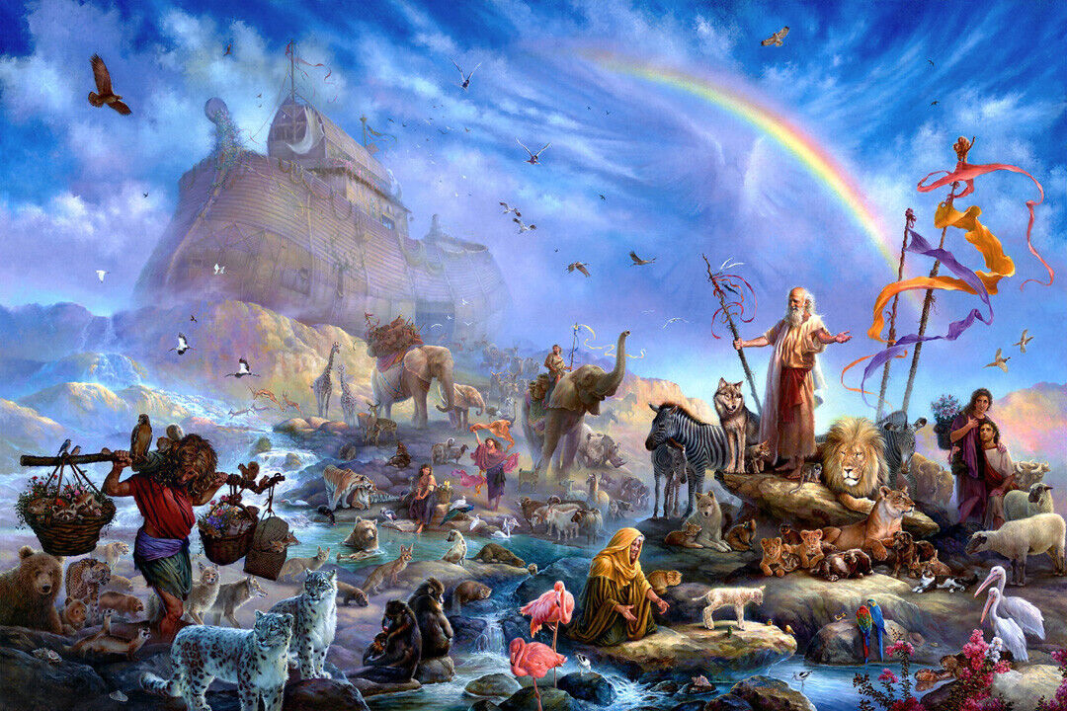
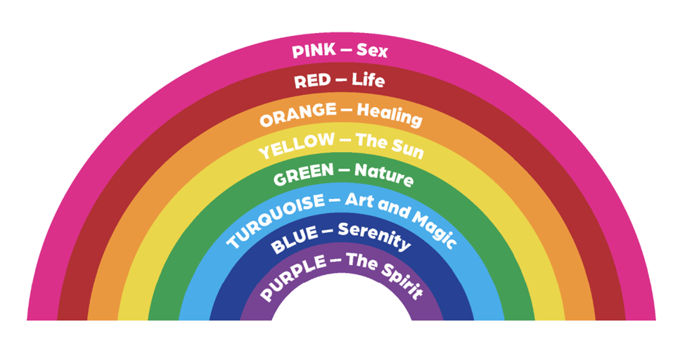
Notice how this thief has “stolen” and corrupted 2) The symbol of God’s Promise (Gen. 9:13)
Gen 9:12,13 “And God said, … I do set my bow in the cloud,
and it shall be for a token of a covenant between me and the earth.”
June 2015
https://www.glbthistory.org/rainbow-flag

Slide 28
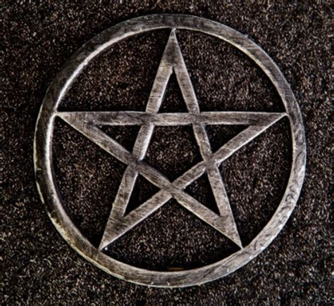
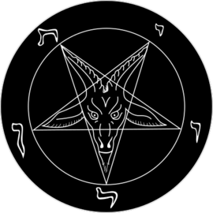
3) This thief has even twisted the symbol of God’s People (Star of David)
The official insignia of the Church of Satan,
representational of carnality and earthy principles.
Lewis & Controversial New Religions, pp. 417.
Sigil of Baphomet
Spells Leviathan (serpent, dragon) לִוְיָתָן‎
Who’s also the Symbol of Babylon. (Rev. 17)

Slide 29
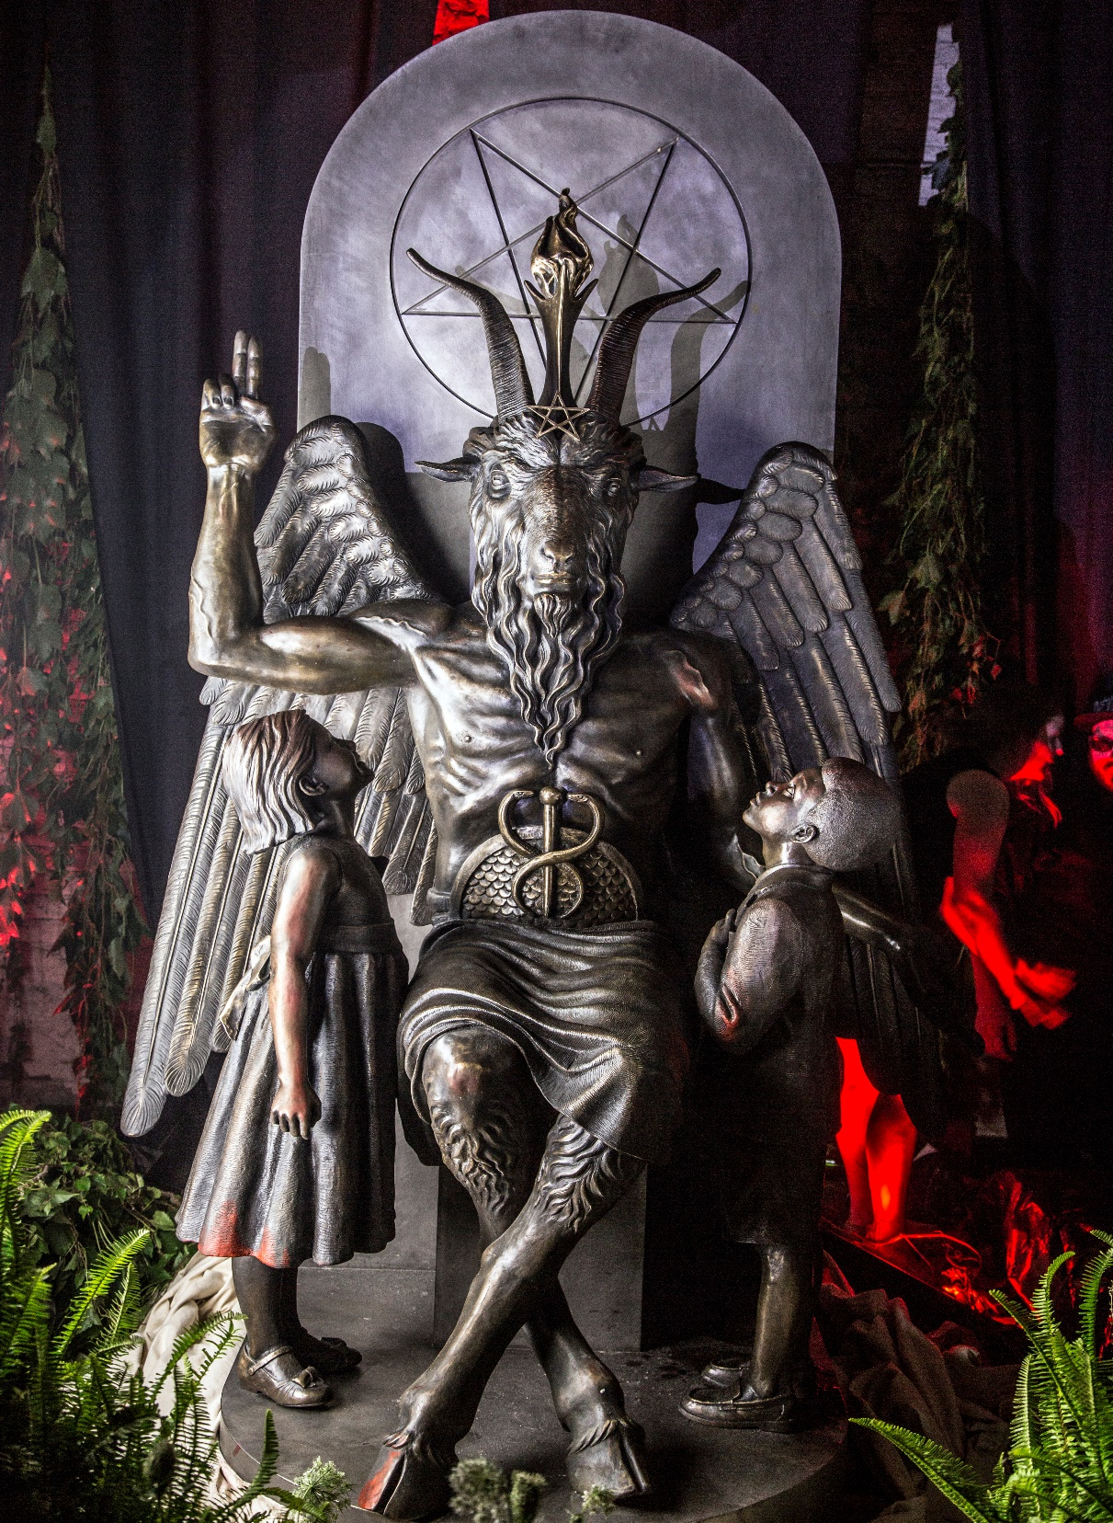
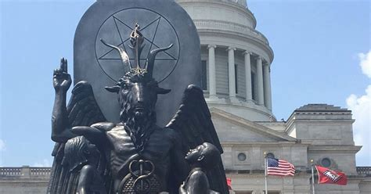
Detroit 2015
Arkansas Capital 2018
“Baphomet contains binary elements symbolizing a reconciliation of opposites, emblematic of the willingness to embrace, and even celebrate differences” Jex Blackmore

Slide 30
Jn 16:33 ”These things I have spoken unto you,
that in me ye might have peace. (eirēnē: to join) .
In the world ye shall have tribulation: thlipsis: pressure
but be of
good cheer;
(2 Cor 4:4; Eph. 2:2-3)
I have overcome the world.”
also Jn 4:4; 5:4

Slide 31
Our Peace (or lack thereof) will be in direct proportion to our Partnership with either
The Good Shepherd Jn 10:10b,27,28
Or the Thief! Jn 10:10a

Slide 32
Joshua 24:15
“choose you this day whom ye will serve;
whether the gods which your fathers served
that were on the other side of the flood, (Egypt)
or the gods of the Amorites… (Canaan)
(You will serve {partner with} some “god”!)
as for me and my house,
we will serve the LORD.”

Slide 33
Joshua 24:16 “And the people answered and said, God forbid that we should forsake the LORD,
to serve other gods;
22 And Joshua said unto the people,
Ye are witnesses against yourselves that ye have chosen you the LORD, to serve him.
23 Now therefore put away the strange gods
which are among you,
and incline your heart unto the LORD God”

Slide 34
Jgs 2:8-12 “Joshua the servant of the LORD, died,
And also all that generation …:
and there arose another generation after them, which knew not the LORD, nor the works which he had done.
11 And the children of Israel did evil in the sight of the LORD, and served Baalim:
And they forsook the LORD God…and followed …the gods of the people that were … about them,
…and served Baal and Ashtaroth.”
Who are you serving?

