Slide 1
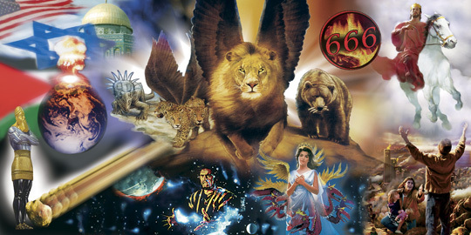
Prophecy is like a complicated puzzle portraying the Story and Struggle of the ages
IN ADVANCE!

Slide 2
Isaiah 46:9-10
“Remember the former things of old: for I am God, and there is none else;
I am God, and there is none like me,
Declaring the end from the beginning, and from ancient times the things that are not yet done, saying, My counsel shall stand,
and I will do all my pleasure:”

Slide 3
> 353 of these pieces dealt specifically with Jesus’ 1st coming.
“Prophets” were handed “pieces” of History’s puzzle in advance!
Jesus fulfilled every one of them!

Slide 4
There are more than 100 prophecies about his second coming recorded in the New Testament!
If Jesus fulfilled all of the O.T. prophecies about his 1st coming,
He will certainly fulfill the O.T. and N.T. ones about his second coming!
Mt 5:18 “Till heaven and earth pass, one jot or one tittle shall in no wise pass from the law, till all be fulfilled.”

Slide 5
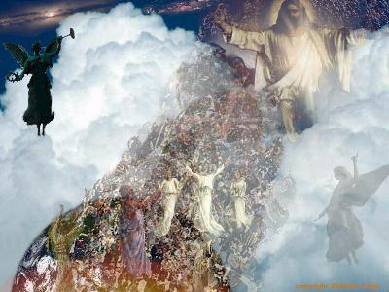
Scripture reveals that there will be two distinct “stages” to his Second Coming.
1st: He will come “in the air” for His Church!
(Acts 1:11;
1 Thes. 4:13-18;
1 Cor. 15:51-58)

Slide 6
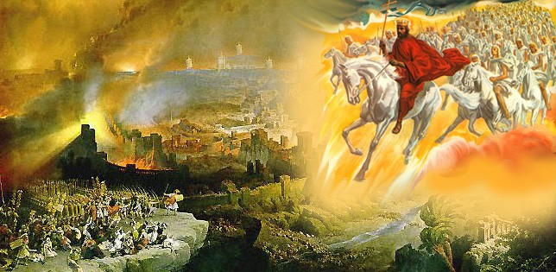
2^{nd:} He’ll come “in power” to reign on the earth. (Ps. 2; Zech.12; 2 Thes. 2; Rev. 19)

Slide 7
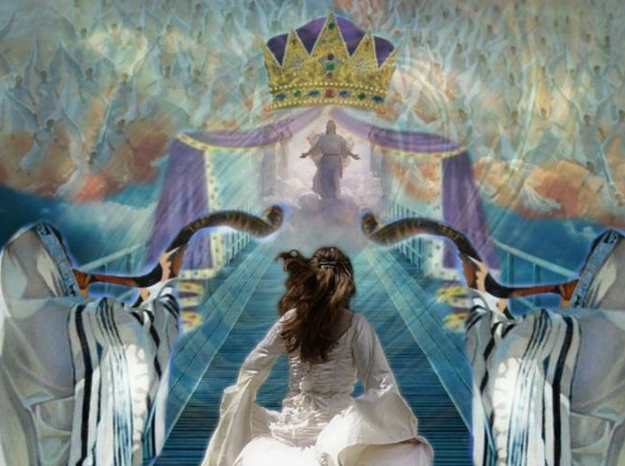
What happens between these two events?
Rev 1:1 “The Revelation of Jesus Christ, which God gave unto him, to shew unto his servants things which must shortly come to pass; and he sent and signified it by his angel unto his servant John”
Rev. 2-3: Letters to the Churches. (Church Age)
Rev. 4: Rapture (Transformation, Evaluation,
Remuneration) of The Church,
and the Consummation of our relationship (Rev. 19)

Slide 8
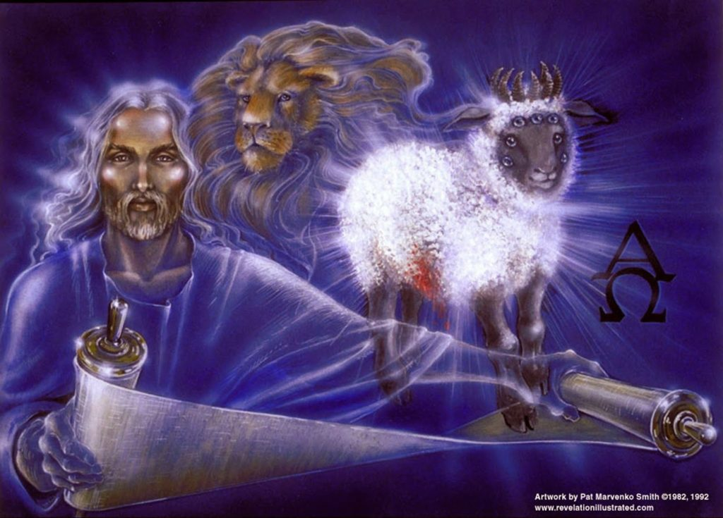
What happens between these two events?
Rev. 5 reveals a transition period in which Jesus is handed a scroll with 7 seals. (Title to Earth)
Rev 5:1-5 “Who is worthy to …loose the seals thereof?...
behold, the Lion of the tribe of Judah, the Root of David,
hath prevailed …to loose the seven seals thereof.
⁶ And I beheld, in the midst of the throne …, stood a Lamb as it had been slain”

Slide 9
Rev 5:8-10 “the 24 elders fell down before the Lamb, having every one of them harps, and golden vials full of odors,
which are the prayers of saints.
And they sung a new song, Thou art worthy to take the book, and to open the seals thereof: for thou wast slain,
and hast redeemed us to God by thy blood …
And hast made us unto our God kings and priests:
and we shall reign on the earth.”

Slide 10
The opening of the seals begins the tribulation.
The Purpose of the Tribulation Period:
To give the world what it wants:
Self rule eventually becomes Satan’s rule!
To turn Israel back to Himself. (Rev. 12)
Ro 11:25-26 “blindness in part is happened to Israel, until the fulness of the Gentiles be come in.
And so all Israel shall be saved: as it is written, There shall come out of Sion the Deliverer”
Self Rule!

Slide 11
The Purpose of the Tribulation Period
To give the world one last chance to repent.
Rev 14:6-7 “I saw another angel fly in the midst of heaven, having the everlasting gospel to preach unto them that dwell on the earth, and to every nation, and kindred, and tongue, and people,
Saying with a loud voice, Fear God, and give glory to him; for the hour of his judgment is come: and worship him that made heaven, and earth…”

Slide 12
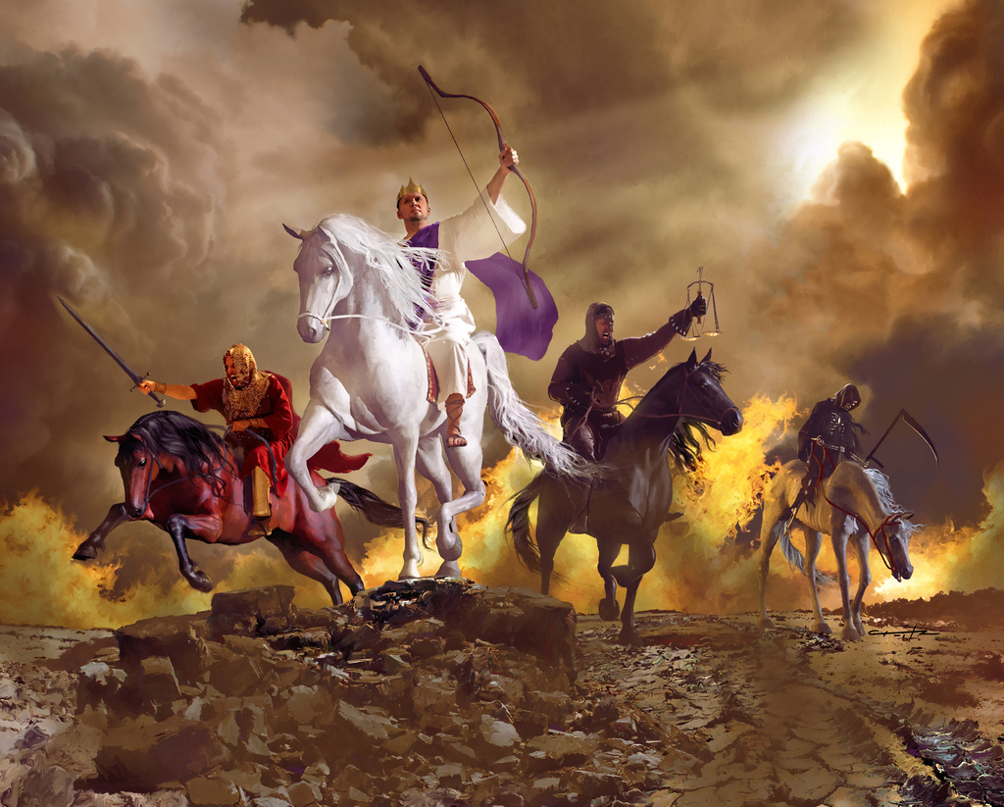
Rev 6:1 “when the Lamb opened one of the seals, and I heard, as it were the noise of thunder, …saying, Come and see.”
Anti-Christ
Death
War
Famine
Vs 2 “and behold a white horse: and he that sat on him had a bow;
and a crown was given unto him: and he went forth …to conquer.”

Slide 13
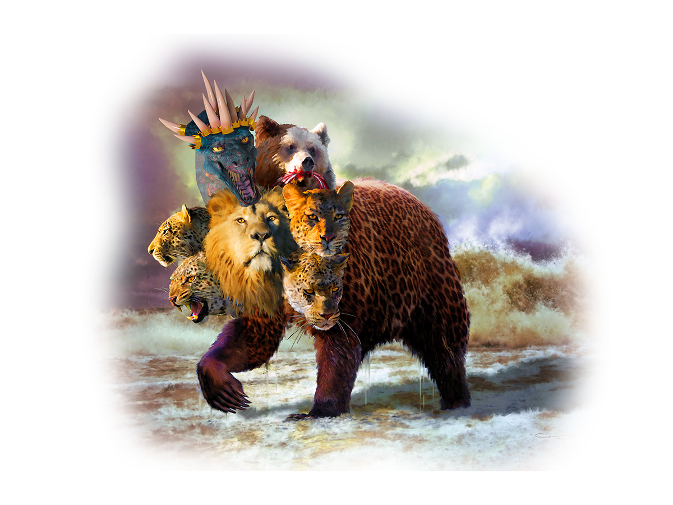
The tribulation will last for 7 years divided into two “halves.”
1. The Tribulation (The Rise of the Beast)
A. A Charismatic leader will rise to power.
1) He’s portrayed as a peaceful rider
on the White horse in Rev. 6:2
and as a terrible beast
in Rev. 13

Slide 14
A. A Charismatic political leader will rise to power.
2) His rise could be initiated by a cataclysmic event
that will “launch” him into the world’s eyes.
(Perhaps the “Rapture” or War of Ezek. 37)
3) He’ll “solve” the Middle East Crisis initiating
a 7 year “Peace Treaty”. (Daniel 9:27)
a) Probably negotiate the rebuilding of the Temple
and be embraced as the Jewish “Messiah”.
https://www.templeinstitute.org/

Slide 15
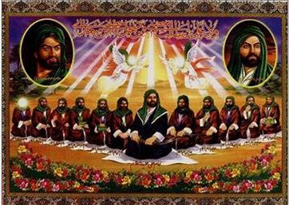
3) He’ll “solve” the Middle East Crisis. (Daniel 9:27)
b) Muslim’s will probably accept him as their own
prophesied “Messiah” known as the “12th Imam”.
“The world will not come to an end until a man from my family and of my name shall be master of the world!
When you see a green ensign coming from the direction of Khorasan, then join them, for the Imam of God will be with the standards who will be called al-Mahdi.” (The Guide)
The “Prophet” Muhammad
https://www.al-islam.org/story-of-the-holy-kaaba-and-its-people-shabbar
/twelfth-imam-muhammad-ibn-al-hasan-al-mahdi

Slide 16
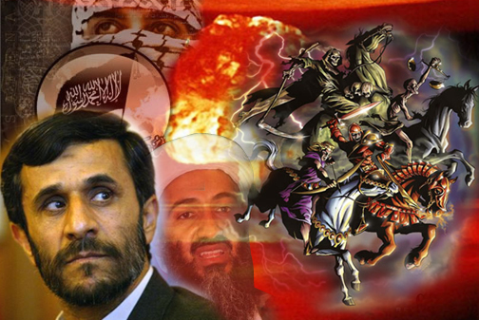
“The Return of the Mahdi is Imminent” Ahmadinejad

Slide 17
1. The Tribulation “Rise of the Beast”
4) He’ll be backed by 10 major Nations in his rise
to world wide power. (Dan. 7:7,24; Rev. 17:12)
“the ten horns …are ten kings, which have received no kingdom as yet; but receive power as kings …with the beast.
These have one mind, and shall give their power and strength unto the beast.
Muslim’s call this the “caliphate”!
(Uniting 2.2 billion Muslims)

Slide 18
1. The Tribulation “Rise of the Beast”
5) His “Kingdom” includes characteristics of the
previous empires. Dan. 7:17-22; Rev. 13:2
(Babylon, Persia, Greece, Rome.)
“the beast …was like a leopard,
his feet were as a bear,
and his mouth as the mouth of a lion:”

Slide 19
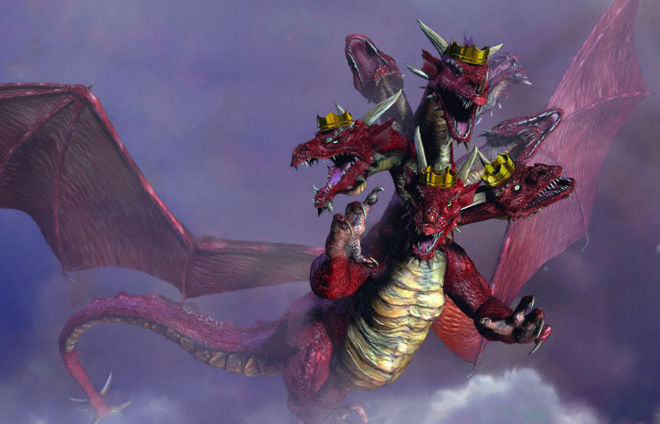
6) His kingdom will be Satanically enabled!
Rev 12:9 “the great dragon was cast out, that old serpent,
called the Devil, and Satan, which deceiveth the whole world:
he was cast out into the earth,
and his angels were cast out with him.”
Rev 13:2 “the dragon gave him (the beast) his power,
and his seat,
and great authority.”

Slide 20
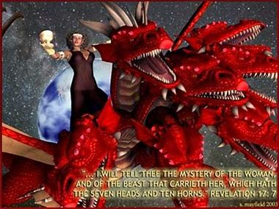
1. The Tribulation “Rise of the Beast”
7) He’ll be backed by the “Church”, using religion
to gain the trust of the people. (Rev. 17)
8) This period of “political
popularity” will last
3 ½ years.
(Dan. 9:27; Rev. 13:1-5)

Slide 21
2. The Transition: “Resurrection of the Beast”
A. There will be a possible assassination attempt.
1) Satan will possess (and apparently resurrect) him.
(Rev. 13:3) “And I saw one of his heads as it were wounded to death; and his deadly wound was healed:
and all the world wondered after the beast.”
And they worshipped the dragon which gave power unto the beast: and they worshipped the beast”
2 Thes 2:3,9 “even the son of perdition…
whose coming is after the working of Satan”

Slide 22
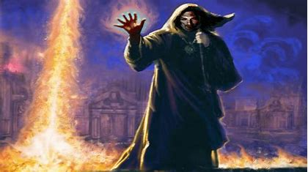
2. The Transition: “Resurrection of the Beast”
B. His “False Prophet” will do miracles. Rev 13:12-13
“he exerciseth all the power of the first beast before him, and causeth the earth and them which dwell therein to worship the first beast, and doeth great wonders,
so that he maketh fire come down from heaven on the earth in the sight of men…”

Slide 23
B. His “False Prophet” will deceive the masses.
“deceiveth them that dwell on the earth by the means of those miracles which he had power to do in the sight of the beast; saying to them that dwell on the earth, that they should make an image to the beast…
And he had power to give life unto the image of the beast, that the image of the beast should both speak,
and cause that as many as would not worship the image of the beast should be killed.”
(Rev. 13:14,15)

Slide 24
2. The Transition: “Resurrection of the Beast”
C. He will Desecrate the Temple demanding worship.
2 Th 2:3,4 “for that day shall not come, except there come a falling away first, and that man of sin be revealed, the son of perdition;
Who opposeth and exalteth himself above all that is called God, or that is worshipped;
so that he as God sitteth in the temple of God,
shewing himself that he is God.”

Slide 25
1) This event ushers in The “Great” Tribulation.
Mt 24:15-24
“When ye therefore shall see the abomination of desolation, spoken of by Daniel the prophet, stand in the holy place, (whoso readeth, let him understand:)
Then let them which be in Judaea flee into the mountains: …
21 then shall be great tribulation, such as was not since the beginning of the world to this time, no, nor ever shall be.
except those days should be shortened, there should no flesh be saved: but for the elect's sake they shall be shortened.
(To 3 ½ years Dan. 9:27; Rev. 12:14; 13:5)

Slide 26
The rise of the Anti-Christ will be:
Rapid “then shall that wicked one be revealed” 2 Th.2:8
Reasonable “whose coming is after the working of Satan with all power and signs and lying wonders, and with all deceivableness of unrighteousness in them that perish; because they received not the love of the truth, that they might be saved!” 2 Th. 2:9,10
Rebellious: He’ll defy God and demand worship!
2 Th 3:4 “exalteth himself above all that is called God.”

Slide 27
Rev. 13:3 “all the world wondered after the beast”
The vast majority of the world will get caught up in the “web” of “wonder” until it’s too late!
Initially Pharaoh hardened his own heart to God. (Ex. 7:14, 22; 8:15,19, 32; 9:6)
Eventually
“the LORD hardened the heart of Pharaoh” Ex. 9:12

Slide 28
This pattern will be repeated!
2 Th 2:11-12 “And for this cause God shall send them strong delusion, that they should believe a lie:
That they all might be damned who believed not the truth, but had pleasure in unrighteousness.”
Have you really “Believed the Truth?”
about God’s plan for your redemption?
Pisteuō: to entrust and commit!

Slide 29
If so, then the rest of the chapter applies to you!
1 Thes. 2:12-16,17
“But we are bound to give thanks always to God for you, brethren beloved of the Lord, because God hath from the beginning chosen you to salvation through sanctification of the Spirit and belief of the truth:”
16 Now our Lord Jesus ... which hath loved us, and hath given us everlasting consolation and good hope through grace…

Slide 30
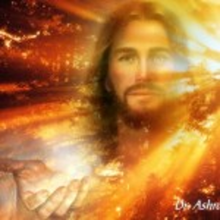
1 Thes. 2:17
“Comfort (parakaleo: to call near) your hearts,
and stablish you (sterizo: turn resolutely)
in every good (agathos: beneficial)
word and work.”
Are you willing to
“resolutely turn” from your own way
Truly “draw near” to Christ,
And invest your life in “every good work” that which is truly beneficial and valuable from God’s perspective?

