Slide 1
God’s Great Plan for His People.

Slide 2
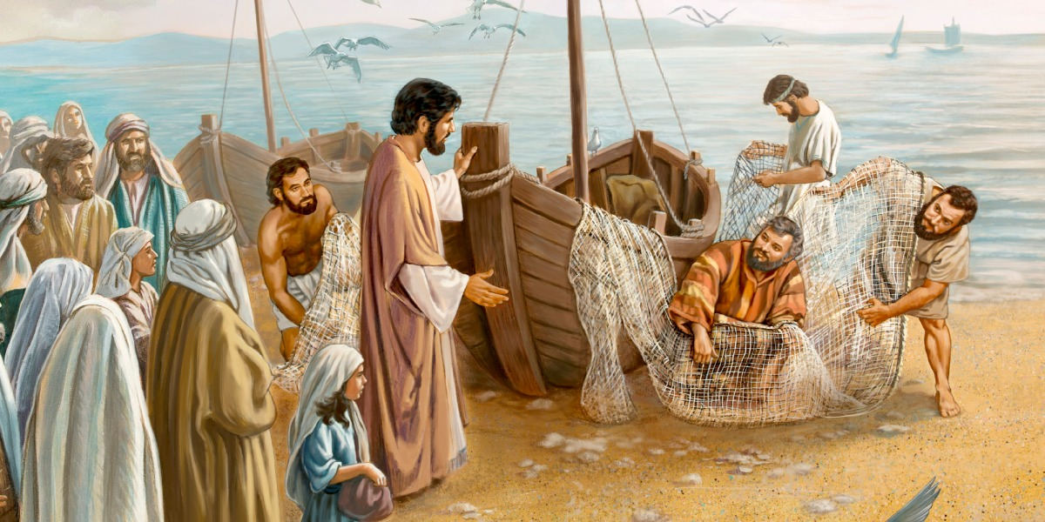
The first Words Jesus spoke when he began his public ministry introduce His Priorities!
Mt 4:17 “Repent, for the Kingdom of Heaven is at hand!”
Mt. 4:19 “Follow me
and I will make you
fishers of men!”

Slide 3
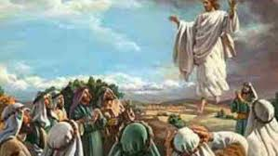
He reinforced these priorities with his last words to His disciples. Mt 28:18-20
“All power is given unto me in heaven and in earth.
¹⁹ Go ye therefore, and teach all nations,
baptizing them in the name of the Father, Son, & Holy Ghost:
²⁰ Teaching them to observe all things whatsoever
I have commanded you:
and, lo, I am with you always,
even unto the end of the world.”

Slide 4
God’s Great Commission reveals that God’s Great Plan involves our:
Salvation: Enabling a Restoration of a Personal relationship with God. Col. 1:13
2. Baptism: Producing an identification and
association with God and His Church. (Ro. 6)
3. Discipleship: Providing a path for personal
Transformation to Christlikeness! (Ro. 8)

Slide 5
Since Satan understands God’s priorities,
Power and plan for each of us;
He seeks to sidetrack us from pursuing them.
This is the essence of Sin!
ἁμαρτία (hamartia) offence, trespass
From hamartano: to err, miss the mark
(Contrast Pr. 14:12 & Ps.16:11; James 1:12-24)

Slide 6
The 3rd priority of the Great Commission helps us to understand & pursue God’s paths.
Discipleship. Mt. 28:20 “Teaching them to observe
(tereo: to guard, value, watch, keep)
all things whatsoever I have commanded you.”
Entellōmai’: from en: fixed position and
telos: to set out for a definite point or goal!

Slide 7
Through Discipleship we grow to:
Understand God’s Goals & Will. 2 Tim 2:15; 3:16
Value (Trust) God and His will enough
to adjust our lives accordingly, (Pr 3:5,6)
producing (by God’s Grace and Spirit)
personal transformation! (Ro. 12:1-2)
(Mt 28:20; 2 Cor 3:18; Jms 1:22-25; 1 Jn 5:3; Eph. 2:8-10)

Slide 8
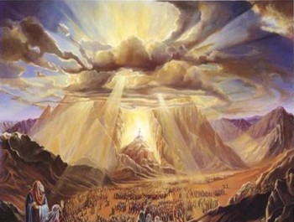
God often describes His people as “jewels”.
Ex 19:5,6 “if ye will obey my voice indeed, and keep my covenant, then ye shall be a peculiar treasure unto me
‎ סְגֻלָּה‎ (segullâ) particular treasure
for all the earth is mine.
And ye shall be unto me
a kingdom of priests,
and an holy nation.”

Slide 9
The New Testament uses similar language.
1 Pt 2:9 “But ye are a chosen generation, a royal priesthood, an holy nation, a peculiar people;
Peripoi’ēsis: precious, purchased possession.
that ye should shew forth the praises of him who hath called you out of darkness into his marvellous light:”
Transforming rocks into “peculiar treasures” takes time, skill and intentional effort!

Slide 10
Mal 3:17 “they shall be mine, saith the LORD of hosts,
in that day when I make up my jewels;
‏סְגֻלָּה‎ (segullâ) particular treasure
and I will spare them, as a man spareth his own son that serveth him.
18 Then shall ye return, and discern between the righteous and the wicked, between him that serveth God and him that serveth him not.”
This Morning I’d like to examine some of the tools God uses to help “Transform us.”

Slide 11
Tools for our Transformation!
God’s Word (The Bible) 2 Tim 3:16
A. The Bible Is our Spiritual Food. Mt 4:4
“Man shall not live by bread alone…”
a) Milk: 1 Pt 2:2 “As newborn babes, desire the sincere
milk of the word, that ye may grow thereby:”
b) Bread: John 6:58; 63 “I am that bread of life….
the words I speak unto you, they are spirit, and …life.”

Slide 12
Tools for our Transformation!
God’s Word (The Bible) 2 Tim 3:16
Jewel’s need heat and pressure to develop.
Jer 23:28-29 “he that hath my word,
let him speak my word faithfully.
What is the chaff to the wheat? saith the LORD.
Is not my word like as a fire? saith the LORD;
and like a hammer that breaketh the rock in pieces?”

Slide 13
Tools for our Transformation!
A. The Bible Is Spiritual Food.
c) Meat: Heb. 5: 13,14 “every one that useth milk is unskilful in the word of righteousness: for he is a babe.
But strong meat belongeth to them that are of full age,
even those who by reason of use have their senses exercised to discern both good and evil.”

Slide 14
Tools for our Transformation!
B. Spiritual “food” must be digested! (Applied) Jm 1:22-25 “But be ye doers of the word, and not hearers only, deceiving your own selves.
For if any be a hearer of the word, and not a doer, he is like unto a man beholding his natural face in a glass:
For he beholdeth himself, and goeth his way, and straightway forgetteth what manner of man he was.”

Slide 15
Tools for our Transformation!
B. Spiritual “food” must be digested! (Applied)
1) Some are spiritually anorexic. (Refusing to eat)
2) Others are spiritually bolemic. (Purging what they
“eat” (hear, read, learn) before it can benefit them.
Both have a distorted view of God and themselves!
John 10:10; 2 Cor 4:4-6; James 1:17-27

Slide 16
B. Spiritual “food” must be digested! (Applied)
3) Still others are spiritually Obese! James 1: 22-24;
Heb 5:14 “Strong meat belongs to those who, by reason of use, (habit/practice) have their senses exercised…”
1 Tim. 4:7,8 “…exercise thyself unto Godliness.
For bodily exercise profits little,
but godliness is profitable unto all things,
having promise of the life that now is,
and that which is to come.”

Slide 17
We’re Transformed By God’s Truths.
(Heb. 4:12; Ro. 12:2)
1) Jesus is “The word of God.” (Rev. 19:13; Jn 1:1-3)
The more of it we know,
Jn 14:21 “He that hath my commandments, and keepeth (tereo: observes/guards) them, he it is that loveth me:
and he that loveth me shall be loved of my Father,
and I will love him, and will manifest myself to him.”
You Are What You Eat!
the more of Him we know.

Slide 18
We’re Transformed By God’s Truths.
2) It’s only by “speaking the truth in love”
that we can “grow up in him”. (Eph. 4:15)
a) We can’t “speak the truth”
if we don’t “know the truth”.
Ps 119:160 “Thy word is true from the beginning: “

Slide 19
We’re Transformed By God’s Truths.
We can’t speak the truth
if we don’t “know the truth”.
Jn 8:31-32 “If ye continue in my word,
then are ye my disciples indeed;
And ye shall know the truth,
and the truth shall make you free.”

Slide 20
Tools for our Transformation!
2. THE PEOPLE OF GOD. (The Church)
God Uses Others To Shape And Sharpen Us.
Pr. 27:17 “Iron sharpeneth iron; so a man
sharpeneth the countenance of his friend.”
A. We all develop “blind spots” where we’re not
seeing clearly. (Mt. 7:3-5; Jer. 17:9; Jms 1:21-22)
“receive with meekness the engrafted word, which is able
to save your souls. But be ye doers of the word,
and not hearers only,
deceiving your own selves.”

Slide 21
God Uses Others To Shape And Sharpen Us.
B. Sometimes we need a “family intervention” (Heb 3:13)
“exhort one another daily…lest any of you be hardened
through the deceitfulness of sin.”
Heb. 10:23-24 “let us hold fast the profession of our faith,
(For He is faithful that promised)
and let us consider (katanoe’o: observe fully) one another
to provoke unto love and to good works:

Slide 22
Hebrews 10:25
“Not forsaking the assembling of ourselves together,
as the manner of some is;
but exhorting (parakaleō: comfort/confront) one another:
and so much the more,
as ye see the day approaching.”
This is how Jesus described the Holy Spirit in Jn 16:7,8
“the comforter (parak’lētos)…will reprove the world of sin and of righteousness and of judgement”

Slide 23
Conclusion:
Discipleship is God’s practical plan whereby He uses His People to teach us to recognize and respond to His Word (2 Tim. 2:1,2;15; 3:16,17)
Under the direction of His Spirit!
He “the comforter” (parak’lētos) will:
“Abide with you forever” Jn 14:5
“teach you all things…” Jn 14:26
“Reprove…of sin, righteousness…Judgement” Jn 17:7

Slide 24
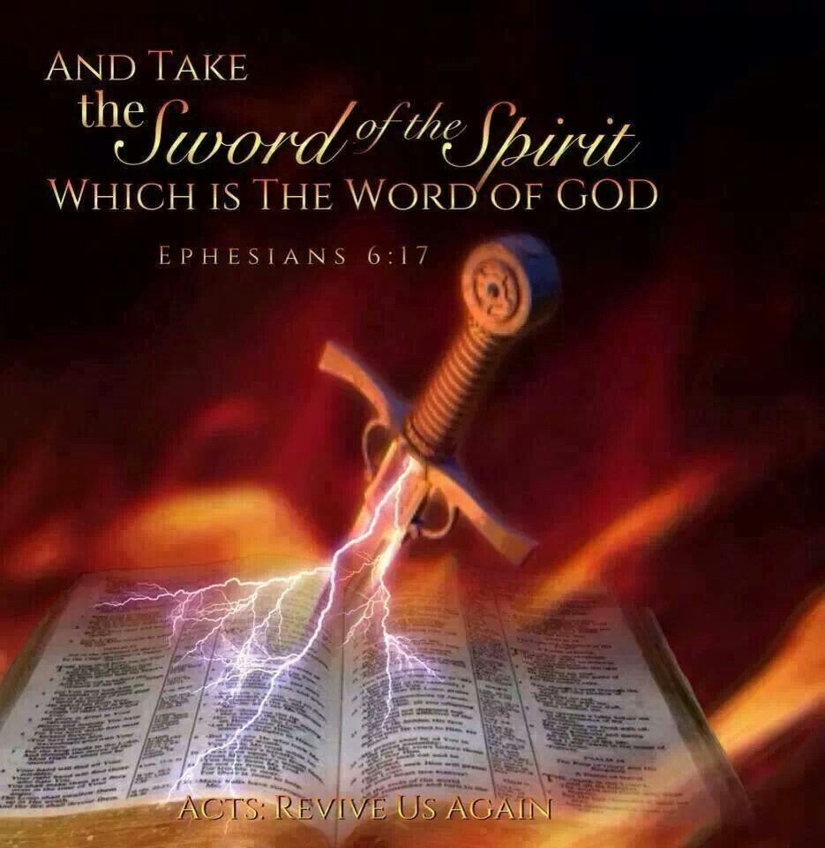
It’s God’s Spirit that directs His Word and His People to help shape and sharpen us into His Jewels.
Heb 4:12 “the word of God is quick, and powerful, and sharper than any twoedged sword,
piercing even to the dividing asunder of soul and spirit,
and is a discerner of the thoughts and intents of the heart.”

Slide 25
It’s God’s Spirit that directs His Word and His People to help shape and sharpen us into His Jewels.
2 Cor 3:2,3 “Ye are our epistle written in our hearts,
known and read of all men:
Forasmuch as ye are manifestly declared to be the epistle of Christ ministered by us, written not with ink,
but with the Spirit of the living God;
not in tables of stone, but in fleshy tables of the heart.

Slide 26
2 Cor 3:4-6 “Such trust have we through Christ to God. Not that we are sufficient of ourselves
to think any thing as of ourselves;
but our sufficiency (hikanot’es: ability) is of God;
Who also hath made us able ministers of the new testament; not of the letter, but of the Spirit:
for the letter killeth,
but the Spirit giveth life.”

Slide 27
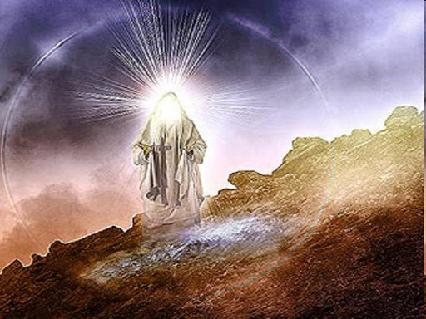
In 2 Cor. 3:7-16 God uses Moses and the OT Jews as an example of how the Law, without God’s Spirit and an open (willing) heart, produces a rigid, blinded, self righteousness.
2 Cor 3:15-16 “But even unto this day, when Moses is read, the vail is upon their heart.
Nevertheless when it (their heart) shall turn to the Lord,
the vail shall be taken away.”

Slide 28
2 Cor. 3:17,18 “Now the Lord is that Spirit:
and where the Spirit of the Lord is, there is liberty.
But we all, with open face beholding as in a glass
the glory of the Lord are changed
(Metamorphoō: transformed) into the same image
{“Conformed to the image of His son” Ro 8:29}
from glory to glory,
even as by the Spirit of the Lord.”

Slide 29
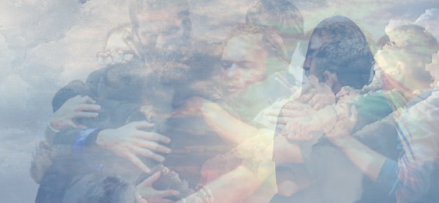
Hebrews 12:1
“Wherefore seeing we also are compassed about with so great a cloud of witnesses,
let us lay aside every weight,
and the sin which doth so easily beset us,
and let us run with patience the race
that is set before us,

Slide 30
“Looking unto Jesus, the author
and finisher of our faith”
Heb 12:2

Slide 31
Has Satan side-tracked from the
“race set before you”? (Heb. 12:2)
If so, Confess, Repent, and Return to God’s
Process, Path and Plan! (1 Jn 1:7-10)
Rev 2:5 “Remember from whence thou art fallen,
and repent, and do the first works; (God’s will)
or else I will come unto thee quickly, and will remove thy candlestick out of his place, except thou repent.”

Slide 32
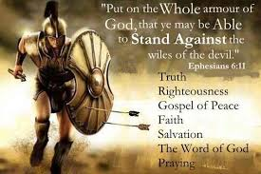
Are you willing to let God and His people (through discipleship) re-direct and Shape you for His Service by learning how to:
Get prepared for the inevitable spiritual battle?
(2 Tim. 2:1-4; Eph. 6:10-18)
Make and use your own
“shield of Faith” (Eph. 6:16)
Get a grip on the
“Sword of the Spirit?” Vs 17

Slide 33
2 Tim. 2:1-3 “Thou therefore, my son,
be strong in the grace that is in Christ Jesus.
And the things that thou hast heard of me…
the same commit thou to faithful men,
who shall be able to teach others also.
Thou therefore endure hardness, as a good soldier”
Who will you allow to help you in this process?
Who will you help in this process? (Jms 5:19,20)

