Slide 1
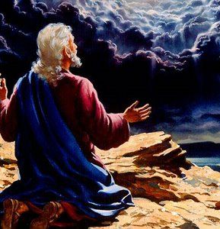
Revelation is about God’s perspective of final events.
It opens and closes with Prayer. Rev 1:10
“I was in the Spirit on the Lord’s day”

Slide 2
Rev. 4:1 “…come up hither and I will show thee things which must be hereafter”

Slide 3
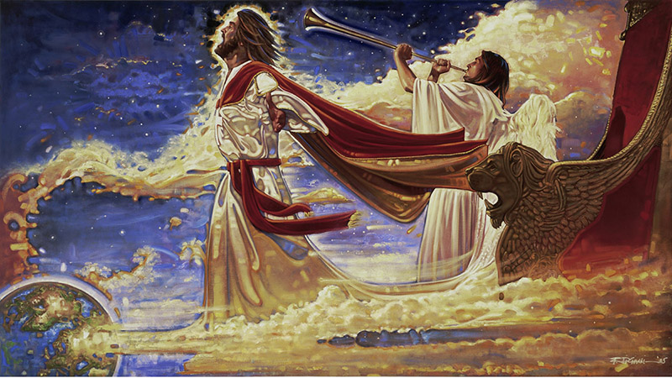
“Surely
I come quickly”
Ron DiCianni
“Even so come, Lord Jesus!”
“The grace of our Lord Jesus Christ be with you all. Amen.” Rev. 22:20,21

Slide 4
Prayer is foundational to understanding God’s Perspective!
“Seek the Lord while He may be found,
call upon him….
for my ways are not your ways saith the LORD…”
Isaiah 55:6-8

Slide 5
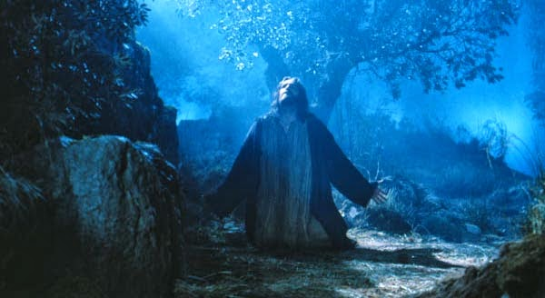
“As he was praying in a certain place, when he ceased…his disciples said…
Lord, teach us to pray.”
Luke 11:1-4

Slide 6
“Disciples” want to learn!
“his disciples said teach us…”
Μαθητής (mathētēs’) a pupil or learner.
Used 269 times in God’s word.
“Believer” (pisteu’o) only found 2 times!
(Acts 5:14 and 1 Tim. 4:12)
Are we really “Disciples” of Jesus?

Slide 7
“Disciples” need to pray!
“teach us to pray…”
Προσεύχομαι (proseu’chomai)
Pros: Toward
Euchomai: Seek God
Prayer involves a deliberate shift of focus toward God!

Slide 8
Transformational Praying
2 Cor 3:18 “But we all, with open face beholding as in a glass the glory of the Lord,
are changed (metamorphoō: Transformed)
into the same image from glory to glory,
even as by the Spirit of the Lord.”

Slide 9
Mt 6:9 “After this manner …pray ye:
“Our Father” Prayer is based on
a Relationship that’s Personal!
God is not everyone’s “Father”.
Jn 8:44 “Ye are of your father the devil,
and the lusts of your father ye will do.”
Jn 1:12 “as many as received him…become
the sons of God…which were born of God”

Slide 10
1. “Our Father” a personal Relationship:
Mt 7:9-11 “Or what man is there of you, whom if his son ask bread, will he give him a stone?
Or if he ask a fish, will he give him a serpent?
If ye then, being evil, know how to give good gifts unto your children, how much more shall your Father which is in heaven give good things…”
“Good” Agathos’: truly Beneficial
(Ro. 8:28; 2 Cor. 12:9)

Slide 11
1. “Our Father” a personal Relationship:
B. No Relationship➔ No Responsibility!
Matthew 7:21-23 “Not every one that saith unto me, Lord, Lord, shall enter into the kingdom of heaven;
Many will say to me in that day, Lord, Lord, have we not … in thy name done many wonderful works?
And then will I profess unto them,
I never knew you:
depart from me, ye that work iniquity.”

Slide 12
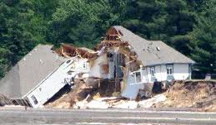
1. “Our Father” a personal Relationship:
B. No Relationship ➔ No Responsibility!
Immediately after this Jesus closed his message with the parable of the Wise and Foolish Builders.
“whosoever heareth…and doeth…” vs 24-27
Information without application will eventually produce Rejection & Destruction!
“Great was the fall of it” Vs 27

Slide 13
Transformational Prayer
Information (Truth)
+ Application (Trust)
= Transformation!

Slide 14
Mt 6:9 “After this manner …pray ye:
1. “Our Father” A Relationship that’s Personal!
2. “Which art in heaven”: Based on a
Perspective that’s eternal.
A. God has a broader perspective.
Ps. 116:15 “Precious in the eyes of the Lord
is the death of his saints”
Life looks different through “Heaven’s Eyes!”

Slide 15
1) Moses “chose rather to suffer affliction with the people of God…For he had respect unto the recompense of reward” Heb 10:25,266
“A single thread in a tapestry
though its color brightly shines,
Can never see its purpose
In the Pattern of the Grand Design.
Through Heaven's Eyes K-Ci & JoJo

Slide 16
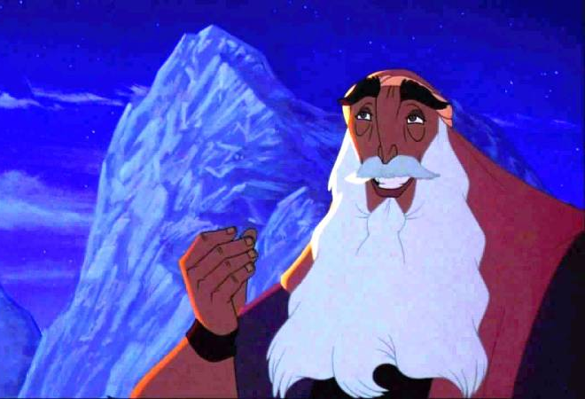
And the stone that sits up on the very top
of the mountain's mighty face;
Doesn’t think that it's more important
than the stones that forms the base.

Slide 17
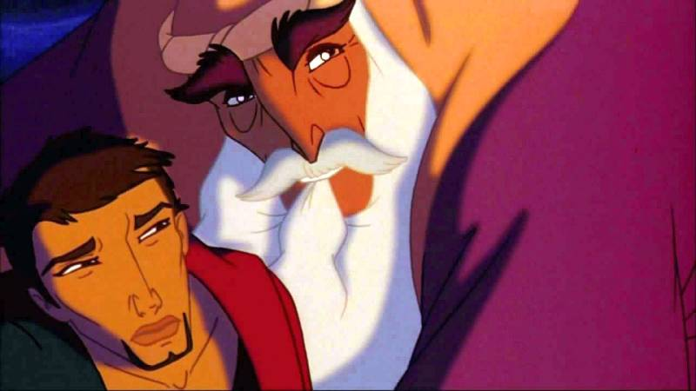
So how can you see what your life is worth
or where your value lies?
You can never see through the eyes of man;
you must look at your life…
through heaven's eyes!

Slide 18
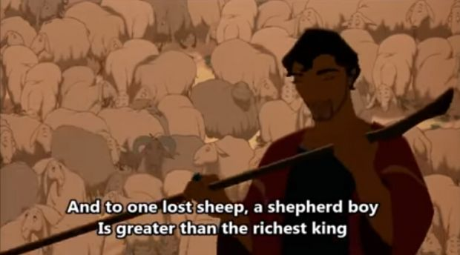
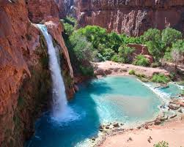
A lake of gold in the desert sand
is less than a cool fresh spring;
And to one lost sheep a shepherd boy
Is greater than the richest King.

Slide 19
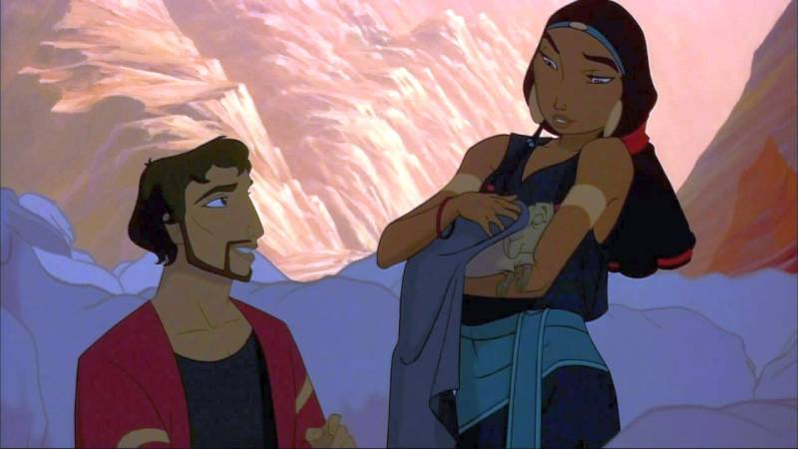
Should a man lose everything he owns
has he truly lost his worth?
Or is it the beginning
of a new and brighter birth?

Slide 20
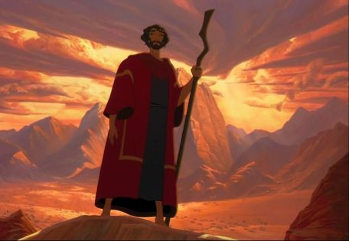
So how do you measure the worth of a man
in wealth or strength or size?
In how much he has gained or gave?
The answer will come to him who tries
to look at his life through heaven's eyes!

Slide 21
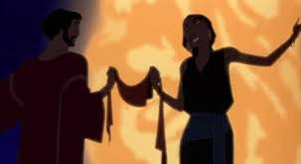
No life can escape being blown about
by the winds of change and chance;
and though you’ll never know all the steps
you must learn to join the dance!

Slide 22
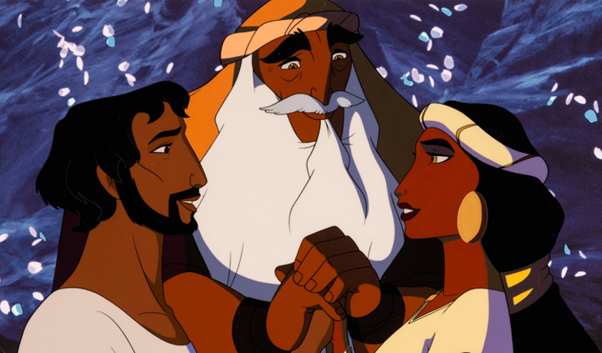
So how do you judge what a man is worth
By what he builds or buys?
You can never see with your eyes on earth
Look through Heaven's eyes!

Slide 23
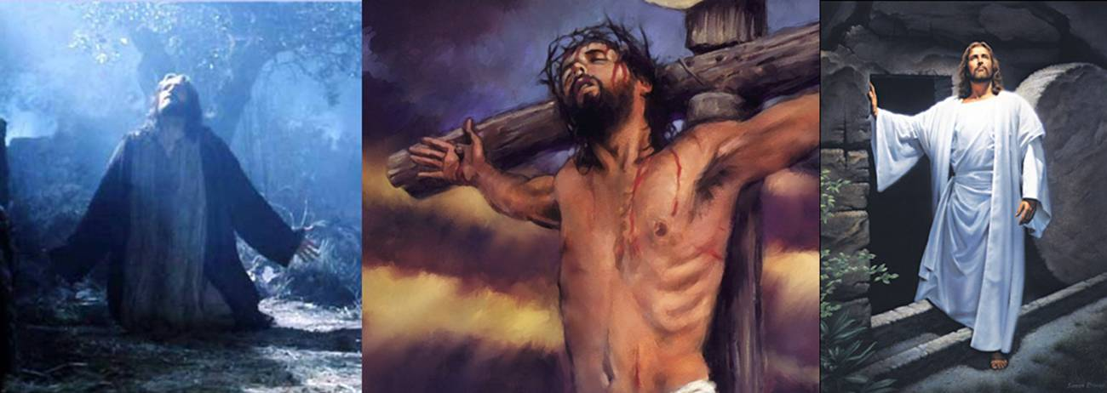
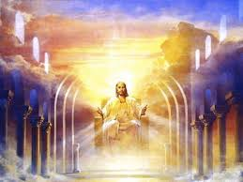
2. Based on a Perspective that’s eternal.
2) Jesus “for the joy set before him
endured the cross…” Heb. 12:1,2

Slide 24
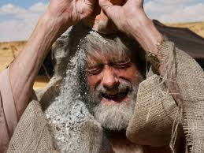
A. Life looks different when you see
through “Heaven’s Eyes!”
2) Jacob “Me have ye bereaved…
Joseph is not, and Simeon is not,
and ye will take Benjamin away:
“all these things are against me.”
(Gen. 42:36)

Slide 25
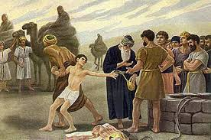
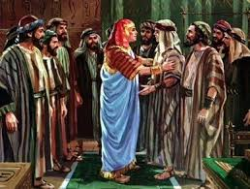
A. Life looks different when you see
through “Heaven’s Eyes!”
4) Joseph Gen 50:20 “ye thought evil
against me;
but God meant it unto good”

Slide 26
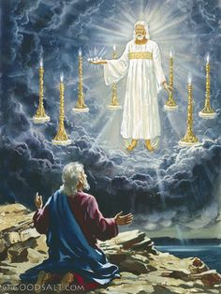
A. Life looks different when you see
through “Heaven’s Eyes!”
5) John was exiled on
Patmos for his witness.
It was here that Jesus met him and gave him the Revelation!

Slide 27
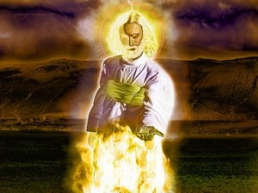
Rev. 10:10,11 “And I took the little book out of the angel's hand, and ate it up;
and it was in my mouth sweet as honey:…
as soon as I had eaten it, my belly was bitter.
And he said unto me,
Thou must prophesy again before many peoples, and nations, and tongues, and kings”
See also Ezekiel 3:2-4 and Jeremiah 15:16

Slide 28
Life involves both the sweet and bitter!
Paul knew a measure of both. 2 Cor. 12:7-9
“lest I should be exalted above measure,
there was given to me a thorn in the flesh,
the messenger of Satan…
For this thing I besought the Lord thrice,
that it might depart from me. And he said,
My grace is sufficient for thee:
for my strength is made perfect in weakness. ”

Slide 29
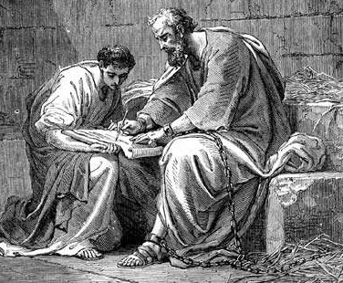
2 Cor 12:9-10 “…Most gladly therefore will I rather glory in my infirmities,
that the power of Christ may rest upon me.
Therefore I take pleasure in infirmities, in reproaches, in necessities, in persecutions,
in distresses for Christ's sake:
for when I am weak,
then am I strong.”

Slide 30
God uses both the sweet as well as the bitter to “season” (prepare) us.
Ro 8:18 “For I reckon that the sufferings of this present time are not worthy to be compared with the glory which shall be revealed in us.
28 For we know that all things work together for good to them that love God, to them who are the called according to his purpose.
29 …to be conformed to the image of his Son”

Slide 31
God’s trying to transform us through a prayerful process that requires:
Faith in a personal relationship!
“our Father”
Jn 1:12; Ro. 5:1; Heb. 11:6

Slide 32
God’s trying to transform us through a prayerful process that requires:
Focus on God’s eternal perspective.
“which art in heaven”
2 Cor. 3:18; 4:4-6; Ro. 8:28,29

Slide 33
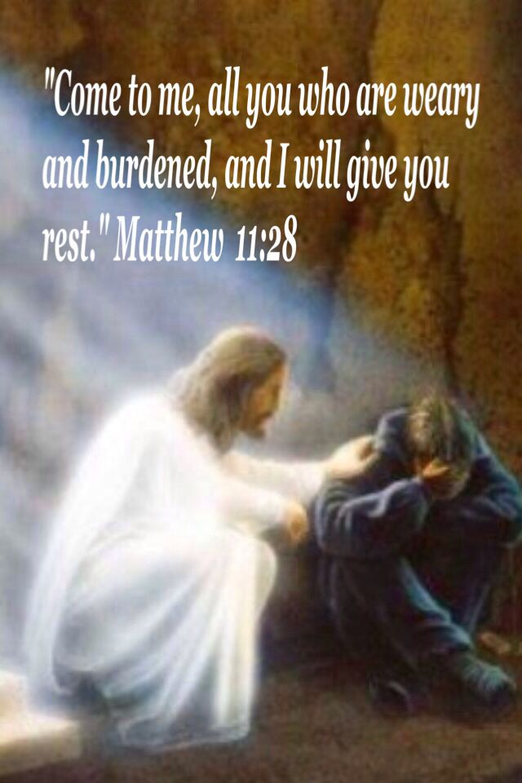
Which are you struggling with?
Faith?
Focus?

