Slide 1
Prayer is foundational to understanding God’s Perspective!
“Seek the Lord while He may be found,
call upon him….
for my ways are not your ways saith the LORD…”
Isaiah 55:6-8

Slide 2
It’s one of the most misunderstood,
And therefore “missed”
disciplines of “Disciples”.

Slide 3
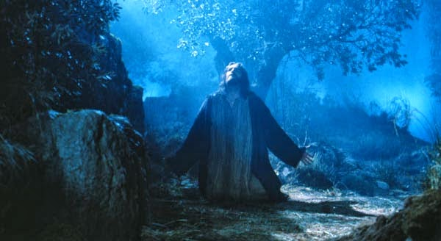
“As he was praying in a certain place, when he ceased…his disciples said…
Lord, teach us to pray.”
Luke 11:1-4

Slide 4
Mt. 6:9 “After this manner pray:”
“Our Father”
Based on a Personal Relationship.
2. “which art In heaven”:
Based on an Eternal Perspective.

Slide 5
Mt. 6:9 “After this manner pray:”
“Hallowed by thy name”
Based on an awareness that’s
“awe-ful”! (filled with Awe)
hagiaz’ō: Sanctified, Venerated, Holy.
Not something to be avoided,
but anticipated!
Not troubling,
but Transforming!

Slide 6
Mt. 6:9 “After this manner pray:”
4. “Thy Kingdom Come”
There are 3 basic dimensions for a “Kingdom” (Basilei’a)
Royalty, Realm, Rule(s)
Without each of these you end up with chaos and confusion.

Slide 7
Dimensions of Basilei’a (Kingdom)
A. Royalty: from basileus’: Sovereign King
➔from bas’is: foundation of power.
There’s Ultimately only 2 “Kings”:
1) Satan: The natural (default) choice!
(1 Cor. 2:14; Eph. 2:1-7)
a) “The prince of this world” (Jn 12:41; 14:30; 16:11)

Slide 8
1) Satan
b) “the god of this world” (2Cor 4:4)
c)“the prince of the power of the air,
the spirit that now worketh in the children of disobedience:” (Eph 2:2)

Slide 9
2) Jesus, who is the:
a) Great King Ps. 95:3 “the LORD is
a great King above all gods.”
b) Glorious King. Ps. 24:10 “The Lord
of hosts, he is the King of glory.”
c) Gracious King. Heb. 4:16 “Let us
come boldly unto the throne of Grace”
d) “The King of Kings” Rev. 19:16

Slide 10
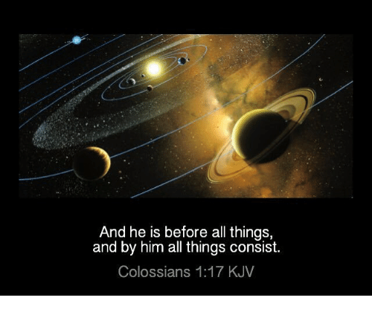
Col 1:16-18 “by him were all things created, that are in heaven, and that are in earth, visible and invisible,
whether they be thrones, or dominions,
or principalities, or powers:
all things were created by him,
and for him:
synista’ō: Set and stay together.

Slide 11
Col 1:18 “And he is the head of the body, the church: who is the beginning,
the firstborn from the dead;
that in all things he might have
the preeminence!”
Prōteu’ō: Be first in rank and influence!
“No man can serve two masters” Mt. 6:24

Slide 12
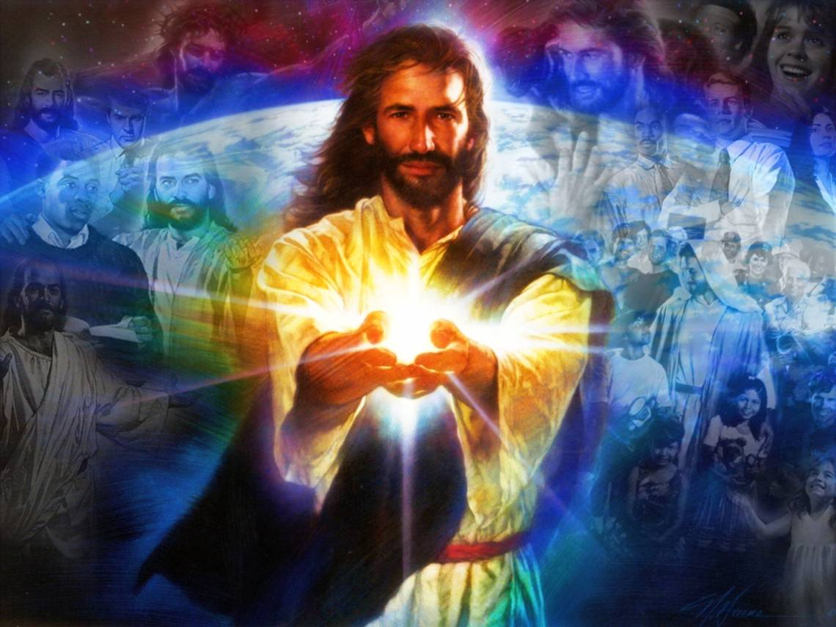
2) There’s Ultimately only two “Kings”
Who’s your “King”?

Slide 13
Dimensions of Basilei’a: A. Royalty
B. Realm: Region, sphere or domain in
which someone/thing prevails or dominates.
There’s ultimately only 2 “Realms”.
1) The Kingdom (Realm) of Darkness
Col. 1:13 “Who hath delivered (rescued) us from the power (exousia: influence/control)
of darkness, (obscurity)

Slide 14
2) The Kingdom (Realm) of Light
Col. 1:13 “Who hath delivered us from the power of darkness, and hath
translated us (metis’tēmi: Deposited)
into the kingdom of his dear Son:
14 In whom we have redemption through his blood, even the forgiveness of sins:”

Slide 15
a)Paul described this as his calling to Agrippa:
Acts 26:16,18 “I have appeared to thee… for this
…to make thee a minister and a witness…
To open their eyes, and to turn them from darkness to light,
and from the power of Satan unto God,
that they may receive forgiveness of sins,
and inheritance among them which are sanctified by faith that is in me. “

Slide 16
B. Realm: Region, sphere or domain in
which someone/thing prevails or dominates.
There’s ultimately only 2 “Realms”.
1) The Kingdom (Realm) of Light:
2) The Kingdom (Realm) of Darkness.
Which Kingdom “prevails”
in your life?

Slide 17
4. “Thy Kingdom Come”
“Kingdom” βασιλεία (Basilei’a) involves
A. Royalty B. Realm
C. Rules: (Laws governing its citizens)
“a set of explicit or understood regulations or principles governing conduct within a particular activity or sphere.”
Senate “Rules” are an oxymoron!

Slide 18
C. Rule: “The Laws of the ‘Kingdom’”
Ultimately there’s 2 “Royals”, 2 “Realms”,
and 2 sets of “Rules.”
1) Rule of “self”. Jdg 21:25
“In those days there was no king …
every man did that which
was right in his own eyes.”

Slide 19
Rule of “self”.
a)“Self” rule is ultimately the rules of Satan!
Gen. 3:5 “Your eyes shall be open, you shall be as gods, knowing good and evil.
Knowing: yada
Recognizing,
Determining,
Declaring)

Slide 20
b) “Self” rule is ultimately short-sighted!
Pr. 14:12; 16:25 “There is a way that seems
right unto a man, but the end thereof
are the ways of death”
Mt. 7:13 “Wide is the gate and broad is the way that leads to destruction,
and many there be which go thereat.”

Slide 21
C. Rule: Ultimately 2 sets of “Rules.”
2) God’s “rules”! Lk 6:46 “why call me Lord,
and do not the things which I say?”
a) Are good for us. Lk 6:47-49 The parable of the wise and foolish men!
What was the difference?
“cometh to me and heareth my sayings
and doeth them” Vs. 47

Slide 22
Deut. 10:12,13 “what doth the LORD thy God require of thee, but to fear the LORD thy God, to walk in all his ways, and to love him,
and to serve the LORD thy God with all thy heart and with all thy soul,
To keep the commandments of the LORD, and his statutes, which I command thee this day
for thy good!”

Slide 23
2) God’s “rules”!
b) Related to the quality of our relationship.
Jn 14:15 “If you love me, keep my commands”
1 Jn 5:2-3 “By this we know that we love the children of God, when we love God, and keep his commandments. For this is the love of God,
that we keep his commandments:
and his commandments are not grievous.”
barys’: a heavy burden.

Slide 24
2) God’s “rules”!
a) Good for us.
b) Related to the quality of our relationship.
c) Related to our calling. Titus 2:14
“Christ…gave himself for us, that he might redeem us from all iniquity, and purify unto himself a peculiar people,
zealous of good works.”

Slide 25
2) God’s “rules”!
c) Related to our calling. Eph. 2:10
“For we are his workmanship,
created in Christ Jesus unto good works,
(agathos ergon: practical, beneficial effort.)
which God hath before ordained that we should walk in them.”

Slide 26
Jos 24:15 “choose this day who ye will serve.”
This is ultimately a choice between
Two “Royals” (Satan or Christ)
Two “Realms” (Darkness or Light)
Two “Rules” (Your own or Christ’s)
Not to choose, is to choose!
Lk 11:23 “He that is not with me is against me:
and he that gathereth not with me scattereth.”

Slide 27
Many spend their lives torn between two “kingdoms”.
Phil. 3:18,19 “Many walk…
Whose end is destruction, (Waste)
whose god is their belly, (Wrong Royal)
Whose glory is their shame,(Wrong Realm)
who mind earthly things.” (Wrong Rules)
James 1:8 “a double minded man…”

Slide 28
For those who choose wisely:
Ph 3:20 “our conversation is in heaven;
polit’euma: Citizenship, community!
from whence also we look for the Savior, the Lord Jesus Christ”

Slide 29
Jesus told the parable of Luke 19:11-27 because:
“they thought that the kingdom of God should immediately appear. He said, A certain nobleman went into a far country to receive for himself a kingdom,
And he called his servants, and delivered them ten pounds, and said,
Occupy till I come.”
and to return!.

Slide 30
“Occupy till I come.”
Πραγματεύομαι (pragmateu’omai)
“Busy yourselves with Trade!”
What are you “trading”
to prepare for
the Kingdom of God?

Slide 31
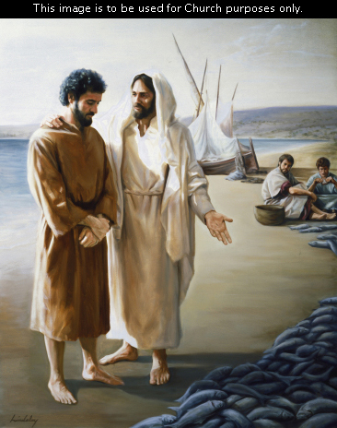
3 times Jesus asked Peter
“lovest thou me
more than these?“ John 21:15,16,17

Slide 32
“Occupy till I come.”
What are you “trading”
to prepare for
the Kingdom of God?

