Slide 1
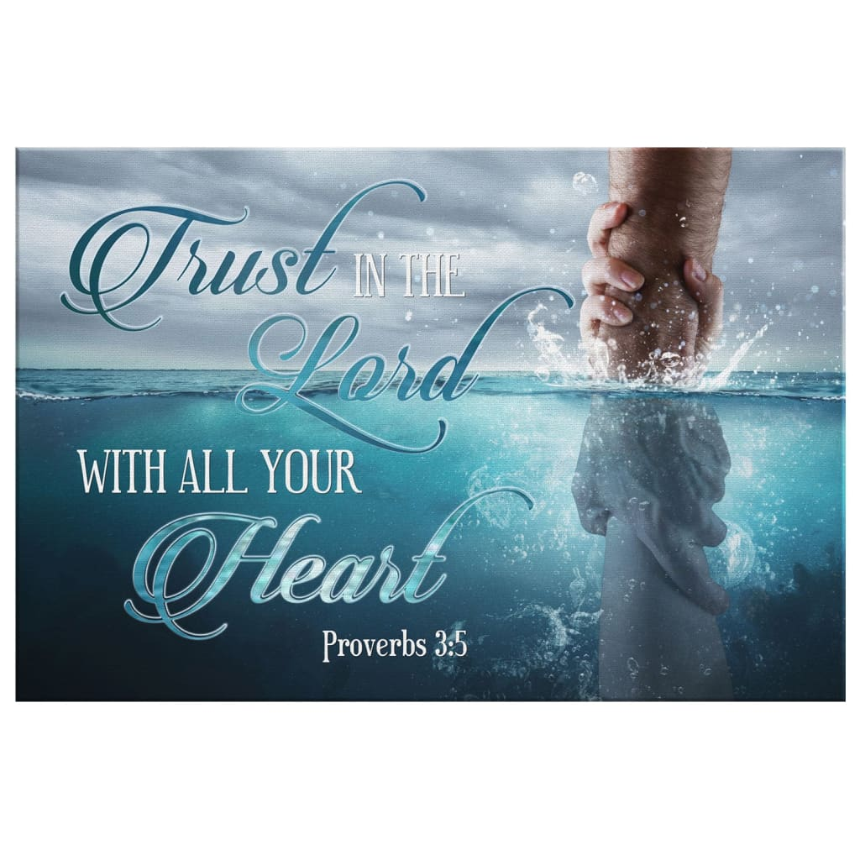
The TRUST Test

Slide 2
Last week we began a series on the importance of Trust and its effect on all of our relationships. Proverbs 3:5-10 provide some clear principles on how to cultivate our Trust (Faith) in God.
T: Take Personal Inventory. Pr 3:5
“Trust (bāṭaḥ: put confidence) in the LORD
with all thine heart,
and lean not unto thine
own understanding.”

Slide 3
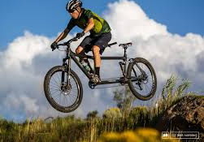
T: Take Personal Inventory. Pr 3:5
“Trust in the LORD with all thine heart,
and lean not unto thine own understanding.”
This allows us to determine the real
source of our faith. (Luke 6:43-49)
(Aka: Who’s in the driver’s seat?)

Slide 4
T: Take Personal Inventory. Pr 3:5
Once we realize that the source and/or magnitude of our trust is misplaced,
we can be open for more reliable sources.
(Isaiah 41:28-31)
That’s when we are better able to:
R: Recognize God. Pr. 3:6 “In all thy ways acknowledge (yada: recognize, perceive, know) Him,
and He shall direct thy paths.”

Slide 5
We’re forgetful, pendulum people. (James 1:8)
Dt 8:1,2 “All the commandments which I command thee this day shall ye observe to do, that ye may live,
and multiply, and go in and possess the land
which the LORD sware unto your fathers.
And thou shalt remember (zâkar: to mark, recognize)
all the way which the LORD thy God led thee
these forty years in the wilderness,
to humble thee, and to prove thee,
whether thou wouldest keep (shamar: preserve, treasure, guard) his commandments, or no.”

Slide 6
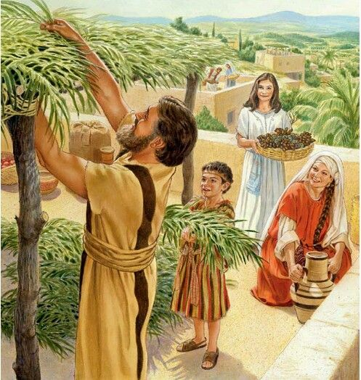
In order to help them facilitate this,
God commanded Israel to observe the
Feast of Tabernacles (Sukkot) each Fall.
(See Lev. 23:39-43; Deut. 16:9-17 )
”Ye shall dwell in booths seven days” Lev 23:42
(sukâ {sukkot}: tent, thicket)

Slide 7
Lev.23:39-42 “Ye shall keep a feast to the LORD seven days.. It shall be a statute for ever in your generations:
ye shall celebrate it in the seventh month. (Sept/Oct)
Ye shall dwell in booths seven days;
That your generations may know that I made the children of Israel to dwell in booths,
when I brought them out of the land of Egypt:
I am the LORD your God.”
This was their version of our Thanksgiving!

Slide 8
This was not to be just a time of celebration,
but of recognition and recalibration,
so that future generations would remember God’s Providence, Protection, & Provision. Ps 78:1-8
“Give ear, O my people, to my law:
incline your ears to the words of my mouth.
I will open my mouth in a parable:
I will utter dark sayings of old:
Which we have heard and known,
and our fathers have told us.”

Slide 9
4 “We’ll not hide them from their children, shewing to the generation to come the praises of the LORD,
and his strength, and his wonderful works….
5 For he …appointed a law in Israel,
which he commanded our fathers, that they should make them known to their children:
6 That the generation to come might know them,
even the children which should be born;
who should arise and declare them
to their children:

Slide 10
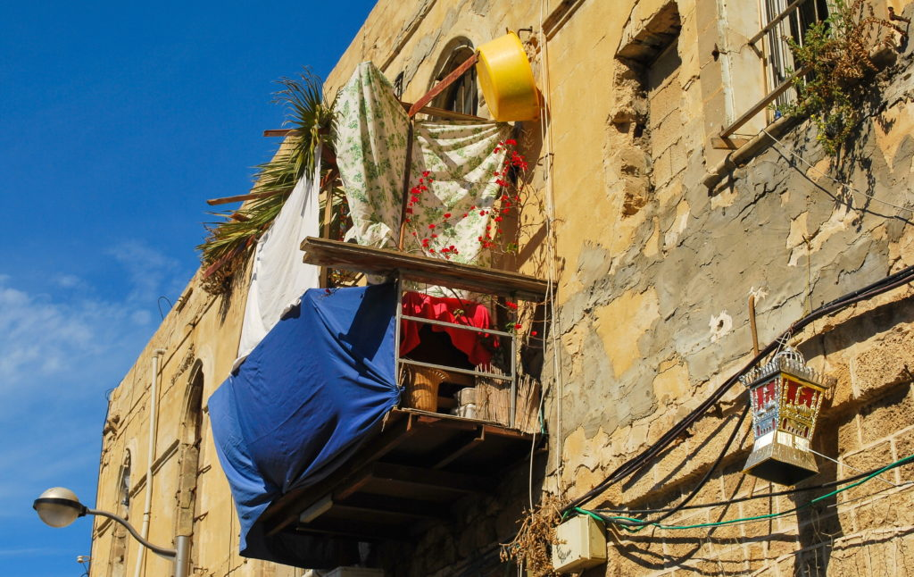
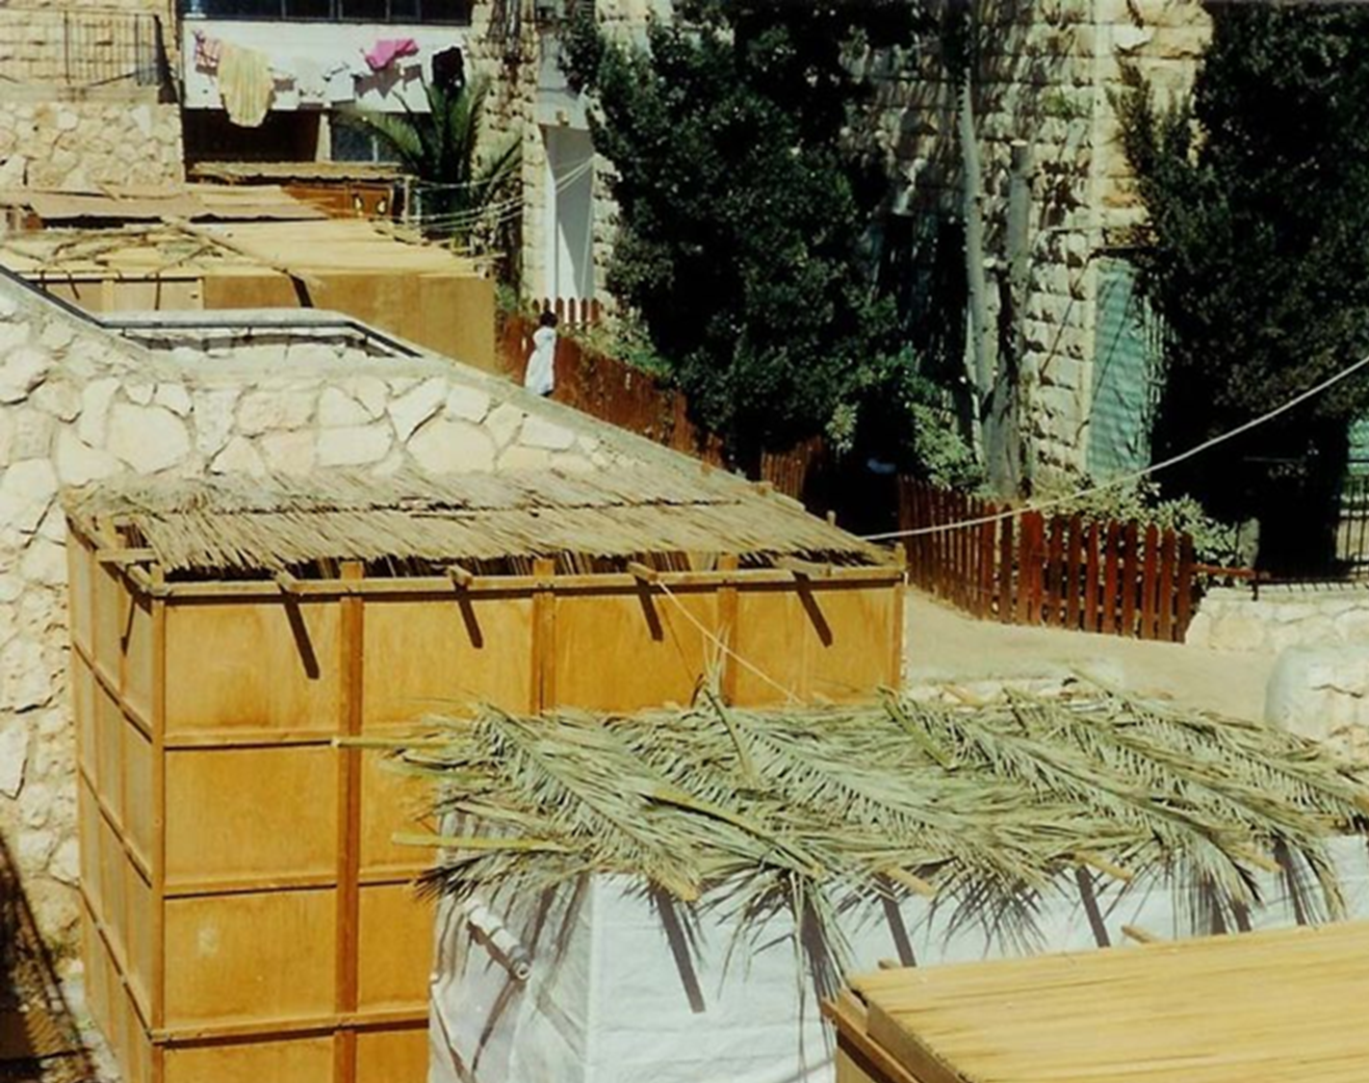
7 “That they might set their hope in God,
and not forget the works of God,
but keep his commandments:”

Slide 11
Deut. 8:2 “thou shalt remember all the way which the LORD thy God led thee…
3 How He humbled thee, and suffered thee to hunger, and fed thee with manna…”
Why remember the Hard and Humbling times?
“…that he might make thee know that man doth not live by bread only, but by every word that proceedeth out of the mouth of the LORD
doth man live.” (Ḥāyâ: sustained)
(See also Mt 4:4)

Slide 12
Deut. 8:2 “thou shalt remember all the way which the LORD thy God led thee…
During winter of 1620-21, food was so scarce that the daily ration of corn was only 5 kernels.

Slide 13
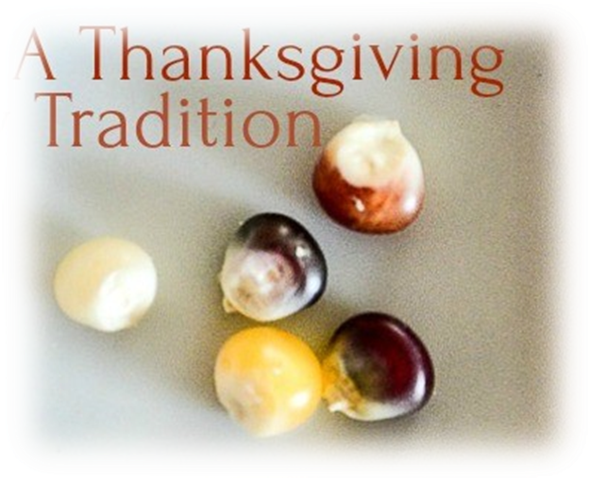
5 Kernels of Remembrance/Recognition:
GOD’S POWER Jer 32:27 “I am the LORD,
is there any thing too hard for me?”
What’s your answer to God’s Question?
A. The PAST: Deut. 8:2 “Remember all the way which
the LORD thy God led thee…”
1) Israel and Ebenezer (1 Sam. 7:12)
1 Sam. 4:3 “fetch the Ark…that it may save us”
They lost both the battle and the Ark!
1 Sam. 7:7 “cry unto the LORD, that He will save us.”
(1 Cor 10:11)

Slide 14
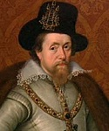
1. GOD’S POWER
A. The PAST: Deut. 8:2
B. The Pilgrims 1) They knew there was A Greater
King Than James!
2) They trusted God to take care of them. Heb. 11:13
“confessed they were strangers and pilgrims”
1 Peter 5:7 “Casting all your care upon him;
for he careth for you.”

Slide 15
C. The Present: “I am the LORD, I change not” Mal. 3:6
God’s Power Is Still Available To Us!
Eph. 3:20,21 “Now unto him that is able to do exceeding abundantly above all that we ask or think,
according to the power that worketh in us.
Unto Him be glory in the church by Jesus Christ
…throughout all ages.”
Phil. 4:13 “I can do all things through Christ
which strengtheneth me.”

Slide 16
GOD’S PROVIDENCE
A. The Past: Deut. 8:4,16 “Thy raiment waxed not
old…who led thee through this wilderness…who fed thee…
lest thou say my power…hath gotten me this wealth”
1 Samuel 7:12 “Then Samuel took a stone…and called
the name of it Ebenezer, saying,
Hitherto hath the LORD helped us.”
B. THE PILGRIMS:
1) “Miraculous” coincidences that guided them.

Slide 17
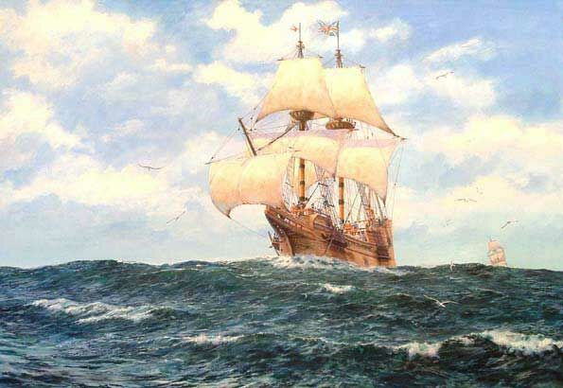
They originally chartered two ships.
The Speedwell began to take on water a few days out of port and they were required to return and “cram” 134 people on the Mayflower.

Slide 18
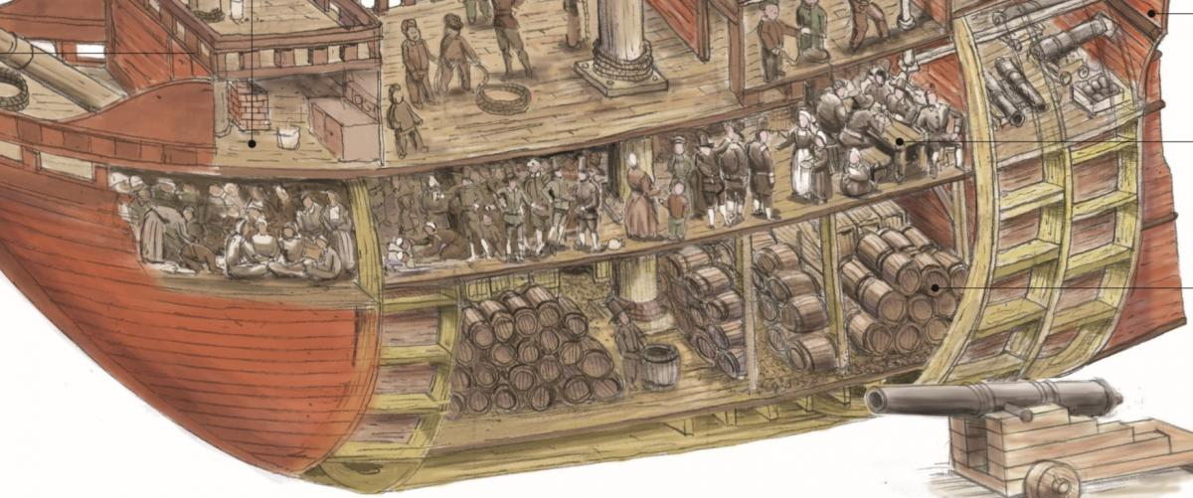
1) 102 passengers (32 crew) spent 66 days.
The living space for the passengers was about 1000 ft2
The ceiling on the tween deck was only about 5'6" high

Slide 19
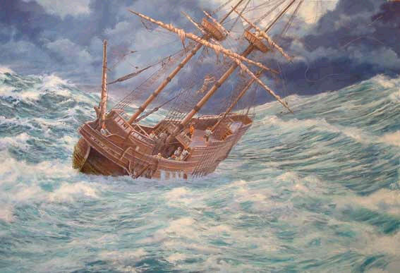
2. God’s Providence: Exodus 19:4
“..and met with many fierce storms, with which the ship was soundly shaken, and her upper works made very leaky; and one of the main beams in the mid ships was bowed and cracked, which put them in some fear that the ship could not be able to perform the voyage.
In sundry of these storms the winds were so fierce, and the seas so high, as they could not bear a knot of sail, but were forced to hull, for divers days together.”
William Bradford “Of Plymouth Plantation”

Slide 20
2. God’s Providence: Exodus 19:4
These storms blew them off course and led them to Plymouth Bay, Mass. Instead of Jamestown, Virginia.

Slide 21
When they couldn’t get to Jamestown, they drew up the “Mayflower Compact”.
“In the name of God, Amen….
Having undertaken for ye glory of God and advancement of ye Christian faith…”

Slide 22
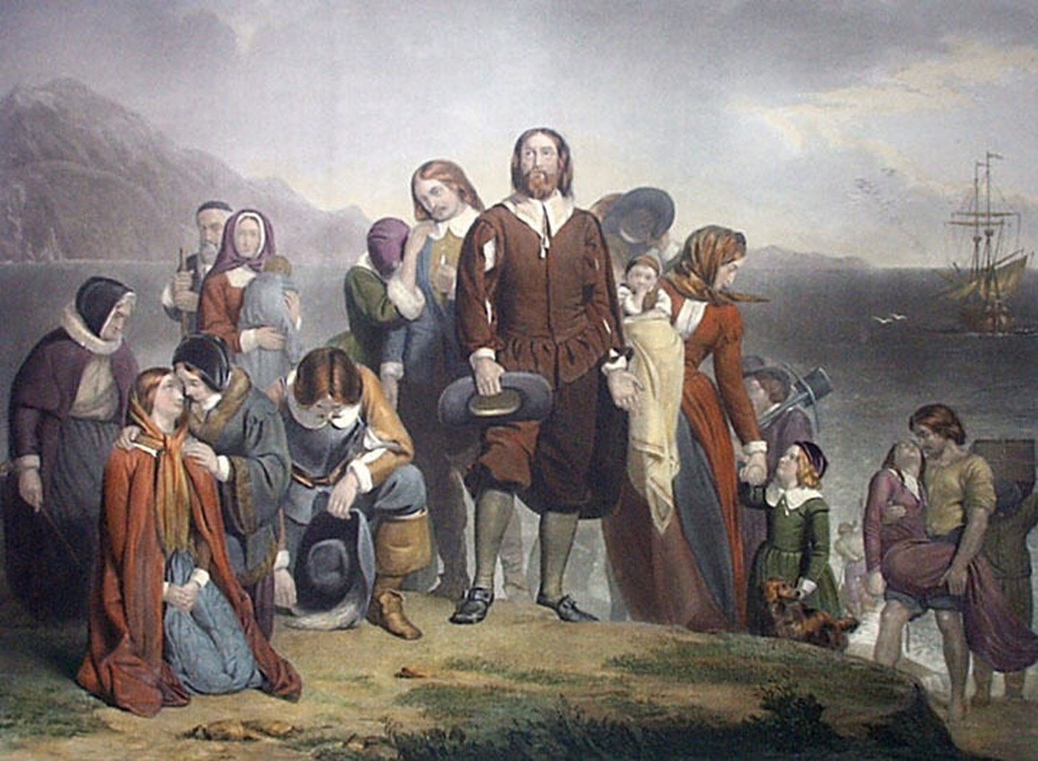
The first thing they did upon landing was to pray and thank God!
“Being thus arrived in a good harbor, and brought safe to land, they fell upon their knees and blessed the God of Heaven who brought them over the vast and furious ocean, and delivered them from all the perils and miseries thereof, again to set their feet on the firm and stable earth, their proper element”

Slide 23
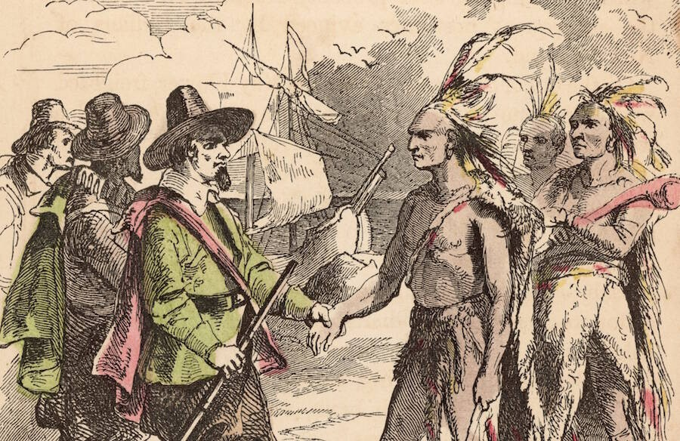
God had miraculously removed the hostile Indians from the area and provided two “ENGLISH” speaking Indians (Samoset and Squanto) to be their guides and interpreters.
They helped broker peace with Chief Massasoit and the Wampanoag Indians

Slide 24
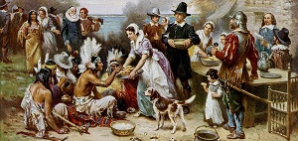
1621: The local Wampanoag tribe, with Squanto and Samoset’s support, helped provide a supply of food to sustain them through the next winter.
Fall: Bradford declared a feast and invited the Indians.
Chief Massasoit showed up with 90 Indians.

Slide 25
“Thou shalt remember all the way…”
C. God’s Providential care is still at work!
Ps. 68:19 “Blessed be the Lord, who daily loadeth us with benefits, even the God of our salvation.”
Mt. 6:33 “But seek ye first the kingdom of God, and his righteousness; and all these things shall be added you.”
Phil. 4:19 “My God shall supply all your need according to His riches in glory by Christ Jesus.”

Slide 26
Recognize: God’s Power…Providence
3. GOD’S PROVISION
A. THE PAST: Israel Deut. 8:
7 “The LORD bringeth thee into a good land…
10 When thou hast eaten and art full, then thou shalt bless the LORD thy God for the good land which he hath given thee.
11 Beware that thou forget not the LORD thy God,
in not keeping his commandments, …
12 Lest when thou hast eaten and art full, and hast built goodly houses, and dwelt therein…
14 thy heart be lifted up and thou forget thy God…”

Slide 27
Recognize: God’s Power…Providence
3. GOD’S PROVISION
A. THE PAST: Deut. 8:3,4, 7-10
B. THE PILGRIMS:
1) The Adventurers “Funded” the trip.
2) A plague had removed the warring tribes.
3) The supplies of corn that the Pilgrims found.
4) God provided English Speaking Indians!
5) Repeated miraculous interventions/provisions.

Slide 28
C. The Present. Lincoln Proclamation 97, March 30, 1863
“We have been the recipients of the choicest bounties of Heaven; we have been preserved these many years in peace and prosperity; we have grown in numbers, wealth, and power as no other nation has ever grown. But we have forgotten God.
We have forgotten the gracious hand which preserved us …and we have vainly imagined, in the deceitfulness of our hearts, that all these blessings were produced by some superior wisdom and virtue of our own. “
Reaffirmed by House Resolution 597 Sept 27,2000

Slide 29
Recognize God’s Power, Providence, Provision…
GOD’S PRESENCE:
Ps. 139:7 “Whither shall I go from thy Spirit…
or… flee from thy presence?”
A. THE PAST: Deut. 8:2 “remember all the way
which the LORD thy God led thee”
8:15 “Who led thee through that great wilderness”
B. THE PILGRIMS… Recognized God’s hand,
even in the “trials and storms.” Ro 8:28

Slide 30
George
Keith
1787
How firm a foundation you saints of the Lord,
is laid for your faith in his excellent Word!
What more can he say than to you he has said,
to you who for refuge to Jesus have fled?
Fear not, I am with you, O be not dismayed,
for I am your God, and will still give you aid;
I'll strengthen you, help you, and cause you to stand,
upheld by my righteous, omnipotent hand.
When through fiery trials your pathway shall lie,
my grace all-sufficient shall be your supply;
the flame shall not hurt you; I only design
your dross to consume and your gold to refine.

Slide 31
GOD’S PRESENCE: Ps. 139:7
C. THE PRESENT:
1) This is a key ingredient in the fear of the Lord.
Pr.16:6 “by the fear of the LORD men depart from evil.”
Pr. 15:3 “The eyes of the LORD are in every place,
beholding the evil and the good.”
2) Does This Truth Bring Comfort Or Concern?
Heb. 4:13 “all things are naked and opened unto the eyes
of him with whom we have to do. “
Heb. 13:5 “be content with such things as ye have:
for …I will never leave thee, nor forsake thee.”

Slide 32
God’s Power, Providence, Provision, Presence
5. GOD’S PEACE:
A. PAST: Deut. 8:7-10 “The LORD bringeth thee into a good land…bread without scarceness,
thou shalt not lack any thing…
B. PILGRIMS:
Jamestown was originally settled for profit.
Plymouth was originally settled for Peace.
If your focus is on profit, you may forfeit peace in the process. (See 1 Tim. 6:9-11)
then bless the LORD.”

Slide 33
C. THE PRESENT:
1) Peace With God is a bi-product of our FAITH.
Ro. 5:1 “Being justified by faith we have peace
with God through our Lord Jesus Christ.”
2) The Peace of God is a bi-product of our FOCUS.
Phil 4:6,7 “Be careful for nothing; but in every thing
by prayer and supplication with thanksgiving let
your requests be made known unto God.
And the peace of God which passeth understanding,
shall keep your hearts and minds through Christ”

Slide 34
2004 journal entry after a restless night with Mary.
“This last Tuesday, Mary and Michael had a restless night. Linda had the first watch, but at around 2:30 they were at it again. I finally got Michael settled, but Mary continued to cry.
As long as I was standing beside her bed watching her or touching her, she was OK. She would look up at me every few moments to make sure I was watching her. If I tried to leave the room or even “sit down” to rest, she would start crying.
It occurred to me that, at least to her, I reflect many of the attributes that I recognize are so perfectly fulfilled in my “Heavenly Father.”

Slide 35
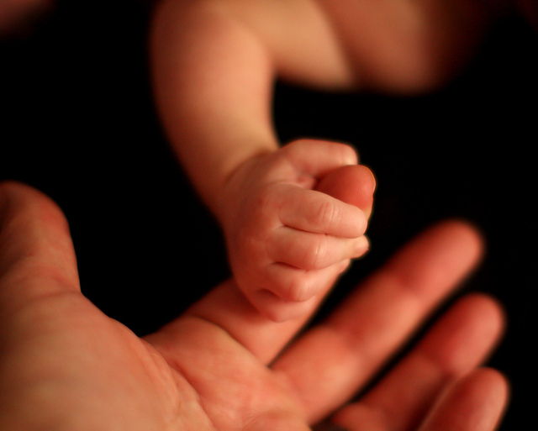
POWER:
PROVIDENCE:
PRESENCE:
PROVISION:
PEACE:
As long as Dad is watching, no “monster”
can get me.
Dad takes care of a whole host of
things that Mary doesn’t even realize.
As long as I was “on watch” she was able
to rest.
She can rest in the knowledge that her Dad
will take care of her.

Slide 36
I realize that I am a poor reflection of these attributes, and as our kids get older,
they recognize that also.
But a poor reflection is a reflection nevertheless.
God is not limited by our own human weaknesses or weariness.
Would to God that I can learn to trust him
with such a child-like faith.”

Slide 37
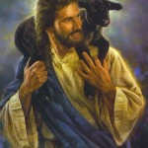
“The Lord is my shepherd, I shall not want”
(Lack) His Power, Provision, Providential care, Presence or Peace
Will you: “In all thy ways
acknowledge him”
Allowing Him to truly:
“Direct thy steps.”
Pr 3:6
Ps 23

Slide 38
Heb. 11:13 “These all died in faith, not having received the promises, but having seen them afar off, and were persuaded of them, and embraced them,
and confessed that they were strangers and pilgrims on the earth.
14 “For they that say such things declare plainly
that they seek a country”

Slide 39
Heb. 11:15 “And truly, if they had been mindful of that country from whence they came out,
they might have had opportunity to have returned.
But now they desire a better country, that is, an heavenly:
16 wherefore God is not ashamed
to be called their God:
for he hath prepared for them a city.”
(See Jn 14:2; Rev 21,22)

