Slide 1
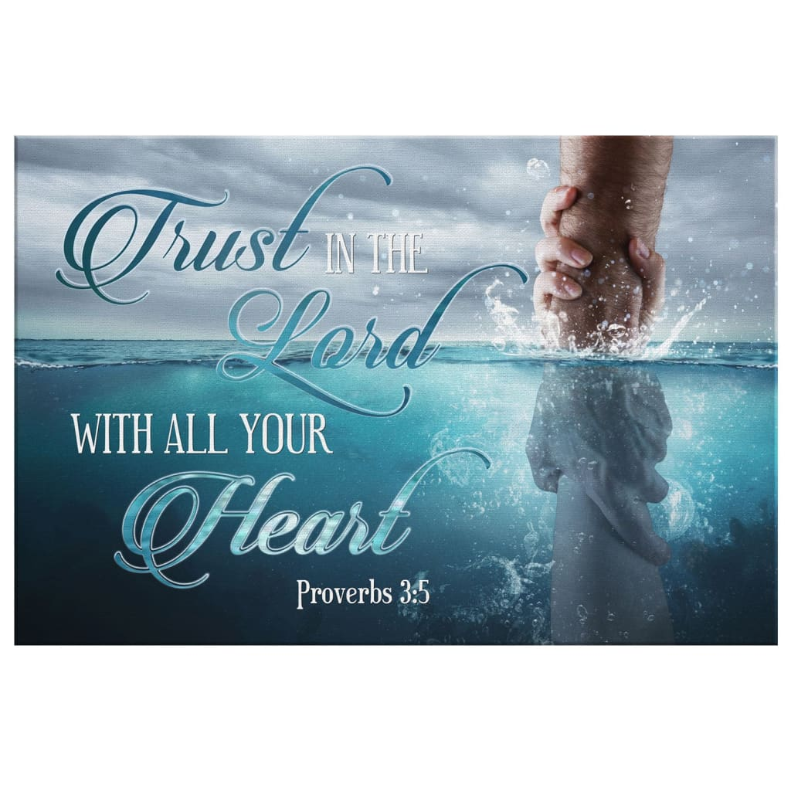
The Trust Test

Slide 2
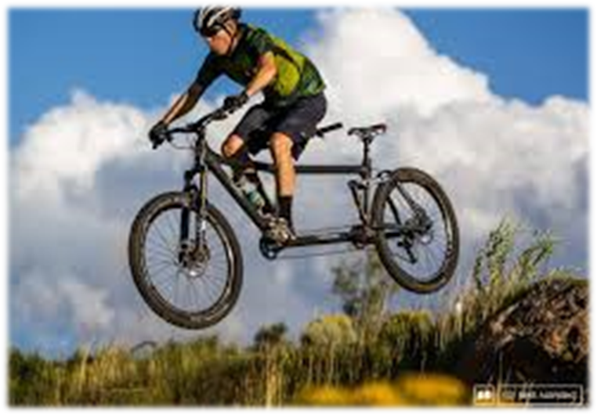
The Trust Test Proverbs 3:5-10
T: Take Personal Inventory. Pr 3:5
“Trust in the LORD with all thine heart;
and lean not unto thine own understanding.”
Are you trusting Jesus:
as your Savior?
as your Lord?

Slide 3
The Trust Test Proverbs 3:5-10
T: Take Personal Inventory. Pr 3:5
R: Recognize God Pr. 3:6 “In all thy ways
acknowledge (yada: recognize, respond to) Him”
Are you cultivating an awareness of God’s Power (Mt 28:18), Providence (Dt 8,4,16),
Provision (Dt. 8); Presence (Ps. 139);
and Peace (Phil. 4:6-10)?

Slide 4
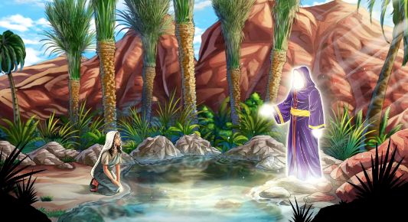
Hagar in Gen. 16:13 “she called the name of
the LORD…, Thou God seest me:
…Have I …looked after (raa: recognized, considered) him that seeth me?”
Ps. 40:17
“I’m poor and needy,
yet thou Lord thinketh
(ḥāšaḇ: to regard, plan)
upon me:”

Slide 5
T: Take Personal Inventory. Pr 3:5
R: Recognize God Pr. 3:6
U: Understand Stewardship Pr. 3:9
“Honor the Lord with thy substance”
kāḇaḏ: Glorify, give weight (value) to.
Are we managing our God given resources
(Time, Talents, Treasures, Testimony)
In a way that honors Him?
Luke 16:10-13

Slide 6
While Taking personal inventory,
Recognizing God’s purposes and even Understanding Stewardship are important,
They’re effectively useless until we decide to truly Surrender to God’s leadership and Lordship in our lives,
Rather than continuing to
“lean to our own understanding”. (Pr. 3:5,6)

Slide 7
S: Surrender to God’s Lordship
Because money and possessions are such an integral part of our society (and soul)
they become a fairly accurate gauge of the level of our trust/surrender. Dt 14:22-23
“Thou shalt truly tithe all the increase ……
the tithe of thy corn, of thy wine, and of thine oil,
and the firstlings of thy herds and of thy flocks;
that thou mayest learn to fear (yārēʾ: revere)
the LORD thy God always.”

Slide 8
S: Surrender to God’s Lordship
Pr 3:9 illustrates this “first-fruit” principle of trust.
“Honor the LORD with thy substance,
and with the firstfruits of all thine increase:”
Honor/obey God first, then
Trust Him to take care of the rest.
Mt 6:33
Illustrate with the tribal boy’s “tithe” of a fish to the missionary!

Slide 9
S: Surrender to God’s Lordship
1. The Meaning Of Surrender.
A. Although the word “Surrender” doesn’t
appear in the KJV of our Bibles,
there are some synonyms that occur frequently.
1) To Yield. (204x) Ro 6:13 “yield yourselves
(paristēmi: stand with) unto God,
as those that are alive from the dead, and your members as instruments of righteousness unto God.”

Slide 10
A. Biblical Synonyms of surrender:
1) Yield. (204x) (stop Fighting) Ro 6:13
Someone can stop fighting and still not:
2) Submit. (148x) James 4:7
“Submit yourselves therefore to God.”
Hypotassō: to line up under, arrange.
This acknowledges God’s authority/right. (See Luke 14:33)
But it doesn’t mean we always follow Him!

Slide 11
A. Biblical Synonyms of Surrender:
1) Yield. (204x) (stop Fighting) Ro 6:13
2) Submit. (148x) Acknowledge authority.
3) Obey. (615x) Cooperate, conform Acts 5:29
“We ought to obey God rather than men.”
Peitharche’ō: be persuaded by authority
Heb 5:9 “he became the author of eternal salvation unto all them that obey him;”
Hypakou’ō: to subordinate, conform

Slide 12
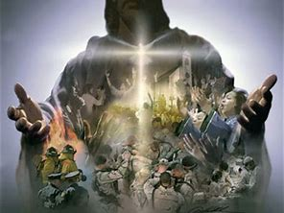
A. Surrender = to Yield, Submit, Cooperate
B. Most try to negotiate a conditional surrender
in which they maintain certain rights.
1) If Jesus isn’t Lord of all,
He isn’t Lord at All!
Luke 6:46 “why call ye me, Lord, Lord,
(Kyrios: supreme authority)
and do not the things
which I say?” Ex. 20:3

Slide 13
He closes Luke 6 with the parable of the wise and foolish man. Vs 47-49
47 “whosever …heareth my sayings and doeth them
48 He is like a (wise) man…that digged deep…
49 but he that heareth, and doeth not, is like a man that without a foundation built an house upon the earth;
against which the stream did beat vehemently,
and immediately it fell;
and the ruin of that house was great.”

Slide 14
1. The Meaning Of Surrender.
A. Surrender = to Yield, Submit, Cooperate
B. We want a conditional surrender.
C. God doesn’t call us to a conditional surrender
but to a “living sacrifice”! Ro. 12:1
“Present your bodies a living sacrifice,
holy and acceptable unto God,
Which is your reasonable service!”
logikos latreia: logical act of worship

Slide 15
1) Jesus used the cross as an illustration of this.
a) The Cross is mentioned 27 times in NT.
16 Times for Jesus,
“If any man will come after me, let him deny himself, and take up his cross, and follow me.
For whosoever will save his life shall lose it:
and whosoever will lose his life for my sake shall find it.
For what is a man profited, if he gain the whole world, and lose his own soul?
or what shall a man give in exchange for his soul?”
11 times for us. Mt 16:24-26

Slide 16
1) Jesus used the cross as an illustration of this.
2) What’s actually being “crucified?”
Jn 6:38 “For I came down from heaven, not to do
mine own will,
Gal 2:20 “I am crucified with Christ: nevertheless
I live; yet not I, but Christ liveth in me:
and the life which I now live in the flesh I live by the faith of the Son of God, who loved me,
and gave himself for me.”
Our Will!
but the will of him that sent me.“

Slide 17
“In every Christian's heart there is a cross and a throne, and the Christian is on the throne
until he puts himself on the cross;
if he refuses the cross, he remains on the throne. Perhaps this is at the bottom of the backsliding and worldliness among gospel believers today.
We want to be saved,
but we insist that Christ do all the dying.
No cross for us, no dethronement,
no dying.

Slide 18
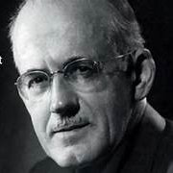
“We remain king within our little kingdom of Mansoul and wear our tinsel crown with all the pride of a Caesar;
but we doom ourselves to shadows and weakness
and spiritual sterility.”
A. W. Tozer (1897-1963)

Slide 20
2. The Measure Of Surrender. Ro 12:1,2
A. Living sacrifice Involves Submission. Jms 4:7; Ro. 6:13
1) Trust is not tested until the request goes against
our natural desires and will. Isaiah 43:1-4
I came to the fast, raging river;
and its current there echoed my fear.
I said, “Lord, please carry me over,
if you are, as you promised, quite near.”
His answer came back in an instant,
“My dear child, trust my grace, ever new.
Take my hand, we will cross this together;
But the path is not over, but through!”

Slide 21
2. The Measure Of Surrender. Ro 12:1,2
B. A Living Sacrifice Implies a cost!
Jesus spoke often & clearly about this. Lk 14:26-35
33 “So likewise, whosoever he be of you that forsaketh not (apotasso) all that he hath,
34 Salt is good: but if the salt have lost his savor, wherewith shall it be seasoned?
35 It is neither fit for the land, nor yet for the dunghill; but men cast it out. He that hath ears to hear,
let him hear.” (akouo: hearken)
he cannot be my disciple.

Slide 22
B. A Living Sacrifice Implies Cost!
1) This includes growing increasingly out of step:
a) With worldly values.
Ro. 12:2 “Be not conformed to this world.”
1 Jn 2:15,16 “Love not the world…”
James 4:4 “the friendship of the world
is enmity with God”
2 Pt 2:9 “ye are a …peculiar people…”
(Peripoi’ēsis: , purchased, precious, preserved)

Slide 23
B. A Living Sacrifice Implies Cost!
1) Growing increasingly out of step
a) With worldly values.
b) With Worldly People. 1 John 2:19
1 Cor 5:6 “A little leaven, leavens the whole lump”
2 Cor 6:17 “come out from among them, and be
ye separate, saith the Lord, and touch not the
unclean thing; and I will receive you,
18 And will be a Father unto you and ye shall be
my sons and daughters saith the almighty”

Slide 24
B. A Living Sacrifice Implies Cost!
1) Growing increasingly out of step with the world
Ro. 12:2 “Be not conformed to this world”
2) Growing increasingly “in step”
Ro. 12:2 “but be ye transformed by the renewing
of your mind….”
Galatians 5:16 “This I say then, Walk in the Spirit, and ye shall not fulfil the lust of the flesh.”
John 15:3 “ye are clean through the word…”
Joshua 1:8; Ps. 119:105
with the Word!

Slide 25
B. A Living Sacrifice Implies Cost!
1) Growing increasingly out of step with the world
2) Growing increasingly “in step” with the Word!
3) Allowing God’s word (will) to Guide you. Pr 3:6
Ro 12:2 that ye might prove (dokimazo: test/approve) what is that Good (agathos: beneficial)
and acceptable (euar’estos: fully agreeable)
and perfect (teleios: complete) will of God. ”
Surrender leads to Submission➔
Success! Joshua 1:8; Ps. 1

Slide 26
C. A Living Sacrifice Implies A Continuous,
Unconditional Surrender!
1) “Acknowledging Him” (Pr 3:6) involves:
a) Recognizing His will
b) Relinquishing our will
c) Responding obediently to God.
2) The Bible calls this “walking in the Spirit”
(Romans 8; Gal. 5:16)
See also 1 Cor 15:31; Col. 3:1-5
(Not a one and done!)

Slide 27
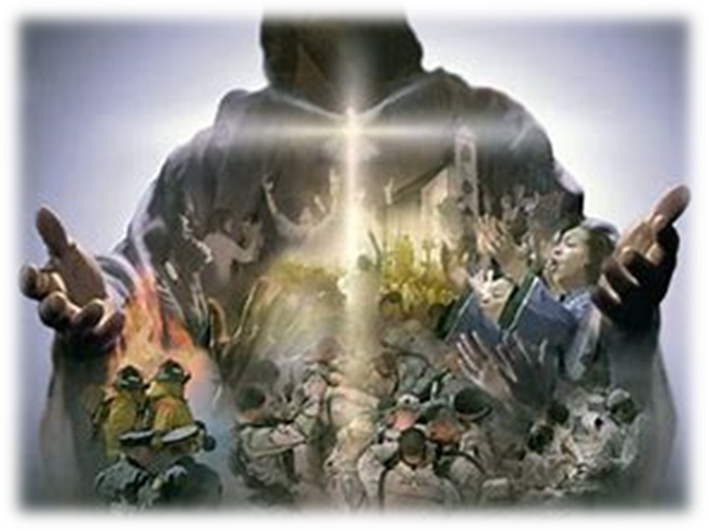
Jesus isn’t looking for people to give their spare evenings, Sundays, or retirement years to him.
He is not impressed by how much of our time, talent, or treasures we offer to him,
after our own wants, needs, and ambitions have been satisfied.
He is looking for those who are willing to follow in his steps to Gethsemane and Calvary.
2 Pt 2:21

Slide 28
He is looking for those who are willing
to sacrifice their own desires for His designs.
He is looking for people who will let Him live through them. 2 Cor 5:14,15
“The love of Christ constrains us because we thus judge, that if one died for all, then were all dead.
And that he died for all, that they which live
should not henceforth live unto themselves,
but unto him which died for them, and rose again…
20 now then we are ambassadors for Christ”

Slide 29
Paul recognized the power and privilege of such a life! Phil 3:7-9 “But what things were gain to me, those I counted loss for Christ.
Yea doubtless, and I count all things but loss for the excellency of the knowledge of Christ Jesus my Lord:
for whom I have suffered the loss of all things,
and do count them but dung, that I may win Christ,
& be found in him, not having mine own righteousness,
which is of the law, but that which is through the faith of Christ, the righteousness which is of God by faith: “

Slide 30
Phil 3:10 “That I may know him, (ginōskō: perceive, understand) and the power of his resurrection,
and the fellowship of his sufferings,
being made conformable unto his death…
12 Not as though I had already attained, either were already perfect: but I follow after…
14 I press toward the mark for the prize of the high calling of God in Christ Jesus.
15 Let us therefore, as many as be perfect, (telios: Mature) be thus minded:”

Slide 31
Gal. 2:20 “I am crucified with Christ: nevertheless
I live; yet not I,
and the life which I now live in the flesh
I live by the faith of the Son of God,
who loved me, and gave himself for me.
21 I do not frustrate the grace of God…”
Frustrate (Atheteō) to despise, reject, set aside
Grace (charis) God’s influence on our hearts,
and its manifestation in and through our lives.
but Christ liveth in me:

Slide 32
21 “I do not frustrate the grace of God…”
What is God’s Grace trying to accomplish in you?
…Through you?
Are you surrendering to His Grace,
Or sabotaging it?
“grieve not the holy Spirit of God, whereby ye are sealed unto the day of redemption.” Eph 4:30

Slide 33
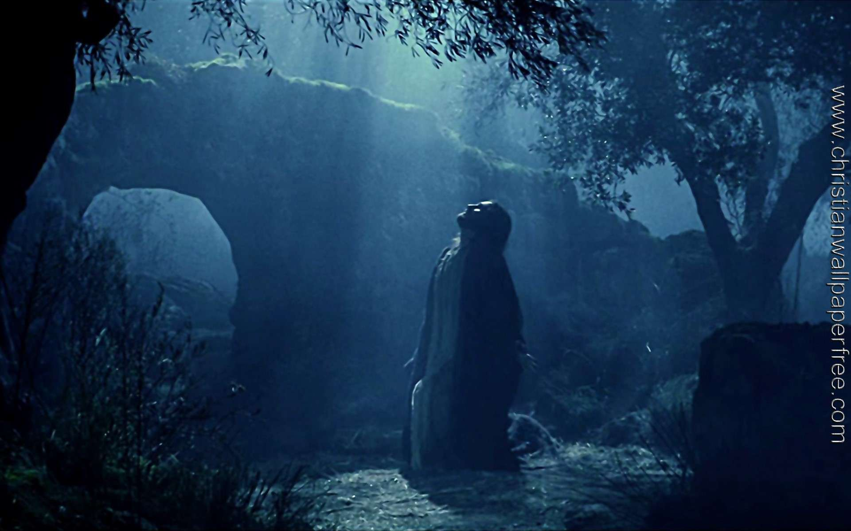
Mt 26:39 “O my Father, if it be possible,
let this cup pass from me:
nevertheless not as I will, but as thou wilt.”
John 12:27-28 “Now is my soul troubled;
and what shall I say? Father, save me from this hour:
but for this cause came I unto this hour.
Father, glorify thy name.”
Mt 26:39

Slide 34
"All those who journey, soon or late,
Must pass within the garden's gate;
Must kneel alone in the darkness there,
and battle with some fierce despair.
God pity those who cannot say,
'not my will but thine’; who only pray,
'Let this cup pass,’ for they fail to see,
the Purpose in Gethsemane."
Ella Wilcox

