Slide 1
The Trust Test

Slide 2
T: Take Personal Inventory. Pr 3:5
“Trust in the LORD with all thine heart;
and lean not unto thine own understanding.”
R: Recognize God Pr. 3:6 “In all thy ways
acknowledge (yada: recognize, respond to) Him”
U: Understand Stewardship Pr. 3:9
“Honor the LORD with thy substance”
kāḇaḏ: Glorify, give weight (value) to.

Slide 3
S: Surrender to God’s Lordship
Pr 3:9 illustrates this “first-fruit” principle of trust.
“Honor the LORD with thy substance,
and with the firstfruits of all thine increase:”
Honor/obey God first,
Then Trust Him to take care of the rest.
Mt 6:33 “Seek ye first the Kingdom of God…”
Col. 1:18 “he is the head of the body, the church:
…that in all things he might have the preeminence.”
(Prōteuō: first in rank and influence)

Slide 4
God uses the challenges of life to Test our Trust (Faith) in each of these areas!
The normal Christian life involves a series of “Trust Tests” through which we learn & grow.
(Is. 48:10,11; Ro 5:3-5; James 1:2-5)
Acts 14:21,22 “They returned again to Lystra… Confirming the souls of the disciples,
and exhorting them to continue in the faith,
and that we must through much tribulation
(thlipsis: pressure) enter into the kingdom of God.”

Slide 5
Each Trust Test sets in motion a type of “Cause and Effect”. Dt 30:15-20; Dt 11:26-28
“I set before you this day a blessing and a curse;
A blessing, if ye obey the commandments of the LORD your God, which I command you this day:
And a curse, if ye will not obey the commandments of the LORD your God, but turn aside out of the way which I command you
to go after other gods….”

Slide 6
Nobody passes every test, but when we fail,
God patiently encourages us to “fail forward!”
(aka: Learn from our failures!)
Proverbs 3:11,12
“My son, despise not the chastening of the LORD; neither be weary of his correction:
For whom the LORD loveth he correcteth;
even as a father the son in whom he delighteth.”
(rāṣâ: is pleased with, approves of)

Slide 7
God patiently encourages us to “fail forward!”
Heb 12:6 “For whom the Lord loveth he chasteneth…
11 Now no chastening for the present seems to be joyous, but grievous: nevertheless afterward it yieldeth the peaceable fruit of righteousness
unto them which are exercised thereby.
12 Wherefore lift up the hands which hang down, …;
13 And make straight paths for your feet,
lest that which is lame be turned out of the way;
but let it rather be healed.”

Slide 8
When we pass our Trust Tests:
A. We honor (Bless) God! Heb. 11:5
“By faith Enoch (ḥănôḵ: dedicated) was translated.. for before his translation he had this testimony,
that he pleased God.” (See Gen. 5:24)
Ps 50:23 “Whoso offereth praise glorifieth me:
and to him that ordereth his conversation aright
will I shew the salvation (yēšaʿ safety, prosperity) of God.”
(yᵊhôšûaʿ see Mt 1:21 and Jn 14:21)

Slide 9
When we pass our Trust Tests:
B. God honors (blesses) us! 1 Sam. 2:30
“for them that honor me I will honor….”
Ps. 37:3-5 “Trust in the LORD, and do good; so shalt thou dwell in the land, and verily thou shalt be fed.
Delight thyself also in the LORD;
and he shall give thee the desires of thine heart.
Commit thy way unto the LORD; trust also in him;
and he shall bring it to pass….
23 “The steps of a good man are ordered by the Lord…”

Slide 10
When we pass our Trust Tests:
C. God blesses others, through us!
Pr. 20:6 “…a faithful man who can find?
7 The just man walketh in his integrity:
his children are blessed after him.”
Pr. 29:2 “When the righteous are in authority, the people rejoice:
but when the wicked beareth rule,
the people mourn.”

Slide 11
D. We prove God by demonstrating the cause
and effect of trusting (obeying) God,
enabling him to prove His Promises
and demonstrate His Power .
Ex. 19:5,6 “if ye will obey my voice, and keep my covenant,
then ye shall be a peculiar treasure unto me above all people: …
And ye shall be unto me a kingdom of priests, and an holy nation.” (1 Pt 2:9)

Slide 12
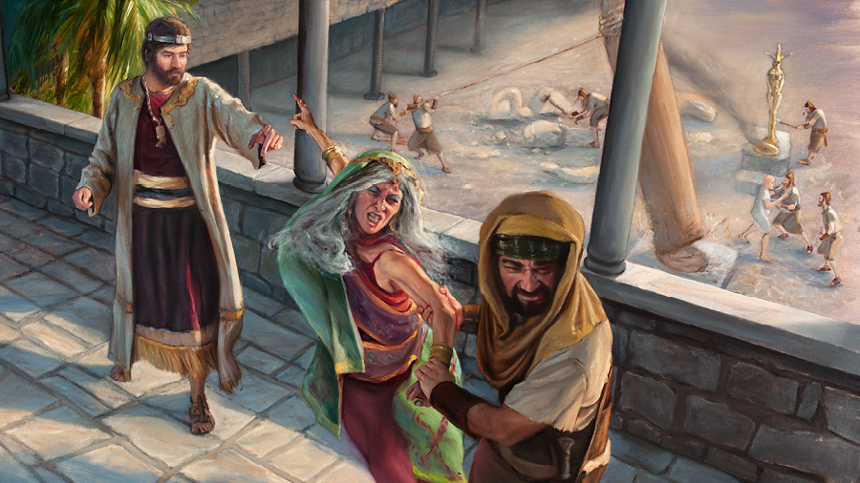
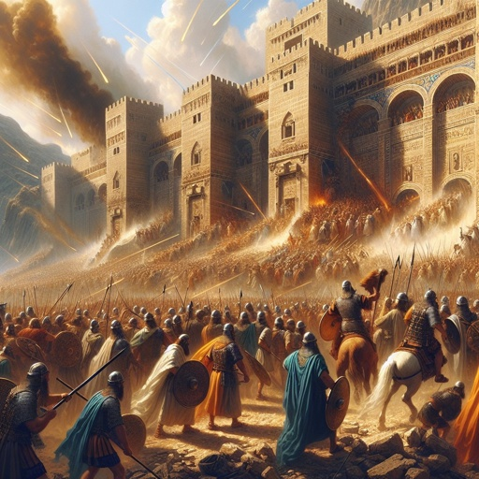
1) The “Cause”: King Asa passed several
early Trust Tests by Faith. 2 Ch 14
a) Purged Judah of Idols
(Even his own mother’s)
b) Trusted God against overwhelming odds!
14:9-15
14:2-8; 15:16

Slide 13
2) The Effect! God:
a) Rescued Judah from the Ethiopians 2 Ch 14:12
“So the Lord smote the Ethiopians before Asa...”
b) Provided a great spoil. Vs 12 “They carried away
much spoil…” 14 “Exceeding spoil …”
c) Brought a great revival of Faith. 15:12
“they entered into a covenant to seek the LORD God of their fathers with all their heart and with all their soul;”
d) Blessed Asa and Judah with Prosperity and peace for >30 years. 2 Ch. 15:19

Slide 14
2. When we “fail” our Trust Tests:
A. We dishonor God.
1) This Grieves God. Ps. 78:41
“ How oft did they provoke him in the wilderness, and grieve (ʿāṣaḇ: vex, hurt) him in the desert!”
2) This “Limits” God. Ps 78:41
Yea, they turned back and tempted God,
and limited the Holy One of Israel.”

Slide 15
Failed Trust tests Grieve and limit God.
Eph. 4:30 “Grieve not the Holy Spirit of God
whereby ye are sealed until the day of redemption”
3) Even Jesus was “limited” by people’s faith.
Mk 6:4 “A prophet is not without honour,
but in his own country, …
5 And he could there do no mighty work…”
Mt. 9:29 “According to your faith be it unto you.”
Mk 9:23 “If thou canst believe, all things are possible”

Slide 16
When we “fail” our Trust Tests:
B. God allows consequences (the curse of Dt 11)
1 Sam 2:30 “them that honor me I will honor,
and they that despise me shall be lightly esteemed.”
Gal. 6:7 “Be not deceived; God is not mocked:
whatsoever a man soweth,
that shall he also reap.”

Slide 17
When we “fail” our Trust Tests:
C. Our choices (and consequences) affect
(curse) those around us! Dt. 20:5,6
“Thou shalt not bow down thyself to them, nor serve them: for I the LORD thy God am a jealous God,
visiting the iniquity of the fathers upon the children unto the third and fourth generation of them that hate me;
And shewing mercy unto thousands of them that love me, and keep my commandments.”
Ro 14:7 “For none of us liveth to himself..”

Slide 18
When we “fail” our Trust Tests:
D. We prove the cause and effect of God’s word.
Dt 11:26 “I set before you a blessing and a curse,
28 A curse if ye will not obey the commandments of the LORD your God, but turn aside out of the way which I command you this day, to go after other gods,
Dt. 8:19 “And it shall be, if thou do at all forget the LORD thy God, and walk after other gods, and serve them, and worship them, I testify against you this day
that ye shall surely perish.” (āḇaḏ: lose yourself)

Slide 19
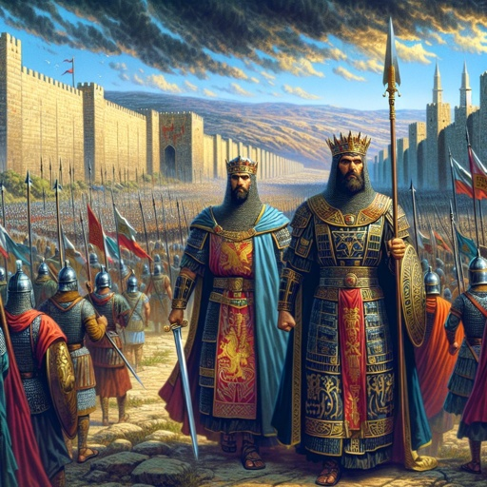
Asa failed God’s Trust tests later in his life.
1) The Cause: 2 Ch 16:
a) Another army invasion, just like in Ch. 14.
Vs 1 “In the 36th year of the reign of Asa, Baasha king of Israel came up against Judah..”

Slide 20
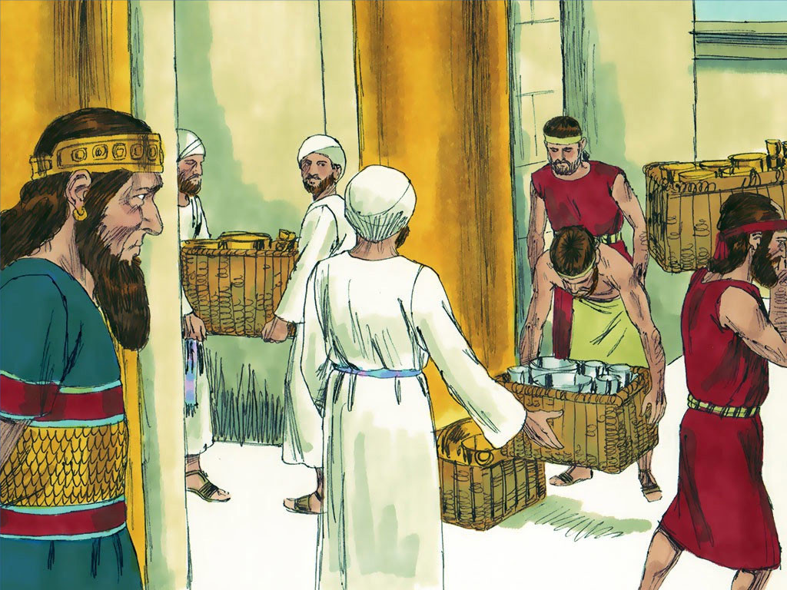
b) Instead of trusting God, He robbed God! vs 2 “Then Asa brought out silver and gold
out of the treasures of the house of the LORD…
To pay God’s enemy to fight for him!
…and sent to Benhadad king of Syria,, saying,
‘there is a league
between me and thee…’”
And it worked! 4-6

Slide 21
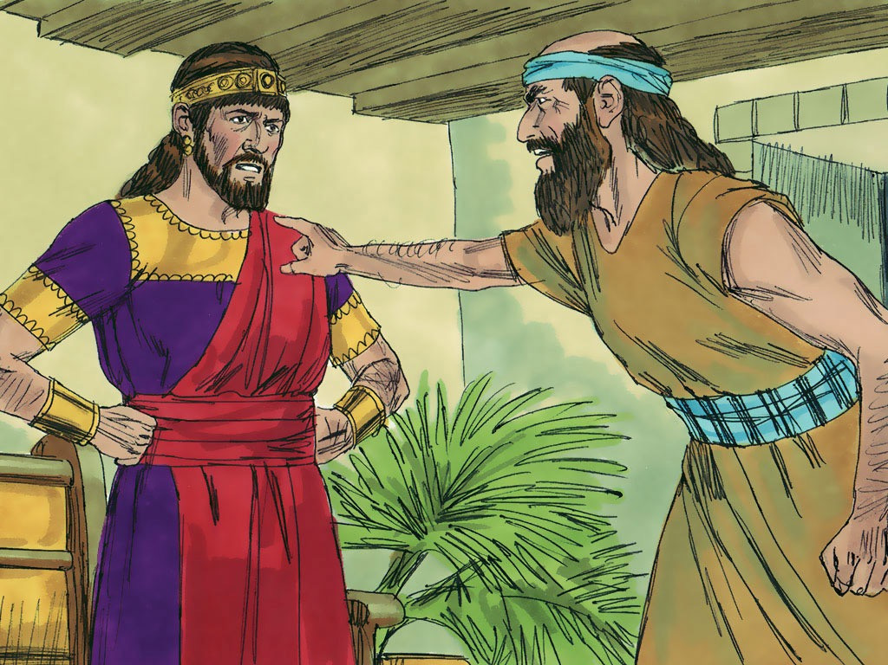
2) The Effect:
a) God sent Hanani to rebuke the him for his unbelief and remind him that: (2 Chron. 16:9)
"the eyes of the LORD run to and fro throughout the whole earth, to show himself strong in the behalf of them whose heart is perfect toward him.
Herein thou hast done foolishly:
therefore, from henceforth thou shalt have wars."
(consequences, 2nd chances?)

Slide 22
b) By trusting Syria instead of God, Asa robbed God of more than the Temple treasures,
he robbed God of an opportunity to prove himself,
both to His own people, and to an unbelieving world.
Instead of repenting,
Asa resented the prophet (Gal. 4:16),
Rebelled against God, (1 Sam 15:26)
Punished/imprisoned the Prophet,
and began persecuting his own people.
(Vs 10)

Slide 23
c) God even gave him a “make up exam”. 12-13
“And Asa in the thirty and ninth year of his reign was diseased in his feet, until his disease was exceeding great: yet in his disease
he sought not to the LORD,
but to the physicians.
And Asa slept with his fathers,
and died in the one and fortieth year of his reign.”

Slide 24
Conclusion:
The final T of the Trust test
Involves “Testing” God’s Promises & Power.
We, like Asa, often fail to recognize the “Cause and Effect” of God’s Commands and Promises,
and how our responses sometimes rob God!
Human Nature, and God’s Nature haven’t changed.
Mal. 3:6 “For I am the LORD, I change not;
therefore ye sons of Jacob are not consumed.”

Slide 25
Where are you in your Course (Journey) of Faith?
T: Take Personal Inventory. Pr 3:5
“Trust in the Lord with all thine heart;
and lean not unto thine own understanding”
Who are you really Trusting?
R: Recognize God. Pr. 3:6 “In all thy ways
acknowledge him, and he shall direct thy paths.
7 Be not wise in thine own eyes, fear the LORD…”
Who do you look to for direction?

Slide 26
Where are you in your Course (Journey) of Faith?
U: Understand Stewardship Pr. 3:9
“Honor (kāḇaḏ: Glorify) the Lord
with thy substance…”
Are the choices you make regarding your Time, Talents, Treasures, and Testimony
designed to bring Glory to God,
or to yourself?

Slide 27
1) Where are you in your Journey of Faith?
Surrender to God’s Lordship Pr 3:9 “Honor the
LORD … with the firstfruits of all thine increase:”
Heb. 10:36 “For ye have need of patience,
that, after ye have done the will of God,
38 “Now the just shall live by faith”
If Jesus isn’t the Lord of your life,
Then Who is? (Luke 6:46)
ye might receive the promise.”

Slide 28
Where are you in your Course (Journey) of Faith?
Take Inventory Recognize God,
Understand Stewardship
Surrender to God’s Lordship
T: Our response to the T.R.U.S. Tests (Proves)
God’s Promised “Cause and Effect”.
Our Obedience Tests His Power.
Our Disobedience Tests His Patience!

Slide 29
2) Which Attitude best reflects your heart?
It’s my life, I'll do what I want!
That’s the heart of a Rebel!
(Ro. 9:20; 1 Sam 15:23)
If God will give me what I want first,
Then I'll give him what He wants.
That’s the heart of a Negotiator!
(Mt 6:33; Heb. 10:36-38)

Slide 30
Which Attitude best reflects your heart?
I'll give God what He wants first, but I’m expecting Him to give me what I want.
That’s the heart of a Manipulator! (Heb. 11:13)
I'll give God what He wants and trust Him to do what He knows is best.
That’s the heart of a Faithful, Trusting servant!
Mt 26:39 “Not as I will, but as thou wilt!”

Slide 31
Dt 30:19 “I call heaven and earth to record this day against you, that I have set before you
life and death, blessing and cursing:
therefore choose life,
that both thou and thy seed may live:
That thou mayest love the LORD thy God,
and that thou mayest obey his voice,
and that thou mayest cleave unto him:
for he is thy life, and the length of thy days:”
What’s your choice? (Joshua 24:15)

