Slide 1
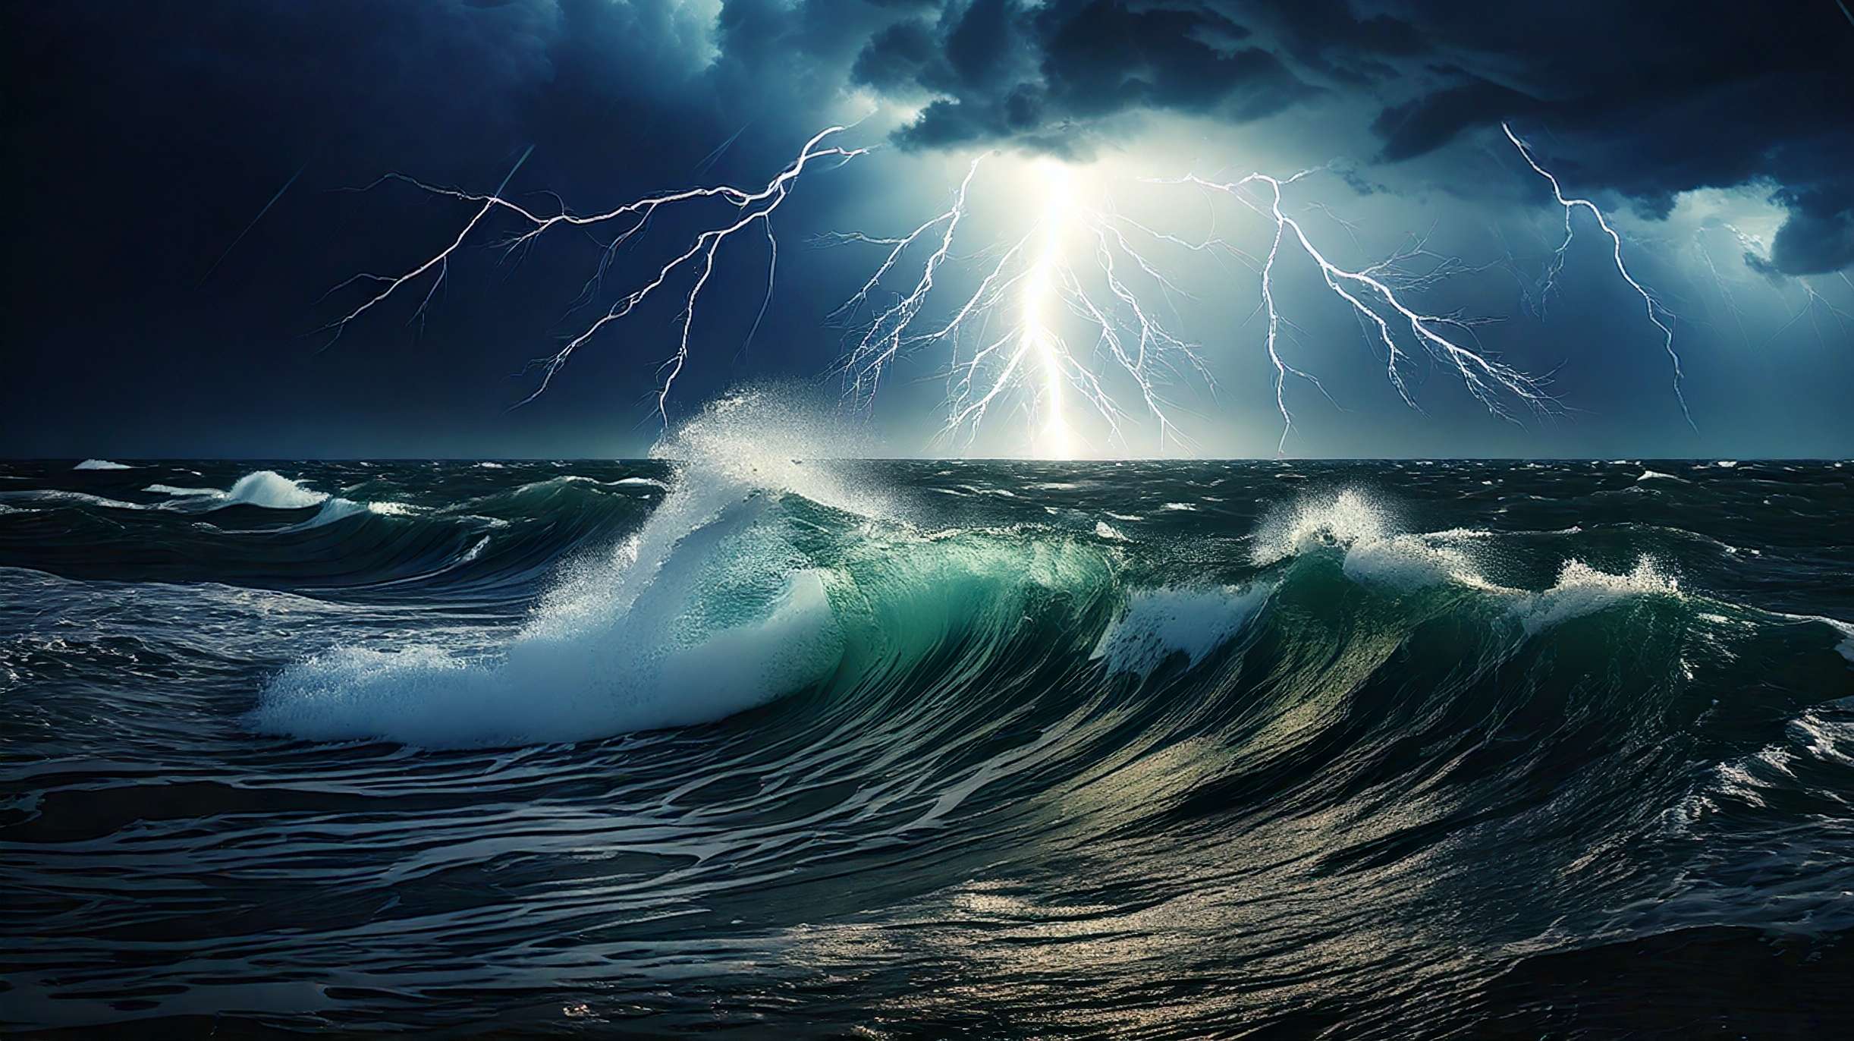
Trusting the God Who Calms Storms
By Joseph Peters

Slide 2

Goal
Everyone should trust that God can rescue us from times of trials.
For these three reasons

Slide 3
Reasons
Jesus Did Not Fear the Storm
Jesus Rebuked the Disciples Faith
Jesus Amazed the Disciples

Slide 4
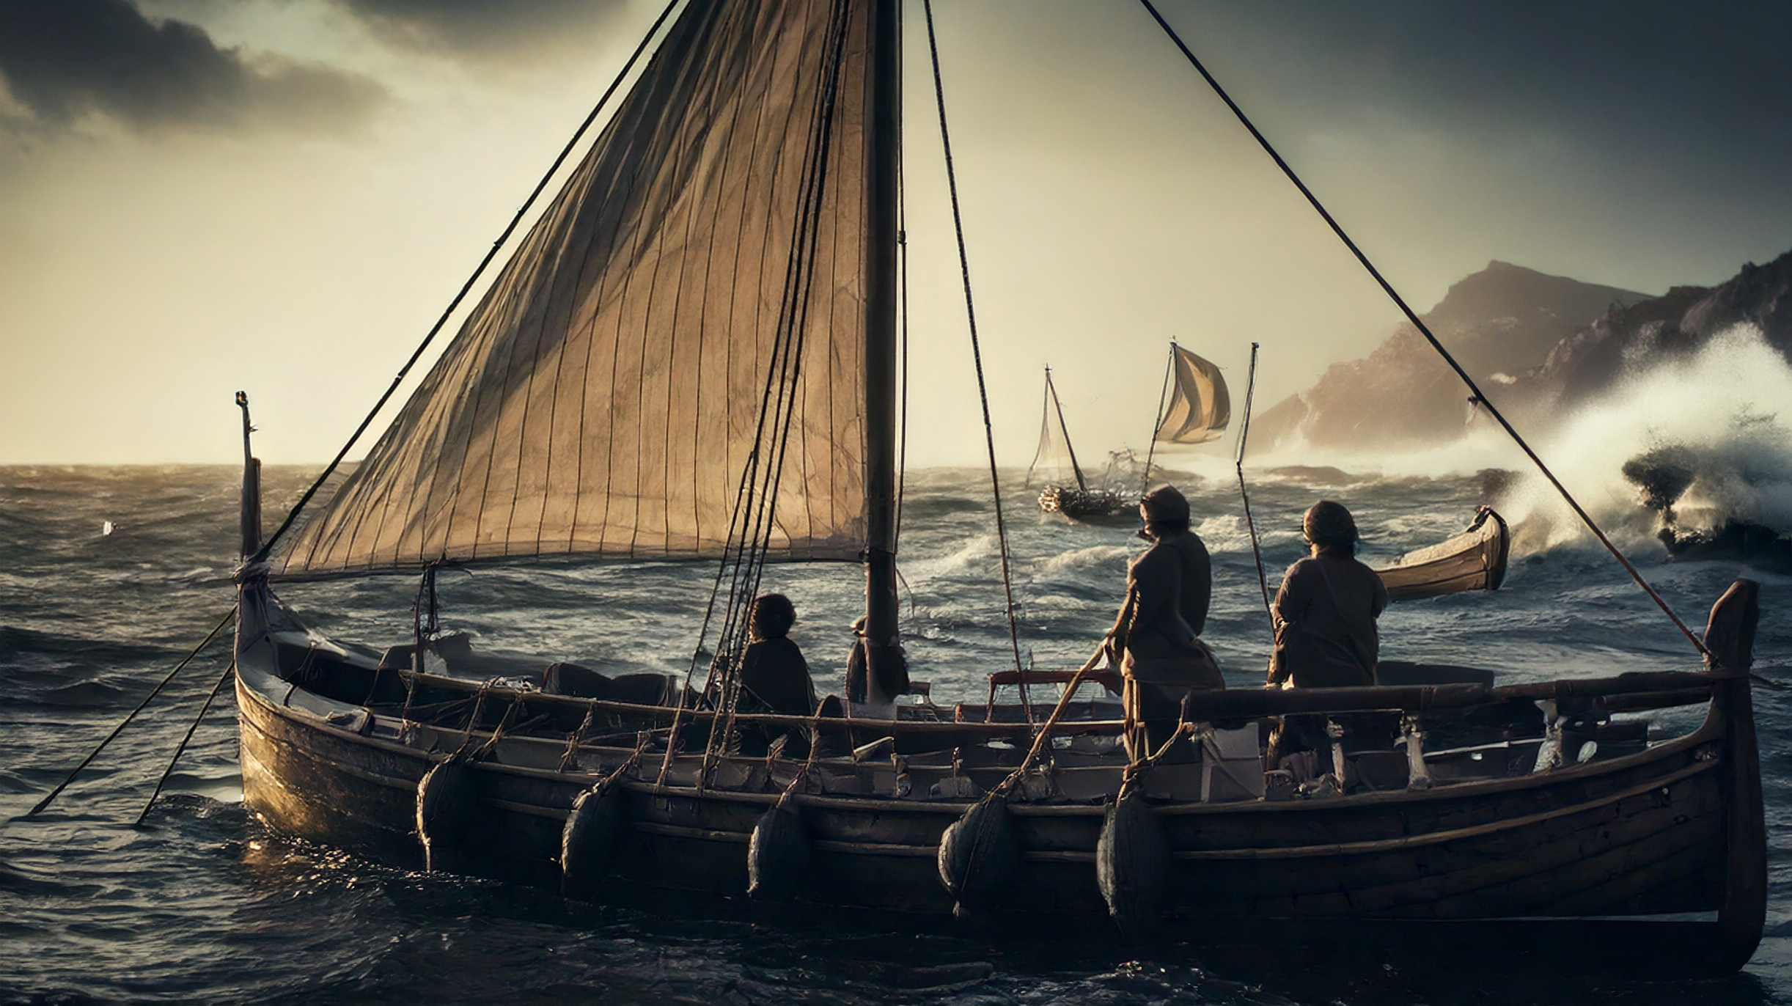
Jesus Did not Fear the Storm

Slide 5
The Start of the Journey
And the same day, when the even was come, he saith unto them, Let us pass over unto the other side. And when they had sent away the multitude, they took him even as he was in the ship. And there were also with him other little ships (Mark 4:35–36).
Now it came to pass on a certain day, that he went into a ship with his disciples: and he said unto them, Let us go over unto the other side of the lake. And they launched forth. (Luke 8:22).

Slide 6
The Conflict
And there arose a great storm of wind, and the waves beat into the ship, so that it was now full. And he was in the hinder part of the ship, asleep on a pillow: and they awake him, and say unto him, Master, carest thou not that we perish (Mark 4:37–38)?

Slide 7
Jonah’s Comparison
But the LORD sent out a great wind into the sea, and there was a mighty tempest in the sea, so that the ship was like to be broken. Then the mariners were afraid, and cried every man unto his god, and cast forth the wares that were in the ship into the sea, to lighten it of them. But Jonah was gone down into the sides of the ship; and he lay, and was fast asleep. So the shipmaster came to him, and said unto him, What meanest thou, O sleeper? arise, call upon thy God, if so be that God will think upon us, that we perish not (Jonah 1:4–6).

Slide 8
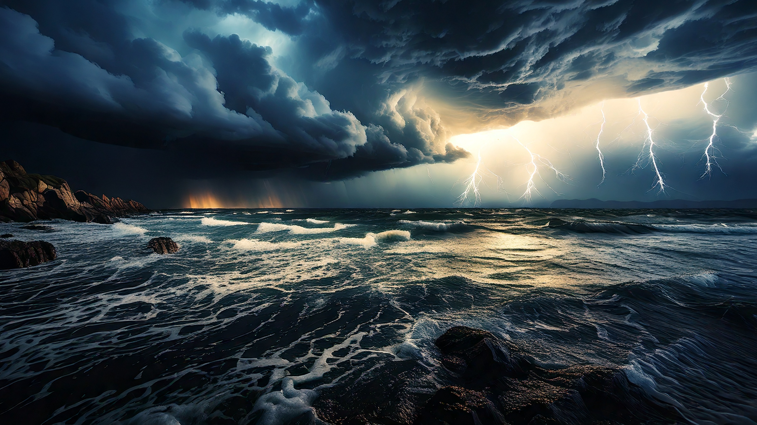
Jesus Rebuked the Disciples Faith

Slide 9
Jesus Rebukes the Storm
And he arose, and rebuked [ἐπιτιμάω] the wind, and said unto the sea, Peace, be still [φιμόω]. And the wind ceased, and there was a great calm. And he said unto them, Why are ye so fearful? how is it that ye have no faith (Mark 4:39–40).

Slide 10
Demonic Forces?
And there was in their synagogue a man with an unclean spirit; and he cried out, Saying, Let us alone; what have we to do with thee, thou Jesus of Nazareth? art thou come to destroy us? I know thee who thou art, the Holy One of God. And Jesus rebuked [ἐπιτιμάω] him, saying, Hold thy peace [φιμόω], and come out of him (Mark 1:23–25).

Slide 11
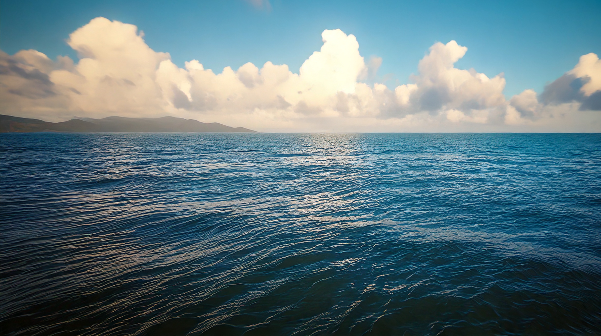
Jesus Amazed the Disciples

Slide 12
Fear and Amazement
And they feared exceedingly, and said one to another, What manner of man is this, that even the wind and the sea obey him (Mark 4:41).

Slide 13
The Power of God
They that go down to the sea in ships, That do business in great waters; These see the works of the LORD, And his wonders in the deep. For he commandeth, and raiseth the stormy wind, Which lifteth up the waves thereof. They mount up to the heaven, they go down again to the depths: Their soul is melted because of trouble. They reel to and fro, and stagger like a drunken man, And are at their wits’ end. Then they cry unto the LORD in their trouble, And he bringeth them out of their distresses. He maketh the storm a calm, So that the waves thereof are still (Psalm 107:23–29).

Slide 14
Conclusion
Everyone should trust that God can rescue us from times of trials.
For these three reasons

Slide 15
Reasons
Jesus Did Not Fear the Storm
Jesus Rebuked the Disciples Faith
Jesus Amazed the Disciples

