Slide 1
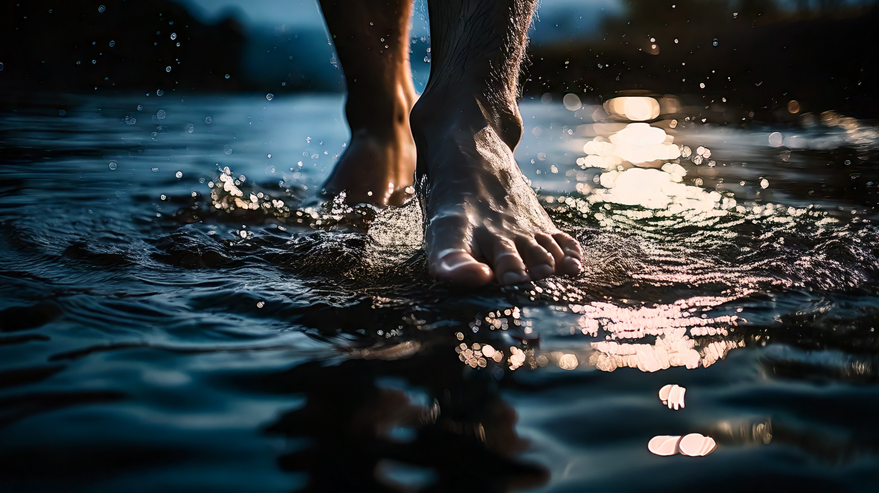
Trusting the God Who Walks on the Storms
By Joseph Peters

Slide 2

Goal
Everyone Should Trust That Jesus Can Help Us through the Storms of Life
For These Three Reasons

Slide 3
Reasons
Jesus Could not be Stopped by the Storm
Jesus Could Help Peter Through the Storm
Jesus Has the Power of God Over Creation

Slide 4
Jesus Leaves the Crowd
Then those men, when they had seen the miracle that Jesus did, said, This is of a truth that prophet that should come into the world. When Jesus therefore perceived that they would come and take him by force, to make him a king, he departed again into a mountain himself alone. And when even was now come, his disciples went down unto the sea, And entered into a ship, and went over the sea toward Capernaum. And it was now dark, and Jesus was not come to them. And the sea arose by reason of a great wind that blew. So when they had rowed about five and twenty or thirty furlongs [3-3.5 Miles], they see Jesus walking on the sea, and drawing nigh unto the ship: and they were afraid. But he saith unto them, It is I; be not afraid. Then they willingly received him into the ship: and immediately the ship was at the land whither they went (John 6:14–21).

Slide 5
Better than Moses
Our fathers did eat manna in the desert; as it is written, He gave them bread from heaven to eat. Then Jesus said unto them, Verily, verily, I say unto you, Moses gave you not that bread from heaven; but my Father giveth you the true bread from heaven. For the bread of God is the which cometh down from heaven, and giveth life unto the world. Then said they unto him, Lord, evermore give us this bread. And Jesus said unto them, I am the bread of life: he that cometh to me shall never hunger; and he that believeth on me shall never thirst (John 6:31–35).

Slide 6
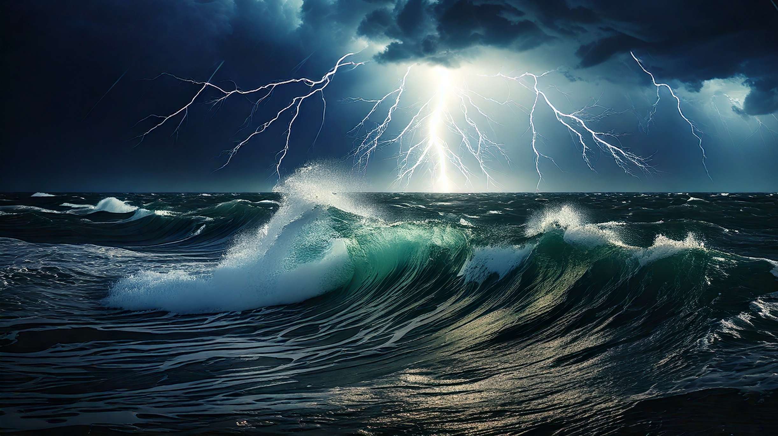
Jesus Could not be Stopped by the Storm

Slide 7
Jesus’ Solace is Interrupted
When Jesus heard of it, he departed thence by ship into a desert place apart: and when the people had heard thereof, they followed him on foot out of the cities. And Jesus went forth, and saw a great multitude, and was moved with compassion toward them, and he healed their sick (Matt 14:13–14).

Slide 8
Jesus’ Resumes His Solace and Prayer Time
And straightway Jesus constrained his disciples to get into a ship, and to go before him unto the other side, while he sent the multitudes away. And when he had sent the multitudes away, he went up into a mountain apart to pray: and when the evening was come, he was there alone (Matt 14:22–23).

Slide 9
The Disciples Struggle in a Storm
But the ship was now in the midst of the sea, tossed with waves: for the wind was contrary. And in the fourth watch of the night Jesus went unto them, walking on the sea (Matt 14:24–25).
And he saw them toiling in rowing; for the wind was contrary unto them: and about the fourth watch of the night he cometh unto them, walking upon the sea, and would have passed by them (Mark 6:48).

Slide 10
A Sign of His Deity
Which alone spreadeth out the heavens, And treadeth upon the waves of the sea… Lo, he goeth by me, and I see him not: He passeth on also, but I perceive him not (Job 9:8, 11)
Thy way is in the sea, And thy path in the great waters, And thy footsteps are not known. Thou leddest thy people like a flock By the hand of Moses and Aaron (Ps 77:19–20).

Slide 11
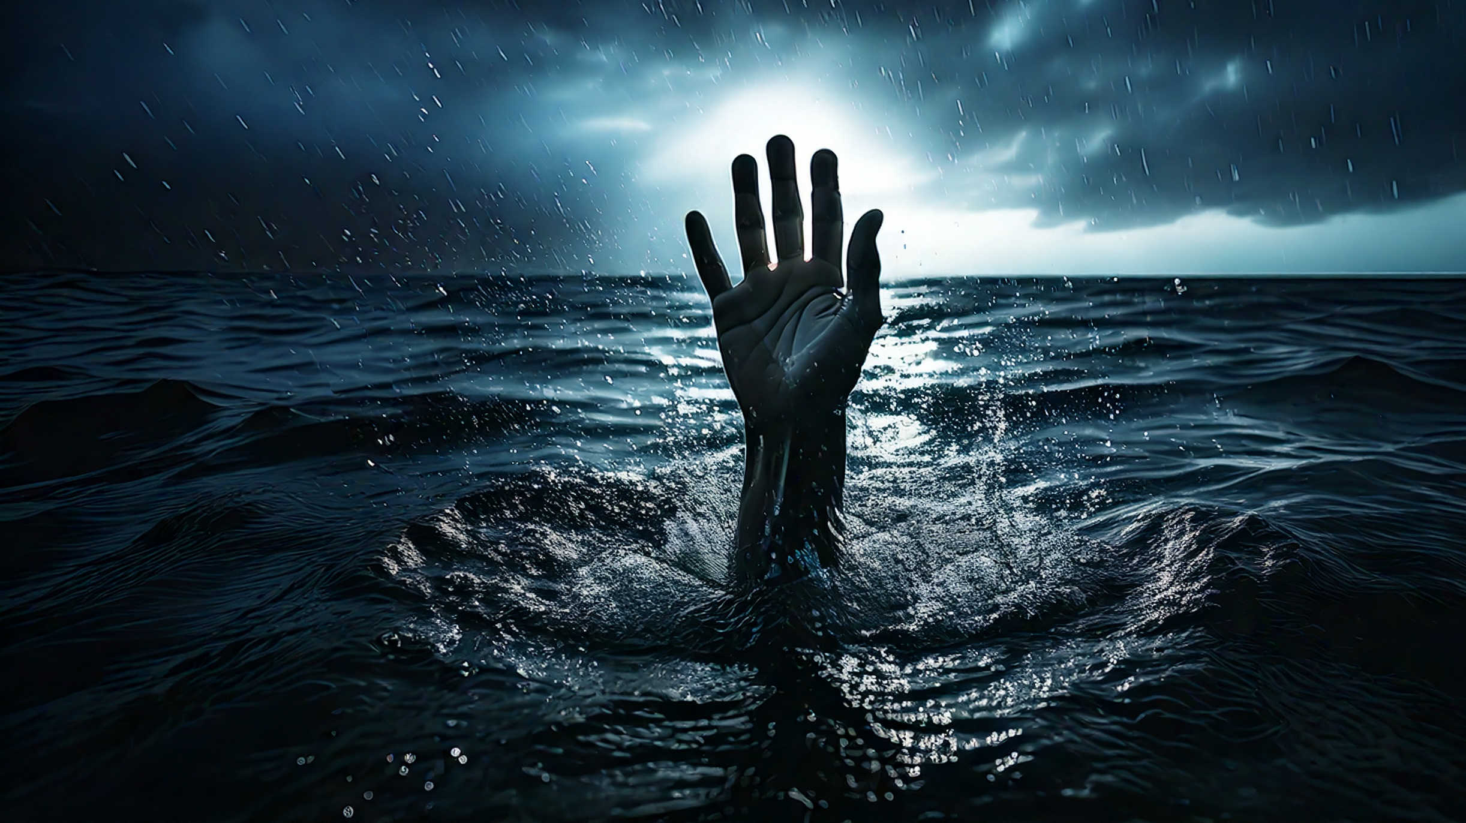
Jesus Could Help Peter Through the Storm

Slide 12
The Great “I Am”
And when the disciples saw him walking on the sea, they were troubled, saying, It is a spirit [φάντασμα]; and they cried out for fear. But straightway Jesus spake unto them, saying, Be of good cheer; it is I [ἐγώ εἰμι]; be not afraid (Matt 14:26–27).
God said to Moses, “I AM WHO I AM” [Ἐγώ εἰμι] (Exod 3:14a).

Slide 13
Peter’s Faith Turned to Doubt
And Peter answered him and said, Lord, if it be thou, bid me come unto thee on the water. And he said, Come. And when Peter was come down out of the ship, he walked on the water, to go to Jesus. But when he saw the wind boisterous, he was afraid; and beginning to sink, he cried, saying, Lord, save me. And immediately Jesus stretched forth his hand, and caught him, and said unto him, O thou of little faith, wherefore didst thou doubt (Matt 14:28–31).
And his disciples came to him, and awoke him, saying, Lord, save us: we perish. And he saith unto them, Why are ye fearful, O ye of little faith (Matt 8:25–26a)?

Slide 14
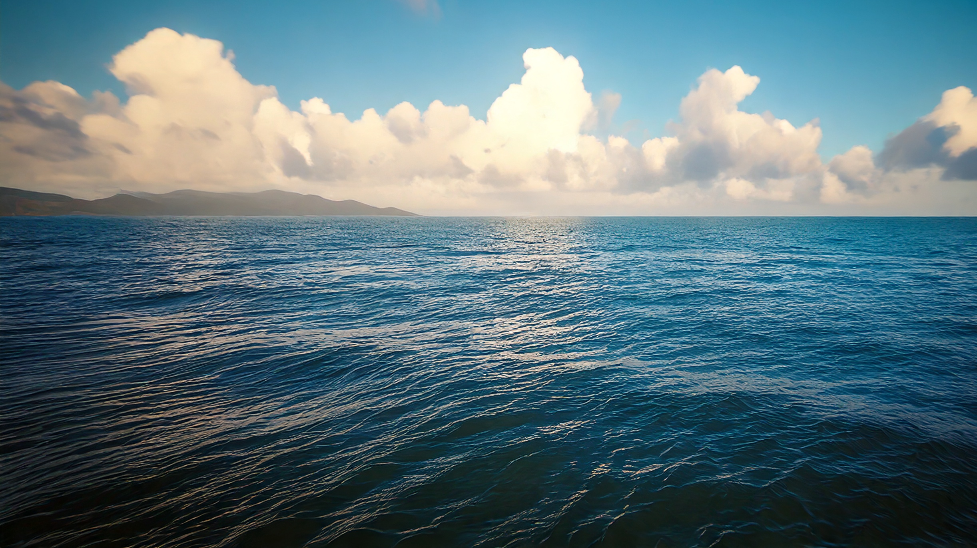
Jesus Has the Power of God Over Creation

Slide 15
Jesus Calms The Storm Again
Then he arose, and rebuked the winds and the sea; and there was a great calm. But the men marvelled, saying, What manner of man is this, that even the winds and the sea obey him (Matt 8:26–27)!
And when they were come into the ship, the wind ceased. Then they that were in the ship came and worshipped him, saying, Of a truth thou art the Son of God (Matt 14:32–33).

Slide 16
Conclusions
Everyone Should Trust That Jesus Can Help Us through the Storms of Life
For These Three Reasons

Slide 17
Reasons
Jesus Could not be Stopped by the Storm
Jesus Could Help Peter Through the Storm
Jesus Has the Power of God Over Creation

