Slide 1
Eph 6:10-18; 2 Cor 10:3-5; 2 Cor 2:11
“Lest Satan should get an advantage of us: for we are not ignorant of his devices.”

Slide 2
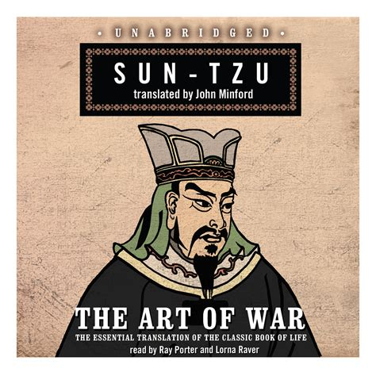
“If you know the enemy and know yourself,
you need not fear the result of a hundred battles.
If you know yourself but not the enemy,
for every victory gained
you will also suffer a defeat.
If you know neither the enemy nor yourself,
You’ll succumb in every battle.” 5th century BC

Slide 3
“To know thyself is the beginning of wisdom.”
Socrates 400 BC
Pr 9:10 “The fear of the LORD is the beginning of wisdom: and the knowledge of the holy is understanding.”
God (through Solomon) 1000 BC
Satan (the adversary) knows our nature,
and uses that knowledge to deceived, distort & delude,
in an attempt to draw us away from God
and ultimately defeat us.

Slide 4
Not only does he seduce us into rejecting God’s wisdom and ways (Gen. 3➔ Rev. 20);
He also motivates us to embrace his wisdom,
contaminated by evil, perversion and rebellion.
“This wisdom descendeth not from above,
but is earthly (epigios),
For where envying and strife is, there is confusion
and every evil (phaulos: foul) work.”
James 3:15-16
sensual (psychikos),
Devilish! (daimoniō’dēs: demonic)

Slide 5
2 Cor 2:11 “Lest Satan should get an advantage of us:
(Pleonekte’ō: covet, defraud, make a gain)
for we are not ignorant of his devices.”
(noe’ma: perception, purpose, disposition)
We’ve already discussed how:
Our limited (self focused) perspective leaves us
questioning orders and complaining about ordeals.
Our propensity for Perversion Produces:
Distortion➔ Subversion ➔ Deception ➔ Rebellion

Slide 6
Notice how these propensities caused Israel to drift from God and move toward
“Fellowship with devils” (1 Cor. 10:20)
1 Cor 10:5-7 “…They were overthrown in the wilderness.
Now these things were our examples, to the intent
we should not lust after evil (kakos: worthless) things,
as they also lusted. (epithumeo: superimposed passion)
Neither be ye idolaters, as were some of them;
As it is written ‘The people sat down to eat and drink, and rose up to play.’”

Slide 7
These verses reference two separate (yet similar) episodes in Israel’s journey that illustrate this propensity for perversion
and how Satan uses it to “overthrow us”.
This morning we’ll look at the first of these events and the Power/Perversion behind it.
They “lusted after evil things” 1 Cor. 10:6

Slide 8
“lust after evil things” 1 Cor. 10:6
1. “Lust” is a Pre-existing (Human) condition.
A. Lust (English) is defined as a strong desire
(for sex, food, fame, satisfaction, etc)
1) Physical / Emotional Desire is a God given
drive that was designed to draw us toward
healthy (interdependent) relationships with
our God, others, and even ourselves.
2) Desires can become subverted and perverted.

Slide 9
“lust after evil things” 1 Cor. 10:6
1. “Lust” is a Pre-existing (Human) condition.
B. Notice how the Old Testament portrays Lust
1) 1st Reference Ps 78:18 “tempted God in their
heart by asking meat for their lust.” (nephesh)
It’s translated soul 475x, life 117x, person 29x,
mind 15x, heart 15x, body 8x, Will/Desire 4x
2) Ps 78:30 “They were not estranged from their lust..”
Taʾawâ: desire, delight, satisfaction

Slide 10
3) Ps 81:11-12 “But my people would not hearken to
my voice; and Israel would none of me.
So I gave them up unto their own hearts' lust:
(sherirût’: imagination, twisted obstinacy)
{From shôrēr’: to be hostile, an opponent}
and they walked in their own counsels.” (môʿēṣâ: purpose)
13 Oh that my people had hearkened unto me,
and Israel had walked in my ways!
14 I should soon have subdued their enemies,
and turned my hand against their adversaries.”

Slide 11
4) Pr 6:23-26 “the commandment is a lamp; and the law is light; and reproofs of instruction are the way of life:
To keep thee from the evil woman,
from the flattery of the tongue of a strange woman.
Lust (Ḥāmad: desire 11x, covet 4x, delight 2x) not after her beauty in thine heart; neither let her take thee with her eyelids.
For by means of a whorish woman
a man is brought to a piece of bread:
and the adulteress will hunt for the precious life.”

Slide 12
4) Pr 6:27-33 “Can a man take fire in his bosom,
and his clothes not be burned?
28 Can one go upon hot coals, & his feet not be burned?
32 But whoso committeth adultery …lacketh understanding: (lēb: heart, mind, wisdom)
he that doeth it destroyeth (Shāḥat: ruins, corrupts, decays) his own soul.”
33 A wound (negaʿ: plague) and dishonor shall he get;
and his reproach shall not be wiped away.

Slide 13
“lust after evil things” 1 Cor. 10:6
Notice how the N.T. describes Lust
epithumeo (v): desire 8x, lust 4x; covet 3x. from:
1) Epi (preposition) Means to Superimpose
(time, place, order, priority, or direction)
“To set your heart upon”
a) This means that lust (or those behind it) seeks to
superimpose (prioritize) its agenda onto (or over)
our hearts
Pr. 4:23 “keep thy heart with all diligence…”
in order to corrupt them!

Slide 14
epithumeo: desire 8x, lust 4x; covet 3x. from:
1) Epi (preposition) Means to Superimpose
2) Thumos (n) Passion.
a) Translated wrath 15x; fierceness 2x,
indignation 1x.
b) from thyō: Meaning to rush.
Translated kill 8x, sacrifice 5x
This implies that when we “rush” to satisfy our lusts,
we end up sacrificing something of value!

Slide 15
If lust (English/Hebrew/Greek) involves desire,
1) What does this have to do with our Sacrifice?
a) What/who we truly desire,
Gen 22:2 “Take now thy son, thine only son Isaac,
whom thou lovest, …; and offer him there…”
b) Sacrifice is a type and method of Worship! Vs 5
“I and the lad will go yonder and worship,
and come again to you.
c) Our sacrifice proves our priorities/devotion. Vs 12
“now I know that thou fearest God….”
we sacrifice for!

Slide 16
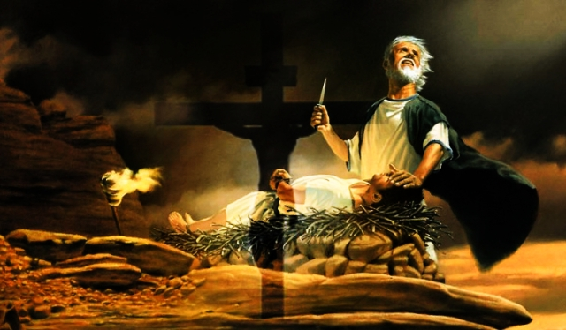
Ge 22:7 “My Father…where is the lamb for the burnt offering?”
Vs 13 and
Heb. 11:17-19
8 “My son, God will provide himself a lamb..”

Slide 17
If lust involves desire:
2) What’s the effect if that desire becomes perverted?
a) Since lust comes from the root words epi (superimpose)
and Thyo, meaning to rush (to sacrifice, and/or kill.)
Our lusts (desires) become “perverted” when Satan (or others) superimpose their agenda over God’s design.
b) This gives Satan ground/ influence. 1 Cor 10:20
“the things which the Gentiles sacrifice, (thyo)
they sacrifice to devils, and not to God:
I would not that ye should have fellowship with devils.”

Slide 18
3) Desire (even for good things) can become perverted by:
The subject. (Who’s behind the enticement)
(Satan: Mt. 4:1-11; Self: James 1:13-16)
The object. (What/who we want/desire) Prov 6,7
The objective (Why we desire it) James 4:3
The timing. (When we want/desire it) Heb. 13:4
The method. (How we seek to satisfy that desire)
(David/Bathsheba 2 Sam. 11;
Amnon and Tamar 2 Sam. 13)

Slide 19
The more we rationalize our perverted desires,
the more influence we give Satan in our lives.
Jms 3:15 “This wisdom descendeth not from above,
but is earthly (epigios), sensual (psychikos),
Devilish!” (daimoniō’dēs: demonic)
Ro. 1:22 “Professing themselves to be wise, …became fools,
23 And changed the glory of the uncorruptible God
into an image made like to corruptible man, ….
24 Wherefore God also gave them up to uncleanness through the lusts of their own hearts,
to dishonor their own bodies between themselves:

Slide 20
25 …changed the truth of God into a lie, and worshipped and served the creature more than the Creator,
26 For this cause God gave them up unto vile affections:
for even their women did change the natural use into that which is against nature:
27 And likewise also the men, leaving the natural use of the woman, burned in their lust one toward another; men with men working that which is unseemly,
28 ..as they did not like to retain God in their knowledge,
God gave them over to a reprobate mind, …”

Slide 21
Satan (adversary) has had thousands of years to perfect using the world (1 Jn 2:15,16)
and our own human weakness (James 1:13-16)
(our propensity for pessimism and perversion)
to distract, distort, delude, and deceive us,
in an attempt to ultimately defeat us.
Thankfully we’re not alone! Ro 8:28-31
“If God be for us, who can be against us?”
See Heb. 13:5,6

Slide 22
He’s given us his power and promises:
“that through these we might become partakers of the divine nature,
having escaped the corruption that is in the world through lust.”
1Jn 4:4 “Ye are of God…
and have overcome them:
because greater is he that is in you,
than he that is in the world.”

Slide 23
1 John 5:4 “this is the victory that overcometh the world,
even our faith.”
What are you doing to grow your faith?

Slide 24
Eph. 6:11
“Put on the whole armor of God,
That ye may be able to stand against the wiles of the devil.”
For we wrestle not against flesh and blood,
but against principalities, against powers,
against the rulers of the darkness of this world,
against spiritual wickedness in high places.”

